Slide 1
Kuali Student Project Overview CANHEIT 2014

Slide 2


Kuali Student Project Overview
What is Kuali Student?
Who is Kuali Student?
Why Kuali Student?
Overview of Products
How to get involved

Slide 3
Quick Poll
How many of you are familiar with Kuali Student?

Slide 4
What is Kuali Student?

Slide 5
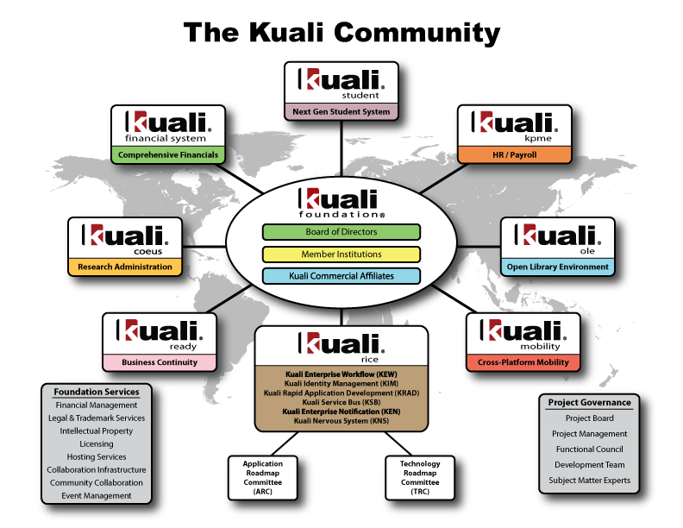

Slide 6








What is Kuali Student?
Kuali Student (KS) is a next generation student system with six modules that support the full student academic lifecycle
KIM People and Permissions
KRMS Rules
KEW Workflow
KRAD Rapid Application Development
rice
Collaborative Functionality
Delivered
In development
Future
Curriculum Management
Enrolment
Admissions
Student Accounts
Academic Plan
Financial Aid

Slide 7
What is Kuali Student?
Kuali Student (KS) is a next generation student system that …
Is designed from the ground up to support local variations in business processes
is being incrementally produced by an international community
institutions can deploy incrementally over time to replace current systems
provides a rich Web based user experience

Slide 8
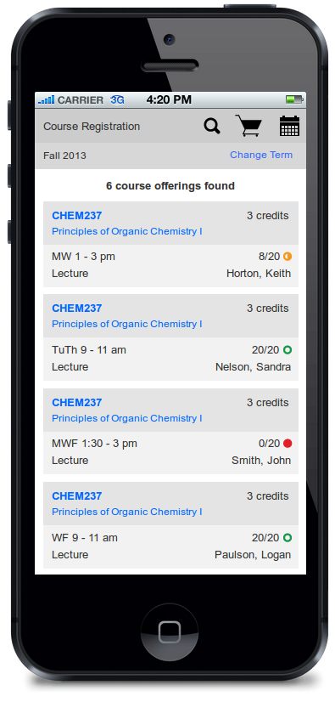
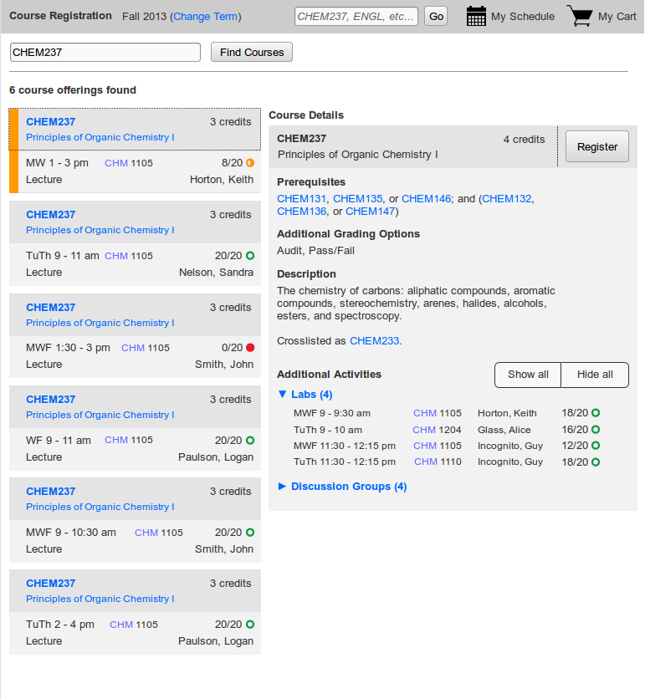
Student UX- Course Registration

Slide 9
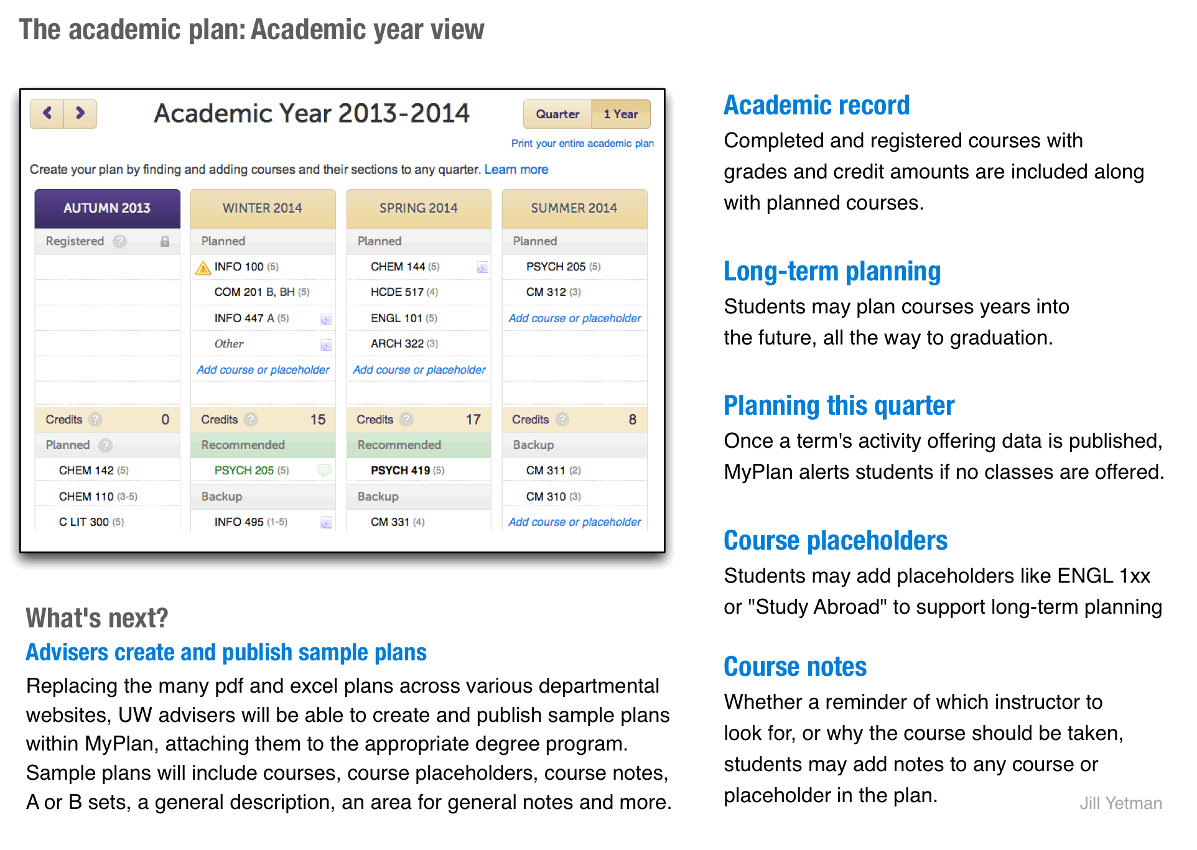
Student UX- Academic Planning

Slide 10
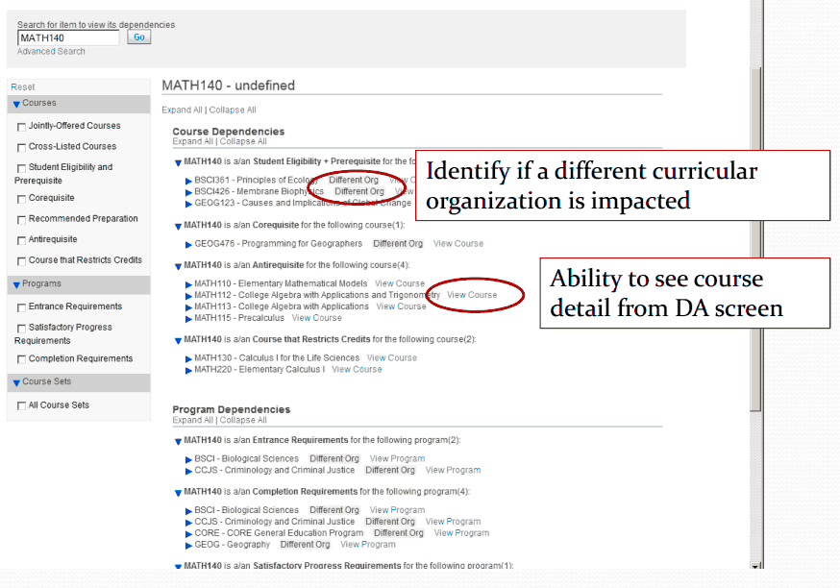
Admin UX- Dependency Analysis

Slide 11
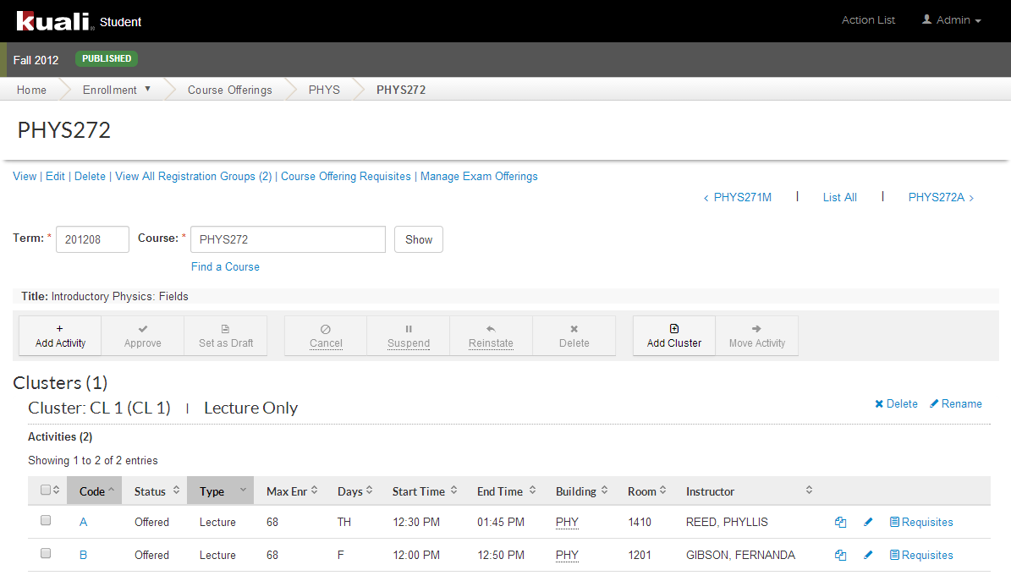
Admin UX- Course Offering

Slide 12
Implementation Approaches
Institutions don’t have to replace SIS with KS
Approach #1: Replace:: Replace select portions of your SIS with KS products.
Example: U of T replacing current CM, Enrolment but not Academic Planning/ Degree Explorer
Approach #2: Augment:: Wrapper/Integrate your current SIS core with KS products.
Example: IU and Utah “hiding” all of PeopleSoft behind KS products, started with PeopleSoft Academic Planning

Slide 13
Implementation Approaches
Approach #3: Legacy Migration and Integration:: Expose current data via Services, i.e deploy standard KS Service Contracts on top of existing systems
Example: UW deploying KS Services Contracts on top of mainframe and 3rd Party Degree Audit System to achieve integration with newer systems like Academic Plan

Slide 14
Quick Poll
How are you replacing or enhancing your SIS?
Do you have a need for a new SIS or a new refreshed front-end for your current SIS?
Which of these strategies have you adopted for your SIS?

Slide 15
Who is Kuali Student?

Slide 16










Investors
Founders
Partners
Typically contribute full development team of 10 or more staff
Typically contribute 3 or more staff and/or cash
Additional Investors
Typically contribute up to 2 staff and/or cash
Notes:
Stellenbosch University and Iowa State University will soon become investing institutions.

Slide 17
Benefits of Investment
Influence product features and requirements
Buy down implementation costs
Access to Founders Releases and insider knowledge to help KS implementation(s)

Slide 18
Parallel Development Teams (PDTs)
Yellow PDT
(Toronto)
Green PDT
(Indiana & Seattle)
Red PDT
(Maryland)
Core Team
Black PDT
(Indiana)
Blue PDT
(South Africa)
Notes:
Not going deep here, just a reminder slide for everyone. Core serves as a central hub to support the efforts undertaken in each of the Parallel Development Teams.

Slide 19
Why Kuali Student?

Slide 20
Why Kuali Student?
Student Centric design leads to rich experience
Locally configurable without the overhead of costly upgrades
Rules for complex relationships

Slide 21

What Makes Us Different?
Efforts to meet complex business requirements

Slide 22
What Makes Us Different?
Development of best practices among investing institutions
Founders
Partners
Notes:
Stellenbosch University and Iowa State University will soon become investing institutions.

Slide 23

What Makes Us Different?
Initiatives that help administrators do their work more…
Effectively
Productively
Efficiently

Slide 24
Product Overview

Slide 25
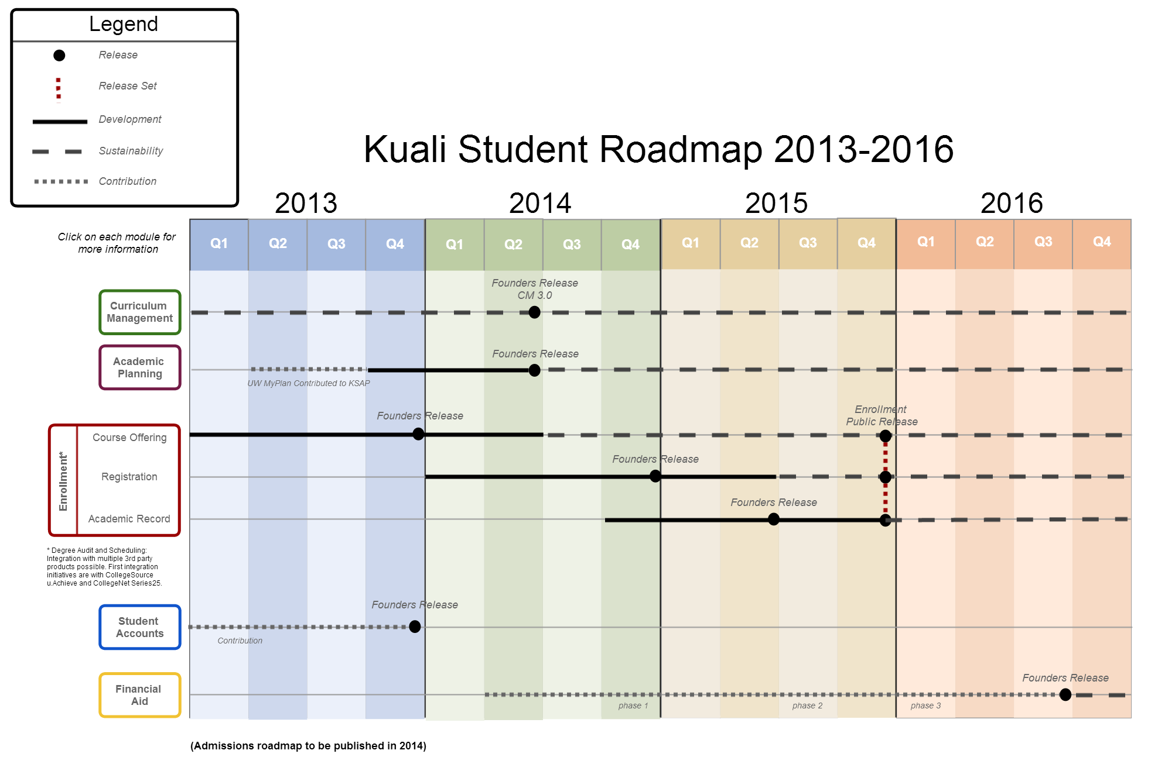

Slide 26


Curriculum Management (CM): Overall Scope
?
Courses
Proposal
Process
Create
Programs
View
Modify
Learning Unit
Administrative
Screens
Retire
Group
Ideas
Catalog
Analyze
Curriculum Management

Slide 27
Quick Poll
How many institutions have a web based Curriculum Management function? Are you planning one?

Slide 28
Curriculum Management (CM): Delivered
2011
First major release (focus on Course)
2012 - 2013
3 Patch releases
Live at UMD
Live at
UMD
BC
UW
UI upgrade started

Slide 29
Curriculum Management (CM): Plans
2014
Upgraded UI
2 new Program types
CM 3.0 Release
2015
Remaining Program types
CM 3.1 Release
Planned go-live at U of T

Slide 30

Academic Plan (KSAP): Overall Scope
Objective: Suite of planning tools that allow students to maximize opportunities on campus and plan for graduation success.
Scope
Course Search
Planner
Audit against degree requirements
Requires interface to degree auditor
Advisor collaboration and interaction
Student schedule builder

Slide 31
Quick Poll
How many institutions have an Academic Planning application? Are you planning one?

Slide 32
Academic Plan (KSAP): Delivered
2012
Developed as MyPlan by the UW
2013
MyPlan enhanced by UW and IU
Live at the UW
Contribution to KSAP started
Live at IU

Slide 33
Academic Plan (KSAP): Plans
2014
2015
Founders Release
Enhancements continue at IU and UW
Reconciles and combines UW and IU features
Development of Founders Release
Public Release

Slide 34
Enrolment: Overall Scope
Institution Facing
Student Facing
Course Offering
Course Registration
Course
Course Assessment
Program Enrolment
Program
Program Offering
Program Assessment
Academic Planning
Academic Record
Common
Setup
People and Permissions

Slide 35
Course Offering: Next Gen Design
CHEM 152: General Chemistry
Course
CHEM 152 for Autumn 2012
Course Offering
Lecture + Lab
Lecture
Format Offering
Lecture A
Lab AA
Lab AB
Lecture B
Cluster
Activity Offering
Reg Group 0101: Lecture A + Lab AA
Reg Group 0102: Lecture A + Lab AB
Reg Group 0201:
Lecture B
Registration Group

Slide 36
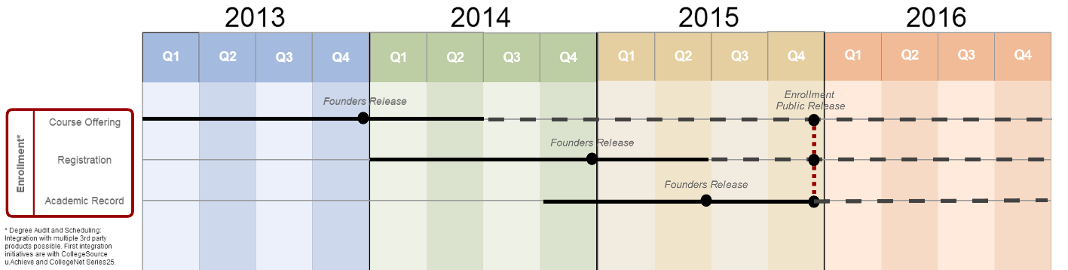
Enrolment: Strategy
Development Strategy
Deliver the “heart” of Enrolment = Enrolment 1
Then deliver the broader vision = Enrolment 2
Deliver Enrolment 1 in 3 chunks
Course Offering
Registration
Academic Record

Slide 37
Enrolment: Delivered
2011
Developed thin-slice across Enrolment as a POC
2012-2013
Developed Course Offering & Academic Calendar
Developed infrastructure components
Founders Release 1
Sandbox implementation at UMD (first implementer)

Slide 38
Enrolment: Plans
2014
Continue enhancements on Course Offering
Develop Course Registration
2015
Develop Academic Record (Transcripts, Program Offering, etc)
Release of Enrolment 1
Goal to have at least one implementation in progress
Founders Release 2

Slide 39
Enrolment: Goals for 2014
Provide a mobile and desktop student experience
Provide a desktop administrators experience to support student tasks
Provide Founders’ Release that enables evaluation and implementation planning

Slide 40
Quick Poll
Which institutions provide Course Registration on mobile devices?

Slide 41

Student Accounts (KSA): Overall Scope
Receivables Management
Payment Billing
Fee Management
Third Party Billing
Collections Management

Slide 42
Student Accounts (KSA): 2013 Update
2012-2013: Developed as a contribution by a commercial partner, Sigma Systems
Implementations: Boston College in progress. Several schools are actively exploring an implementation

Slide 43
How to Get Involved

Slide 44
Become an Investor
Entitled to seats on the Board and Functional Council
Your institutional needs can influence product strategy formulated by the community
Your institution gets access to Founders Releases and insider knowledge to help your KS implementation(s)

Slide 45
Become an Adopter
Learn more about Implementing KS
Engage with the Implementation Users Group (IUG)
Website: http://www.kuali.org/ks/involved
Wiki: https://wiki.kuali.org/x/ZgBPCw
Forum: ks.collab@kuali.org

Slide 46
Contact
Learn more about why & how to participate in development of KS
Contact Rajiv Kaushik or Rick Skeel: ks.info@kuali.org

Slide 47
What Questions Do you Have?
?

