Slide 1

The Balancing Act of Forging the Next Generation Student Information Services
Graham Kemp
June 3, 2014
Notes:
Company ID: UN42706
Customize fields
Where is it hosted
What SAP customers use it?
Export function for selected types
Mobile?

Slide 2
Agenda
Overview - University of Toronto
Background – Next Generation Student Information Services
Our thinking of the way forward
Strategy and projects
Major NGSIS projects which are underway
Introduction to KUALI

Slide 3

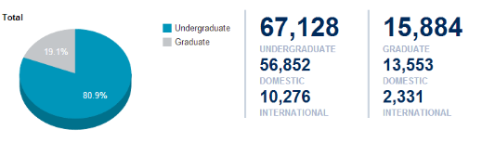
University of Toronto at a Glance
Enrollment: 83,156 (2013)
3 campuses: Downtown Toronto (St. George), Mississauga (in the west) and Scarborough (in the east)
Undergraduate programs: 700+
Graduate programs: 215
Professional programs: 63
Staff and faculty: 18, 860
Alumni (up to Fall 2013) : 530,000
Operating budget (2012-2013): $1.8 billion
Notes:
Company ID: UN42706

Slide 4
EASI - Enterprise Applications and Solutions Integration
CIO
Director
EASI
Program
Director KS
Manager
Tech Svcs
Manager
FIS
Program Director
NGSIS
NGSIS PM
Manager
Telecom
Manager
UTBI
Manager
SIS
KUALI
Enrolment
Manager HRIS
Project Teams (5)
Academic Services
Manager
Web
Major Initiatives:
RAISE
TOP
NGSIS
UTBI
eProcurement
Invoice Workflow

Slide 5
Challenges with Current SIS
Implemented in 1998 – Major focus on registration
Architecture
Lacked much of the functionality required now and in the future
Many manual interventions and processes
Mainframe
Software AG - Natural Language
Performance
Cost

Slide 6
U of T Student System - Current State
Student
Web Service
294,000 logons first day of classes
48,000 distinct users first week of classes
SIS
1.8 million lines of code
7,750 programs
700 batch jobs
External systems
e.g. OUAC
AMS
Blackboard
Bank payments
Security
450 tables
100 GBs of data
10-15 million database calls per hour during busy times in year
Administrative
1,200 users
300 concurrent
200 system interfaces
70 power users depend on ROSI data
20 divisional systems depend on ROSI data
1000+ Shadow Systems

Slide 7
Going Forward
We did not want to just replace the current SIS – ROSI
Create a renewed and expanded suite of student information services
Serving not only students but faculty and staff
We selected a Hybrid approach
Package Solutions
Local Development
Community/Open Source
Collaborative Initiatives

Slide 8
Going Forward
To be phased in over multiple years while maintaining and improving current service levels
Probably the largest single project undertaken at the UofT
Daunting challenge
Requires patience
Understanding
Confidence
We must take care while stepping down the current SIS

Slide 9
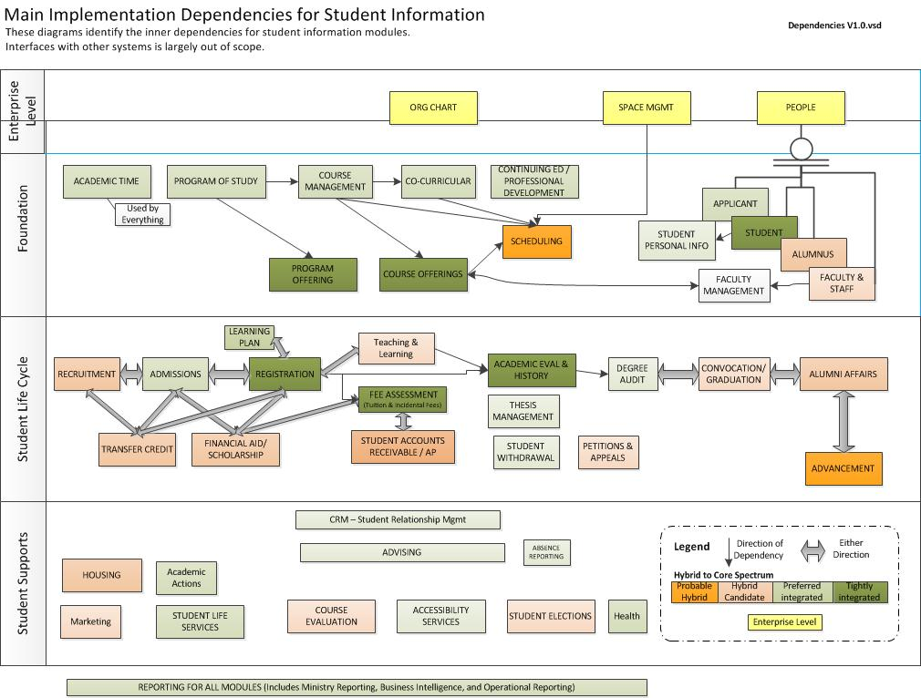
KIM

Slide 10
NGSIS Governance
Executive Steering
Committee
Executive
Sponsors
CIO
Program Director
Academic
Lead
NGSIS
Core Team
Program Advisory Groups
Functional and Technical Teams
Process Streamlining

Slide 11
Strategy
2013
2014
2015
Build credibility
Emphasis is on short term service improvements
Initiate large scale change projects
Capitalize on credibility
Emphasis is on large scale change projects
Implement technical infrastructure
Continue to provide targeted service improvements
Implement selected large scale change projects
Continue to provide targeted service improvements
Continually Evaluate Progress

Slide 12
Year 1 & 2 (2012 – 2014)
Focus on Short Term Service Improvements
over 30 new
improvements
Student
Web
Service
SAP
HR, Finance
Research
Main SIS
Improve UHIP process
Automate Residence Financial Interface
Fix Summer Fee calculations
Add New Financial Reports
added
One Stop Registration Status
Enhance Transcript Service
Improve Invoice Format
Personalised Calendar
Personalised Exam Schedule
Safety Abroad Address
Course
Finder
Degree
Explorer
Manage
Residences
Extend
Campus Map
Choose
Residence
Co-curricular
Record
Ontario Market Share
Recruitment
Find Text Books
Transfer
Credits
Join Varsity
Team
Course Enrolment
Program Enrolment
Student Performance

Slide 13
Strategic Plan
3 Tier Plan
2013
2014
2015-16
Service Improvements:
Over 30 new service improvements for students and staff
Large Scale Change:
Participation in KUALI community source development
Curriculum Management - KUALI
Improvements to students accounts
ACORN student web service
Implement Development Instance of KUALI Enrolment
Technical Improvements:
Expanded system hours
Hardware improvements
Enable live connections to the main system for divisions
Build the new infrastructure

Slide 14
What is KUALI?
Consortium of Universities working together to build community open source systems specifically for Higher Education
Developed and supported by a dedicated community
Institutions can take advantage of the development with open source licensing agreement
Modular nature allows integration with legacy and vendor soluions
KCAs – rSmart, Sigma, OpenCollab

Slide 15
Project Plan: 2014 - 2016
Person (2%) (student)
Awards (5%)
Degree Audit
(3%)
Convocation (2%)
SAP
HR, Finance
Research
ACORN
New
Student
Web
Service
Admissions (12%)
Enrolment (24%)
Kuali Development
Student Accounts
Tuition & Incidental Fee Calculation
(11%)
SAP
Student Accounts
Common programs (26%)
Curriculum Management
Courses & Programs
Common resources (9%) courses, org structure, degree, subject posts
Common technical and security components (7%)
Large Scale Projects Underway

Slide 16
Demonstrate Hybrid Model
Accessible Campus On-line Resource Network - ACORN
Student Accounts
Curriculum Management
Business Intelligence

Slide 17
ACORN
Evolve services as new on-line resources and tools are available to the students and staff
New visual design and branding
Allow for future integration of key products
Selected registration improvements
Pre-requisite warning
Registration “preplanning” shopping cart
Mobile platform
On track for the first release in the Fall of 2014

Slide 18
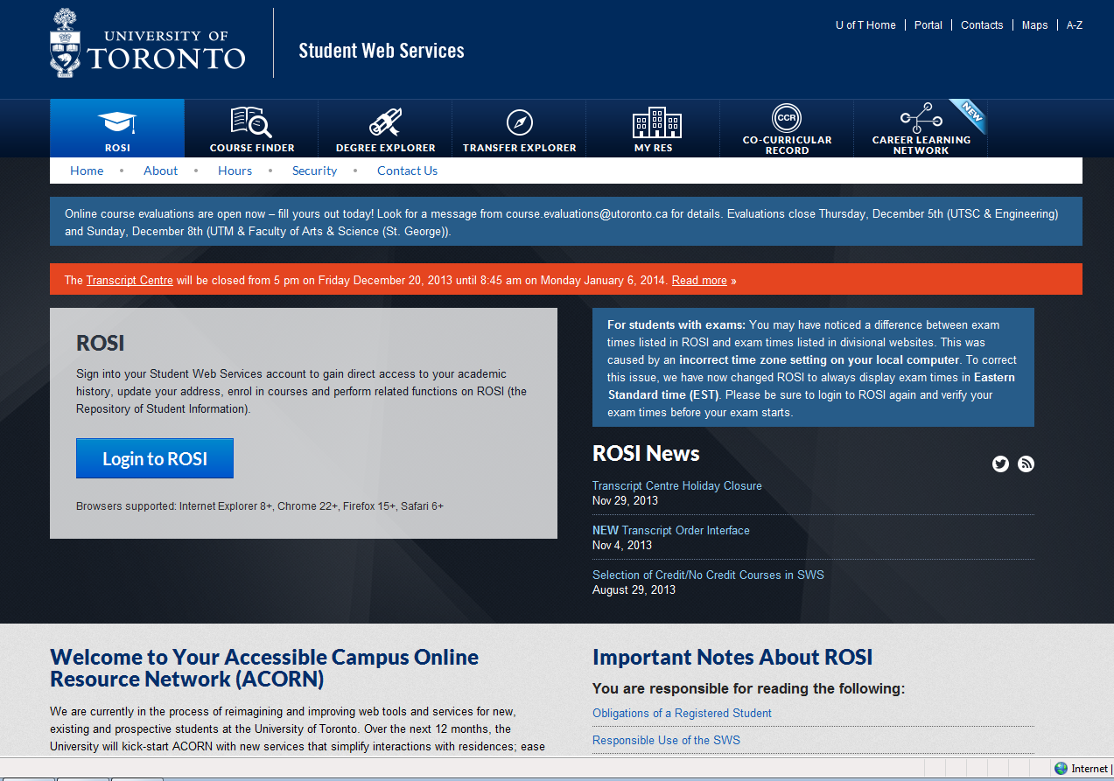

Slide 19
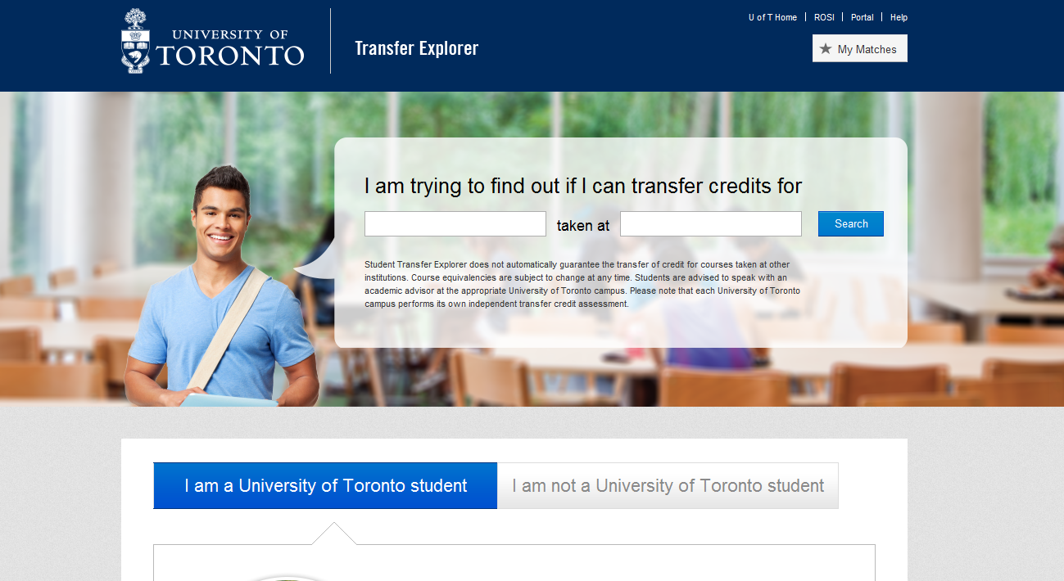
Can I transfer my credits?
FOM
Graduate
Students
Graduate
Students
FOM
Graduate
Students

Slide 20
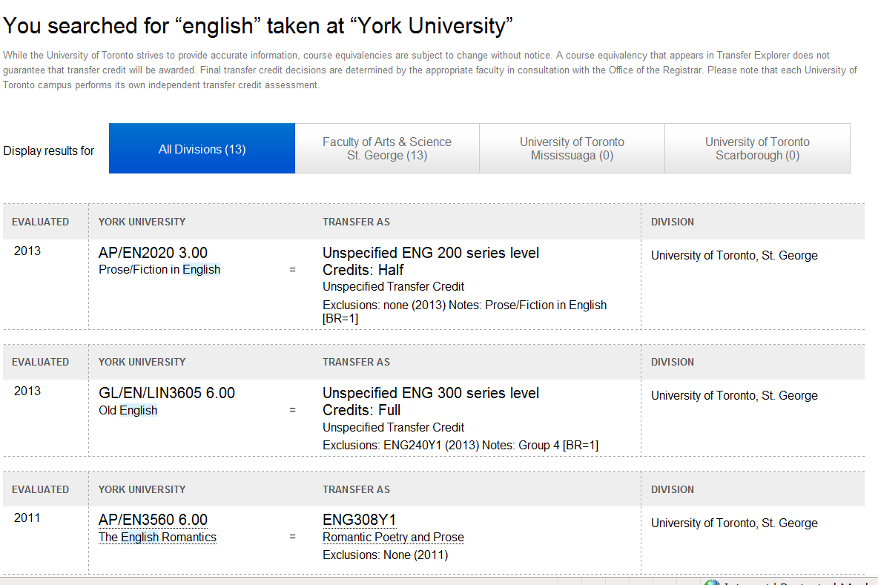
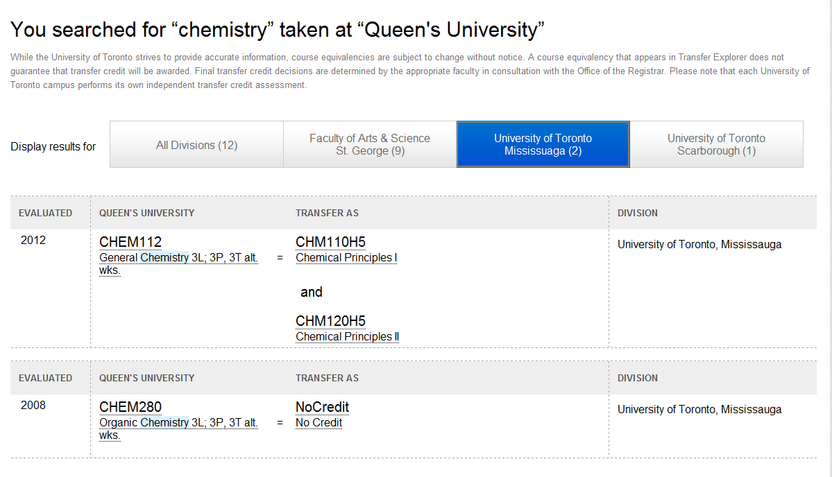

Slide 21
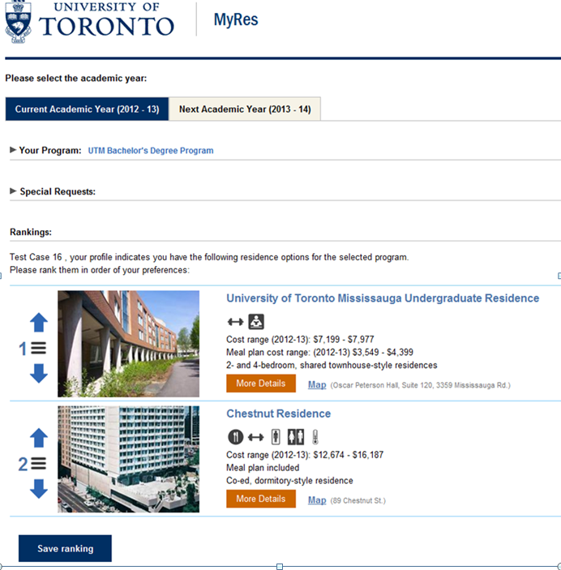
Help me to choose my residence…
Graduate
Students

Slide 22
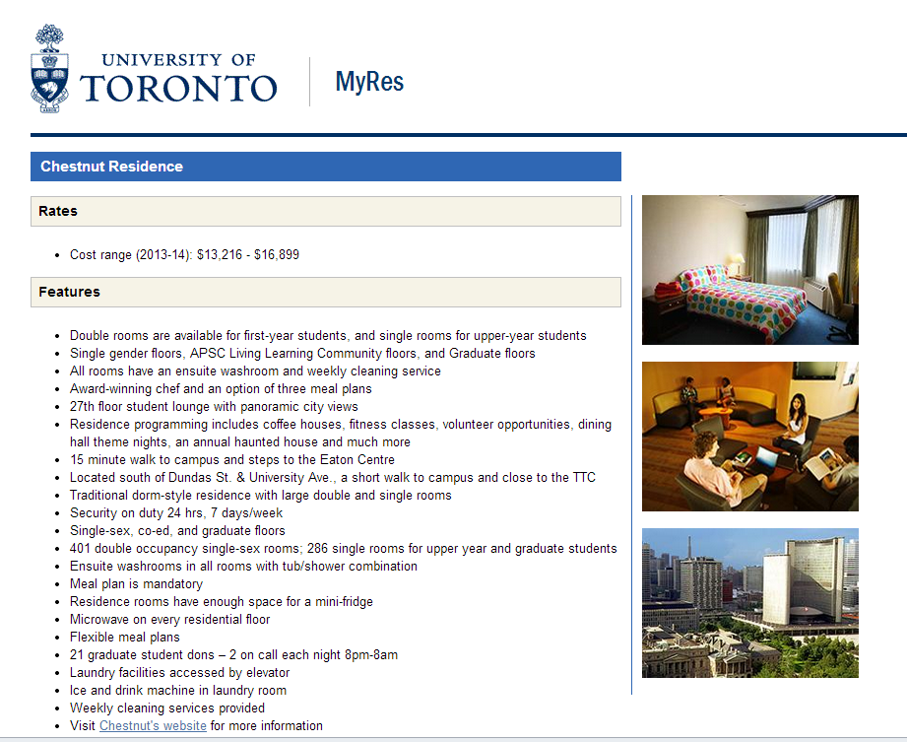
I’d like to compare my residence choices…

Slide 23
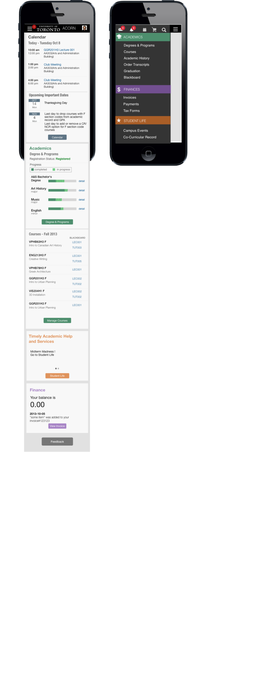
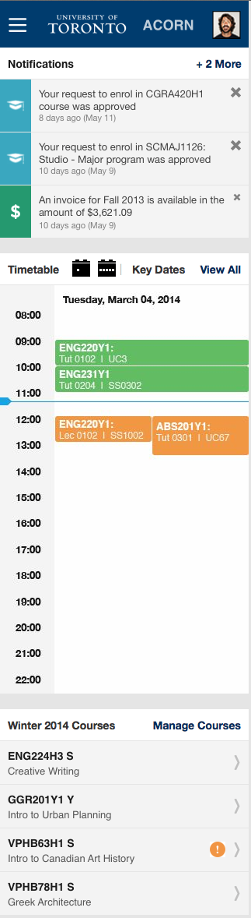
Mobile – Responsive Design
Menu view
Reformats popular dashboard features
Reformats most popular menu options for mobile device

Slide 24
Student Accounts
Total Students – 83,012
150 different combinations of academic and incidental fees
885 distinct ancillary fees
Generates >8 million financial transactions annually
> $186 million in scholarships, fellowships and bursaries
>$945 million in student fees

Slide 25
Student Accounts Issues
Inconsistent rules and/or lack of options to manage deferral of fees
Limited ability to offer different payment and refund options
No ability to apply payment to specific fees
Inconsistent and/or lack of rules to retroactive registration charges;
Undergraduate leaves
Administrative error
Compassionate relief
Parents who pay tuition cannot access invoice and payment information
Not able to reconcile ROSI to the financial system

Slide 26
Student Accounts – Investigation of Issues
Process Streamline (requirements) reports completed by Financial Services:
Financial Counselling
Residence Fees
Graduate Awards Disbursements
Undergraduate Award Disbursements
Educational Assistance
Undergraduate Academic Fees
Graduate Academic Fees
Incidental Fees
Academic Billing (Oct 2013)
Over 250 issues identified

Slide 27
Student Accounts – Phase 1
Adoption of SAP Student Accounts module with some customization for reporting
Provides a replica of the student account within the SAP financial system
Allows full reconciliation between SAP and ROSI
Allow use of SAP standard reporting
Less configuration of systems
Less duplication of data and keeps our options open for future KUALI deliverables including KSA

Slide 28
UTBI
A comprehensive reporting repository of the students lifecycle and a flexible toolset for analysis of that information
Empowerment
Provide flexible, self service access to student data
Broaden distribution to data to those who need it
Evidence based decision making
Facilitate better planning
Efficiency
Reduce data gathering and analysis from days to minutes
Single version of the truth

Slide 29


Today’s Reporting UTBI Repository
SIS
HRIS
Pro
Data Warehouse
RIS
Procurement Spending
Degrees Awarded
Student Enrolment (MTCU)
Graduate Student Income
FIS
HR
Research
Student Housing
OUAC Admissions
Other
UofT Admissions
Course Enrolment
Program Enrolment
Program Performance
Degree
Explorer
Cognos BI Tools Analytical Reporting

Slide 30
Admissions to Graduation Lifecycle
What is our share of Ontario
high school graduates?
Ontario Market Share
Admissions
Course and Program Enrolment
Program Performance
Admissions to Performance
Retention Analysis
How many stay and graduate?
Lets compare admissions
to performance …
Where are they admitted?
What programs & courses do they take?
How do they do?

Slide 31
Future Projects?
Expand Repository to collaborate with:
Degree Explorer
Ontario Market Share
Admissions
Course and Program Enrolment
Program Performance
Admissions to Performance
Retention Analysis
Co-Curricular
More Self Service Options
MyRes
Mobile BI
Student Accounts
Executive Dashboard & KPIs
SGS Reports
Predictive Analytics
Course
Evaluations

Slide 32
KUALI Participation - UofT
We are investing/contributing to the development of these KS products
We are replacing some key parts of ROSI with KS products as part of the NGSIS hybrid approach
Current focus of KS development is Enrolment; this is a high priority for the University
We are implementing Curriculum Management
Providing staff for development of Course Offering and Registration

Slide 33
KUALI
Challenges
Advantages
Cost
Stronger set of functionality
Specifically designed for Higher Education
Service Oriented Architecture
Modular in design
Collaborative nature of the development
Many partners
Getting our requirements on the table and prioritized
Fluidity of partner resources
Timing and scheduling
Changing the development culture at UofT

Slide 34
KS KUALI Organization - Student Structure
U of T Contribution
Program Director
Program Coordinator
Functional Director
Development Manager
QA Manager
Principal Product Manager
Product Managers
Analysis Team Lead
Lead Architect
Core Analysis Team
Core Technical Team
UX Architect
Core UX Team
Services Architect
Core Services Team
Core QA Team
Board
PDT Leads
PDTs
Functional Council
Project Advisory Group

Slide 35
Curriculum Management
Curriculum management provides the structure and facilitates creation and modification of the curricular catalog
Automated workflow and approval for proposals
User initiated course creation, modification and retirement
Version control
Rules to relate courses to each other and programs
Provides search capability on key words in the title and body
Viewing interdependencies
Comparing versions of courses and programs with highlighted differences

Slide 36
Curriculum Management – Eco-system Implement undergraduate A&S
Develop ecosystem of products to support a single source of program and
course information for the U of T
Course & Program Screens
Search, Browse, Propose, Approve
Source for:
ROSI/NGSIS
Divisional Calendars
CM Database
source of courses & programs
update program
status from
Sakia
view rules from Degree Explorer

Slide 37
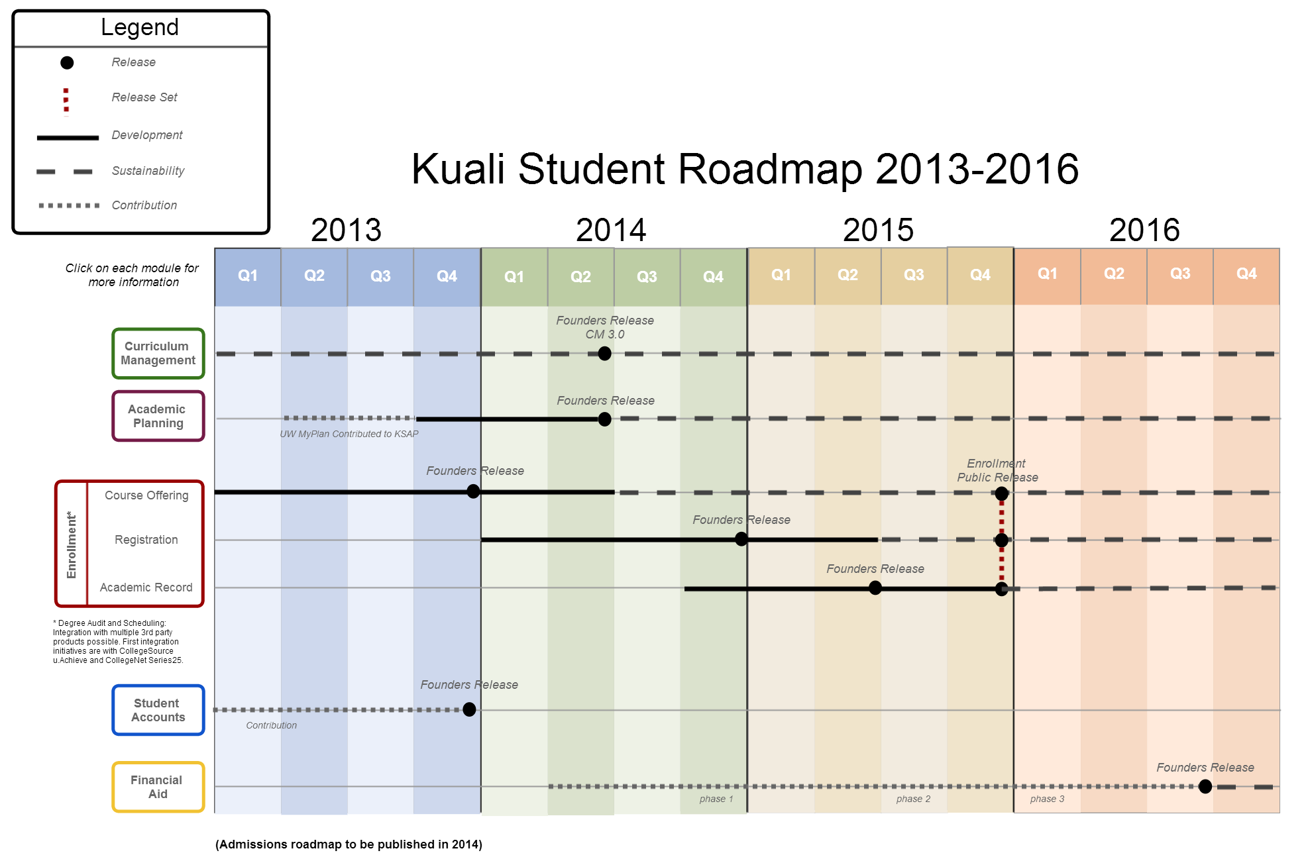

Slide 38
Rajiv Kaushik
Program Director – KUALI Student
KUALI Student: Student System Solutions Already Making a Difference
McDougall 249 at 11:15

Slide 39
Challenges
Building and keeping momentum with continuous improvement
Keeping sponsors and user community engaged
When do we start transitioning to new system?
Will it meet the requirements and expectations?
What do we need to build locally?
As we build/extend the KUALI modules do we contribute back/
Cultural changes for development
Timelines
Business process and best practice
Complexity of the University of Toronto
Balancing resources and budget to meet all the demands
As we implement new services - sustainment

Slide 40
Questions
Graham Kemp – graham.kemp@utoronto.ca
Cathy Eberts cathy.eberts@utoronto.ca
Rajiv Kaushik rajiv.kaushik@utoronto.ca

