Slide 1

Using Microsoft Stream for video sharing and lecture delivery at U of T
Blake Markle - Janet Koecher

Slide 2
Blake Markle Classroom technology coordinator
IITS - UTSC

Slide 3
What is sTREAM?
Microsoft Stream is a corporate video-sharing service that was released in 2017 and is part of the Office 365 suite of apps.
Stream allows users to upload videos and share them with individuals or groups within the organization.
"Corporate YouTube"
Will replace Office 365 Video

Slide 4
OVerview
Enterprise Video service
People in your organization can upload, view, and share videos securely.
Recordings of classes, meetings, presentations, training sessions, or other videos that aid your team's collaboration.
Easy to share comments on a video, tag timecodes in comments and descriptions to refer to specific points in a video
Notes:
Microsoft Stream is an Enterprise Video service where people in your organization can upload, view, and share videos securely. You can share recordings of classes, meetings, presentations, training sessions, or other videos that aid your team's collaboration. Microsoft Stream also makes it easy to share comments on a video, tag timecodes in comments and descriptions to refer to specific points in a video and discuss with colleagues.

Slide 5
OVerview
Microsoft Stream is a secure video service so you can manage who views your video content and determine how widely to share within your organization. Secure application access is enabled by Azure Active Directory, a recognized leader in identity management systems, to protect sensitive corporate content.
Notes:
Microsoft Stream is a secure video service so you can manage who views your video content and determine how widely to share within your organization. Secure application access is enabled by Azure Active Directory, a recognized leader in identity management systems, to protect sensitive corporate content.

Slide 6
OVerview
Microsoft Stream also helps you organize content into Channels and Groups so it's easier to find. Microsoft Stream works well with other Office 365 apps like Teams, SharePoint, OneNote, and Yammer, giving even more ways to discover more relevant content.
Notes:
Microsoft Stream also helps you organize content into Channels and Groups so it's easier to find. Microsoft Stream works well with other Office 365 apps like Teams, SharePoint, OneNote, and Yammer, giving even more ways to discover more relevant content.

Slide 7
What else does it do?
Stream allows the uploader to share with specific individuals or groups within the organization.
Stream has integrated social functionality allowing users to like, follow, and share content posted by others.
Exciting new machine-learning features such as automatic transcription and facial recognition.

Slide 8
What doesN’T it do?
Live Streaming
Recording
Youtube Experience
Notes:
Live Streaming – on its way
Recording – it’s not a recorder, it’s a video hosting platform. No direct recording into Stream though that might come along with live streaming
Youtube Experience – mose a corporate, enterprise experience

Slide 9
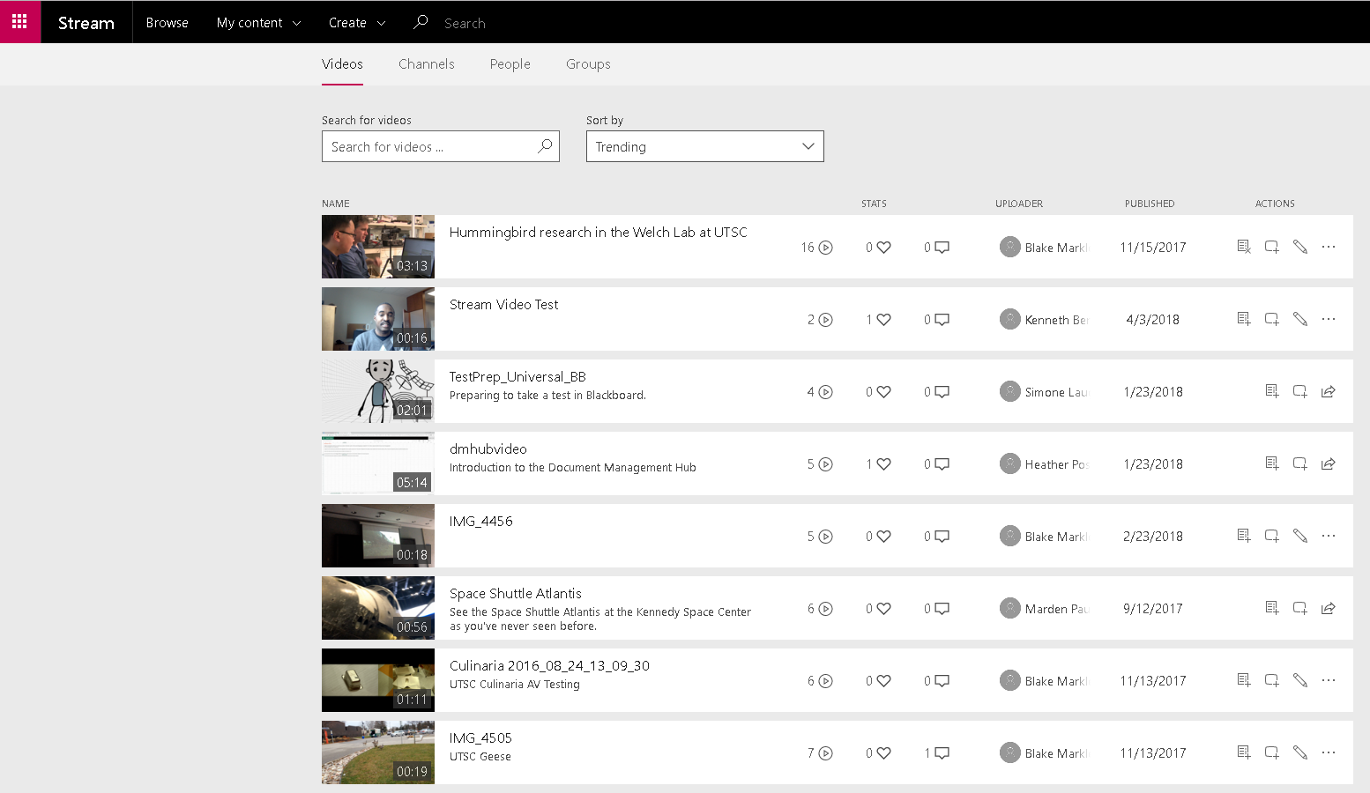
WHAT DOES IT LOOK LIKE?

Slide 11
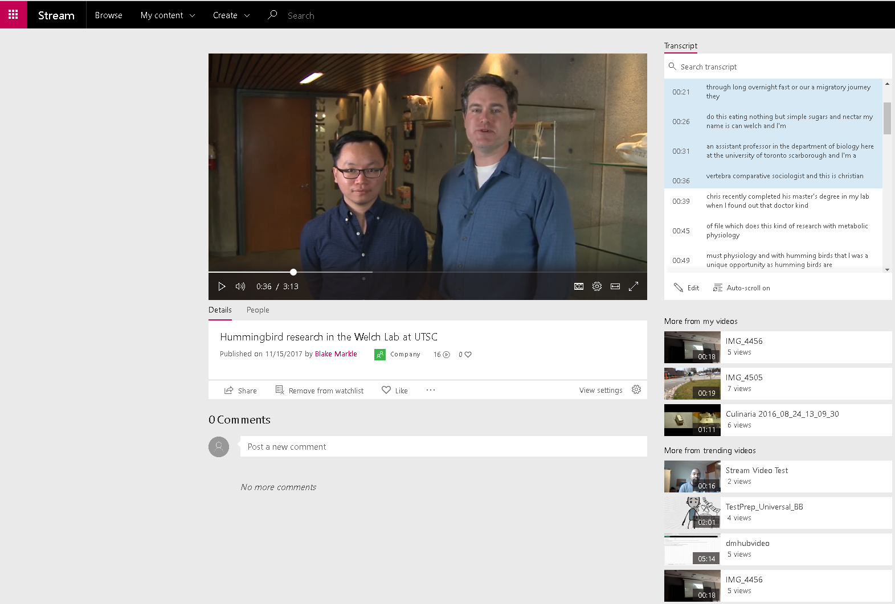
What does it look like? Part II

Slide 13
File Types
Most of them.
https://docs.microsoft.com/en-us/stream/input-audio-video-formats-codecs#input-containerfile-formats
FLV (with H.264 and AAC codecs) (.flv)
MXF (.mxf)
GXF (.gxf)
MPEG2-PS, MPEG2-TS, 3GP (.ts, .ps, .3gp, .3gpp, .mpg)
Windows Media Video (WMV)/ASF (.wmv, .asf)
AVI (Uncompressed 8bit/10bit) (.avi)
MP4 (.mp4, .m4a, .m4v)/ISMV (.isma, .ismv)
Microsoft Digital Video Recording(DVR-MS) (.dvr-ms)
Matroska/WebM (.mkv)
WAVE/WAV (.wav)
QuickTime (.mov)

Slide 14
USE CASES
Lecture recordings

Slide 15
USE CASES
Lecture recordings
Teaching vignettes, supplementary course materials

Slide 16
USE CASES
Lecture recordings
Teaching vignettes, supplementary course materials
Internal communications content

Slide 17
USE CASES
Lecture recordings
Teaching vignettes, supplementary course materials
Internal communications content
‘How-To’ videos from various departments or faculties, for instructors, students and staff. E.g. IT help videos

Slide 18
USE CASES
Lecture recordings
Teaching vignettes, supplementary course materials
Internal communications content
‘How-To’ videos from various departments or faculties, for instructors, students and staff. E.g. IT help videos
Vlogs by faculty, staff, students

Slide 19
USE CASES
Lecture recordings
Teaching vignettes, supplementary course materials
Internal communications content
‘How-To’ videos from various departments or faculties, for instructors, students and staff. E.g. IT help videos
Vlogs by faculty, staff, students
U of T news videos

Slide 20
USE CASES
Lecture recordings
Teaching vignettes, supplementary course materials
Internal communications content
‘How-To’ videos from various departments or faculties, for instructors, students and staff. E.g. IT help videos
Vlogs by faculty, staff, students
U of T news videos
Fun stuff!

Slide 21
Capacity
How much can you upload?
https://docs.microsoft.com/en-us/stream/quotas-and-limitations

Slide 22
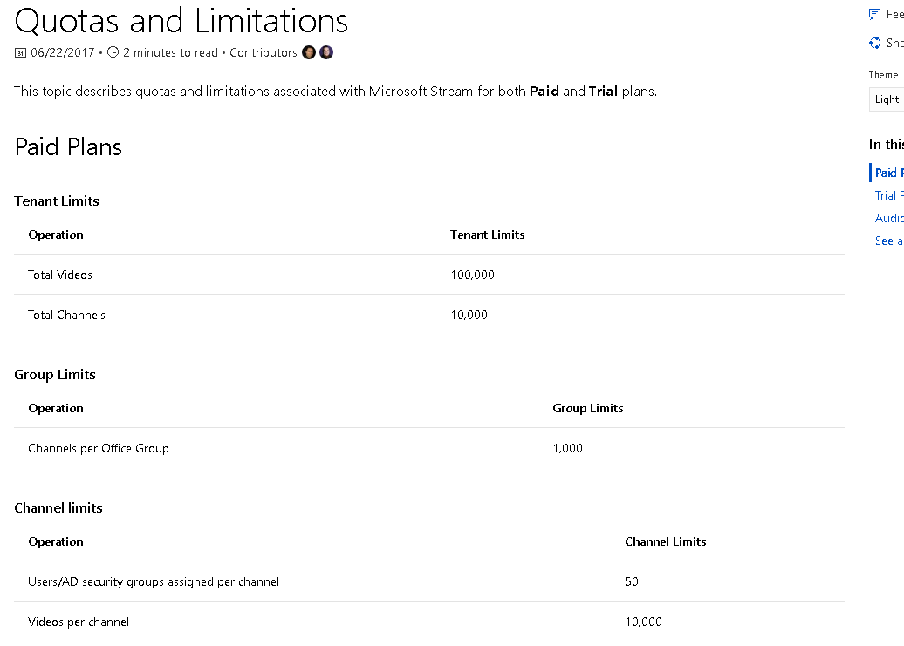

Slide 23
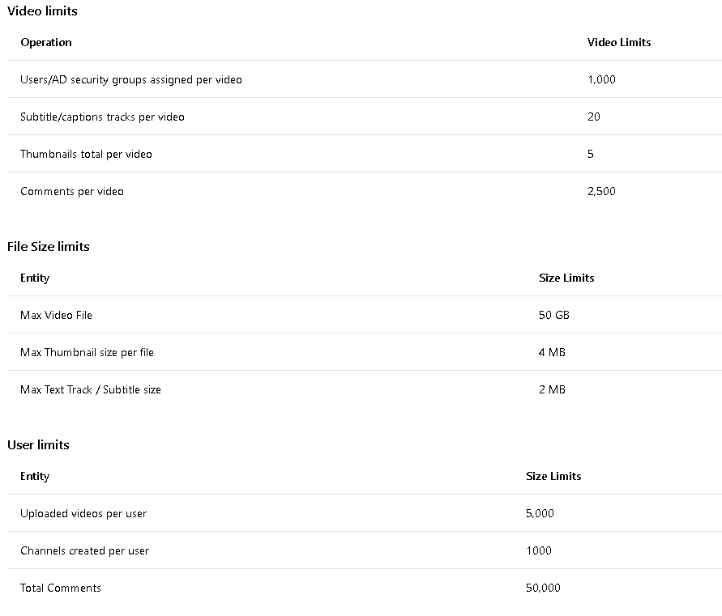

Slide 24
Capacity
How much space do users get?
The storage pool is 500GB + .5GB per user in the tenant
Over 45TB for U of T
To compare, Youtube has 76 PB worldwide = 1689 x U of T Stream

Slide 25
Capacity
Would this be enough for lecture recordings for all of U of T?
UTSC WebOption currently has 1.25 TB online, per academic year
UTSC approx. 1/6 size of total U of T
= 7.5 TB
More than enough

Slide 26
Security
Users have full control of who can see or edit the videos they upload.
If Stream were to be used as a repository for enterprise lecture recording, using Microsoft Groups could facilitate the sharing of lecture videos with the students of each class – that is, if Groups is leveraged in that way and there is a group created for each course number.

Slide 27
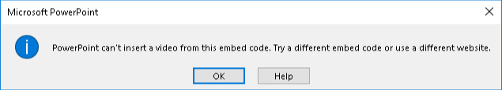
Channels and Groups
:-(
Cannot Embed Stream in PowerPoint (for now)

Slide 28
Analytics
Simple analytics currently in place
More sophisticated statistics features planned for 2018.
Portal and channel analytics also planned for the future.
Useful for instructors to gauge what part of their content being viewed and by whom.
Mandatory class content can also be enforced using this.
A storage-monitoring tool for Stream admins is also in the works.
Notes:
Simple analytics – number of views per video – is currently in place for a Stream Admin. More sophisticated statistics features such as view trend, which part of video has been viewed, are planned for 2018.
Detailed portal and channel analytics are also planned for the future.
These will be useful for instructors to gauge which of their content is being viewed and by whom. Mandatory class content can also be enforced using this.
A storage-monitoring tool for Stream admins is also in the works.

Slide 29
Demonstration
https://web.microsoftstream.com/video/cb6fc206-4c21-499f-936d-c177966c54b9

Slide 30
Demonstration
https://web.microsoftstream.com/video/567c93b8-b0b9-4270-8445-911ad78b7172?list=studio

Slide 31
FAQ
Q: Is it possible to edit closed caption text once the video is uploaded? For example, if the name of a professor is rendered incorrectly.

Slide 32
FAQ
Q: Is it possible to edit closed caption text once the video is uploaded? For example, if the name of a professor is rendered incorrectly.
A: Yes
Notes:
A: Yes, inline editing is now part of the Microsoft Stream Plan 2 for Faculty
(demonstrate)

Slide 33
FAQ
Q: Is it possible to batch upload/import videos? We have departments at U of T with dozens of videos already hosted on YouTube, it would be great if they didn’t have to reupload one by one to Stream.

Slide 34
FAQ
Q: Is it possible to batch upload/import videos? We have departments at U of T with dozens of videos already hosted on YouTube, it would be great if they didn’t have to reupload one by one to Stream.
A: No
Notes:
A: There isn’t a batch upload feature yet (we do it in Azure Media Services, but not in Stream). It’s a requested feature, but there is no date.

Slide 35
FAQ
Q: Where are the Stream videos hosted? We are aware that the university’s O365 tenant is hosted on Canadian servers, but our Sharepoint admin pointed out that Stream is not hosted in that tenant. There were many concerns chiefly from our faculty members about intellectual property being hosted outside of the country.

Slide 36
FAQ
Q: Where are the Stream videos hosted? We are aware that the university’s O365 tenant is hosted on Canadian servers, but our Sharepoint admin pointed out that Stream is not hosted in that tenant. There were many concerns chiefly from our faculty members about intellectual property being hosted outside of the country.
A: Azure Cloud Storage
Notes:
A: Stream is hosted in Azure, not Office 365, which means it doesn’t count towards your SharePoint storage quota. The Azure storage that Stream uses is in the US for now, but Stream will be moving to Canada in early 2018. We won’t migrate any user’s Office 365 Video content until we have feature parity and until we can make sure that data residency is maintained.

Slide 37
FAq
Q: Is it possible to share a video with a non- U of T person? If they have a Microsoft account? What about if they don’t?

Slide 38
FAq
Q: Is it possible to share a video with a non- U of T person? If they have a Microsoft account? What about if they don’t?
A: No
Notes:
A: External sharing is a well known requirement and is being worked on, but we don’t have a date for it. It’ll likely be authenticated external users first vs. anonymous external users (i.e. not a YouTube experience).
Note: there is a Features Breakdown comparing Stream and O365 Video, which mentions the expected timeline of this and other new features expected in the near future:
https://docs.microsoft.com/en-us/stream/office-365-video-feature-breakdown

Slide 39
FAq
Q: Is there a timeline for live video streaming functionality in Stream?

Slide 40
FAq
Q: Is there a timeline for live video streaming functionality in Stream?
A: No
Notes:
A: Live video streaming is on the roadmap as well, although I might suggest using Skype Broadcast for that in the short term.
Note: Skype Broadcast is not currently enabled in our O365 license.

Slide 41
FAQ
Q: Is there a timeline for storage monitoring on the admin side? I.e. a way of seeing how much storage you are using, what's consuming it, etc.

Slide 42
FAQ
Q: Is there a timeline for storage monitoring on the admin side? I.e. a way of seeing how much storage you are using, what's consuming it, etc.
A: No
Notes:
A: There is an admin portal and admin settings, but I don’t see an easy way to look at storage. The storage pool is 500GB + .5GB per user in the tenant, which is huge for a tenant the size of U of T, but I agree that having tools to view usage would be handy. It’s in development and as of the beginning of November, we were showing off a preview of the UI

Slide 43
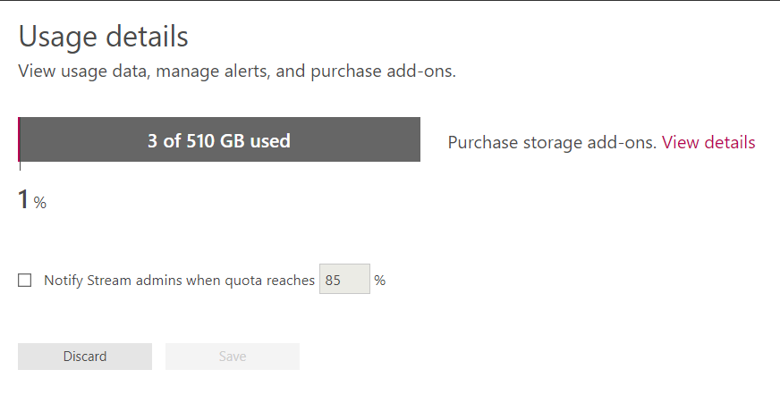
FAQ
Q: Is there a timeline for storage monitoring on the admin side? I.e. a way of seeing how much storage you are using, what's consuming it, etc.
Notes:
A: There is an admin portal and admin settings, but I don’t see an easy way to look at storage. The storage pool is 500GB + .5GB per user in the tenant, which is huge for a tenant the size of U of T, but I agree that having tools to view usage would be handy. It’s in development and as of the beginning of November, we were showing off a preview of the UI

Slide 44
FAQ
Q: Will Stream continue to be offered as a free preview, or will it be added to the services included in our A1plus license?

Slide 45
FAQ
Q: Will Stream continue to be offered as a free preview, or will it be added to the services included in our A1plus license?
A: Yes
Notes:
A: Stream is part of A1 (and A1plus), so every U of T user will have access to it.

Slide 46
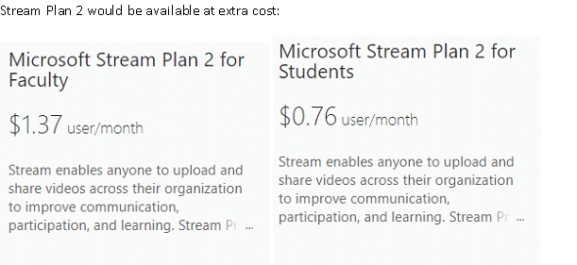
FAQ
Stream Plan 2 (which includes Transcripts and “People”) would be available at extra cost:

Slide 47
Janet Koecher Audio Visual Team Lead
Discovery Commons
Faculty of Medicine
Notes:
Thanks Blake, for that comprehensive overview of Stream. I'm... and I'm going to talk to you about a trial that we did recently with Stream

Slide 48
The Use case at discovery commons (Faculty of Medicine)
We record about 10 – 20 lectures per week
1st and 2nd year lectures in the MD Program
Lectures are videoconferenced between St George and Mississauga
We use a Tandberg Content Server for recording
Recordings are posted same day
We currently use Kaltura for content delivery https://kmc.kaltura.com/index.php/kmc/kmc4#content|manage
Notes:
One of the things that we do for the MD Program is we record about 10 – 20 lectures per week.
And these are 1st and 2nd year lectures in the program
All of the lectures are videoconferenced between the ST George and Mississaga campusses, so the students at both sites attend the same lecture and they're full interactive with cameras on the students and mics on all of the student desks.
Because we have cameras in the rooms, our recordings include a camera view of the lecturer at the front of the room as a PIP in the powerpoint, and we use a Tandberg content server, which is part of the videoconferencing infrastructure, to record
Kaltura: enterprise system, extremely robust, never had an issue in the 7 years we've been using it. Show Kaltua content, upload, analytics.

Slide 49
Why move from kaltura?
High annual fees
84Tb combined storage and bandwidth
Less than 5% is storage
Notes:
… so when we heard that Stream may be a potential solution for us, we were certainly wiling to give it a try with the hopes maybe it could provide what kalltura was doing, but without the high cost.

Slide 50


STREAM

Slide 51




THE PILOT
For playback
Embed code
&
For download
For back up
Video
Notes:
Would run for 2 weeks: March 19 – 30th
We uploaded videos to Stream, posted their links in Blackboard and MedSIS
Videos would play in the Stream portal
Ability to download videos is missing, so we also uploaded to MyMedia and posted download only link
As a back up, we also uploaded the videos to Kaltura

Slide 52
Week 1
March 19 - 23
200
175
150
125
100
75
50
25
0
Number
of
views
Day 1 Day 2 Day 3 Day 4 Day 5
https://web.microsoftstream.com/studio/channels

Slide 53
Week 1
March 19 - 23
200
175
150
125
100
75
50
25
0
Number
of
emails
Number
of
views
Day 1 Day 2 Day 3 Day 4 Day 5

Slide 54
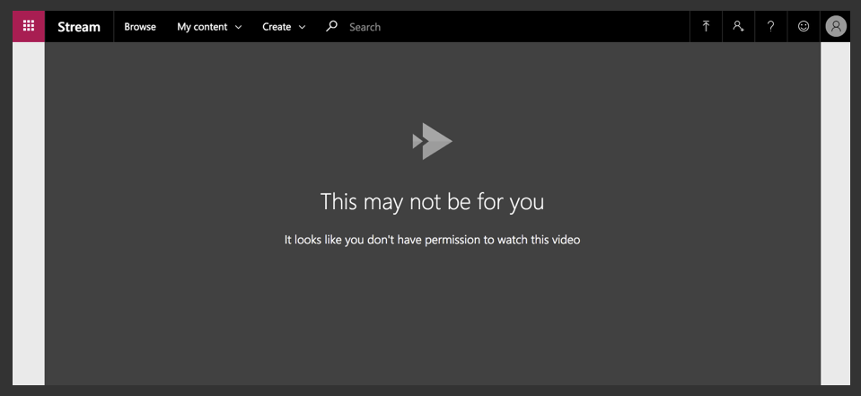

Slide 55
Pulling the Plug on THE PILOT
On Friday, ITS was alerted that there was an issue
I told students to download the lectures from MyMedia over the weekend and into Monday morning
A support ticket was submitted to Microsoft on Monday morning
By mid-day Monday, it was clear that no students were able to view the videos
On Monday afternoon, I removed all of the Stream links in Blackboard and MedSIS and replaced them with the Kaltura links
Notes:
…
And I do want to give a huge shout out and thank you to the ITS team who was helping us with this, who were very busy with the O365 rollout and all of the other issues associated with that. They really helped us out a lot.

Slide 56
Postscript
On Monday, April 2nd, a full week after the issue was escalated to Microsoft, the issue was resolved
We'll stay with Kaltura for the next academic year and watch how it develops with a plan to do another trial in the spring of 2019
To use this as a CDN for lecture recordings, departments would need:
a storage model that isn't currently available
a service level agreement with Microsoft that sets out expectations when there are issues
Notes:
It’s early days for this Microsoft product, and obviously it’s early days for U of T using the product, but I do think that it has great potential and look forward to seeing it mature over the next few months.

Slide 57

Questions

