Slide 1
NGSIS Platform Modernization
TKF 2018

Slide 2
Agenda
Project Background
Technical Integration
Printing
Change Management
To date
Planned
Demo
User Interface
Downloads
Crush FTP
Rocket Shuttle v12
Questions

Slide 3
Project Background
Started in July 2015
Initial conversion on the mainframe
Risk: Mainframe not suitable for Java
Migration off the mainframe started in Jan 2017
Migrate Java code and mainframe sub-systems
Regression test everything – 1300 test cases
Target cutover date: November 18th 2018

Slide 4
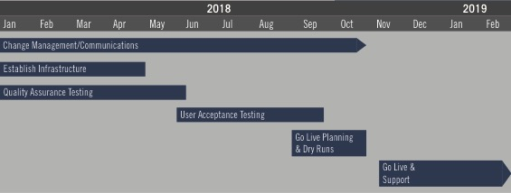
Project Timeline

Slide 5
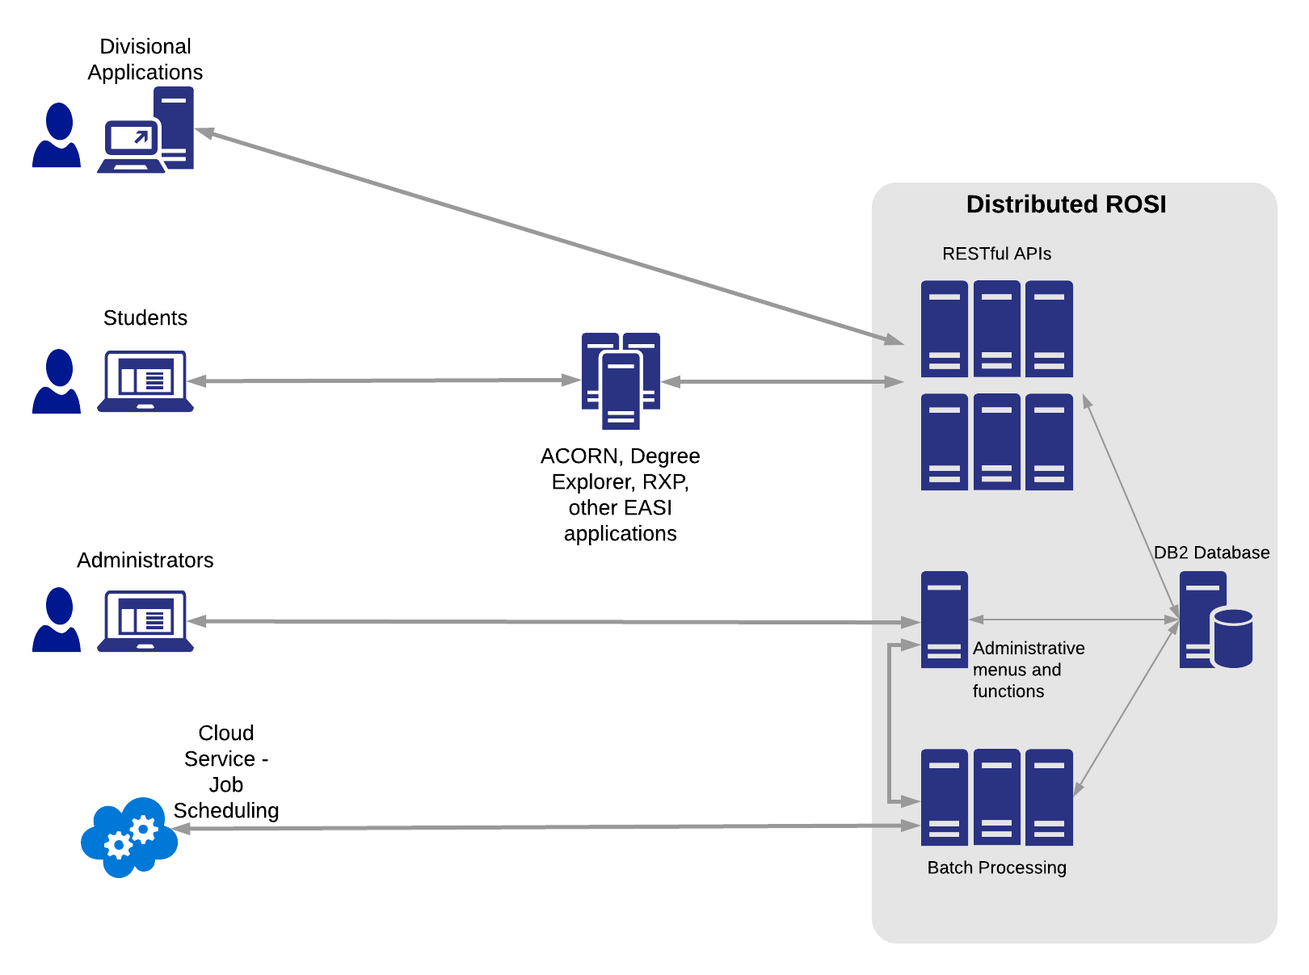
Technical Integration

Slide 6
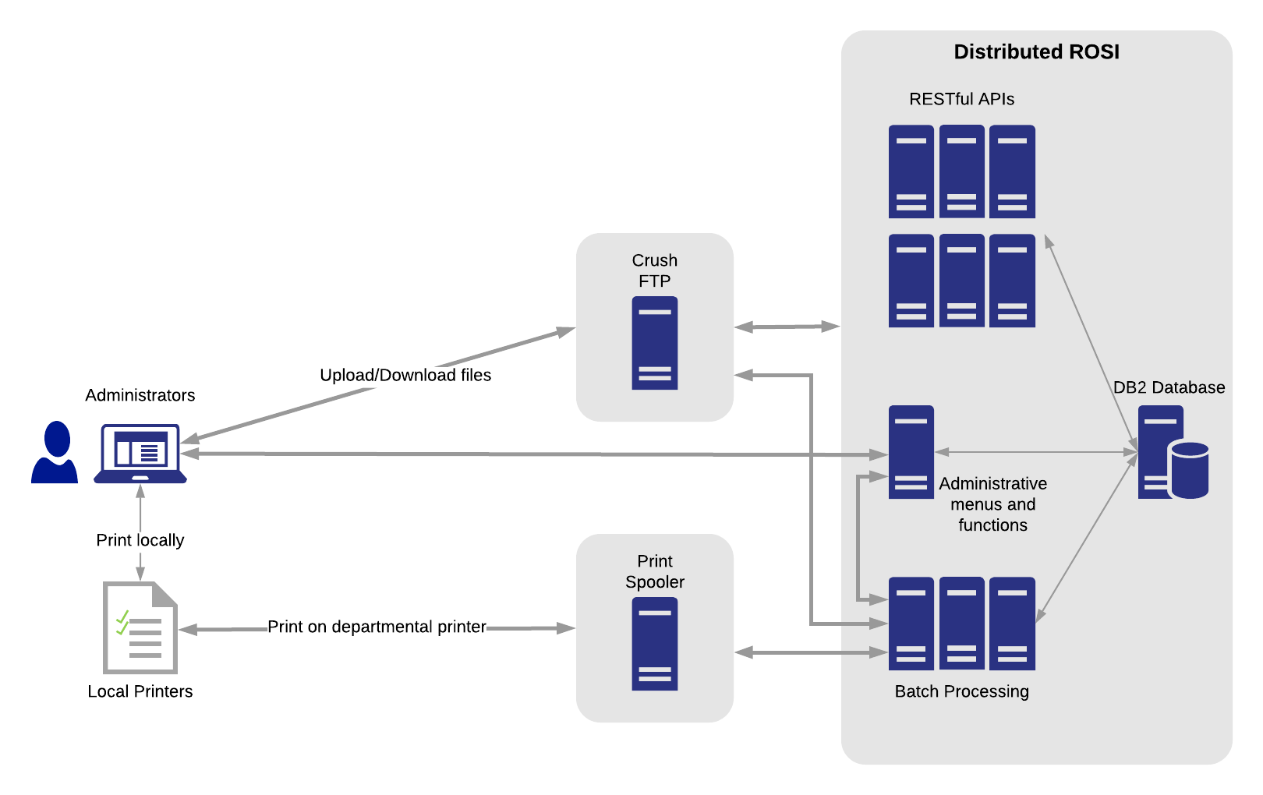
Printing

Slide 7
Change management
To date:
Divisional visits (fall 2017)
Listserv messages
Web site updates
Registrarial Professional Development Day presentation
Regular updates: ROSI Change Advisory Board (CAB); NGSIS Core Team
Planned:
Divisional testing (June to September)
Divisional visits (summer 2018) – broader demos and Q&A meetings
Extensive messaging on listservs, web sites, videos
Updated ROSI documentation
“cheat sheet” -- quick reference one-pager for keyboarding changes
Drop-in spots immediately before cutover
ROSI Help – extra hands on deck

Slide 8
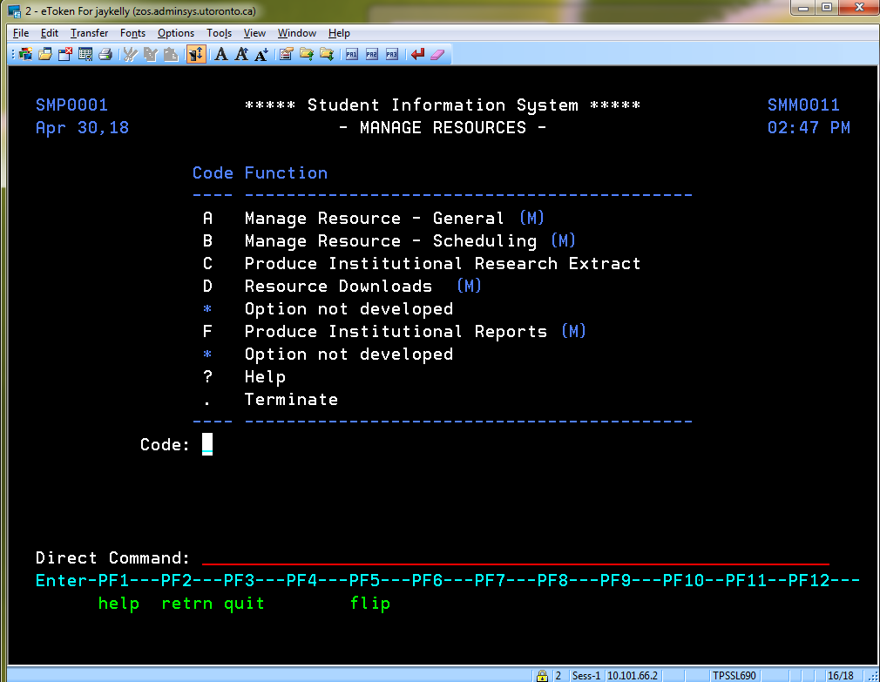
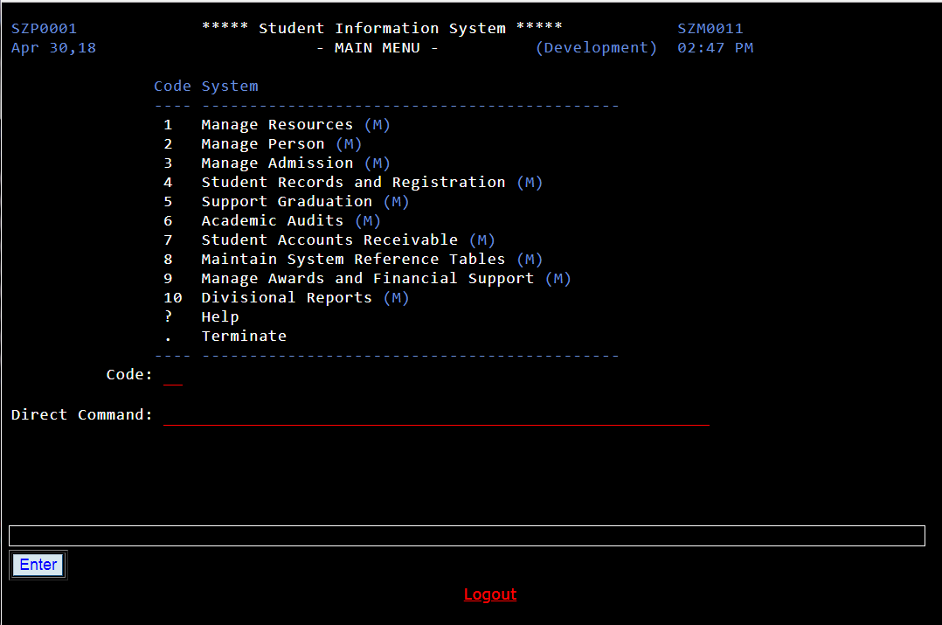
User interface: screen appearance

Slide 9
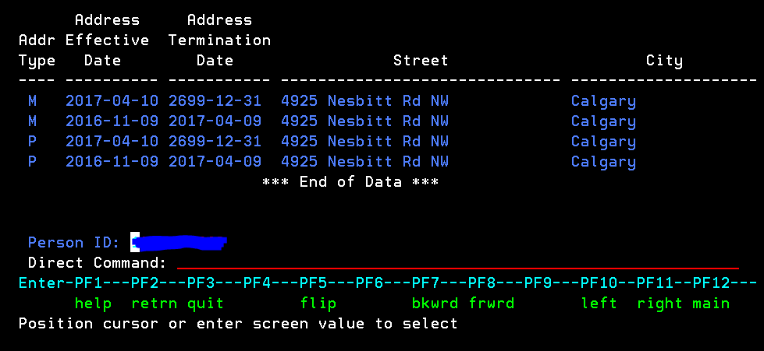
User interface: PF keys

Slide 10
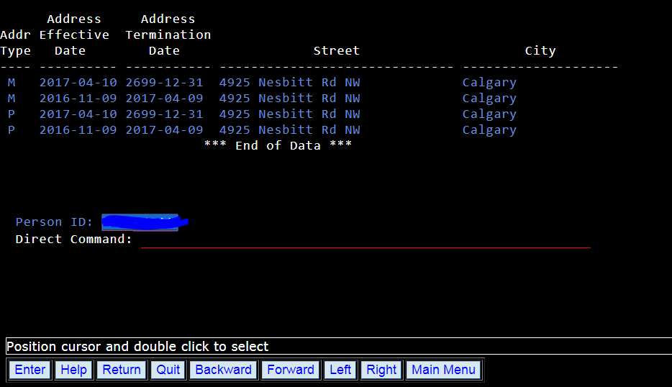
User interface: buttons

Slide 11
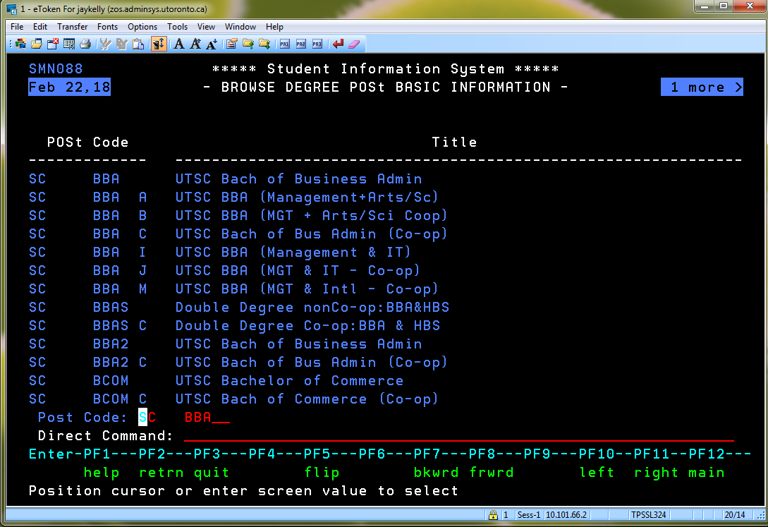
User interface: Click + Enter now double-click
Now: hover, click once, and then hit Enter

Slide 12
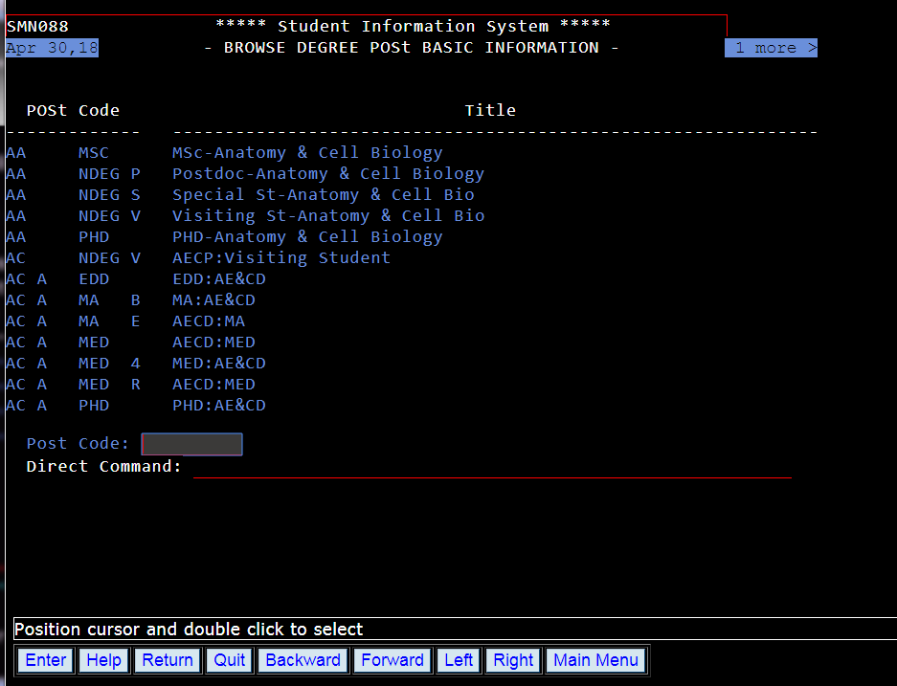
Future: just double-click to select

Slide 13
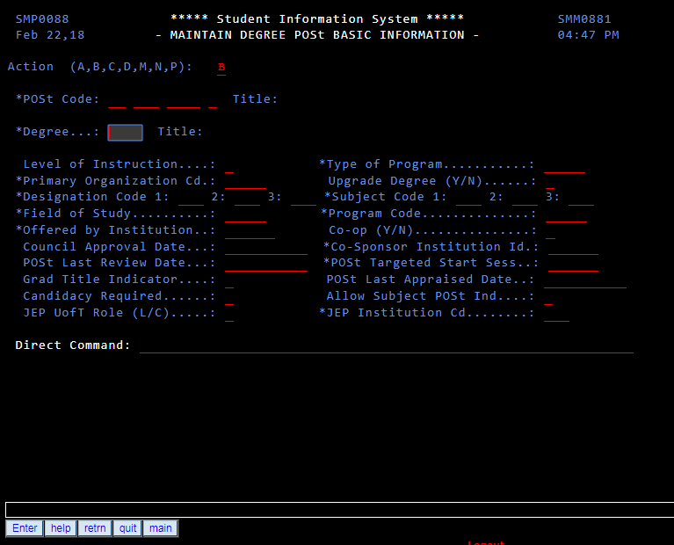
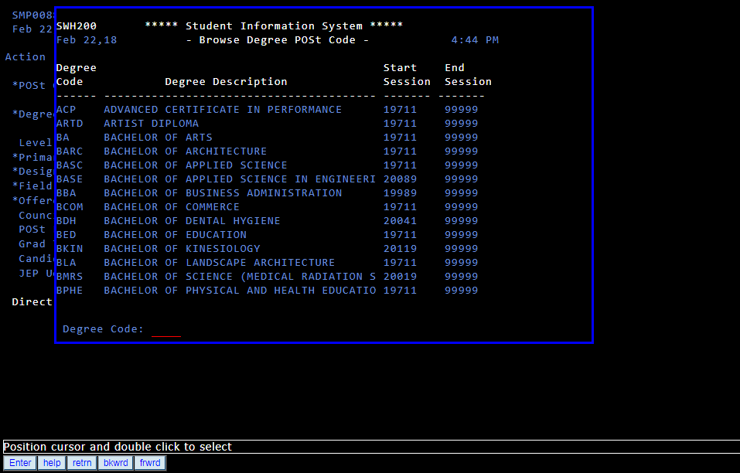
Double-click also works to open a field help pop-up window
Double-click the field
Field help list pops up

Slide 14
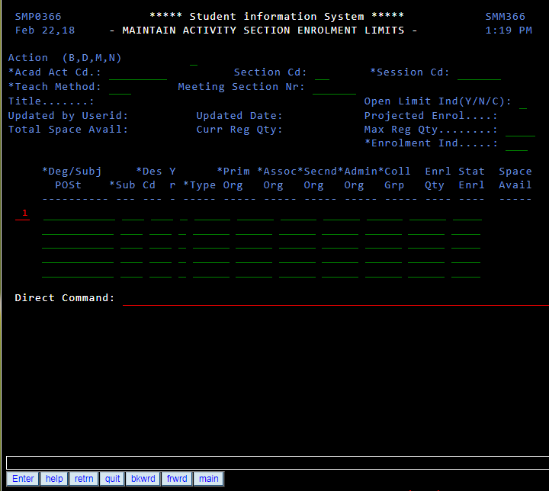
User interface: tabbing

Slide 15
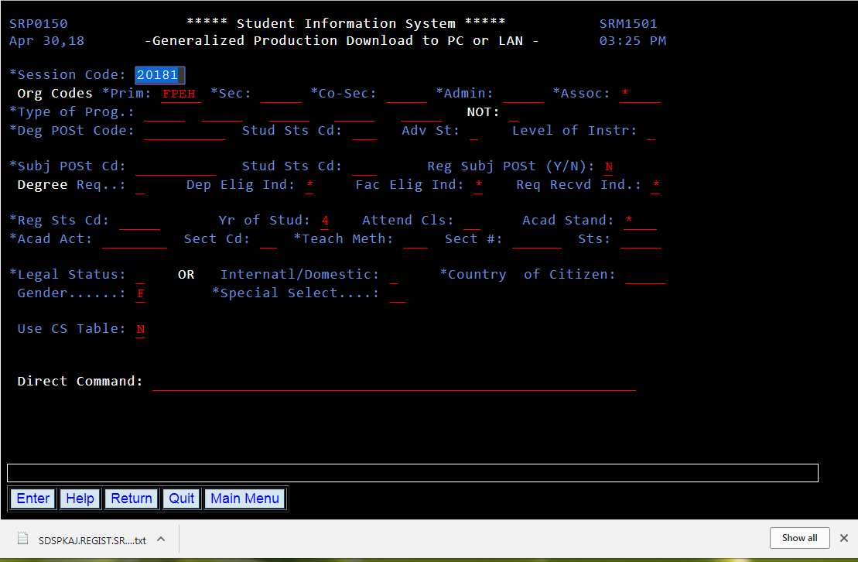
Downloads and datasets
Entire Connect downloads to your PC now appear like any other download from a web site, in the downloads tab of your browser.

Slide 16
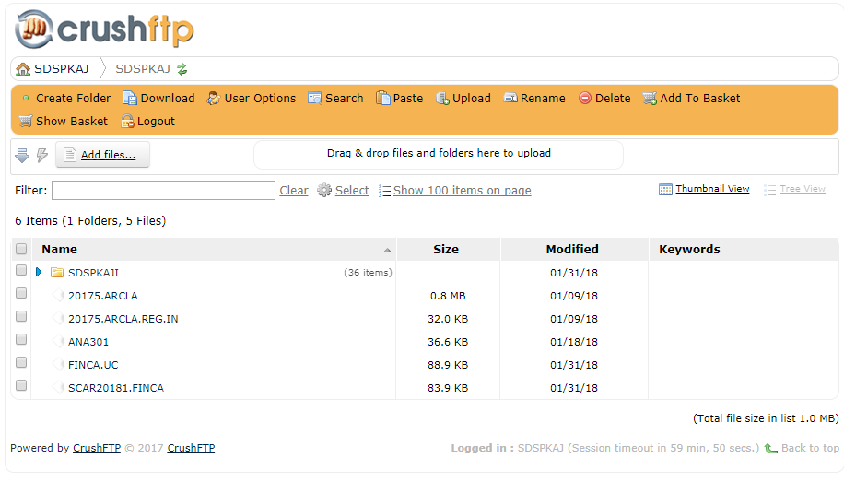
Downloads and datasets
Datasets will now be accessed using a new, web-based tool called crushFTP.

Slide 17
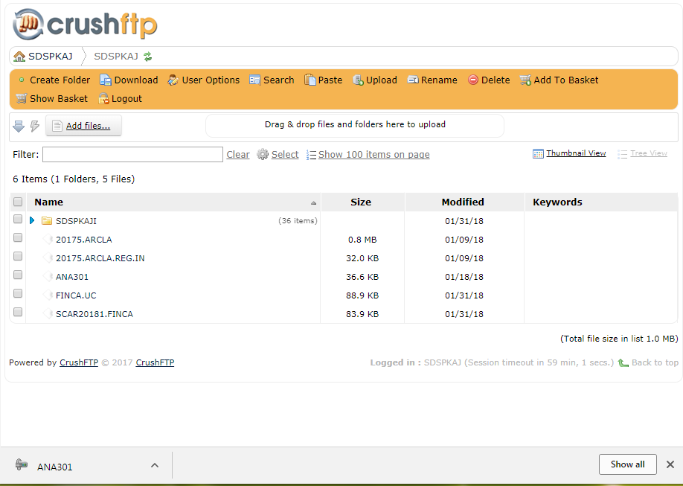

Slide 18
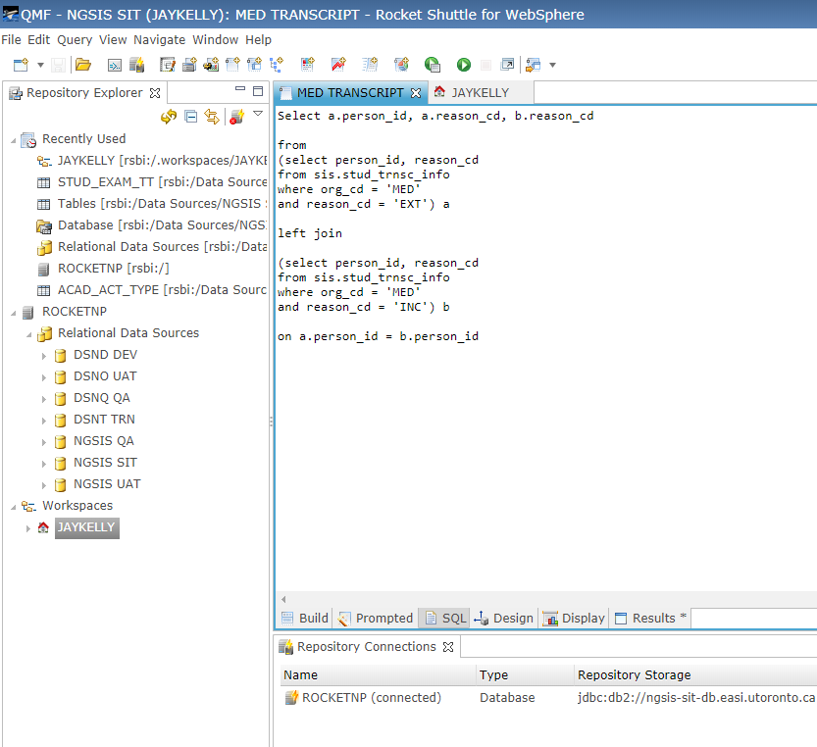
Rocket Shuttle – new version
The updated version of RocketShuttle will be web-based, but for the most part will function in the same ways as the current RocketShuttle.
User libraries will be copied over, although individual users will need to drag-and-drop their query libraries into their personal workspaces in the new version.

