Slide 1

Open Your Textbooks
Laurie Harrison - Director, Online Learning Strategies
Will Heikoop - Coordinator, Online Learning Strategies
All images CC0 from pixabay.com unless otherwise noted.

Slide 2

Just what is an open textbook?
An open textbook is provided under an open copyright license, and made available online to be accessed for free by students (as well as other instructors and the public).
These books can be viewed online or downloaded for no cost and they can also be printed on demand for a much lower cost than a typical physical textbook.

Slide 3

Why embrace open texts?
PRICE: As textbook prices continue to soar, student textbook purchasing is decreasing. We don’t want students to have to choose between doing well in their classes and purchasing textbooks worth hundreds of dollars.
UPDATED: The ability to make minor changes or updates to a textbook or create an abridged version of the book, without requiring students to purchase an entire book, is a bonus.
ADAPTABLE: The pedagogical advantage is the opportunity for instructors to make changes, or adapt, the textbook to match their classroom instruction needs and style.
Notes:
https://open.bccampus.ca/open-textbook-101/

Slide 4
Why embrace open texts?
The 5Rs of Openness (David Wiley)
– Retain – the right to make, own, and control copies of the content
– Reuse – the right to use the content in a wide range of ways (e.g., in a class, in a study group, on a website, in a video)
– Revise – the right to adapt, adjust, modify, or alter the content itself (e.g., translate the content into another language)
– Remix – the right to combine the original or revised content with other open content to create something new (e.g., incorporate the content into a mashup)
– Redistribute – the right to share copies of the original content, your revisions, or your remixes with others (e.g., give a copy of the content to a friend)
Notes:
https://opencontent.org/blog/archives/3221

Slide 5
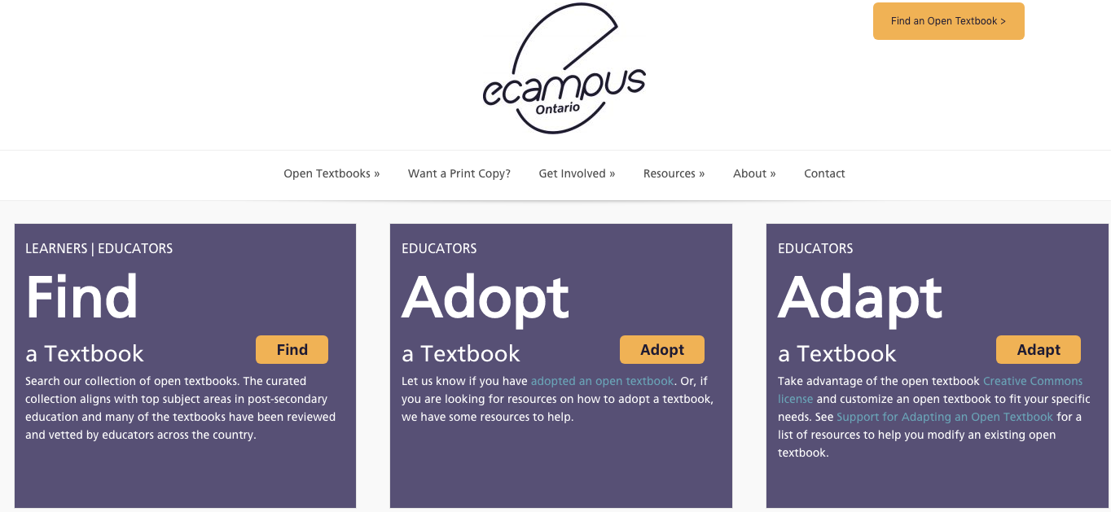
Where can I find open textbooks?
Screenshot of eCampusOntario Portal
https://openlibrary.ecampusontario.ca/
Notes:
Laurie

Slide 6
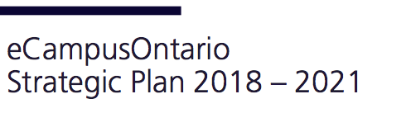
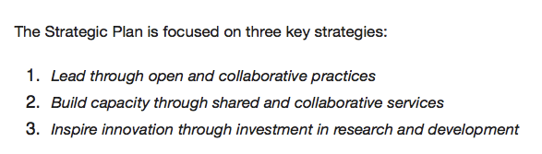
Provincial Priority
UofT instructors have received $250K in the past year to support development and adaptation of four open eTextbooks.

Slide 7

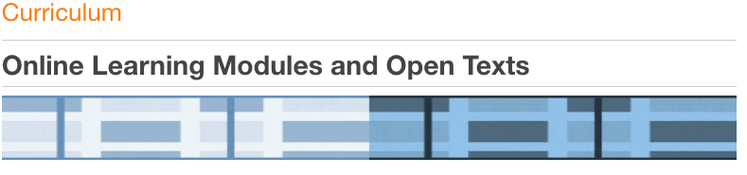
Open UToronto
Open Textbooks – Creation
· Introduction to History and Philosophy of Science
· Understanding American Politics
· Learning and Teaching Qualitative Research in Ontario: A Resource Guide
Open Textbooks – Adaptation
· Neuroscience – Canadian 1st Edition
· Introduction to Animal Physiology
open.utoronto.ca
Notes:
Laurie

Slide 8
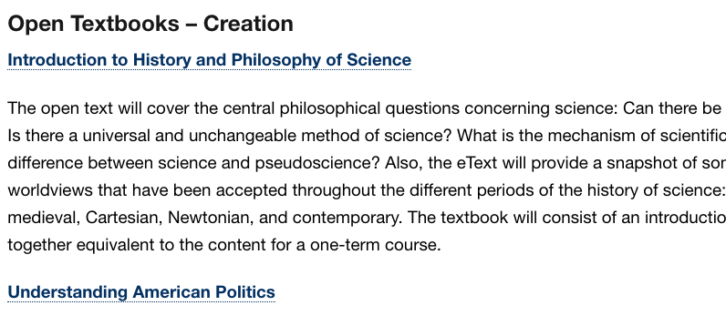
Open textbooks at UofT!
http://www.ocw.utoronto.ca/curriculum/
Screenshot of Open UToronto website
Notes:
Will

Slide 9
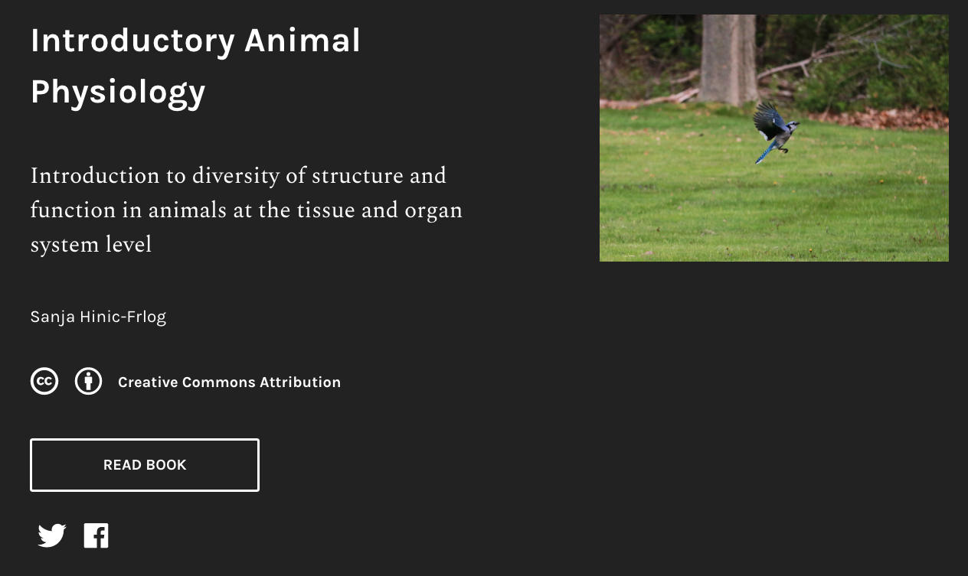
Pressbooks
Pressbooks is an online publishing platform that is built on the popular WordPress website publishing and blogging platform
Screenshot of landing page - Introductory Animal Physiology Open Text
Notes:
Pressbooks is an online book/document formatting system that you can use to create books that are accessible on all platforms: in print and digital, including all smartphones, tablets, ereader devices, and computers.

Slide 10
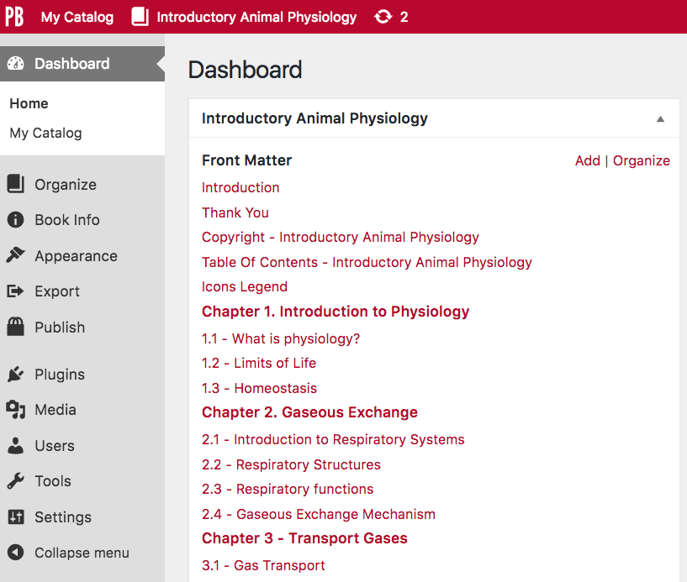
Pressbooks
Screenshot of Pressbooks Dashboard - Introductory Animal Physiology

Slide 11
Pressbooks Set Up
Pressbooks must be installed on a new WordPress Multisite site as Pressbook will transform the whole site dedicated to ebooks i.e the Pages section of the admin will be removed.
Install Steps:
Setup a WordPress Multisite
Setup Pressbooks
Setup Pressbooks Dependencies (for ebook export formats)*
Pressbook Github Repo: https://github.com/pressbooks/pressbooks
Pressbooks is free software, released under the GPL v3.0 or later license. *All dependencies are free except PrinceXML

Slide 12

The instructor perspective:
Sanja Hinić-Frlog, Biology, UTM
- I was never able to find the resource which perfectly fit the knowledge level of my students or how I approach teaching of the relevant content.
- I was able to organize the entire open textbook around the learning outcomes I wanted to focus on and at the level that best matched the students enrolled in this course (mix of introductory and advanced content).

Slide 13

The instructor perspective:
Sanja Hinić-Frlog, Biology, UTM
Creating an open textbook in Pressbooks allowed me to develop a teaching tool that best matched my course goals.
For example, the textbook can be organized around learning outcomes or goals that an instructor may want students to be able to do by the end of the course. Instructors do not have to fit their course goals
into a pre-existing mold made by a single publisher.

Slide 14
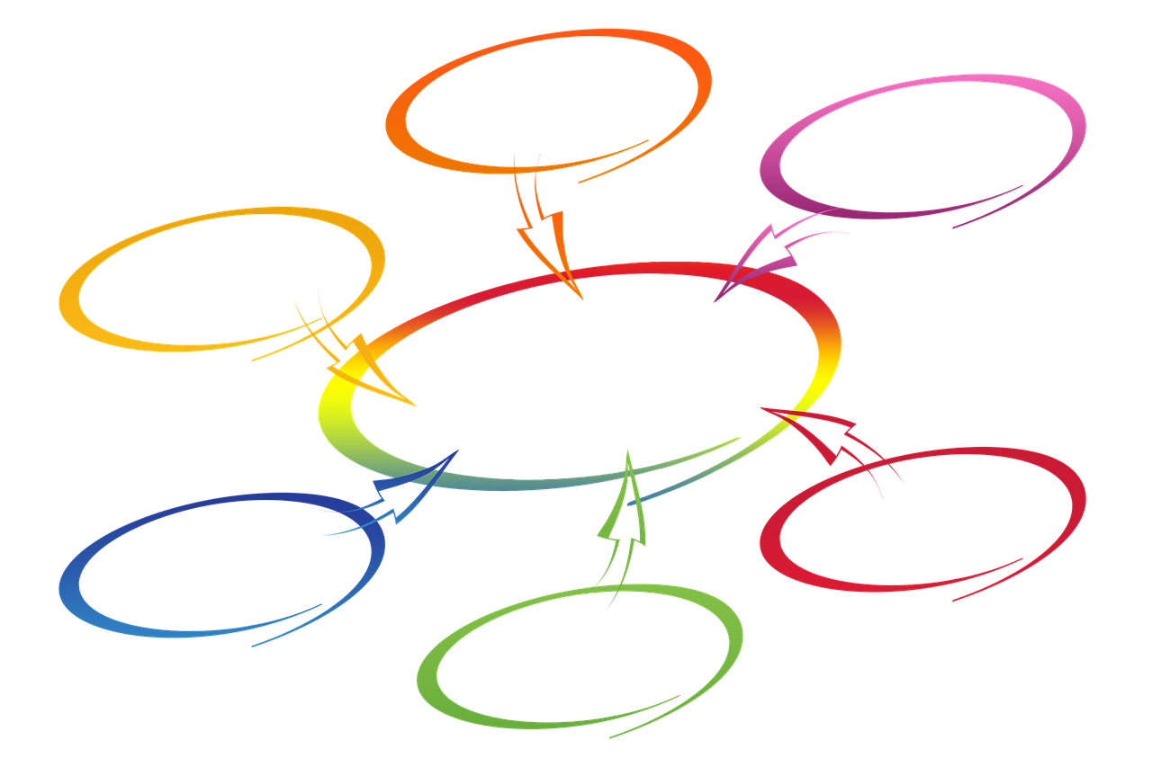
The instructor perspective:
Sanja Hinić-Frlog, Biology, UTM
Instructors can collaborate with students and encourage them to take an active interest in their own education. For example, students often approach me with issues they have with a published textbook. Using an open textbook allows me to directly involve students in editing (or creating) the content in an informed way.

Slide 15



UofT’s Open Textbook Numbers
10
Ontario Universities using these texts
~ 3000
Students accessing these texts per year
~ 250,000
Student savings in dollars per year

Slide 16
How can I use open texts?
Ontario’s Open Textbook Library can be used by everyone.
Anyone can visit openlibrary.ecampusontario.ca and download a PDF or view the mobile friendly web view – without having to create an account. You do not need to be at a particular school or any school for that matter to use textbooks from the Open Textbook Library.

Slide 17

Questions

