Slide 1

SharePoint Online: Getting Started
TechKnowFile 2018
Heather Postill, MISt
Enterprise Applications & Solutions Integration

Slide 2
Agenda
What is SharePoint Online?
EASI Document Management
Steps to Success
Identifying requirements
Building a business case
Knowing your content
Create a roadmap
Strategies for adoption
Resources

Slide 3
Information [Mis]management Stats
83% of knowledge workers lose time to versioning issues every day and 92% use email to collaborate
On average knowledge workers spend 50% of their time searching for information and take an average of 18 minutes to locate each document
A 2014 AIIM survey found that 60% of SharePoint projects are stalled, struggling or failing

Slide 4
What is SharePoint Online?
SharePoint Online is a cloud-based service that provides a secure place to store, organize, share, and access information. It is part of Office 365.
Document Management
Document versioning and history
Metadata or folders
Check out
Approvals, workflow and routing (document workflows not end to end business processes)
Automated retention and review
Records Management
File plans and automated retention
Collaboration: departments, project teams, work groups, communities of practice
Internal wikis
Discussion Boards
Content Management
Forms/lists
Tasks and issues tracking
Co-authoring of documents
Intranets/ internal portals
SharePoint is a business solution, supported by IT. It is not an IT solution.

Slide 5
Where Does SharePoint Online fit?
OneDrive
Personal space
Good for individual or limited collaboration
Teams and Groups
Group collaboration
Limited scope (project, working group, focus area)
SharePoint Online
‘Permanent’ and/or authoritative
Wider scope or audience
May have retention and governance
Each solution has strengths, weakness and different features even though they all technically run on SharePoint. EASI does not support OneDrive or Teams and Groups.

Slide 6
About EASI Document Management
Mandate: assist divisions, departments and units with their electronic document management needs through guidance, consulting, mentoring, best practices and peer networking.
Service owners and Tier 3 support for SharePoint Online
EASI can help determine:
If SharePoint Online is the right tool
What kinds of sites you need
The best information architecture/site organization
What other features you might need
Options for governance
Resource planning
We are NOT enforcers
Notes:
How many of you are happy with your current file share or document repositories and can find exactly what you need? If you simply move them as is to SPO, where will you be?

Slide 7
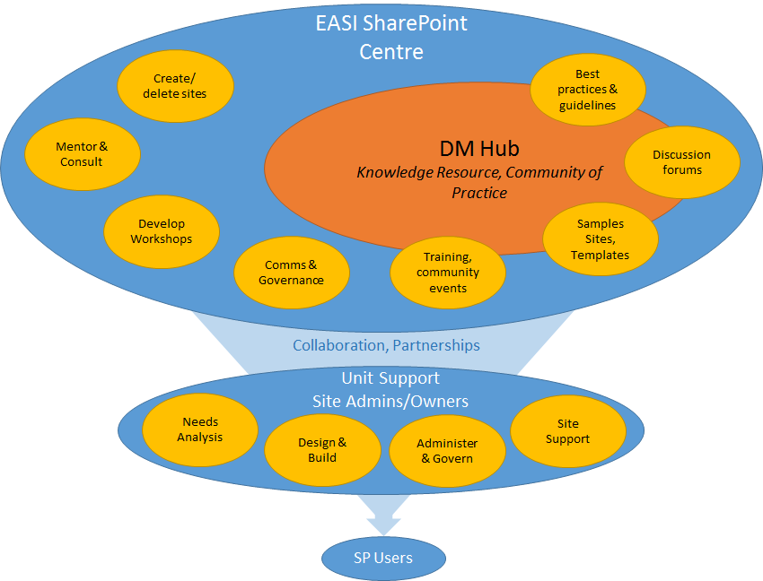
Collaborative Support Model

Slide 8
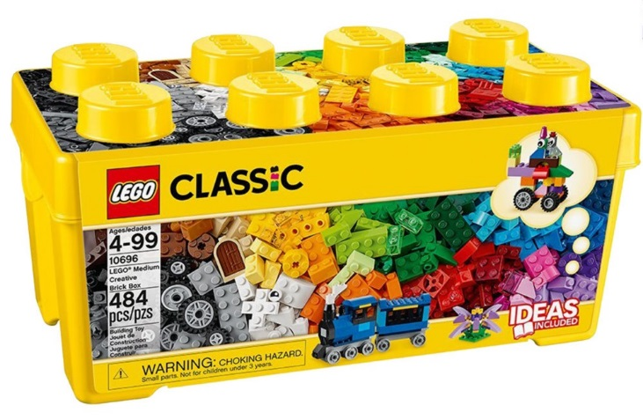
SharePoint is Like Lego™
SharePoint Online is a platform, not a tool
Still needs…
Configuration and structure
Design/branding
Support
Training
Monitoring
…and Governance
Change/evolution
Policies
Help/feedback loops
*Assembly required

Slide 9
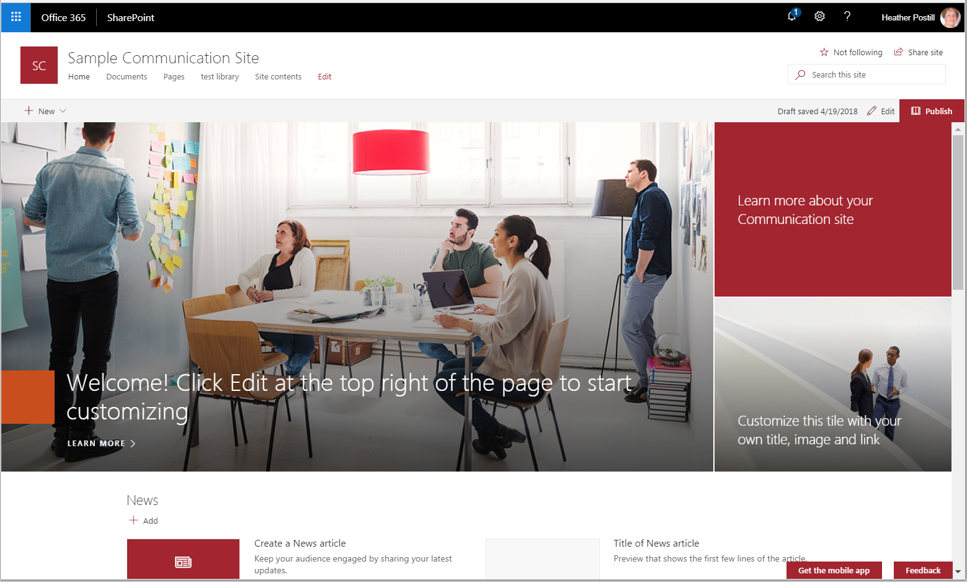
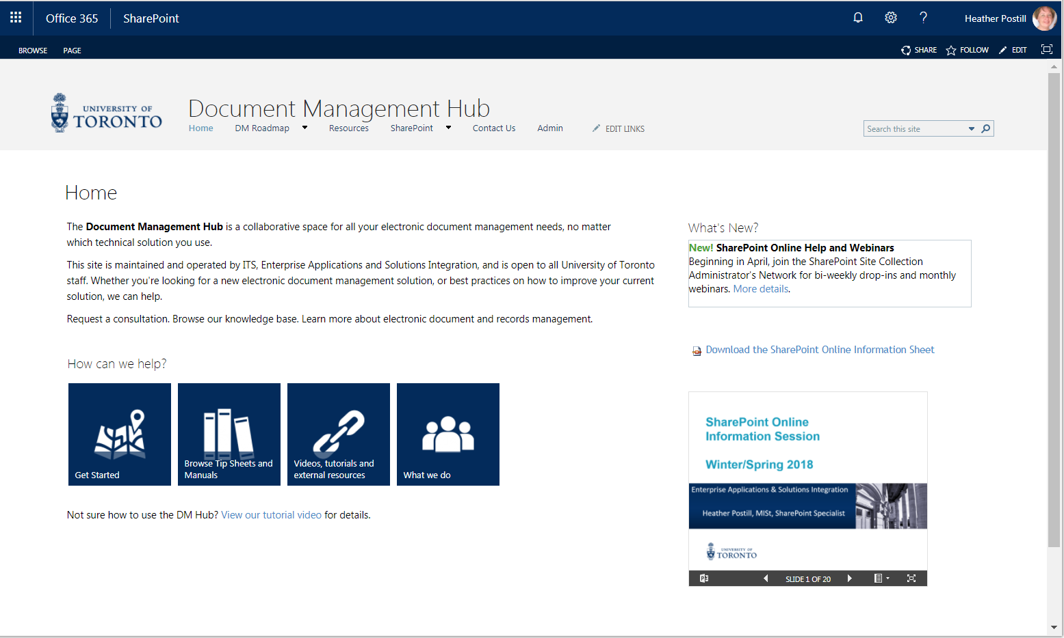
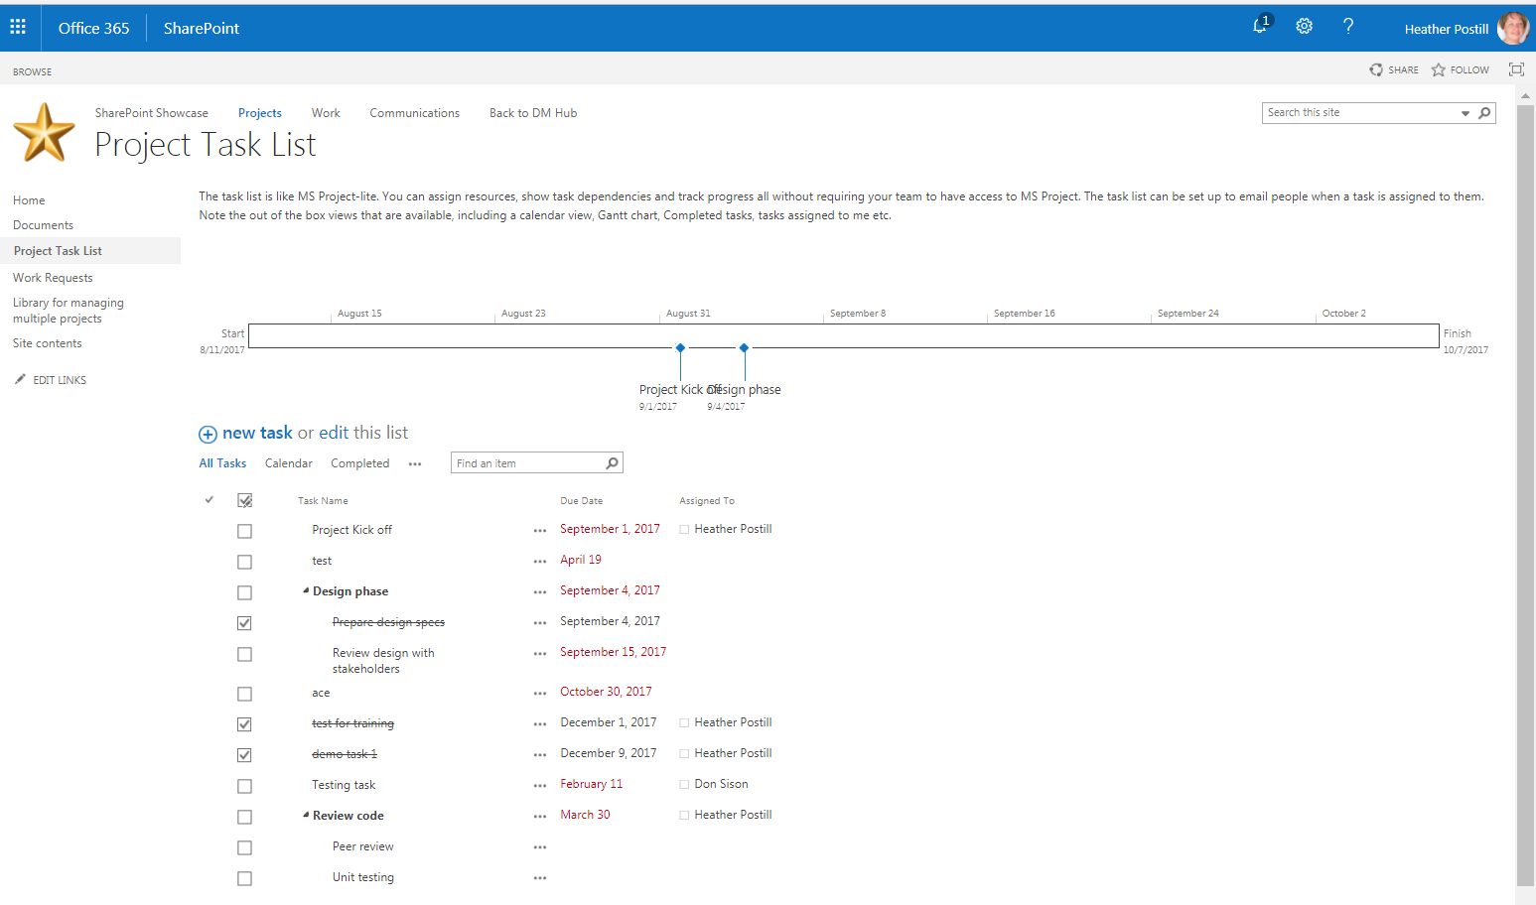
Communication Sites
Classic Sites
Project Sites

Slide 10
How Long Does it Take to Create a Site?
Depends on:
What you want to do
What resources you have
How much time you have to work on it
How prepared you are
80% of the work happens before you even get to SharePoint

Slide 11
Steps to Success
Determine your requirements
Build a business case
Determine the right fit
Conduct a content inventory
Involve your team
Create a roadmap
6
5
4
3
2
1
EASI can help you climb these steps

Slide 12
1. Determine Your Requirements
What do you want to do?
Identify your goals, challenges or problems with respect to documents and information in your unit
Think beyond “sharing data with the team”
Do management and users have different goals?
What do users need to do with the content?
“What” goes hand in hand with “why”

Slide 13
2: Build A Business Case
Why do you want to do it?
Even if you don’t require a formal business case for approval, capturing this assists with communication
If you don’t know why you want to undertake this effort, no one else will either
Determine the benefits of addressing your challenges:
Financial savings
Time savings
Happier or more productive team members
Improved accuracy
Ensuring compliance
Focus on the end user where possible
What is the cost of not addressing challenges?
Legal or regulatory non-compliance

Slide 14
Examples Of Valid Business Cases
Goal(s) | Why
Replace a current system | End of life; system lacks some features such as searching; reduces costs of maintaining another system; security concerns
Digitize paper files | Reduce storage costs; improve retrieval time
Consolidate information sources | Reduce the risk of users using obsolete or incorrect versions; put all content under governance
Streamline internal business processes | Improve productivity; eliminate the need to track processes and documents in 2 systems (duplicate effort)
Improve findability | Reduce the amount of time to retrieve information so that support workers can answer more client requests
Create an intranet | Centralize information that should not go on the public facing website; only 1 place to look
Notes:
Talk about specific cases:
Unit not really tracking who was assigned to what. Resulted in a major item being overlooked and last minute scrambling to save face. Loss to reputation
Unit managing requests separately from associated documents. Working in 2 systems=inefficient. Manually creating reports.

Slide 15
3. Determine the Right Fit
Based on your needs, SharePoint Online may or may not be the right fit.
If you’re in UTM, UTSC, Arts & Science or OISE, talk to your divisional IT group
Contact EASI
Just because it’s possible… does not mean it’s a good idea!

Slide 16
4. Content Inventory and Analysis
A content inventory is a comprehensive list of your content that has been organized within a spreadsheet or software. It identifies what the organization has (documents, records and copies, both paper and electronic), identifies how information is created and used, identifies where information is stored and exposes problems and inconsistencies in information management practices.
The objective of the content inventory is to:
Locate and describe information holdings | Identify vital and permanent records
Identify obsolete or duplicate content | Identify storage needs
Identify content owners | Identify document formats
Special governance and retention | Identify audience and access rules
Establish frequency of use and currency (last modified)
You can’t manage what you don’t know about
Notes:
Some units are good at this, others less so. I recently hosted a focus group and people were surprised by all the content sources they didn’t know about.

Slide 17
5. Create A Roadmap
How will you do it?
Do not try to implement everywhere right away
Identify priorities
Quick-wins vs. bigger ROI
Who is ready now?
Break the work up into smaller deliverables
Establish a realistic timeline
Establish resources and who needs to be involved

Slide 18
6. Involve Your Team
Involving team members early builds momentum and breaks down resistence
Focussing on users’ needs will make adoption much easier
Surveys on habits, challenges and most frequently used resources
Focus groups
Workshop ideas and design options
Leverage your implementation plan and get early adopters to help out with subsequent phases.
Power Users/Champions who will spread the word

Slide 19
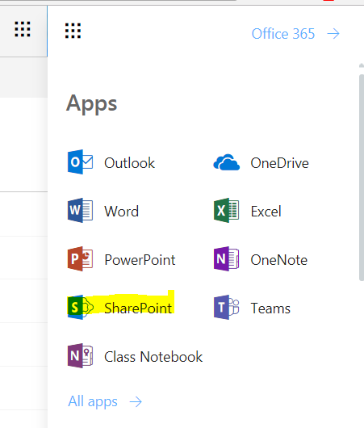
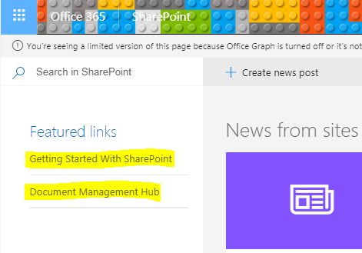
Resources
Document Management Hub: https://utoronto.sharepoint.com/sites/splearn
SharePoint Showcase (sample sites): https://utoronto.sharepoint.com/sites/spshowcase
Join our peer network (SCAN) for montly webinars
EASI SharePoint Online Information Sessions via ODLC
UTARMS Records Management courses via ODLC
EASI Consulting

Slide 20

Questions?
Contact us:
heather.postill@utoronto.ca
pamela.harris@utoronto.ca

Slide 21
Backup Slides

Slide 22
Business Value
PEOPLE
Simple access to knowledge and expertise from anywhere in enterprise
Seemless integration with familiar business tools in common collaboration
KNOWLEDGE
Integrated document management, approval, and publishing for improved collaboration
Subscriptions (alerts); proactive notification about changes or new information
PROCESSES
TECHNOLOGY
Ad-hoc integration of content with short-term work
Workplace to start project planning and discussions
Lower cost and time to deploy and maintain a corporate portal
Leverage familiar business tools and interfaces
Out-of-the-box vs. custom development

Slide 23
Common information challenges (hide)
How many of you have:
Wasted time wading through disorganized file shares with limited search capabilities to find the right content
Used local stored spreadsheets to track items or statuses
Manually reviewed and cleaned-up file shares
Had to come into the office to retrieve files or been unable to access files while travelling
Emailed wrong version of a file to boss, client or co-worker
Worked on wrong version of a file and had to redo all the changes
Spent time spent collecting and consolidating feedback/changes on a document
Notes:
Hide slide. Use for intro only.

