Slide 1
The Changing Nature of Work: Preparing for the evolution of work in the digital age
Alexander G. Izaguirre, PhD, MBA
Executive Partner | Executive Programs
May 3rd, 2018

Slide 2
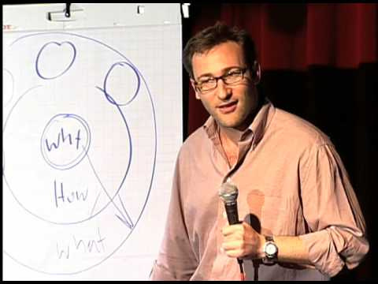
How Great Leaders Inspire Action: By Simon Sinek (Stop @ 5:45)
“People don’t buy what you do, they buy why you do it”
- Simon Sinek -
Simon Sinek: How great leaders inspire action | TED Talk | TED.com
Notes:
Placeholder for text (substitute your own text; delete when not used)

Slide 3
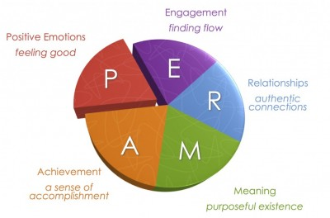
Positive Psychology: By Martin Seligman
The PERMA model was designed by Martin Seligman with five core element of psychological well-being and happiness.
Seligman believes that these five elements can help people reach a life of fulfillment, happiness, and meaning. This model can also be applied to institutions to develop programs to help people develop new cognitive and emotional tools.
Martin Seligman’s: Positive Psychology | TED Talk | TED.com
Notes:
Placeholder for text (substitute your own text; delete when not used)

Slide 4
Trust: By Patrick Lencioni
Members of teams with an absence of trust…
Conceal their weaknesses and mistakes from one another
Hesitate to ask for help or provide constructive feedback
Hesitate to offer help outside their own areas of responsibility
Jump to conclusions about the intentions and aptitudes of others without attempting to clarify
Fail to recognize and tap into one another’s skills and experiences
Waste time and energy managing their behaviors for effect
Dread meetings and find reasons to avoid spending time together
Hold grudges
Notes:
Placeholder for text (substitute your own text; delete when not used)

Slide 5
Trust: By Patrick Lencioni
Members of trusting teams…
Admit weaknesses and mistakes
Ask for help
Accept questions and input about their areas of responsibility
Give one another the benefit of the doubt before arriving at a negative conclusion
Take risks in offering feedback and assistance
Appreciate and tap into one another’s skills and experiences
Focus time and energy on important issues, not politics
Offer and accept apologies without hesitation
Look forward to meetings and other opportunities to work as a group
Notes:
Placeholder for text (substitute your own text; delete when not used)

Slide 6
Trust: By Daniel Z. Levin
COMPETENCE
BENEVOLENCE
INTEGRITY
According to Dr. Daniel Z. Levin, from the Rutgers School of Business, Trust or the willingness to be vulnerable occurs when people have a positive expectation that relying on someone will be beneficial and not harmful.
Trust can me divided into three dimensions: competence, benevolence and integrity. A lack of confidence in one or more of these dimensions will break down trust.
TRUST
Notes:
Placeholder for text (substitute your own text; delete when not used)

Slide 7
Sanford’s Challenge and Support Theory: By Nevitt Sanford
Challenge
Support
Development
Notes:
Placeholder for text (substitute your own text; delete when not used)

Slide 8
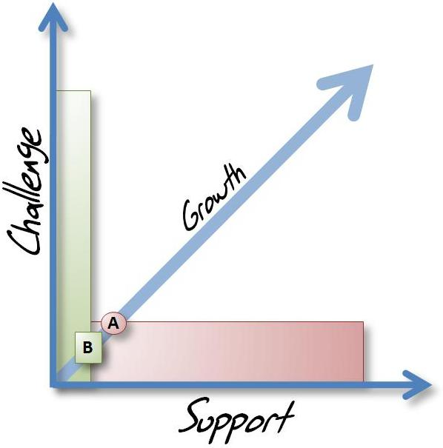
Sanford’s Challenge and Support Theory: By Nevitt Sanford
Challenge: A step that pushes a learner to acquire new growth.
Too much challenge = frustration
Support: An environment that is conducive to learner exploration of his/her own identity and/or skills in a safe and encouraging way
Too much support = no learning
Notes:
Placeholder for text (substitute your own text; delete when not used)

Slide 9
Clarity: Why setting expectations is critical
The brain is actively searching for clues about whether a situation offers risk or reward.
Providing clear expectations can help employees focus on the rewarding parts of their job.
Focus on providing clarity around:
Roles and responsibilities
Career path
Behaviors
Communication
Purpose
Notes:
Placeholder for text (substitute your own text; delete when not used)

Slide 10
Inspiration: Faith vs. Logic
“To one who has faith, no explanation is necessary. To one without faith no explanation is possible ”
- Thomas Aquinas -
Notes:
Placeholder for text (substitute your own text; delete when not used)

Slide 11
Inspiration: Faith vs. Logic
“Faith consists in believing when it is beyond the power of reason to believe”
- Voltaire -
Notes:
Placeholder for text (substitute your own text; delete when not used)

Slide 12
Inspiration: Maturity model
What the world needs motivates me
What my organization does motivates me
What my team does motivates me
What I do motivates me
Inspiring is a leadership team sport
Team members need to believe in themselves before they can effectively support a team.
Teams need to believe in something more than the needs of the team or risk becoming tribal.
The goal is to align people and teams with a movement.
Notes:
Placeholder for text (substitute your own text; delete when not used)

Slide 13
What Drives Engagement?
Neuroscience suggest, the level of risk or reward in a situation plays a significant role in how engaged a person will be.
The higher the reward the greater the engagement, the higher the risk the lower the engagement.
There are four dimensions to consider (TERA)
Tribe
Expectations
Rank
Autonomy
Notes:
Placeholder for text (substitute your own text; delete when not used)

Slide 14
TERA
Tribe
Your sense of security with others
Brain asks: Are you with me or against me?
Supports reward: Checking in, the we factor
Supports risk: Maintaining a “professional distance”
Notes:
Placeholder for text (substitute your own text; delete when not used)

Slide 15
TERA
Expectations
Your ability to predict the future
Brain asks: Do you make it clear or confusing?
Supports reward: Create milestones and expectations
Supports risk: Firefighting and lack of plans
Notes:
Placeholder for text (substitute your own text; delete when not used)

Slide 16
TERA
Rank
Your relative importance to others
Brain asks: Are you higher than me or lower than me
Supports reward: Asking questions, inviting participation
Supports risk: Giving advice or feedback
Notes:
Placeholder for text (substitute your own text; delete when not used)

Slide 17
TERA
Autonomy
Your sense of control of events
Brain asks: Do you limit me or liberate me?
Supports reward: Managing by objective (not task)
Supports risk: Micromanaging and limiting choice
Notes:
Placeholder for text (substitute your own text; delete when not used)

Slide 18
An Approach to Improving Team Dynamics
5 “Why” Themes
Get Clear
State Success
Explore Possibilities
Design
Scenarios
Notes:
Placeholder for text (substitute your own text; delete when not used)

Slide 19
Get Clear
What are the challenges from IT’s point of view
What are the challenges from the business’s point of view
What else can we observe either directly or indirectly
5 “Why” Themes
Get Clear
State Success
Explore Possibilities
Design
Scenarios
Notes:
Placeholder for text (substitute your own text; delete when not used)

Slide 20
State Success
For each challenge develop a statement that describes what success would look like should this issue be address.
The statement should keep in mind the needs of any relevant stakeholder.
Developing success statements for each challenge makes it clear that there are a number of possibilities to consider.
5 “Why” Themes
Get Clear
State Success
Explore Possibilities
Design
Scenarios
Notes:
Placeholder for text (substitute your own text; delete when not used)

Slide 21
Explore Possibilities
5 “Why” Themes
Get Clear
State Success
Explore Possibilities
Design
Scenarios
Notes:
Placeholder for text (substitute your own text; delete when not used)

Slide 22

GTS Approach: Design Scenarios
5 “Why” Themes
Get Clear
State Success
Explore Possibilities
Design
Scenarios
Notes:
Placeholder for text (substitute your own text; delete when not used)

Slide 23
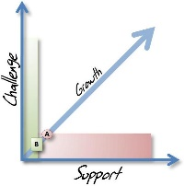
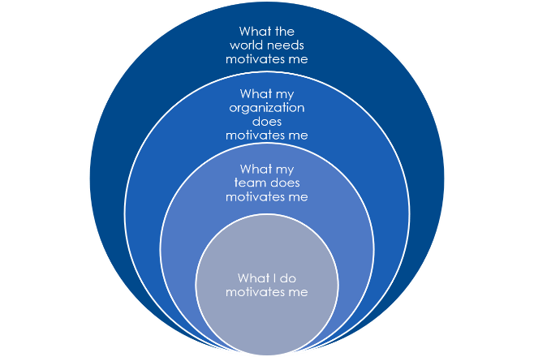
The Five “Why” Themes
Martin Seligman’s PERMA
People are happy when they experience:
P – Positive Emotion
E – Engagement
R - Relationships
M – Meaning
A - Accomplishment
Daniel Z. Levin’s Trust
Trust can me divided into three dimensions:
Competence
Can this person do what is expected of them?
Benevolence
Does this person care about me?
Integrity
Will this person do the right thing?
Nevitt Sanford’s Development
Development occurs best when people are challenged and supported:
Challenge + Support = Development
Too much challenge = frustration
To much support = no learning
Clarity
The brain is actively searching for clues about whether a situation offers risk or reward. Focus on providing clarity around:
Roles and responsibilities
Career path
Behaviors
Communication
Purpose
Inspiration
Belief does not require evidence and is typically present in transformative movements:
Maturity Model
Team members need to believe in themselves before they can effectively support a team. Teams need to believe in something more than the needs of the team or risk becoming tribal. The goal is to align people and teams with a movement.

Slide 24
Inspiring and Fun Links
How Great Leaders Inspire Action (https://www.ted.com/talks/simon_sinek_how_great_leaders_inspire_action#t-437187)
PERMA (https://www.youtube.com/watch?v=iK6K_N2qe9Y)
Steve Jobs' 2005 Stanford Commencement Address (https://www.youtube.com/watch?v=UF8uR6Z6KLc)
Poking Life (https://www.youtube.com/watch?v=MRlEXs3oi78)
The art of innovation | Guy Kawasaki | TEDxBerkeley (https://www.youtube.com/watch?v=Mtjatz9r-Vc)
IF AIR TRAVEL WORKED LIKE HEALTH CARE (https://www.youtube.com/watch?v=5J67xJKpB6c)
Notes:
Placeholder for text (substitute your own text; delete when not used)

Slide 25
Gartner Recommended Research
Research Presentation for 'Flipping to Digital Leadership: The 2015 CIO Agenda' Dave Aron and Others (G00270827)
Unrelenting Business Disruptions Require New Approaches to Driving 'Big Change' Anthony J. Bradley and Others (G00263984)
The 90% Club: Winning the Game Before the Team Takes the Field Richard Hunter and Others (G00264096)
CIOs Build a Better Brand by Building Trust Bard Papegaaij and Leigh McMullen (G00255735)
The "It" Factor Heather Collela (G00258078)

Slide 26
Gartner Recommended Research (continued)
Decisive Leadership: Making and Surviving Difficult CIO Decisions Tina Nunno, Dave Aron (G00171480)
How to Establish and Leverage Your IT Brand Patrick Meehan, Leigh McMullen (G00238541)
Developing Buy-In for Change Mike Rollings (G00226571)
The Business-Oriented Technical Professional Andrew R. Walker, Andy Rowsell-Jones (G00206743)
IT Score for the Enterprise Colleen Young (G00205879)
How to Run an IT Strategy Kickoff Workshop John P. Roberts (G00210711)

Slide 27
Gartner Recommended Research (continued)
Building the IT Brand: Impacting the Front Office and Beyond Patrick Meehan, Leigh McMullen (G00226621)
Special Report: CIO Power Politics Tina Nunno, Heather Colella (G00226256)
New Skills for the New IT John Roberts, Lily Mok (G00227676)
Five Best Practices to Improve Professional Development in the IT Workforce Diane Berry, Lily Mok (G00239855)
IT Score for CIOs and Senior Executives Kathy Harris and others (G00170892)

