Slide 1
UTSC Analysis of Student Retention and Graduation leveraging BI Tools
Mariam Aslam, Student Success Research Analyst &
Wei Xiong, Data Analyst, Business Intelligence
TechKnowFile - May 3rd, 2018
Notes:
- Preliminary – the first of many reports – based on 1 year and bit of research and analysis
- The purpose beyond the desire to understand student success at UTSC is also practical

Slide 2
What is the nature of our student success?
Understand, unpack and promote student academic success
An initiative of the Dean’s Office led to the appointment of the Student Success Research Analyst to explore student success trends
It aligns with two of the Strategic Mandate Agreement (SMA) metrics:
  retention from 1st to 2nd year
  6 year graduation rate
Ongoing outcomes include proposed policies and interventions to facilitate timely graduation
2
Notes:
Mariam
1st bullet – understand student success
3rd bullet – practical but graduation has a positive impact n recruitment and reputation; the higher the retention rate the more the fiscal benefits
why 6 years? Answer: graduation and time to graduation which is used by COU in reporting the rates (McCleans would have used it)
speaking about predictors

Slide 3
Annual progress report
The initial research questions guiding the research included:
What are the correlative factors that ‘define’ a successful student?
What does retention look like from year 1 to 2 in relation to the correlative factors included?
What does graduation in 4, 5 or 6 years look like in relation to the correlative factors included?
What implications do these findings have for future research opportunities and policy implications?
3
Notes:
Mariam

Slide 4
Highlights from annual progress report
Initial exploratory analysis of retention and graduation for 8 cohorts
Fall of 2009 (20099) through the fall of 2016 (20169) entering cohorts
Software used for analysis are:
  Tableau - platform allows to visualize data and dashboards
  Statistical Analysis System (SAS) - allows for logistic regression analysis of attrition data
4
Notes:
Mariam

Slide 5
Framework: Consortium for
Student Retention Data Exchange (CSRDE)
CSRDE definition:
  First-time, full-time, degree seeking students
    For this study, full time students for this study include students registered in at least 80% of the traditional full course load or 4 courses for their first semester (at November 1st)
    This is the North American wide industry standard which is used by UofT’s official reporting in the Council of Ontario Universities’ (COU) Common University Data Ontario (CUDO)
    Standard used in reports required by province under Strategic Mandate Agreement (SMA)
5
Notes:
Mariam –
Full time includes students registered in a minimum of 80% of traditional full course load (4 courses per semester) – different from full time that UofT considers for OSAP
The CSRDE definition is what the University of Toronto uses for official reporting in the Council of Ontario Universities’ (COU) Common University Data Ontario (CUDO) and is expected as the standard to be used in reports required by the province under future Strategic Management Agreements (SMA) https://cudo.ouac.on.ca/
We’ve been using the CSRDE definition but between the different RO and P&B and we noticed small differences –
We learned that P&B had slightly larger cohorts based on their understanding of the CSRDE definition
Even if they don’t retain from first to second year but retain later, still retention – stop-outs
Retention of the 99 (alternative program) and 98 (alternative campus)????
Students advanced level credits included for students that are IB, AP and A levels – no students with post secondary experience but credits from previous education that hold credit here
-
- If we expand outside of this definition – it would be one off projects

Slide 6
Single variable predictors
For the members of each of the cohorts we identified the following predictors in relation to retention and graduation included:
Gender (F, M, U)
Legal status (international and domestic)
Degree type (Arts, Science and Business - at admission)
Co-op status (at admission)
Admission group (direct admission, alternate program, alternate campus)
Admission average (<75%, 75-79.9%, 80-84.9%, >=85%)
OSAP aid (yes, no)
6
Notes:
Mariam
Gender (F, M, U) – U – even though small but still need to be covered
Legal status – mostly defined by their fees, handful of intl students exempt and pay domestic fees (refugee/married to Canadian citizens/dependents of diplomats)
Degree type (Arts, Science and Business – at admission) – we can work backwards from graduation to have a deeper learning about our students about what they graduated with and what they were at admission
Co-op status – same as degree type; likely we will do a smaller studies; for example smaller sample of students who are admitted at coop and then find themselves not in coop or visa versa to learn about their career trajectory with us. For example, we can hypothesoxe students admitted into coop or BBA and then find themselves out it would likely have a lower retention or graduation rate
Admission group – when students apply to UTSC they can apply to any one of 21 admission categories; some of which are direct admission to limited subject posts but most of which are general categories and admission requirements for each of these admission categories vary so it is quite common for students to apply to one admission category and be given admission to an alternate program; also common for students to apply to one UofT campus and receive admission to an alternate campus - admission group includes directly admitted to the admission category they requested and alternate program for those that admitted to programs they did not apply for (ex. BBA coop but get BBA or pre-program in the earlier years of the cohorts and more recently almost all of those that were once offered pre-program social sciences). The decision for social sciences because we are not sure what their alternate choice would be so there is an avenue for them to still try to get to BBA. In the general literature of student retention students who do not get the program of choice they have a lower rate of retention and this data we are interested. Because this project is not based on admission choices and recruitments, though we may be able to make recommendations in the future, we are not looking at the choice number we use it for conversion predictions but we also have access to the uoft coding of 98, 99 – gives us the information of their alternate offering of either program and campus (previously referred to left field (ROSI code LFO). An example: Rotman = 1 choice, UTSC BBA coop = 2, UTM Commerce = 3 but UTSC is there as an option so they are still direct. This iformation allows us to look campus transfers and predictor
Admission average - 101, 105 less obviously related to retention but still important
Transition to next slide – so interested in these factors in relation to retention and graduation

Slide 7
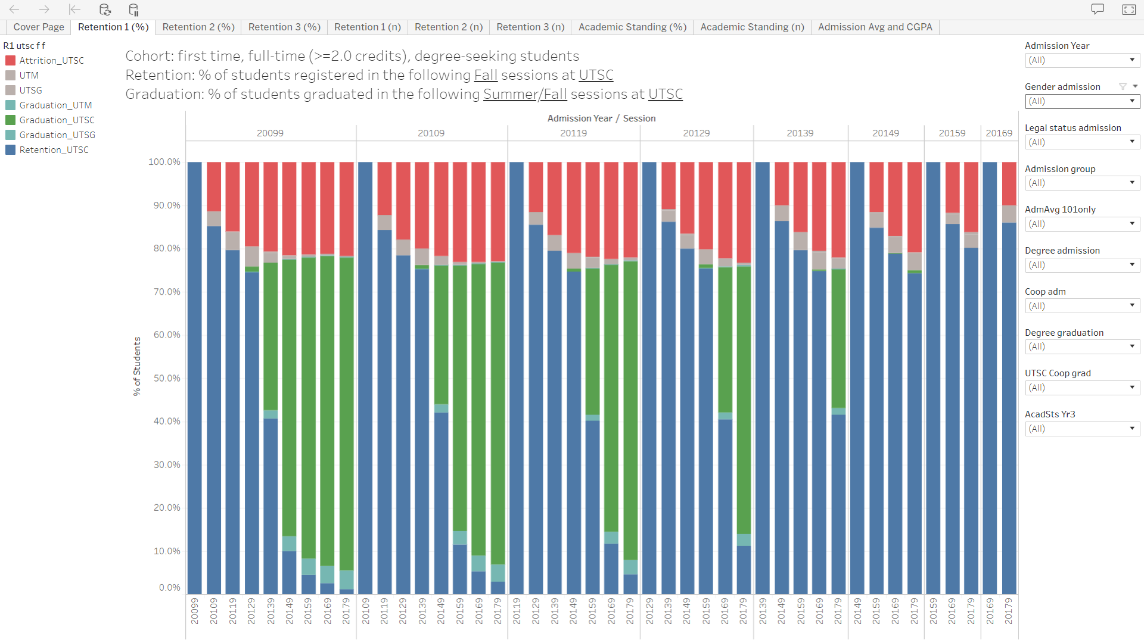
Tableau: Visualization
Dashboard
Entry Cohorts
Legend
Filters
7
Notes:
Mariam to start first, and Wei to do a live demonstration after
Retention and graduation full % screenshot - For each of these cohorts we are following their careers with annual snapshots of the annual November 1st official count date
- We have slowed down the data entry because the definition his being strengthened based on institutional wide understandings
Very top level view of UTSCs retention and graduation data for our initial cohorts
Currently Bill has access to Tableau but for those interested, access is doable through UTORid – just like the program enrolment reports. This dataset is only available to the ppl on this project and Dean’s group
Allows us to focus is on one cohort, single variables
Mounting all of these data into this software was very time consuming but makes this project doable
Efforts in managing the data using Excel
# of 16102 = over 16000 students represented – not full entry cohorts because of CSRDE; for each of these students there are data points so 16000 multiplied by all the characteristics each year, by their retention = massive volume of data and it will be growing annually with each new cohort and the continued experience of previous cohorts and our research may suggest other avenue of inquiry which will require more data

Slide 8
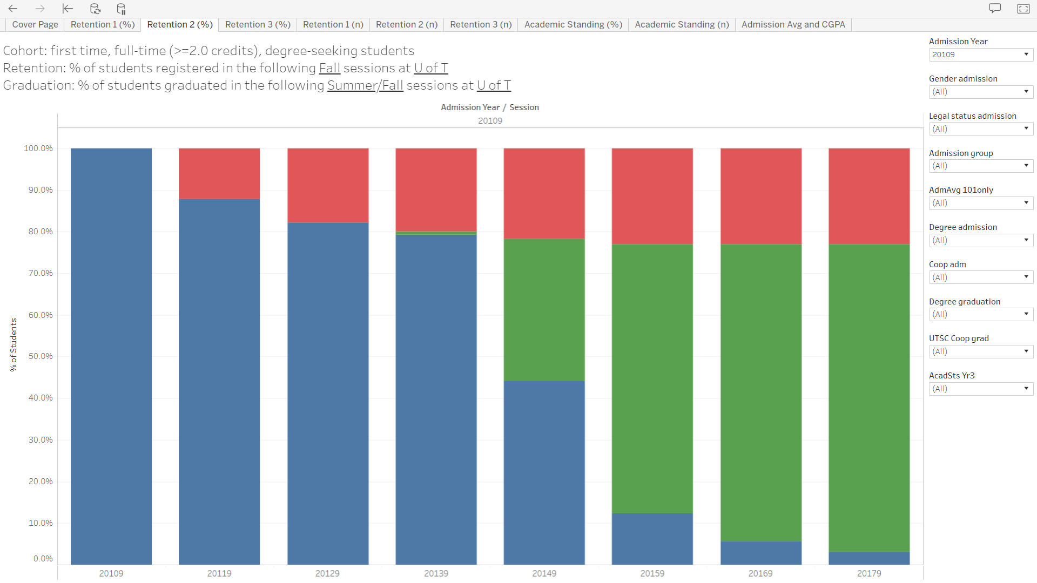

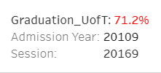
Tableau: Visualization
8
Notes:
Mariam to start first, and Wei to do a live demonstration after
Retention and graduation full % screenshot - For each of these cohorts we are following their careers with annual snapshots of the annual November 1st official count date
- We have slowed down the data entry because the definition his being strengthened based on institutional wide understandings
Very top level view of UTSCs retention and graduation data for our initial cohorts
Currently Bill has access to Tableau but for those interested, access is doable through UTORid – just like the program enrolment reports. This dataset is only available to the ppl on this project and Dean’s group
Allows us to focus is on one cohort, single variables
Mounting all of these data into this software was very time consuming but makes this project doable
Efforts in managing the data using Excel
# of 16102 = over 16000 students represented – not full entry cohorts because of CSRDE; for each of these students there are data points so 16000 multiplied by all the characteristics each year, by their retention = massive volume of data and it will be growing annually with each new cohort and the continued experience of previous cohorts and our research may suggest other avenue of inquiry which will require more data

Slide 9
Process of building Tableau dashboard
Identify CSRDE cohort, for 2009 to 2016 Fall admissions
For each new student, retrieve data
(retention, graduation, academic standing, etc.)
from subsequent Fall sessions
Using SAS, clean & link ALL data together and create a master SAS data file
Import SAS file to Tableau
Create Tableau dashboard data visualizations for
retention, CGPA, academic status and graduation
9
Notes:
Wei

Slide 10
Table 1: Overall retention (year 1 to year 2)
Cohort Year | 20099 | 20109 | 20119 | 20129 | 20139 | 20149 | 20159 | 20169
Cohort Size | 2,075 | 2,203 | 2,337 | 2,544 | 2,546 | 2,617 | 2,685 | 2,877
Retention (n) | 1,840 | 1,934 | 2,068 | 2,267 | 2,292 | 2,314 | 2,369 | 2,589
Retention (%) | 88.7% | 87.8% | 88.5% | 89.1% | 90.0% | 88.4% | 88.2% | 90.0%
Attrition (n) | 235 | 269 | 269 | 277 | 254 | 303 | 316 | 288
Attrition (%) | 11.3% | 12.2% | 11.5% | 10.9% | 10.0% | 11.6% | 11.8% | 10.0%
10
Notes:
Wei -
Table 1 shows institutional retention from year 1 to year 2, for the entry cohorts from 2009 until 2016, from fall to fall, for First-time, full-time, degree seeking students. Institutional retention means retention within U of T, no matter retained at Scarborough campus or transferred to other two campuses.
For example, for students who were admitted to UTSC in fall 2010, the retention indicates if they were retained within U of T institution in the fall of 2011. The reason we are looking at institution retention, rather than retention only at Scarborough campus, is because this is what the SMA (Strategic Management Agreements) will measure.
From this table, we can see that out of 2,203 first-time, full-time, degree-seeking admissions to UTSC in 2010 fall, 87.8% were retained next fall at U of T institution. In the same year, the UTSC campus retention was 3.4% less than the institutional retention, meaning that 3.4% of the entry cohort was transferred to either St George or Mississauga campuses.
For the past eight years, the year 1 to year 2 institution retention for UTSC students was between 88 and 90%, which means every 9 out 10 students were retained at U of T institution.

Slide 11
Table 2: Graduation rates
Cohort Year | 20099 | 20109 | 20119 | 20129 | 20139
Cohort Size | 2,075 | 2,203 | 2,337 | 2,544 | 2,546
4-Year Graduation | 35.9% | 34.1% | 35.3% | 35.3% | 33.8%
5-Year Graduation | 67.7% | 64.6% | 64.7% | 65.1% | -
6-Year Graduation | 73.6% | 71.2% | 72.5% | - | -
11
Notes:
Wei
Similar to retention within U of T institution, we look at graduation within U of institution b/c this is what SMA and provost office interested in.
This table demonstrates institutional graduation rates at four, five or six years. Graduation data include both the June and November convocations in each calendar year.
As shown here, about every 1 out of 3 students graduated within the traditional four years, and every 2 out of 3 students graduated within five-years. The 6-year graduation increases by a lesser increment to just slightly above 70%.
The pattern of about only every 1 out of 3 students graduated within four years is consistent across North America. In a study titled “Four-Year Myth,” focusing on the American context, the authors identify reasons contributing to a longer stay in university, including transferring institutions, registering in fewer courses a term/semester, and socio-economic status. (Complete College America (2014), http://completecollege.org/wp-content/uploads/2014/11/4-Year-Myth.pdf)

Slide 12
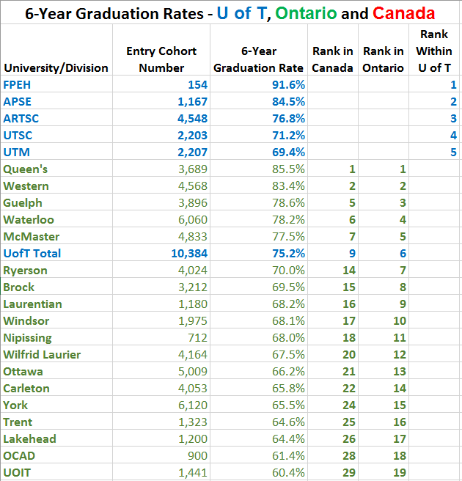
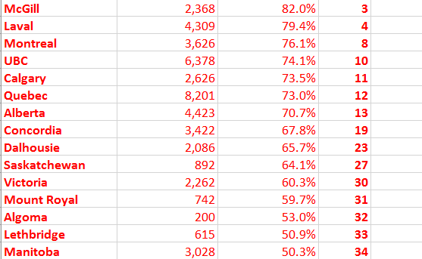
Bigger picture: how does UofT rank*?
12
Notes:
Mariam
- Transition intro: going from 8 cohorts to 3 for the narrowing in because of Provost concern of students leaving in good standing after 3 years of student (murky middle) – specific to males
2010 6 year graduation to show comparison

Slide 13
Process of retention analysis
Example
2014 Fall: CSRDE admission cohort (n=2,617)
2016 Fall: academic “good standing” (n=1,831)
2017 Fall: attrition counts (n=62), attrition rate 3.4% (=62/1,831)
analyze following 7 variables
Gender
Admission Average
Admission group
OSAP Aid
Legal Status
Degree Types
Co-op Status
Combine three years’ (2012, 2013, 2014) data together for attrition (203, 3.7%)
Single variable - compares male versus female, etc.
Multivariable logistic regression - compares male versus female, etc.
13
Notes:
Wei

Slide 14
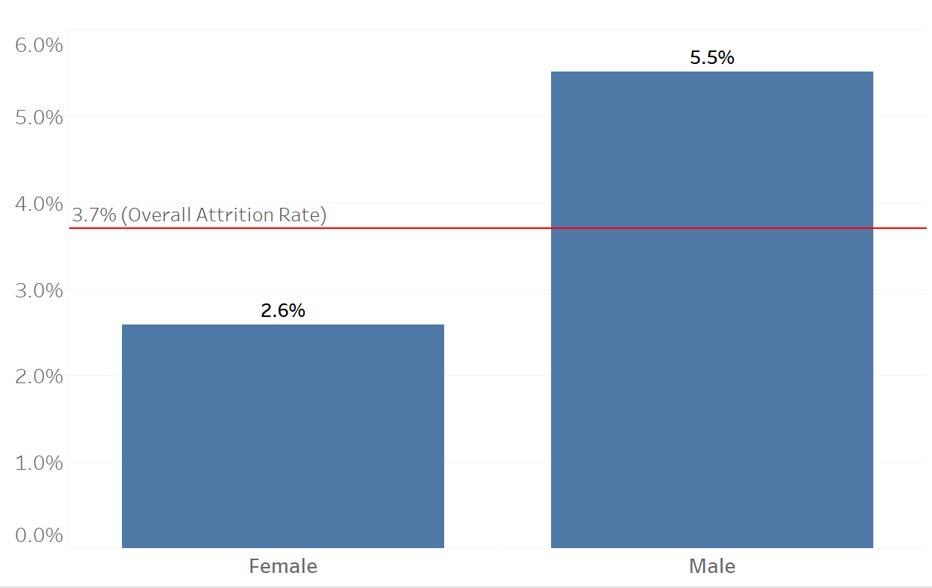
Gender and attrition rate
Attrition %
(n=3,326)
(n=2,123)
14
Notes:
Wei

Slide 15
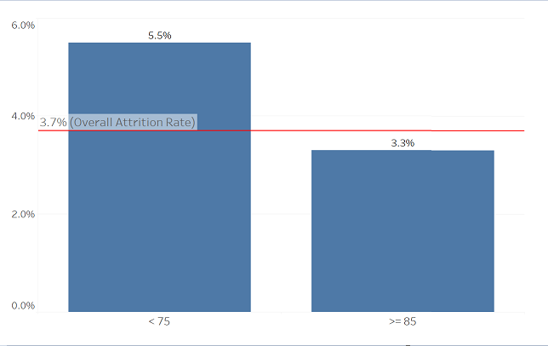
Admission average and attrition rate
Attrition %
(n=238)
(n=1,930)
15
Notes:
Wei

Slide 16
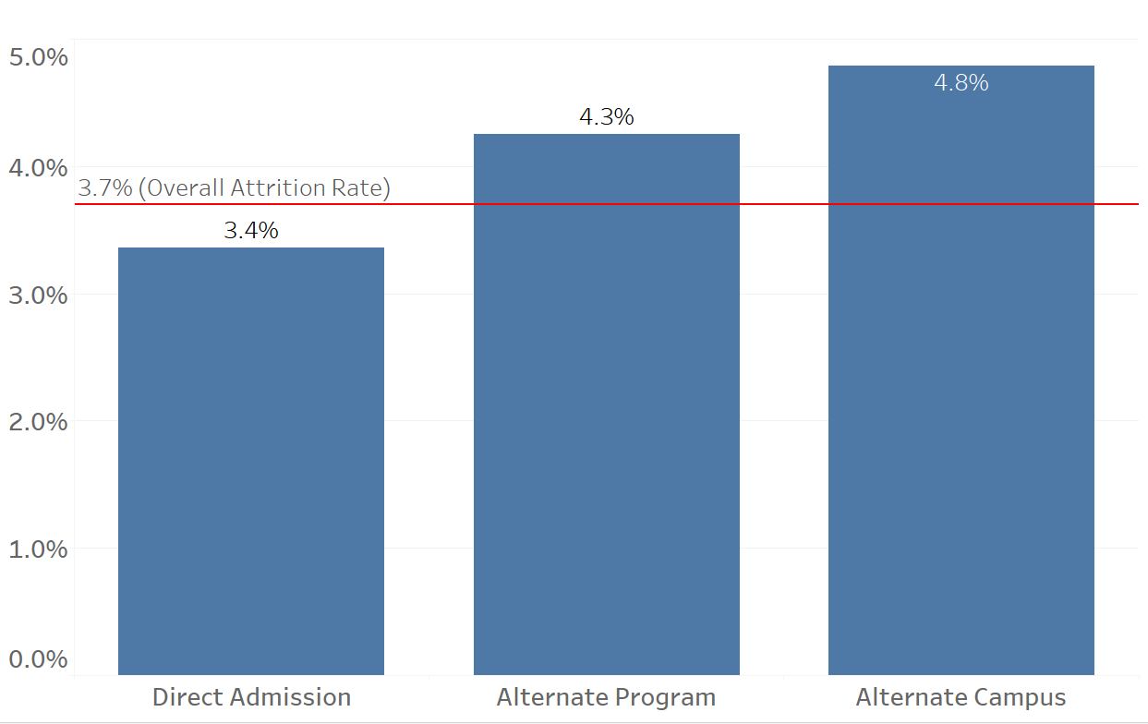
Admission group and attrition rate
Attrition %
(n=3,509)
(n=1,460)
(n=480)
16
Notes:
Wei

Slide 17
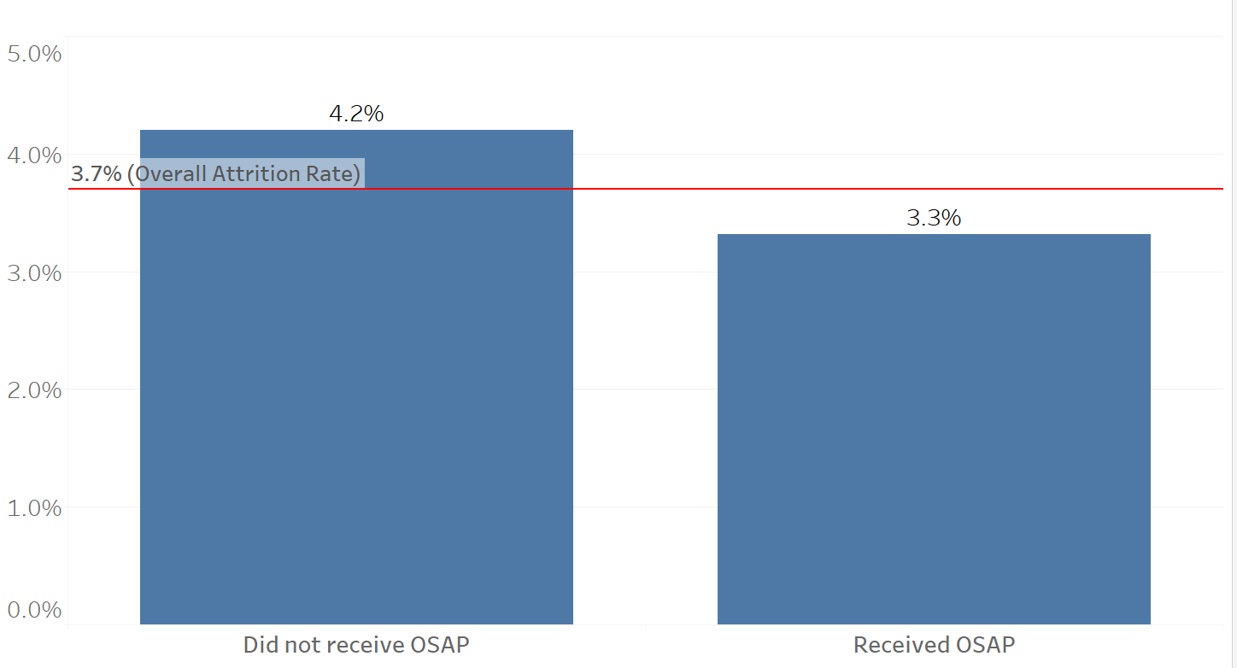
OSAP aid and attrition rate
Attrition %
(n=2,524)
(n=2,925)
17
Notes:
Wei

Slide 18
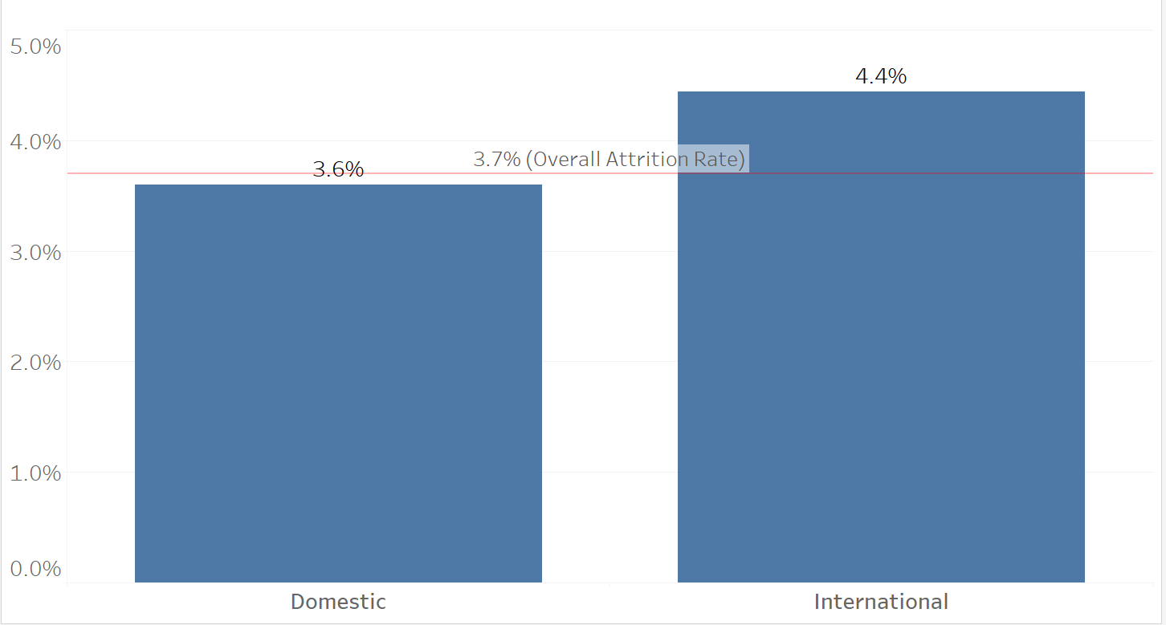
Legal status and attrition rate
Attrition %
(n=4,616)
(n=833)
18
Notes:
Wei

Slide 19
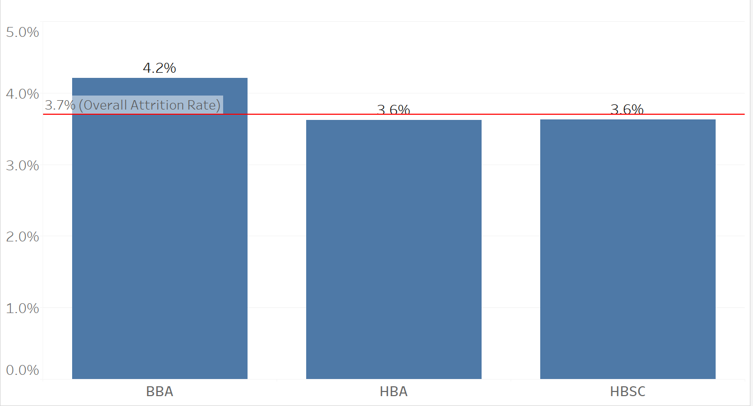
Degree on admission and attrition rate
Attrition %
(n=949)
(n=1,715)
(n=2,785)
19
Notes:
Wei

Slide 20
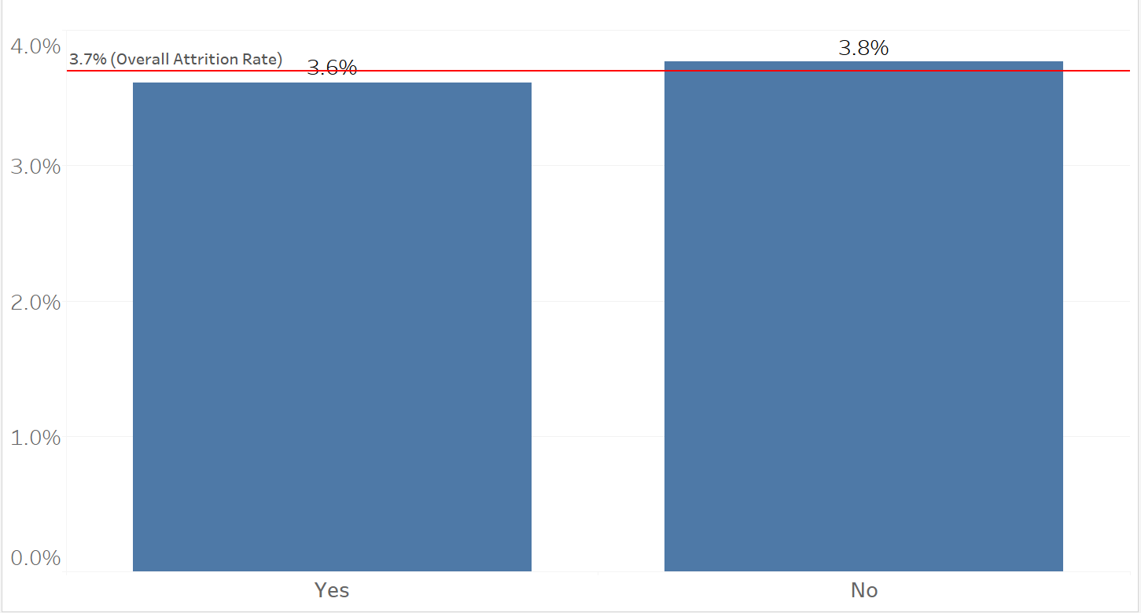
Coop on admission and attrition rate
Attrition %
(n=1,469)
(n=3,980)
20
Notes:
Wei

Slide 21
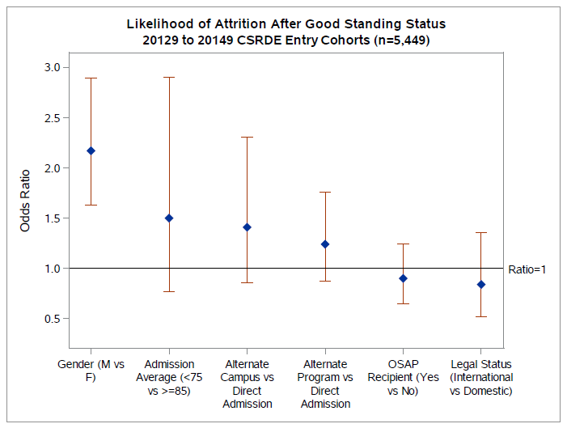
Finding: multi-variable logistic regression for attrition
All 7 variables were analyzed. Top 5 variables are shown in the graph.
21
Notes:
Wei

Slide 22
Next-steps
Retention analysis:
  Extending admission cohort from 3 years (2012-2014) to 6 years (2009-2014)
  Focusing on Ontario students
  Excluding stop-outs: attrition following Good Standing, but graduation on subsequent years
  Adding age as a predicting variable
  Merging PCCF (postal code conversion file) with Stats Canada Census data to add income data as another predictor
  Geo-mapping Stats Canada Census data
Age:
The later in one’s working life one completes an undergraduate degree, the smaller the overall return [could attribute to why the degree is not completed at an older age] (US research) (Pascarella & Terenzini, 2005).
Students aged 25 or older are twice as likely to drop out (Australian research) (Moodie, 2016).
Controlling for both age and SES in the UK:
Students over the age of 30 and with a lower SES have a higher likelihood of not competing their degrees (Perisic, 2017).
Socio-economic status (SES):
Important to understand potential constraints such as time spent working off campus (US research).
  Can contribute to ideas around policy interventions related to Financial Aid/Work Study (Schuh, Jones, Harper et al., 2011).
Lower SES increases the chances of attrition
  Example from Australia – students from lower SES made up 17.1% of the population but have a drop out rate of 31% (Moodie, 2016).
22
Notes:
Mariam

Slide 23
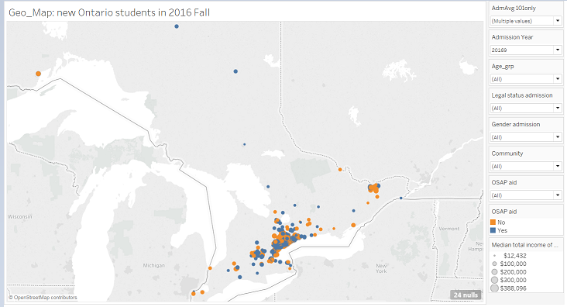
Next steps: geo-mapping census data
23
Notes:
Wei

Slide 24
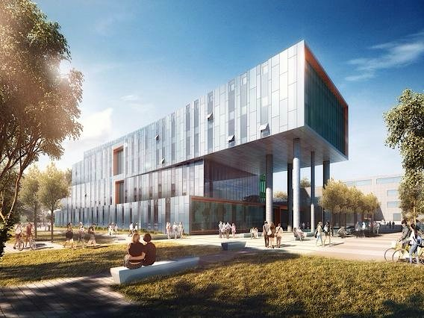
Questions?
Contact:
Mariam Aslam
maslam@utsc.utoronto.ca
Wei Xiong
w.xiong@utoronto.ca

