Slide 1





Slide 2
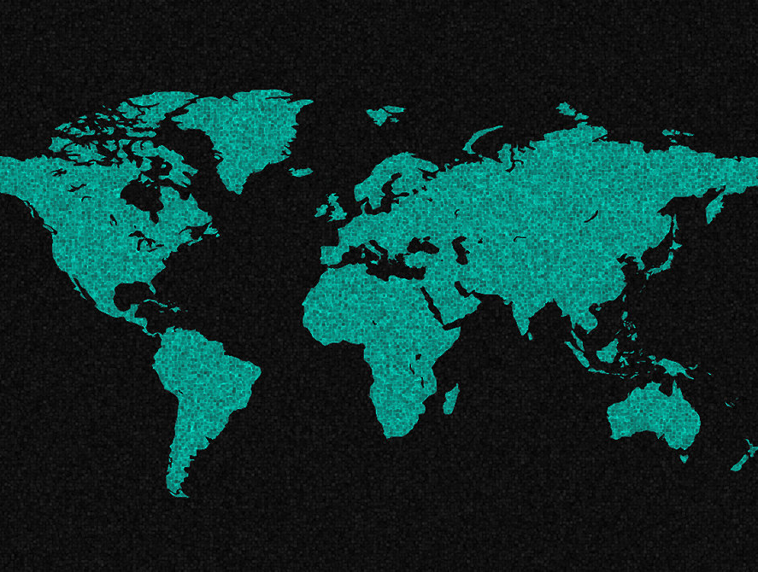
SELECT A CONTINENT
EUROPE
AFRICA

Slide 3
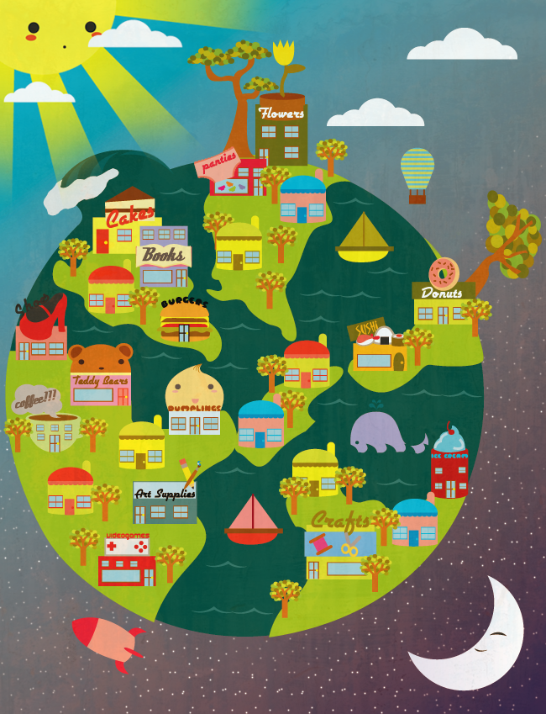

Slide 4
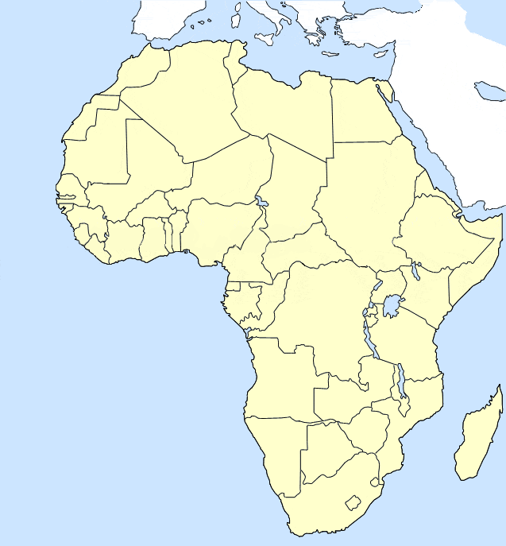

Slide 5
