Slide 1

Dockercon16 Overview
Omid Nejati | DevOps Engineer

Slide 2
DockerCon 2016 Seattle
1 day workshops
2 days show
4000 attendees
DockerCon 2014 had 500
800 Sessions submitted
2900 contributors
460K Dockerized apps
3000% growth in 2 years

Slide 3
Workshops
Docker for beginners
Docker for Java Developers
Docker Orchestration
Slides
Orchestration Workshop
Docker Security workshop
https://github.com/riyazdf/dockercon-workshop

Slide 4
What is New on Docker
Docker for mac and windows (Beta Version)
www.docker.com/getdocker
Docker 1.12 with orchestration built-in
Swarm mode
Cryptographic node identity
Docker service API
Routing mesh

Slide 5
What is New on Docker
Docker for AWS and Azure (Beta Version)
www.beta.docker.com
Distributed Application Bundle (DBA)
www.docker.com/dab
Docker Store
The Store offers better discovery, security, trust and reputation indicators
www.store.docker.com

Slide 6
Trends
Cloud: 80% say Docker central to cloud strategy
App Modernization: 3 out of 4 top initiatives resolve around application
DevOps: 44% looking to adopt DevOps
60% of Docker users are running in production

Slide 7
Challenges on Docker
Docker Security
Docker Storage
Docker monitoring

Slide 8



Docker Security
Image Security
Docker Security Scanning
Docker Cloud and Docker Hub can scan images in private repositories to verify that they are free from known security vulnerabilities or exposures, and report the results of the scan for each image tag.
Aqua Peekr
Free SaaS Scanner for Container Images. Peekr scans public or private registry images for known vulnerabilities and malicious code.
Infrastructure Security
The Docker Bench for Security is a script that checks for dozens of common best practices around deploying Docker containers in production.
https://github.com/docker/docker-bench-security

Slide 9
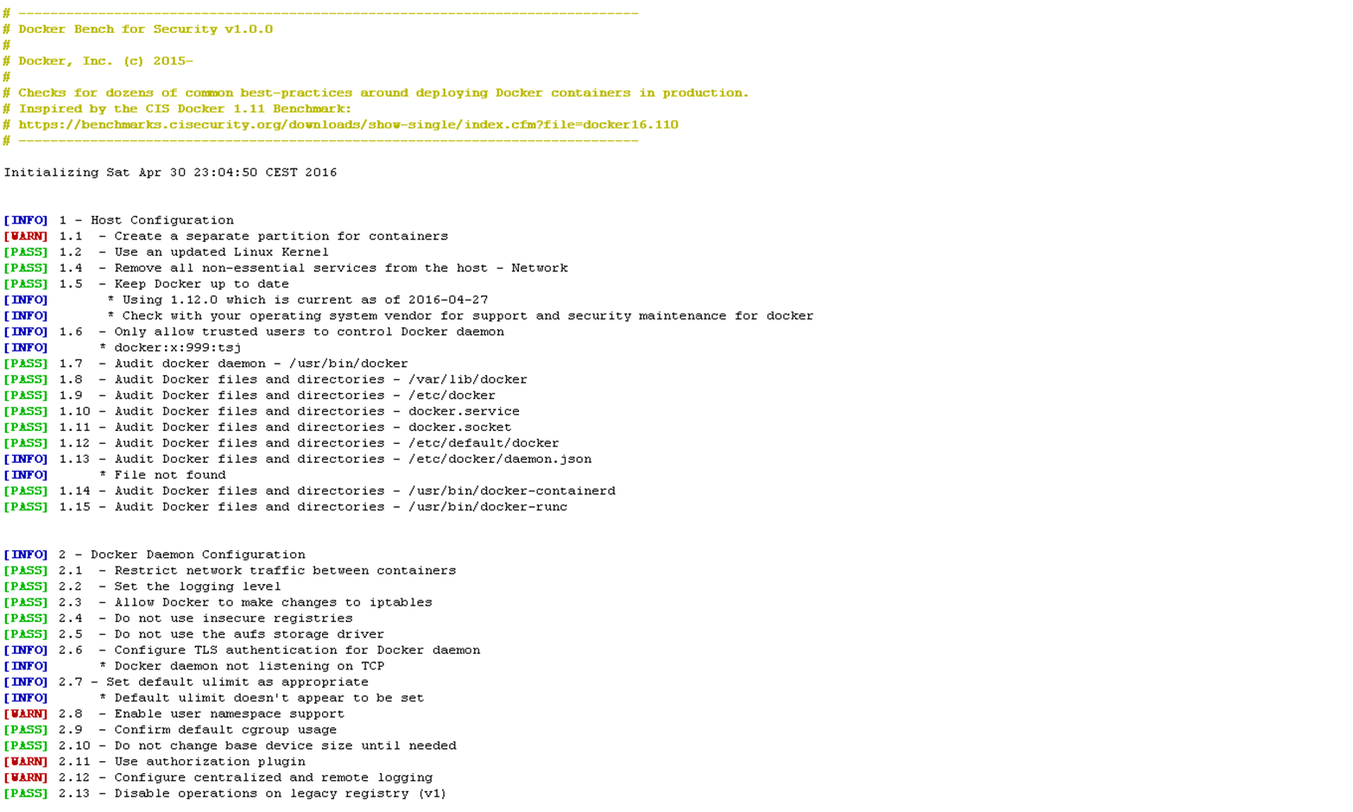
Docker Security

Slide 10



Docker Storage
Storing data within the container
Store your data outside Docker’s Union Filesystem
Mounting a volume within the Docker host’s filesystem
Storing data on a network-attached block device using the Volume plug-in for Docker via -volume-driver flag
docker run --name my-special-container busybox
#then write to a directory you want to use inside the container
docker run --name my-special-container -v /container/dir busybox
docker run --name my-special-container -v /host/dir:/container/dir busybox

Slide 11



Docker monitoring
https://prometheus.io/
http://www.sysdig.org/
http://www.zabbix.com/

Slide 12
Thanks

