Slide 1
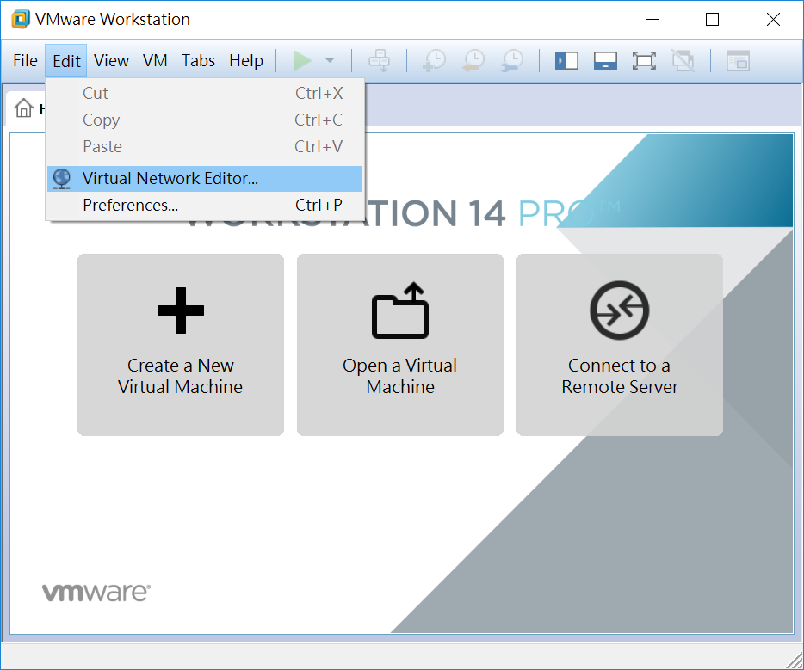

Slide 2
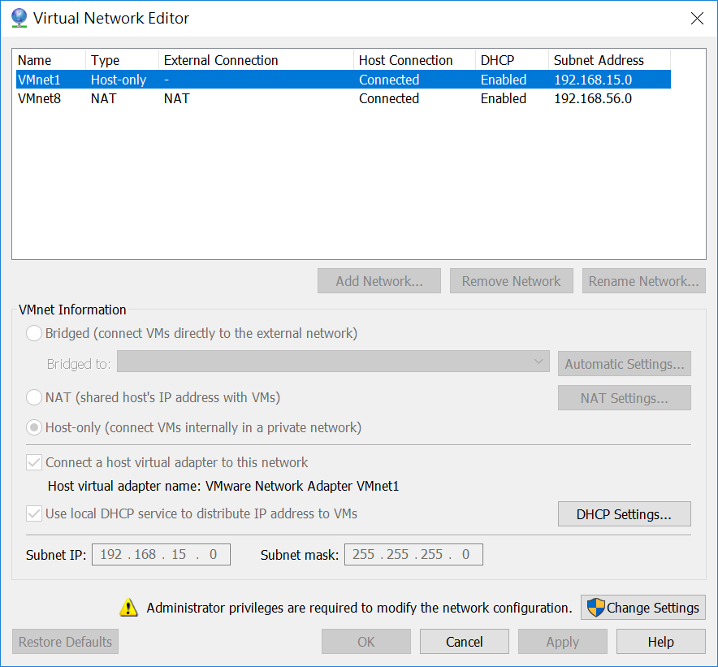

Slide 3
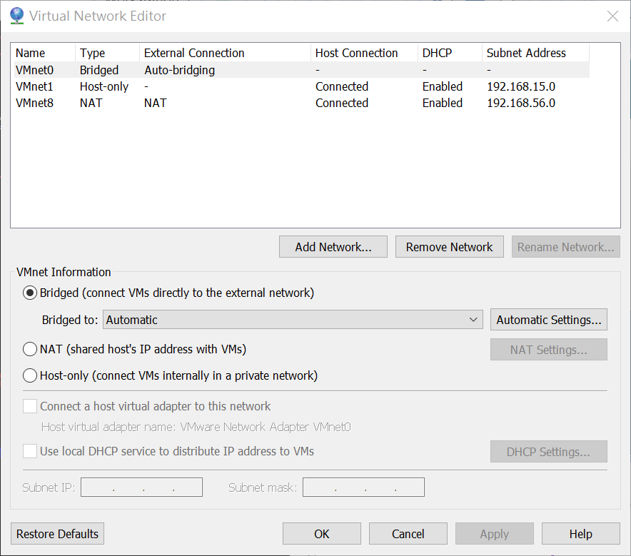

Slide 4
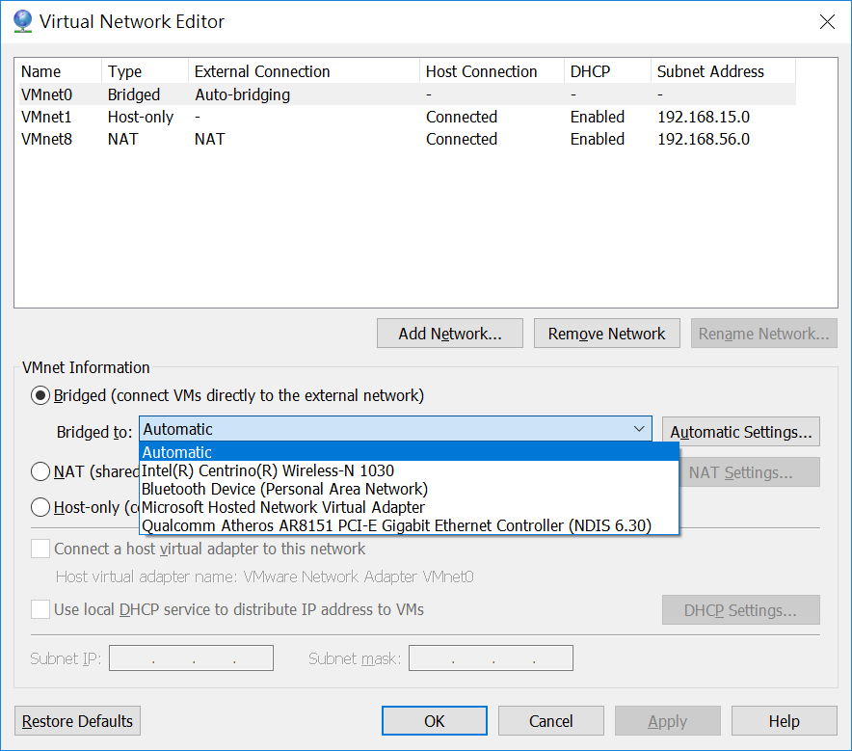

Slide 5
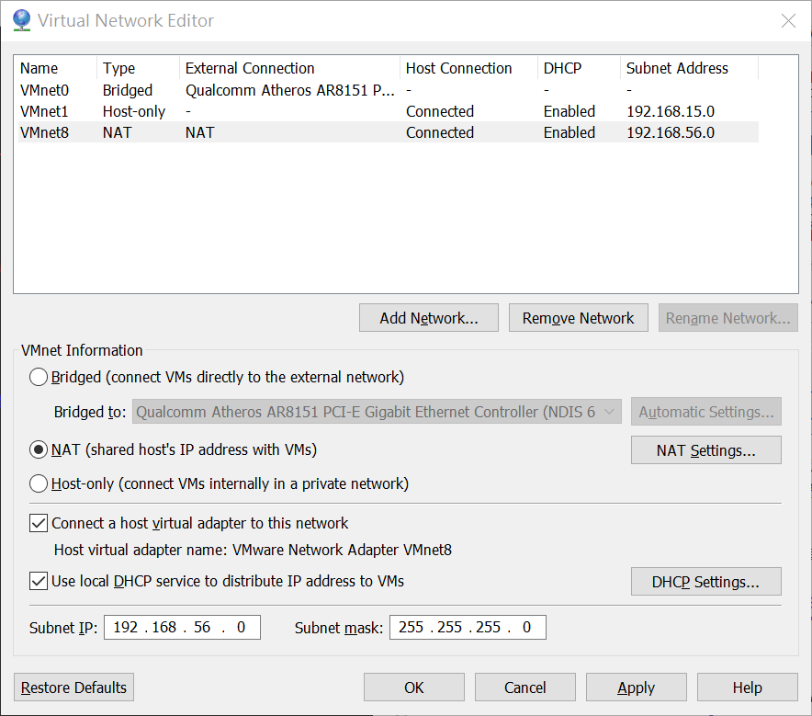

Slide 6
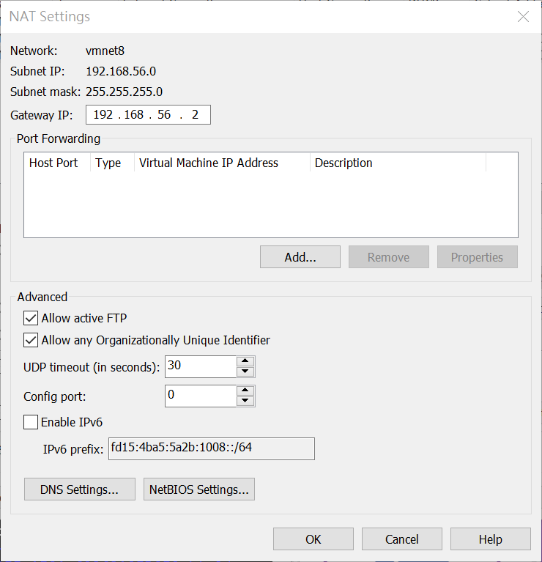

Slide 7

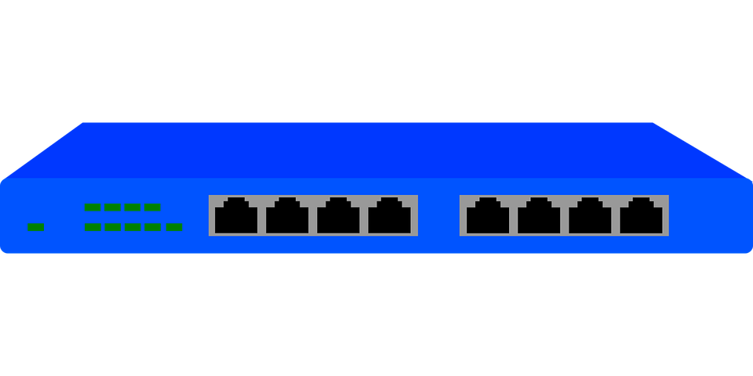
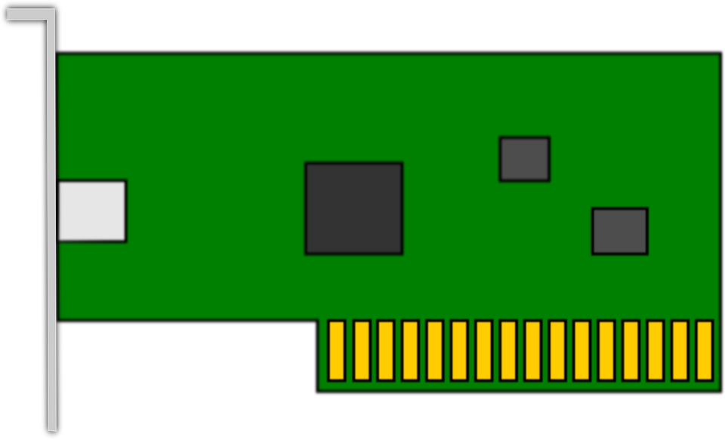
Notes:
圖片來源：
Pixabay
https://pixabay.com/zh/

Slide 8
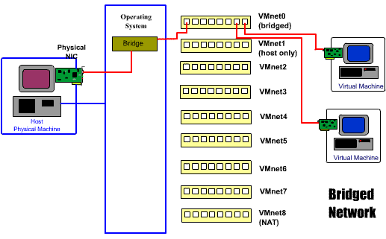



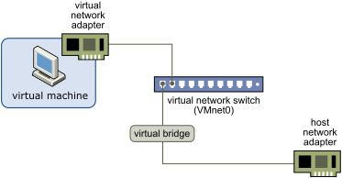
Network
Operating System
Bridge
VMnet0（Bridged）
VMnet1（Host Only）
Virtual Machine
VMnet2
VMnet3
VMnet4
Host Physical Machine
Virtual Machine
VMnet5
VMnet6
VMnet7
VMnet8（NAT）
Notes:
圖片來源：
Intro to Virtual Machine Networking
https://diarmuidmccarthy.wordpress.com/2011/02/15/hello-world/
Configuring Bridged Networking
https://docs.vmware.com/en/VMware-Workstation-Pro/12.0/com.vmware.ws.using.doc/GUID-BAFA66C3-81F0-4FCA-84C4-D9F7D258A60A.html

Slide 9
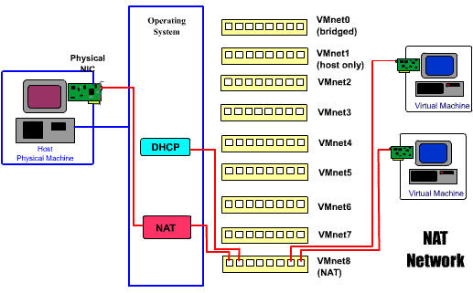
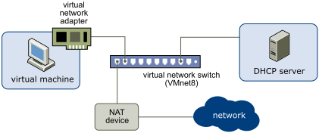
Operating System
VMnet0（Bridged）
VMnet1（Host Only）
Virtual Machine
VMnet2
VMnet3
VMnet4
Host Physical Machine
Virtual Machine
VMnet5
DHCP
VMnet6
VMnet7
NAT
VMnet8（NAT）
Network
Notes:
圖片來源：
Intro to Virtual Machine Networking
https://diarmuidmccarthy.wordpress.com/2011/02/15/hello-world/
Configuring Network Address Translation
https://docs.vmware.com/en/VMware-Workstation-Pro/12.0/com.vmware.ws.using.doc/GUID-89311E3D-CCA9-4ECC-AF5C-C52BE6A89A95.html

Slide 10
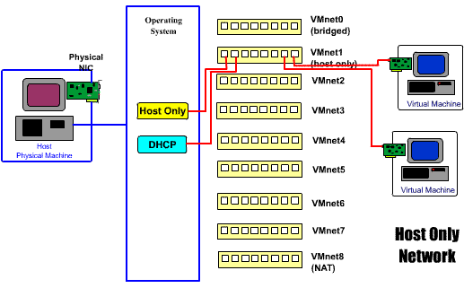
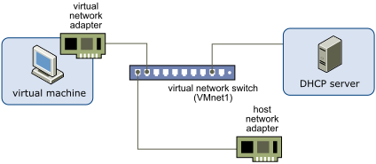
Operating System
VMnet0（Bridged）
Host Only
VMnet1（Host Only）
Virtual Machine
VMnet2
VMnet3
VMnet4
Host Physical Machine
Virtual Machine
VMnet5
DHCP
VMnet6
VMnet7
VMnet8（NAT）
Network
Notes:
圖片來源：
Intro to Virtual Machine Networking
https://diarmuidmccarthy.wordpress.com/2011/02/15/hello-world/
Configuring Host-Only Networking
https://docs.vmware.com/en/VMware-Workstation-Pro/12.0/com.vmware.ws.using.doc/GUID-93BDF7F1-D2E4-42CE-80EA-4E305337D2FC.html

