Slide 1
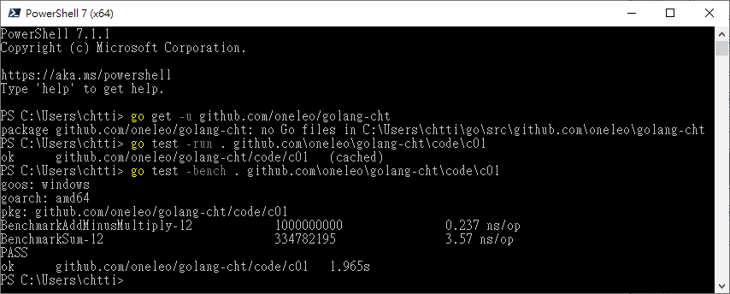

Slide 2
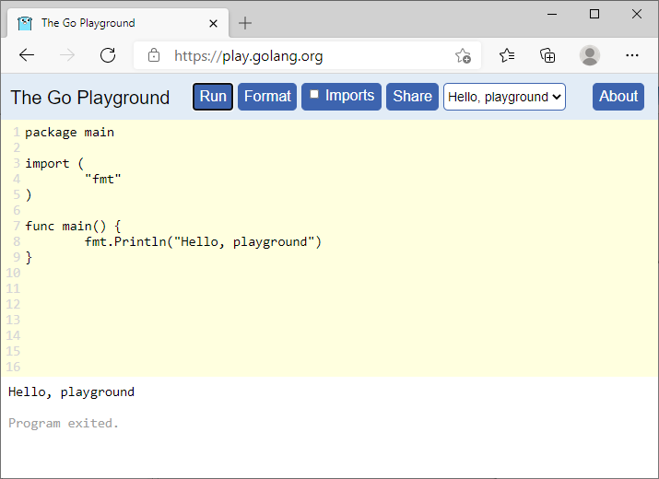
套件子句
匯入段落
主要程式碼

Slide 3
Go Modules指令 | 作用
go mod init | 產生 go.mod 檔案
go mod download | 下載 go.mod 檔案中指明的所有依賴
go mod tidy | 整理現有的依賴
go mod graph | 檢視現有的依賴結構
go mod edit | 編輯 go.mod 檔案
go mod vendor | 匯出專案所有的依賴到 ./vendor/ 目錄
go mod verify | 驗證一個模組是否被篡改過
go mod why | 檢視為什麼需要依賴某模組

Slide 4
25 關鍵字（keywords）
break | default | func | interface | select
case | defer | go | map | struct
chan | else | goto | package | switch
const | fallthrough | if | range | type
continue | for | import | return | var
用於程式宣告、實體宣告和定義、流程控制

Slide 5
39 保留字（predeclared identifiers）
型別 types |  |  |  | 常數constants | 函式 functions
uint8 | int8 | bool | string | true | append | make | close
uint16 | int16 | byte | uintptr | false | copy | new | panic
uint32 | int32 | int | float32 | iota | delete | complex | recover
uint64 | int64 | uint | float64 | nil | len | real | print
 |  | rune | complex64 |  | cap | imag | println
 |  |  | complex128 |  |  |  | error

Slide 6
宣告及指派變數
記憶體
位址 | 資料
… | …
0xBF00 | 25
0xBF08
0xBF10
… | …
var Age int = 25

Slide 7
整數 |  |  |  |  |  | 浮點數 |  |  | 複數
Signed |  |  | Unsigned
型別 | 大小 | 範圍 | 型別 | 大小 | 範圍 | 型別 | 大小 | 範圍 | 型別 | 大小 | 範圍
int8 | 8 bits | -2⁷ ~ 2⁷-1 | uint8 | 8 bits | 0 ~ 2⁸-1 | float32 | 32 bits | -(2-2⁻³²)×2¹²⁷ ~ +(2-2⁻²³)×2¹²⁷ | complex64 | 64 bits | 實虛各float32
int16 | 16 bits | -2¹⁵ ~ 2¹⁵-1 | uint16 | 16 bits | 0 ~ 2¹⁶-1 | float64 | 64 bits | -(2-2⁻⁵²)×2¹⁰²³ ~ +(2-2⁻⁵²)×2¹⁰²³ | complex128 | 128 bits | 實虛各float64
int32 | 32 bits | -2³¹ ~ 2³¹-1 | uint32 | 32 bits | 0 ~ 2³²-1
int64 | 64 bits | 2⁶³ ~ 2⁶³-1 | uint64 | 64 bits | 0 ~ 2⁶⁴-1
int | 32/64 bits |  | uint | 32/64 bits | 32/64 bits

Slide 8
運算符號 Operators and punctuation
算術 Arithmetic | 逐位 Bitwise | 比較 Comparison | 指派 Assignment | 宣告 Declaration | 陳述 Statements List
+ | & | == | = | := | ,
- | | | < | += | 傳遞 Direction | 列舉 Enumerations, Variadic
* | ^ | > | -= | <- | ...
/ | << | = | *= | 分組 Grouping | 區間 Blocks（If/For）
% | >> | != | /= | () | ;
遞增／減 Increment/Decrement | &^ | <= | %= | 索引 Option | 表示 Key, Expression, Label
++ |  | >= | &= | [] | :
-- |  |  | |= | 重賦 Repetition | 空白 Blank, Anonymous
邏輯 Logical |  |  | ^= | {} | _
&& |  |  | <<= | 選用 Selector
|| |  |  | >>= | .
! |  |  | &^=

Slide 9
Precedence | Operator
5 | * | / | % | << | >> | & | &^
4 | + | - | | | ^
3 | == | != | < | <= | > | >=
2 | &&
1 | ||

Slide 12


Slide 13


Slide 14





!A
A
A | B
A
B
A
A ^ B
B
A
A & B
B
A &^ B
A
B

Slide 15
A

Slide 16
A
B

Slide 17
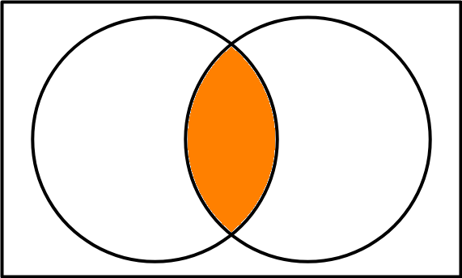
A
B

Slide 18
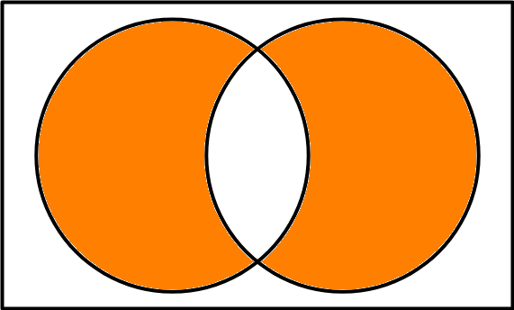
A
B

Slide 19
A
B

Slide 20
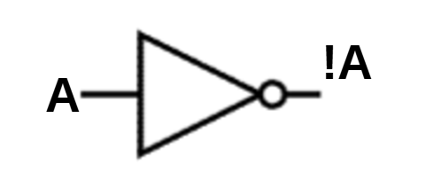
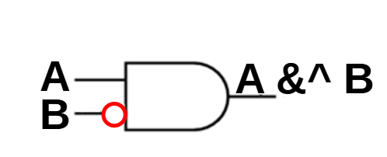

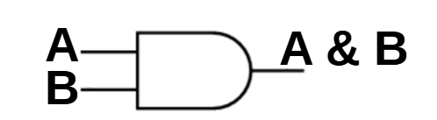
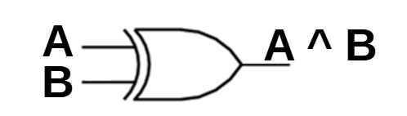

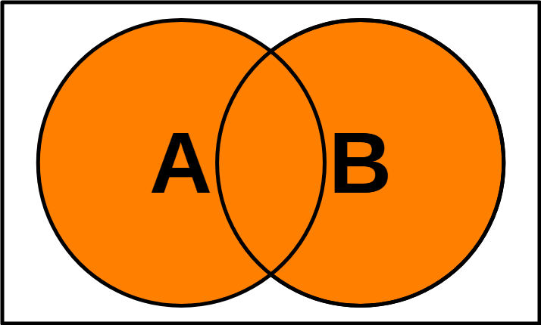
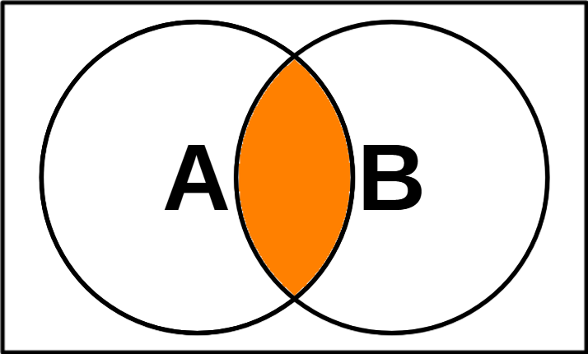
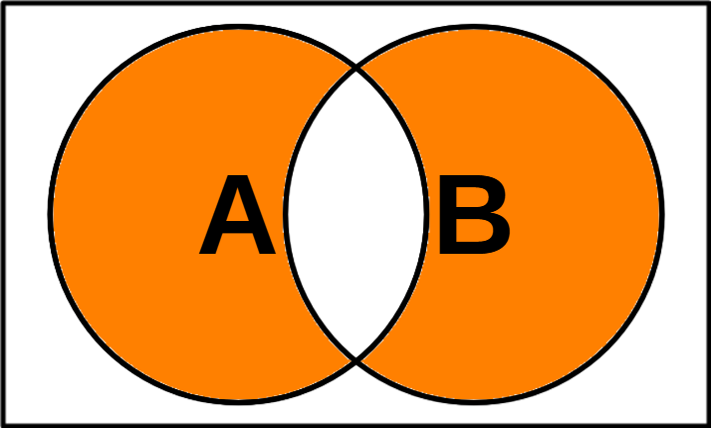
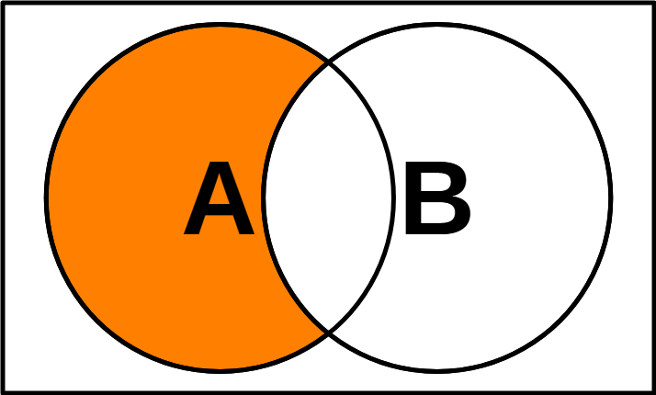
 |  | !A | A | B | A & B | A ^ B | A &^ B
A | B | NOT A | A OR B | A AND B | A XOR B | A AND（NOT B）
0 | 0 | 1 | 0 | 0 | 0 | 0
0 | 1 | 1 | 1 | 0 | 1 | 0
1 | 0 | 0 | 1 | 0 | 1 | 1
1 | 1 | 0 | 1 | 1 | 0 | 0

Slide 21
常用跳脫序列 | 值
\n | 換行字元
\t | 跳位字元
\" | 雙引號
\\ | 反斜線

Slide 23
Table Temp

Slide 24
AppendVector
 |  |  |  |  | b
a |  |  |  |  | len(a) |  |  |  |  | cap(a)

Slide 25
AppendVector
 |  |  |  |  | b
a

Slide 26
Copy
a
b

Slide 27
Cut
 |  |  |  |  |  | i |  | j
a

Slide 28
Delete
 |  |  |  |  |  | i
a

Slide 29
Delete without preserving order
 |  |  |  |  |  | i
a

Slide 30
Cut(GC)
 |  |  |  |  |  |  |  |  | nil | nil
 |  |  |  |  |  | i |  | j | ➁
a |  |  |  |  |  | ➀

Slide 31
Delete(GC)
 |  |  |  |  |  |  |  |  |  | nil
 |  |  |  |  |  | i |  |  |  | ➁
a |  |  |  |  |  | ➀

Slide 32
Delete without preserving order(GC)
 |  |  |  |  |  |  |  |  |  | nil
 |  |  |  |  |  | i |  |  |  | ➁
a |  |  |  |  |  | ➀

Slide 33
Expand
 |  |  |  |  |  | j
 |  |  |  |  | ➁
a |  |  |  |  | ➀
 |  |  |  |  | i

Slide 34
Extend
 |  |  |  |  |  |  |  |  | j
a

Slide 35
Filter (in place)
 | (keep) | (keep) |  | (keep) |  |  | (keep)
a

Slide 36
Insert
 |  |  |  |  | ➁
a |  |  |  |  | ➀
 |  |  |  |  | i

Slide 37
InsertVector
 |  |  |  | b | ➁
a |  |  |  |  | ➀
 |  |  |  |  | i

Slide 38
Push
 |  |  |  |  |  |  |  | x
a

Slide 39
Pop
 |  |  |  |  |  |  |  | x
a

Slide 40
Push Front/Unshift
 | x
a

Slide 41
Pop Front/Shift
a
 | x

