Slide 1

SQL Bootcamp
Instructors: Priyanka Guha
Yiping Lyu

Slide 2
Agenda
Installation
Basic concepts about data and database
Introduction to AdventureWorks Database
SQL query
-Basic SQL query
-SQL Operators
-SQL Server functions
-Joins and Subquery

Slide 3
Basic concepts about data and database
Data: stored representations of facts concerning objects and events
Structured: numbers, text, dates
Unstructured: images, video clips, documents
Database: an organized collection of logically related data(tables, schema, records, fields)
Information: data processed to increase knowledge of the person using the data
Metadata: data that describe the properties and the context of user data

Slide 4
DBMS(Database Management System)
A software system that is used to create, maintain, and provide controlled access to databases
Database server is the server on which RBMS software is installed
Storage – is where actual data resides
The database server and storage should be in the same data center, and possibly the same subnet

Slide 5
AdventureWorks Database

Slide 6
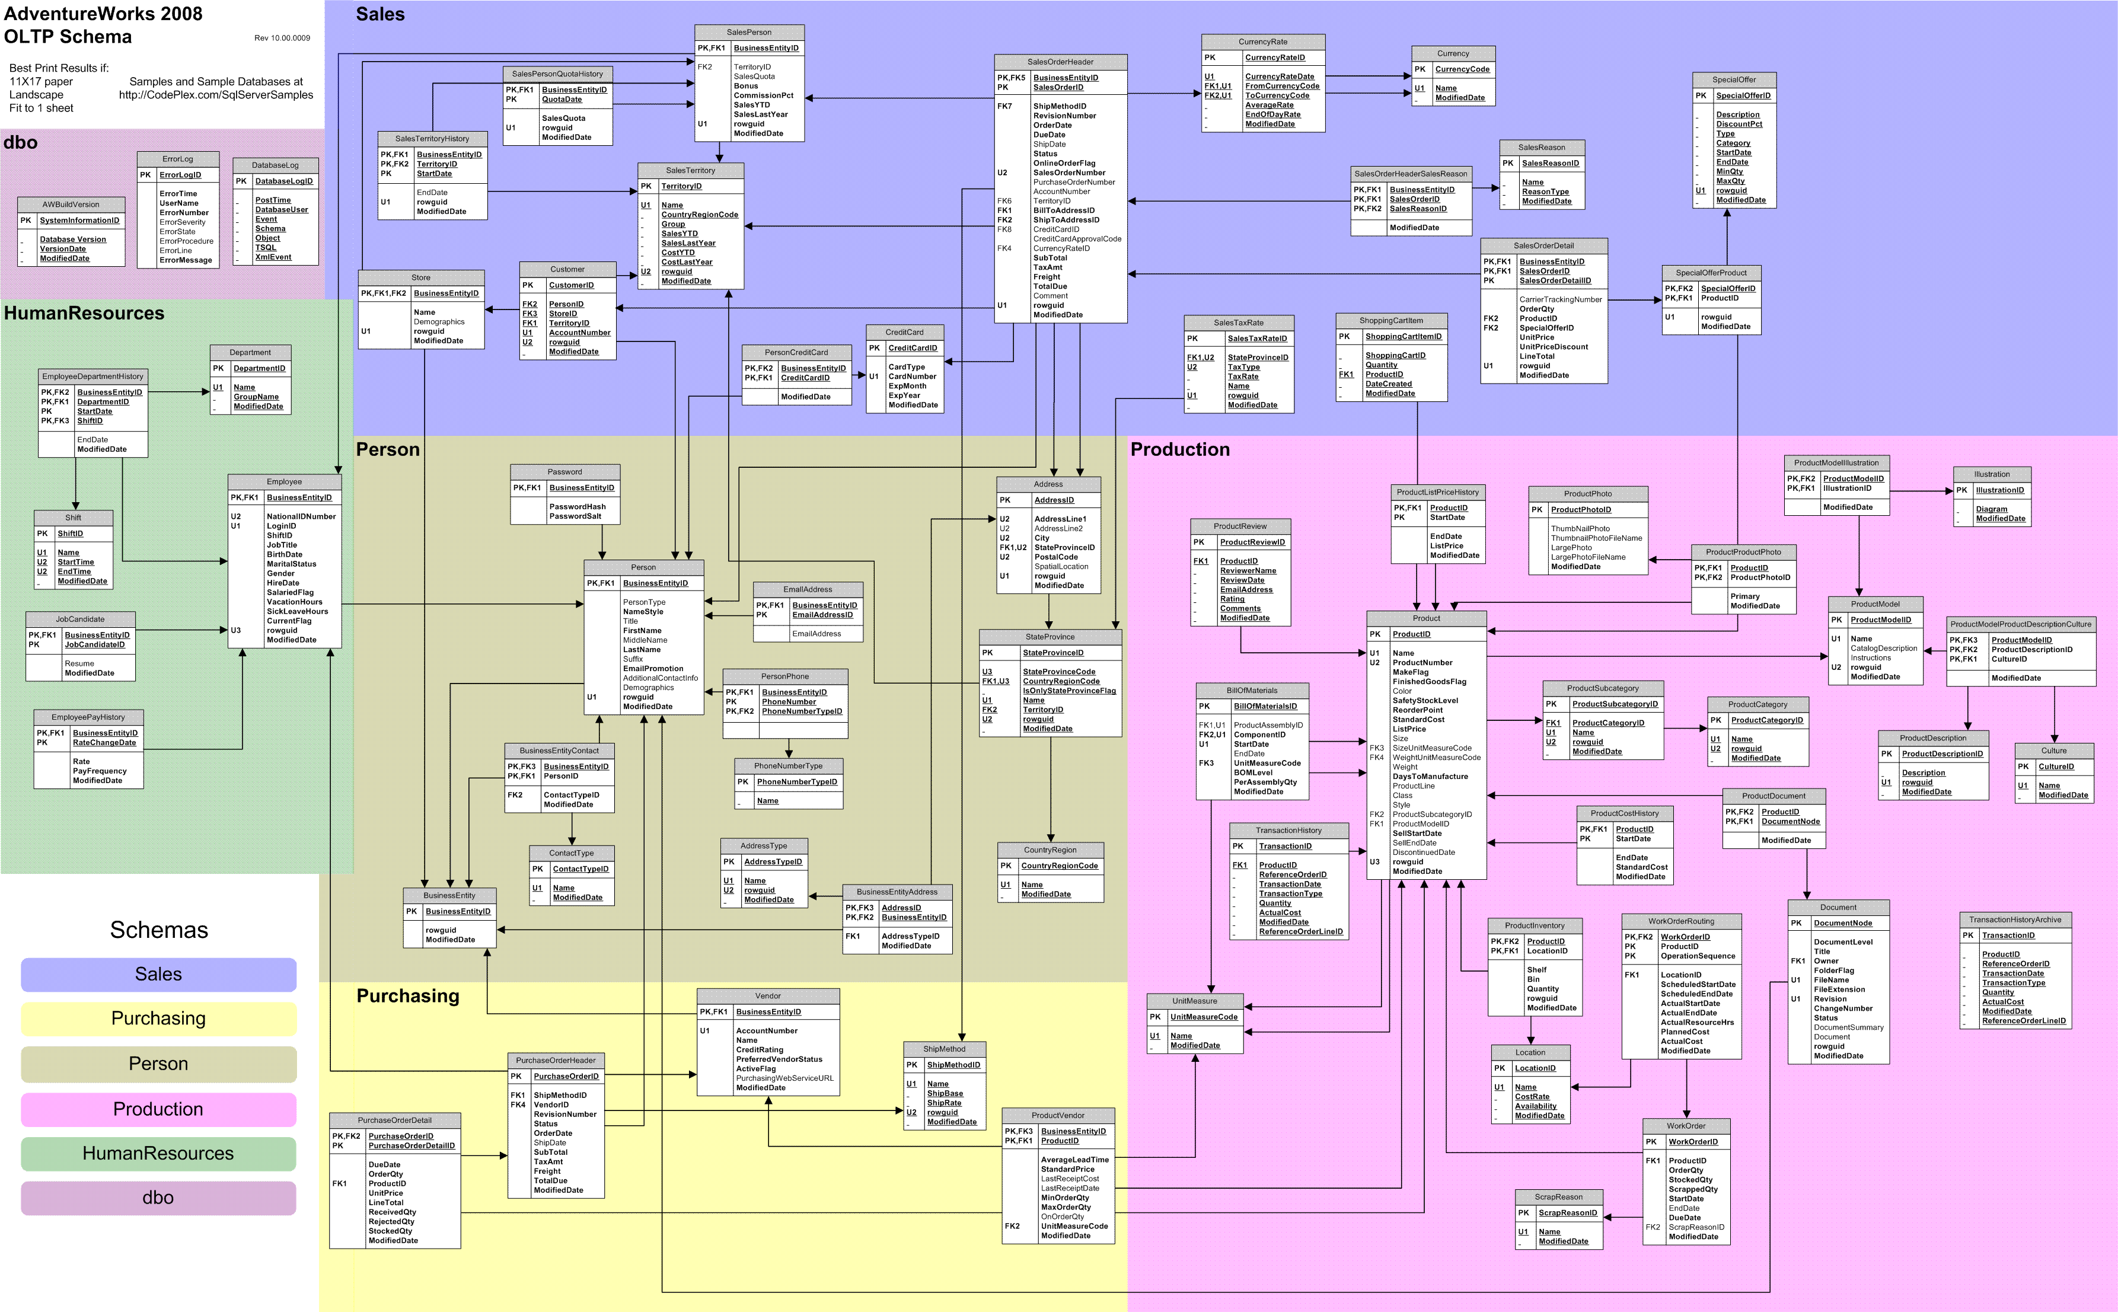

Slide 7
Basic SQL Query
SQL is a standard language for storing, retrieving and manipulating data in databases.
SQL commands fit into two broad categories:
Data definition language
SQL commands: CREATE TABLE, ALTER TABLE, DROP TABLE
Data manipulation language
SQL commands: DELETE, INSERT, MERGE, SELECT, UPDATE

Slide 8
SQL Syntax
SELECT column_name(s) FROM table_name WHERE condition GROUP BY column_name(s) HAVING condition ORDER BY column_name(s);

Slide 9

Basic SQL Example

Slide 10
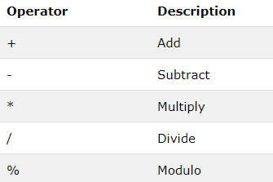
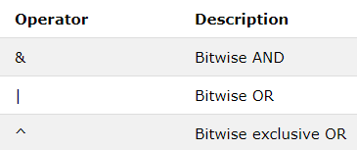
SQL Operators
SQL Arithmetic Operators
SQL Bitwise Operators
Source: https://www.w3schools.com

Slide 11
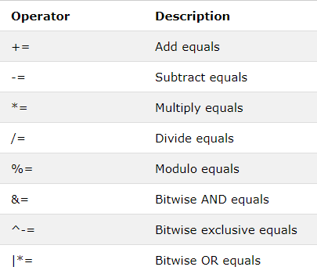
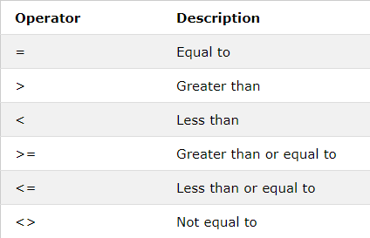
SQL Operators-continued
SQL Comparison Operators
SQL Compound Operators
Source: https://www.w3schools.com

Slide 12
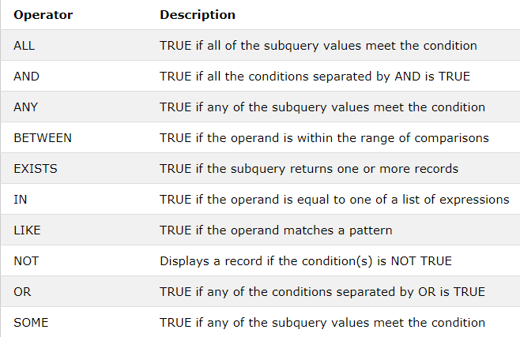
SQL Operators-continued
SQL Logical Operators
Source: https://www.w3schools.com

Slide 13
SQL Server Functions
String Functions
Date Functions
Numeric Functions
Conversion Functions
Advanced Functions

Slide 14
String Functions
CONCAT()/+
LEN()
UPPER() & LOWER()
REPLACE() & STUFF
SUBSTRING()

Slide 15
Date Functions
DATEADD()
DATEDIFF()
DAY()/MONTH()/YEAR()

Slide 16
Numeric Functions
AVG()
CEILING()
COUNT()
FLOOR()
MAX()
MIN()
SUM()

Slide 17
Grouping Data
GROUPBY
HAVING

Slide 18
Conversion Functions
CAST()
CONVERT()

Slide 19
Advanced Functions
ISDATE()
ISNULL()
ISNUMERIC()
NULLIF()

Slide 20
Subquery
A subquery is a SQL query within a query. Subqueries are nested queries that provide data to the enclosing query. SQL subquery is usually added in the WHERE Clause of the SQL statement. Most of the time, a subquery is used when you know how to search for a value using a SELECT statement, but do not know the exact value in the database.
Use a join or a subquery any time that you reference information from multiple tables.

Slide 21
Joins
A JOIN clause is used to combine rows from two or more tables, based on a related column between them.
Different Types of SQL JOINs:
(INNER) JOIN: Returns records that have matching values in both tables
LEFT (OUTER) JOIN: Return all records from the left table, and the matched records from the right table
RIGHT (OUTER) JOIN: Return all records from the right table, and the matched records from the left table
FULL (OUTER) JOIN: Return all records when there is a match in either left or right table

Slide 22
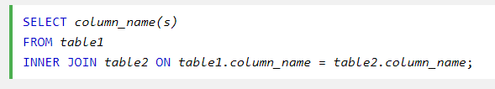
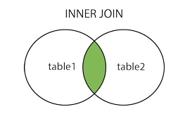
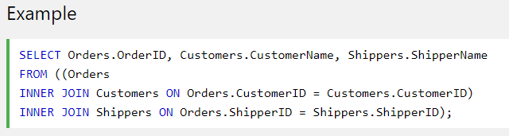
INNER JOIN Syntax
Source: https://www.w3schools.com

Slide 23
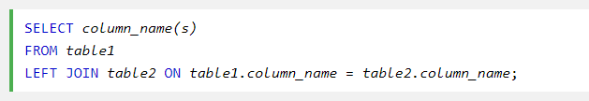
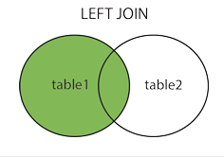
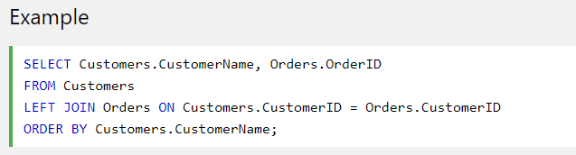
LEFT OUTER JOIN Syntax
Source: https://www.w3schools.com

Slide 24
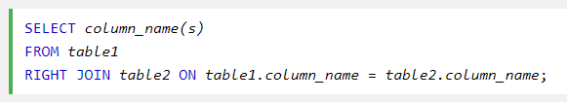
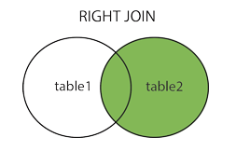
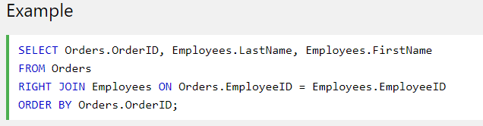
RIGHT OUTER JOIN Syntax
Source: https://www.w3schools.com

Slide 25
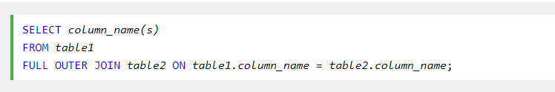
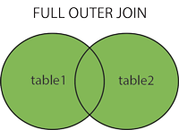
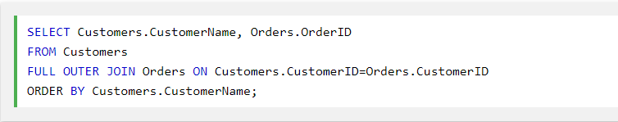
FULL OUTER JOIN Syntax
Source: https://www.w3schools.com

