Slide 1
Everything about COVID-19
Reported by: Haoran Deng
Group NO.1
October 28, 2021
Notes:
Good morning, dear professor Jiang and dear classmates, my name is Haoran Deng.
It’s my great honor to be on behalf of group NO.1 to make a brief introduction about our TC project,
whose name is Everything about COVID-19.

Slide 2
Content
01
Design Principles
02
Project Show
03
About us
Notes:
My report consists of 3 different parts:
First of all, Design Principles. In this part, I’ll point out our target readers and some principles in our mind when we are designing our TC project.
Secondly, Project Show. In this part, I’ll show you how our TC project works in practice.
Finally, I’ll proudly introduce my teammates to all of you. Without their contributions, this project would never become possible.

Slide 3
Design Principles
Notes:
Now, let’s begin the first part: Design Principles.

Slide 4



Design Principles
What is the BEST form of media?
Expensive
Hard to store
Hard to carry
No image
Notes:
Before my introduction, I’d love to ask you a question: What is the best form of media?
Some of you may say, books. But, well, books are a little expensive and it’s hard to store them properly because they are made of papers.
How about videos? But you can’t carry videos everywhere, you’ll always need something to play them.
So maybe music? but there’s no image in music, it’s not vivid enough.

Slide 5
Design Principles
Accessible everywhere
Web page
Cheap
Vivid
Notes:
In order to resolve these problems,
and given the fact that most of my teammates majored in Computer Science during undergraduate studies,
we decided to make a web page.
Web page has 3 main advantages:
Firstly, it’s accessible everywhere. Through Internet, you just need to simply click your mouse and you can view web pages.
Secondly, it’s cheap. Yon can store web pages on cloud servers provided by like Tencent or Alibaba.
Thirdly, it’s vivid. You can put images, videos and anything you want on web pages, it’s just like a combination of different forms of media.

Slide 6
Design Principles
Target reader
Aims
English native speaker
Young and living in China
Prevention knowledge
Video
Picture
Scientific papers
Timely information
Confirmed number
Use English
Familiar with Internet
Need COVID-19 info
Notes:
Now, I want to point out our target readers.
They are English native speakers, and most of them are young and currently living in China, maybe foreign students in China.
Which means that we have to use English in our web page.
Besides, given the fact that they are young, they must be familiar with Internet, so web page is useful to them.
And they really need COVID-19 information about China.
So generally speaking, our aims are to provide:
1. Accurate prevention knowledge through videos and pictures.
2. Some scientific papers about COVID-19 to help readers get a complete view on COVID-19.
3. And timely information like confirmed numbers of different provinces in China.

Slide 7
Design Principles
Layout
Colors
Center
Blanks
Rows
C o l u m n s
Size
Menu
Titles
Information
Eye-catching content
Notes:
Now the question is, what is our methodology.
I want to show you how we design the web page’s layout and colors.
As for layout, we put most content at the center of the screen to make it easier for our readers to read.
And we also use blanks between rows and columns to divide the page into different parts, just like this.
Finally, we use words with different size to emphasize some important contents.
As for colors, we use blue for our menu bar, you will see it later, black for some titles of videos and pictures, gray for information which are not that important,
and we use red for some eye-catching content.

Slide 8
Project Show
Notes:
That’s enough talking, now, let’s begin the second part: Project Show.

Slide 9
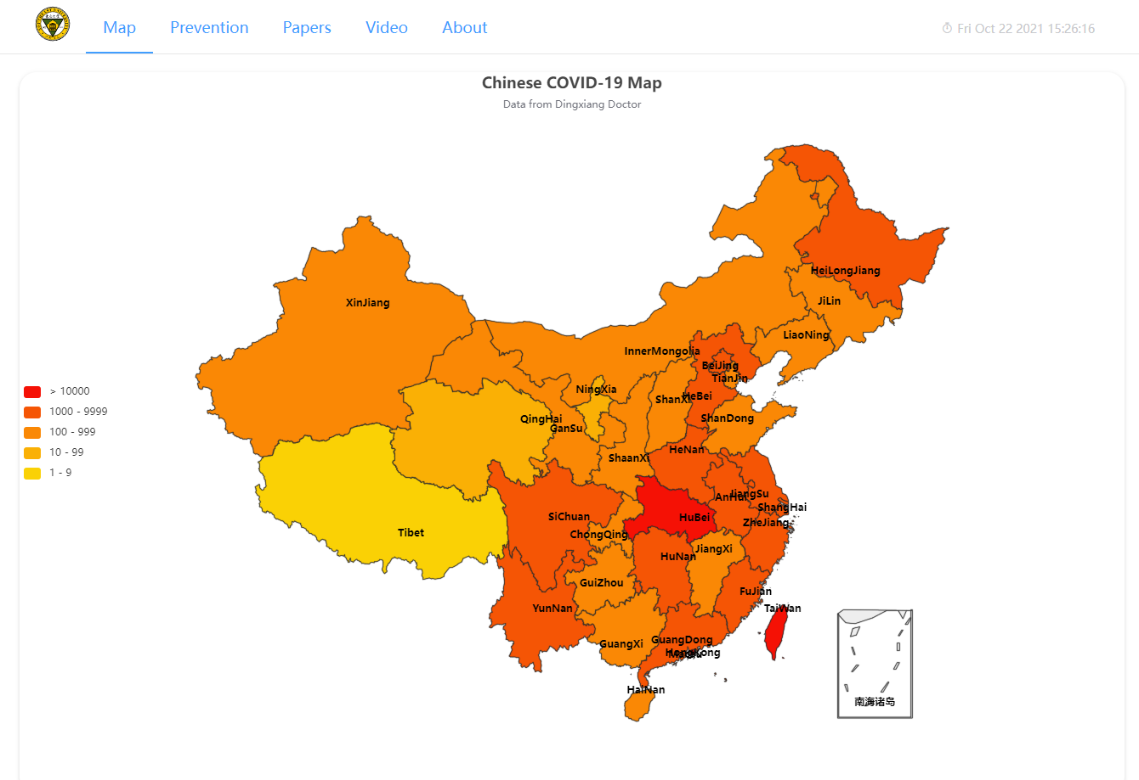
Project Show
Menu Bar
Content
Notes:
This is the front page of our web page.
As you can see, our web page has two parts: menu bar and content.
Just like what I’ve said, main color of menu bar is blue.
And we have 2 special designs in menu bar: SEU’s logo and a small timer. Right here and here.
You can go to the home page of SEU by clicking the logo, and the timer is prepared for oversea readers. It can provide current time dynamically.
We place a Chinese map with confirmed numbers in different provinces in the front page to draw our readers’ attention.
Map’s data comes from Dingxiang Doctor, they’ll be updated once a day.
And we have 5 different colors corresponding to different confirmed numbers.
You can zoom in, zoom out the map, you can also highlight a particular province, and you can see its confirmed number.
Besides that, you can even select all the provinces with their confirmed numbers in the same range, that’s my favorite part.

Slide 10
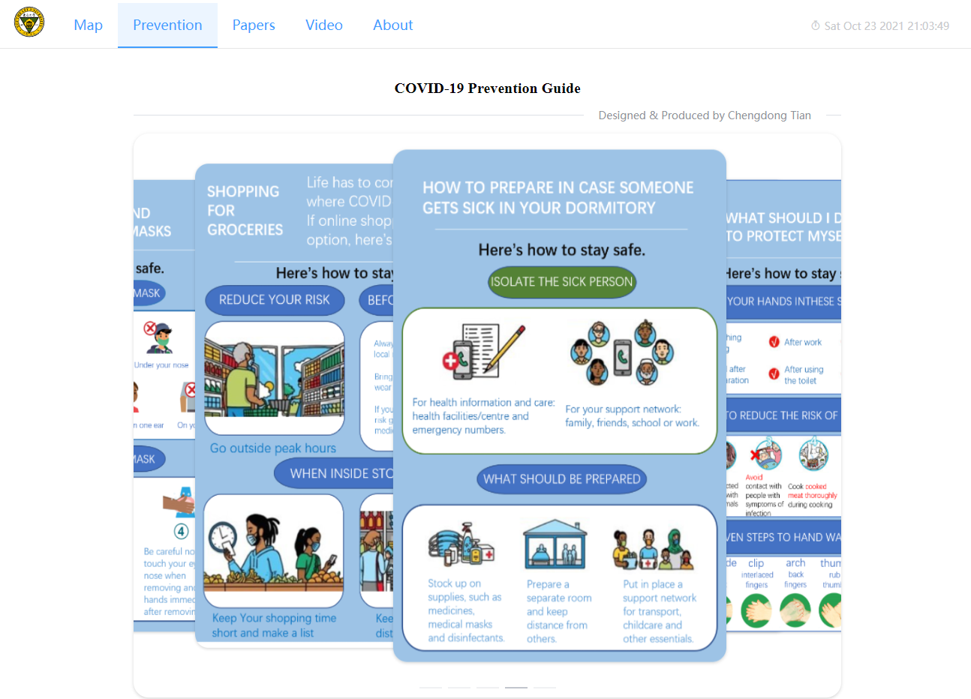
Project Show
Notes:
The second page consists of some posters with COVID-19 prevention tips,
and they are designed and produced by my teammate Chengdong Tian.
Due to the time limit, we won’t have him to make introductions about these posters.
But as you can see, these posters are easy to understand and to follow.
And you can switch between these posters by clicking here and here, and when your mouse is out of the box, it will begin to switch automatically.

Slide 11
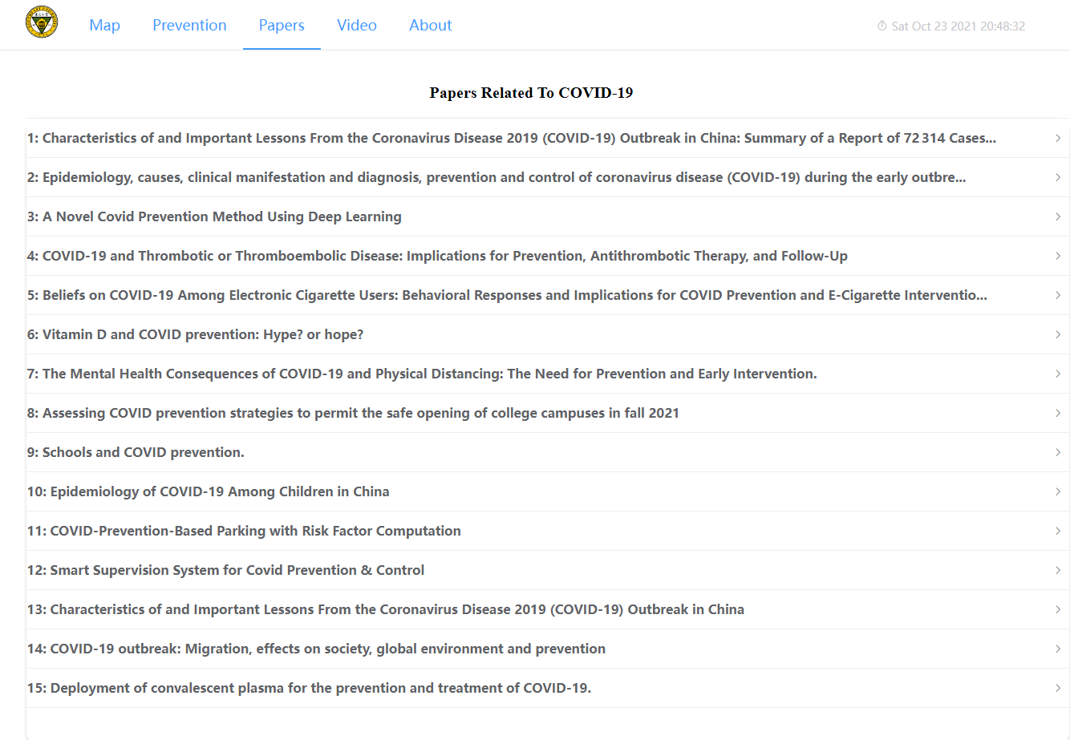
Project Show
Notes:
The third page has top 15 scientific papers collected from google scholar.
And if you click these titles, you can see some information about this paper, like its writers, abstract and its original link.
You can have access to these papers by simply clicking original links.
And in order to make it easier for our readers to read, we design a small scroll bar on the right side, as you can see.
Besides that, you can only view one paper at one time, you know, two many papers will annoy people sometimes.

Slide 12
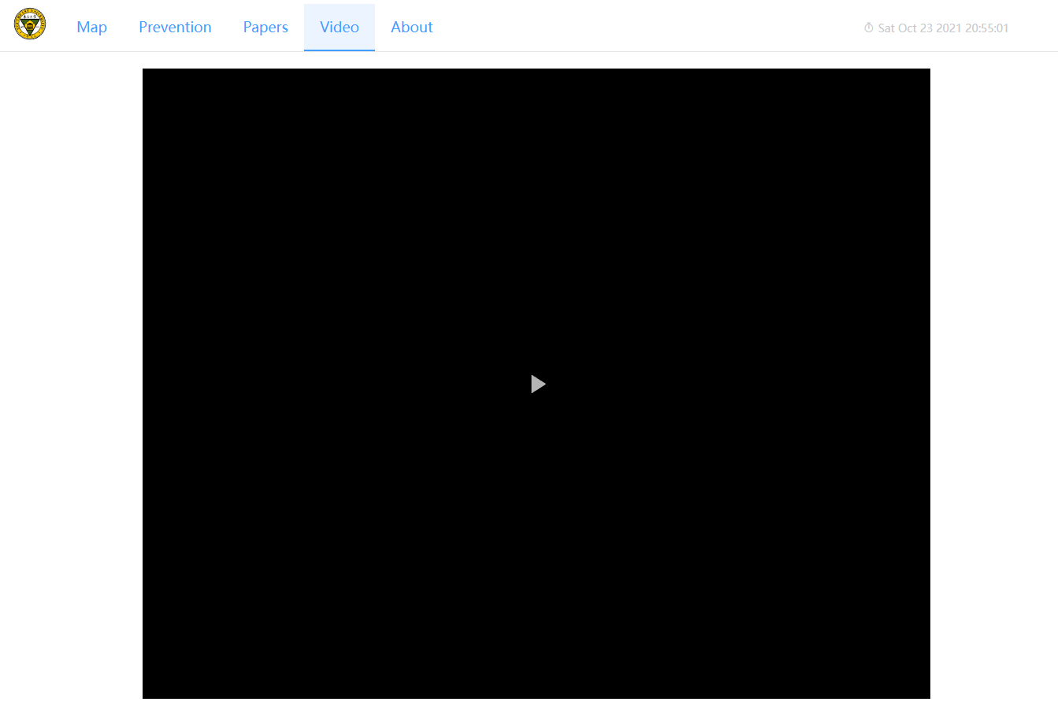
Project Show
Notes:
In the fourth page, we put a video with some useful information about COVID-19 prevention.
This video is made by our group, now let’s take a look.

Slide 13
About us
Notes:
Well, these are main functions of our web page.
Now, let’s begin the third part: about us.

Slide 14
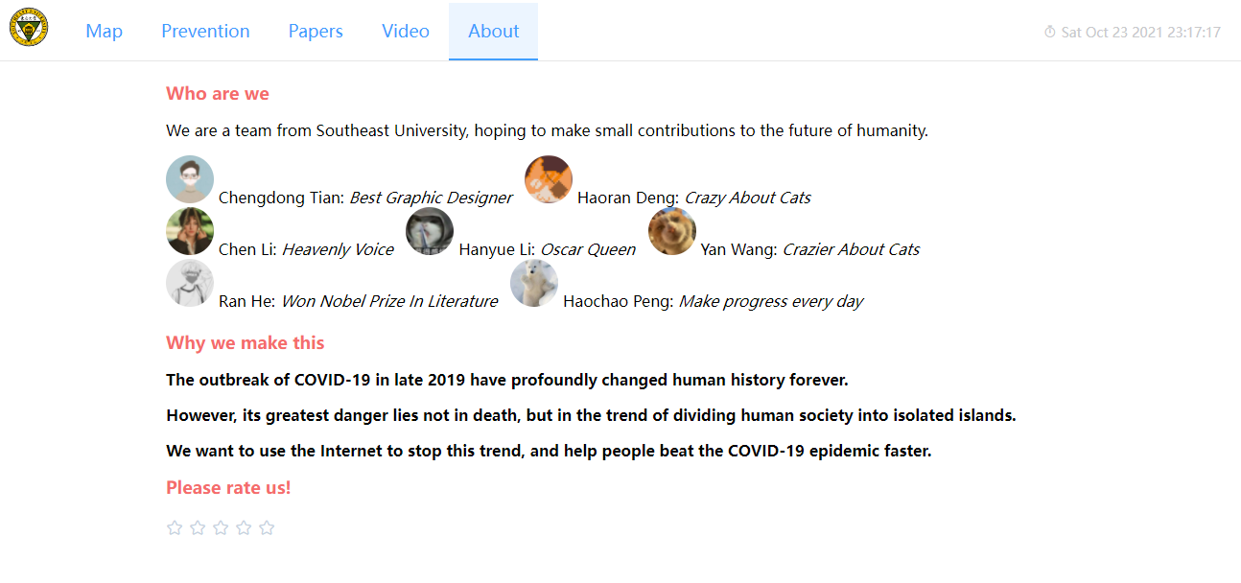
About us
Notes:
The first question: who are we.
As you can see, we are a team from Southeast University, hoping to make small contributions to the future of humanity.
Well It’s really a big dream.
We have 7 members:
Chengdong Tian, best graphic designer, who’s in charge of designing posters.
Haoran Deng, It’s me, I love cat, and I designed and implemented the whole web page.
Chen Li, she has a heavenly voice, and you’ve just heard her in the video.
Hanyue Li, she’s the actor in the video, and I believe she’ll win Oscar in 2022.
Yan Wang, our editor and camerawoman, who loves cats more than me.
Ran He, he wrote most of our texts in videos, and I believe he’ll win Nobel prize in 2022.
Haochao Peng, he makes progress everyday, and he made subtitles for our video too.
the second question is why we make this.
Finally, we put a rate box here, so we can know what our readers think of our project.
As you can see, it has 5 different levels.
Now, it’s your turn to rate my team.

Slide 15
About us
Also thanks to:
Dingxiang Doctor for COVID-19 confirmed number
Bytedance for web video player
Echarts for online Chinese map
Semantic Scholar for paper data
Notes:
Also, we want to show our great thanks to the following companies and organizations,
they selflessly share data and information about COVID-19 with us to help us accomplish our TC project.

Slide 16
Thank you!
Notes:
That is our TC project, thank you very much!

