Slide 1

Orientation
Introduction to
International Conference
Presentation Skills

Slide 2
Introduction to
International Conference

Slide 3
1. Teaching Contents
2. Recommended Textbook
3. Recommended E-textbook
4. Video Sources
5. Watch and Comments

Slide 4
International Conference
1.Teaching Contents:
1) Opening Speech (开幕词)
2) Introduction to Keynote Speaker (介绍发言人)
3) Keynote Speaker’s Speech (主旨发言人发言)
4) Question and Answer (问题与回答)
5) Closing Speech (闭幕词)
6) Introduction to College/Laboratory
(学院或实验室介绍)

Slide 5

International Conference
2. Recommended Textbook：
English For Academic
Communication (Edition2 )
Written by Cong Cong &
Wenyu Wang

Slide 6
International Conference
3. Recommended E-textbook:
English for International Conference Exchange
国际学术交流英语
English for Academic Communication (Edition1 )

Slide 7
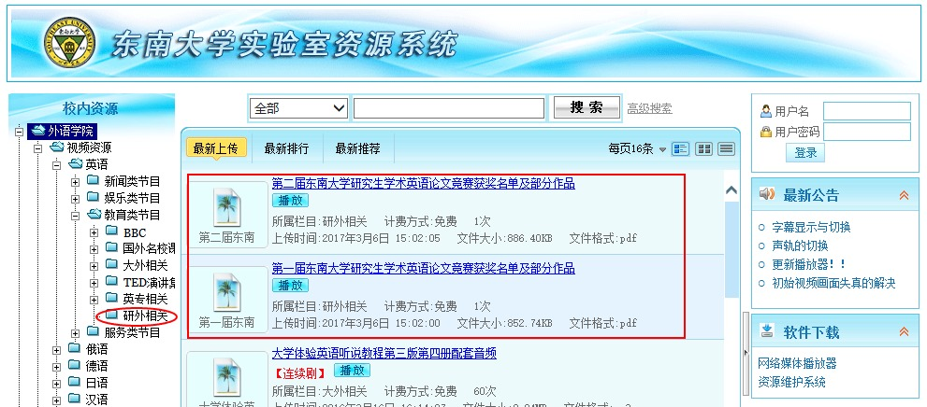
International Conference
4. Video Sources:

Slide 8
International Conference
Procedures:
请使用IE浏览器或者其他浏览器的IE模式访问：东南大学实验
室资源 外语学院（http://223.3.95.153/default.aspx），在安装
了播放器（已下载）之后点击播放即可正常访问。
Recommended Sample:
4th Simulated International Conference
Presentation Contest
推荐观看：第四届东南大学研究生模拟国际会议展演

Slide 9
International Conference
5. Watch and Comments
Tips: Students watch the video clip, and the teacher helps
students to identify the different steps such as Opening Speech,
Introduction to Keynote Speaker, Keynote Speaker’s Speech,
Question and Answer, Closing Speech of International
Conference.

Slide 10
Presentation Skill
Pronunciation
1. 辅音弱化
两个辅音连在一起，前面一个辅音要弱化发音。
如：He didn’t go to the party because he disliked that big dog.
2. 连读
前一个单词的结尾是辅音，后一个单词的首音是元音，
可以连读。
如： put it up take it off walk away
3. 变音（美音，加音有，英音无）
把大气流的清辅音发成对应的小气流的浊辅音
如： k→g p→b t→d tr →dr
come in, pretty good, native speaker, responsibility, take it off

Slide 11
Presentation Skill
Intonation
Mother: Clean? ↗
Son: Clean. ↘
Mother: Clean?? ↘↗
Son: Clean. ↗↘
↗ 表示疑问或意义没有完结，需要补充；
↘ 表示肯定；
↘↗ 表示特别疑问；
↗↘表示特别肯定。

Slide 12
Presentation Skill
Recommended Article:
《对大学英语语音语调创新教学的思考》
石玲 凌建辉

Slide 13
Thank you!

