Slide 1
Technical communication (TC)
技术传播与写作 3
Effective communication for a job
---resume and application letter

Slide 2
Contents
1
Background
2
Warm- up
3
Tasks

Slide 3
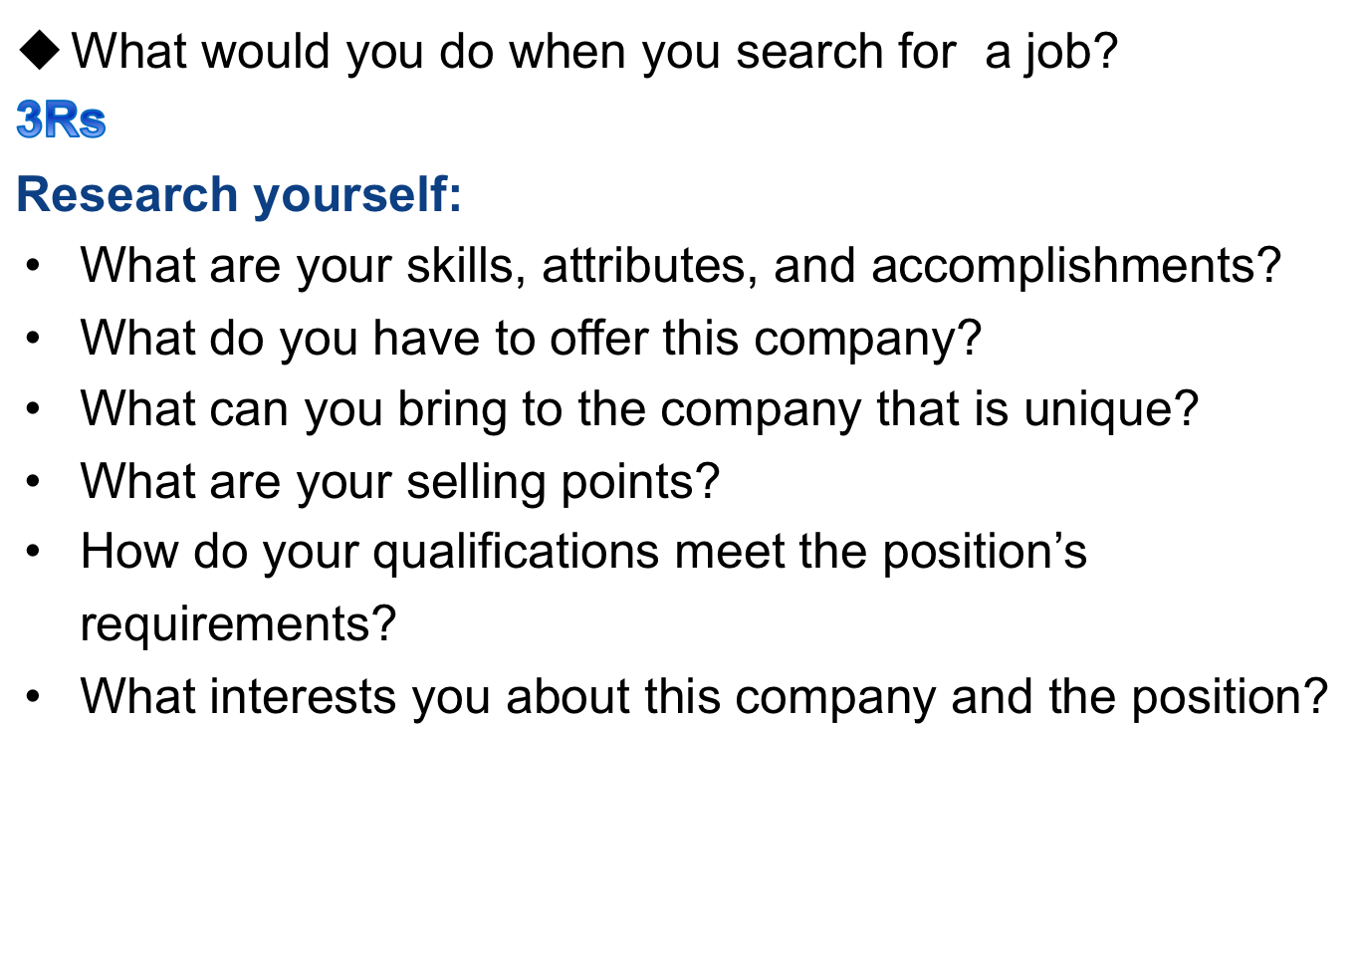
Background

Slide 4
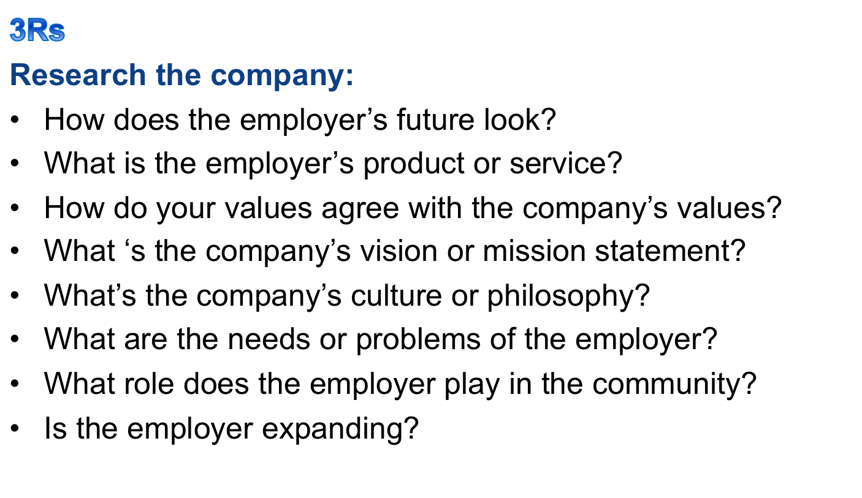
Background

Slide 5

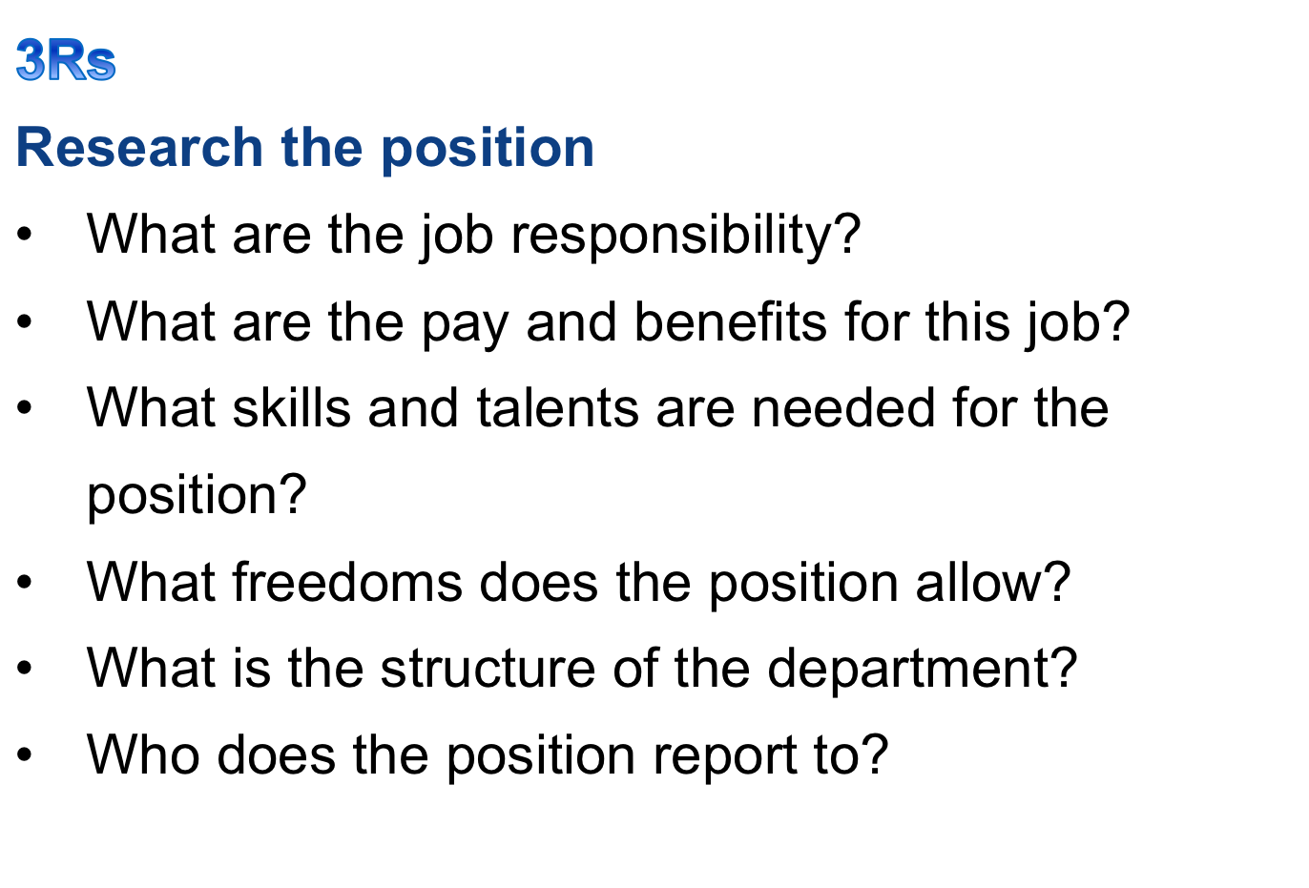

Slide 6
Warm- up and discussion
Types of resume? (See the word file)
Reverse chronological resume (traditional)
Functional (untraditional)
What are the differences? And why?

Slide 7
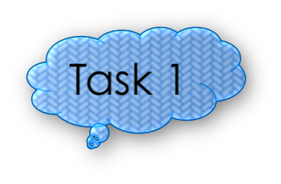

Warm- up and discussion
What are the components of a resume? (See the word file)
  Identification
    Your name
    Contact information (street address,city, province,phone numbers,email,website address)
  Career objectives: like subject line in a memo, precise,specific
  Summary of qualifications
  Employment (job title, name of the company, location, time peirod, job duties etc.)
  Education
  Professional skills (quantify your achievement)

Slide 8
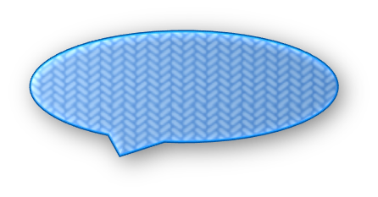


TASK 1--Rewrite career objective
Comments?
Seeking employment in a business environment offering an opportunity for professional growth.
What kind of business?
What kind of opportunities for professional growth?

Slide 9
TASK 1--Revised version
To market financial planning programs and provide financial counseling to ensure positive client relations.
Comments: not only specifies which job the applicant is seeking but also how they will benefit the company.

Slide 10
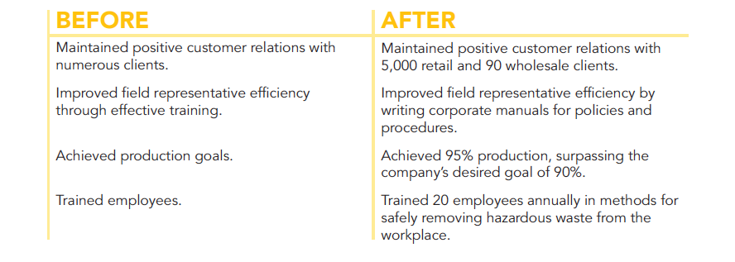
Task 2: Quantify your achievements

Slide 11
Letter of application (cover letter)
4 paragraph pattern
The Introductory Paragraph
The Education Paragraph
The Employment Paragraph
The Concluding Paragraph

Slide 12
Example of introductory paragraph
I am writing in response to your notice in the online May 13 New York Times. I would like to be considered for the position in system programming. I hope you find that my studies in computer science at Southeast University, along with my programming experience at Airborne Instruments, qualify me for the position.

Slide 13
The Education Paragraph--examples
Example About a Project Based on a Course Assignment
At Southeast University, I have taken a wide range of science courses, but my most advanced work has been in chemistry. In one laboratory course, I developed a new aseptic brewing(酿造)technique that lowered the risk of infection by more than 40 percent. This new technique was the subject of an article in the Southeast Science Digest. Representatives from three national breweries(酿酒厂) have visited our laboratory to discuss the technique with me.

Slide 14
Task 3: write a concluding paragraph
Mentioning you resume or CV;
Contacts; request for an interview
Example 1
The enclosed resume provides more information about my education and experience. Could we meet at your convenience to discuss the skills and experience I could bring to Pentamax? You can leave a message for me anytime at (303) 555-5957 or lilyseu@seu.edu.cn

Slide 15

Thanks ！

