Slide 1
Honeyhive Take Home
Alexander Moreno

Slide 2
Steps
Provide a topic analysis on what kinds of inputs and outputs the prompt template fails on
Analyze the model outputs for problematic behaviors
Suggest improvements to the original prompt template
Suggest evaluation criteria to compare prompt templates

Slide 3
1. Provide a topic analysis on what kinds of inputs and outputs the prompt template fails on
Take failure subset of data
Analyze inputs concatenated into a single string
Analyze e-mails
Do pre-processing: high level idea is to reduce words to core ‘sub-word:’ different variants of words are the same
Do topic modeling using Latent Dirichlet Allocation (LDA, Blei et al. 2002)

Slide 4
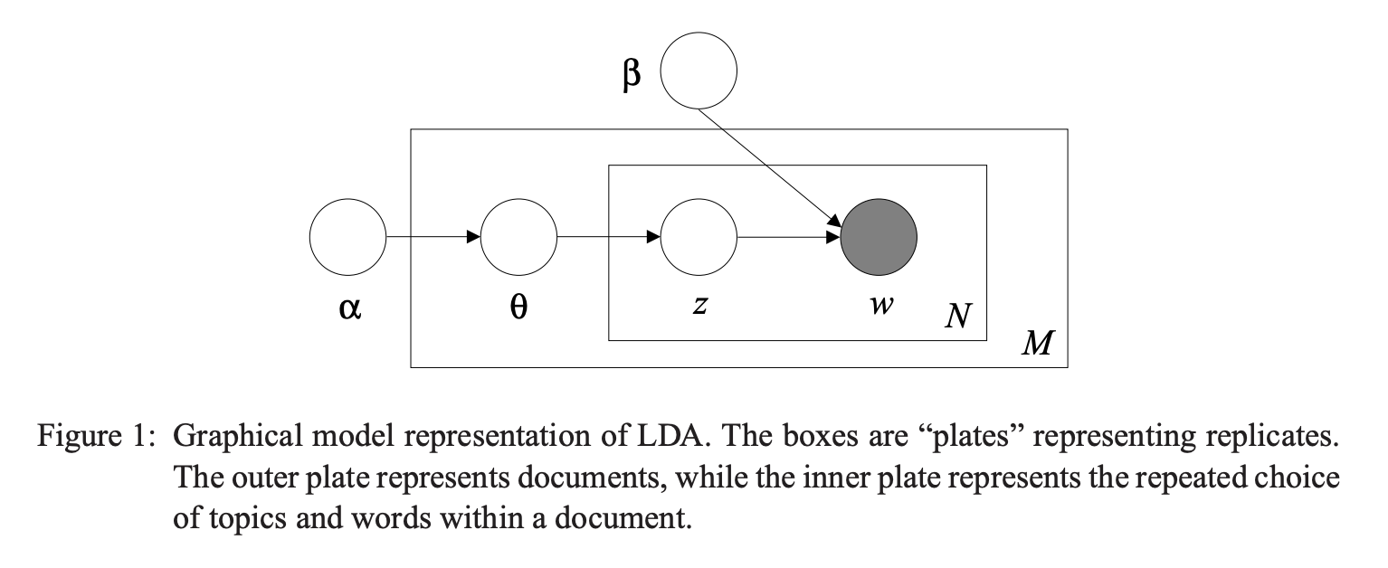
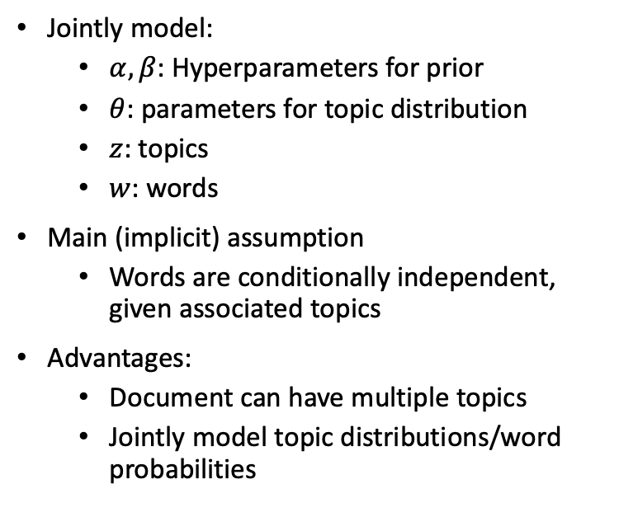
LDA: Background
Jointly model:
$α,β$: Hyperparameters for prior
$θ$: parameters for topic distribution
$z$: topics
$w$: words
Main (implicit) assumption
Words are conditionally independent, given associated topics
Advantages:
Document can have multiple topics
Jointly model topic distributions/word probabilities

Slide 5
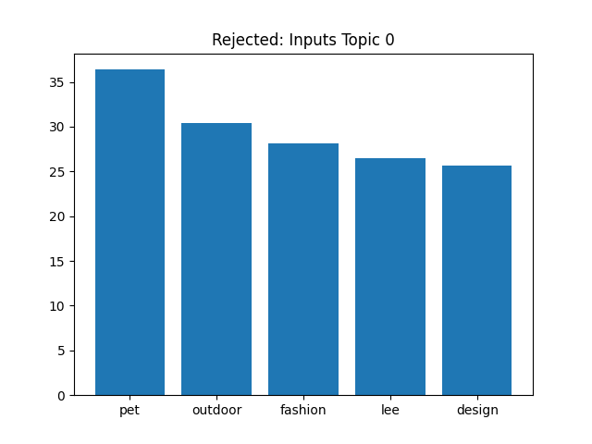
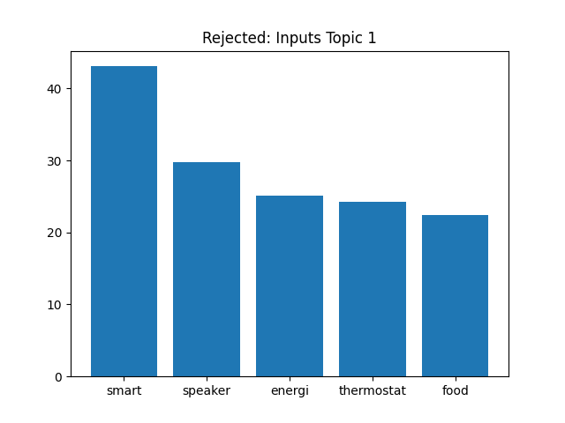
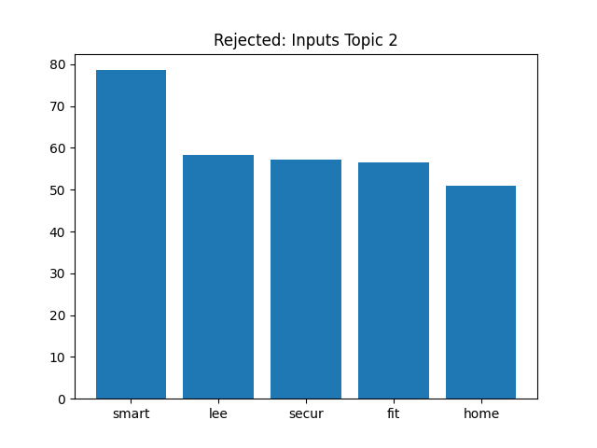
LDA: 3 Input topics, top 5 words
Topic 0: seems to be about pet products for outdoors
Topic 1: smart electronics
Topic 2: also smart devices, but on security
Lee a common name: perhaps shouldn’t have used name as part of the string

Slide 6
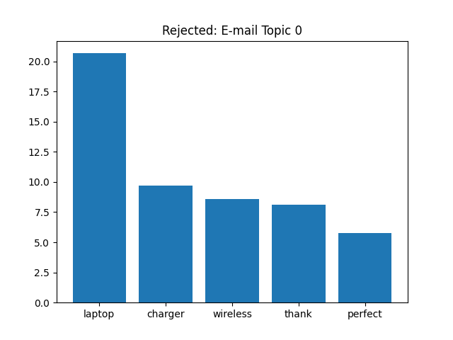
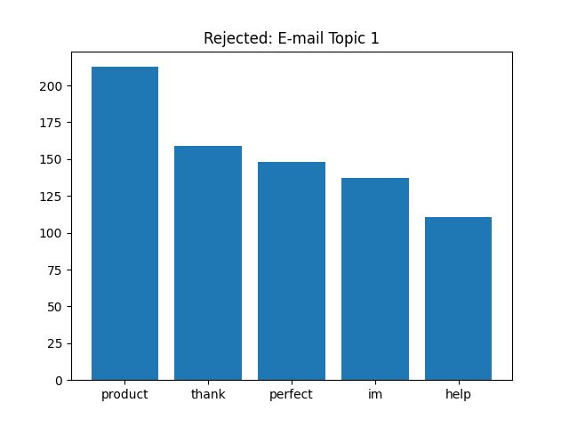
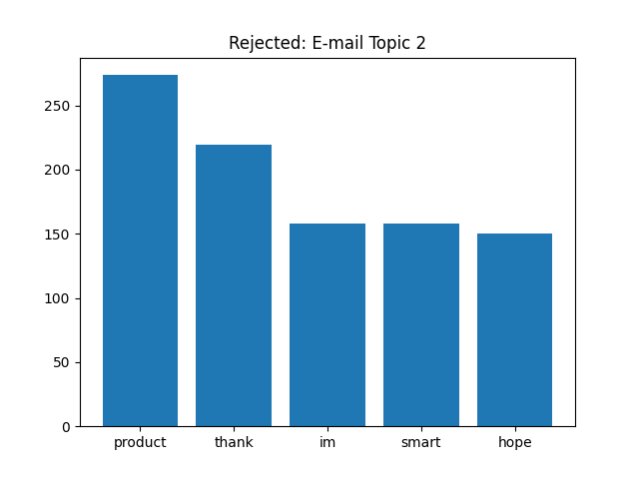
LDA: same, for e-mail topics
Topic 0: electronics
Topic 1: not entirely clear other than that it’s about a product and they’re trying to help
Topic 2: smart products, other words have to do with politeness

Slide 7
Limitations and Potential Extensions
Words (or n-grams) are conditionally independent, given their associated topics
Not sure how to relax this.
Pre-processing turns slightly different words into the same word: could we use word embeddings instead?
Limwattana, Siriwat, and Santitham Prom-on. "Topic modeling enhancement using word embeddings." 2021 18th International Joint Conference on Computer Science and Software Engineering (JCSSE). IEEE, 2021.

Slide 8
2. Analyze the model outputs for problematic behaviors
Two approaches:
Analyze words in e-mail predictive of failure
Not all that related to the critique
Do topic modeling on critiques for failure cases
This had two major bugs!
Wasn’t doing pre-processing for the critique
Was using the vocabulary from the inputs/e-mail, not the critique

Slide 9
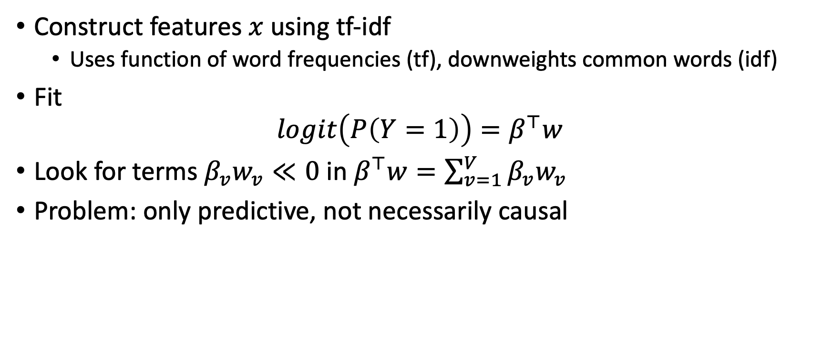
Failure/Success Model: Logistic Regression
Construct features $x$using tf-idf
Uses function of word frequencies (tf), downweights common words (idf)
Fit
$$logit\left(P\left(Y=1\right)\right)=β^{⊤}w$$
Look for terms $β_{v}w_{v}≪0$ in $β^{⊤}w=\sum_{v=1}^{V}{β_{v}w_{v}}$
Problem: only predictive, not necessarily causal

Slide 10
Heuristic Finding
The ‘problem words’ seem to have nothing to do with the critiques from reading
Example e-mail:
Hi Alex,
I hope all is going well. I saw on LinkedIn that you are a licensed architect. I'm selling a new product called the Smart Thermostat. This thermostat is programmable and saves energy and money. I think you would really appreciate it.
If you are interested, please let me know and I can send you more information.
Thank you for your time,
‘Problem’ words: ['sell', 'im’]
Critique:
The email lacks empathy towards Alex's interests, needs, or challenges. The product benefits are not tied to Alex's industry or role, and the email sounds too pushy without explaining why the product is relevant to Alex's work. A more personalized approach would be more effective.
If one reads enough of the ‘problem’ words and critiques, this happens again and again. This is not a good approach.

Slide 11
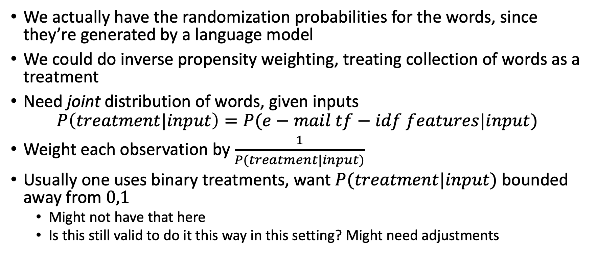
Potential Extension: Causal
We actually have the randomization probabilities for the words, since they’re generated by a language model
We could do inverse propensity weighting, treating collection of words as a treatment
Need joint distribution of words, given inputs
$$P\left(treatment|input\right)=P(e−mail tf−idf features|input)$$
Weight each observation by $\frac{1}{P(treatment|input)}$
Usually one uses binary treatments, want $P(treatment|input)$ bounded away from $0,1$
Might not have that here
Is this still valid to do it this way in this setting? Might need adjustments

Slide 12
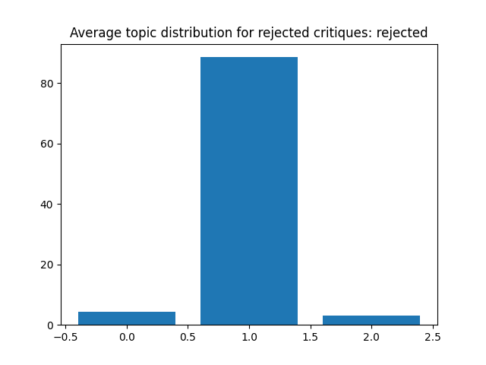
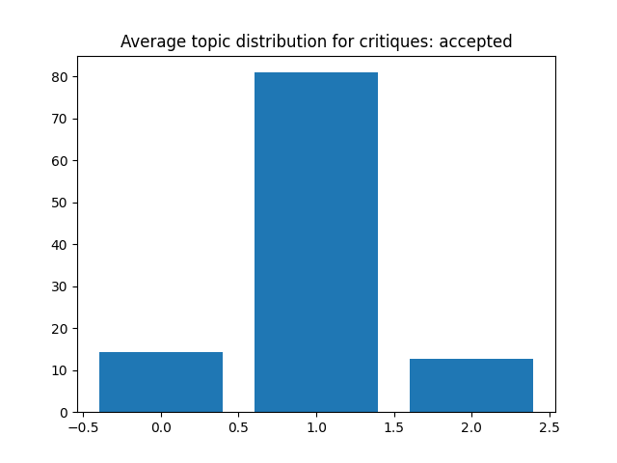
LDA: Topics for Accepted/Rejected
We can see that both are concentrated on topic 1, but rejected even more so
Need to focus on topic 1 then

Slide 13
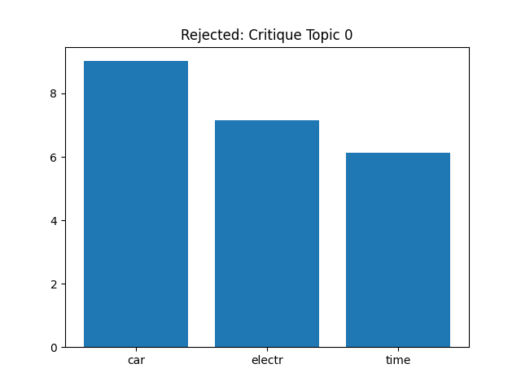
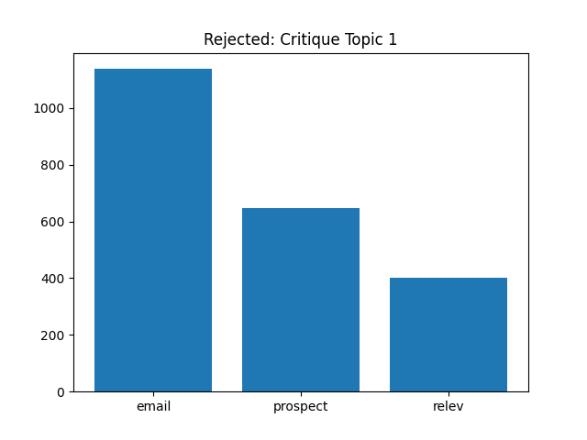
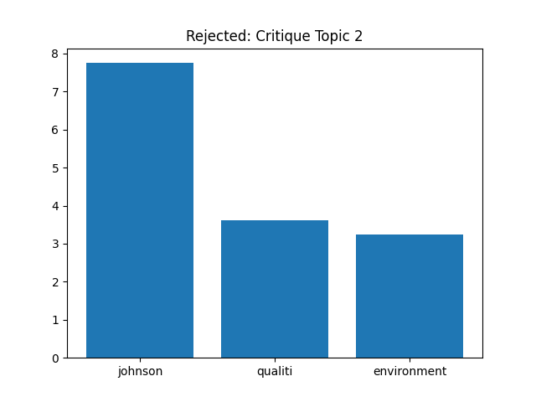

Revised Topic Modeling for Critique
These are from the debugged topic models
Topic 1 talks about the e-mail, talks about the prospect, and will generally mention a lack of relevance to the prospect (noticed from reading them)

Slide 14
3. Suggest improvements to the original prompt template
Remove words predictive of failure
Could use language model, predict next word, don’t choose high probability next word if it has a high negative coefficient in logistic model, choose next word in pmf by order
Problem: doesn’t address causality (statistical definition), only prediction
Handling lack of personalization
(non-ML based): Noticed that lots of the failures suggested personalizing more, so suggested adding more information from the input to the e-mail
Could try to include this in the decoder: include an output penalty that favors words in the inputs
Both of these were implemented as suggestions to changing the e-mails, we didn’t actually improve the e-mails directly

Slide 15
Suggest evaluation criteria to compare prompt templates
Compare prompt templates based on success predictions
Current implementation gives probability predictions using logistic regression
Noticed that a lot of the critiques are about lack of personalization
Idea (didn’t implement)
Favor e-mail outputs that are closer to the inputs
Can use cosine distance
Another simple method would be, if we had input word embeddings and e-mail word embeddings
Average each to get document embeddings
Look at closeness between documents

Slide 16
Future Extensions
We didn’t use the embeddings
Could’ve done clustering with the embeddings directly
Not obvious how to get an interpretable model where we can visualize word probabilities/frequencies/likelihood
Could we do this?
Causal model for relationships between e-mails and failure
We have the randomization probabilities, so this should be doable in principle

Slide 17
Corpus class
__init__: initializes a bunch of variables, preprocesses corpus, gets matrix of word counts an tf-idf matrix
preprocess_corpus: reduction to core words
get_top_n_words_for_k_topics: Fit LDA and get topics
get_topics_for_index: Get topics for specific index
Plotting functions
logistic_regression: features are tf-idf, response is acceptance probability
words_influencing_result: words with either small or negative impact to linear predictor
Predict: given an e-mail, predict whether it will be accepted
Predict proba: given an e-mail, predict acceptance probability

Slide 18
Additional: Discussions
Embeddings:
K-means using embeddings
Based on e-mail samples, critique samples
Summarization over the e-mails in that cluster
Generate a report: accepted/rejected
LLM
Take all the points in that cluster
Have it summarize it

Slide 19
Additional: Discussions
How we experience these problems
Customers: prompt for e-mail/code generation
ML role within company/ML problem
How do you build an effective evaluation mechanism?
Questions will arise: how do you assess the accuracy of reward model?
How interpretable is it?
Reward model in evaluation/endgoal: how do you improve the prompt based on reward model
Practically the customer cares about
Extending this logic to production: annotation from human users, accept/reject/edit, UI/UX action
Assess from user interaction events: failure modes, input failure clusters
Further move along prompt engineering process
Got to do v0 version
Of everything that will happen
Open research questions
Reward model, sample efficient/interpretable/fastest reward model
Batch evaluation: 1000s of samples
Synthetic data generation: how do you generate right input samples

