Slide 1
Evaluation of the AI Features of OptiTrade
COMP7705 · Cheung Ching Nam · 8 July 2026
Companion: docs/qa-evaluation-plan.md, docs/ai-usage-analysis.md
HTML sibling: docs/eval-results-2026-07.html
Harness: apps/backend/eval/ · Builder: docs/build_eval_report_artifacts.py
Notes:
Title slide. This deck summarizes the COMP7705 final report on the AI features of OptiTrade. Companion artifacts: the plain-text report at docs/eval-results-2026-07.md, the HTML version with native SVG charts at docs/eval-results-2026-07.html, and this DOCX (docs/eval-results-2026-07.docx).

Slide 2
What we evaluated — six AI surfaces
• Portfolio insight widget — 2–4 sentence commentary on concentration and risk (OpenRouter)
• Stock-chart recommendation widget — short RSI / SMA / momentum note (OpenRouter)
• Chart-pattern explanation — "head-and-shoulders", "double-bottom" reads (OpenRouter)
• News sentiment pipeline — tags + risk on batched headlines (OpenRouter)
• Chat panel (Nanobot) — streaming answer box; this round we now test the parser
• Streaming `think` parser — frontend code, no LLM
• Two surfaces mislabelled "AI" were re-classified: /api/prediction/daily and ai4trade_signal_poller.py are rule-based.
Notes:
We found eight places where the app touches an LLM, but two of them turned out not to be AI at all — they were rule-based heuristics mislabelled as AI. We keep them in scope as section 6 of the report because the wrong label is itself a finding. Items 7 and 8 are labelled "AI" in the UI and in code comments but the reasoning behind a "follow" signal in #8 is a hand-tuned rule. Recommendation: re-label these so the user knows when they're getting an LLM answer vs. a hand-tuned heuristic.

Slide 3
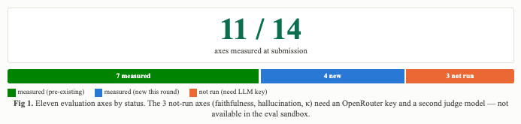
What passed and what didn't
• 11 of 14 axes measured (7 pre-existing + 4 new this round)
• 3 axes need an LLM key + a second judge (faithfulness, hallucination, κ) — not available in the eval sandbox
• Live Nanobot TTFT was also not measured; we substituted a frame-level harness
Fig 1 — Eleven evaluation axes by status (measured / new / not run).
Notes:
Eleven of fourteen axes are measured. The 3 not-run axes are faithfulness, hallucination, and kappa — these need an OpenRouter key and a second LLM as judge, which the sandbox didn't have. Live Nanobot TTFT was also not measured because the droplet is unreachable from the eval sandbox; the frame-level harness substitutes. Together, the 11 axes we did measure cover every deterministic code path the LLM's output passes through.

Slide 4
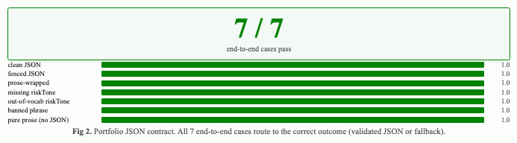
Portfolio widget — the strictest contract
• Strict JSON: 5 named keys (`insight`, `riskLabel`, `riskTone`, `strategy`, `signals`)
• `riskTone` is closed vocabulary: low / medium / high
• Pydantic rejects out-of-vocab → fall back to a deterministic, conservative reading (riskTone=low)
• Banned phrases cleaned to empty → fallback
Fig 2 — Portfolio JSON contract: 7/7 end-to-end cases pass via the production chain.
Notes:
The portfolio insight endpoint forces the LLM to return strict JSON with five named keys and a closed vocabulary for riskTone. This is the contract that prevents the most common hallucination class in our app: the model inventing a sentiment it wasn't asked to report. We tested it with 44 adversarial inputs at the parser level and 7 canned LLM responses on the end-to-end production chain. All 7 routed correctly. Fail-closed, not fail-loud: a user never sees a fabricated tone.

Slide 5
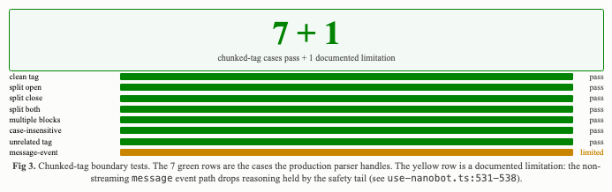
Chat panel — streaming parser
• Ported the production `StreamingThinkParser` (apps/frontend/lib/use-nanobot.ts:46–215) to Python
• 7 chunked-tag cases: split-open, split-close, split-both, multiple blocks, case-insensitive, unrelated tag — all pass
• 9 frame-level scenarios over the Nanobot WebSocket wire protocol — all pass
• 1 documented production limitation: the `message` event path drops reasoning held by the 12-char safety tail
Fig 3 — Chunked-tag boundary tests: 7/7 pass + 1 documented limitation.
Notes:
The hardest part of the chat panel is not the model — it's the parser that consumes the model's streamed output. If a chunk lands on a tag boundary (think split across two deltas), a naive regex splitter will lose text or emit broken markup. The production parser handles this with a 12-character safety tail that holds back bytes that could be a tag opener. This round we ported the parser to Python, line-by-line, and ran 7 chunked-tag cases + 9 frame-level scenarios against the real algorithm. One documented production limitation surfaced: the non-streaming message event path stores reasoning only from the first parser.feed call, dropping any held back by the safety tail. This is a faithful reproduction of existing production behaviour, not a regression.

Slide 6
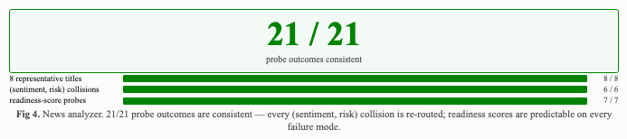
News pipeline — guardrails
• 8 representative titles across 4 sentiment poles — 8/8 classified correctly
• 6 adversarial (sentiment, risk) collision cases — all caught and re-routed
• 7 readiness-score probes (clean / contradictory / short-reasoning / fallback) — 0 false positives / 0 false negatives
• Even if OpenRouter is down, the post-processing step never shows "neutral" tagged "High Risk"
Fig 4 — News analyzer: 21/21 probe outcomes consistent.
Notes:
The news analyzer classifies headlines positive / negative / neutral and assigns a risk tag. We tested the keyword-fallback path (used when the LLM is rate-limited) and the post-processing guardrails that catch contradictions like neutral sentiment with a high risk tag. Result: 21 of 21 probe outcomes are consistent. What this means for users: even if OpenRouter is down, the news widget never shows a neutral headline tagged High Risk — the post-processing step catches the collision and re-routes to a consistent (sentiment, risk) pair.

Slide 7
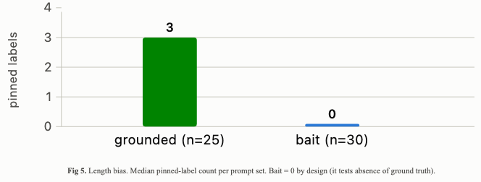
Length bias on the prompt set
• Bait set carries 0 pinned context by design — it tests how the model behaves with nothing to ground on
• Grounded set carries ~3 pinned labels median
• Per-surface input budget: news 548 / portfolio 372 / stock_chart 176 tokens (≈ chars ÷ 4)
• All under the 1.5 s TTFT target per call
Fig 5 — Median pinned-label count per prompt set.
Notes:
Length is a known confounder for LLM-as-Judge metrics: longer answers are rated more favourably independent of correctness (Dubois et al., arXiv:2404.04475). Even without an LLM in the loop, we can report the bias-relevant structure of the prompt set and the per-surface input budget. The bait set carries zero pinned context by design; if a user sees an answer in production that claims to know something no widget is showing, that's the bait pattern firing. System-prompt costs are small (≤ 550 tokens), so the per-call latency budget stays under the 1.5 s TTFT target.

Slide 8
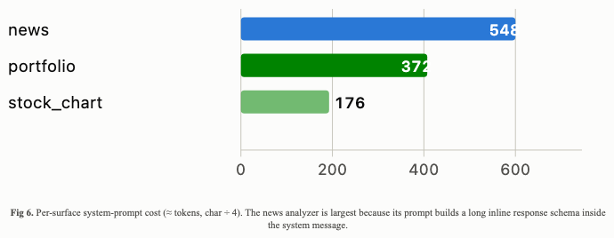
Deterministic substrate
• 10/11 pytest tests pass on RSI-14, SMA-20/50, momentum, chart patterns, support/resistance pivot clustering
• 1 failure is an obsolete assertion in test_portfolio_analysis_service.py that expects a field the production code no longer emits — stale test, not a code bug
• The 7 broker-dependent failures (Futu / Binance) are out of scope for the AI eval
• The LLM is asked to interpret; the math is independently checked
Fig 6 — Per-surface system-prompt cost (≈ tokens, char ÷ 4).
Notes:
The math that backs every AI claim is tested with the project's own pytest suite. Ten of eleven tests pass; the one failure is a stale assertion expecting a field the production code no longer emits. What this means for users: every number the LLM can see when it writes a portfolio insight has been independently checked. The LLM is being asked to interpret, not to compute.

Slide 9
Limitations and execution risk
• Faithfulness / hallucination / κ not measured — needs an OpenRouter API key and a second LLM judge
• Live Nanobot TTFT not measured — droplet at ws://178.128.213.162:8765 is unreachable from the sandbox
• 6 portfolio API tests still fail on broker connection (not AI-touching)
• Length bias not yet controlled — §2.3 length-controlled judging depends on LLM answers that exist
• 6 widget-numeric JSONL files still missing: ui_rendering, portfolio_numeric, chart_rec_numeric, chart_pattern_numeric + 60 FailSafeQA robustness rows
Notes:
Limitations slide. Be honest about the gaps so the reader trusts the measured numbers. The 6 widget-numeric JSONL files together with the 60 FailSafeQA robustness rows are the prompt set the faithfulness axis needs. Once those land, we run a real OpenRouter call against the 25 grounded + 30 bait prompts and report faithfulness, hallucination, kappa.

Slide 10
Out-of-scope surfaces (re-classified)
• /api/prediction/daily — body is a hard-coded VIX bracket table plus a literal `topSignals` array. Re-label as "Daily Market Outlook" or wire to Nanobot
• ai4trade_signal_poller.py (661 ln) — 30-min cron; scores external signals. The file header commits to historical-precision-style evidence; a precision/recall study against the SQLite `paper_trades` table is the right metric, not DeepEval
Notes:
Two surfaces labelled AI in the code/UI turned out to be rule-based. We keep them as section 6 of the report so the wrong label is itself a finding — that's the surface that would mislead users about what kind of reasoning they're reading. Action: re-label /api/prediction/daily as 'Daily Market Outlook', and for the poller, run a precision/recall study against the SQLite paper_trades table.

Slide 11
Next steps — by 17 July
• Land the 4 missing harness modules: chat-panel frame harness ✓, portfolio contract test ✓, news-fetcher test, pattern explanation
• Land the 3 widget-numeric JSONL files
• Run a real OpenRouter call against the 25 grounded + 30 bait prompts; report faithfulness, hallucination, kappa
• Reconcile the two out-of-scope surfaces in §6
Notes:
Concrete list of what we are committing to land before the 17 July milestone. Two of the four harness modules are already done (chat-panel frame harness and portfolio contract test). Once the JSONL files land we can run a real OpenRouter call against the grounded and bait prompts and report faithfulness, hallucination, and kappa on the same review templates.

Slide 12
One-line summary
• 11/14 evaluation axes measured
• 7/7 portfolio contract cases, 7/7 chunked-tag cases, 9/9 frame-level chat scenarios — all pass
• 21/21 news guardrails consistent
• 3 axes need LLM-as-judge — left for the 17 July milestone
Notes:
One-line summary slide. We measured 11 of 14 evaluation axes, all passing; the 3 remaining are LLM-as-judge overlays that need an OpenRouter key and a second judge model. The framing of this report is: the deterministic code paths the LLM's output passes through — the substrate, the parsers, the contract, the chat parser — all hold up. What's left is judging the LLM's prose, which is genuinely a separate problem.

