Slide 1
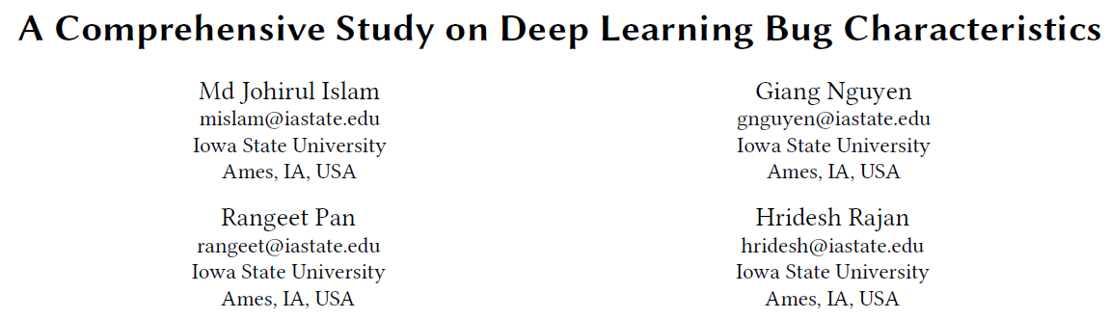

Slide 2



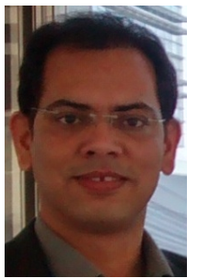
Hridesh Rajan
Professor
Notes:
愛荷華州立大學
Software Engineering (SE), programming languages (PL), and data science

Slide 3
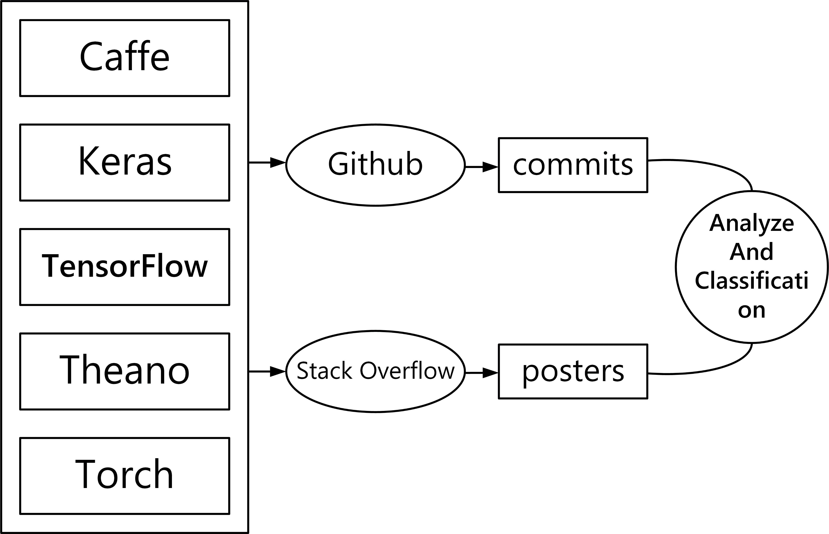
Research Objective

Slide 4
Motivation
A class of machine learning algorithms known as deep learning has received much attention in both academia and industry.
Existing work
bugs in the implementation of machine learning libraries themselves (Ferdian Thung, Shaowei Wang, David Lo, and Lingxiao Jiang. 2012. An empirical study of bugs in machine learning systems, International Symposium on Software Reliability Engineering)
bugs in the usage of a specific deep learning library (Yuhao Zhang, Yifan Chen, Shing-Chi Cheung, Yingfei Xiong, and Lu Zhang. 2018. An empirical study on TensorFlow program bugs, ACM SIGSOFT International Symposium on Software Testing and Analysis)

Slide 5
In this paper
Focuses on the characteristics of bugs in software that makes use of deep learning libraries.
Caffe\Keras\Tensorflow\Theano\Torch
RQ1: (Bug Type) What type of bugs are more frequent?
RQ2: (Root cause) What are the root causes of bugs?
RQ3: (Bug Impact) What are the frequent impacts of bugs?
RQ4: (Bug prone stages) Which deep learning pipeline stages are
more vulnerable to bugs?
RQ5: (Commonality) Do the bugs follow a common pattern?
RQ6: (Bug evolution) How did the bug pattern change over time?
Notes:
Deep learning process can be divided into seven stage pipeline [26]. The stages are data collection, data preparation, choice of model, training, evaluation, hyper parameter tuning and prediction.

Slide 6
Method: Data collection
Stackoverflow
Searching for posts tagged with Caffe, Keras, Tensorflow, Theano, and Torch.
Filter out posts that did not contain any source code because posts about bugs usually contain code snippets
Grade more than 5
Manually read: If the best-accepted answer was to fix the usages of the deep learning API(s) in the question, we considered that post as talking about deep learning bugs.

Slide 7
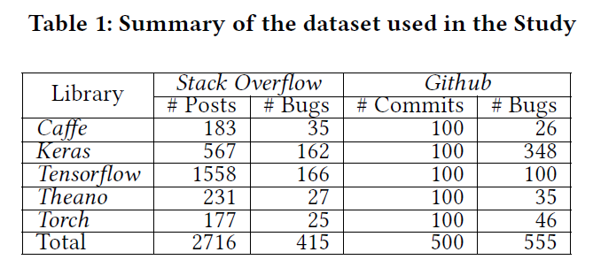
Method: Data collection
Github
find the repositories that contain the keywords related to the libraries
commits whose title contains the word ”fix”
manually check the import statements in the program
randomly select 100 commits for each library
manually read

Slide 8
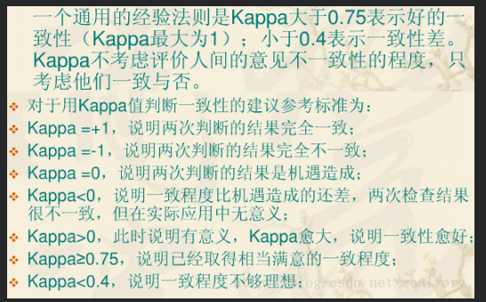
Method: Labeling the Bugs
Cohen’s Kappa coefficient
5% : 0
10% : 82%
>90%

Slide 9
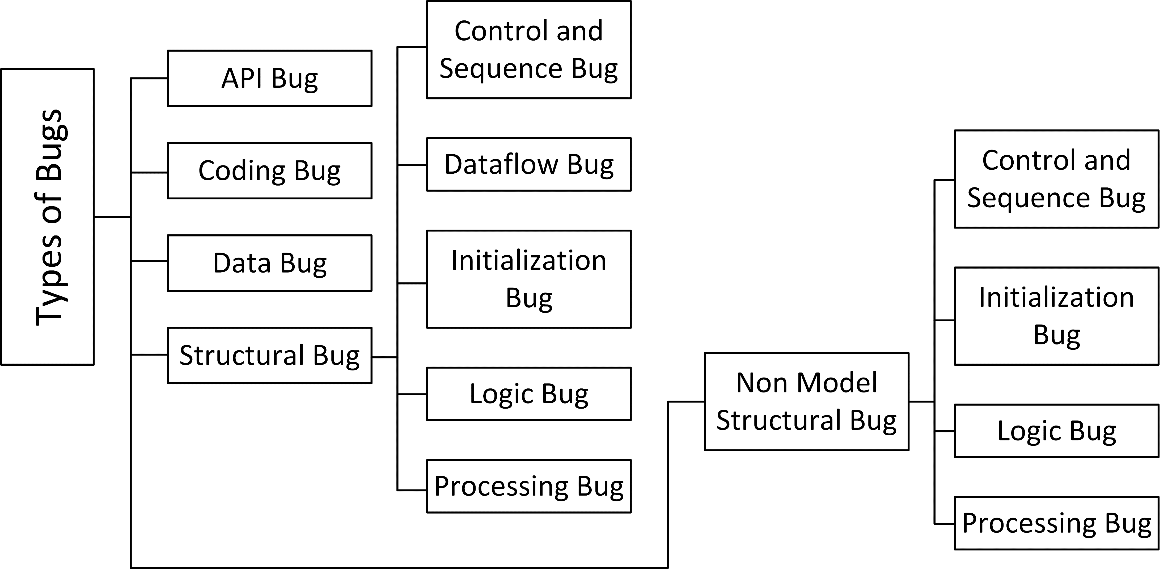
Classification (Types of Bugs)
Boris Beizer. 1984. Software system testing and quality assurance

Slide 10
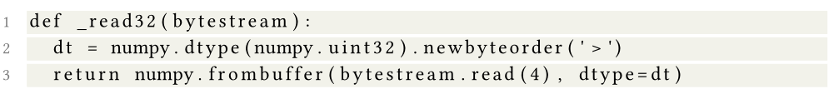
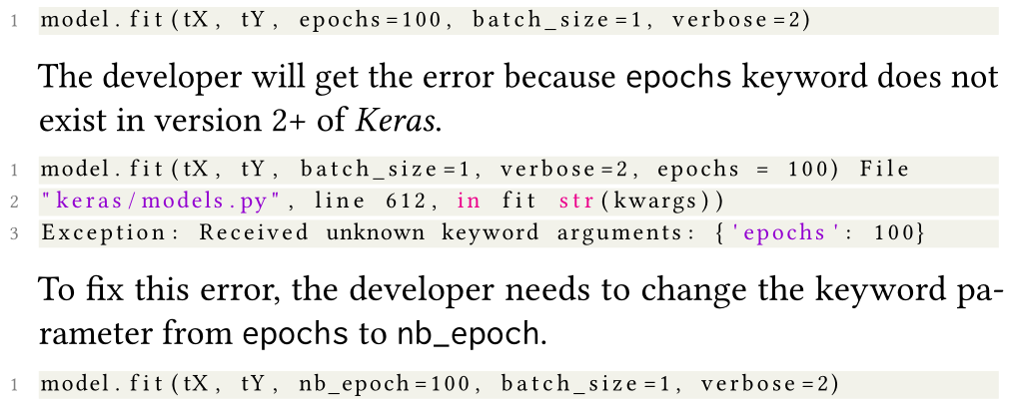
Data bugs
API bugs

Slide 11
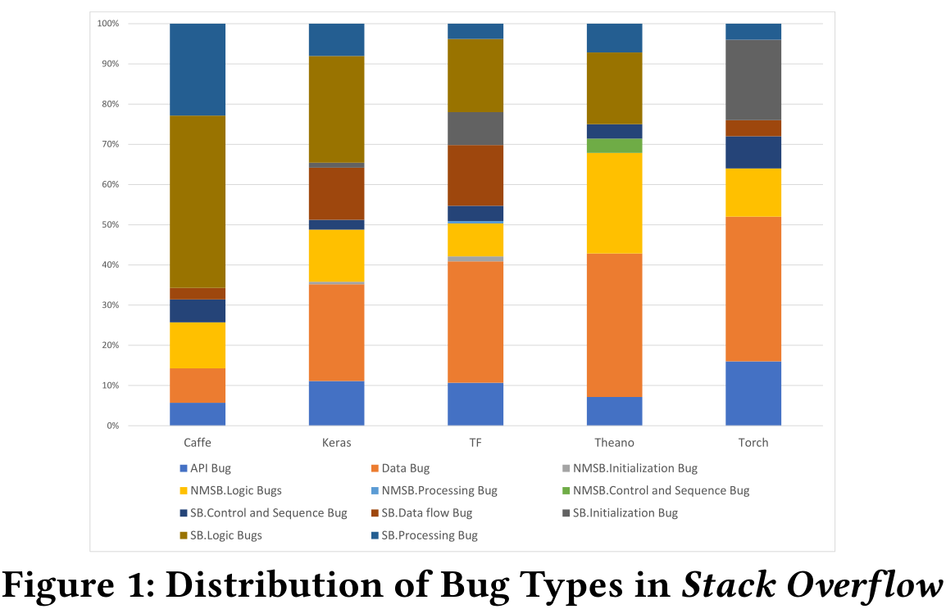

Slide 12
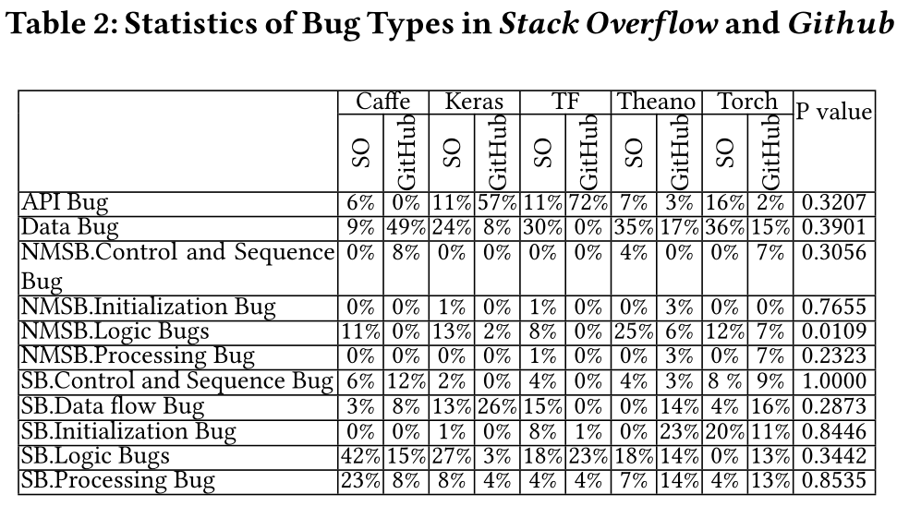

Slide 13
RQ1: (Bug Type) What type of bugs are more frequent?
Finding1: Data Bugs appear more than 26% of the times
Finding 2: Caffe has 43% Structural Logic Bugs
Finding 3: Torch, Keras, Tensorflow have 16%, 11% and 11% API bugs respectively
Finding 4: All the bug types except Non Model Structural Logic Bug have a similar pattern in Github and Stack Overflow for all the libraries

Slide 14
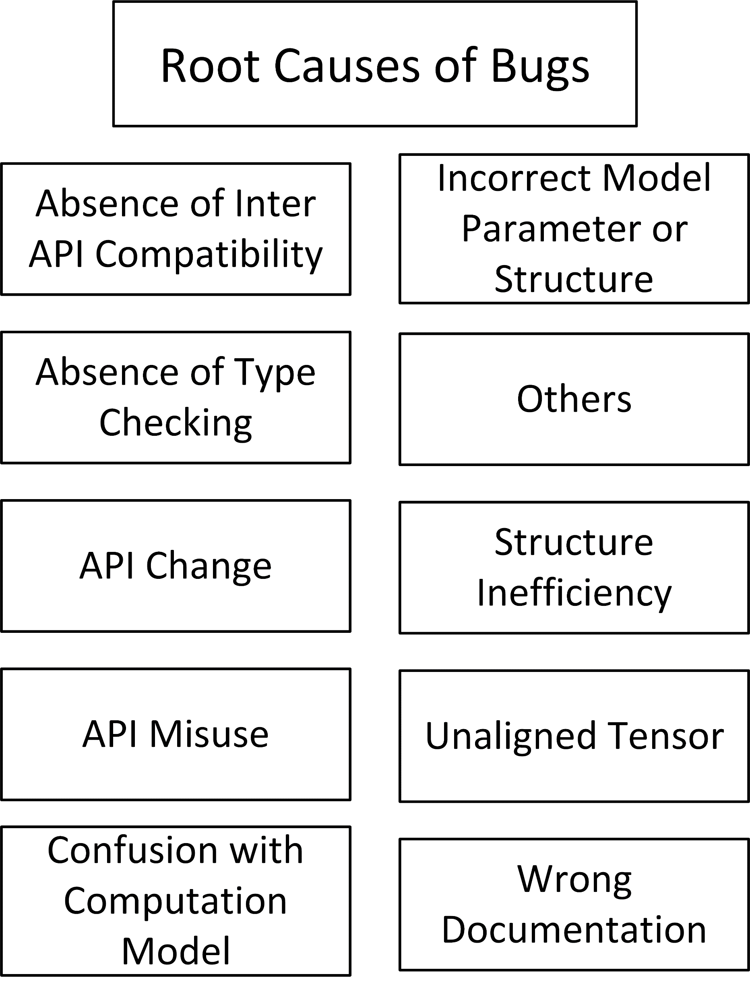
Classification (Root Causes of Bugs)

Slide 15
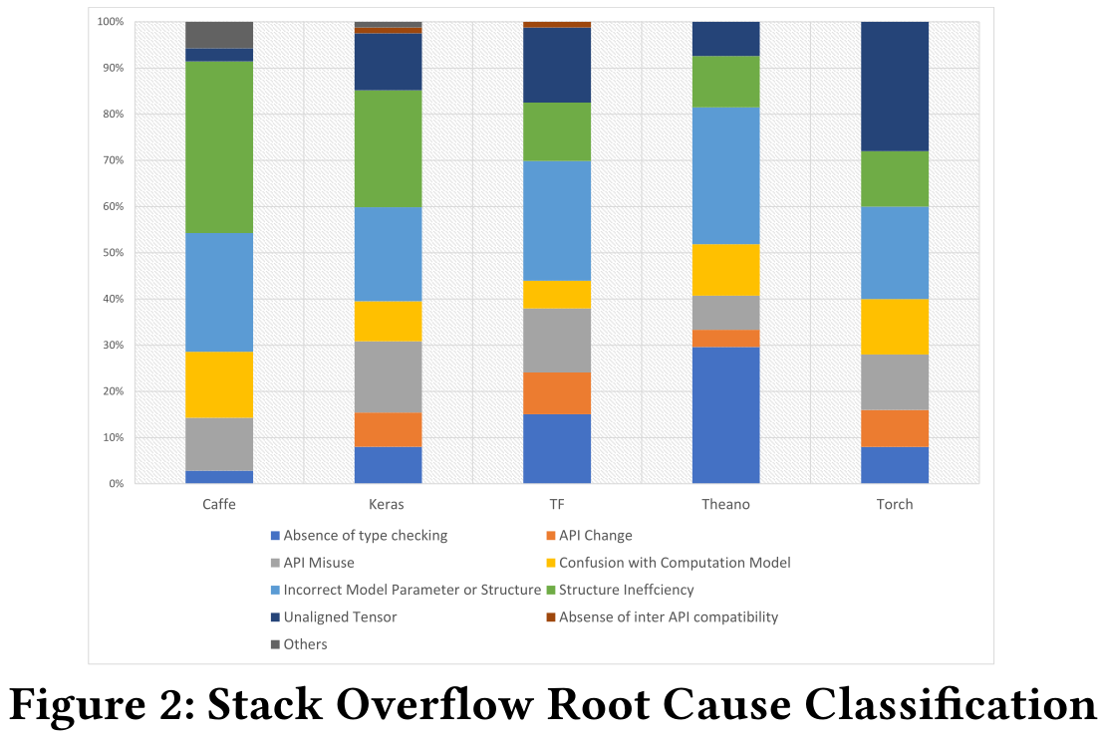

Slide 16
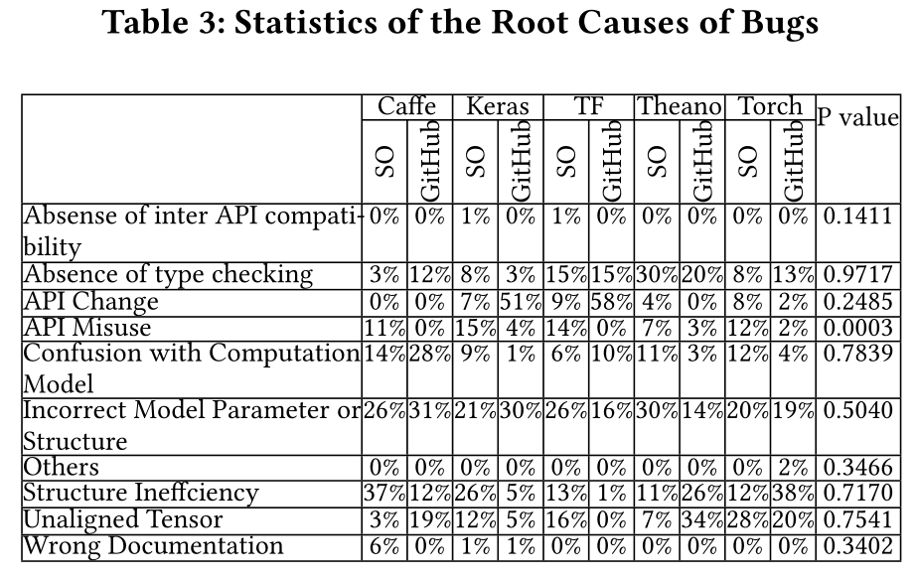

Slide 17
RQ2: (Root cause) What are the root causes of bugs?
Finding 5: Incorrect Model Parameter (IPS) is the most common root cause resulting in average 24% of the bugs across the libraries.
Finding 6: Keras, Caffe have 25% and 37% bugs that arise from Structural Inefficiency (SI)
Finding 7: Torch has 28% of the bugs due to Unaligned Tensor (UT)
Finding 8: Theano has 30% of the bugs due to the absence of type checking
Finding 9: Tensorflow and Keras have 9% and 7% bugs due to API change
Finding 10: Except API Misuse all other root causes have similar patterns in both Github and Stack Overflow root causes of bugs
Finding 11: Structural Inefficiency (SI) contributes 3% - 53% and IPS contributes 24% - 62% of the bugs related to model

Slide 18
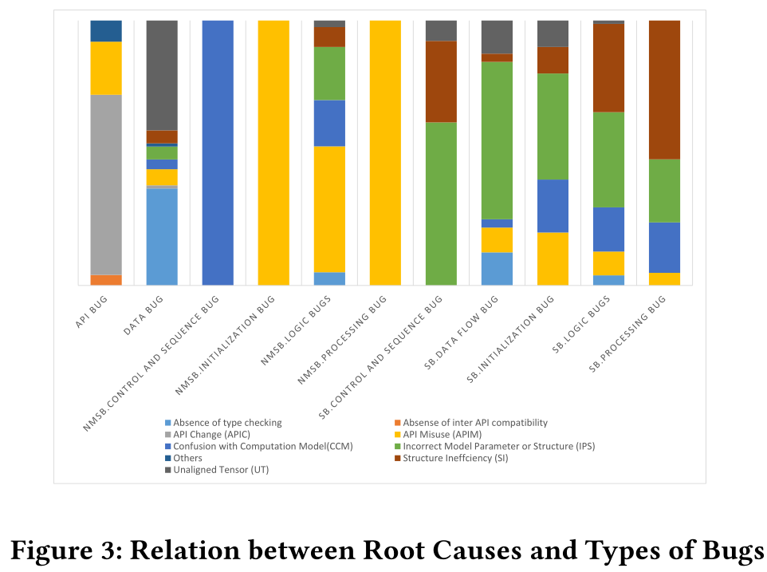

Slide 19
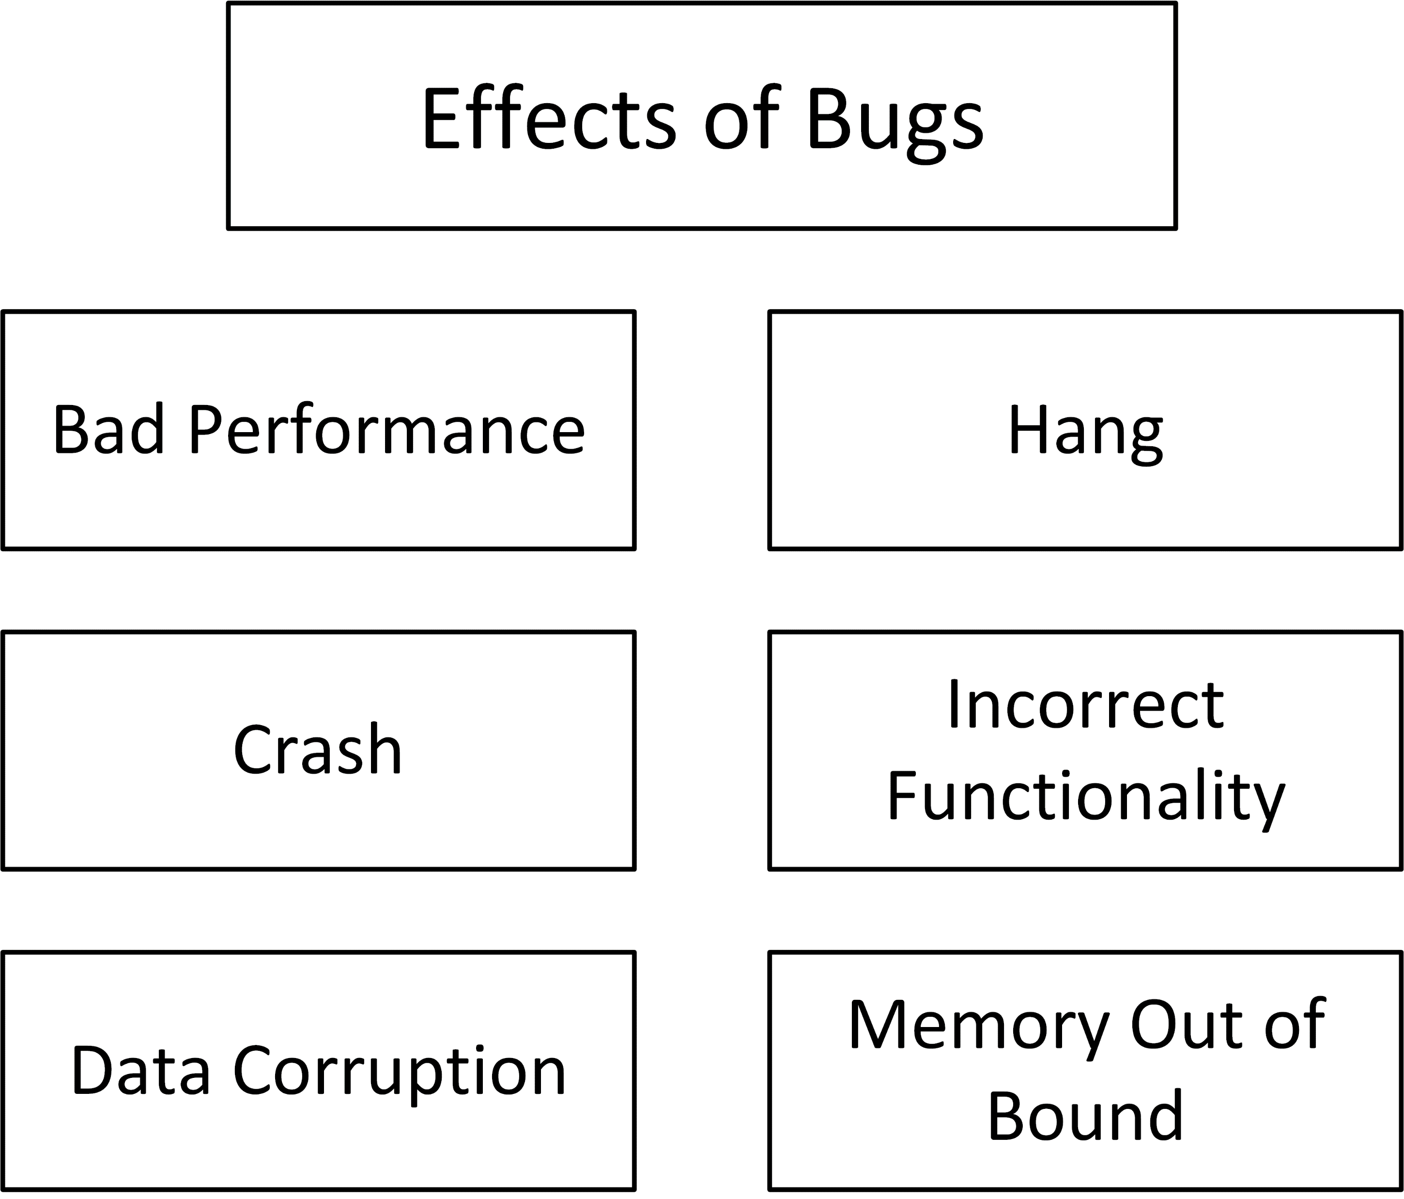
Classification (Effects of Bugs)

Slide 20
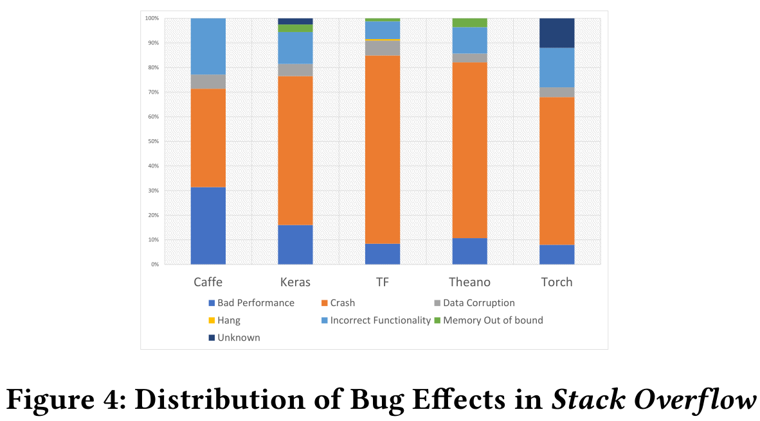

Slide 21
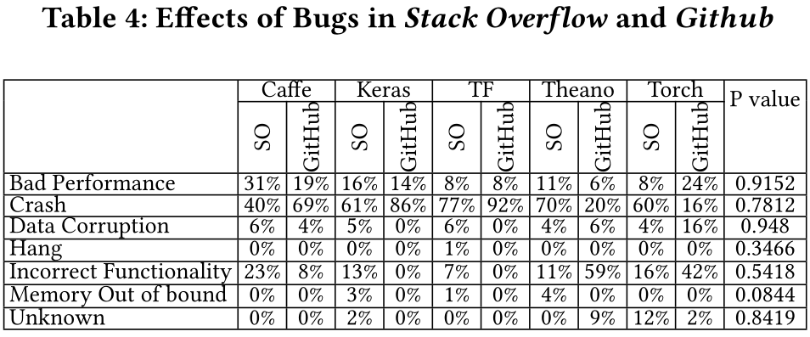

Slide 22
RQ3: (Bug Impact) What are the frequent impacts of bugs?
Finding 12: More than 66% of the bugs cause crash.
Finding 13: In Caffe, Keras, Tensorflow, Theano, Torch 31%, 16%, 8%, 11%, and 8% bugs lead to bad performance respectively.
Finding 14: 12% of the bugs cause Incorrect Functionality.
Finding 15: For all the libraries the P value for Stack Overflow and Github bug effects reject the null hypothesis to confirm that the bugs have similar effects from Stack Overflow as well as Github bug.

Slide 23
RQ4: (Bug prone stages) Which deep learning pipeline stages are more vulnerable to bugs?
Finding 16: 32% of the bugs are in the data preparation stage.
Finding 17: 27% of the bugs are seen during the training stage.
Finding 18: Choice of model stage shows 23% of the bugs

Slide 24
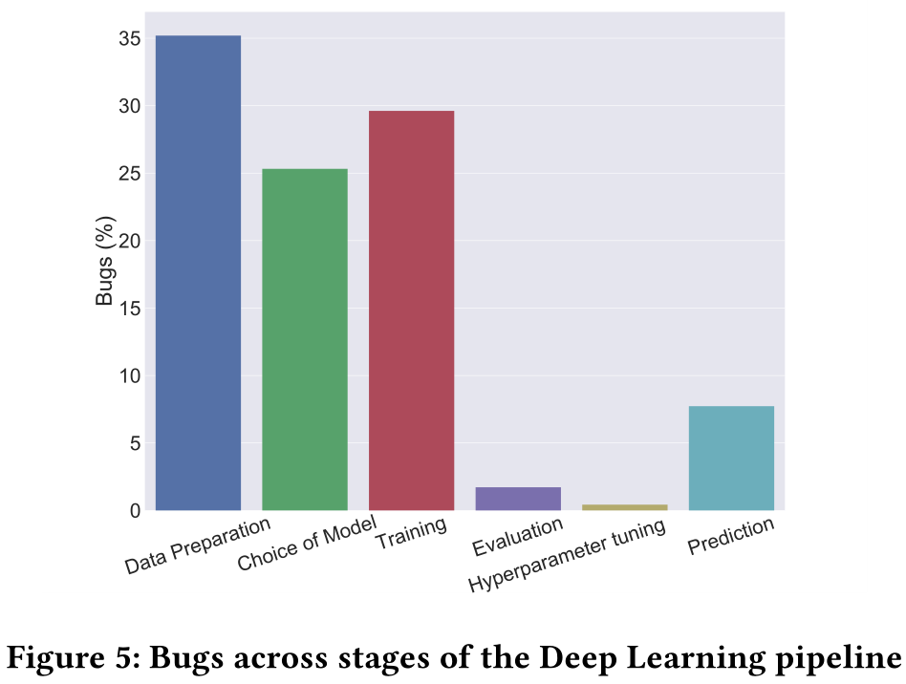

Slide 25
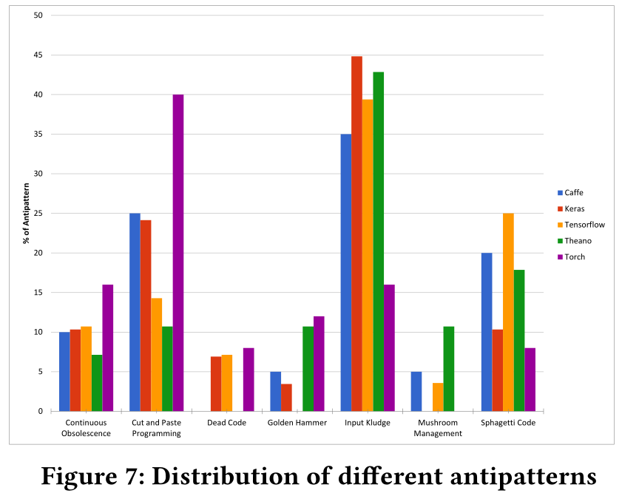
RQ5: (Commonality) Do the bugs follow a common pattern?
Finding 19: Tensorflow and Keras have a similar distribution of antipatterns while Torch has different distributions of antipatterns
Antipatterns:
https://sourcemaking.com/antipatterns/software-development-antipatterns

Slide 26
RQ6: (Bug evolution) How did the bug pattern change over time?
Finding 20: In Keras, Caffe, Tensorflow Structural logic bugs are showing increasing trend.
Finding 21: Data Bugs slowly decreased since 2015 except Torch.

Slide 27
