Slide 1
An introduction to probabilistic graphical models and the Bayes Net Toolbox for Matlab
Kevin Murphy
MIT AI Lab
7 May 2003

Slide 2
Outline
An introduction to graphical models
An overview of BNT

Slide 3
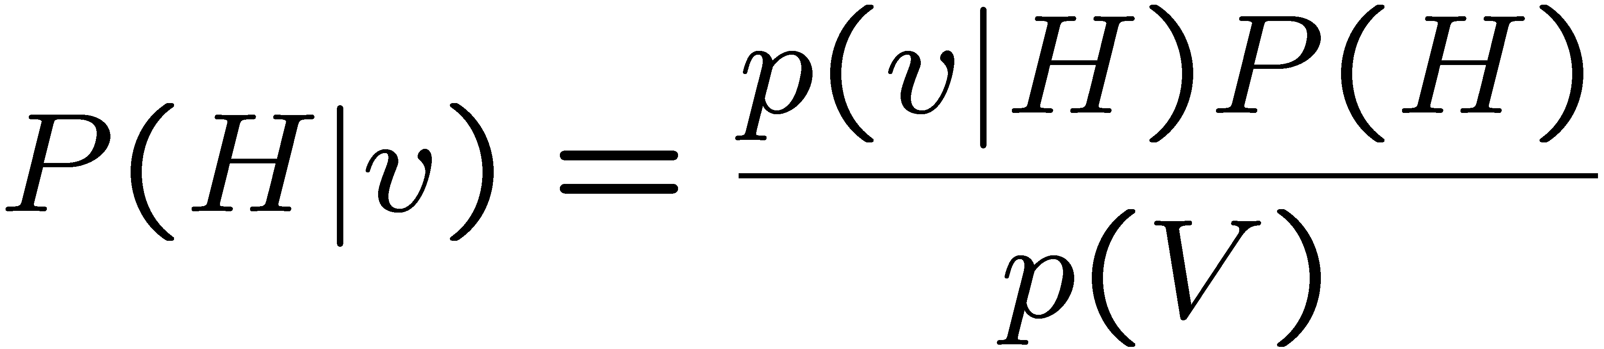
Why probabilistic models?
Infer probable causes from partial/ noisy observations using Bayes’ rule
  words from acoustics
  objects from images
  diseases from symptoms
Confidence bounds on prediction
(risk modeling, information gathering)
Data compression/ channel coding

Slide 4
What is a graphical model?
A GM is a parsimonious representation of a joint probability distribution, P(X₁,…,X_{N})
The nodes represent random variables
The edges represent direct dependence (“causality” in the directed case)
The lack of edges represent conditional independencies

Slide 5
Probabilistic graphical models
Probabilistic models
Graphical models
Directed
Undirected
(Bayesian belief nets)
(Markov nets)
Mixture of Gaussians
PCA/ICA
Naïve Bayes classifier
HMMs
State-space models
Markov Random Field
Boltzmann machine
Ising model
Max-ent model
Log-linear models

Slide 6
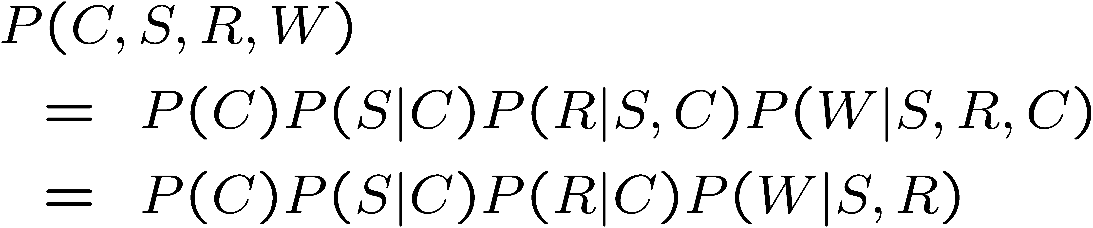
Toy example of a Bayes net
Ancestors
Parents
DAG
C
X_{i} ? |X_{<i} | X_{πi}
e.g.,
R ? S | C
W ? C | S, R
S
R
W
Conditional Probability Distributions

Slide 7
A real Bayes net: Alarm
Domain: Monitoring Intensive-Care Patients
37 variables
509 parameters
…instead of 2⁵⁴
MINVOLSET
PULMEMBOLUS
INTUBATION
KINKEDTUBE
VENTMACH
DISCONNECT
PAP
SHUNT
VENTLUNG
VENITUBE
PRESS
MINOVL
FIO2
VENTALV
ANAPHYLAXIS
PVSAT
ARTCO2
TPR
SAO2
INSUFFANESTH
EXPCO2
HYPOVOLEMIA
LVFAILURE
CATECHOL
LVEDVOLUME
STROEVOLUME
HISTORY
ERRBLOWOUTPUT
HR
ERRCAUTER
CVP
PCWP
CO
HREKG
HRSAT
HRBP
BP
Figure from N. Friedman

Slide 8
Toy example of a Markov net
X₁
X₂
X₃
X₄
X₅
X_{i} ? X_{rest} | X_{nbrs}
e.g, X₁ ? X₄, X₅ | X₂, X₃
Potential functions
Partition function

Slide 9
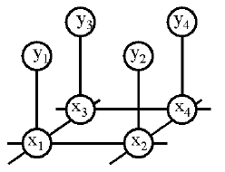
A real Markov net
Observed pixels
Latent causes
Estimate P(x₁, …, x_{n} | y₁, …, y_{n})
Ψ(x_{i}, y_{i}) = P(observe y_{i} | x_{i}): local evidence
Ψ(x_{i}, x_{j}) / exp(-J(x_{i}, x_{j})): compatibility matrix
c.f., Ising/Potts model

Slide 10
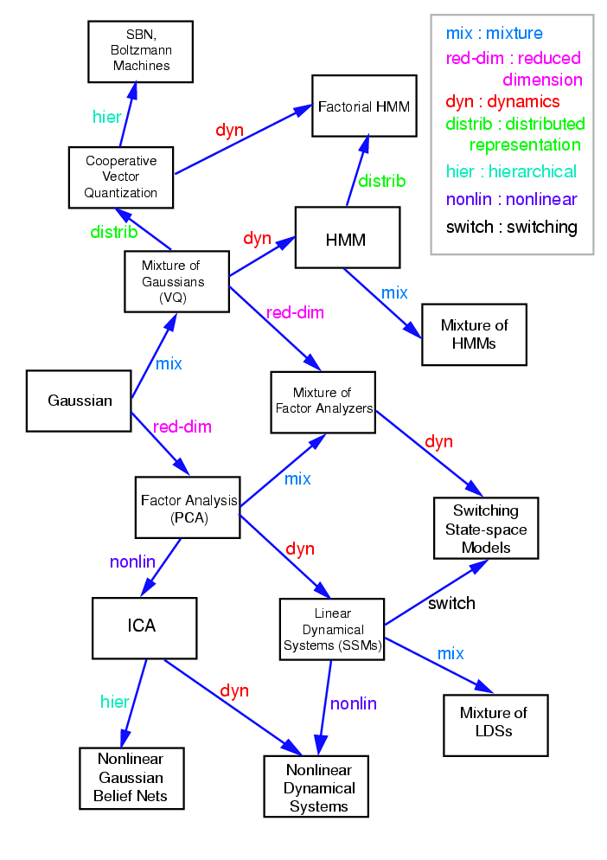
Figure from S. Roweis & Z. Ghahramani

Slide 11
State-space model (SSM)/
Linear Dynamical System (LDS)
X₁
X₂
X₃
“True” state
Y₁
Y₃
Noisy observations
Y₂

Slide 12
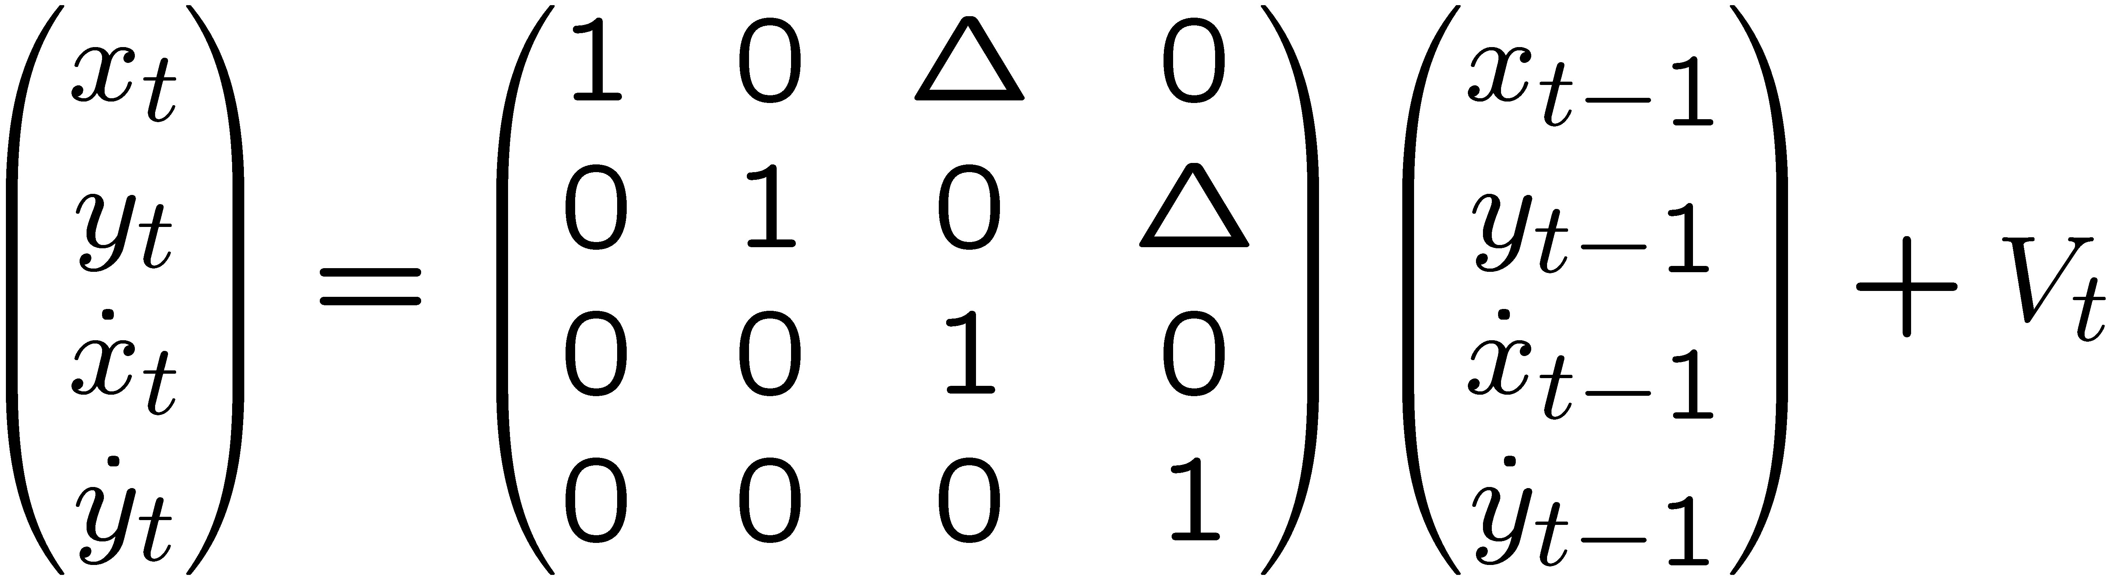
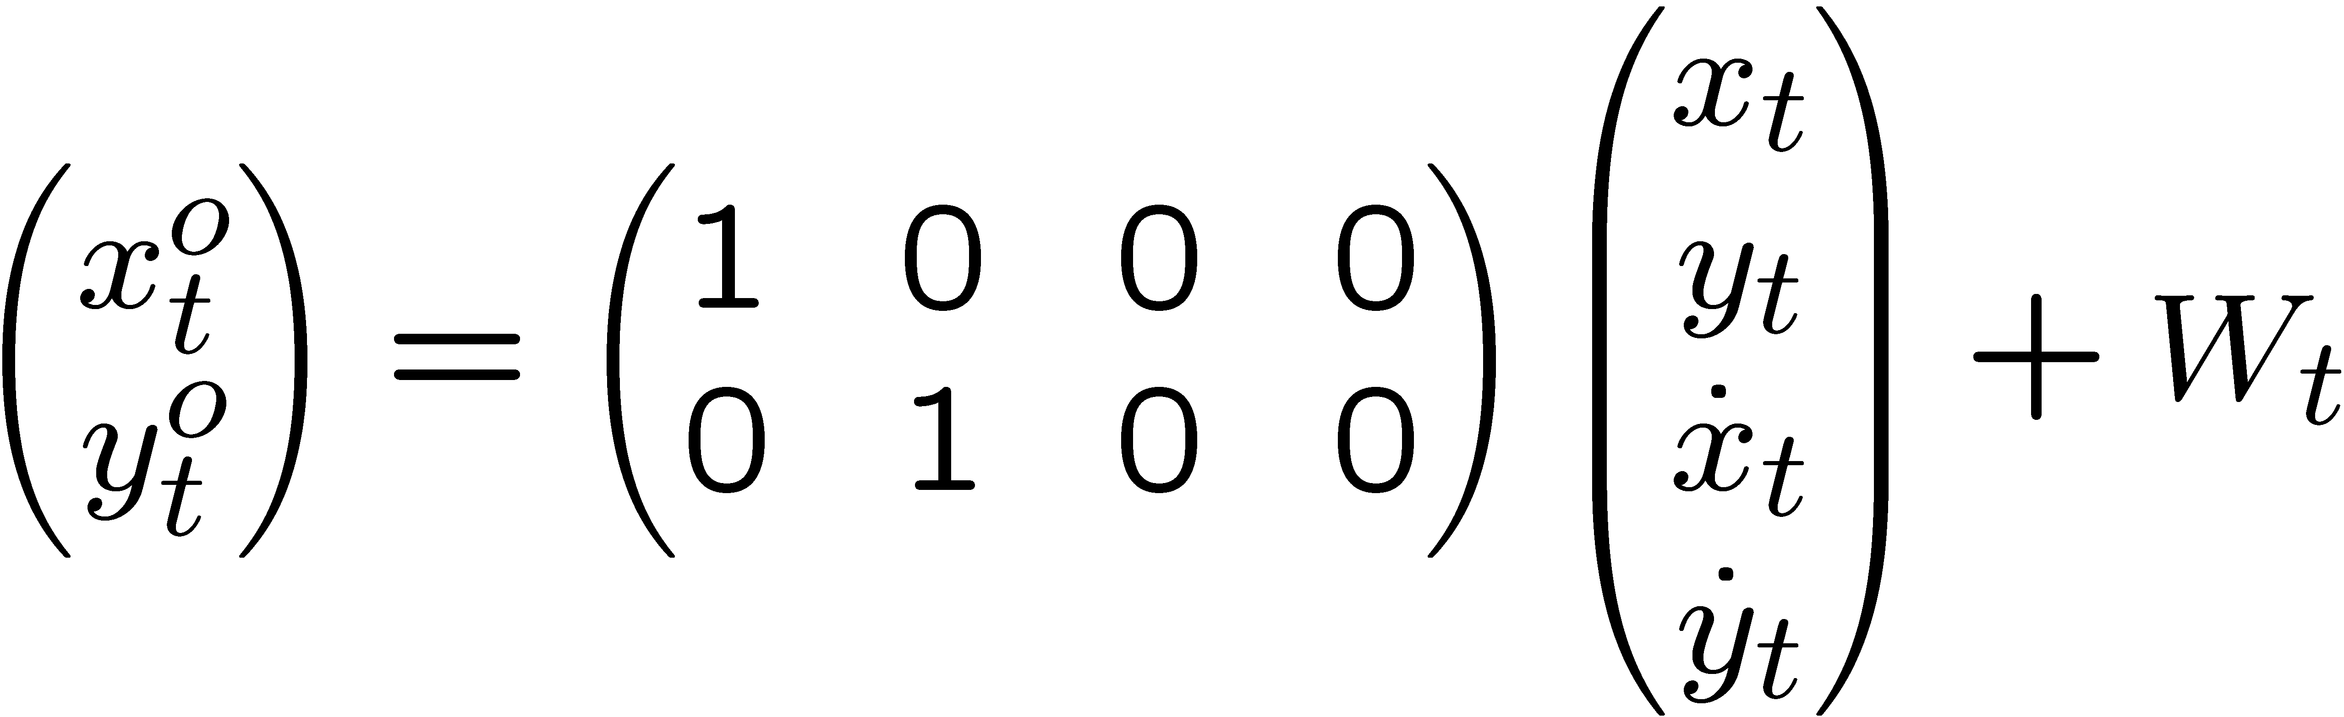
LDS for 2D tracking
Sparse linear Gaussian systems
) sparse graphs
X₁
X₂
X₁
X₂
X₁
X₂
X₃
y₁
y₂
y₁
y₂
Y₁
Y₂
Y₃
o
X₁
o
X₂
o
o
y₁
y₂

Slide 13
Hidden Markov model (HMM)
X₁
X₂
X₃
Phones/ words
Y₁
Y₃
Y₂
acoustic signal
Sparse transition matrix ) sparse graph
transition
matrix
Gaussian
observations

Slide 14
Inference
Posterior probabilities
  Probability of any event given any evidence
Most likely explanation
  Scenario that explains evidence
Rational decision making
  Maximize expected utility
  Value of Information
Effect of intervention
  Causal analysis
Explaining away effect
Earthquake
Burglary
Radio
Radio
Alarm
Call
Call
Figure from N. Friedman

Slide 15
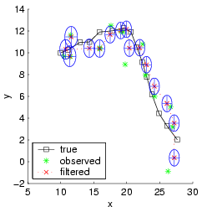
Kalman filtering (recursive state estimation in an LDS)
X₁
X₂
X₃
Y₁
Y₂
Y₃
Estimate P(X_{t}|y_{1:t}) from P(X_{t-1}|y_{1:t-1}) and y_{t}
Predict: P(X_{t}|y_{1:t-1}) = s_{Xt-1} P(X_{t}|X_{t-1}) P(X_{t-1}|y_{1:t-1})
Update: P(X_{t}|y_{1:t}) / P(y_{t}|X_{t}) P(X_{t}|y_{1:t-1})

Slide 16
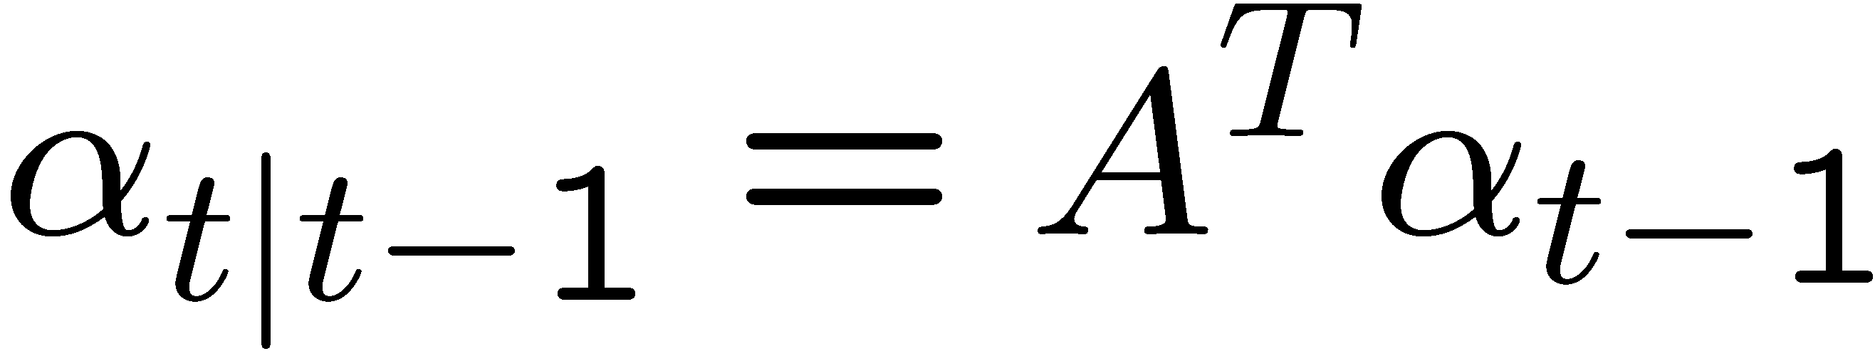
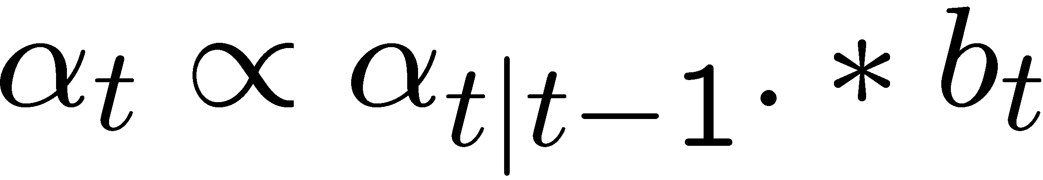
Forwards algorithm for HMMs
Predict:
Update:
Discrete-state analog of Kalman filter
O(T S²) time using dynamic programming

Slide 17
Message passing view of forwards algorithm
α_{t|t-1}
X_{t-1}
X_{t}
X_{t+1}
b_{t}
b_{t+1}
Y_{t-1}
Y_{t+1}
Y_{t}

Slide 18
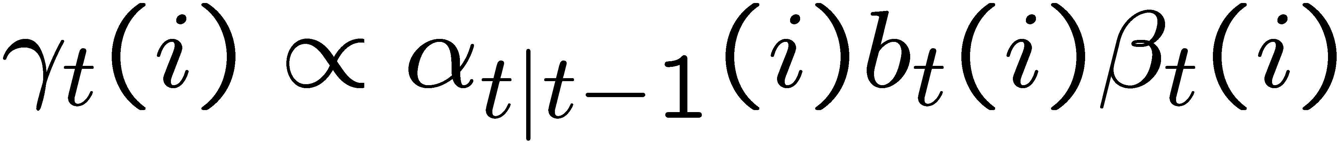
Forwards-backwards algorithm
α_{t|t-1}
β_{t}
X_{t-1}
X_{t}
X_{t+1}
b_{t}
Y_{t-1}
Y_{t+1}
Y_{t}
Discrete analog of RTS smoother

Slide 19
Belief Propagation
aka Pearl’s algorithm, sum-product algorithm
Generalization of forwards-backwards algo. /RTS smoother
from chains to trees
Collect
Distribute
root
root
root
root
Figure from P. Green

Slide 20
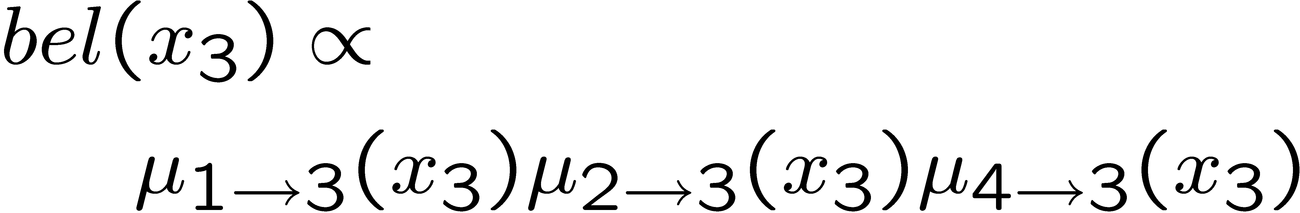
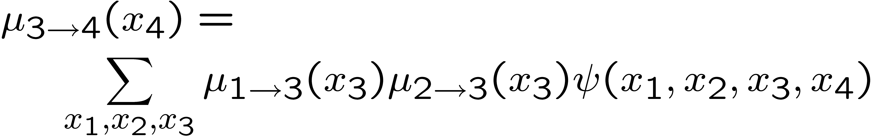
BP: parallel, distributed version
X₁
Stage 1.
Stage 2.
X₁
X₃
X₄
X₃
X₄
X₂
X₂

Slide 21
Inference in general graphs
BP is only guaranteed to be correct for trees
A general graph should be converted to a junction tree, which satisfies the running intersection property (RIP)
RIP ensures local propagation => global consistency
ABC
BC
BCD
D
A
D
μ(BC)
μ(D)

Slide 22
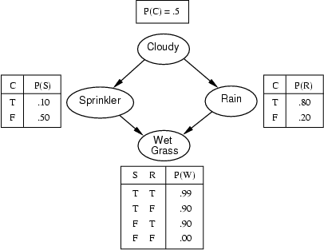
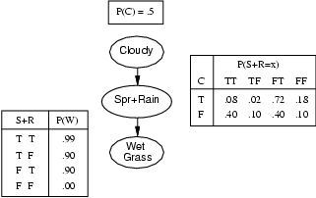
Junction trees
Nodes in jtree are sets of rv’s
“Moralize” G (if directed), ie., marry parents with children
Find an elimination ordering π
Make G chordal by triangulating according to π
Make “meganodes” from maximal cliques C of chordal G
Connect meganodes into junction graph
Jtree is the min spanning tree of the jgraph

Slide 23
Computational complexity of exact discrete inference
Let G have N discrete nodes with S values
Let w(π) be the width induced by π, ie., the size of the largest clique
Thm: Inference takes Ω(N S^{w}) time
Thm: finding π* = argmin w(π) is NP-hard
Thm: For an N=n £ n grid, w*=Ω(n)
Exact inference is computationally intractable in many networks

Slide 24
Approximate inference
Why?
  to avoid exponential complexity of exact inference in discrete loopy graphs
  Because cannot compute messages in closed form (even for trees) in the non-linear/non-Gaussian case
How?
  Deterministic approximations: loopy BP, mean field, structured variational, etc
  Stochastic approximations: MCMC (Gibbs sampling), likelihood weighting, particle filtering, etc
- Algorithms make different speed/accuracy tradeoffs
- Should provide the user with a choice of algorithms

Slide 25
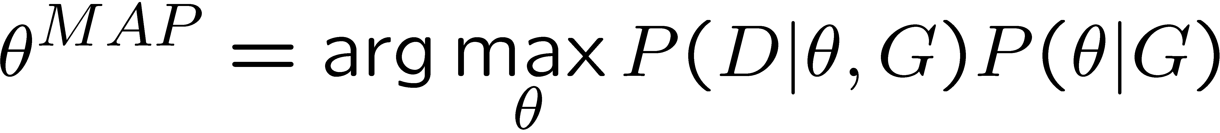
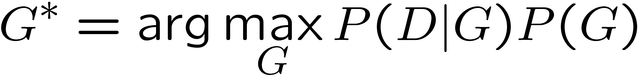
Learning
Parameter estimation:
Model selection:

Slide 26
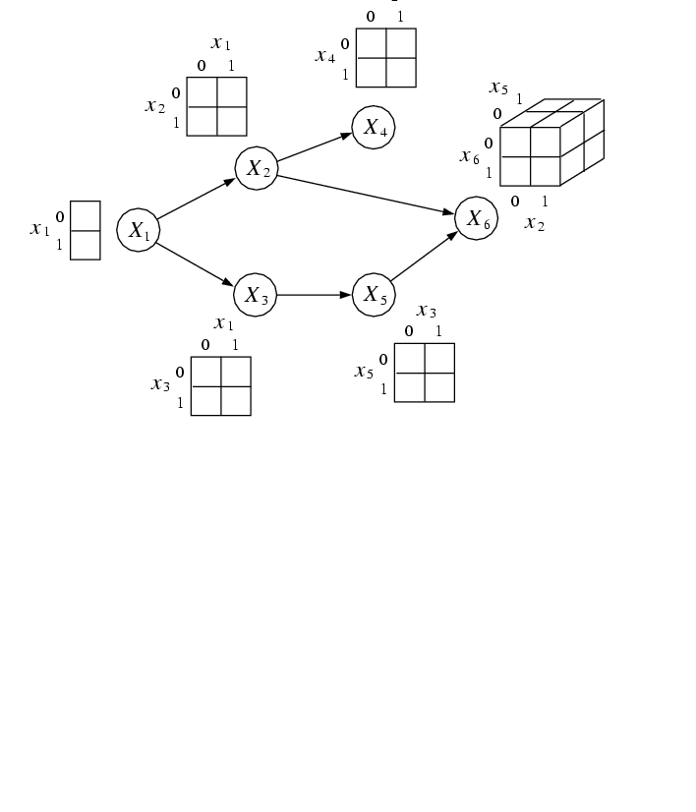
Parameter learning
iid data
Conditional Probability Tables (CPTs)
X₁ | X₂ | X₃ | X₄ | X₅ | X₆
0 | 1 | 0 | 0 | 0 | 0
1 | ? | 1 | 1 | ? | 1
 |  | …
1 | 1 | 1 | 0 | 1 | 1
Figure from M. Jordan

Slide 27
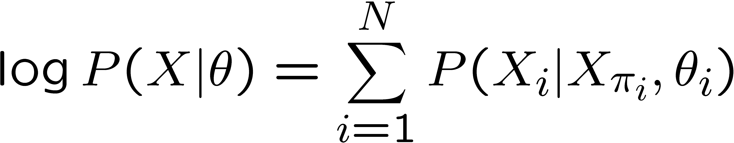
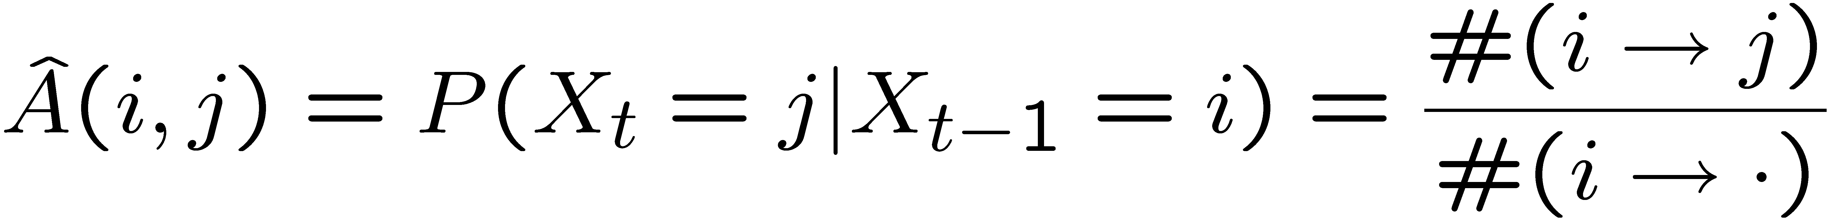
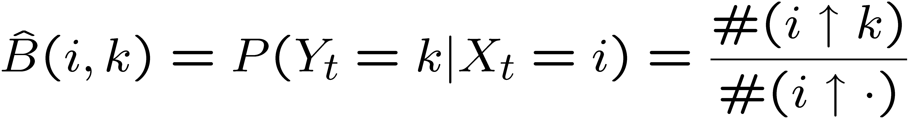
Parameter learning in DAGs
For a DAG, the log-likelihood decomposes into a sum of local terms
Hence can optimize each CPD independently, e.g.,
X₁
X₂
X₃
Y₁
Y₂
Y₃

Slide 28
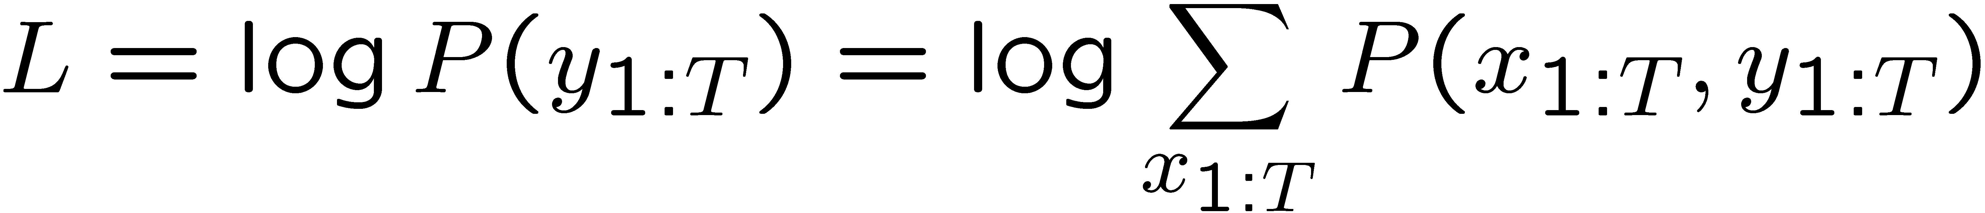
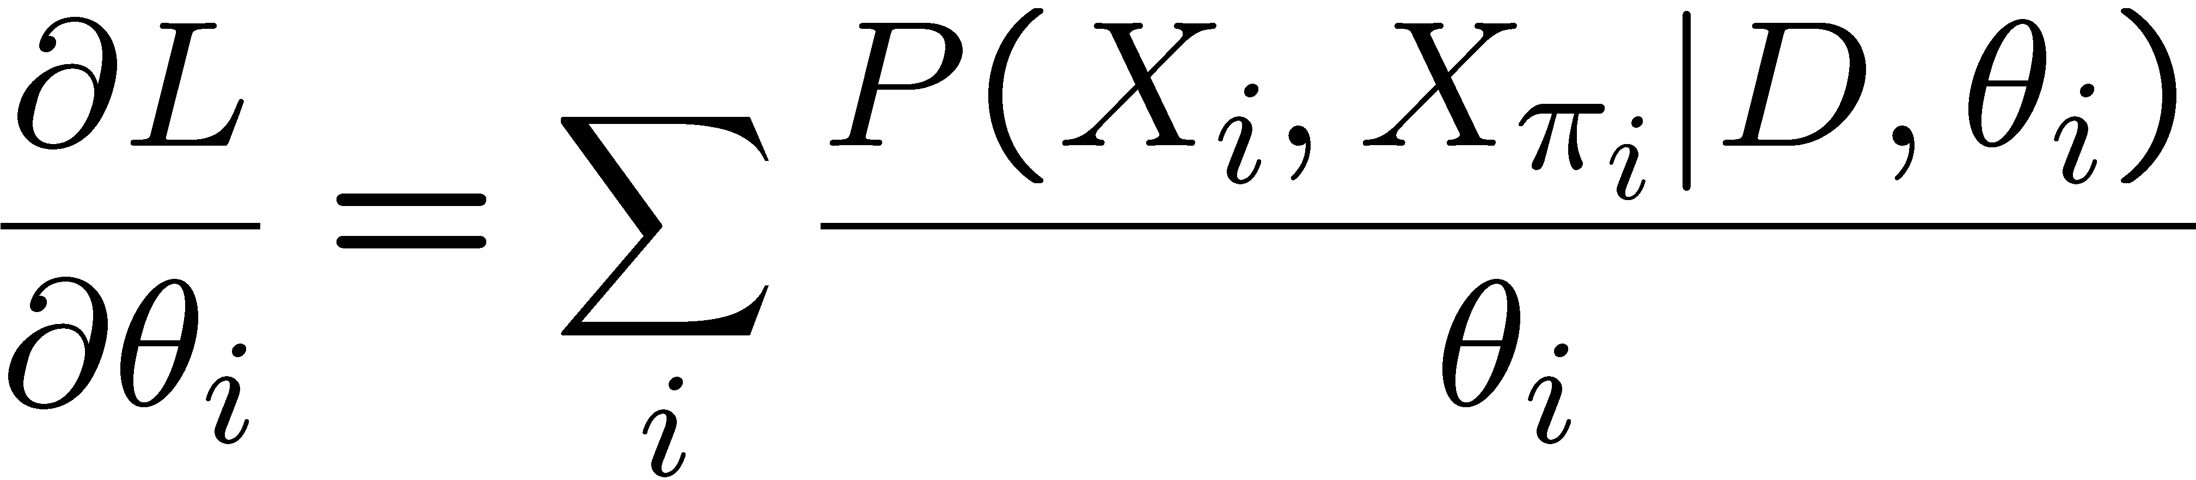
Dealing with partial observability
When training an HMM, X_{1:T} is hidden, so the log-likelihood no longer decomposes:
Can use Expectation Maximization (EM) algorithm (Baum Welch):
  E step: compute expected number of transitions
  M step : use expected counts as if they were real
  Guaranteed to converge to a local optimum of L
Or can use (constrained) gradient ascent

Slide 29
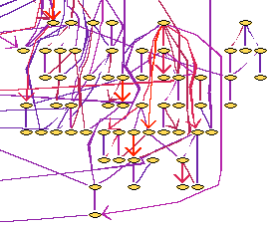
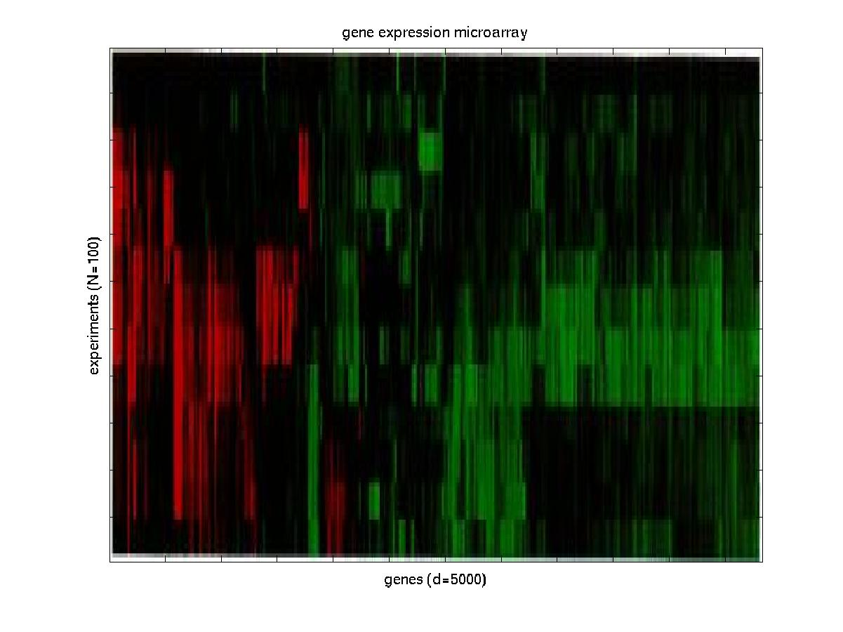
Structure learning
(data mining)
Gene expression data
Figure from N. Friedman

Slide 30
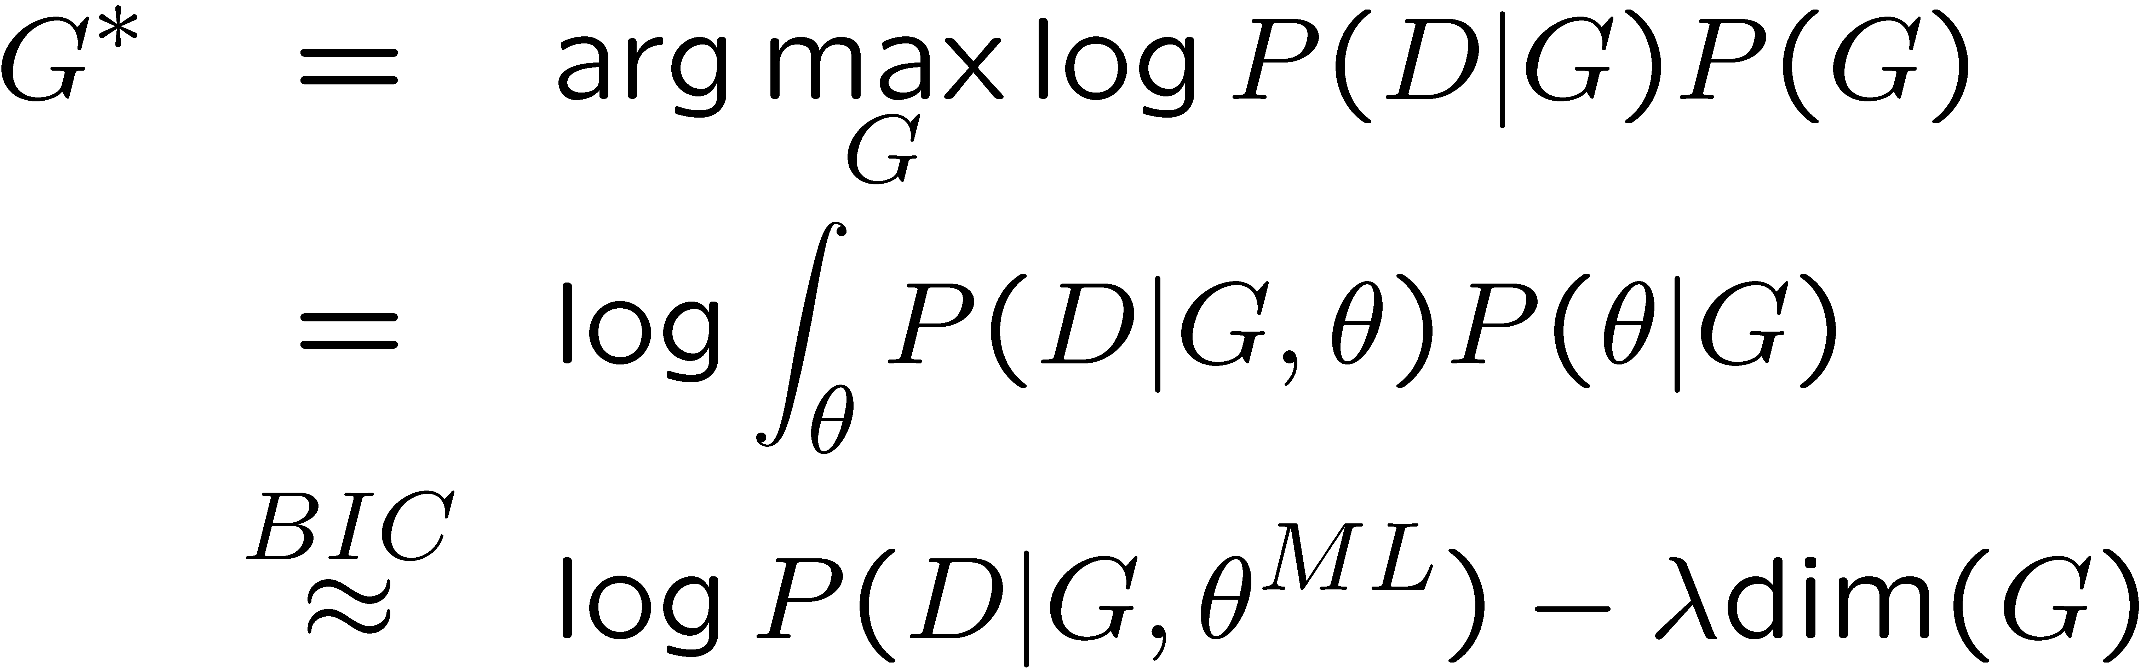
Structure learning
Learning the optimal structure is NP-hard (except for trees)
Hence use heuristic search through space of DAGs or
PDAGs or node orderings
Search algorithms: hill climbing, simulated annealing, GAs
Scoring function is often marginal likelihood, or an
approximation like BIC/MDL or AIC
Structural complexity penalty

Slide 31
Summary: why are graphical models useful?
- Factored representation may have exponentially fewer parameters than full joint P(X₁,…,X_{n}) =>
  lower time complexity (less time for inference)
  lower sample complexity (less data for learning)
- Graph structure supports
  Modular representation of knowledge
  Local, distributed algorithms for inference and learning
  Intuitive (possibly causal) interpretation

Slide 32
The Bayes Net Toolbox for Matlab
What is BNT?
Why yet another BN toolbox?
Why Matlab?
An overview of BNT’s design
How to use BNT
Other GM projects

Slide 33
What is BNT?
BNT is an open-source collection of matlab functions for inference and learning of (directed) graphical models
Started in Summer 1997 (DEC CRL), development continued while at UCB
Over 100,000 hits and about 30,000 downloads since May 2000
About 43,000 lines of code (of which 8,000 are comments)

Slide 34
Why yet another BN toolbox?
In 1997, there were very few BN programs, and all failed to satisfy the following desiderata:
  Must support real-valued (vector) data
  Must support learning (params and struct)
  Must support time series
  Must support exact and approximate inference
  Must separate API from UI
  Must support MRFs as well as BNs
  Must be possible to add new models and algorithms
  Preferably free
  Preferably open-source
  Preferably easy to read/ modify
  Preferably fast
BNT meets all these criteria except for the last

Slide 35
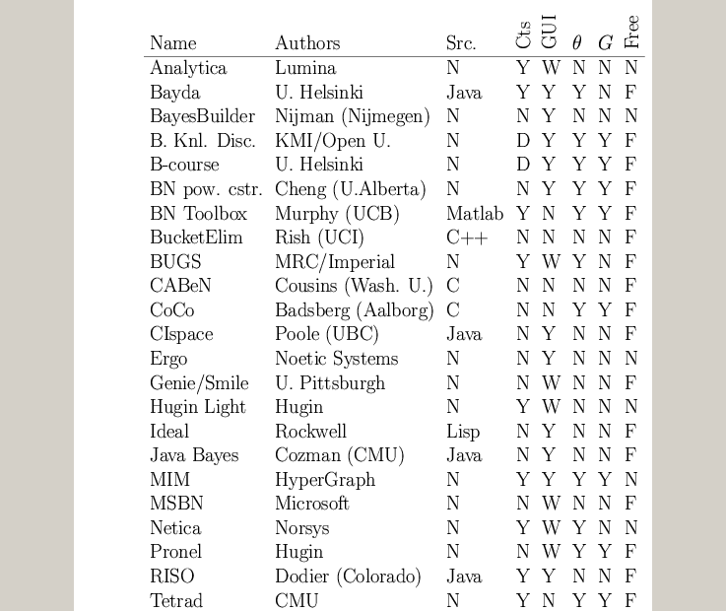
A comparison of GM software
www.ai.mit.edu/~murphyk/Software/Bayes/bnsoft.html

Slide 36
Summary of existing GM software
~8 commercial products (Analytica, BayesiaLab, Bayesware, Business Navigator, Ergo, Hugin, MIM, Netica), focused on data mining and decision support; most have free “student” versions
~30 academic programs, of which ~20 have source code (mostly Java, some C++/ Lisp)
Most focus on exact inference in discrete, static, directed graphs (notable exceptions: BUGS and VIBES)
Many have nice GUIs and database support
BNT contains more features than most of these packages combined!

Slide 37
Why Matlab?
Pros
  Excellent interactive development environment
  Excellent numerical algorithms (e.g., SVD)
  Excellent data visualization
  Many other toolboxes, e.g., netlab
  Code is high-level and easy to read (e.g., Kalman filter in 5 lines of code)
  Matlab is the lingua franca of engineers and NIPS
Cons:
  Slow
  Commercial license is expensive
  Poor support for complex data structures
Other languages I would consider in hindsight:
  Lush, R, Ocaml, Numpy, Lisp, Java

Slide 38
BNT’s class structure
Models – bnet, mnet, DBN, factor graph, influence (decision) diagram
CPDs – Gaussian, tabular, softmax, etc
Potentials – discrete, Gaussian, mixed
Inference engines
  Exact - junction tree, variable elimination
  Approximate - (loopy) belief propagation, sampling
Learning engines
  Parameters – EM, (conjugate gradient)
  Structure - MCMC over graphs, K2

Slide 39
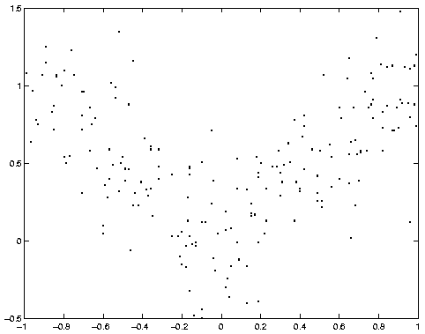
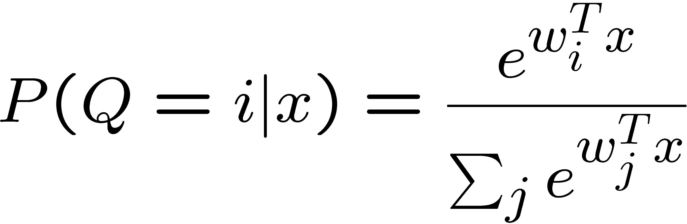
Example: mixture of experts
X
Q
Y
softmax/logistic function

Slide 40
1. Making the graph
X = 1; Q = 2; Y = 3;
dag = zeros(3,3);
dag(X, [Q Y]) = 1;
dag(Q, Y) = 1;
X
Q
Graphs are (sparse) adjacency matrices
GUI would be useful for creating complex graphs
Repetitive graph structure (e.g., chains, grids) is best
created using a script (as above)
Y

Slide 41
2. Making the model
X
node_sizes = [1 2 1];
dnodes = [2];
bnet = mk_bnet(dag, node_sizes, …
‘discrete’, dnodes);
Q
X is always observed input, hence only one effective value
Q is a hidden binary node
Y is a hidden scalar node
bnet is a struct, but should be an object
mk_bnet has many optional arguments, passed as string/value pairs
Y

Slide 42
3. Specifying the parameters
X
bnet.CPD{X} = root_CPD(bnet, X);
bnet.CPD{Q} = softmax_CPD(bnet, Q);
bnet.CPD{Y} = gaussian_CPD(bnet, Y);
Q
CPDs are objects which support various methods such as
  Convert_from_CPD_to_potential
  Maximize_params_given_expected_suff_stats
Each CPD is created with random parameters
Each CPD constructor has many optional arguments
Y

Slide 43
4. Training the model
X
load data –ascii;
ncases = size(data, 1);
cases = cell(3, ncases);
observed = [X Y];
cases(observed, :) = num2cell(data’);
Q
Y
Training data is stored in cell arrays (slow!), to allow for
variable-sized nodes and missing values
cases{i,t} = value of node i in case t
engine = jtree_inf_engine(bnet, observed);
Any inference engine could be used for this trivial model
bnet2 = learn_params_em(engine, cases);
We use EM since the Q nodes are hidden during training
learn_params_em is a function, but should be an object

Slide 44
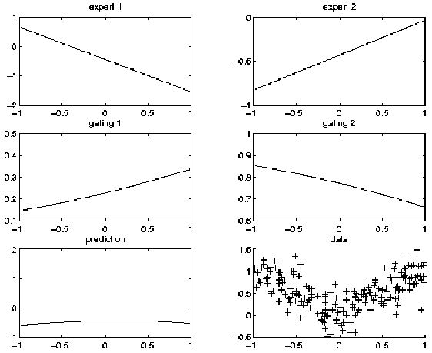
Before training

Slide 45
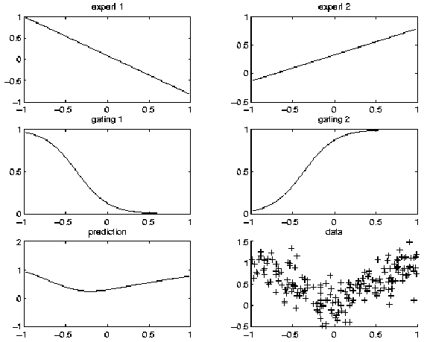
After training

Slide 46
5. Inference/ prediction
engine = jtree_inf_engine(bnet2);
evidence = cell(1,3);
evidence{X} = 0.68; % Q and Y are hidden
engine = enter_evidence(engine, evidence);
m = marginal_nodes(engine, Y);
m.mu % E[Y|X]
m.Sigma % Cov[Y|X]
X
Q
Y

Slide 47
Other kinds of CPDs that BNT supports
Node | Parents | Distribution
Discrete | Discrete | Tabular, noisy-or, decision trees
Continuous | Discrete | Conditional Gauss.
Discrete | Continuous | Softmax
Continuous | Continuous | Linear Gaussian, MLP

Slide 48
Other kinds of models that BNT supports
Classification/ regression: linear regression, logistic regression, cluster weighted regression, hierarchical mixtures of experts, naïve Bayes
Dimensionality reduction: probabilistic PCA, factor analysis, probabilistic ICA
Density estimation: mixtures of Gaussians
State-space models: LDS, switching LDS, tree-structured AR models
HMM variants: input-output HMM, factorial HMM, coupled HMM, DBNs
Probabilistic expert systems: QMR, Alarm, etc.
Limited-memory influence diagrams (LIMID)
Undirected graphical models (MRFs)

Slide 49
A look under the hood
How EM is implemented
How junction tree inference is implemented

Slide 50
How EM is implemented
P(X_{i}, X_{πi} | e_{l})
Each CPD class extracts its own expected sufficient stats.
Each CPD class knows how to compute ML param. estimates,
e.g., softmax uses IRLS

Slide 51
How junction tree inference is implemented
Create the jtree from the graph
Initialize the clique potentials with evidence
Run belief propagation on the jtree

Slide 52
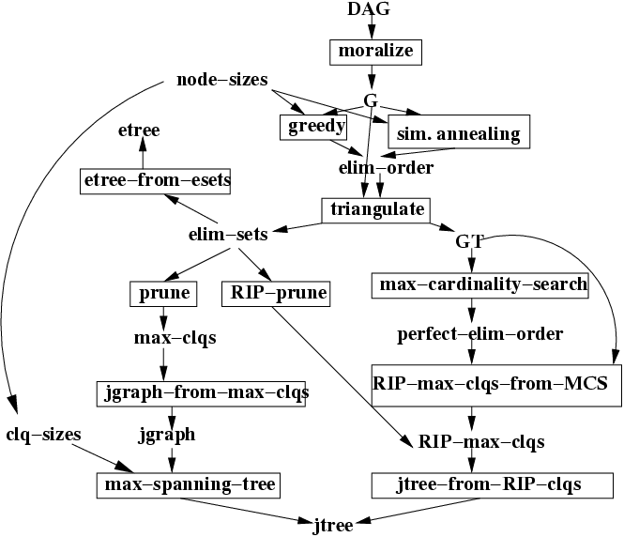
1. Creating a junction tree
Uses my graph theory toolbox
NP-hard to optimize!

Slide 53
2. Initializing the clique potentials

Slide 54
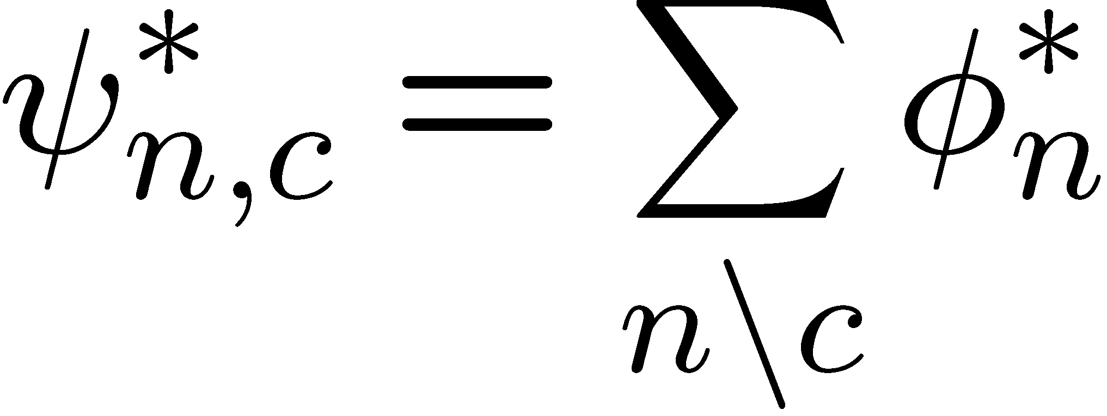
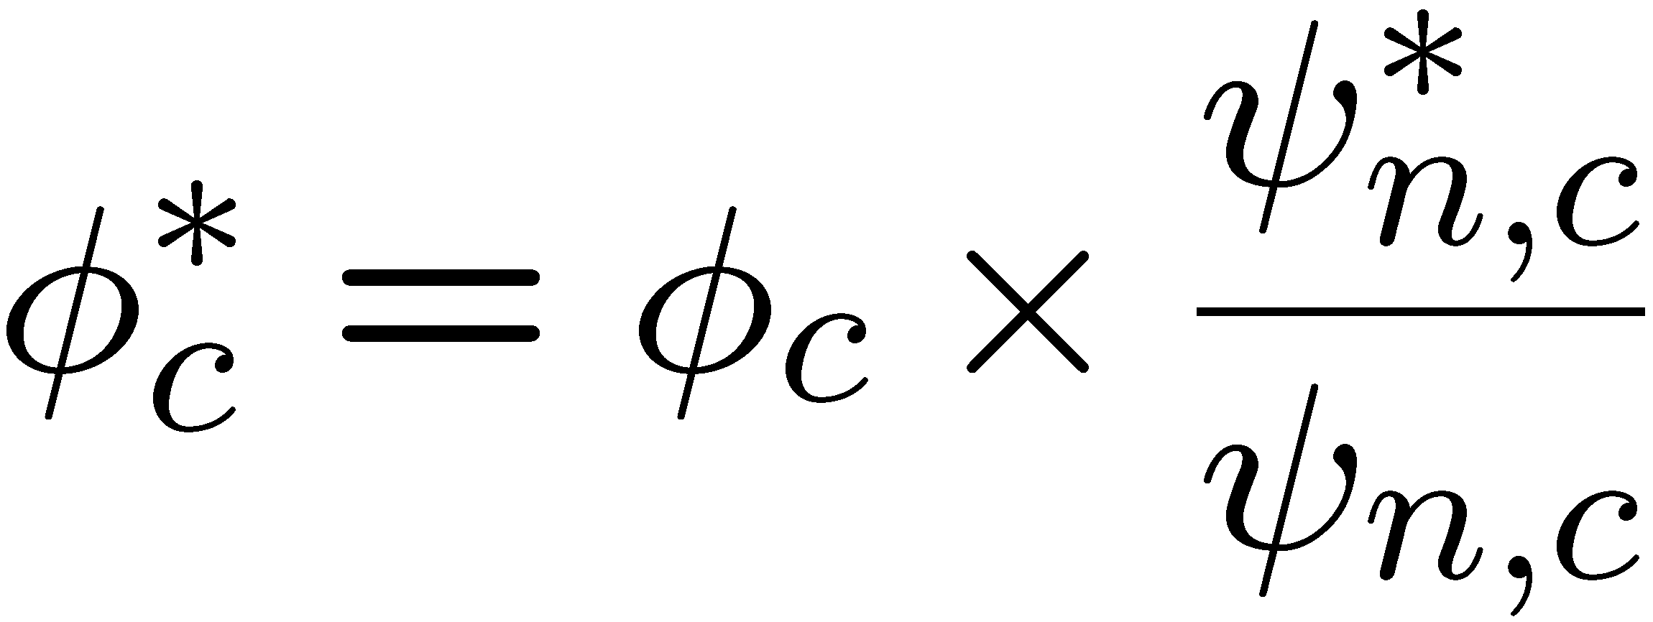
3. Belief propagation (centralized)

Slide 55
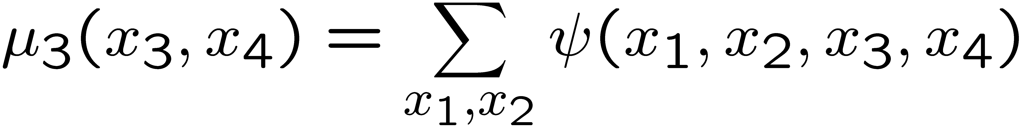
Manipulating discrete potentials
Marginalization
Multiplication
Division

Slide 56
Manipulating Gaussian potentials
Closed-form formulae for marginalization, multiplication and “division”
Can use moment (μ, Σ) or
canonical (Σ⁻¹ μ, Σ⁻¹) form
O(1)/O(n³) complexity per operation
Mixtures of Gaussian potentials are not closed under marginalization, so need approximations (moment matching)

Slide 57
Semi-rings
By redefining * and +, same code implements Kalman filter and forwards algorithm
By replacing + with max, can convert from forwards (sum-product) to Viterbi algorithm (max-product)
BP works on any commutative semi-ring!

Slide 58
Other kinds of inference algo’s
Loopy belief propagation
  Does not require constructing a jtree
  Message passing slightly simpler
  Must iterate; may not converge
  V. successful in practice, e.g., turbocodes/ LDPC
Structured variational methods
  Can use jtree/BP as subroutine
  Requires more math; less turn-key
Gibbs sampling
  Parallel, distributed algorithm
  Local operations require random number generation
  Must iterate; may take long time to converge

Slide 59
Summary of BNT
Provides many different kinds of models/ CPDs – lego brick philosophy
Provides many inference algorithms, with different speed/ accuracy/ generality tradeoffs (to be chosen by user)
Provides several learning algorithms (parameters and structure)
Source code is easy to read and extend

Slide 60
Some other interesting GM projects
PNL: Probabilistic Networks Library (Intel)
  Open-source C++, based on BNT, work in progress (due 12/03)
GMTk: Graphical Models toolkit (Bilmes, Zweig/ UW)
  Open source C++, designed for ASR (HTK), binary avail now
AutoBayes: code generator (Fischer, Buntine/NASA Ames)
  Prolog generates matlab/C, not avail. to public
VIBES: variational inference (Winn / Bishop, U. Cambridge)
  conjugate exponential models, work in progress
BUGS: (Spiegelhalter et al., MRC UK)
  Gibbs sampling for Bayesian DAGs, binary avail. since ’96
gR: Graphical Models in R (Lauritzen et al.)
  Work in progress

Slide 61
To find out more…
#3 Google rated site on GMs (after the journal “Graphical Models”)
www.ai.mit.edu/~murphyk/Bayes/bayes.html

