Slide 1
IMPACTS OF CLIMATE CHANGE ON METAL CONTAMINATION IN WELL WATER THROUGH SALTWATER INTRUSION, FLOODING AND DROUGHT
Anita Taylor

Slide 2
Land Acknowledgement
Dalhousie University is located in Mi’kma’ki, the ancestral and unceded territory of the Mi’kmaq.
We are all treaty people.
We recognize that African Nova Scotians are a distinct people whose histories, legacies and contributions have enriched that part of Mi’kma’ki known as Nova Scotia for over 400 years.

Slide 3
Objectives:
This study aims to gain an understanding on how climate change will influence what is in well water. Biological contamination will not be a focus in this scope.
To assess the variations in metal contamination levels in well water under different climate change-induced factors, including saltwater intrusion, flooding and drought events.
To contribute to the existing knowledge based on the interactions between climate change and metal contamination in well water, providing insights for future predictive modelling that could influence policymaking, water resource management, and environmental planning.
To assess the potential impact of climate change on the vulnerability and resilience of well water as a source of drinking water, considering the specific metal contamination risks.
Exploratory data analysis for some potential future model

Slide 4
Research Objectives
Hypothesis
Increased saltwater intrusion due to climate change may lead to elevated levels of metal contamination in well water.
Drought events resulting from climate change may result in higher concentrations of metals in well water via oxidation.
Flooding may lead to a dilution effect on metals in well water.
This study aims to gain an understanding on how climate change will influence well water.
To assess the variations in metal contamination levels in well water under different climate change-induced factors, including saltwater intrusion, flooding and drought events.
To contribute to the existing knowledge based on the interactions between climate change and metal contamination in well water, providing insights for future predictive modelling that could influence policymaking, water resource management, and environmental planning.
To assess the potential impact of climate change on the vulnerability and resilience of well water as a source of drinking water, considering the specific metal contamination risks.

Slide 5
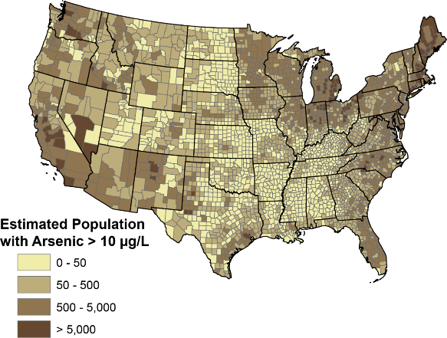
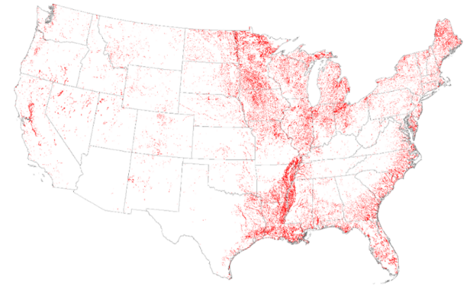
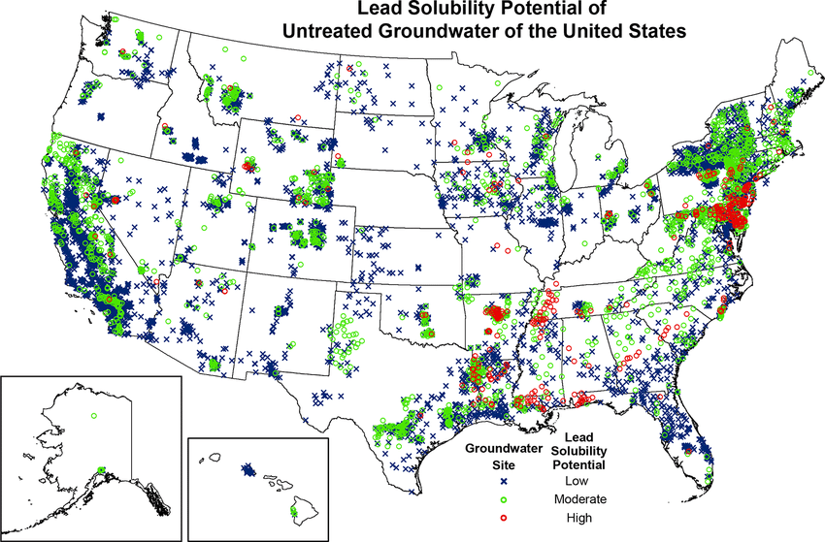
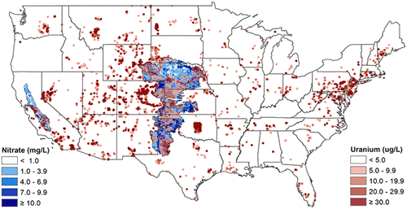
Metals of Interest
As
Mn
(McMahon et al., 2019)
(DeSimone et al., 2014)
Pb
U
(Nolan & Weber, 2015)
(Jurgens et al., 2019)

Slide 6
Metals of Interest
As
Carcinogen. The genotoxic property of arsenic disrupts DNA repair mechanisms, leading to genetic alterations and the development of cancerous cells .
Arsenic can cross the blood-brain barrier to accumulate in the central nervous system leading to neurotoxic effects
Cardiovascular diseases
Mn
Prolonged exposure to elevated manganese levels leads to neurological effects, particularly in infants and children .
Other effects are more detrimental, including motor dysfunction, with movement and coordination difficulties; or with muscle rigidity, tremors, memory deficits and cognitive impairment resembling Parkinson's disease
Hepatoxicity effect as manganese accumulates in the liver
Pb
Neurotoxic effects such as cognitive function impairment, developmental delays, learning disabilities, decreased IQ and behavioral problems in children and adults.
Cumulative effects
U
Carcinogen. Uranium exposure is associated with an increase of certain cancers, due to DNA mutations promoting the development cancerous cells of leukemia, kidney and lung cancer.
Elevated and prolonged contamination of it in drinking water results in kidney damage
Bone and reproductive health

Slide 7
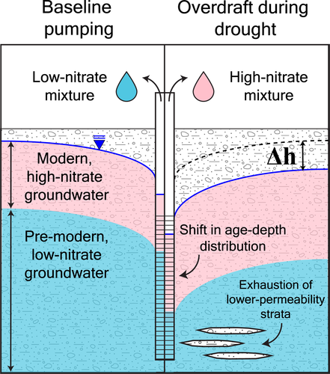
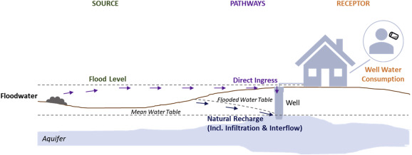
Climate Change: Secondary Effects
Precipitation
  Droughts
    Concentration effects
    Drawdown
    Redox/Oxidation
  Floods
    Dilution effects
    Contamination plumes
    Geochemical contact time
(Levy et al., 2021)
(Andrade et al., 2018)

Slide 8
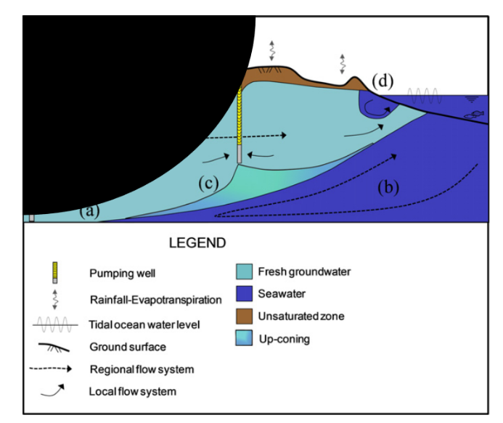
Climate Change: Secondary Effects
Sea Water Intrusion
  Expanding Wedge
  Up-coning
  Cation exchanges
(Werner et al., 2013)
Notes:
A. D. Werner et al., ‘Seawater intrusion processes, investigation and management: Recent advances and future challenges’, Adv. Water Resour., vol. 51, pp. 3–26, Jan. 2013, doi: 10.1016/j.advwatres.2012.03.004.

Slide 9
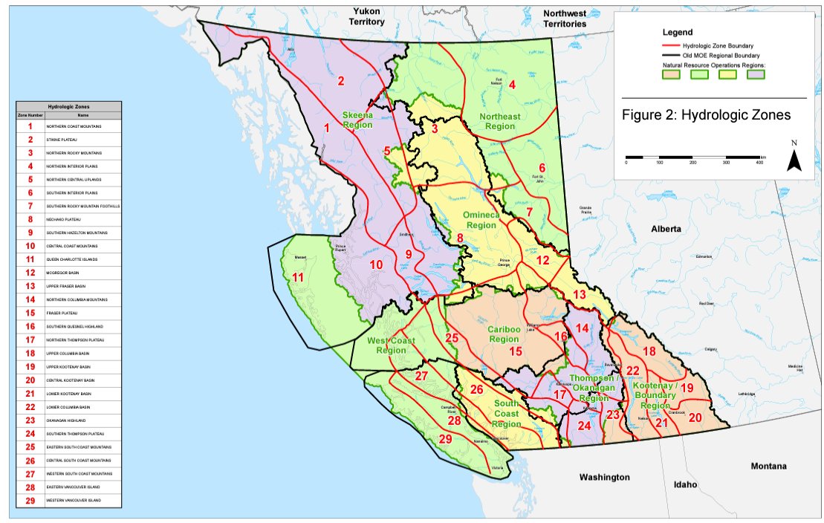
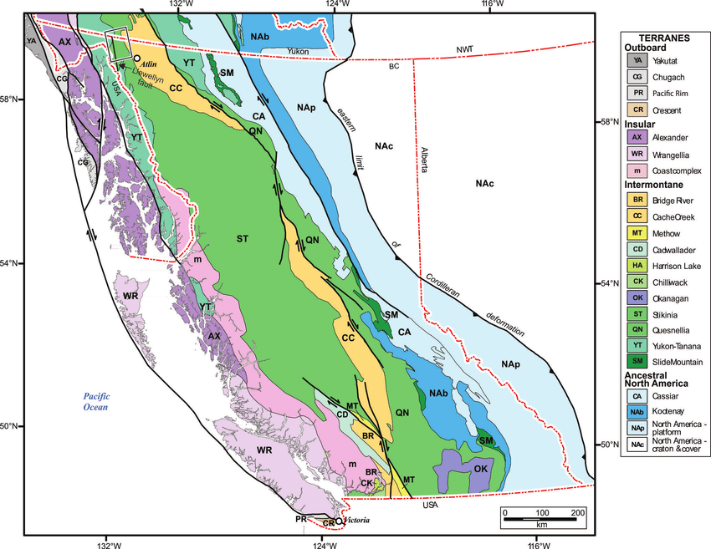
B.C. Descriptors
(B.C. Ministry of Environment and Climate Change Strategy, 2023)
(Ootes et al., 2017)
Notes:
iMAP B.C
B.C ministry of environment and natural resources

Slide 10
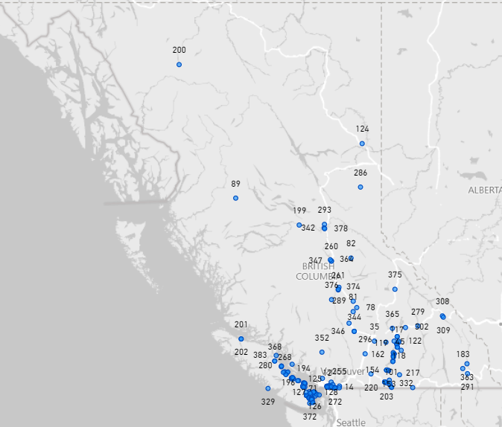
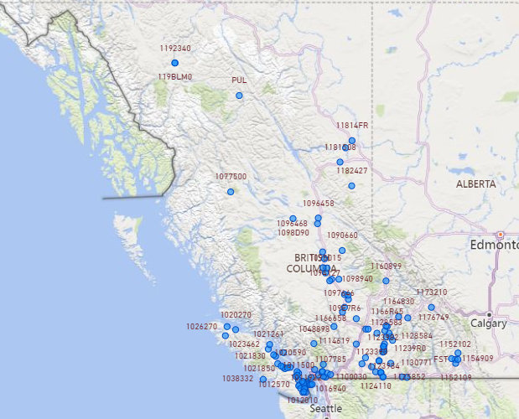
B.C. Descriptors

Slide 11
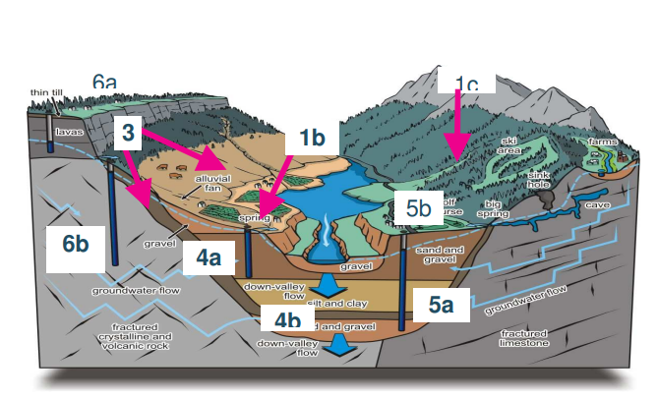
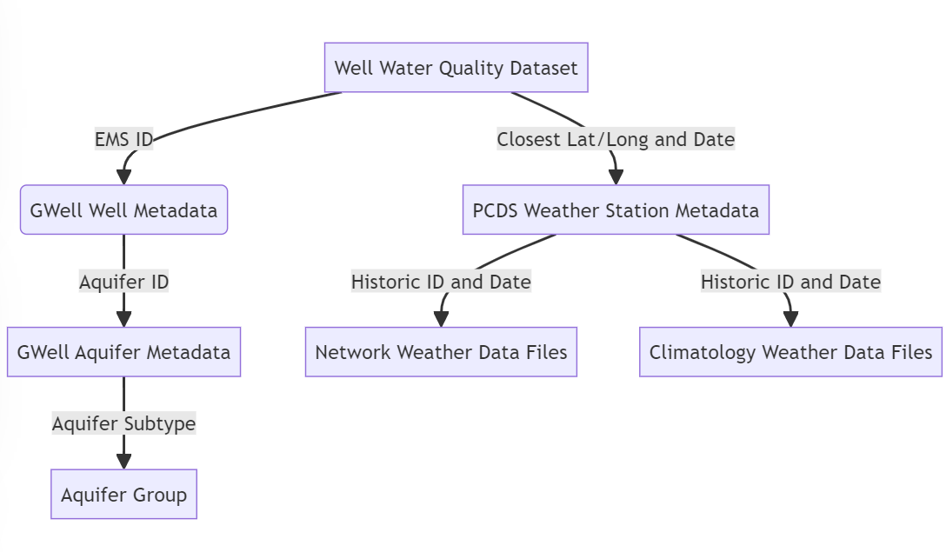
Schema Setup
(Carmichael et al., 2008).
1a, 1b, 1c, 2, 3, 4a – Aquifer Group 1
4b, 4c – Aquifer Group 2
5a, 6a, 6b – Aquifer Group 3

Slide 12
Schema Setup
(Carmichael et al., 2008).
1a, 1b, 1c, 2, 3, 4a – Aquifer Group 1
4b, 4c – Aquifer Group 2
5a, 6a, 6b – Aquifer Group 3
AG1 – Unconfined
AG2 – Confined
AG3 - Fractures

Slide 13
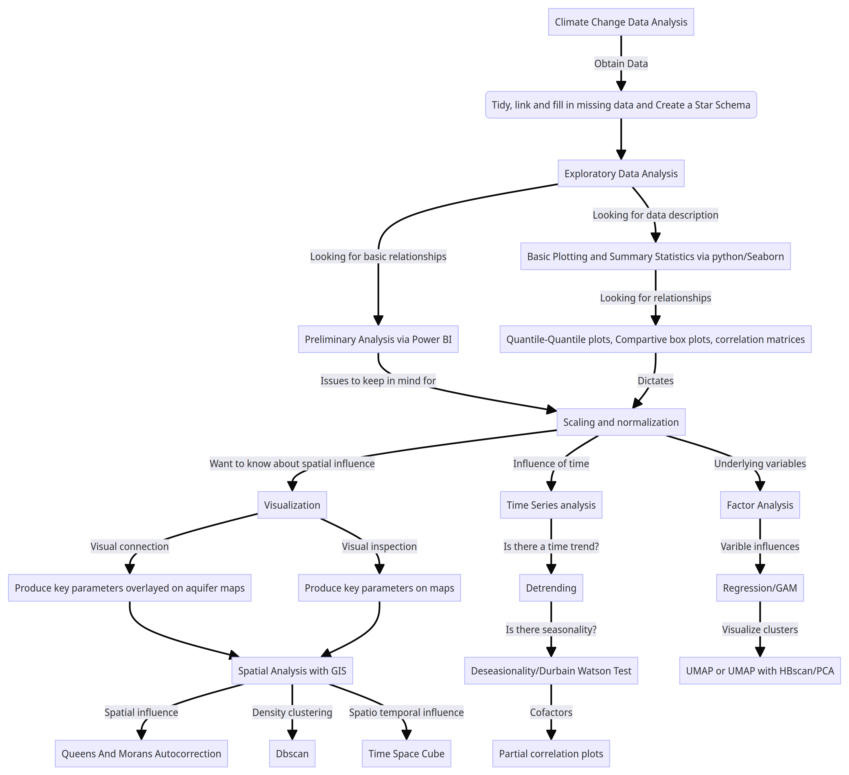
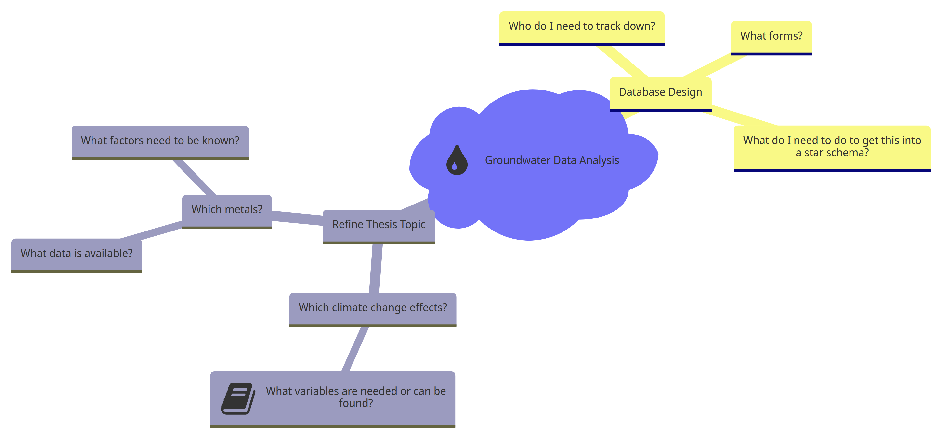
Methodology
Notes:
Diagram of what should have been done

Slide 14
Generalized Trends
Initial exploratory data analysis indicated that groundwater contamination was influenced by aquifer and groundwater chemistry, adsorption, and redox reactions, given influence of alkalinity influences on most metal, lower turbidity, and the correlations between manganese and iron.
Confined aquifers and fractured aquifers were influenced differently than unconfined aquifers that often had a hydraulic connection to overland water bodies – especially when it came to seasonality and time effects.
low precipitation seems to demonstrate a concentration effect or perhaps a change in redox chemistry
flooding often resulted in a dilution effect in a lot of metal contamination. “Drought” conditions had a stronger relationship with uranium, but the concentrations remained below the Canadian Drinking Water Guidelines. As expected, arsenic was very influenced by less precipitation and oxidating conditions and Fe-Mn was highly related to reducing conditions
soluble uranium seemed to persist in reducing conditions. This might be due to the complex’s uranium forms with calcium.
Notes:
Key diagrams
Key visualizations

Slide 15
Correlation Matrices
Element of Interest | Related Element | Normal |  | Flood |  | Drought
 |  | Pearson | Kendall | Pearson | Kendall | Pearson | Kendall
As | - | - | - | - | - | - | -
Mn | Fe | 0.5168 | 0.4111 | 0.5175 | 0.4092 | - | -
N | - | - | - | - | - | - | -
Pb | Cd | 0.9534 | 0.5630 | 0.7089 | 0.5768 | 0.6691 | 0.4870
U | Ca | 0.5670 | 0.3620 | 0.4978 | - | - | -
 | Hardness | 0.5610 | 0.3977 | - | - | - | -
Notes:
Key diagrams

Slide 16
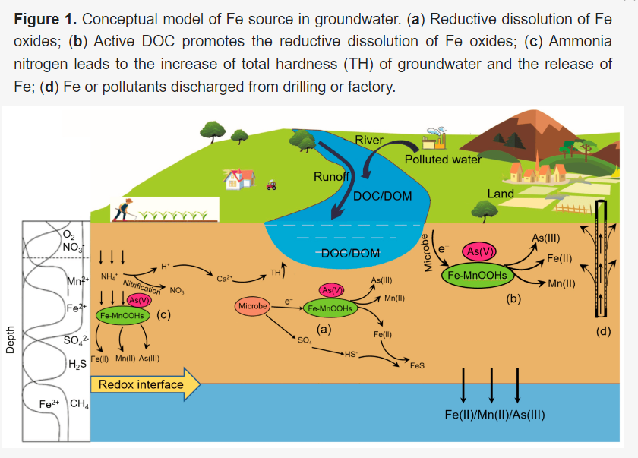
Correlation Matrices
Element of Interest | Related Element | Normal |  | Flood |  | Drought
 |  | Pearson | Kendall | Pearson | Kendall | Pearson | Kendall
As | - | - | - | - | - | - | -
Mn | Fe | 0.5168 | 0.4111 | 0.5175 | 0.4092 | - | -
N | - | - | - | - | - | - | -
Pb | Cd | 0.9534 | 0.5630 | 0.7089 | 0.5768 | 0.6691 | 0.4870
U | Ca | 0.5670 | 0.3620 | 0.4978 | - | - | -
 | Hardness | 0.5610 | 0.3977 | - | - | - | -
(Xia et al., 2022)
Notes:
Key diagrams

Slide 17
Correlation Matrices
Element of Interest | Related Element | Normal |  | Sea Water Intrusion
 |  | Pearson | Kendal | Pearson | Kendal
As | - | - | - | - | -
Mn | Fe | 0.5168 | 0.4111 | - | -
N | - | - | - | - | -
Pb | Cd | .9534 | .5630 | 0.7810 | 0.4870
 | Fe | - | - | 0.5940 | 0.4338
 | U | - | - | -0.5228 | -0.4382
U | Ca | .5670 | .3620 | - | -
 | Cl | - | - | -0.5538 | -0.3452
 | Pb | - | - | -0.5128 | -0.4382
 | K | - | - | 0.5514 | 0.3521
 | Hardness | 0.5610 | 0.3977 | 0.5536 | 0.3399
 | Alkalinity | - | - | 0.6212 | 0.3873
Notes:
Key diagrams

Slide 18
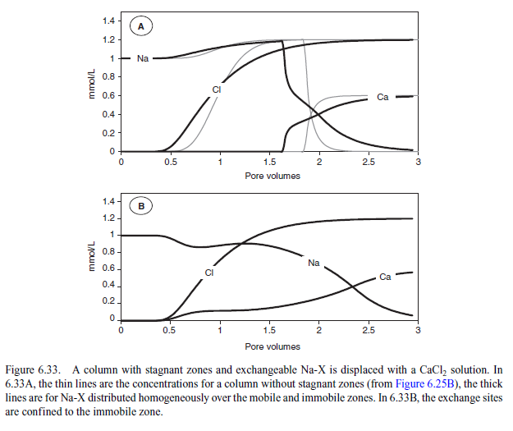
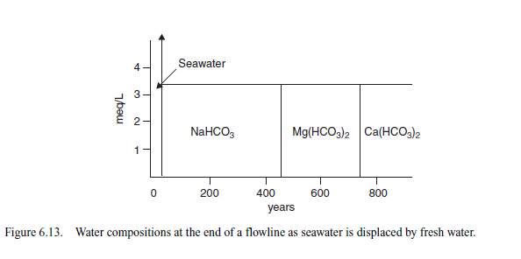
Correlation Matrices
Element of Interest | Related Element | Normal |  | Sea Water Intrusion
 |  | Pearson | Kendal | Pearson | Kendal
As | - | - | - | - | -
Mn | Fe | 0.5168 | 0.4111 | - | -
N | - | - | - | - | -
Pb | Cd | .9534 | .5630 | 0.7810 | 0.4870
 | Fe | - | - | 0.5940 | 0.4338
 | U | - | - | -0.5228 | -0.4382
U | Ca | .5670 | .3620 | - | -
 | Cl | - | - | -0.5538 | -0.3452
 | Pb | - | - | -0.5128 | -0.4382
 | K | - | - | 0.5514 | 0.3521
 | Hardness | 0.5610 | 0.3977 | 0.5536 | 0.3399
 | Alkalinity | - | - | 0.6212 | 0.3873
(Appelo & Postma, 2004)
Notes:
Key diagrams

Slide 19
With Climate Change Factors
 | Factor 1 | Factor 2 | Factor 3 | Factor 4 | Factor 5 | Factor 6 | Factor 7
Main | SWI and weathering | Time and redox | Direct climate change | Unconfined/ Confined | Fractures/ unconfined
Drought | SWI and weathering | Time and redox | Direct climate change | Unconfined/ Confined | Fractures/ confined | Distance
Flood | SWI and weathering | Time and redox | Unconfined/ Confined | Direct climate change | Distance | Fractures | Anthropogenic
Notes:
Comparison chart

Slide 20
 | Main | Drought | Flood
Factor 1 | Specific Conductance | Specific Conductance | Specific Conductance | Factor 1
 | Residue Filterable 1.0u | Residue Filterable 1.0u | Residue Filterable 1.0u
 | Ca | Alkalinity Total 4.5 | Chloride
 | Alkalinity Total 4.5 | Sulfate | Alkalinity Total 4.5
 | Sulfate | Ca | Sulfate
 | U | Chloride | Ca
 | Chloride
Factor 2 | Pb | Pb | Pb | Factor 2
 | Fe | Fe | Fe
 | Mn | Sample Months | Sample Months
 | Sample Months
Factor 3 | Maximum °C | Maximum °C | Minimum °C | Factor 4
 | Minimum °C | Minimum °C | Maximum °C
 |  | Precipitation
Factor 4 | Aquifer_2 | Aquifer_2 | Aquifer_2 | Factor 3
 | Aquifer_1 | Aquifer_1 | pH
 |  |  | Aquifer_1
Factor 5 | Aquifer_1 | Aquifer_2 | Fe | Factor 6
 | Aquifer_3 | K | Mn
 |  | Mn | Aquifer_3
 |  | Aquifer_3
Factor 6 |  | Latitude | Latitude | Factor 5
 |  | U | U
 |  | Chloride | Longitude
 |  |  | Precipitation
 |  |  | As | Factor 7
 |  |  | Pb
Notes:
Factor chart

Slide 21
Conclusions
Initially
  Aquifer and groundwater chemistry influenced. Potential seasonality
  Droughts represented redox change and concentration effect
  SWI indicated a change in groundwater geochemistry
  Flooding overwhelmed the system. A dilution effect could be seen but incoming anthropogenic contamination was also a factor

Slide 22
Objectives:
  Hypotheses:
Increased saltwater intrusion due to climate change may lead to elevated levels of metal contamination in well water.
Drought events resulting from climate change may result in higher concentrations of metals in well water via oxidation.
Flooding may lead to a dilution effect on metals in well water.
This study aims to gain an understanding on how climate change will influence what is in well water. Biological contamination will not be a focus in this scope.
To assess the variations in metal contamination levels in well water under different climate change-induced factors, including saltwater intrusion, flooding and drought events.
To contribute to the existing knowledge based on the interactions between climate change and metal contamination in well water, providing insights for future predictive modelling that could influence policymaking, water resource management, and environmental planning.
To assess the potential impact of climate change on the vulnerability and resilience of well water as a source of drinking water, considering the specific metal contamination risks.

Slide 23
Acknowledgements
I’d like to thank all those who supported me:
To my mother Anne and sister Avea, who spent countless hours per week helping me edit and type, so I didn’t have to “drop out”.
To Leili who helped me navigate campus and lab work while I had tumors in my shoulders, knees, arms, and spine; and took charge of communication when I went mute.
To my friend Matthew who stood by me throughout burnout, lack of accommodations, helped me overcome neurodiverse barriers and connect with people who got me back on track.
To Dale and the Neil Squire Society, who bought workplace accommodation technology and assisted me with disability technical support.
To Brishna who helped bring me food when I was bedridden due to tumors and was refused for more disability support.
To Chris and everyone who helped proofread my drafts
To Dr McBean at University of Guelph who helped me edit and refine ideas.
To my supervisor, Dr Gagnon at Dalhousie University.
To Glaiza who helped me as well

Slide 24
References
Al-Amri, N. S., Abdurahman, S. G., & Elfeki, A. M. (2023). Modeling Aquifer Responses from Flash Flood Events through Ephemeral Stream Beds: Case Studies from Saudi Arabia. Water, 15(15), Article 15. https://doi.org/10.3390/w15152735
Allen, D. M., Stahl, K., Whitfield, P. H., & Moore, R. D. (2014). Trends in groundwater levels in British Columbia. Canadian Water Resources Journal / Revue Canadienne Des Ressources Hydriques, 39(1), 15–31. https://doi.org/10.1080/07011784.2014.885677
Almost 9M Canadians depend on ground water. (2019, March 9). Ground Water Canada. https://www.groundwatercanada.com/almost-9m-canadians-depend-on-ground-water-4620/
Amanambu, A. C., Obarein, O. A., Mossa, J., Li, L., Ayeni, S. S., Balogun, O., Oyebamiji, A., & Ochege, F. U. (2020). Groundwater system and climate change: Present status and future considerations. Journal of Hydrology, 589, 125163. https://doi.org/10.1016/j.jhydrol.2020.125163
Andrade, L., O’Dwyer, J., O’Neill, E., & Hynds, P. (2018). Surface water flooding, groundwater contamination, and enteric disease in developed countries: A scoping review of connections and consequences. Environmental Pollution, 236, 540–549. https://doi.org/10.1016/j.envpol.2018.01.104
Appelo, C. A. J., & Postma, D. (2004). Geochemistry, Groundwater and Pollution. CRC Press.
BC Mining Law Reform. (2021). Maps. BC Mining Law Reform. https://reformbcmining.ca/maps/
B.C. Ministry of Environment and Climate Change Strategy. (2023, February 28). British Columbia Regional Streamflow Inventory Reports [Govermental]. Province of British Columbia. https://www2.gov.bc.ca/gov/content/environment/air-land-water/water/water-science-data/water-data-tools/provincial-hydrology-program/resources/streamflow-inventory#reports
Blake, F., Grant, K., MacKenzie, D., Scott, J., & Craw, D. (2019). Surficial arsenic redistribution above gold-mineralised zones in East Otago, New Zealand. New Zealand Journal of Geology and Geophysics, 62(4), 573–587. https://doi.org/10.1080/00288306.2019.1647854
Bondu, R., Cloutier, V., Rosa, E., & Benzaazoua, M. (2016). A Review and Evaluation of the Impacts of Climate Change on Geogenic Arsenic in Groundwater from Fractured Bedrock Aquifers. Water, Air, & Soil Pollution, 227(9), 296. https://doi.org/10.1007/s11270-016-2936-6
Bruins, J. (2016). Manganese Removal from Groundwater. Role of Biological and Physico-Chemical Autocatalytic Processes.
Carmichael, V., Kenny, S., Gellein, C., Wei, M., & Allen, D. (2008). Re-evaluating the aquifer hydraulic properties within the Okanagan Valley, British Columbia, Canada. GeoEdmonton’08. https://members.cgs.ca/documents/conference2008/GEO2008/pdfs/193.pdf
Crawford, S. E., Brinkmann, M., Ouellet, J. D., Lehmkuhl, F., Reicherter, K., Schwarzbauer, J., Bellanova, P., Letmathe, P., Blank, L. M., Weber, R., Brack, W., van Dongen, J. T., Menzel, L., Hecker, M., Schüttrumpf, H., & Hollert, H. (2022). Remobilization of pollutants during extreme flood events poses severe risks to human and environmental health. Journal of Hazardous Materials, 421, 126691. https://doi.org/10.1016/j.jhazmat.2021.126691
DeSimone, L., McMahon, P., & Rosen, M. (2014). The quality of our Nation’s waters—Water quality in Principal Aquifers of the United States 1991-2010 (ISSN 2330–5703; U.S. Geological Survey Circular 1360). U.S. Geological Survey. https://pubs.usgs.gov/circ/1360/
Earle, S. (2019). Physical Geology—2nd Edition. BCcampus. https://opentextbc.ca/physicalgeology2ed/
Ferguson, G., Cuthbert, M. O., Befus, K., Gleeson, T., & McIntosh, J. C. (2020). Rethinking groundwater age. Nature Geoscience, 13(9), 592–594. https://doi.org/10.1038/s41561-020-0629-7
iMapBC. (n.d.). Retrieved December 1, 2023, from https://maps.gov.bc.ca/ess/hm/imap4m/

Slide 25
References
Johnston, A. G., & Mccartney, W. D. (1965). Manganese occurrences in Canada. https://ostrnrcan-dostrncan.canada.ca/handle/1845/104174
Jurgens, B. C., Faulkner, K., McMahon, P. B., Hunt, A. G., Casile, G., Young, M. B., & Belitz, K. (2022). Over a third of groundwater in USA public-supply aquifers is Anthropocene-age and susceptible to surface contamination. Communications Earth & Environment, 3(1), 1–9. https://doi.org/10.1038/s43247-022-00473-y
Jurgens, B. C., Parkhurst, D. L., & Belitz, K. (2019). Assessing the Lead Solubility Potential of Untreated Groundwater of the United States. Environmental Science & Technology, 53(6), 3095–3103. https://doi.org/10.1021/acs.est.8b04475
Kennedy, G. W., & Drage, J. (2020). A review of private well contaminants, testing, and mitigation behaviours in Nova Scotia (Open File Report ME 2020-004). Nova Scotia Energy and Mines Geological Survey. https://novascotia.ca/natr/meb/data/pubs/20ofr04/ofr_me_2020-004.pdf
Krupka, K., & Serne, R. (2002). Geochemical Factors Affecting the Behavior of Antimony, Cobalt, Europium, Technetium, and Uranium in Vadose Sediments. https://doi.org/10.2172/15004491
Larry D. Jones. (1990). URANIUM AND THORIUM OCCURRENCES IN BRITISH COLUMBIA (OPEN FILE 1990–32). Minisby of Energy, Mines and Petroleum Resources. https://cmscontent.nrs.gov.bc.ca/geoscience/publicationcatalogue/OpenFile/BCGS_OF1990-32.pdf
Levy, Z. F., Jurgens, B., Burow, K., Voss, S., Faulkner, K., Arroyo‐Lopez, J., & Fram, M. (2021). Critical Aquifer Overdraft Accelerates Degradation of Groundwater Quality in California’s Central Valley During Drought. Geophysical Research Letters, 48. https://doi.org/10.1029/2021GL094398
Leyden, E., Cook, F., Hamilton, B., Zammit, B., Barnett, L., Lush, A. M., Stone, D., & Mosley, L. (2016). Near shore groundwater acidification during and after a hydrological drought in the Lower Lakes, South Australia. Journal of Contaminant Hydrology, 189, 44–57. https://doi.org/10.1016/j.jconhyd.2016.03.008
Masuda, H. (2018). Arsenic cycling in the Earth’s crust and hydrosphere: Interaction between naturally occurring arsenic and human activities. Progress in Earth and Planetary Science, 5(1), 68. https://doi.org/10.1186/s40645-018-0224-3
McGuigan, C. F., Hamula, C. L. A., Huang, S., Gabos, S., & Le, X. C. (2010). A review on arsenic concentrations in Canadian drinking water. Environmental Reviews, 18(NA), 291–307. https://doi.org/10.1139/A10-012
McMahon, P. B., Belitz, K., Reddy, J. E., & Johnson, T. D. (2019). Elevated Manganese Concentrations in United States Groundwater, Role of Land Surface–Soil–Aquifer Connections. Environmental Science & Technology, 53(1), 29–38. https://doi.org/10.1021/acs.est.8b04055
Neidhardt, H., & Shao, W. (2023). Impact of climate change-induced warming on groundwater temperatures and quality. Applied Water Science, 13(12), 235. https://doi.org/10.1007/s13201-023-02039-5
Nicomel, N. R., Leus, K., Folens, K., Van Der Voort, P., & Du Laing, G. (2016). Technologies for Arsenic Removal from Water: Current Status and Future Perspectives. International Journal of Environmental Research and Public Health, 13(1), Article 1. https://doi.org/10.3390/ijerph13010062
Nolan, J., & Weber, K. A. (2015). Natural Uranium Contamination in Major U.S. Aquifers Linked to Nitrate. Environmental Science & Technology Letters, 2(8), 215–220. https://doi.org/10.1021/acs.estlett.5b00174
Ootes, L., Elliott, J., & Rowins, S. (2017). Testing the relationship between the Llewellyn fault, gold mineralization, and Eocene volcanism in northwest British Columbia: A preliminary report.
Peel, H. R., Balogun, F. O., Bowers, C. A., Miller, C. T., Obeidy, C. S., Polizzotto, M. L., Tashnia, S. U., Vinson, D. S., & Duckworth, O. W. (2022). Towards Understanding Factors Affecting Arsenic, Chromium, and Vanadium Mobility in the Subsurface. Water, 14(22), Article 22. https://doi.org/10.3390/w14223687
Pell, J., & Hora, Z. (1990). High-tech metals in British Columbia.

Slide 26
References
Richardson, C. M., Davis, K. L., Ruiz-González, C., Guimond, J. A., Michael, H. A., Paldor, A., Moosdorf, N., & Paytan, A. (2024). The impacts of climate change on coastal groundwater. Nature Reviews Earth & Environment, 5(2), 100–119. https://doi.org/10.1038/s43017-023-00500-2
Rudd, H., Neal, A., Genereux, D. P., Shea, D., & Nichols, E. G. (2023). Vulnerability of wells in unconfined and confined aquifers to modern contamination from flood events. Science of The Total Environment, 901, 165729. https://doi.org/10.1016/j.scitotenv.2023.165729
Schock, M., Scheckel, K., DeSantis, M., & Gerke, T. (2005). Mode of Occurrence, Treatment and Monitoring Significance of Tetravalent Lead.
Skierszkan, E. K., Dockrey, J. W., Helsen, J., Findlater, L.-L., Bataille, C. P., de Laplante, G., McBeth, J. M., Mayer, K. U., & Beckie, R. D. (2021). Persistence of Uranium in Old and Cold Subpermafrost Groundwater Indicated by Linking 234U-235U-238U, Groundwater Ages, and Hydrogeochemistry. ACS Earth and Space Chemistry, 5(12), 3474–3487. https://doi.org/10.1021/acsearthspacechem.1c00307
Wei, M., Klaus Rathfelder, & Jennifer Turner. (2016). Determining the Likelihood of Hydraulic Connection – Guidance for the Purpose of Apportioning Demand from Diversion of Groundwater on Streams (Technical WSS2016-01; Water Science Series). Water Protection and Sustainability Branch, Ministry of Environment of British Columbia. https://a100.gov.bc.ca/pub/acat/documents/r50832/HydraulicConnectMW3_1474311684426_4310694949.pdf
Werner, A. D., Bakker, M., Post, V. E. A., Vandenbohede, A., Lu, C., Ataie-Ashtiani, B., Simmons, C. T., & Barry, D. A. (2013). Seawater intrusion processes, investigation and management: Recent advances and future challenges. Advances in Water Resources, 51, 3–26. https://doi.org/10.1016/j.advwatres.2012.03.004
Wossenyeleh, B. K., Verbeiren, B., Diels, J., & Huysmans, M. (2020). Vadose Zone Lag Time Effect on Groundwater Drought in a Temperate Climate. Water, 12(8), 2123. https://doi.org/10.3390/w12082123
Xia, X., Teng, Y., & Zhai, Y. (2022). Biogeochemistry of Iron Enrichment in Groundwater: An Indicator of Environmental Pollution and Its Management. Sustainability, 14(12), Article 12. https://doi.org/10.3390/su14127059
Zhang, L., Wu, Y., Ni, Z., Li, J., Ren, Y., Lin, J., & Huang, X. (2023). Saltwater intrusion regulates the distribution and partitioning of heavy metals in water in a dynamic estuary, South China. Marine Environmental Research, 186, 105943. https://doi.org/10.1016/j.marenvres.2023.105943
Zhong, S., Zhou, S., Liu, S., Wang, J., Dang, C., Chen, Q., Hu, J., Yang, S., Deng, C., Li, W., Liu, J., Borthwick, A. G. L., & Ni, J. (2023). May microbial ecological baseline exist in continental groundwater? Microbiome, 11(1), 152. https://doi.org/10.1186/s40168-023-01572-4

Slide 29
The research team acknowledges funding through the NSERC Alliance “Partnership for Innovation in Climate Change Adaptation in Water & Wastewater Treatment” and its member partners.
The research team acknowledges additional specific support…

Slide 30
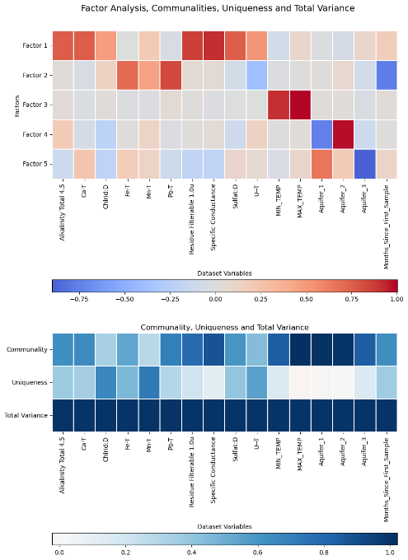
Main Factor Analysis
The first factor [F1] made-up 24.4% of the proportional variance and seemed to be that of saltwater intrusion (Section 9.7, Appendix). The largest variables were specific conductance [0.9167], residue filterable [0 .8647], Ca [0.7572], alkalinity total 4.5 [alkalinity] [0.75720], and sulfate [0.7530]. Uranium and chloride had a weaker makeup of said factor
Factor 2 [F2] consisted of Pb [0. 8249], Fe [0.7101] and a negative relationship to time (Months_Since_First_Sample)[- 0.7700]. There was also a weak proponent of Mn.
Factor 3 [F3] is 11.5 % of the proportional variance and has minimum and maximum average monthly temperature as the major proponents. This the factor likely for climate change effects. Maximum temperature is above one indicating that it is highly correlated with minimum temperature.
Notes:
F4 and f5

Slide 31
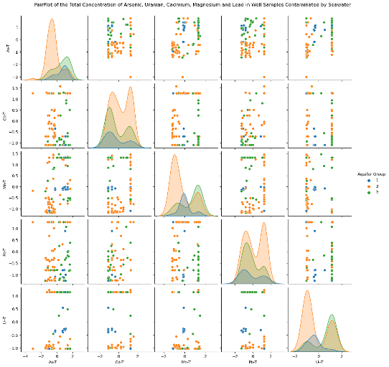
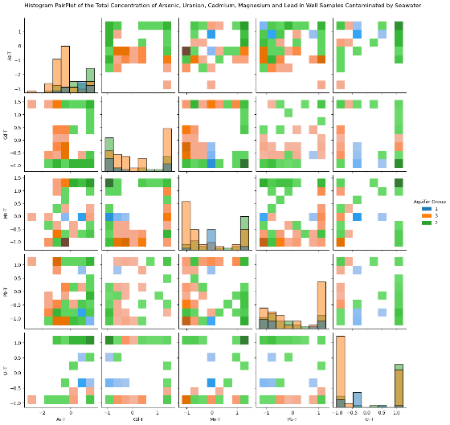
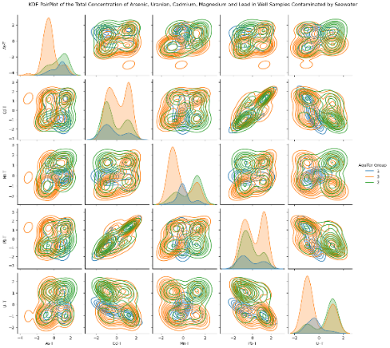
Saltwater Intrusion
Dataset Based on SWI over Limit | As Above Limit | Pb Above Limit | Mn Above Limit | U Above Limit | Specific Conductance over cutoff | Residue Filterable 1.0u over cutoff | Chloride over cutoff | Total data points
Normal | 81 | 289 | 344 | 6 | 107 | 79 | 52 | 1147
Residue Filterable 1.0u | 5 | 17 | 26 | 0 | 70 | - | 32 | 71
Chloride | 2 | 13 | 13 | 0 | 38 | 31 | - | 45
Specific Conductance | 7 | 22 | 38 | 0 | - | 70 | 32 | 98
Chloride + Specific Conductance | 2 | 9 | 10 | 0 | - | 24 | - | 37
Residue Filterable 1.0u + Specific Conductance | 5 | 17 | 26 | 0 | - | - | 24 | 70
Chloride + Residue Filterable 1.0u | 2 | 9 | 10 | 0 | 24 | - | - | 31
Chloride or Specific Conductance | 71 | 26 | 41 | 0 | 99 | 70 | 47 | 106
All | 2 | 9 | 10 | 0 | - | - | - | 24
A)
B)
C)

Slide 32

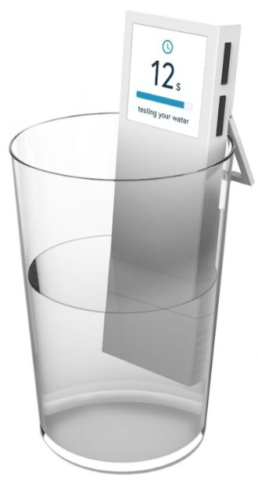
Background
Cofounded a company called Drinkable
Private well owners make up 42% of all domestic water use in NS. It is estimated that over 50% of them have never tested or can’t recall testing the chemical quality of their well water (Kennedy 2020)
Similar rates in Ontario, etc.
Complacency, procrastination, cost, inconvenience were barriers.
New Problem: What do we do with the potential data?

Slide 33
Issues: Part I
Current climate change water modelling
  Rarely accounts for groundwater
Aquifer Vulnerability modeling
  Often localized (i.e. DRASTIC)
Databases
  Scattered, small
  Unstandardized and essentially patchwork
  Often focused on stream flow
  At most tracked groundwater levels not water quality

Slide 34
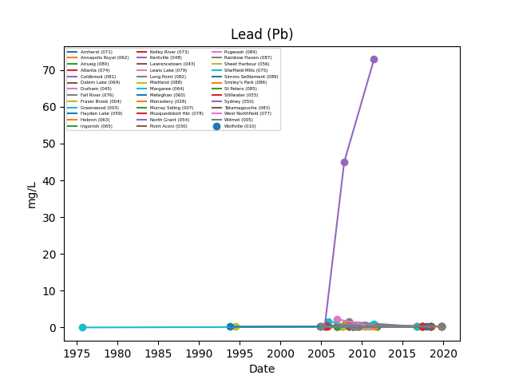
Issues: Part I
Current climate change water modelling
  Rarely accounts for groundwater
Aquifer Vulnerability modeling
  Often localized (i.e. DRASTIC)
Databases
  Scattered, small
  Unstandardized and essentially patchwork
  Often focused on stream flow
  At most tracked groundwater levels not water quality

Slide 35
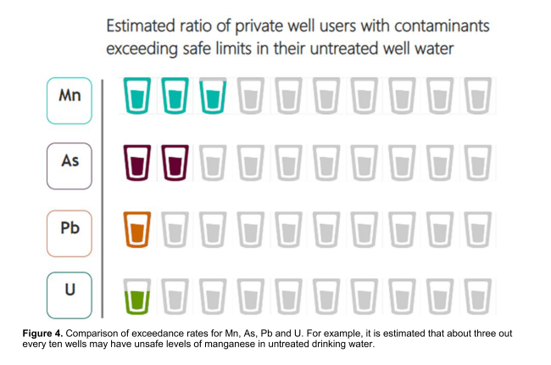
Metals of Interest
As
Mn
(McMahon et al., 2019)
(DeSimone et al., 2014)
Pb
U
(Kennedy & Drage, 2020)
(Nolan & Weber, 2015)
(Jurgens et al., 2019)

Slide 36
Additional Variables That Could be Used
Groundwater Depth
Br, Mg
Nitrate/Nitrite
Corrosion ratios
Focus on rock types
Better drought indicators
Peak flows/flood indicators
Aquifer vulnerability
Aquifer traits
Snowmelt

Slide 37
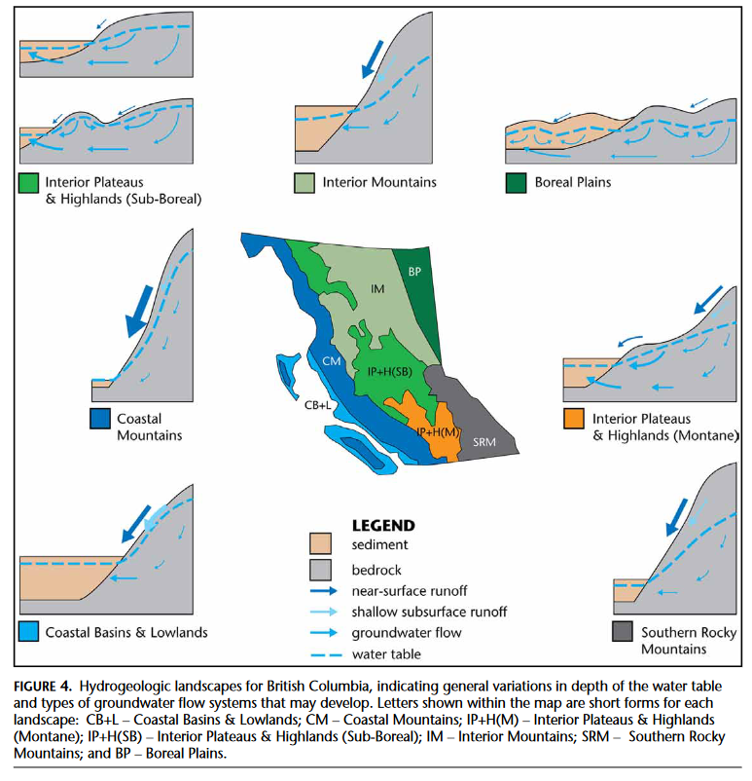
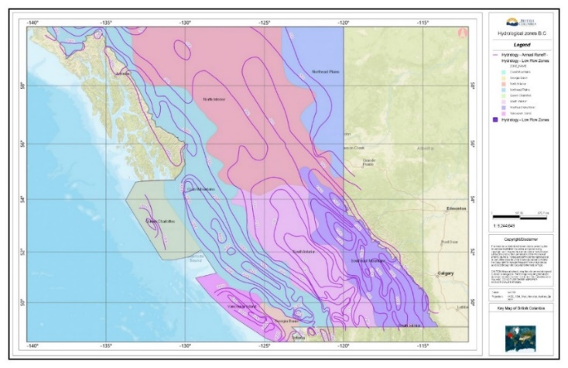
Geological Differences and Generalizations
(iMapBC, n.d.)
(Wei et al., 2016)

Slide 38
Future Directions
Spatial autocorrelation
Temporal/seasonal analysis
More inclusive of geology
Well depth and groundwater level
Larger SWI dataset
Regression/GAM
Validation on separate data
Comparison of more key minerals
Utilize flood plain maps

Slide 39
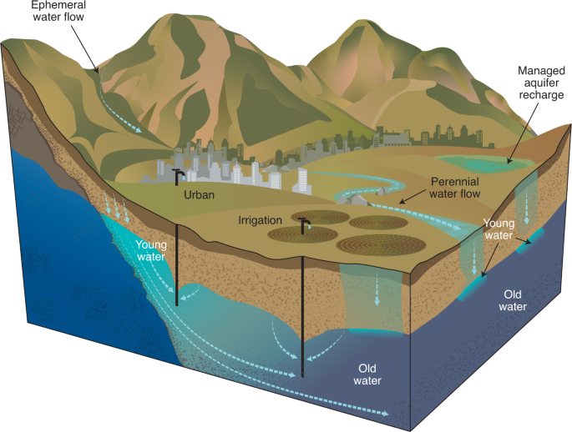
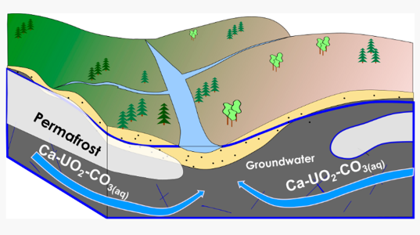
Groundwater Age
(Skierszkan et al., 2021)
(Ferguson et al., 2020)

Slide 40
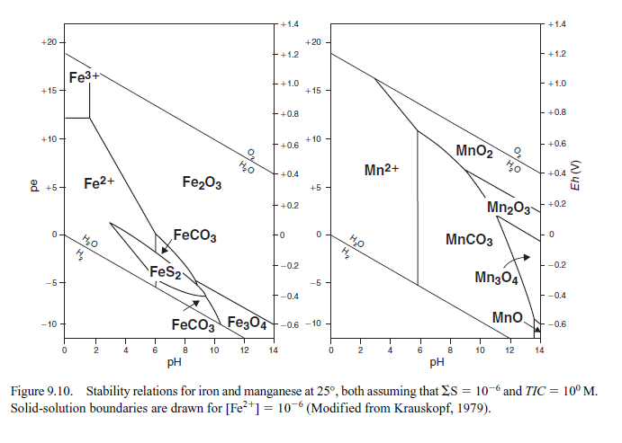
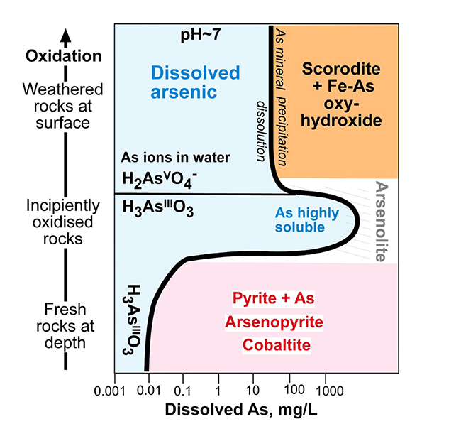
Geochemistry
(Blake et al., 2019)
(Appelo & Postma, 2004)

Slide 41
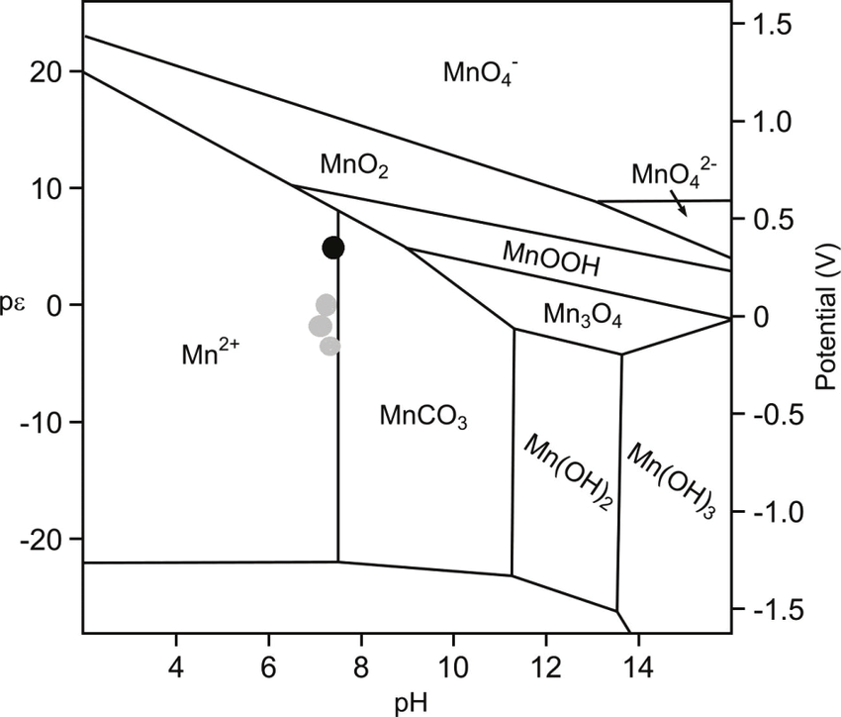
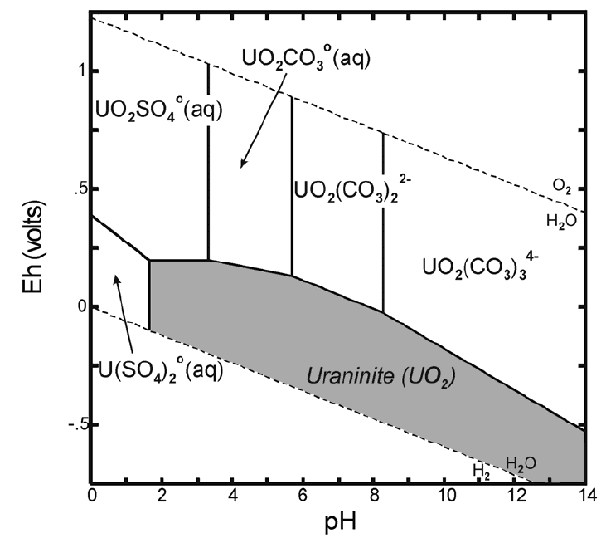
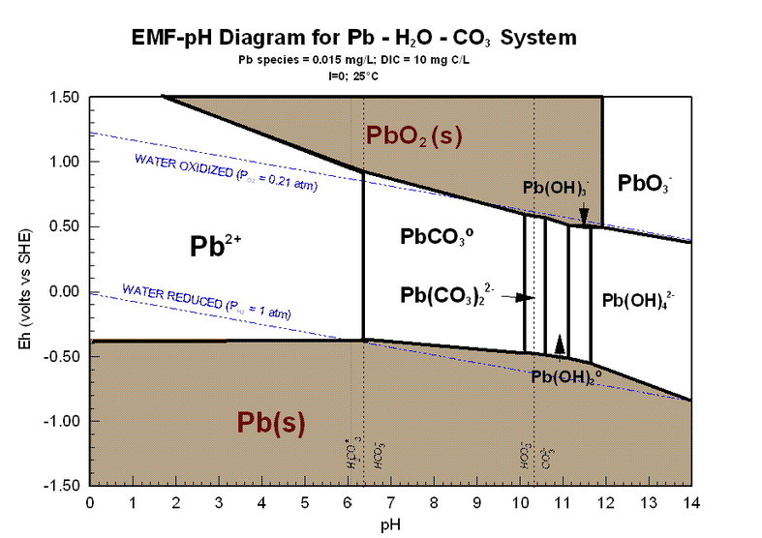
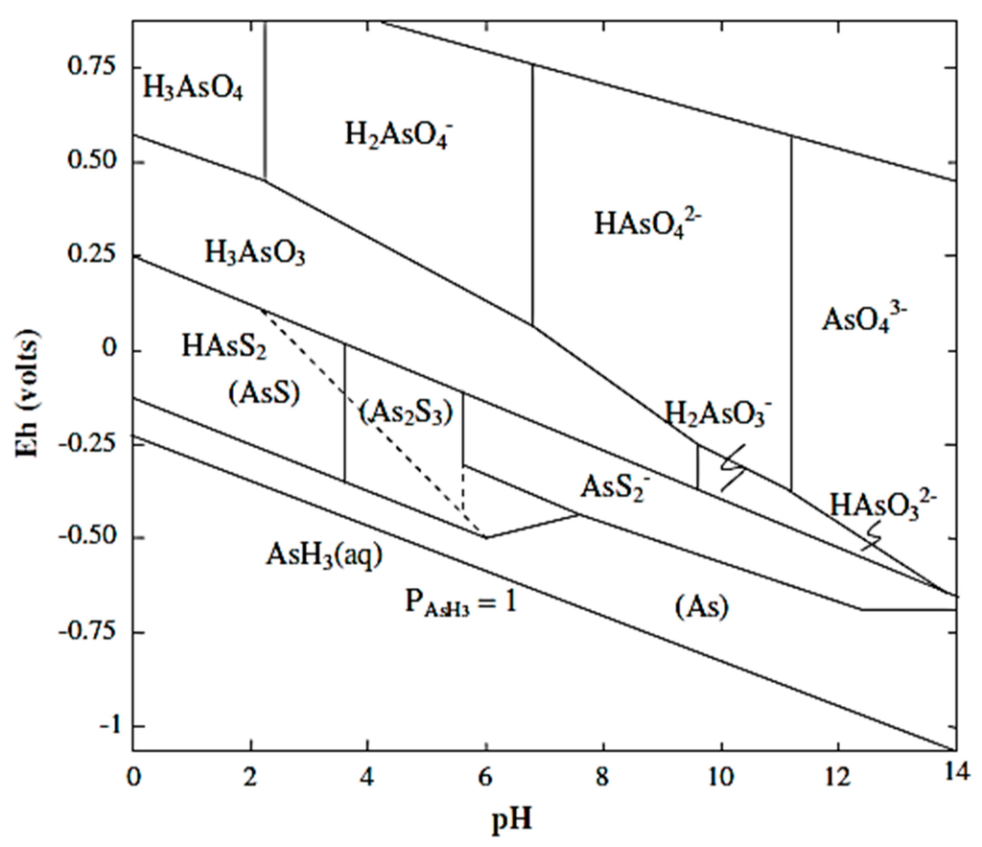
Geochemistry
(Bruins, 2016)
(Krupka & Serne, 2002)
(Schock et al., 2005)
(Nicomel et al., 2016)

Slide 42
OLS Regression
Statistically significant predictors from OLS regression models for As
 | Main | SWI | Drought | Flood
Alkalinity | + |  | + | +
Chloride | - |  | -
Fe | + | + | + | +
P | + |  | +
Sulfate | + | + | +
Hardness* | +
K | + | - | +
pH |  |  | +
Residue Filterable |  |  |  | +
Time | -
x | - | -
N |  | -
Aquifer_1 |  | + | + | +
Aquifer_2 |  |  | + | +
Aquifer_3 |  | - |  | +
Precipitation |  |  |  | -
Maximum °C |  |  |  | -
Minimum °C |  |  |  | +
Statistically significant predictors from OLS regression models for Mn
 | Main | SWI | Drought | Flood
Alkalinity | + | - |  | +
Chloride |  | -
P |  | +
Specific Conductance |  | + | +
Residue Filterable | -
pH |  | - | -
Fe | + |  | + | +
K | + | + | + | +
N | + |  | + | +
x | - | - | - | -
y |  | -
Aquifer_1 | -
Aquifer_2 |  | +
Aquifer_3
Maximum °C | - |  |  | -
Minimum °C | +
Hardness* | +
FD* | +
HW* | +
MT* | -
Statistically significant predictors from OLS regression models for Pb
 | Main | SWI | Drought | Flood
P | -
Residue Filterable | + |  | + | +
Sulfate | - | - | -
HW* | +
Time | - | -
Fe |  | + | + | +
K |  | - | -
Aquifer_1 |  | + | + | +
Aquifer_2 |  | + | + | +
Aquifer_3 |  | + | + | +
N |  |  | -
Precipitation |  |  | - | -
Specific Conductance |  |  |  | -
Minimum °C |  |  |  | +
Maximum °C |  |  |  | -
pH
Statistically significant predictors from OLS regression models for U
 | Main | SWI | Drought | Flood
Alkalinity |  | + |  | +
Sulfate |  | + | + | +
Chloride |  |  | -
K |  |  | + | +
Fe |  |  |  | -
N | - |  |  | -
X | +
Y | + |  |  | +
Precipitation |  |  | -
pH |  | -
Time |  | + | + | +
Aquifer_1 | - | - | - | -
Aquifer_2 | - |  | -
Aquifer_3 |  | + | +
Min Temp | -
Max Temp | +
MT* | +

Slide 43
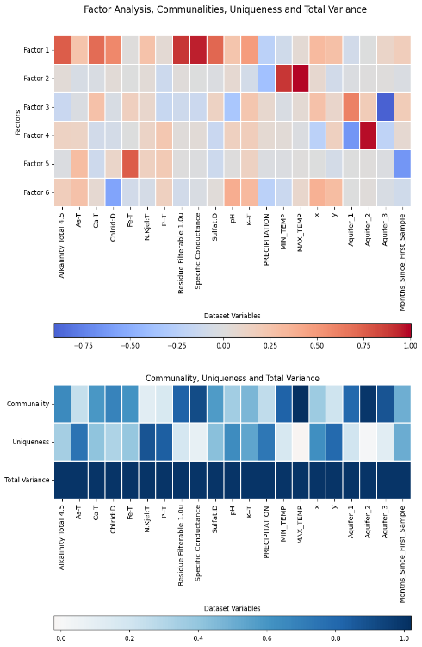
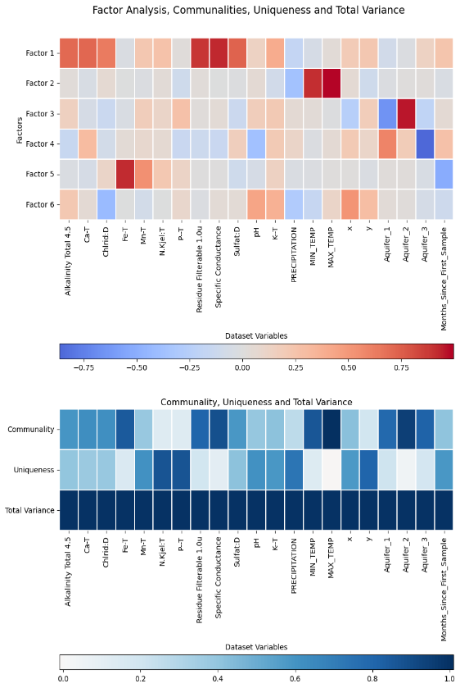
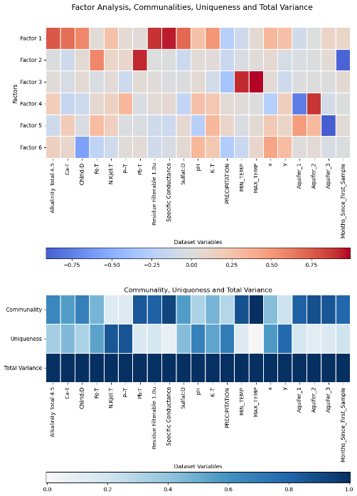
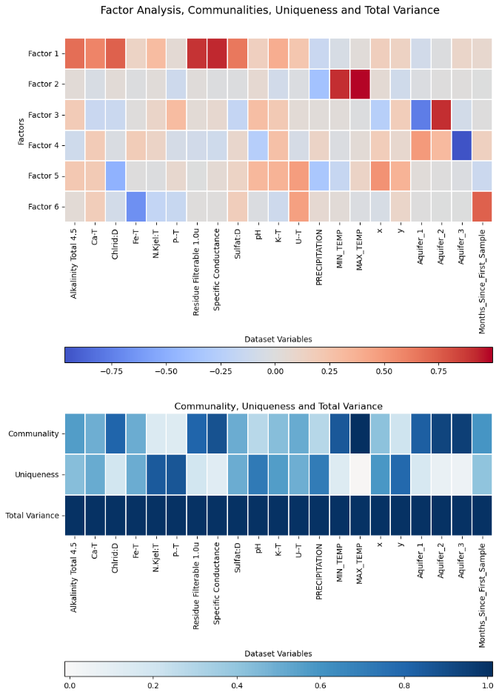
Factor Analysis Focused on Metals of Interest
A)
B)
C)
D)
As
Mn
Pb
U

Slide 44
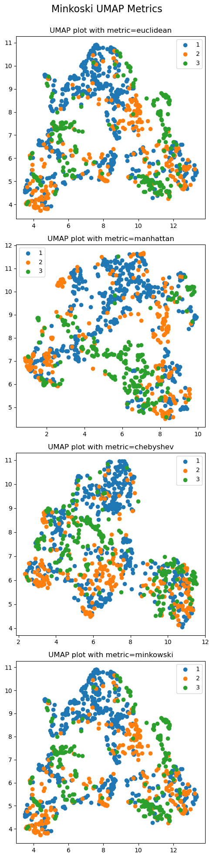
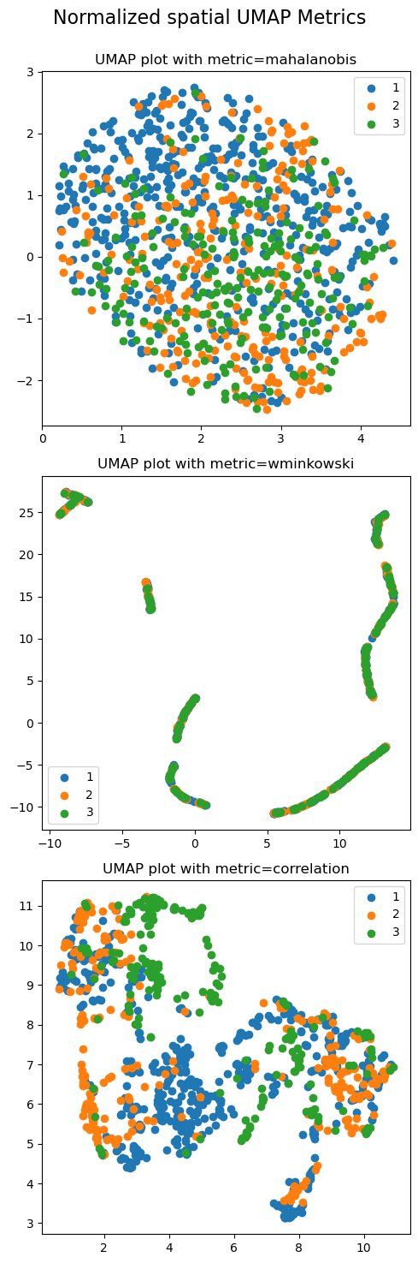
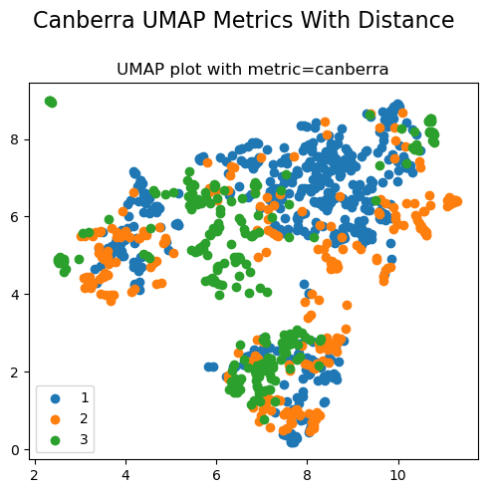
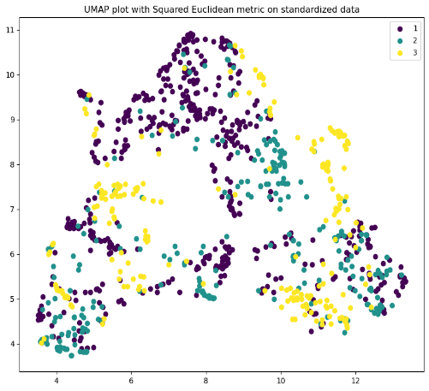
UMAP
A)
B)
C)

Slide 45
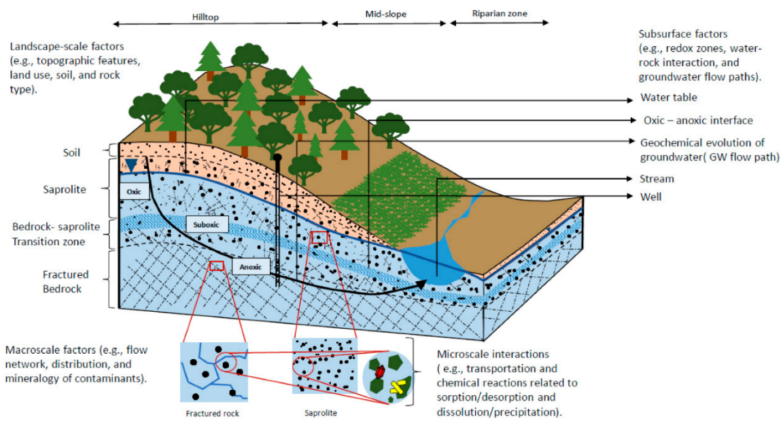
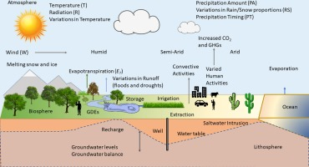
Climate Change Effects
(Amanambu et al., 2020).
(Peel et al., 2022)

Slide 46
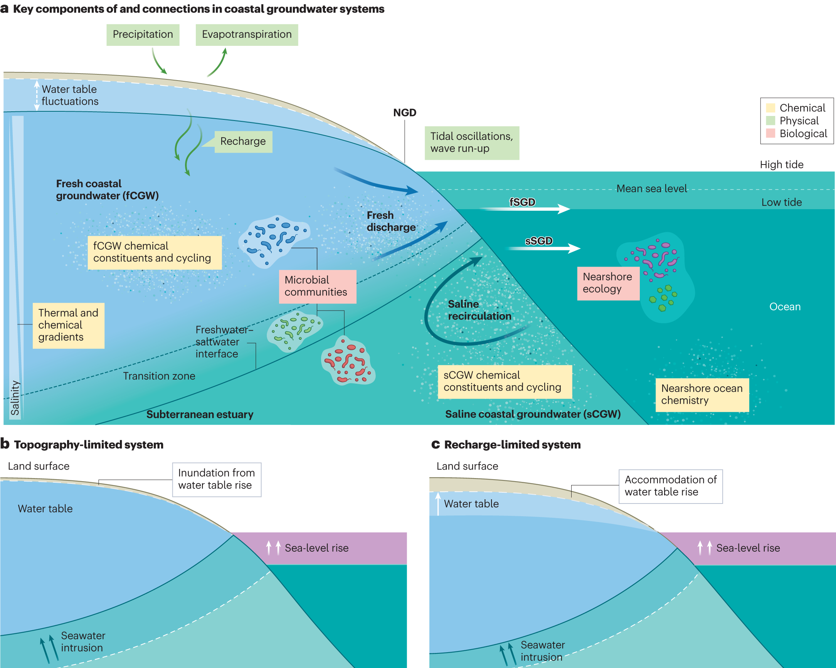
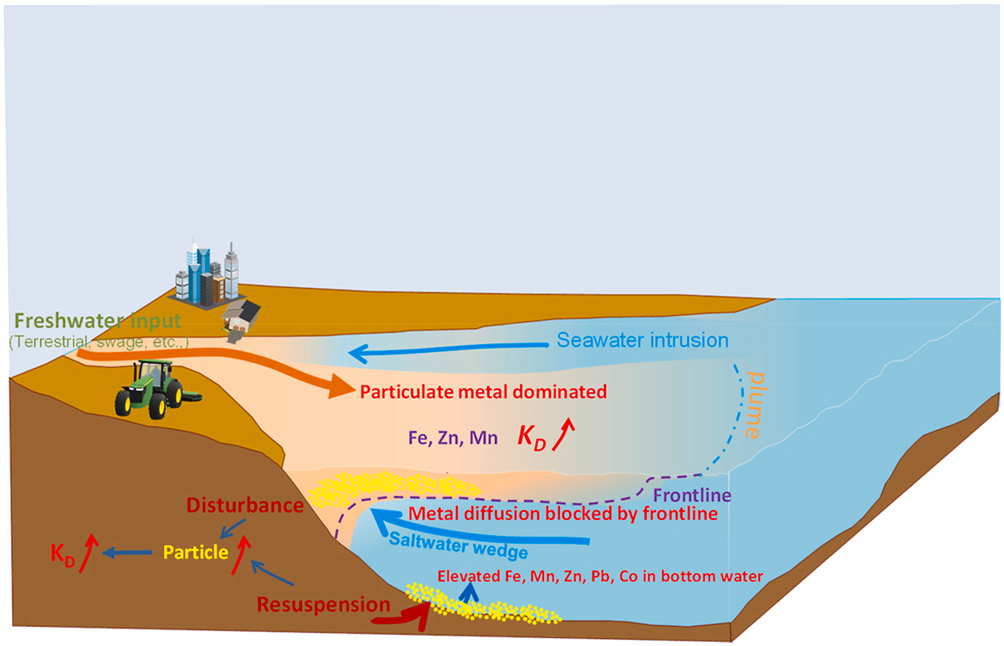
Saltwater Intrusion
(Zhang et al., 2023)
(Richardson et al., 2024)

Slide 47
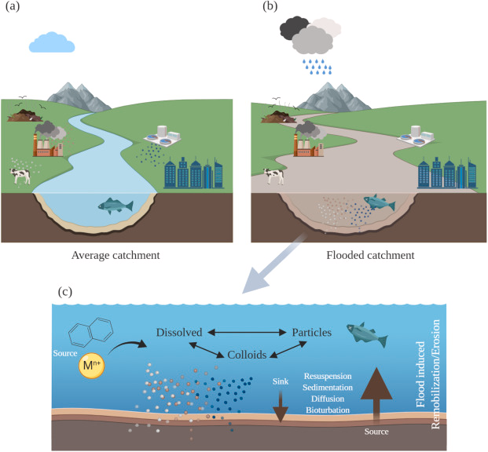
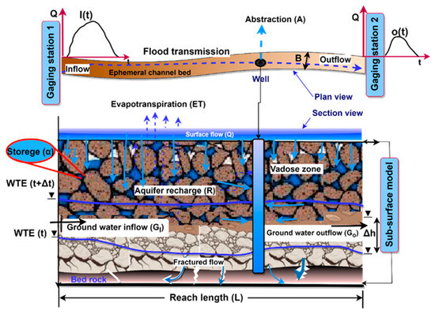
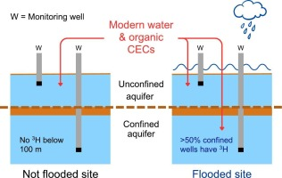
Floodplains and Flooding Effects
(Rudd et al., 2023)
(Al-Amri et al., 2023)
(Crawford et al., 2022)
Notes:
.

Slide 48



Droughts
(Bondu et al., 2016)
(Wossenyeleh et al., 2020)
(Leyden et al., 2016)

Slide 49
Variables Measured
Rock Geochemistry | Redox (including microbial) | Sea Water Intrusion | Climate Change Factors | Metals
Hardness (Total) [mg/L CaCO3] | Sulfate [mg/L] | Specific Conductance [uS/cm] | Tx_Climatology [°C] | U [mg/L]
K [mg/L] | pH | Residue Filterable 1.0u [mg/L] | Tn_Climatology [°C] | Pb [mg/L]
Ca [mg/L] | P [mg/L] | Chloride [mg/L] | Maximum Temperature [°C] | Mn [mg/L]
Alkalinity Total 4.5 [mg/L] | N.Kjel:T [mg/L] |  | Minimum Temperature [°C] | Cd [mg/L]
 | Fe [mg/L] |  | Precip_Climatology [mm] | As [mg/L]
 |  |  | Precipitation [mm]

Slide 50


Hydraulic Connection/ Aquifer Types
(Wei et al., 2016).
(Allen et al., 2014)

Slide 51


Geomicrobiology
(Zhong et al., 2023)
(Neidhardt & Shao, 2023)
Notes:
Love Zhong’s diagram.

Slide 52


Geological Redox
(Appelo & Postma, 2004)
(Appelo & Postma, 2004)

Slide 53




Metals of Interest
As
Mn
(McGuigan et al., 2010)
(Johnston & Mccartney, 1965)
Pb
U
(Pell & Hora, 1990)
(Larry D. Jones, 1990)

Slide 54


Anthropogenic Influences
(BC Mining Law Reform, 2021)
(Jurgens et al., 2022)

Slide 55

Groundwater Reliance and Pollution
 | As Above Limit | Pb Above Limit | Mn Above Limit | U Above Limit | Specific Conductance over cutoff | Residue Filterable 1.0u over cutoff | Chloride over cutoff | Total Data Points
Full Dataset | 81 | 289 | 344 | 6 | 107 | 79 | 52 | 1147
Drought Dataset | 37 | 138 | 162 | 4 | 69 | 49 | 29 | 530
Flood Dataset | 31 | 124 | 135 | 1 | 32 | 22 | 18 | 455
Chloride or Specific Conductance | 71 | 26 | 41 | 0 | 99 | 70 | 47 | 106
(Almost 9M Canadians Depend on Ground Water, 2019)

Slide 56


Rock Cycles
(Masuda, 2018)
(Earle, 2019)

