Slide 1
Energy Efficient Protocols For Wireless Sensor Network
Supervisor : Submitted by:
Dr. Sushma Jain Mandeep Singh Bandral
Assistant Professor 801233008
Thapar University ME(IS)

Slide 2
OUTLINE
Wireless Sensor Network
Related work
System Model
Network Model
Radio Model
Node Information
Protocols Description
Algorithms
Result

Slide 3
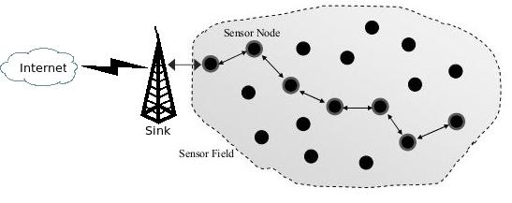
Wireless Sensor Network
Wireless sensor network have different components:
Sensor
Analog to Digital converter
Transmitter
Receiver
Battery
Fig1: Wireless sensor network

Slide 4
Related work
Protocol | Year | Technique | Description
LEACH | 2000 | Clustering | Make Cluster and chose cluster head Based on random probability.
PEGSIS | 2002 | Chain like Structure | Generate a chain like structure and each node send data to its neighbor
PEDAP | 2003 | Prim Technique | Generate a mst by using a prim algorithm taking sink as a root
REEF | 2005 | Mst | By sending the information to the base station and then base station decide to send data by direct or by through neighbor

Slide 5
Protocol | Year | Technique | Description
EERP | 2008 | Tier shifting | Send data to the base station by tier shifting
REARP | 2009 | Relay nodes | Fixed position Relay
GFFOD | 2010 | Different Deployment | Show analysis of different deployment techniques
CREEC | 2011 | Two energy called threshold energy | Use both direct throw energy and though neighbor energy

Slide 6
Protocol | Year | Techniques | Description
MSMTP | 2011 | Multi hop | Use mst and phase shift To send the data to base station
CELL-LEACH | 2012 | Clustering | Make cell and select cell head and send the data to the base station.
S-LEACH | 2013 | Cluster | Pair wise Key method

Slide 7
Assumption
Base Station is fixed and located far away from the sensing field.
All nodes in the network are homogenous and energy constraints.
Data fusion and aggregation is used to reduce the size of the data. Assuming that combining n packet of size k bits result in one packet of size k instead of nk.

Slide 8
System Model
The system model is divided into different components
WSN: It consists of N number of sensor nodes which are stationary and a fixed location base station BS.
BS: The base station consists of powerful central processing unit, a memory unit, small memory used for storing the data and an unlimited power source.
Nodes
Nodes Energy
Fusion

Slide 9
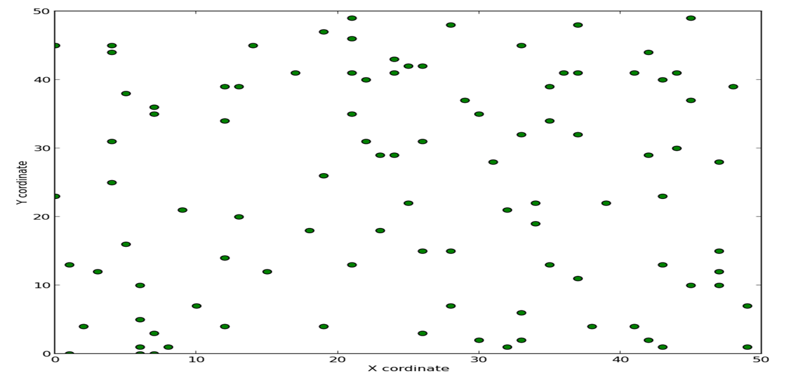
Network Model
The network model for proposed algorithms is formed by deploying 100 sensor nodes randomly and uniformly over the network of area 50m x 50m in case of TBEEP. The network design for multi path routing algorithm consists of weighted connected graph G=(V, E) where V denotes the number of nodes in a network i.e., V: {s_{1,} s₂, …., s_{n}} and E represents the number of link i.e E:{u_{i}, u_{j}|(u_{i}, u_{j})Є V}. The link (u_{i}, u_{j}) represents that there is a connection from node u_{i} to node u_{j} and works in full duplex mode. The d(u_{i}, u_{j}) represents the distance or Range between from node i to node j.
:
Fig 2: Random deployment

Slide 10
Radio Model
The radio frequency model used for this technique is same as LEACH. The radio dissipates
E_{elect} = 50nJ/bit
E_{amp} = 100pJ/bit/m²
Transmitting:
E_{tr}(k,d)= E_{elect}(k)+E_{amp}(k,d).
E_{tr}(k,d)= kE_{elect}+kE_{amp}d²
E_{tr}(k,d)= kE_{elect}+kE_{amp}d⁴
Receiving:
E_{Rx}(k)= E_{elect} . k

Slide 11
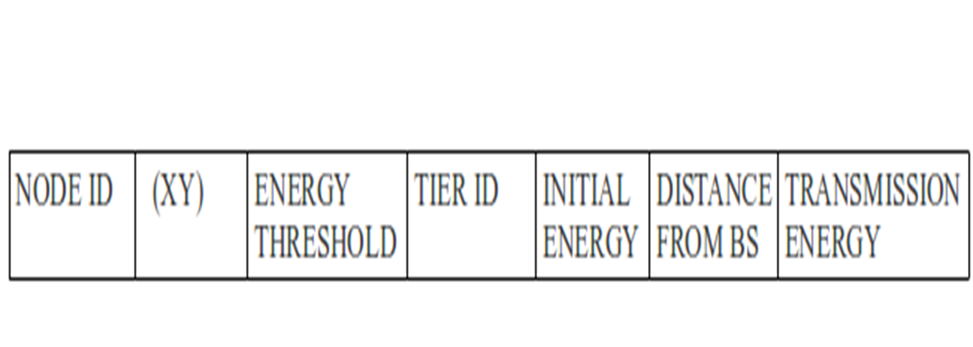
Node Information
The node information contains
Fig 3: Node Information
Location of nodes
Energy required to transmitted the data to base station
cluster-id or tier id
unique identification
Initial energy
Position of the node and distance

Slide 12
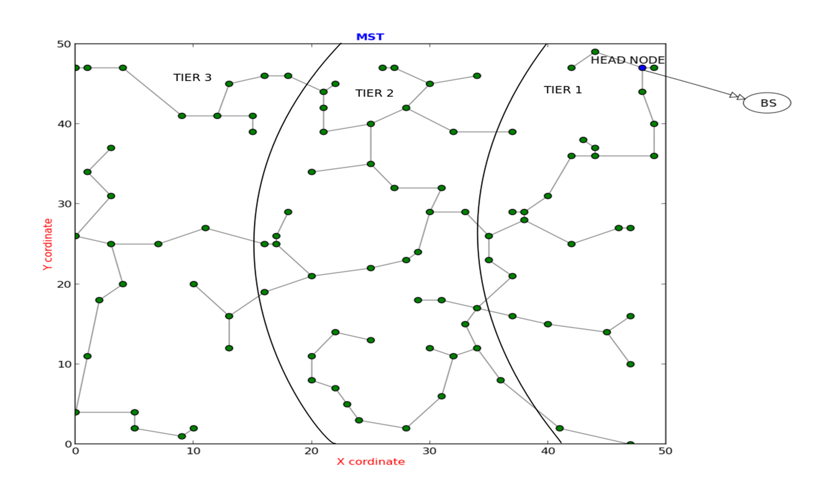
Protocol Description
Tier Based Energy Efficient Protocol
The model incorporates two basic features:
Minimum spanning Tree
Multi Tier Trace Back Routing Protocol
Fig 4: Minimum Spanning Tree

Slide 13
Algorithm
Step1: Deploy nodes in a specified or decided area in a uniform/Random manner
and initialize each node with some initial energy and classify these nodes in
the form of tiers on the basis of distance from the base station.
Step 2: Generate MST by using prims algorithm.
Step 3: Select a node having highest energy in tier 1 as head node. If its energy is
greater than the required transmission energy then it can transmit the data
to base station .
Step 4: On transmitting data to base station, deduct energy from head node and
when its energy goes below dead energy then that node is discarded.
Step 5: Now choose another node from tier 1 on the basis of condition described in
step3. Continue selecting nodes from tier 1 till there is no such node left
in tier 1 whose energy is greater than threshold energy.
Step 6: Now select a node having energy greater than transmission energy from
next tier and then transmit data to base station from that node.

Slide 14
Step 7: Continue selecting nodes and going to next tier till tier id gets equals to 4.
Step 8: At this stage define a new threshold value which is half of the previous
one and tier id is set to 1.
Step 9: Now again tier1 will be executed and this whole process is repeated till
threshold energy goes below dead energy which will take the whole
network down.
Multipath Routing Algorithm
The model incorporates two basic features:
Find multiple shortest path using source to destination
2 Find best path by using Fuzzy cardinal priority ranking

Slide 15
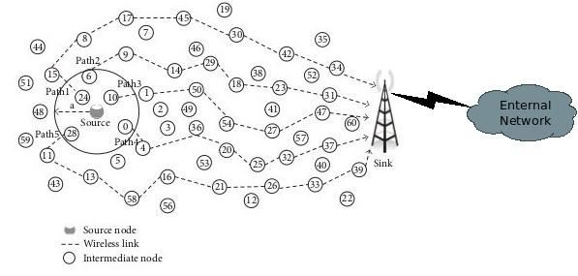
Fig 5: Multipath Routing
Single Path Routing Algorithm
The model incorporates two basic features:
Find single shortest path using source to destination
Find best hop by using Fuzzy cardinal priority ranking

Slide 16
Algorithm MPRA
Step1: Deploy nodes in a specified or decided sensing field in a random manner and initialize each node with some amount of initialize energy.
Step2: Delay of particular link is distributed randomly in a network.
Step3: Assign a unique identification number to each node 0in a network.
Step4: By the use of greedy approach find the multiple optimal or best paths from source node towards base station (BS) and stored in a routing table.
Step5: Follow fuzzy cardinal priority ranking algorithm to find the best optimal path by using the parameters transmission energy, remaining energy, hop count and delay.
Step6: If the optimal path is obtained in a result go to step 8. If the resultant is not an optimal path then go to step 7.
Step7: If no path exists between node and base station in routing table then packet is dropped and go to step 10.
Step8: Now the transmission of data take place through this path and this process will consume the energy (as specified in radio model) and increase the packet received variable by 1 go to step 10. If the remaining energy of any node is less than the required transmission and receiving energy then the node is considered as dead and the current path is discarded. Go to step 9.
Step9: Now choose a next optimal path from the routing table and apply step 6.
Step10: The process repeat until the energy of node is not equal to dead energy which will take the whole network down.

Slide 17
Algorithm Fuzzy Cardinal Priority Ranking
/* Paths_ List is actually list of list in the form [(a, b, 2, 4, 1) (b, c, 3, 6, 1)] */
1: Initialization
2: Total Fuzzy Energy Cost← 0
3: Total Fuzzy Delay Cost← 0
4: Total Fuzzy Hop count Cost← 0
5: For i ← 0 to length(Paths_List) do
6: Total Energy(i)←Sum of energy of each sub path of path
7: Total Delay(i)←Sum of delay of each sub path of path
8: Total Hop count(i)←Sum of hop counts of each sub path of path
9: End For
/*Total Energy, Total Delay, Total Hop count lists will be obtained*/
10: E_{max} ← maximum of Total Energy
11: E_{min} ← minimum of Total Energy
12: D_{max} ← maximum of Total Delay
13: D_{min} ← minimum of Total Delay
14: H_{max} ← maximum of Total Hop count

Slide 18
Contd.
15: H_{min} ← minimum of Total Hop count
16: For i ← 0 to length(Paths_List) do
17: Fuzzy Energy Cost(i)← (E_{max} - i) / (E_{max} - E_{min} )
18: Fuzzy Delay Cost(i)← (D_{max} - i) / (D_{max} - D_{min} )
19: Fuzzy Hop count Cost(i)← (H_{max} - i) / (H_{max} - H_{min})
20: Total Fuzzy Energy Cost=Total Fuzzy Energy Cost(i) + Fuzzy Energy Cost(i)
21: Total Fuzzy Delay Cost=Total Fuzzy Delay Cost(i) + Fuzzy Delay Cost(i)
22: Total Fuzzy Hop count Cost = Total Fuzzy Hop count Cost(i) + Fuzzy Hop count Cost(i)
23: End For
/*This will give cost list according to all three parameters in range of 0 to 1*/
24: Sum← Total Fuzzy Energy Cost + Total Fuzzy Delay Cost + Total Fuzzy Hop count Cost
25: For j ← 0 to length(Fuzzy Energy Cost) do
26: βfactorlist(j) ← ( Fuzzy Energy Cost(j) + Fuzzy Delay Cost(j) + Fuzzy Hopcount Cost(j)) / Sum
27: End For
28: β_{max}← maximum in β factor list
29: Return path with value β_{max}
/* maximum value of beta max gives first optimal path */

Slide 19
Result
Simulation performed with 100 nodes deployed randomly and uniformly in a sensing field of area 50m x 50m, taking 0.5 J/node as initial energy.
Delay is distributed randomly among the links
Base station is Fixed at location (50,150).

Slide 20
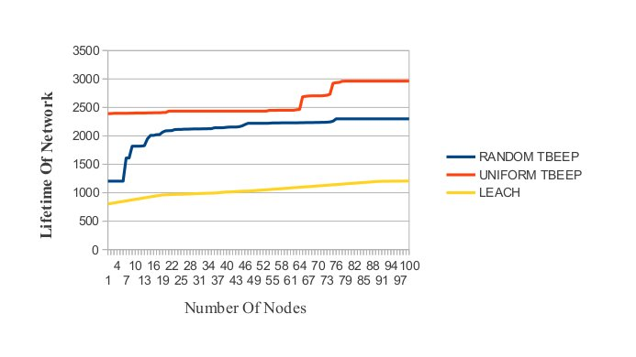
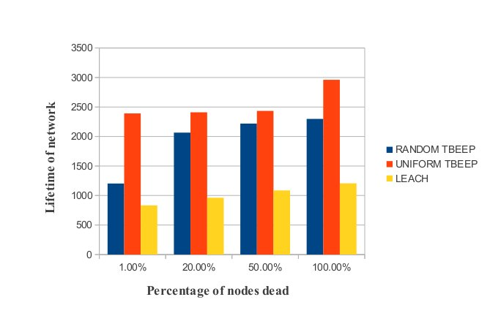
Fig 6: Round number corresponding to which a node dies
Fig 7: Simulation results for a 50m*50m network with initial energy 0.5J/node

Slide 21
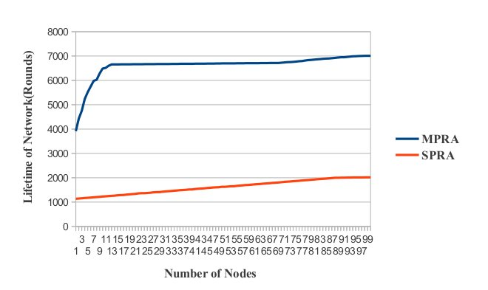
1 | Initial Energy | 0.5 Joule
2 | Packet size | 2000 bits
3 | E_{elect} | 5nj/bit
4 | E_{amp} | 100pj/bit/m²
5 | Number of Nodes | 100
6 | Area | 50*50m²
7 | Dead Energy | 0.002 Joule
8 | Threshold Energy | 0.256 Joule
9 | Position of BS | (50,100)
10 | Range | 20 meter
11 | Delay | 20ms
TABLE I. Input Requirements
Fig 8: lifetime of network

Slide 22
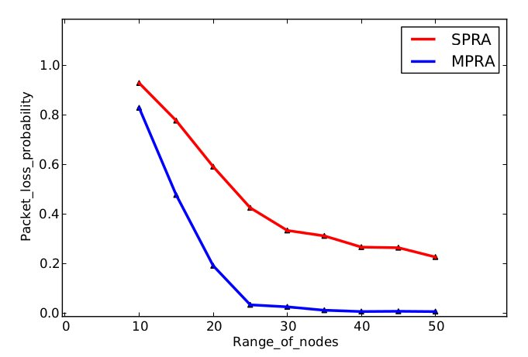
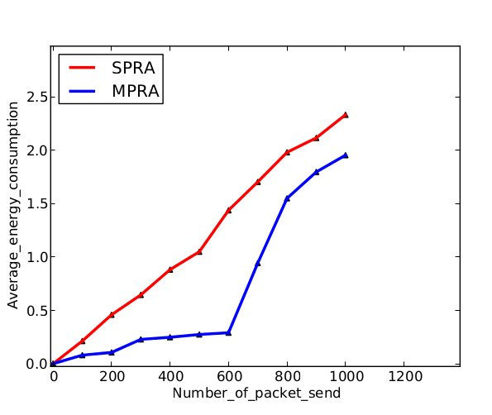
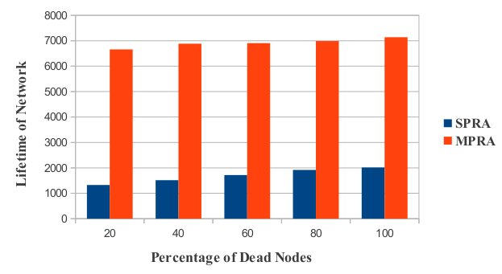
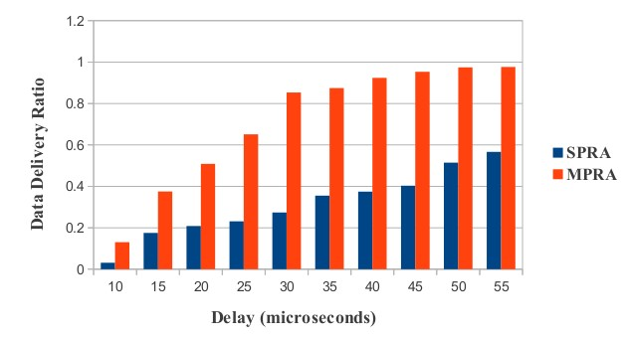
Fig 10: Average Energy consumption
Fig 9: packet loss probability
Fig 11: Percentage od dead node
Fig 12: Data Delivery Ratio

Slide 23
In this paper, MPRA is proposed and compared with an existing SPRA protocol. The simulation results explain that the proposed algorithm is 2.5 times better than SPRA. In Multipath routing algorithm, a backup path is used when current selected path is unable to forward the packet to the base station. The energy consumption for both the schemes is less in comparison to LEACH. These proposed algorithms increase the lifetime of the network by increasing the number of rounds. As a future reference one can think of using heterogeneous energy and apply security. In future, the network can be made more reliable by data storage capability, because in these algorithms if receiver node died before accepting data from sender all data will be lost.
Conclusion and Future Scope

Slide 24
Contribution to Society
The protocol generated improves sensors lifetime which make this work useful in multiple applications. It can help in various projects like large scale environment monitoring, health monitoring. During border area surveillance (notice illegal activities), Traffic Control System (informs person on priory about traffic on that path), predicting fire behavior in fields, it will be beneficial. It will also be favorable in cases like, movement tracking of vehicles, and wild animals, etc. These days WSN’s are in almost every field and reduced energy consumption is a primary requirement. Thus protocol designed is going to be very advantageous for society.

Slide 25
References
[1] Heinzelman, Wendi Rabiner, Anantha Chandrakasan, and Hari Balakrishnan "Energy-efficient communication protocol for wireless micro sensor networks," In System Sciences Proceedings of the 33rd Annual Hawaii International Conference IEEE, 2000, pp. 1-10.
[2] Lindsey, Stephanie, and Cauligi S. Raghavendra, "PEGASIS: Power-efficient gathering in sensor information systems," In Aerospace conference proceedings IEEE, Vol. 3, 2002, pp.1125-1130.
[3] Tan, Huseyin Qzgur, and Ibrahim Korpeoglu, "Power ecient data gathering and aggregation in wireless sensor networks," ACM Sigmod Record, Vol. 32, No. 4 , 2003 , pp. 66-71.
[4] AManjeshwar, Arati, and Dharma P. Agrawal, "TEEN: A routing protocol for enhanced efficiency in wireless sensor networks," In IPDPS, Vol. 1, 2001, pp. 189-196.
[5] Jung, Jongsik, Taekeun Park, and Cheeha Kim, "A forwarding scheme for reliable and energy-ecient data delivery in cluster-based sensor networks," Communications Letters, Vol. 9, No. 2, 2005, pp.112-114.
[6] H Junping, Hu, Jin Yuhui, and Dou Liang. "A time-based cluster-head selection algorithm for LEACH." In Symposium on Computers and Communications IEEE, 2008, pp. 1172-1176.

Slide 26
[7] Xin Liu, Quanyu Wang and Xuliang Jin, "An energy-efficient routing protocol for wire-less sensor networks," Proceedings of the 7th World Congress on Intelligent Control and Automation IEEE,2008, pp.1728-1735. [8] Akramul Azim and Mohammad Mahfuzul Islam, "Hybrid LEACH: A relay node based low energy adaptive clustering hierarchy for wireless sensor networks," Proceedings of the 9th Malaysia International Conference on Communications IEEE, 2009, pp. 325-339. [9] Zhong Shen, Yilin Chang, Hai Jiang, Member, Yanling Wang, and Zhongjiang Yan, "A generic framework for optimal mobile sensor deployment," IEEE Transactions on Vehicular Technology, Vol. 59, No. 8, 2010, pp. 4043-4057. [10] Jisoo Shin and Changjin Suh, "CREEC: chain routing with even energy consumption,“ Journal of Communication and Networks, Vol. 13, No. 1, FEBRUARY 2011, pp. 17-25. [11] S. H. Gajjar, K. S. Dasgupta, S. N. Pradhan, K. M. Vala, "Lifetime improvement of LEACH protocol for wireless sensor network," in proc. International Conference of Engineering IEEE, 2013, pp. 1-6. [12] Rupesh Mehta, Abhishek Pandey and Pratik Kapadia, "Reforming Clusters Using C-LEACH in Wireless Sensor Networks," International Conference on Computer Commnication and Informatics, IEEE, 2012, pp.1-4. [13]Rupesh Mehta, Abhishek Pandey and Pratik Kapadia, "Reforming Clusters Using C- LEACH in Wireless Sensor Networks," International Conference on Computer Communication and Informatics, IEEE, 2012, pp.1-4.

Slide 27
Thank you

