Slide 1
SegNet

Slide 2
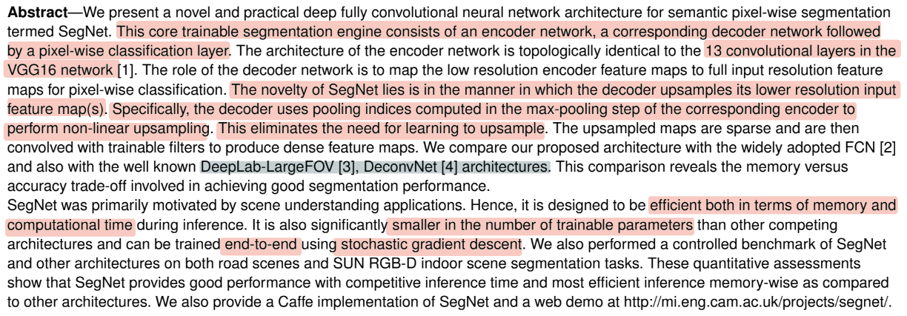
Abstract

Slide 3
Introduction
Now there is an active interest for semantic pixel-wise labelling
However, some of these recent approaches have tried to directly adopt deep architectures designed for category prediction to pixel-wise labelling
The results, although very encouraging, appear coarse.
This is primarily because max pooling and sub-sampling reduce feature map resolution.

Slide 4
Introduction
Our motivation to design SegNet arises from this need to map low resolution features to input resolution for pixel-wise classification. This mapping must produce features which are useful for accurate boundary localization.
Model appearance (road, building), shape (cars, pedestrians) and understand the spatial-relationship (context) between different classes such as road and side-walk.
The engine must also have the ability to delineate objects based on their shape despite their small size
Notes:
SegNet은 다음과 같이 road scene understading을 목적으로 설계되었다.Appearance(도로, 건물 등), shape(자동차, 보행자 등)를 잘 인식하고 다른 class간의 spatial-relationship(context)를 이해할 수 있어야 함
Encoder에서 추출된 image representation으로부터 boundary information을 유지하는 것이 중요
대부분 pixel을 차지하는 도로나 건물 같은 큰 object들에 대해서는 smooth segmentation을 생성할 수 있어야 함
또한, 보행자와 같은 작은 object에 대한 shape도 잘 나타낼 수 있어야 함

Slide 5
Introduction
From a computational perspective, it is necessary for the network to be efficient in terms of both memory and computation time during inference.
The ability to train end-to-end in order to jointly optimise all the weights in the network using an efficient weight update technique such as stochastic gradient descent (SGD)
Notes:
계산량 관점에서는 memory 및 inference time에서 효율적으로 동작할 수 있어야 함
전체 네트워크의 학습 파라미터를 end-to-end로 한번에 학습
빠르게 weight update를 반복하면서 수렴할 수 있는 SGD를 사용

Slide 6
Introduction
The encoder network in SegNet is topologically identical to the convolutional layers in VGG16
We remove the fully connected layers of VGG16 which makes the SegNet encoder network significantly smaller and easier to train than many other recent architectures
SegNet is the decoder network which consists of a hierarchy of decoders one corresponding to each encoder.
Appropriate decoders use the max-pooling indices received from the corresponding encoder to perform non-linear upsampling of their input feature maps
Notes:
Encoder
VGG16의 입력 이후 13개의 convolutional layer까지는 동일
학습 파라미터 수를 줄여서 쉽게 학습하기 위해 마지막의 fully connected layer는 제거
Decoder
Encoder와 동일한 계층 구조를 가짐
Encoder의 max pooling layer에서 위치정보(max-pool indices)를 받아서 non-linear upsampling을 수행
Boundary delineation 성능은 향상되면서 모델의 학습 파라미터 수는 크게 증가하지 않음

Slide 7
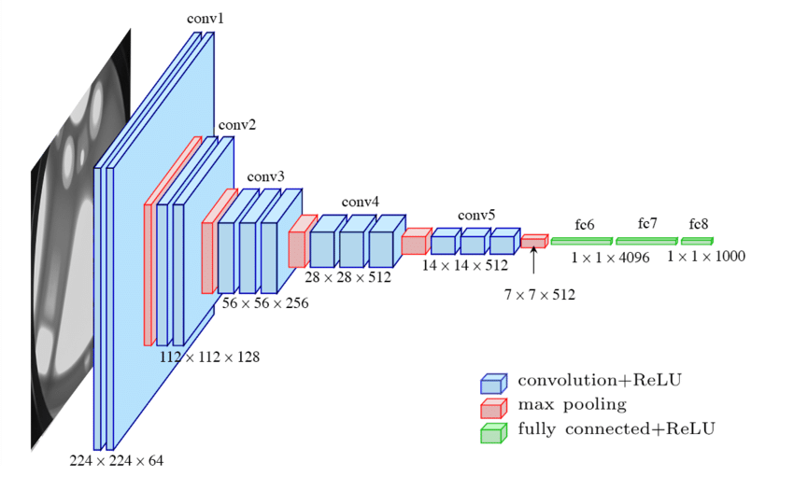
vgg16
conv : 3*3
activation = ‘ReLU’
maxpooling : 2*2
Classification

Slide 8
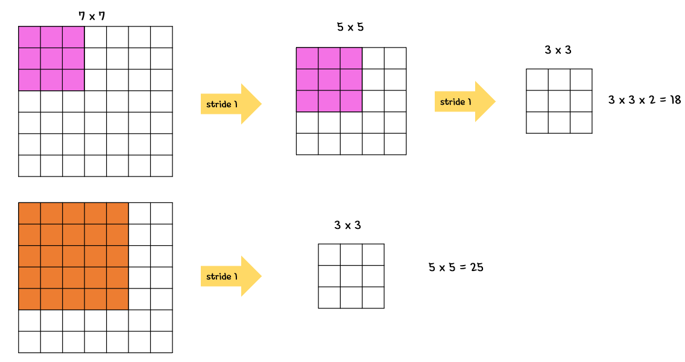
vgg16
3*3 filter : 학습의 속도가 빨라지며, 층의 개수가 늘어나면서 특성에 비선형성을 더 증가시켜 특성이 점점 더 유용

Slide 9
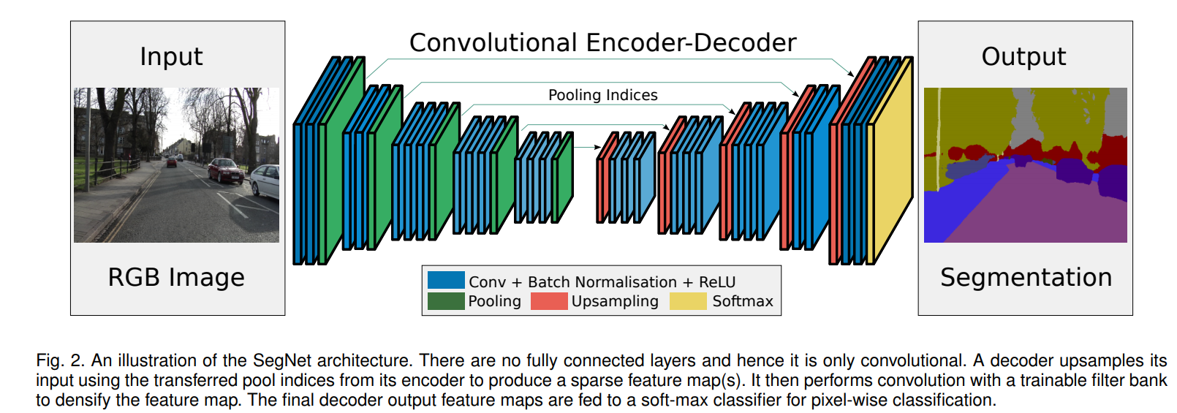
SegNet
Notes:
우선, SegNet 구조는 아래 그림 2와 같으며 encoder 구조는 VGG16에서 f.c layer를 제외한 것과 동일하다.
decoder의 경우 encoder의 mirrored 구조

Slide 10
SegNet - Encoder

Slide 11
SegNet - Encoder
vgg13 : remove 3 fully connected layer → reduce the number of parameters(9배 속도 향상)
conv→BN →ReLU → max pooling(2*2,2)
Notes:
f.c layer를 제외한 이유는 SegNet이 메모리 사용량, 계산량 등 computation cost 측면에서 강점을 가지기 위해 f.c layer를 제외하였다.
2x2 Max pooling을 수행하는 동안에 해당하는 Max Pooling Indeices(위치정보를 의미)를 저장한다

Slide 12
SegNet - Decoder
Notes:
vgg16을 거꾸로 진행하면서 pooling대신 upsampling을 사용하면

Slide 13
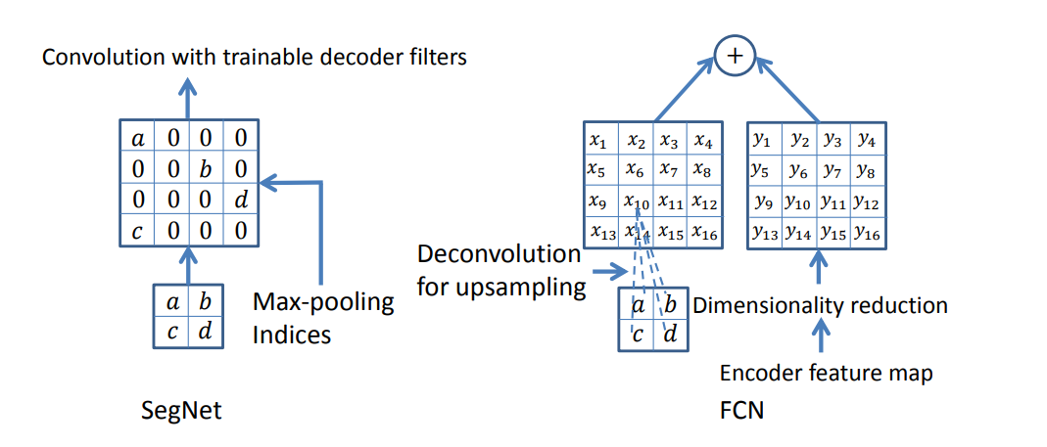
SegNet - Decoder
SegNet has an encoder network and a corresponding decoder network
Decoder network upsamples its input feature map using the memorized max-pooling indices from the corresponding encoder feature map → Max-pooling Indices
Notes:
Upsampling과 Convolution을 수행하며, 마지막 Layer에는 각 픽셀의 class 예측을 위한 softmax classifier가 존재한다.
max에 해당되는 위치정보를 저장했으니 그에 따라

Slide 14
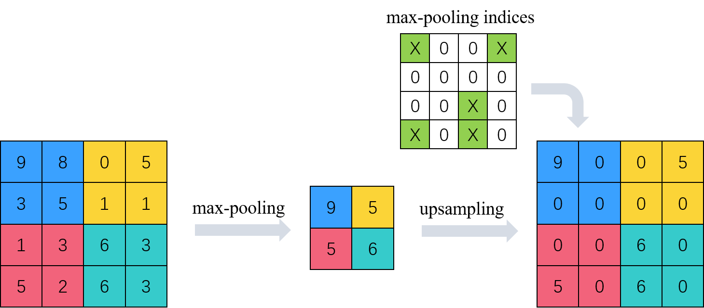
Max-pooling indices
Notes:
SegNet은 encoder의 feature map 정보를 효율적으로 decoder로 전달하여 boundary delineation을 향상시키면서 메모리도 아끼는 방식을 사용하였다.Segmentation의 boundary delineation을 위해 encoder의 feature map에서 boudary 정보를 capture and store하는 것은 필수적이다.
accuracy는 아주 조금 감소하지만 memory는 크게 아낄 수 있음

Slide 15
Architecture
The output of the soft-max classifier is a K channel image of probabilities where K is the number of classes
Advantages
(i) it improves boundary delineation
(ii) it reduces the number of parameters enabling end-to-end training,
(iii) this form of upsampling can be incorporated into any encoder-decoder architecture such as with only a little modification
Notes:
1) boundary delineation(번역 : 경계 묘사)를 향상시킬 수 있다.
2) end-to-end를 가능케하는 파라미터 개수를 줄일 수 있다.
3) 이러한 upsampling 방식은 모든 encoder-decoder 형식에 통합될 수 있다.

Slide 16
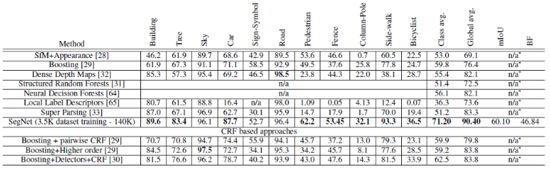
Result
Segnet is best performance

Slide 17
Code
파이토치
https://github.com/vinceecws/SegNet_PyTorch/blob/master/SegNet.py
텐서플로우
https://github.com/toimcio/SegNet-tensorflow/blob/master/SegNet.py

Slide 18
self.norm1 = tf.nn.lrn(self.inputs_pl, depth_radius=5, bias=1.0, alpha=0.0001, beta=0.75, name='norm1')
 | # first box of convolution layer,each part we do convolution two times, so we have conv1_1, and conv1_2
 | self.conv1_1 = conv_layer(self.norm1, "conv1_1", [3, 3, 3, 64], self.is_training_pl, self.use_vgg,
 | self.vgg_param_dict)
 | self.conv1_2 = conv_layer(self.conv1_1, "conv1_2", [3, 3, 64, 64], self.is_training_pl, self.use_vgg,
 | self.vgg_param_dict)
 | self.pool1, self.pool1_index, self.shape_1 = max_pool(self.conv1_2, 'pool1')
 | # Second box of convolution layer(4)
 | self.conv2_1 = conv_layer(self.pool1, "conv2_1", [3, 3, 64, 128], self.is_training_pl, self.use_vgg,
 | self.vgg_param_dict)
 | self.conv2_2 = conv_layer(self.conv2_1, "conv2_2", [3, 3, 128, 128], self.is_training_pl, self.use_vgg,
 | self.vgg_param_dict)
 | self.pool2, self.pool2_index, self.shape_2 = max_pool(self.conv2_2, 'pool2')
 | # Third box of convolution layer(7)
 | self.conv3_1 = conv_layer(self.pool2, "conv3_1", [3, 3, 128, 256], self.is_training_pl, self.use_vgg,
 | self.vgg_param_dict)
 | self.conv3_2 = conv_layer(self.conv3_1, "conv3_2", [3, 3, 256, 256], self.is_training_pl, self.use_vgg,
 | self.vgg_param_dict)
 | self.conv3_3 = conv_layer(self.conv3_2, "conv3_3", [3, 3, 256, 256], self.is_training_pl, self.use_vgg,
 | self.vgg_param_dict)
 | self.pool3, self.pool3_index, self.shape_3 = max_pool(self.conv3_3, 'pool3')
 | # Fourth box of convolution layer(10)
 | if self.bayes:
 | self.dropout1 = tf.layers.dropout(self.pool3, rate=(1 - self.keep_prob_pl),
 | training=self.with_dropout_pl, name="dropout1")
 | self.conv4_1 = conv_layer(self.dropout1, "conv4_1", [3, 3, 256, 512], self.is_training_pl, self.use_vgg,
 | self.vgg_param_dict)
 | else:
 | self.conv4_1 = conv_layer(self.pool3, "conv4_1", [3, 3, 256, 512], self.is_training_pl, self.use_vgg,
 | self.vgg_param_dict)
 | self.conv4_2 = conv_layer(self.conv4_1, "conv4_2", [3, 3, 512, 512], self.is_training_pl, self.use_vgg,
 | self.vgg_param_dict)
 | self.conv4_3 = conv_layer(self.conv4_2, "conv4_3", [3, 3, 512, 512], self.is_training_pl, self.use_vgg,
 | self.vgg_param_dict)
 | self.pool4, self.pool4_index, self.shape_4 = max_pool(self.conv4_3, 'pool4')
 | # Fifth box of convolution layers(13)
 | if self.bayes:
 | self.dropout2 = tf.layers.dropout(self.pool4, rate=(1 - self.keep_prob_pl),
 | training=self.with_dropout_pl, name="dropout2")
 | self.conv5_1 = conv_layer(self.dropout2, "conv5_1", [3, 3, 512, 512], self.is_training_pl, self.use_vgg,
 | self.vgg_param_dict)
 | else:
 | self.conv5_1 = conv_layer(self.pool4, "conv5_1", [3, 3, 512, 512], self.is_training_pl, self.use_vgg,
 | self.vgg_param_dict)
 | self.conv5_2 = conv_layer(self.conv5_1, "conv5_2", [3, 3, 512, 512], self.is_training_pl, self.use_vgg,
 | self.vgg_param_dict)
 | self.conv5_3 = conv_layer(self.conv5_2, "conv5_3", [3, 3, 512, 512], self.is_training_pl, self.use_vgg,
 | self.vgg_param_dict)
 | self.pool5, self.pool5_index, self.shape_5 = max_pool(self.conv5_3, 'pool5')
 | # ---------------------So Now the encoder process has been Finished--------------------------------------#
 | # ------------------Then Let's start Decoder Process-----------------------------------------------------#
 | # First box of deconvolution layers(3)
 | if self.bayes:
 | self.dropout3 = tf.layers.dropout(self.pool5, rate=(1 - self.keep_prob_pl),
 | training=self.with_dropout_pl, name="dropout3")
 | self.deconv5_1 = up_sampling(self.dropout3, self.pool5_index, self.shape_5, self.batch_size_pl,
 | name="unpool_5")
 | else:
 | self.deconv5_1 = up_sampling(self.pool5, self.pool5_index, self.shape_5, self.batch_size_pl,
 | name="unpool_5")
 | self.deconv5_2 = conv_layer(self.deconv5_1, "deconv5_2", [3, 3, 512, 512], self.is_training_pl)
 | self.deconv5_3 = conv_layer(self.deconv5_2, "deconv5_3", [3, 3, 512, 512], self.is_training_pl)
 | self.deconv5_4 = conv_layer(self.deconv5_3, "deconv5_4", [3, 3, 512, 512], self.is_training_pl)
 | # Second box of deconvolution layers(6)
 | if self.bayes:
 | self.dropout4 = tf.layers.dropout(self.deconv5_4, rate=(1 - self.keep_prob_pl),
 | training=self.with_dropout_pl, name="dropout4")
 | self.deconv4_1 = up_sampling(self.dropout4, self.pool4_index, self.shape_4, self.batch_size_pl,
 | name="unpool_4")
 | else:
 | self.deconv4_1 = up_sampling(self.deconv5_4, self.pool4_index, self.shape_4, self.batch_size_pl,
 | name="unpool_4")
 | self.deconv4_2 = conv_layer(self.deconv4_1, "deconv4_2", [3, 3, 512, 512], self.is_training_pl)
 | self.deconv4_3 = conv_layer(self.deconv4_2, "deconv4_3", [3, 3, 512, 512], self.is_training_pl)
 | self.deconv4_4 = conv_layer(self.deconv4_3, "deconv4_4", [3, 3, 512, 256], self.is_training_pl)
 | # Third box of deconvolution layers(9)
 | if self.bayes:
 | self.dropout5 = tf.layers.dropout(self.deconv4_4, rate=(1 - self.keep_prob_pl),
 | training=self.with_dropout_pl, name="dropout5")
 | self.deconv3_1 = up_sampling(self.dropout5, self.pool3_index, self.shape_3, self.batch_size_pl,
 | name="unpool_3")
 | else:
 | self.deconv3_1 = up_sampling(self.deconv4_4, self.pool3_index, self.shape_3, self.batch_size_pl,
 | name="unpool_3")
 | self.deconv3_2 = conv_layer(self.deconv3_1, "deconv3_2", [3, 3, 256, 256], self.is_training_pl)
 | self.deconv3_3 = conv_layer(self.deconv3_2, "deconv3_3", [3, 3, 256, 256], self.is_training_pl)
 | self.deconv3_4 = conv_layer(self.deconv3_3, "deconv3_4", [3, 3, 256, 128], self.is_training_pl)
 | # Fourth box of deconvolution layers(11)
 | if self.bayes:
 | self.dropout6 = tf.layers.dropout(self.deconv3_4, rate=(1 - self.keep_prob_pl),
 | training=self.with_dropout_pl, name="dropout6")
 | self.deconv2_1 = up_sampling(self.dropout6, self.pool2_index, self.shape_2, self.batch_size_pl,
 | name="unpool_2")
 | else:
 | self.deconv2_1 = up_sampling(self.deconv3_4, self.pool2_index, self.shape_2, self.batch_size_pl,
 | name="unpool_2")
 | self.deconv2_2 = conv_layer(self.deconv2_1, "deconv2_2", [3, 3, 128, 128], self.is_training_pl)
 | self.deconv2_3 = conv_layer(self.deconv2_2, "deconv2_3", [3, 3, 128, 64], self.is_training_pl)
 | # Fifth box of deconvolution layers(13)
 | self.deconv1_1 = up_sampling(self.deconv2_3, self.pool1_index, self.shape_1, self.batch_size_pl,
 | name="unpool_1")
 | self.deconv1_2 = conv_layer(self.deconv1_1, "deconv1_2", [3, 3, 64, 64], self.is_training_pl)
 | self.deconv1_3 = conv_layer(self.deconv1_2, "deconv1_3", [3, 3, 64, 64], self.is_training_pl)
 | with tf.variable_scope('conv_classifier') as scope:
 | self.kernel = variable_with_weight_decay('weights', initializer=initialization(1, 64),
 | shape=[1, 1, 64, self.num_classes], wd=False)
 | self.conv = tf.nn.conv2d(self.deconv1_3, self.kernel, [1, 1, 1, 1], padding='SAME')
 | self.biases = variable_with_weight_decay('biases', tf.constant_initializer(0.0),
 | shape=[self.num_classes], wd=False)
 | self.logits = tf.nn.bias_add(self.conv, self.biases, name=scope.name)

Slide 19
END

