Slide 1
Data Mining Presentation #2
3조 배소미 유채린 한주연

Slide 2
Contents
Total Comparison
Train/Test File Analysis
Performance Analysis
Examples of False Positive and False Negative

Slide 3
Total Comparison
배소미
유채린
한주연
Merge 4 files with selected components (preprocessing)
↓
Extract Features per category
↓
Count the number of document with feature per each category
↓
Calculation chi-square of each features
↓
Each feature assigned Max chi-square value and make the train file (1~4)
↓
5th file preprocessing same way and apply vector space (test file)
↓
Run SVM
Merge 4 Files and create new file
The New file form is [category# Text contents]
↓
Extract features from merged file without duplication
↓
Count appearance of each feature
↓
Calculate chi-square of each features
↓
?
Merge 4 files
↓
Extract features from merged file without duplication
↓
Count appearance time of each feature from documents
↓
Calculate chi-square of each features
↓
Make a file for training
↓
Apply same vector space for making testing file
↓
Run SVM

Slide 4
Train/Test File Analysis
 | 배소미 | 유채린 | 한주연
Data Type | HashMap TreeSet | HashMap | Dictionary, List
Split character | , / . < > “ [ ] { } ‘ ; ? ! : ( ) 。 、# = + * $ & - \s | Eliminate special letters and continuous space | < > \s / . [ ] { } “ , ( ) ‘ :
Features | 572368 | 63,912 | 583600
Chi-square range | [0.17461258, 223.5008] | [0.0013013141, 306.51678] | [0.17461258, 2419.68729529]
Capacity | 49,873kb / 39,240 kb |  | 47,782 kb / 10,148 kb
* (Train) / (Test)
Notes:
참고로 메소드 두개이용해서,, split햇다구 하면 대갠내요,,
public static String StringReplace(String str)
public static String continueSpaceRemove(String str)

Slide 5
Performance Analysis
 | 배소미 | 유채린 | 한주연
Language | JAVA | JAVA | Python
Tool | Eclipse Neon | Eclipse Neon | PyCharm 2017.1.1
Accuracy | 40.4% |  | 69.0453% (2777/4022)
Code line | 587 lines / 190 lines |  | 186 lines / 33 lines
Lead time | Long .. |  | 10 minutes/ 55 seconds
Process | Intel® Core™ i3-6100U CPU @ 2.30 GHz | Intel® Core™ i5-5200U CPU @ 2.20 GHz | Intel® Core™ i3-6100U CPU @ 2.30 GHz
RAM | 4.00 GB | 8.00 GB | 8.00 GB
System | 64-bit, x64 | 64-bit, x64 | 64-bit, x64
* (Train) / (Test)

Slide 6
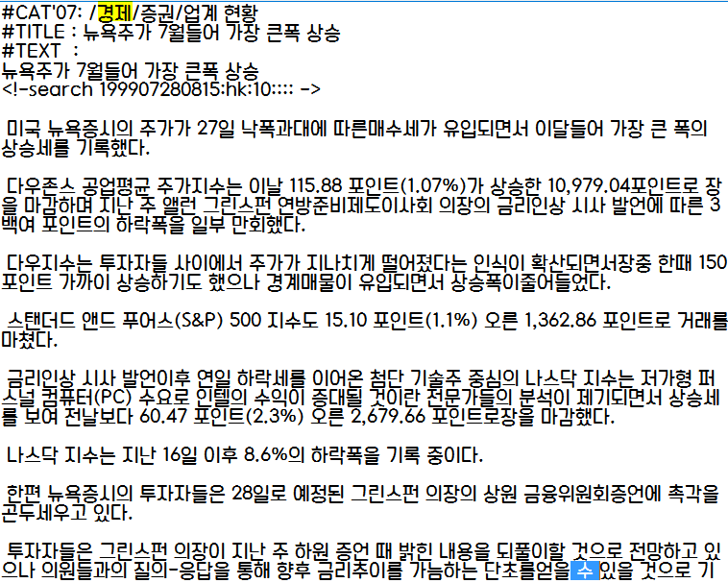
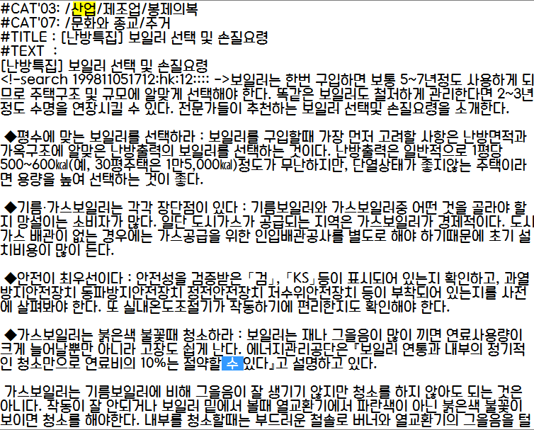
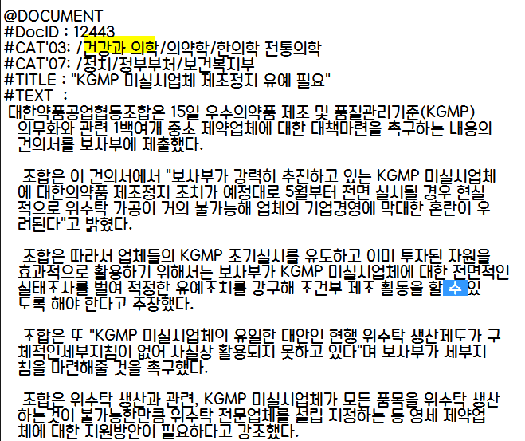
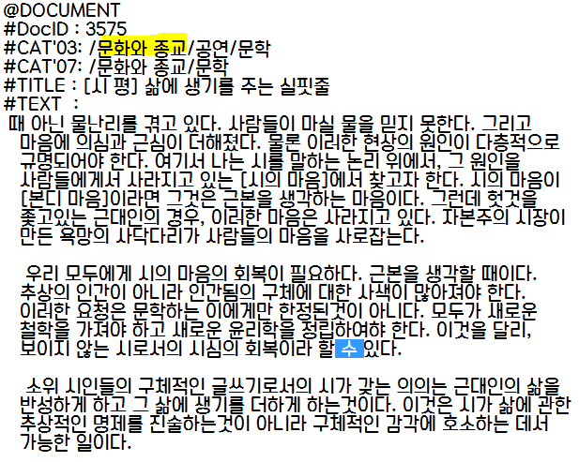
Examples of Error Factor
One-word duplication

Slide 7
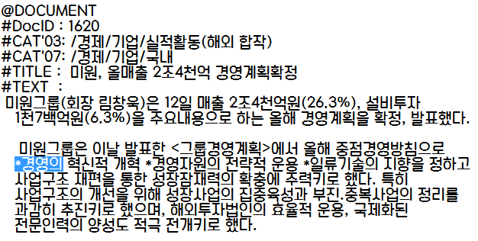
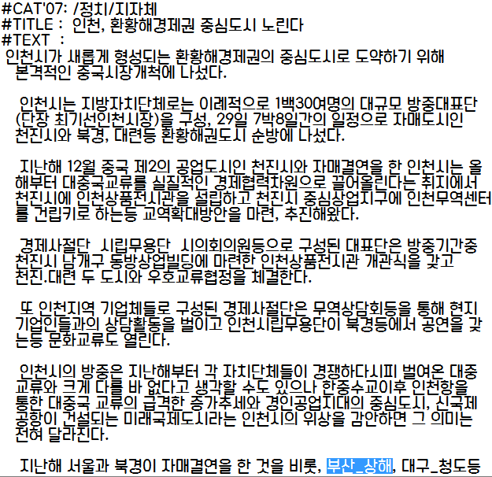
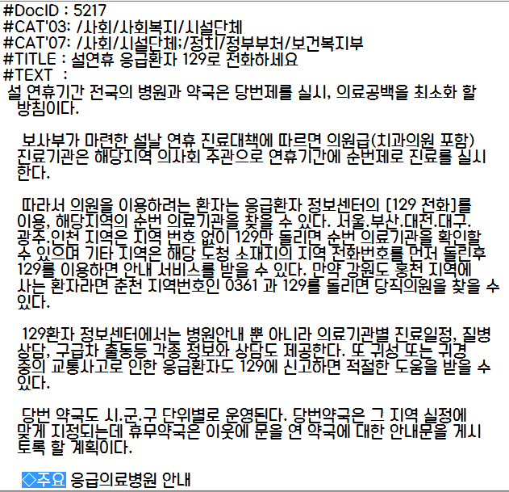
Examples of Error Factor
Un-handled special characters

Slide 8
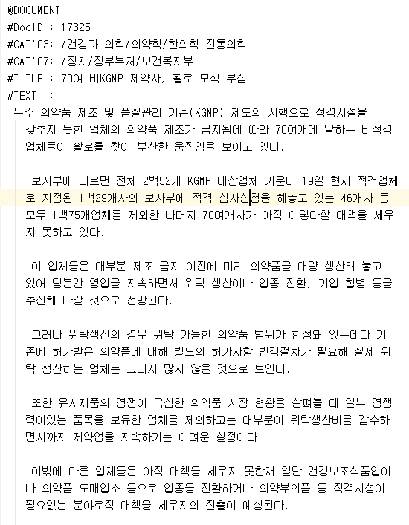
Examples of False Positive
Category Standard: 0.건강과 의학
Ordinary document category#: 0.건강과 의학
Output file document category#: 1.경제

Slide 9
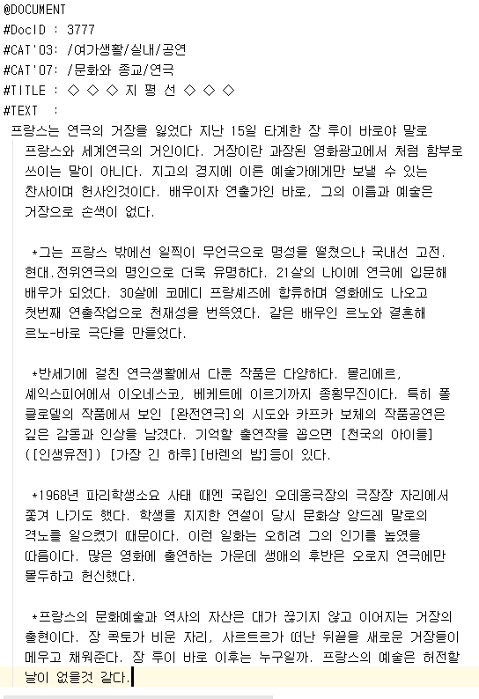
Examples of False Negative
Category Standard: 0.건강과 의학
Ordinary document category#: 7.여가생활
Output file document category#: 4.문화와 종교

Slide 10
Thank You.

