Slide 1
DataI/O 2025 Beginner Track Project
Presented by Team KFC:
Zheng Ni
Rocky Fang
Ken Ning

Slide 2
Contents
Introduction
Basic Distribution Around U.S.
Distribution by Map
Deeper Research
California – the Exception
Conclusion

Slide 3
Introduction
In this project, we did some data visualization and attempt to analyze deeper meanings and connections of the data.
Our project uses the dataset EV Charging Stations in the USA, and also used another dataset EV Registrations by State from U.S. Department of Energy. (https://afdc.energy.gov/data/10962)
As beginners to data analytics, our group started from visualization and did some deeper research in the process of both learning and using Python to deal with the dataset.

Slide 4
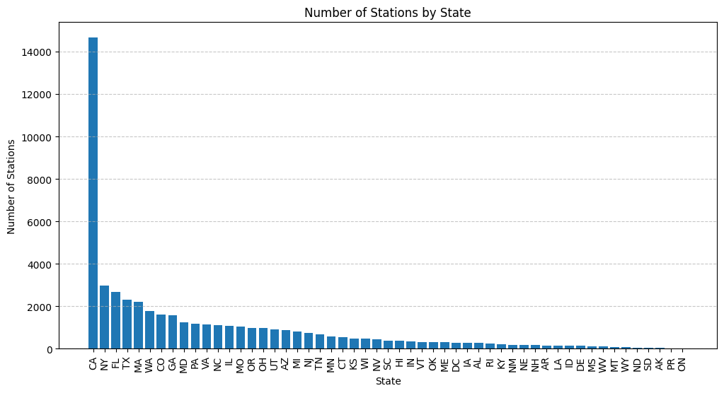
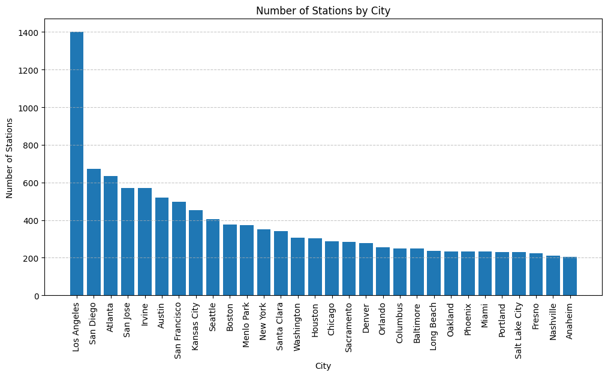
Basic Distribution Around U.S.
The easiest visualization: Bar chart based on EV Stations by state and by city.
From this, we can observe that California and the city of Los Angeles have the largest number of stations in the U.S.

Slide 5
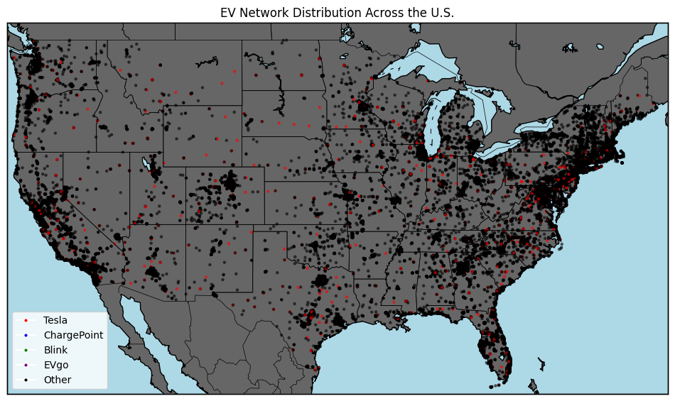
Distribution by Map
We first used Python’s basemap package to draw a map of the U.S. Then we used the latitudes and longitudes the dataset provides to get every station on the map.
We made EV Network as a parameter to show the various distribution of stations around the U.S.
The variance is very abundant, leaving only Tesla obvious.

Slide 6
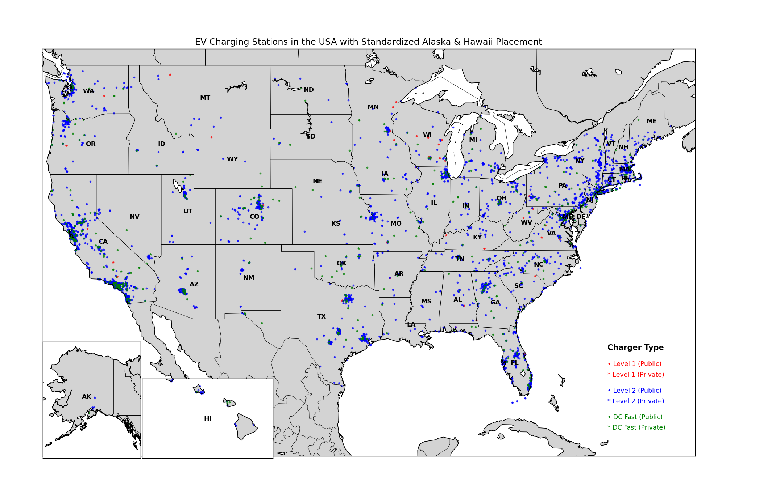
Distribution by Map
We further made a better map including Alaska and Hawaii and labeled it with charger types (different levels, private/public)
From this, we can observe that level 2 chargers have a much larger quantity than level 1 and DC Fast.

Slide 7
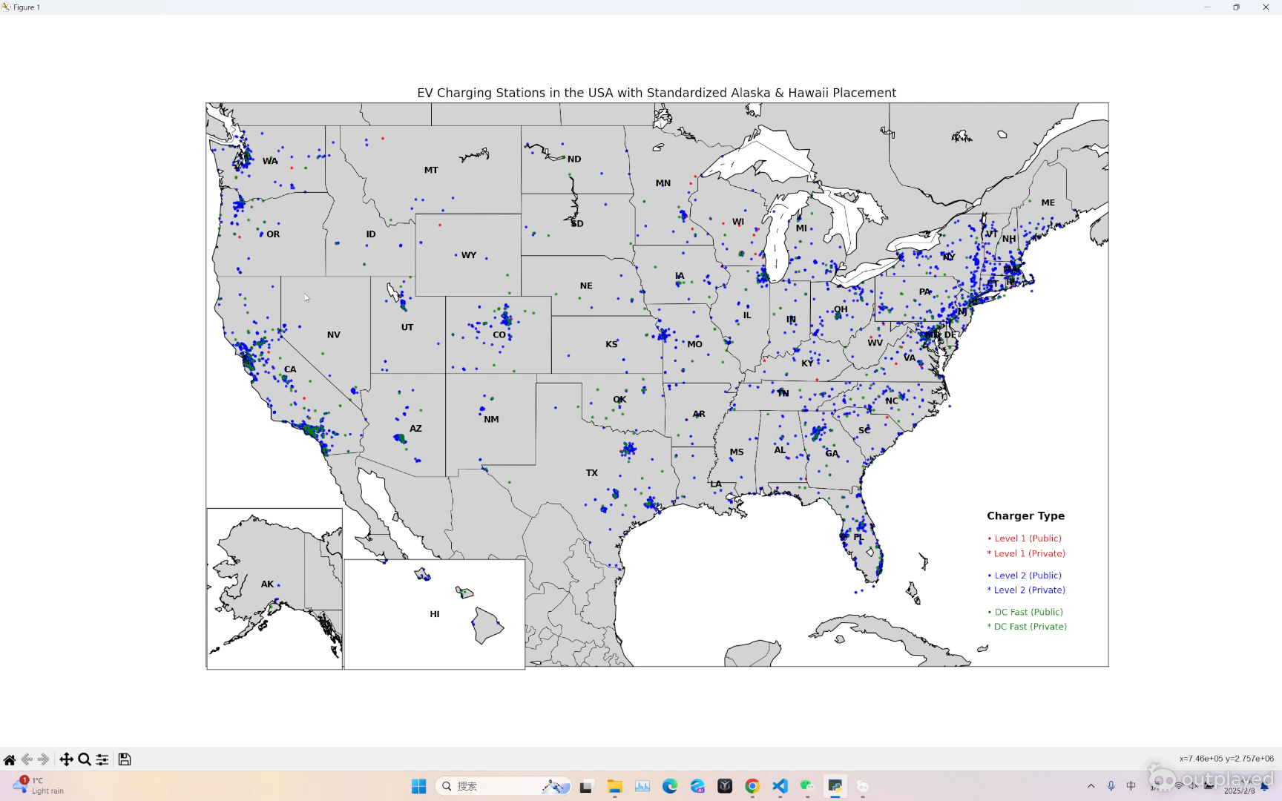
Distribution by Map
You can even interact with this map to find more details. Demo:

Slide 8
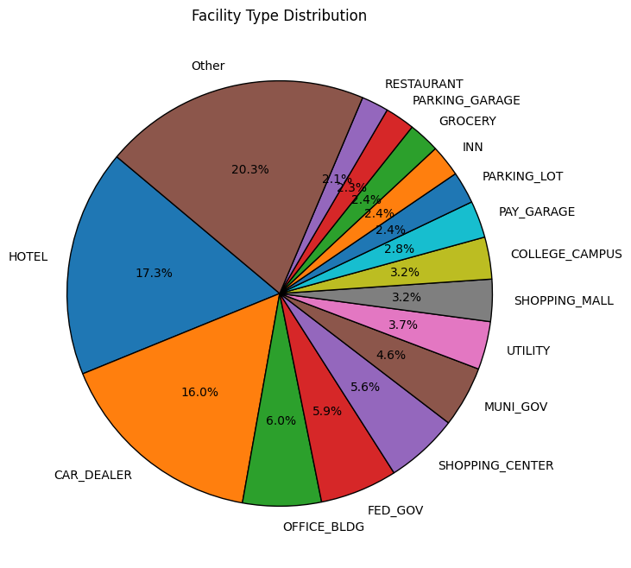
Deeper Research
To further evaluate the dataset, we tried to find more facts about EVs in the U.S.
Among the facility types, hotel and car dealer are the most popular.

Slide 9
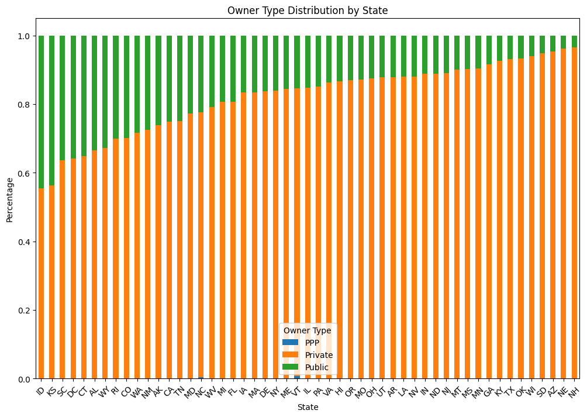
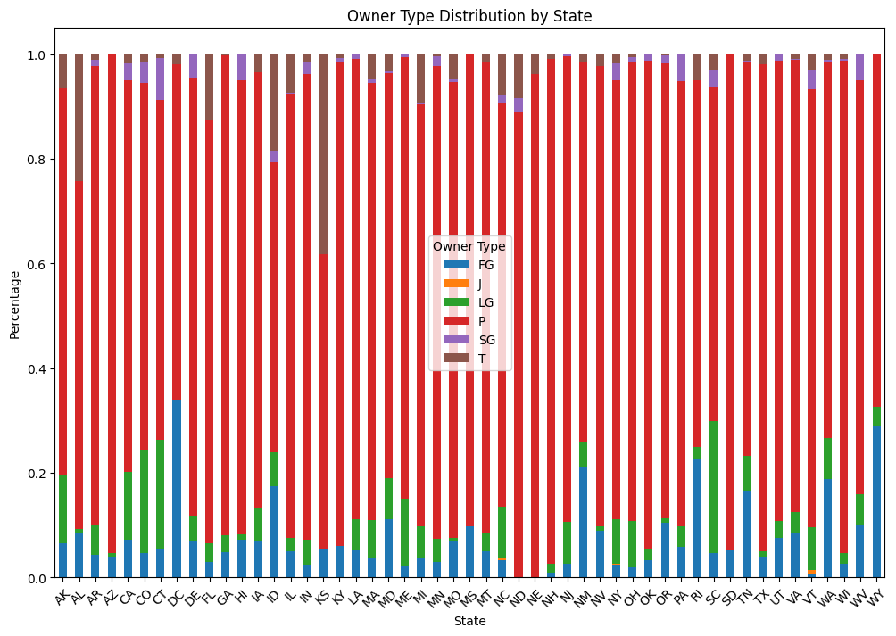
Deeper Research
Owner Type Distribution by State

Slide 10
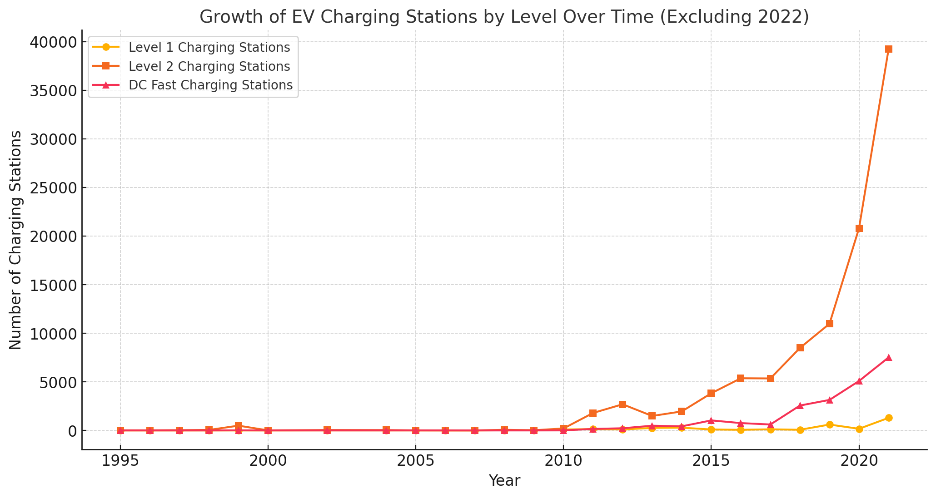
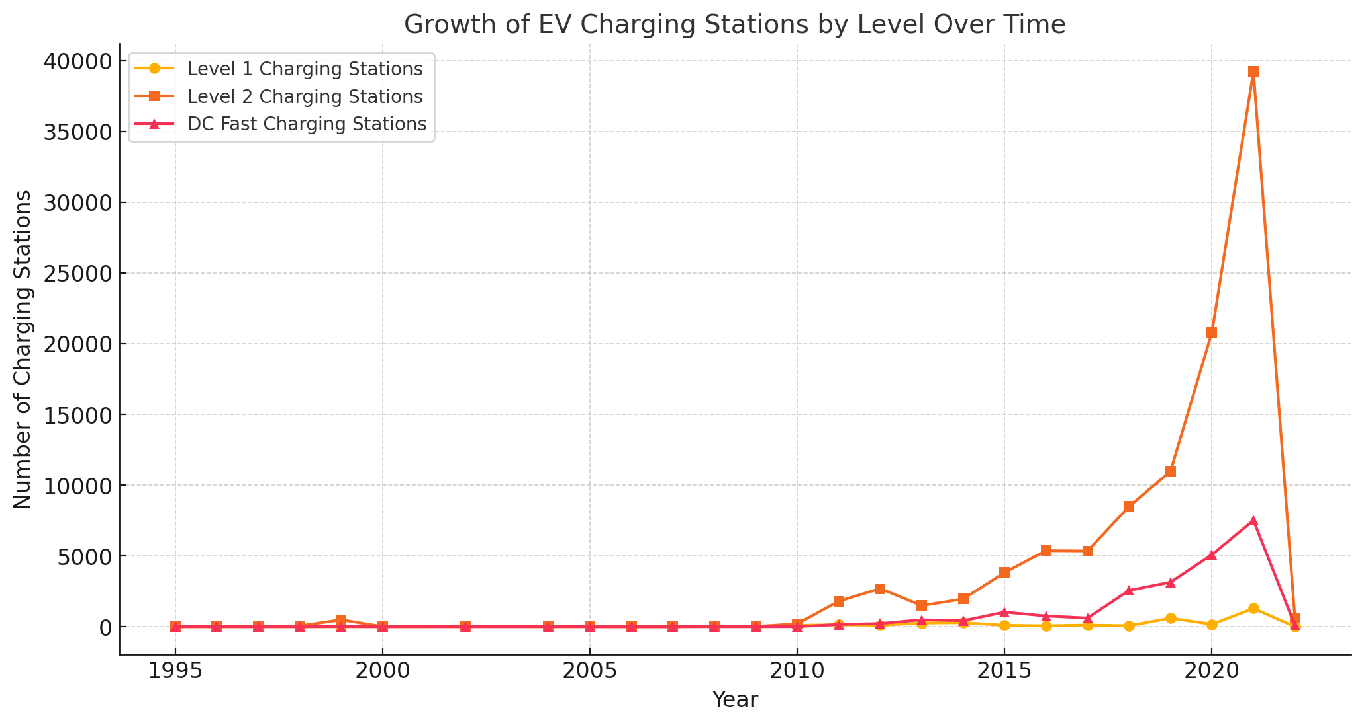
Deeper Research
Since 2022 seems to have an incomplete data, we removed the data of 2022 in later analysis.

Slide 11
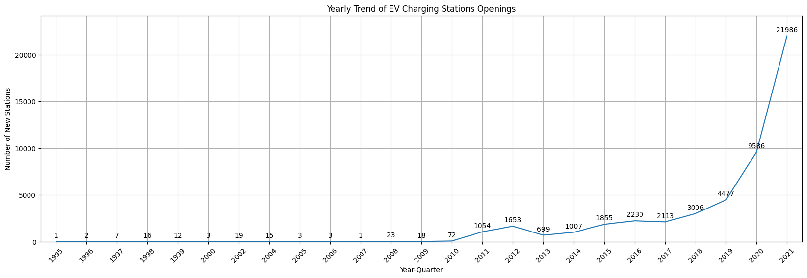
Deeper Research
The number of EV charging stations quickly raised in 2020 and 2021.

Slide 12
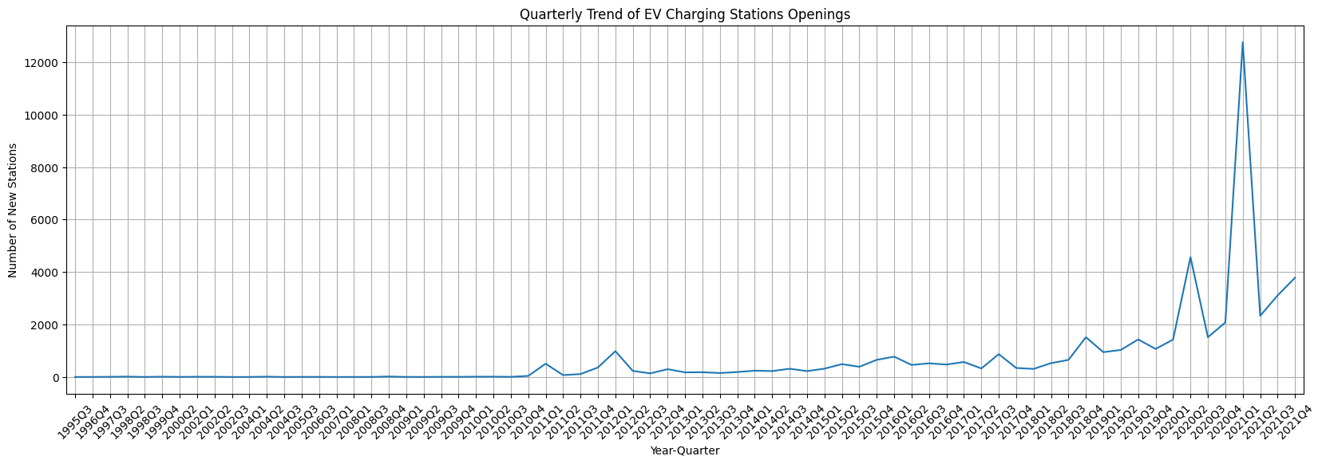
Deeper Research
A more detailed trend based on each quarter.

Slide 13
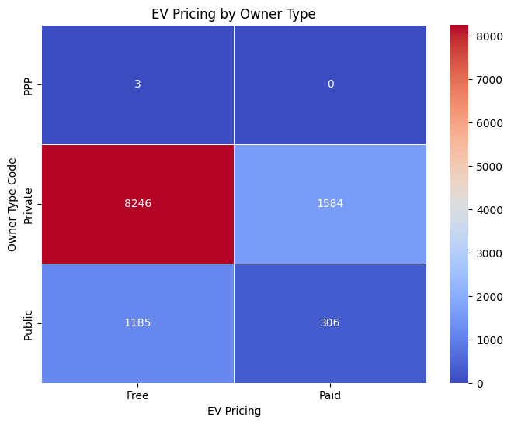
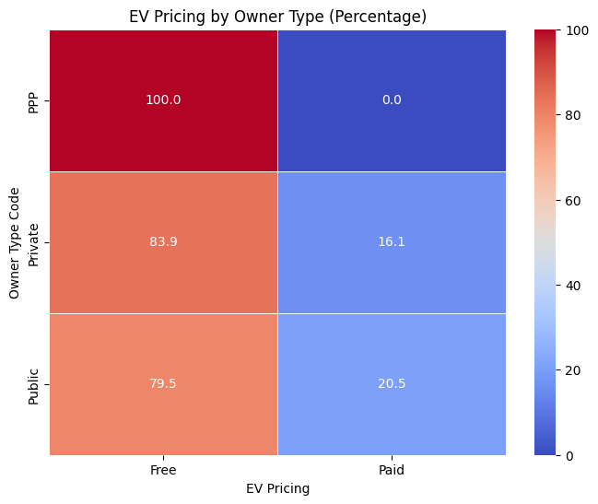
Deeper Research
We also tried to analyze if public/private would make difference in whether the charging station is free or not.
There are significantly more private stations, but it doesn’t show a big difference whether private or public would impact the charge.

Slide 14
Deeper Research
We collected data of EV registrations by states from the Internet, and tried to find the relationship between the registration number and station number.
Because of the difference, we dealt with EV registration count with a log to make the bar chart look better.

Slide 15
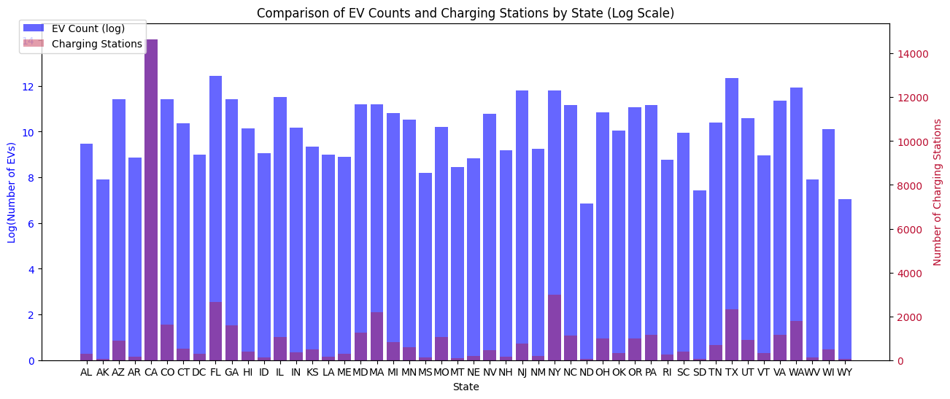
Deeper Research
California seemed to have too large numbers of EVs and EV charging stations, so we removed the data of CA for a later chart to make the trend clearer.
Actually it’s hard to get any conclusion from this chart.

Slide 16
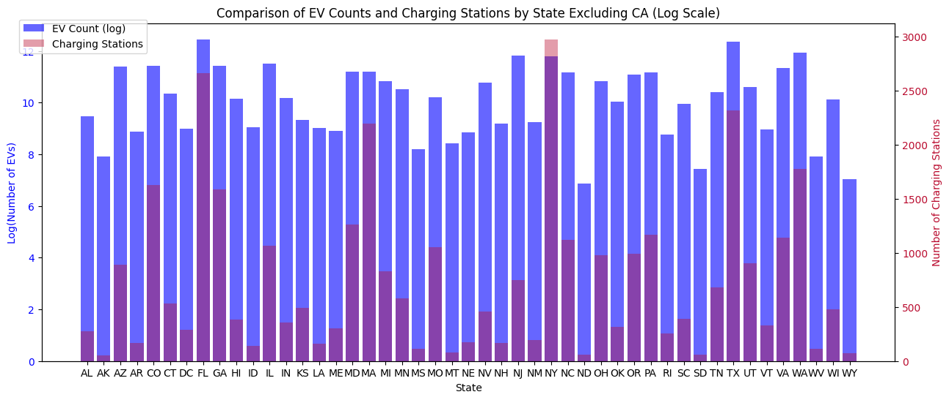
Deeper Research
It seems much better without the data of CA! (I’m sorry California ☹)
Though there are not strongly positively correlations for every state clearly, we can infer that the more EVs the state registers, the more EV charging stations it will have, most significant in NY and FL.

Slide 17
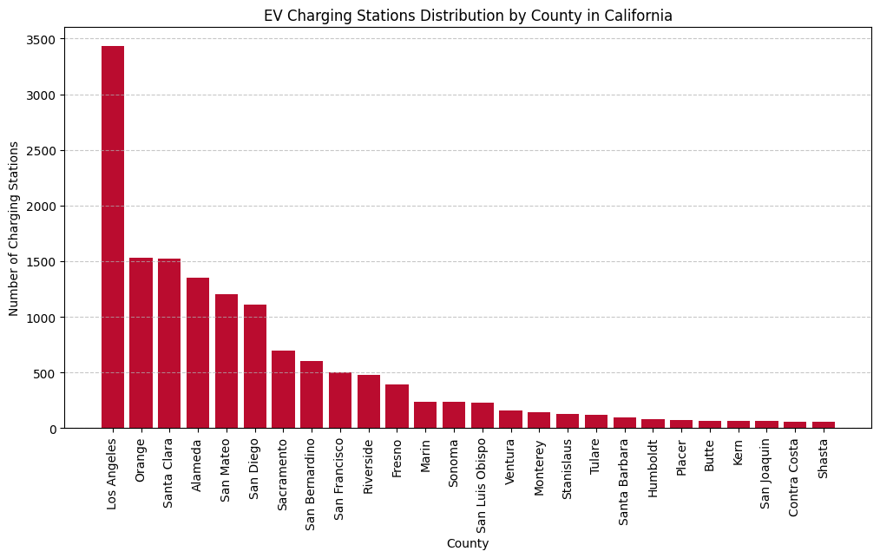
California Alone
CA has the LARGEST number of EV charging stations in the U.S., almost five times the second place NY, so we decided to make CA an exception and do some extra analysis on CA.
Here is the distribution by counties of CA:
Los Angeles County has the most.
This correlates to the distribution by cities in the U.S. (Though not exactly the same)

Slide 18
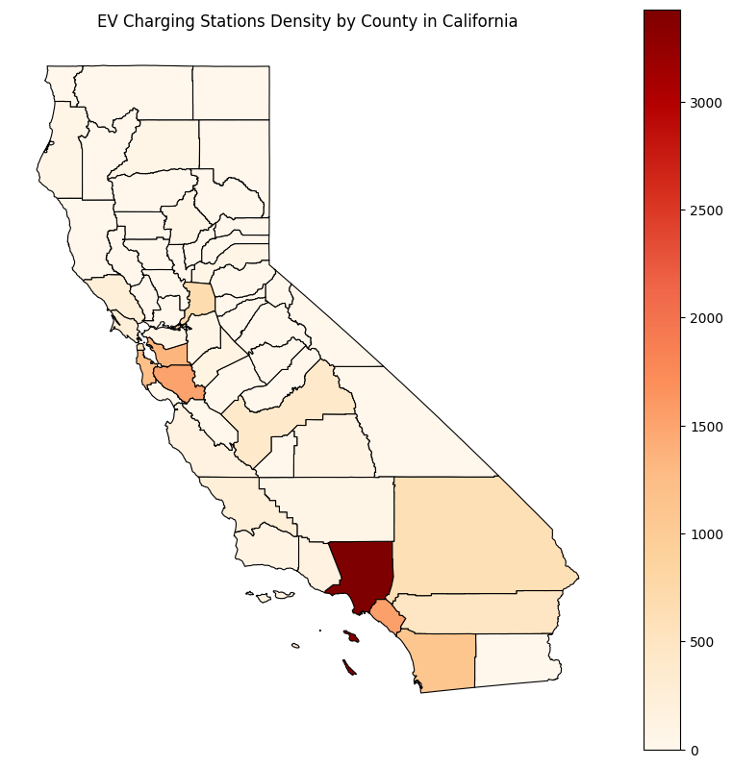
California Alone
We also created a heatmap for each county of California. It does not have a very clear view, but is enough for us to analyze the regions of CA that have the most EVs.
We got the map (.geojson file) from github.
(https://github.com/codeforgermany/click_that_hood/blob/main/public/data/california-counties.geojson)
South California and Bay area have the most EV charging stations, which are also two most significant regions in CA in economics.

Slide 19
Conclusion
Through the process of dealing with data analysis, we also practiced our ability to code with Python.
Pandas, Numpy, Seaborn, Matplotlib, Basemap, etc. The packages were used to help with our data visualization and analysis.
We did some very good work assignment and concluded a Python program of over 800 lines, producing about 20 diagrams.
Repository: https://github.com/onetrue-6657/dataio2025

