Slide 1
Azure DocumentDB
Santosh Hari

Slide 2
NoSQL
NoSQL is a marketing misnomer, it should be non-relational databases
Primary USPs
develop with agility
operate at any scale

Slide 3
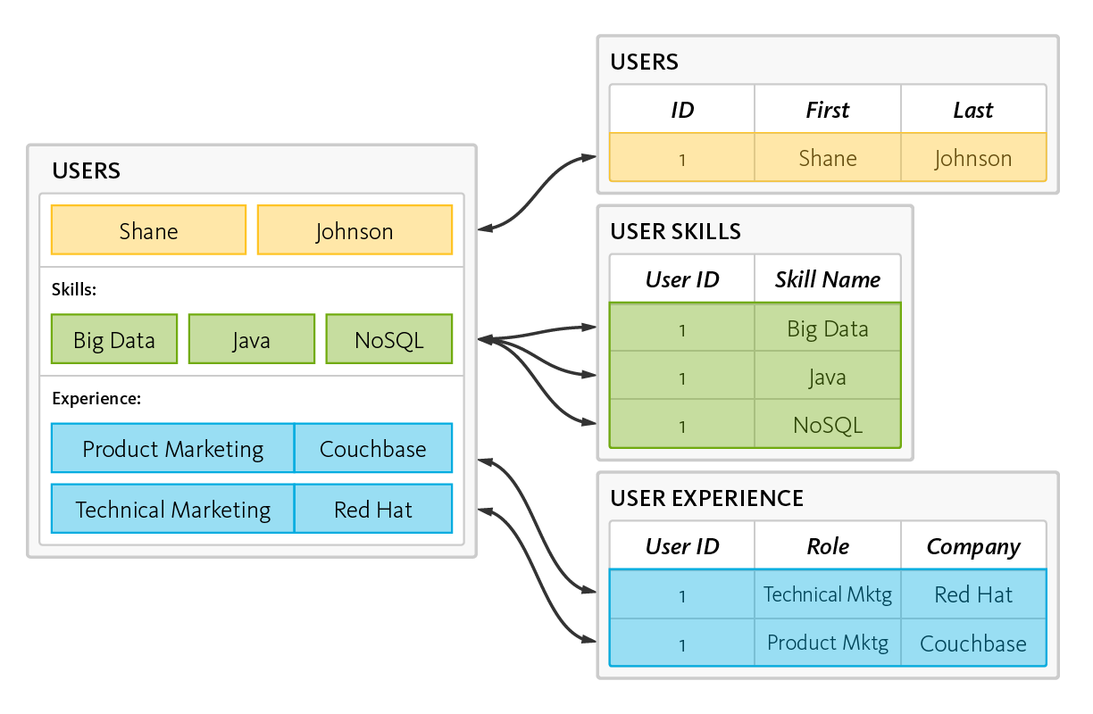
RDBMS – Reads, Writes, data shredding and reassembling
Notes:
data is read and written by disassembling, or “shredding,” and reassembling objects
This is the object-relational “impedance mismatch.” The workaround is object-relational mapping frameworks, which are inefficient at best, problematic at worst.

Slide 4
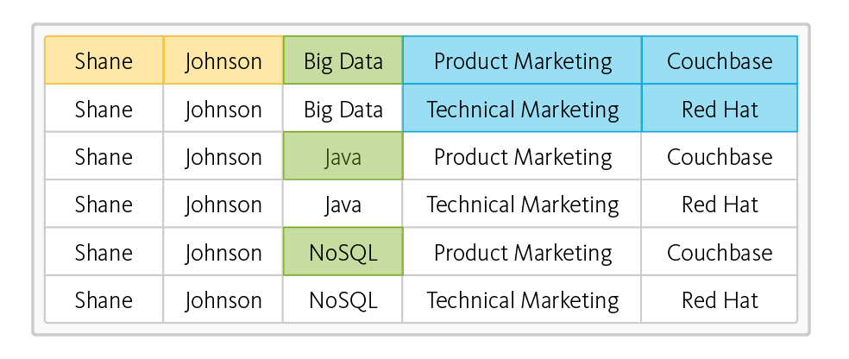
RDBMS – read operation – takes six rows from three tables
Notes:
This is the object-relational “impedance mismatch.” The workaround is object-relational mapping frameworks, which are inefficient at best, problematic at worst.

Slide 5
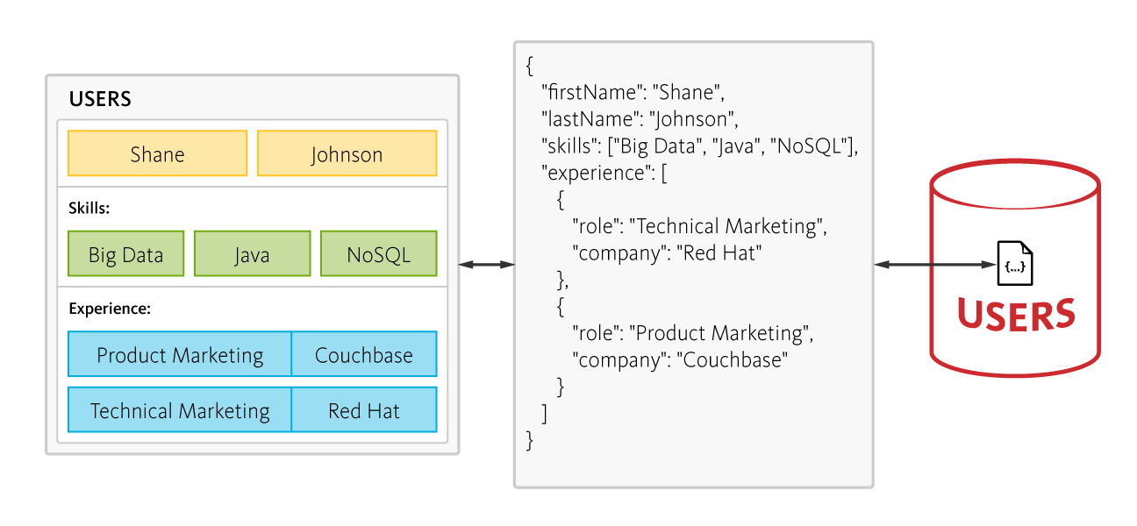
NoSQL – 6 rows of data, no joins, one fetch
Notes:
In contrast, a document-oriented NoSQL database reads and writes data formatted in JSON – which is the de facto standard for consuming and producing data for web, mobile, and IoT applications. It not only eliminates the object-relational impedance mismatch, it eliminates the overhead of ORM frameworks and simplifies application development because objects are read and written without “shredding” them – i.e., a single object can be read or written as a single document, as illustrated here:
DO NOT SWITCH SOLELY FOR THIS REASON!!!

Slide 6
NoSQL - Scale
RDBMS best at scaling up i.e add resources to one machine
Single point of failure
Cost and physical limitations
Always ACID, not much flexibility
NoSQL scale out – run on commodity hardware on multiple nodes
Easy to add and remove nodes to handle loads
No single PoF
Flexibility in handling trade offs (CAP Theorem)

Slide 7
SQL v/s NoSQL
 | SQL | NoSQL
Model | Relational | Non-relational
Storage | Tables | JSON docs, Key-value pairs, column stores, graphs
Data Properties | Every record in table has same properties | Flexibility in properties varies across records
Relationships | Uses joins | Uses denormalization
Schema | Strict | Flexible
ACID transactions | Supports | Varies by solution
Data Consistency | Strong | Variable
Scale | Vertical | Horizontal

Slide 8
SQL or NoSQL
NoSQL is a supplement/complement to SQL
Or vice versa
NOT a replacement
Polyglot persistence

Slide 9
Types of NoSQL
Document databases - JSON documents. Mongo, Azure DocumentDB
Graph stores - Neo4J and Giraph.
Key-value stores - Redis
Wide-column - Cassandra and Hbase
Notes:
Document databases pair each key with a complex data structure known as a document. Documents can contain many different key-value pairs, or key-array pairs, or even nested documents. Mongo, Azure DocumentDB
Graph stores are used to store information about networks of data, such as social connections. Graph stores include Neo4J and Giraph.
Key-value stores are the simplest NoSQL databases. Every single item in the database is stored as an attribute name (or 'key'), together with its value. Examples of key-value stores are Riak and Berkeley DB. Some key-value stores, such as Redis, allow each value to have a type, such as 'integer', which adds functionality.
Wide-column stores such as Cassandra and HBase are optimized for queries over large datasets, and store columns of data together, instead of rows.

Slide 10




NoSQL on Azure
 | DocumentDB | Table Storage | HBase | Redis Cache
Tech | Document | Key Value | Column Family | Redis (Key-Value)
Data storage | JSON docs on SSD | Entities in key-value pairs | Tables, rows, columns | In-mem Key-value
Query | SQL subset | oData subset | Hive and SQL subset | Command for search
Transaction boundaries | All docs in 1 collection | All entities in 1 partition | All cells in 1 row | Atomic operations
SP, UDF, Triggers | Yes | No | No | No

Slide 11
Other Azure products that work with NoSQL
Azure Search
Azure App Services
Azure Blob Storage
Azure SQL Database
Azure Machine Learning
Notes:
Azure Search can be used via the web app to enable users to search for posts.
Azure App Services can be used to host applications and background processes.
Azure Blob Storage can be used to store full user profiles including images.
Azure SQL Database can be used to store massive amounts of data such as login information, and data for usage analytics.
Azure Machine Learning can be used to build knowledge and intelligence that can provide feedback to the process and help deliver the right content to the right users.

Slide 12
Use cases for document dbs
User generated content – blogposts, chat sessions, ratings, comments, feedback, polls
Catalog data - user accounts, product catalogs, device registries for IoT
Logging and Time-series data – event logs, input source for data analytics jobs performed offline
Gaming – in-game stats, social media integration, and high-score leaderboards
User preferences data - modern web and mobile applications
IoT and Device sensor data - ingest bursts of data from device sensors, adhoc querying and offline analytics
Notes:
UGC in social media applications is a blend of free form text, properties, tags and relationships \not bounded by rigid structure.
Content such as chats, comments, and posts can be stored in DocumentDB without requiring transformations or complex object to relational mapping layers.
Data properties can be added or modified easily to match requirements as developers iterate over the application code, thus promoting rapid development.
Catalog Data - Attributes for this data may vary and can change over time to fit application requirements.Consider an example of a product catalog for an automotive parts supplier. Every part may have its own attributes in addition to the common attributes that all parts share. Furthermore, attributes for a specific part can change the following year when a new model is released. As a JSON document store, DocumentDB supports flexible schemas and allows you to represent data with nested properties, and thus it is well suited for storing product catalog data.
Logging - perform ad-hoc queries over a subset of data for troubleshooting. Subset of data is first retrieved from the logs, typically by time series. Then, a drill-down is performed by filtering the dataset with error levels or error messages.Long running data analytics jobs performed offline over a large volume of log data. Examples of this use case include server availability analysis, application error analysis, and clickstream data analysis. Typically, Hadoop is used to perform these types of analyses with data from DocumentDB using Hadoop connector
Gaming - handle updating profile and stats from millions of simultaneous gamersmillisecond reads and writes to help avoid any lagsautomatic indexing allows for filtering against multiple different properties in real-time
User preferences data - most modern web and mobile applications come with complex views and experiences. These views and experiences are usually dynamic, catering to user preferences or moods and branding needs. Hence, applications need to be able to retrieve personalized settings effectively in order to render UI elements and experiences quickly.
IOT - Bursts of data can be ingested by Azure Event Hubs as it offers high throughput data ingestion with low latency. Data ingested that needs to be processed for real time insight can be funneled to Azure Stream Analytics for real time analytics. Data can be loaded into DocumentDB for adhoc querying. Once the data is loaded into DocumentDB, the data is ready to be queried. The data in DocumentDB can be used as reference data as part of real time analytics. In addition, data can further be refined and processed by connecting DocumentDB data to HDInsight for Pig, Hive or Map/Reduce jobs. Refined data is then loaded back to DocumentDB for reporting.

Slide 13
Azure Document DB
Fully managed Azure-based NoSQL document database-as-a-service
Built for fast and predictable performance, high availability, automatic scaling, and ease of development
Allows flexible data model, consistent low latencies, and rich query capabilities
Great fit for web, mobile, gaming, and IoT, and many other applications that need seamless scale

Slide 14
Why use Azure Document DB
Allows (subset of) SQL queries
CRUD friendly
JSON data – easy to consume
Support for SP, UDF, Triggers
Easy to translate Javascript and MongoDB skills
Support some ACID transactions – docs within 1 collection
(Underrated) Document database as a service – handle a lot of configuration, provisioning and uptime headaches
Easiest jump for .NET and SQL Server devs to NoSQL

Slide 15
When to not use Azure DocumentDB
If your data has complex relationships
If your data has rigid schemas
If your data has complex transactions
If your data needs aggregation
If your data needs encrypted storage
If you’re planning to move your entire datastore to Azure DocumentDB
Azure specific – if you don’t like technology lock-in
Notes:
Complex relationships – obvious (denormalized data and flex schema)
Rigid schema – for instance if your data was imported from XML docs
Complex transactions – supports some but can’t cross boundaries
Aggregation – since some properties could be present or not, it’s not a good fit for data aggregation
Encrypted data storage – protocol is encrypted, data is not. No current in-built mechanisms for encrypted data storage
Moving entire datastore to Azure DocumentDB – use as supplement not replacement
Azure specific – although adding protocol support for MongoDB

Slide 16
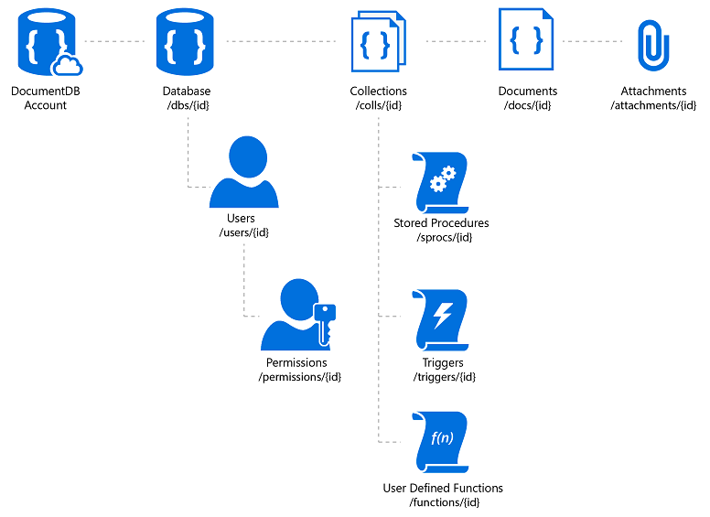
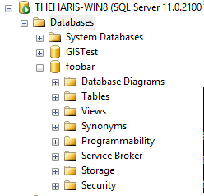
Azure Document DB Hierarchy

Slide 17
Hierarchy - Account
ACCOUNT
Notes:
Account
Logical container (no cost)
Provides keys and resource location for databases and contents
Create db account and view keys

Slide 18
Hierarchy - Database
DATABASE
Notes:
Database
Logical container (no cost)
Contains collections of documents, users and permissions

Slide 19
Hierarchy - Collection
COLLECTION
Notes:
Collection
Physical entity (paid)
Different pricing tiers
container of JSON documents and the associated JavaScript application logic – (stored proc, trigger, UDF)

Slide 20
Hierarchy - Documents
DOCUMENTS
Notes:
Documents
CRUD, enumerate and query arbitrary JSON documents
No schema, no secondary indices
No special data type or encodings
Read consistency level of documents follows the consistency policy on the database account
Database is a logical container of document storage partitioned across collections. It is also a users container.
User The logical namespace for scoping permissions.
Permission An authorization token associated with a user for access to a specific resource.
Collection A collection is a container of JSON documents and the associated JavaScript application logic. A collection is a billable entity, where the cost is determined by the performance level associated with the collection. Collections can span one or more partitions/servers and can scale to handle practically unlimited volumes of storage or throughput.
Stored Procedure Application logic written in JavaScript which is registered with a collection and transactionally executed within the database engine.
Trigger Application logic written in JavaScript executed before or after either an insert, replace or delete operation.
UDF Application logic written in JavaScript. UDFs enable you to model a custom query operator and thereby extend the core DocumentDB query language.
Document User defined (arbitrary) JSON content. By default, no schema needs to be defined nor do secondary indices need to be provided for all the documents added to a collection.
Attachment An attachment is a special document containing references and associated metadata for external blob/media. The developer can choose to have the blob managed by DocumentDB or store it with an external blob service provider such as OneDrive, Dropbox, etc.

Slide 21
Web App!
Notes:
Look at notes

Slide 22
Stored Proc!

Slide 23
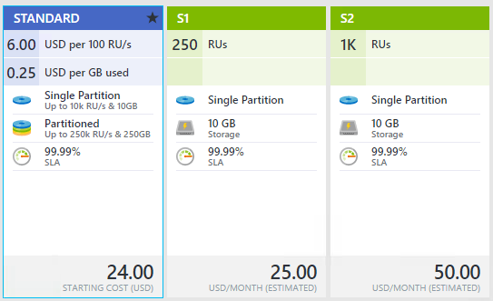
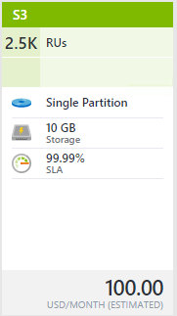
Collections - Tiers
Throughput, partitioning and storage
Notes:
Standard – pay as you go, allows partitioning, storage measured in GB, 400-250K RUs, 250GB storage max (can be increased)
S1, S2, S3 – predefined. 10GB storage max, throughput max 2.5K RUs

Slide 24
Collections - Throughput
Measured in RUs, 1 RUs = throughput for a 1KB document/second
Create document | ~15 RU
Read document | ~1 RU
Query document by id | ~2.5 RU
Query | Request Unit Charge | # of Returned Documents
Select food by id | ~2.5 RU | 1
Select foods by manufacturer | ~7 RU | 7
Select by food group and order by weight | ~70 RU | 100
Select top 10 foods in a food group | ~10 RU | 10
Notes:
Throughput = amount of items passing through a system

Slide 25
Collections - Throughput
What happens when you exceed provisioned throughput?
HTTP Status 429 Status Line: RequestRateTooLarge x-ms-retry-after-ms :100

Slide 26
Collections - Throughput
Factors
Document size
Document property count
Data consistency
Indexed properties
Document indexing
Query patterns complexity
Notes:
Document size - As units inc, read inc, write inc
Document property count - As pc inc, write units inc
Data consistency - consistency levels of Strong or Bounded Staleness, read units inc
Indexed properties - As index decrease, read units dec, write units dec. Look at lazy indexing.
Document indexing - By default each document automatically indexed, if you choose not to index some of your documents - read dec, write dec
Query patterns - As complexity of a query (number of predicates, nature of predicates, projections, number of UDFs, and size of source data set) inc, read inc, write inc

Slide 27


Slide 28
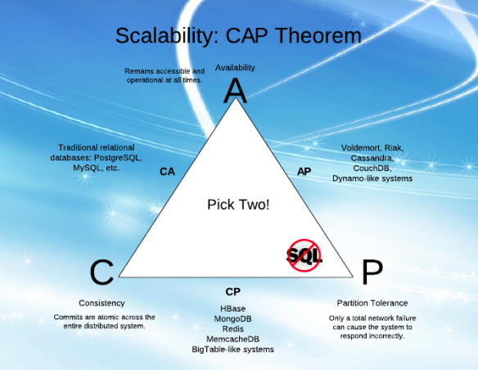
RDBMS
https://dzone.com/articles/better-explaining-cap-theorem
Notes:
Consistency: every read would get you the most recent write
Availability: every non-failed node always executes queries
Partition-tolerance: even if the connections between nodes are down, the other two (A & C) promises, are kept.
Availability is achieved by replicating the data across different machines
Consistency is achieved by updating several nodes before allowing further reads
Total partitioning, meaning failure of part of the system is rare. However, we could look at a delay, a latency, of the update between nodes, as a temporary partitioning. It will then cause a temporary decision between A and C
-On systems that allow reads before updating all the nodes, we will get high Availability
-On systems that lock all the nodes before allowing reads, we will get Consistency

Slide 29
Collections - Partitions
Physical entities for storing collections
SSD storage with repl for high avail
Managed by Azure, transparent to app
Uses partition key – groups docs by PK
Notes:
Partition key is a hash
Documents with same PK stored in same partition
Example department could be PK for employees
to achieve full throughput of collection, choose PK that allows you to evenly distribute requests

Slide 30
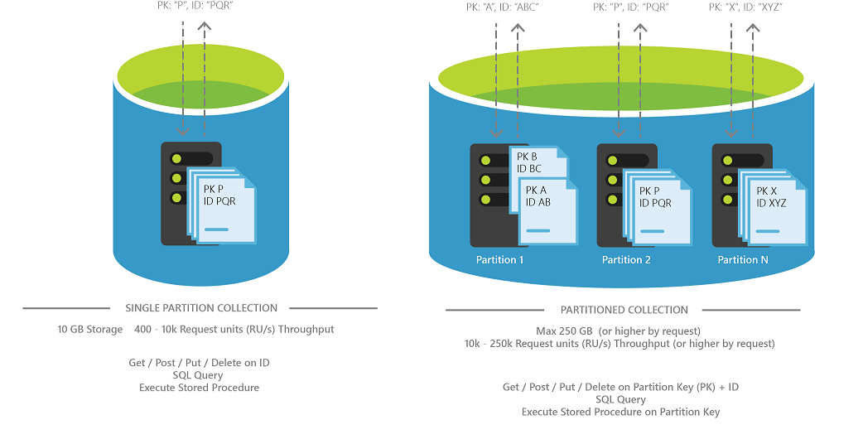
Collections - Partitions
SINGLE
PARTITIONED
LOW DATA VOLUME
MAX 10GB, 10K RUs
SIMPLE KEY (id)
HIGH DATA VOLUME
MAX 250GB (unlimited), 250K RU0
COMPOUND KEY (PK+id)
Notes:
Partitioned collections can span multiple partitions and support very large amounts of storage and throughput. You must specify a partition key for the collection.
Single-partition collections have lower price options and the ability to query and perform transactions across all collection data. They have the scalability and storage limits of a single partition. You do not have to specify a partition key for these collections.

Slide 31
Collections - Consistency
Strong – highest latency RW, highest C (dev)
Session (default) – low latency + high C within a session, not so great system wide (good for data entry people)
Bounded Staleness – low latency + predictable consistency system wide (prod)
Eventual – lowest latency RW, weakest C (prod)
Notes:
Strong: Strong consistency guarantees that a write is only visible after it is committed durably by the majority quorum of replicas. Strong consistency provides absolute guarantees on data consistency, but offers the lowest level of read and write performance
Session: ability to read your own writes. A read request for session consistency is issued against a replica that can serve the client requested version (part of the session cookie). Session consistency provides predictable read data consistency for a session while offering the lowest latency writes. Reads are also low latency as except in the rare cases, the read will be served by a single replica.
Bounded staleness: provides more predictable behavior for read consistency while offering the lowest latency writes. As reads are acknowledged by a majority quorum, read latency is not the lowest offered by the system. This provides a stronger guarantee than Session or Eventual.
Eventual: weakest form of consistency wherein a client may get the values which are older than the ones it had seen before, over time. In the absence of any further writes, the replicas within the group will eventually converge. The read request is served by any secondary index.
Eventual consistency provides the weakest read consistency but offers the lowest latency for both reads and writes.

Slide 32
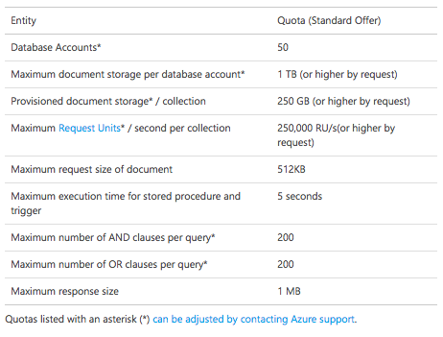
Limits

Slide 33
Document Studio
Open source client management viewer/explorer
https://github.com/mingaliu/DocumentDBStudio

Slide 34
Migration tool
Source Code: https://github.com/azure/azure-documentdb-datamigrationtool
Compiled version: http://www.microsoft.com/downloads/details.aspx?FamilyID=cda7703a-2774-4c07-adcc-ad02ddc1a44d
Imports from these sources:
Json
CSV
Mongo
SQL Server
Azure Table
And many more
https://azure.microsoft.com/en-us/documentation/articles/documentdb-import-data/

