Slide 1
THE PROJECT
1/5
Explainable detection of credential attacks
The problem
12 of 12
• Brute force, password spraying and stolen credentials (MITRE T1110, T1078) are among the most common ways in.
• Small teams often have no SIEM, and generic thresholds are opaque, noisy and easy to evade by going slow or spreading across IPs.
• Goal: a lightweight, read-only engine that explains every alert and is tested honestly, on hard synthetic data and on a real log.
attacker IPs found in an independent real sshd log (9 of 12 before fixes)
39 → 12
alerts grouped into one incident per attacker on the real log
What it does
• Reads Linux sshd logs and Windows Security event exports
• 12 transparent YAML rules, each mapped to MITRE ATT&CK
• Every alert shows its reason and the raw log lines behind it
33
automated tests pass; results reproduced from a fresh clone
Ndumiso Mbanjwa | CyberFox Society R&D Internship | github.com/onewithalgo-web/cyberfox-detection-engine
Notes:
Open with the problem: small teams, opaque thresholds, evasion by going slow. The project is a lightweight explainable engine. The three numbers are the headline results, each explained on the results slide, including the caveat that 12/12 is not fully held-out.

Slide 2
METHODOLOGY
2/5
Approach: build, break it, fix it, validate
1 Build
2 Test
3 Study misses
4 Fix
5 Validate
Write rules as short YAML files with sliding windows
Labelled synthetic logs with benign noise and evasion attacks
Why was each attack missed? Slow, distributed, invisible?
New rules and parser fixes, re-run all tests
Independent real log with ground truth counted separately
Design principles
How results are scored
• Explainable: every alert states its reason, technique and evidence
• Transparent: one YAML file per rule, thresholds tunable per run
• Safe: read-only; synthetic data plus one public research dataset
• Alert counts as correct if it matches an attack's source, an expected rule and its time window
• Stricter incident precision: one credit per detected attack, so corroborating alerts do not flatter the score
• Real log: attackers = IPs with 5+ failed logins, counted from raw text without the engine
Ndumiso Mbanjwa | CyberFox Society R&D Internship | github.com/onewithalgo-web/cyberfox-detection-engine
Notes:
The loop is the method. The real value came from step 3 and 5: studying misses on synthetic data found two rules, and the real log found a parser gap and a third rule. I also report a stricter precision metric because several rules can corroborate one attack.

Slide 3
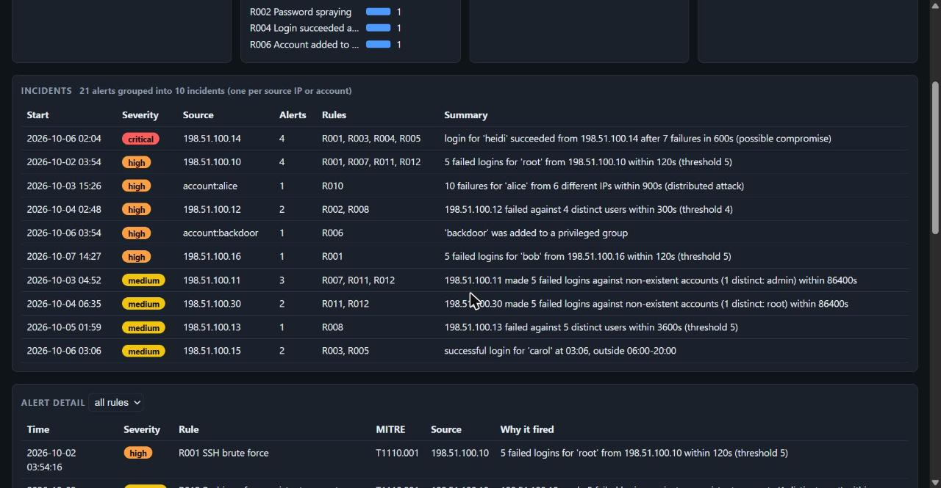
IMPLEMENTATION
3/5
Implementation: from raw logs to one incident per attacker
Logs
Parsers
Rule engine
Alerts
Incidents
Output
Linux auth.log + Windows CSV
normalise to events
12 YAML rules, sliding windows
reason, MITRE, evidence
one per attacker
CLI, JSON, dashboard
12 rules in four groups
• Rate attacks: brute force fast, slow and very slow (R001, R007, R011); spraying fast and slow (R002, R008)
• Evasion-aware: distributed brute force across IPs (R010); probing of non-existent accounts (R012)
• Account compromise: success after failures (R004); off-hours and new-source logins (R003, R005)
• Persistence: privileged-group add and new account (R006, R009)
• Python, one dependency (PyYAML); 33 tests incl. Linux-vs-Windows parity
Dashboard (one self-contained HTML file): 21 alerts grouped into 10 incidents; click a row for raw log evidence.
Ndumiso Mbanjwa | CyberFox Society R&D Internship | github.com/onewithalgo-web/cyberfox-detection-engine
Notes:
Walk the flow left to right. The two evasion-aware rules came directly from missed attacks. The dashboard is a single HTML file with an incidents table; clicking an incident lists its alerts and clicking an alert shows the raw log lines.

Slide 4
OUTCOME
4/5
Results: tested on hard synthetic data and a real log
Independent real log
LogHub OpenSSH: 2,000 real lines, 12 attacker IPs, 528 failed logins
9 / 12
12 / 12
first run, no false positives
after fixes, no false positives
39 → 12
635 → 305
alerts to incidents, one per attacker
synthetic: alerts to incidents
The misses taught three fixes: a parser gap for syslog 'message repeated N times', a rule for slow probing of non-existent accounts (R012), and account-level correlation (R010).
Caveat: R012 was written after seeing the miss, so 9 of 12 is the clean figure.
Detection gain (73% to 91%) came from new rules driven by missed attacks. Most of the precision jump at D comes from one option, an ignore-list set to the generator's own VPN range; without it precision is 94%. The insider with valid credentials is never detected (0 of 30).
Ndumiso Mbanjwa | CyberFox Society R&D Internship | github.com/onewithalgo-web/cyberfox-detection-engine
Notes:
Be upfront about two caveats. First, the big precision jump at D is one tuning option set to the generator's VPN range; without it precision is about 94 percent. Second, R012 was designed after the real log showed a miss, so the clean real-world number is 9 of 12. Grouping into incidents cut triage load by 69 percent on the real log.

Slide 5
CONCLUSION
5/5
Honest limits, lessons and next steps
Limitations
Lessons
Next steps
• Rules and options were tuned on the same generator, so synthetic figures show the method, not production performance
• Real test is small: one server, four hours, one attack style
• Windows parser verified only by a synthetic round-trip
• Valid-credential misuse and many-account, many-IP campaigns are out of reach of auth logs
• Independent real data found gaps synthetic data could not
• Studying misses beat tuning thresholds: it produced the best rules
• A stricter metric and an audit of my own claims corrected an overstated result
• Explainability makes errors visible: evidence lines exposed a wording bug
• Per-user baselines to cut new-source noise without an ignore-list
• More real datasets, especially Windows event logs
• Endpoint telemetry for insider misuse
• Streaming mode and alert export to a SIEM
Code, 33 tests, docs and reproducible results: github.com/onewithalgo-web/cyberfox-detection-engine
Ndumiso Mbanjwa | CyberFox Society R&D Internship | github.com/onewithalgo-web/cyberfox-detection-engine
Notes:
Close on honesty: the engine works as a transparent method, the evidence is strongest where it was independently tested, and the limits are stated up front. The repository has everything needed to reproduce the numbers.

