Slide 1
Case study :
The travelling salesman problem
Given a finite number of cities, N, and the cost of travel (or the distance) between each pair of cities, we need to find the cheapest way (or the shortest route) for visiting each city exactly once and returning to the starting point.
The TSP is represented in numerous transportation and logistics applications such as
planning truck routes to pick up parcel post,
A classic example of the TSP is the scheduling of a machine to drill holes in a circuit board.

Slide 2
How does a genetic algorithm solve the travelling salesman problem?
First, we need to decide how to represent a route of the salesman. The most natural way of representing a route is the path representation. Each city is given a numerical name, the route through the cities is represented as a chromosome.

Slide 3
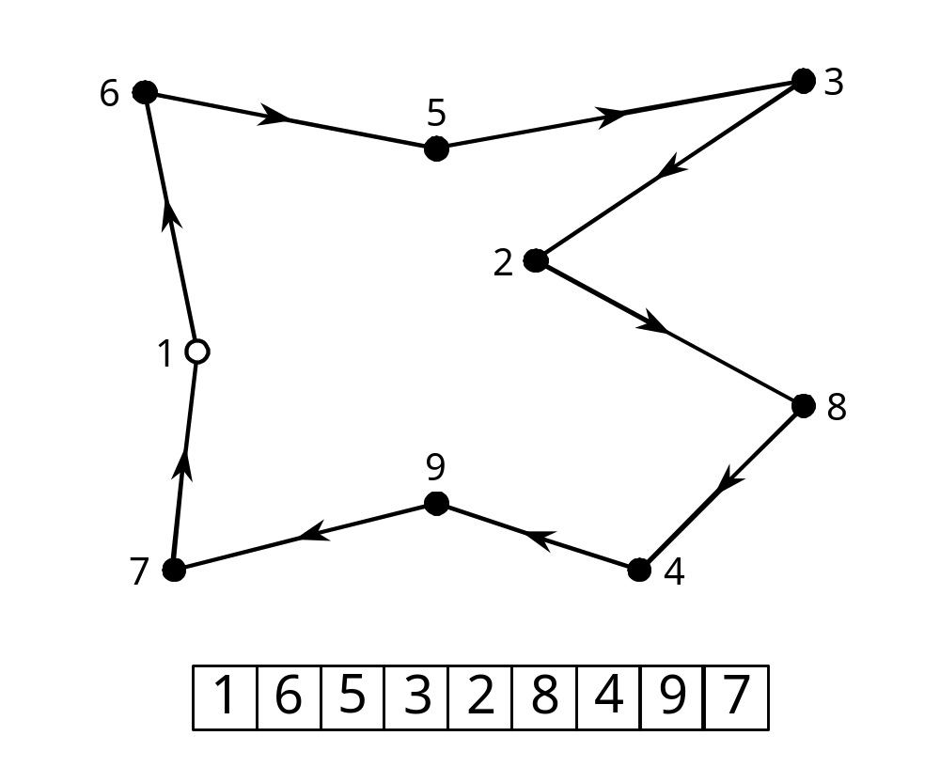
An example of the salesman’s route
Suppose we have nine cities named from 1 to 9. In a chromosome, the order of the integers represents the order in which the cities will be visited by the salesman.

Slide 4
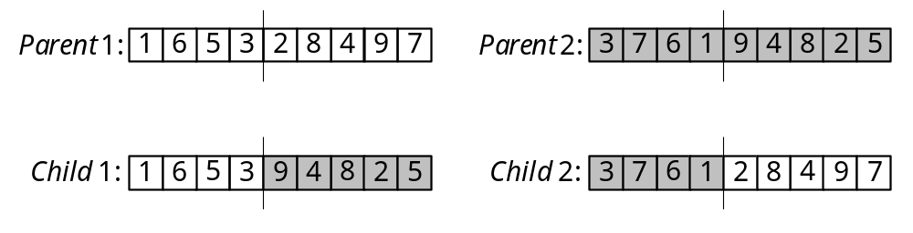
How does the crossover operator works?
The crossover operator in its classical form cannot be directly applied to the TSP. A simple exchange of parts between two parents would produce illegal routes – some cities would be visited twice while some others would not be visited at all:

Slide 5
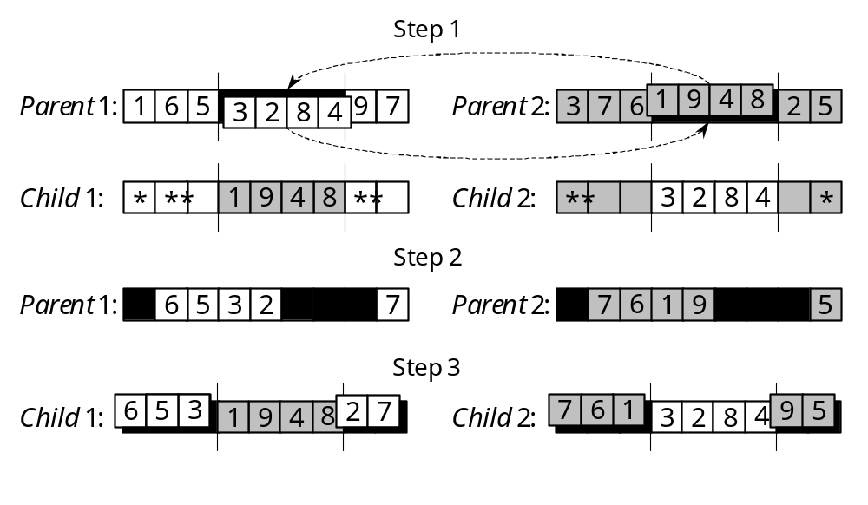
Two-Point Ordered Crossover operators for the TSP

Slide 6
How does the mutation operator works?
There are two types of mutation operators: reciprocal exchange and inversion.
The reciprocal exchange operator simply swaps two randomly selected cities in the chromosome.
The inversion operator selects two random points along the chromosome string and reverses the order of the cities between these points.

Slide 7
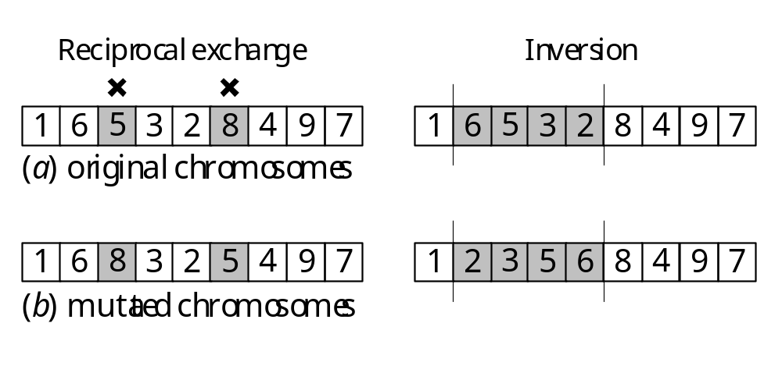
Mutation operators for the TSP

Slide 8
How do we define a fitness function in the TSP?
The fitness of each individual chromosome is determined as the reciprocal of the route length.
In other words, the shorter the route, the fitter the chromosome.

Slide 9
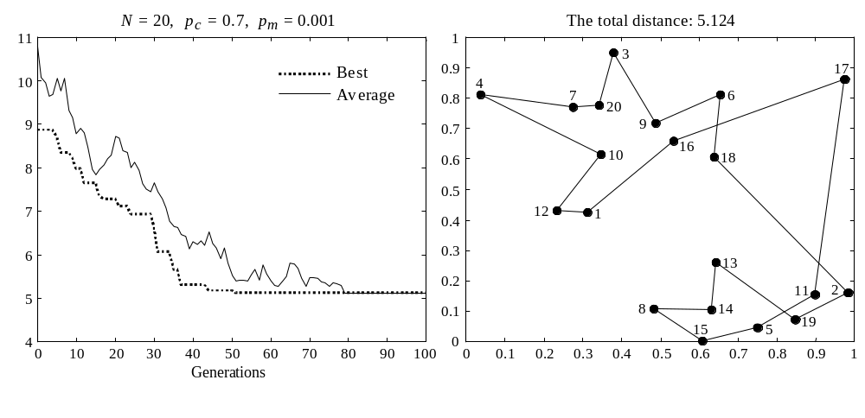
Performance graph and the best salesman’s route created in a population of 20 chromosomes after 100 generations
Distance

Slide 10
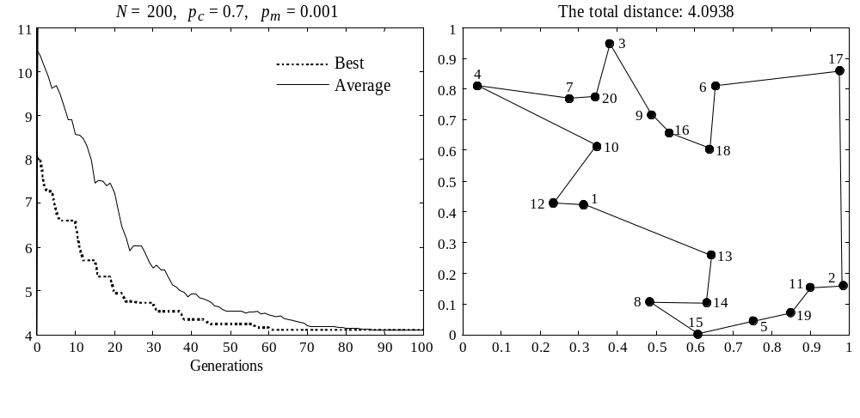
Performance graphs and the best routes created in a population of 200 chromosomes: mutation rate is 0.001

Slide 11
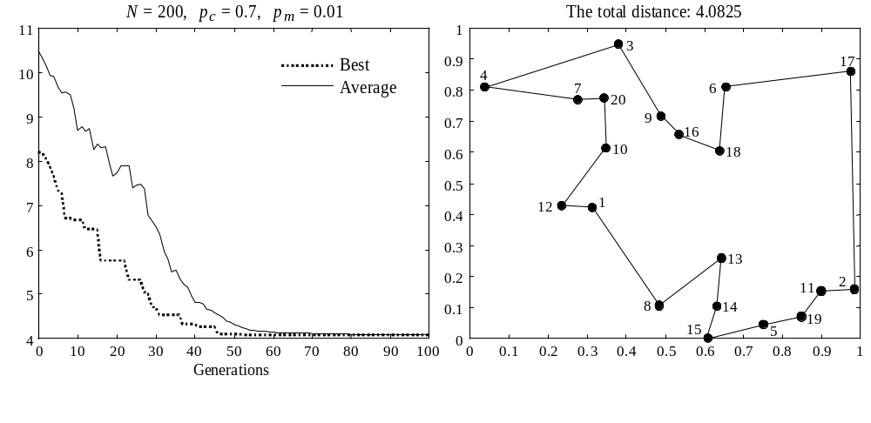
Performance graphs and the best routes created in a population of 200 chromosomes: mutation rate is 0.01

