Slide 1
Answer of Quiz 3

Slide 2
Question 1
Given simple graph G=(V,E), |V|=n and |E|=m, please prove that G is connected when m>(n-1)(n-2)/2.

Slide 3
Answer of Question 1
Proof. Supposed that G is unconnected, G has at least 2 connected component, signed as G1=(V1, E1) and G2=(V2, E2), where |V1|=n1, |V2|=n2 and n1+n2=n.
Because G is a simple graph,
|E1|<=n1(n1-1)/2 and |E2|<=n2(n2-1)/2.

Slide 4
Answer of Question 1
Therefore, m<=n1(n1-1)/2+n2(n2-1)/2.
Since n1<=n-1 and n2<=n-1,
M<=(n-1)(n1-1+n2-1)=(n-1)(n-2)/2
This is contradictory to the condition that
m>(n-1)(n-2)/2.
Thus, G is connected.

Slide 5
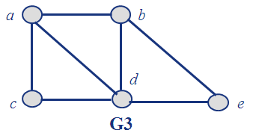
Question 2
Can the following graph be drawn in one stroke ?

Slide 6
Answer of Question 2
The degrees of vertex a and b of graph G are odd, and the degrees of other vertices are even, which is following the sufficient condition of Euler path. Thus, G be drawn in one stroke.
Theorem 2: A connected graph has an Euler path but not an Euler circuit if and if only if it has exactly two vertices of odd degree.

Slide 7
Question 3
Prove that K₅ and K_{3,3} are non-planar graphs.

Slide 8
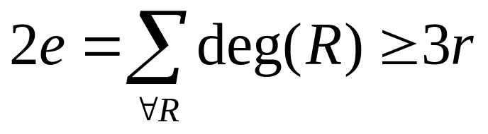
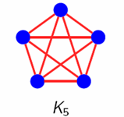
Answer of Question 3
Proof. (1) Supposed K5 is planar, r = e – v + 2 according to Euler formula.
Since each region has degree greater than or equal to three, it follows that
2e/3>=e – v + 2. Thus, e<=3v-6.
For K5, e=10 and v=5, so K5 is non-planar.

Slide 9
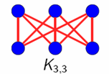
Answer of Question 3
Proof. (2) Supposed K3,3 is planar, r = e – v + 2 according to Euler formula.
Since each region has degree greater than or equal to three, it follows that 2e>=4r.
e/2>=e – v + 2. Thus, e<=2v-4.
For K5, e=9 and v=6, so K5 is non-planar.

Slide 10
Question 4
Prove that there are three persons who know each other or don’t know each other in every six persons in the world.

Slide 11
Answer of Question 4
Proof. Six vertices represent six persons. If two persons know each other, the edge between the vertices is colored in red. Otherwise, the edge is colored in blue.
The problem is changed to prove that K6 can be colored to be a red K3 and blue K3.

Slide 12
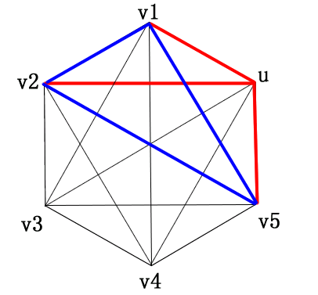
Answer of Question 4
In K6, vertex u is incident with 5 edges.
According to drawer principle, there are at least 3 edges colored in the same.
Supposed (u, v1), (u, v2) and (u, v5) are colored in red,
consider the color of edges (v1, v2), (v1, v5) and (v2, v5).

Slide 13
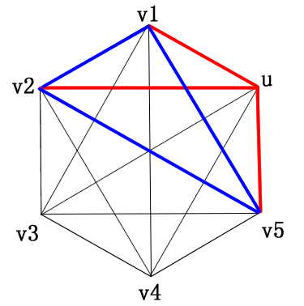
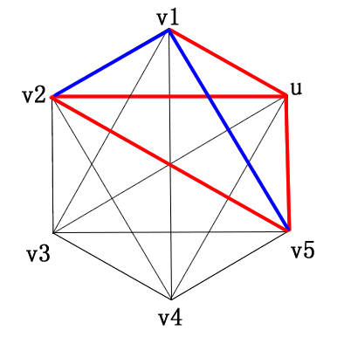
Answer of Question 4

Slide 14
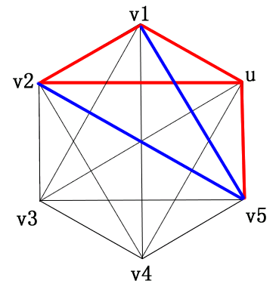
Answer of Question 4

Slide 15
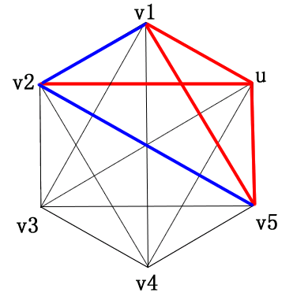
Answer of Question 4

Slide 16
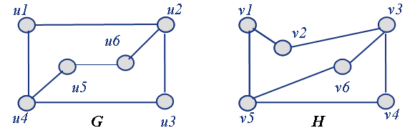
Question 5
Find out whether G and H are isomorphic. No matter what the judgment is, please give your explanation and argument.

Slide 17
Answer of Question 5
Solution: They are isomorphic. The isomorphism is:
f(u1)=v6, f(u2)=v3, f(u3)=v4, f(u4)=v5, f(u5)=v1, f(u6)=v2

