Slide 1
Artificial Intelligence
应伟勤
Email： yingweiqin@scut.edu.cn
华南理工大学软件学院

Slide 2
Lecture 1
Introduction to Artificial Intelligence
Intelligent machines, or what machines can do
The history of artificial intelligence
Research & Application Field of AI

Slide 3
Intelligent machines, or what machines can do
Philosophers have been trying for over 2000 years to understand and resolve two Big Questions of the Universe: How does a human mind work, and Can non-humans have minds?
  These questions are still unanswered.
Intelligence
  1. Someone’s Intelligence is their ability to understand and learn things.
  2 Intelligence is the ability to think and understand instead of doing things by instinct or automatically.
(Essential English Dictionary, Collins, London, 1990)

Slide 4
■ In order to think, someone or something has to have a brain, or an organ that enables someone or something to learn and understand things, to solve problems and to make decisions. So we can define intelligence as the ability to learn and understand, to solve problems and to make decisions.
■ The goal of artificial intelligence (AI) as a science is to make machines do things that would require intelligence if done by humans. Therefore, the answer to the question Can Machines Think? was vitally important to the discipline.
  ■ The answer is not a simple “Yes” or “ No ”.

Slide 5
■ One of the most significant papers on machine intelligence, “Computing Machinery and Intelligence”, was written by the British mathematician Alan Turing（图灵） over sixty years ago. However, it still stands up well under the test of time, and the Turing’s approach remains universal.
■ He asked: Is there thought without experience? Is there mind without communication? Is there language without living? Is there intelligence without life? All these questions, as you can see, are just variations on the fundamental question of artificial intelligence, Can machines think?

Slide 6
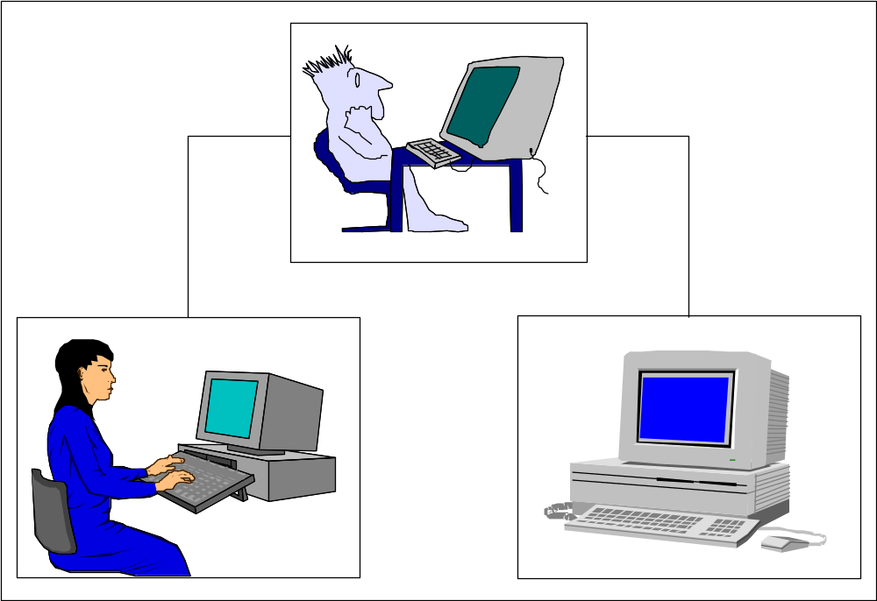
Turing did not provide definitions of machines and thinking, he just avoided semantic arguments by inventing a game, the Turing Test.
The Turing Test measures the performance of an intelligent machine against that of a human being.
Instead of asking, ‘Can machines think?’, Turing said we should ask, ‘Can machines pass a behaviour test for intelligence?’

Slide 7
The test places the machine and a human counterpart in rooms apart from a second human being, referred to as the interrogator. The interrogator is not able to see or speak directly to either of them, does not know which entity is actually the machine, and may communicate with them solely by use of a textual device such as a terminal.
The interrogator are asked to distinguish the computer from the human being solely on the basis of their answers to questions asked over this device. If the interrogator cannot distinguish the computer from the human, then Turing argues, the machine may be assumed to be intelligent.

Slide 8
Turing Test

Slide 9
He predicted that by the year 2000, a computer could be programmed to have a conversation with a human interrogator for five minutes and would have a 30 percent chance of deceiving the interrogator that it was a human.
Although modern computers still cannot pass the Turing test, it provides a basis for the verification and validation of knowledge-based systems.

Slide 10
A machine or program thought intelligent in some narrow area of expertise is evaluated by comparing its performance with the performance of a human expert.
To build an intelligent computer system, we have to capture, organise and use human expert knowledge in some narrow area of expertise.

Slide 11
The history of artificial intelligence
1.The birth of artificial intelligence (1943 – 1956)
The first work recognised in the field of AI was presented by Warren McCulloch（麦卡洛克） and Walter Pitts（皮茨） in 1943. They proposed a model of an artificial neural network and demonstrated that simple network structures could learn.
McCulloch, the second “founding father” of AI after Alan Turing, had created the corner stone of neural computing and artificial neural networks (ANN).

Slide 12
The third founder of AI was John von Neumann（冯诺依曼）, the brilliant Hungarian-born mathematician. He was an adviser for the Electronic Numerical Integrator and Calculator project at the University of Pennsylvania and helped to design the Electronic Discrete Variable Calculator. He was influenced by McCulloch and Pitts’s neural network model. When Marvin Minsky（明斯基） and Dean Edmonds, two graduate students in the Princeton mathematics department, built the first neural network computer in 1951, von Neumann encouraged and supported them.

Slide 13
Another of the first generation researchers was Claude Shannon（香农）. He graduated from MIT and joined Bell Telephone Laboratories in 1941. Shannon shared Alan Turing’s ideas on the possibility of machine intelligence. In 1950, he published a paper on chess-playing machines, which pointed out that a typical chess game involved about 10¹²⁰ possible moves (Shannon, 1950). Even if the new von Neumann-type computer could examine one move per microsecond, it would take 3*10¹⁰⁶ years to make its first move. Thus Shannon demonstrated the need to use heuristics in the search for the solution.

Slide 14
In 1956, John McCarthy, Martin Minsky and Claude Shannon organised a summer workshop at Dartmouth College. They brought together researchers interested in the study of machine intelligence, artificial neural networks and automata theory. Although there were just ten researchers, this workshop gave birth to a new science called artificial intelligence.

Slide 15
2.The rise of artificial intelligence, or the era of
great expectations (1956 – late 1960s)
The early works on neural computing and artificial neural networks started by McCulloch and Pitts was continued. Learning methods were improved and Frank Rosenblatt（罗森布拉特） proved the perceptron convergence theorem, demonstrating that his learning algorithm could adjust the connection strengths of a perceptron.
Notes:
罗森布拉特

Slide 16
One of the most ambitious projects of the era of great expectations was the General Problem Solver (GPS). Allen Newell（纽厄尔） and Herbert Simon（西蒙） from the Carnegie Mellon University developed a general-purpose program to simulate human-solving methods.

Slide 17
However, GPS failed to solve complex problems.
In the sixties, AI researchers attempted to simulate the thinking process by inventing general methods for solving broad classes of problems. They used the general-purpose search mechanism to find a solution to the problem. Such approaches, now referred to as weak methods, applied weak information about the problem domain.

Slide 18
3.Unfulfilled promises, or the impact of reality
(late 1960s – early 1970s)
Because AI researchers were developing general methods for broad classes of problems, early programs contained little or even no knowledge about a problem domain.
To solve problems, programs applied a search strategy by trying out different combinations of small steps, until the right one was found. This approach was quite feasible for simple toy problems, so it seemed reasonable that, if the programs could be “scaled up” to solve large problems, they would finally succeed.

Slide 19
Many of the problems that AI attempted to solve were too broad and too difficult.
A typical task for early AI was machine translation. For example, the National Research Council, USA, funded the translation of Russian scientific papers after the launch of the first artificial satellite (Sputnik) in 1957. Initially, the project team tried simply replacing Russian words with English, using an electronic dictionary. However, it was soon found that translation requires a general understanding of the subject to choose the correct words. This task was too difficult. In 1966, all translation projects funded by the US government were cancelled.

Slide 20
In 1971, the British government also suspended support for AI research. Sir James Lighthill had been commissioned by the Science Research Council of Great Britain to review the current state of AI. He did not find any major or even significant results from AI research, and therefore saw no need to have a separate science called “artificial intelligence”.
Notes:
莱特希尔

Slide 21
Probably the most important development in the seventies was the realisation that the domain for intelligent machines had to be sufficiently restricted.
4.The technology of expert systems, or the key to success (early 1970s – mid-1980s)

Slide 22
DENDRAL
DENDRAL was developed at Stanford University to determine the molecular structure of Martian soil. The project was supported by NASA. Edward Feigenbaum (费根鲍姆)(Simmon的弟子), Bruce Buchanan (布坎南)(a computer scientist) and Joshua Lederberg(莱德伯格)(a Nobel prize winner in genetics) formed a team.
There was no scientific algorithm for mapping the mass spectrum into its molecular structure. Feigenbaum’s job was to incorporate the expertise of Lederberg into a computer program to make it perform at a human expert level. Such programs were later called expert systems.
Notes:
费根鲍姆
莱德伯格
布坎南

Slide 23
DENDRAL marked a major “paradigm shift” in AI: a shift from general-purpose, knowledge-sparse weak methods to domain-specific, knowledge-intensive techniques.
The DENDRAL project originated the fundamental idea of expert systems – knowledge engineering, which encompassed techniques of capturing, analysing and expressing in rules an expert’s “know-how”.

Slide 24
MYCIN
MYCIN was a rule-based expert system for the diagnosis of infectious blood diseases. It also provided a doctor with therapeutic advice in a convenient, user- friendly manner.
MYCIN’s knowledge consisted of about 450 rules derived from human knowledge in a narrow domain through extensive interviewing of experts.

Slide 25
A 1986 survey reported a remarkable number of successful expert system applications in different areas: chemistry, electronics, engineering, geology, management, medicine, process control and military science (Waterman, 1986). Although Waterman found nearly 200 expert systems, most of the applications were in the field of medical diagnosis.
Seven years later a similar survey reported over 2500 developed expert systems (Durkin, 1994).
Notes:
沃特曼
杜尔金

Slide 26
However:
Expert systems are restricted to a very narrow domain of expertise.
  For example, MYCIN, which was developed for the diagnosis of infectious blood diseases, lacks any real knowledge of human physiology. If a patient has more than one disease, we cannot rely on MYCIN. In fact, therapy prescribed for the blood disease might even be harmful because of the other disease.

Slide 27
Expert systems have difficulty in recognising domain boundaries. When given a task different from the typical problems, an expert system might attempt to solve it and fail in rather unpredictable ways.
Expert systems, especially the first generation, have little or no ability to learn from their experience. Expert systems are built individually and cannot be developed fast. Complex systems can take over 30 person-years to build.

Slide 28
5.How to make a machine learn, or the rebirth of neural networks (mid-1980s – onwards)
Disillusions about the applicability of expert system technology even led to people predicting an AI “winter” with severely squeezed funding for AI projects.
AI researchers decided to have a new look at neural networks.

Slide 29
In the eighties, because of the need for brain-like information processing, as well as the advances in computer technology and progress in neuroscience, the field of neural networks experienced a dramatic resurgence. Major contributions to both theory and design were made on several fronts.

Slide 30
Hopfield introduced neural networks with feedback –Hopfield networks, which attracted much attention in the eighties (Hopfield, 1982).
Kohonen published a paper on self-organising maps (Kohonen, 1982).
Barto, Sutton and Anderson published their work on
reinforcement learning and its application in
control (Barto et al., 1983).

Slide 31
But the real breakthrough came in 1986 when the back-propagation learning algorithm, first introduced by Bryson and Ho in 1969 (Bryson & Ho, 1969), was reinvented by Rumelhart and McClelland in Parallel Distributed Processing (1986).

Slide 32
6.Evolutionary computation, or learning by doing(early 1970s–onwards)
Natural intelligence is a product of evolution. Therefore, by simulating biological evolution, we might expect to discover how living systems are propelled towards high-level intelligence. Nature learns by doing; The fittest species have a greater chance to reproduce, and thereby to pass their genetic material to the next generation.
The evolutionary approach to artificial intelligence is based on the computational models of natural selection and genetics. Evolutionary computation works by simulating a population of individuals, evaluating their performance, generating a new population, and repeating this process a number of times.

Slide 33
Evolutionary computation combines three main techniques: genetic algorithms, evolutionary strategies, and genetic programming.
  The concept of genetic algorithms was introduced by John Holland in the early 1970s (Holland, 1975). He developed an algorithm for manipulating artificial ‘chromosomes’ (strings of binary digits), using such genetic operations as selection, crossover and mutation.
  Ingo Rechenberg and Hans-Paul Schwefel, students of the Technical University of Berlin, proposed evolutionary strategies (Rechenberg, 1965). Evolutionary strategies were designed specifically for solving parameter optimisation problems in engineering.
  Genetic programming is to evolve a computer code that solves the problem. That is, genetic programming generates computer programs as the solution.(Koza,1992)

Slide 34
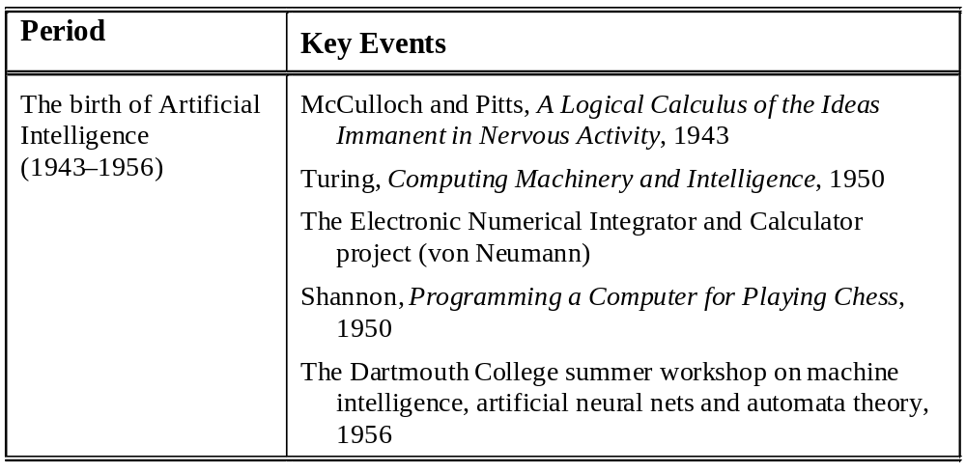
Main events in the history of AI

Slide 35

Period Key Events
The rise of artificial
intelligence
(1956–late 1960s)
LISP (McCarthy)
The General Problem Solver (GPR) project (Newell and Simon)
Newell and Simon, Human Problem Solving, 1972
Minsky, A Framework for Representing Knowledge, 1975
The disillusionment
in artificial
intelligence (late
1960s–early 1970s)
Cook, The Complexity of Theorem Proving Procedures, 1971
Karp, Reducibility Among Combinatorial Problems, 1972
The Lighthill Report, 1971

Slide 36
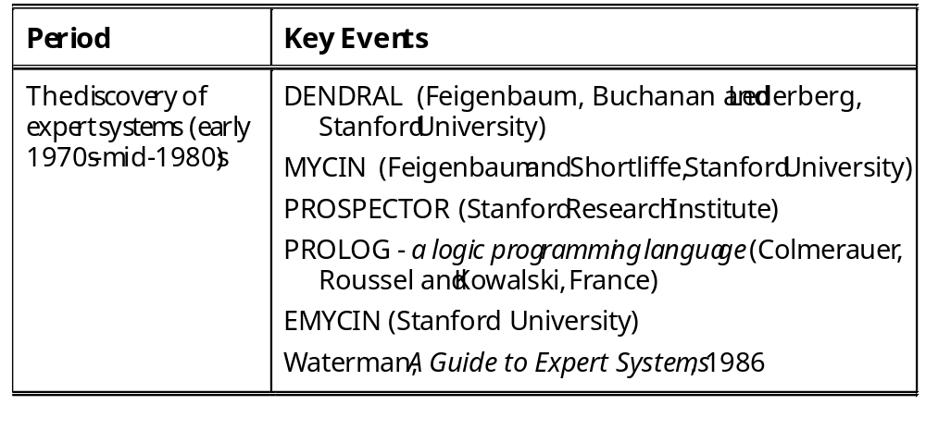

Slide 37
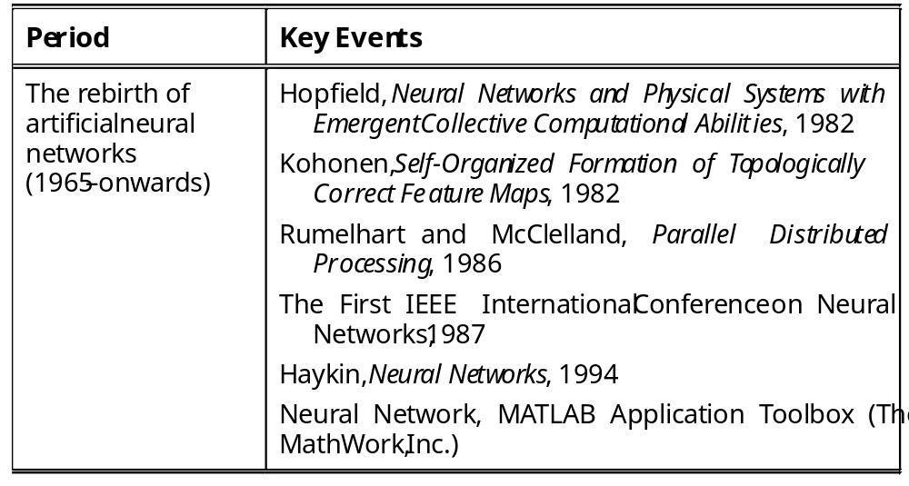

Slide 38
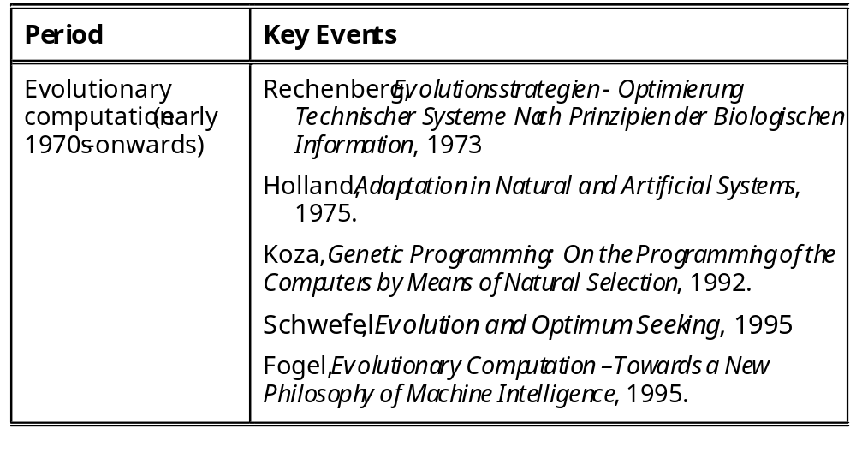

Slide 39
Research & Application Field of AI (What Can Be Done by AI)
1. Game playing
国际象棋机器博弈：
IBM Deep Blue vs Ќажпаров in 1996 (2:4)
& 1997 (3.5:2.5)
围棋机器博弈：
Google AlphaGo Lee vs 李世石 in March 2016(4:1)
Google AlphaGo Master vs 柯洁 in May 2017(3:0)
完全信息博弈（国际象棋、中国象棋、围棋、五子棋）
不完全信息博弈（军旗、扑克斗地主、升级）

Slide 40
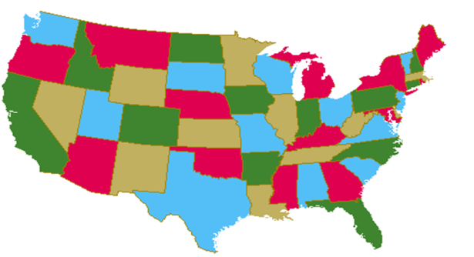
2. Logic Reasoning & Automatic Theorem Proving
Prove theorem by operating the fact data-base
·四色定理：一张地图，用一种颜色对一个地区着色，那么一共只需要四种颜色就能保证每两个相邻的地区颜色不同。
直到1976年6月，美国数学家 K. Appel与 W. Haken，借助3台电子计算机，用了1200小时，才终于完成了“四色猜想”的证明，从而使"四色猜想"成为了四色定理。

Slide 41
3. Natural Language Understanding
It deals with voice understanding and language translation. This is a very difficult task, a very complex encoding and decoding problem. For do so, we need:
  do voice analysis, syntax structure and semantics understanding
  make frequency-spectrum analysis and recognition
  establish knowledge base of specialized knowledge and common knowledge as well as the context

Slide 42
4. Expert System
ES is an important and most active application area of AI.
ES is an intelligent computer programming system in which there exists knowledge and experience of specialized area in quantity in expert level, and can use the expert knowledge to handle and solve the problem in the specified domain. ES can be used to medicine, industry, agriculture, business and military.

Slide 43
5. Machine Learning
Feedback
information
Verify
Environment
Learning
Knowledge
base
Executor
Fig.1 Model of Machine Learning
Based on large quantity of knowledge, knowledge base system.
New branch- Data Mining & Knowledge Discover

Slide 44
6. Artificial Neural Network(ANN)
ANN has been applied into the Pattern Recognition, Image Process, Automation Control, Information Process, Robotics and other AI areas.

Slide 45
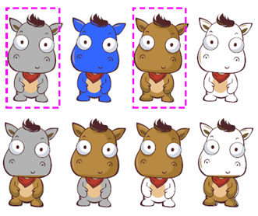
7. Evolutionary computation
Genetic algorithm, evolutionary strategies, and genetic programming
自然计算（Nature-Inspired Computation）：演化算法，模拟退火算法，蚁群算法，粒子群优化算法
  函数优化问题求解（参数优化等）
  组合优化问题求解（0-1背包、TSP、排课、调度、车辆路径）
  演化硬件
  多目标优化

Slide 46
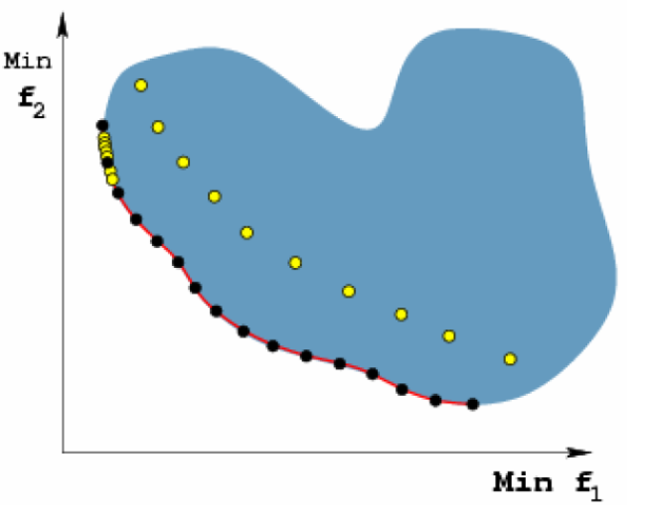
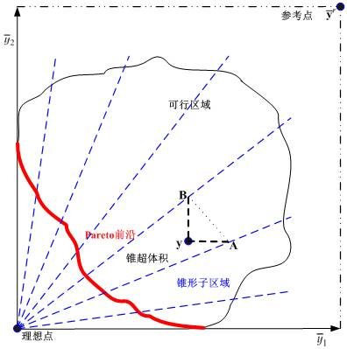
7. Evolutionary computation
基于锥束分解的演化多目标优化

Slide 47
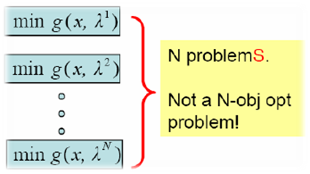
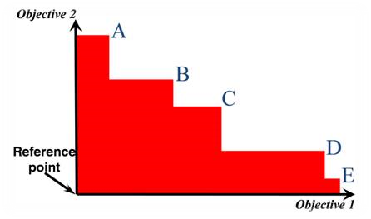
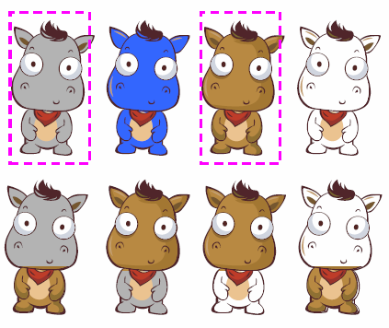
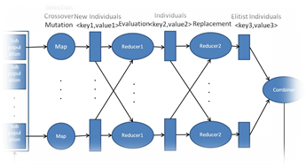
锥形子区域
分解
超体积
以锥形子区域为纽带将分解和超体积的优点有机结合
锥超体积演化算法
利用演化算法天然并行性
并行锥超体积演化算法

Slide 48
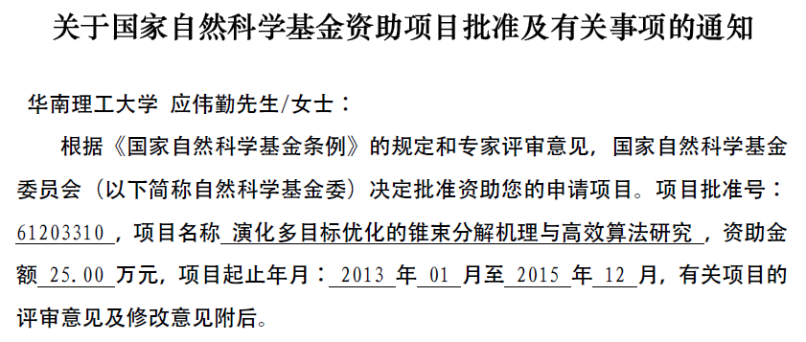
7. Evolutionary computation
基于锥束分解的演化多目标优化

Slide 49
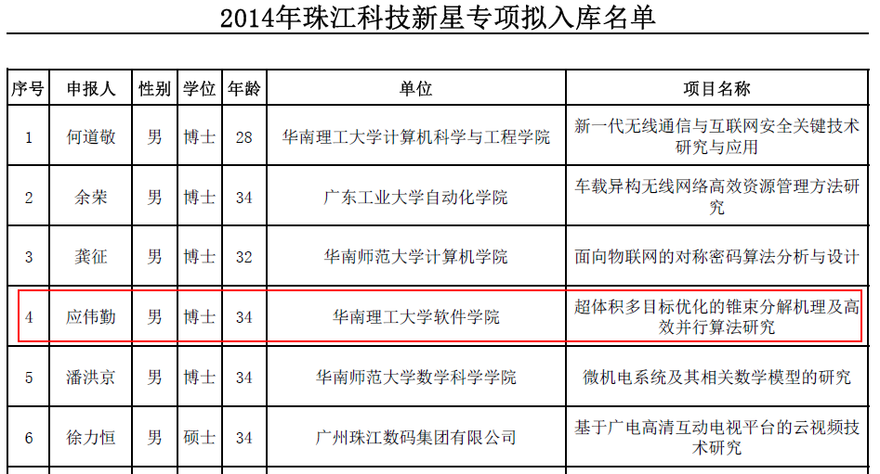
7. Evolutionary computation
基于锥束分解的演化多目标优化

Slide 50
8. Robotics
An interested research area of AI. The AI & Robotics promote each other.
The development of Intelligent Robots needs the guidance of the principles and techniques of AI, and Robotics can provide AI a suitable test-bed.
  Many techniques of AI can be used and tested in Robotics, such as sensing, planning, decision-making.
机器人足球世界杯Robocup（Robot World Cup）

Slide 51

9. Pattern Recognition
Pattern Recognition is to recognize the imitate sample of a given object. The “pattern” can be an object, a graph, a voice, a character and/or light signal.
TV
Camera
Reference
Pattern Base
Pre-processing
Pattern
Representation
Recognition
Output
Fig. 2 A Pattern Recognition Process

Slide 52
Other fields
10. Computer Vision
11. Automatic Programming
12. Intelligent Retrieval
13. Combinational & Scheduling Problem
14. Multi-agent & Distributed AI
……

Slide 53
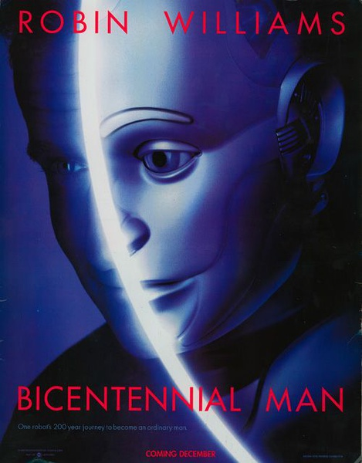
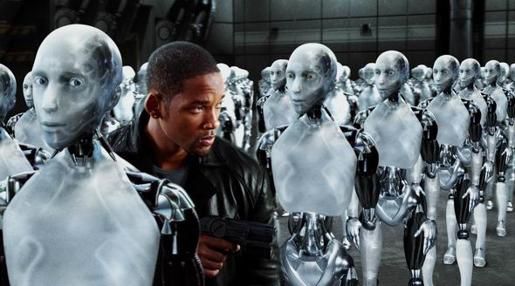
1、机器人（人工智能）会比人聪明吗？
2、机器人会造反吗？

