Slide 1



Building the Facial Expressions Recognition System Based on RGB-D Images in High Performance
Trung Truong and Ngoc Quoc Ly
Faculty of Information Technology
University of Science, VNUHCM-HCMUS
8th Asian Conference on Intelligent Information and Database Systems
14-16 March 2016, Da Nang, Vietnam

Slide 2
Outline
Motivation
Problem Statement
Method
Experiments
Conclusions
Future work

Slide 3
Motivation| Problem Statement | Method | Experiments | Conclusion | Future work
Develop security cameras & surveillance system
Expression is a part of behavior. It contributes to enhance the understanding of image and video in intelligent system.
Behavioral science research
Automation of objective measurement of facial activity

Slide 4
Motivation| Problem Statement | Method | Experiments | Conclusion | Future work
Application:
More human-like human-computer, and human-robot interaction (e.g.: elder care robot).
Detect terrorist attacks (e.g.: security at airport)
Face Retrieval based on attributes system

Slide 5
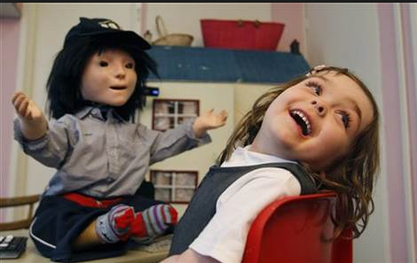
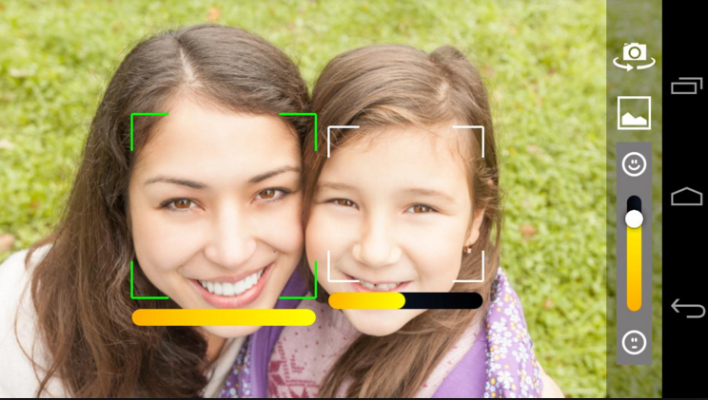
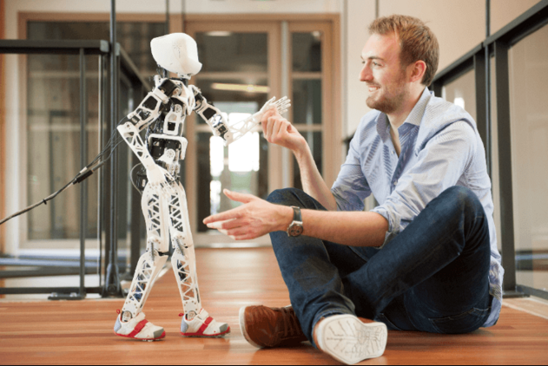
Motivation|| Problem Statement | Method | Experiments | Conclusion
Application:
Robot teaches autistic kids interact
human-computer-interaction
SmileCam - smile detector

Slide 6
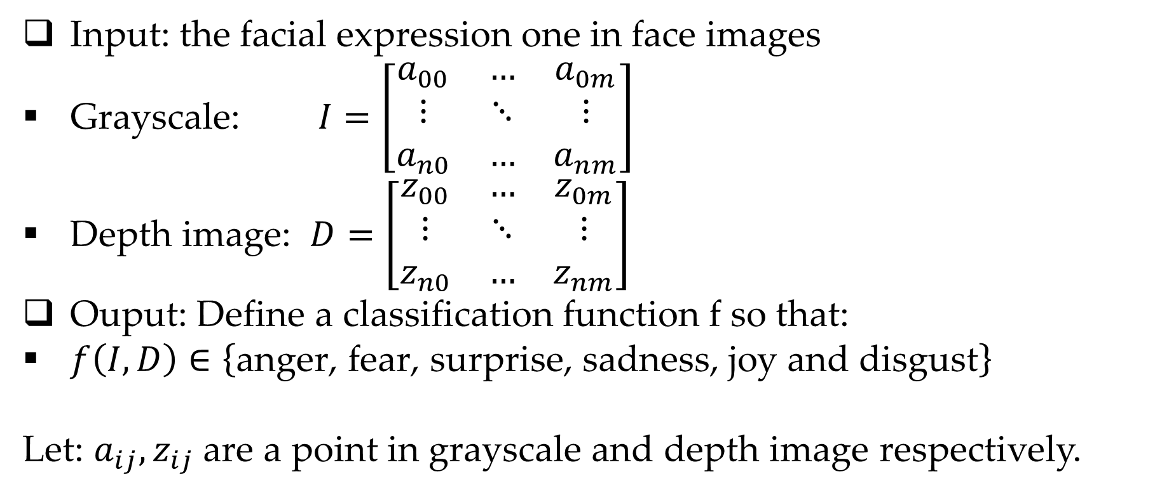
Motivation|| Problem Statement | Method | Experiments | Conclusion
Input: the facial expression one in face images
Grayscale: $I=\left[\begin{matrix}a_{00} & … & a_{0m} \\ ⋮ & ⋱ & ⋮ \\ a_{n0} & … & a_{nm}\end{matrix}\right]$
Depth image: $D=\left[\begin{matrix}z_{00} & … & z_{0m} \\ ⋮ & ⋱ & ⋮ \\ z_{n0} & … & z_{nm}\end{matrix}\right]$
Ouput: Define a classification function f so that:
$f\left(I,D\right)∈\left\{\text{anger}\text{, }\text{fear}\text{, }\text{surprise}\text{, }\text{sadness}\text{, }\text{joy} \text{and} \text{disgust}\right\}$
Let: $a_{ij},z_{ij}$ are a point in grayscale and depth image respectively.

Slide 7
Motivation|| Problem Statement | Method | Experiments | Conclusion
Traditional method based on 2D image
Recent method based on 3D image
Challenges in 3D image:
Pose
Illumination
Occlusion
Challenges in 2D image:
Pose
Illumination
Occlusion
Kinect device

Slide 8
Motivation|| Problem Statement | Method | Experiments | Conclusion
Framework:
texture feature:LBP
Shape feature
input
RGB image and depth image
preprocessing
Feature extraction
representation
Covariance matrix
Noise filter, smooth
Eye, nose, mouse detection
3D point cloud converting
Training stage

Slide 9
Motivation|| Problem Statement | Method | Experiments | Conclusion
Framework:
Output
texture feature:LBP
shape feature
At training stage
expression
Covariance matrix
input
RGB image and depth image
preprocessing
Feature extraction
representation
classification
Covariance matrix
kNN
Noise filter, smooth
Eye, nose, mouse detection
3D point cloud converting
Testing stage

Slide 10
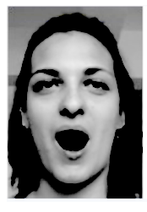

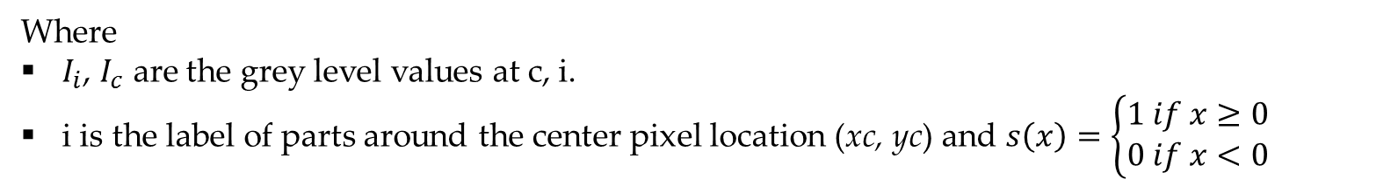
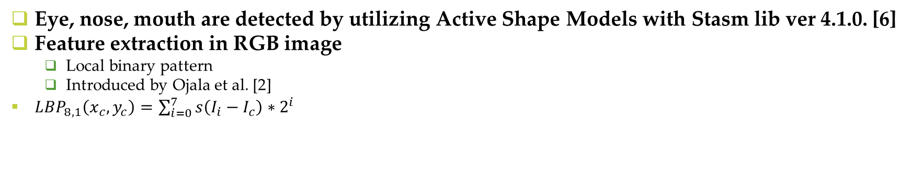
Motivation|| Problem Statement | Method | Experiments | Conclusion
Eye, nose, mouth are detected by utilizing Active Shape Models with Stasm lib ver 4.1.0. [6]
Feature extraction in RGB image
Local binary pattern
Introduced by Ojala et al. [2]
${LBP}_{8,1}\left(x_{c},y_{c}\right)=\sum_{i=0}^{7}{s\left(I_{i}−I_{c}\right)∗2^{i}}$
Where
$I_{i}$, $I_{c}$ are the grey level values at c, i.
i is the label of parts around the center pixel location (xc, yc) and $s\left(x\right)=\left\{\begin{aligned}1 if x≥0 \\ 0 if x<0\end{aligned}\right.$
Pros: computational simplicity, extracting texture feature (i.e.: furrow..)
Cons: illumination, local feature
Original image and ${LBP}_{8,1}$ image

Slide 11
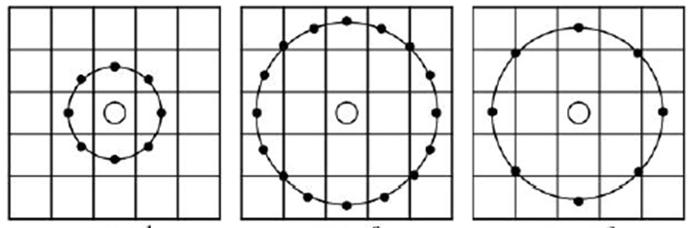
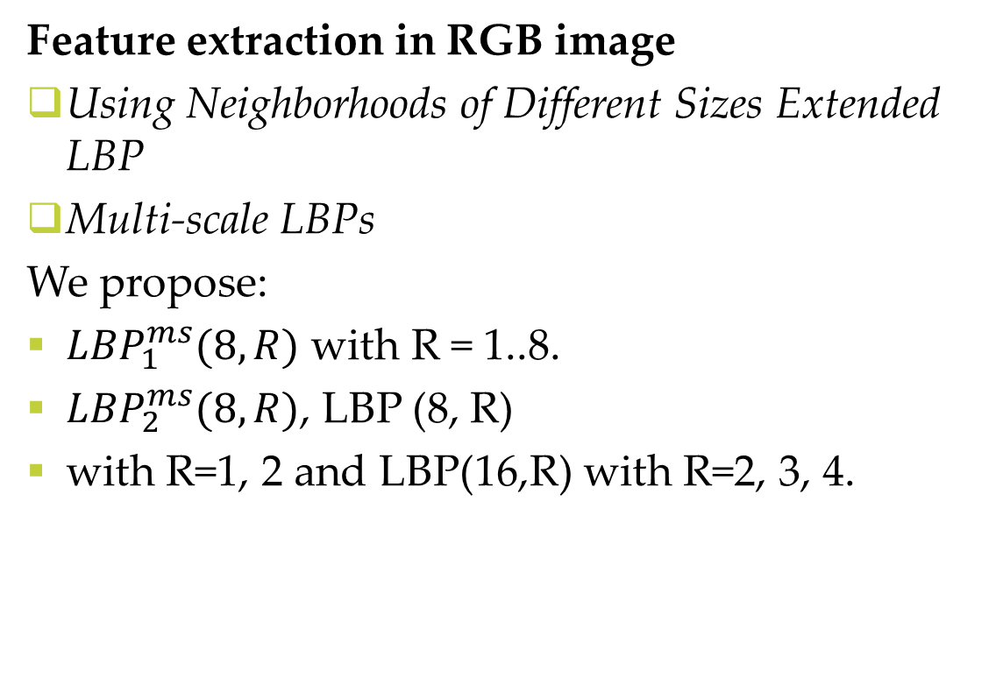
Motivation|| Problem Statement | Method | Experiments | Conclusion
Feature extraction in RGB image
Using Neighborhoods of Different Sizes Extended LBP
Multi-scale LBPs
We propose:
${LBP}_{1}^{ms}(8,R)$ with R = 1..8.
${LBP}_{2}^{ms}(8,R)$, LBP (8, R)
with R=1, 2 and LBP(16,R) with R=2, 3, 4.
LBP (8, 1)
LBP (16, 2)
LBP (8, 2)

Slide 12
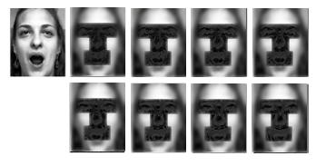



Motivation|| Problem Statement | Method | Experiments | Conclusion
Feature extraction in RGB image
Using Neighborhoods of Different Sizes Extended LBP
Multi-scale LBPs
${LBP}_{1}^{ms}(8,R)$ with R = 1..8.
Pros:
increase discriminative power
handle variations in illumination
real-time processing
computational simplicity
Left to right, original image and ${LBP}_{2}^{ms}(8,R)$

Slide 13
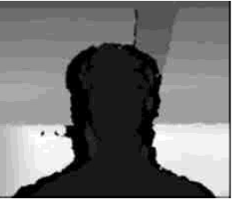
Motivation|| Problem Statement | Method | Experiments | Conclusion
Normal Estimation on Point Clouds
3D point cloud
Normal descriptor
Depth image

Slide 14
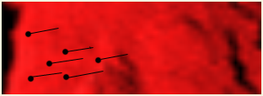
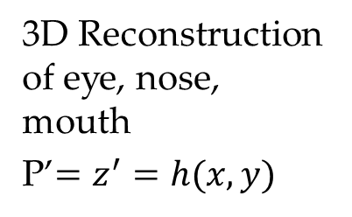

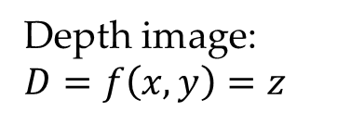
Motivation|| Problem Statement | Method | Experiments | Conclusion
Depth of box 300mm
Points (outlier), not in box, will be remove
3D Reconstruction of eye, nose, mouth
P’$=z^{′}=h(x,y)$
Input: depth image 3D
Applying morphological closing fill holes.
Gaussian filter is applied for smoothing depth image
Reconstruct 3D point cloud from Camera Calibration and depth image P’
Remove outlier: P
$$P^{′}$$
D
P
Depth image: $D=f\left(x,y\right)=z$

Slide 15
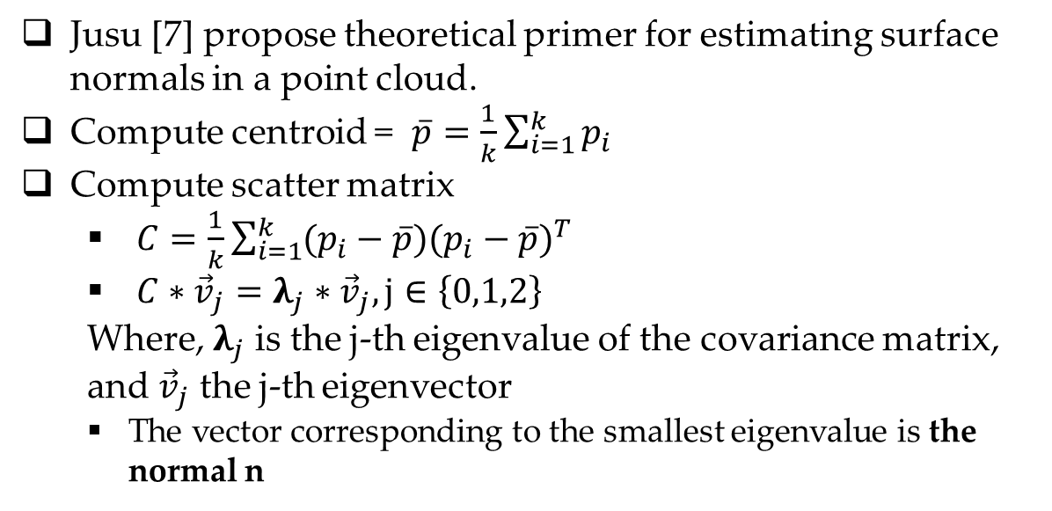


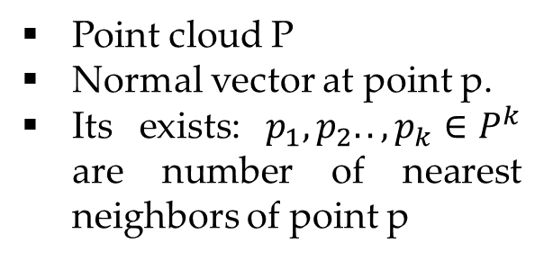
Motivation|| Problem Statement | Method | Experiments | Conclusion
Where is the number of point neighbors considered in the neighborhood of , represents the 3D centroid of the nearest neighbors, is the -th eigenvalue of the covariance matrix, and the -th eigenvector
$$p_{1}$$
p
Hyperplane Normal
$$p_{2}$$
Jusu [7] propose theoretical primer for estimating surface normals in a point cloud.
Compute centroid = $\overline{p}=\frac{1}{k}\sum_{i=1}^{k}{p_{i}}$
Compute scatter matrix
$C=\frac{1}{k}\sum_{i=1}^{k}{(p_{i}−\overline{p}){(p_{i}−\overline{p})}^{T}}$
$C∗{\vec{v}}_{j}=λ_{j}∗{\vec{v}}_{j}, j∈\left\{0,1,2\right\}$
Where, $λ_{j}$ is the j-th eigenvalue of the covariance matrix, and ${\vec{v}}_{j}$ the j-th eigenvector
The vector corresponding to the smallest eigenvalue is the normal n
Point cloud P
Normal vector at point p.
Its exists: $p_{1},p_{2}.. ,p_{k}∈P^{k}$ are number of nearest neighbors of point p

Slide 16




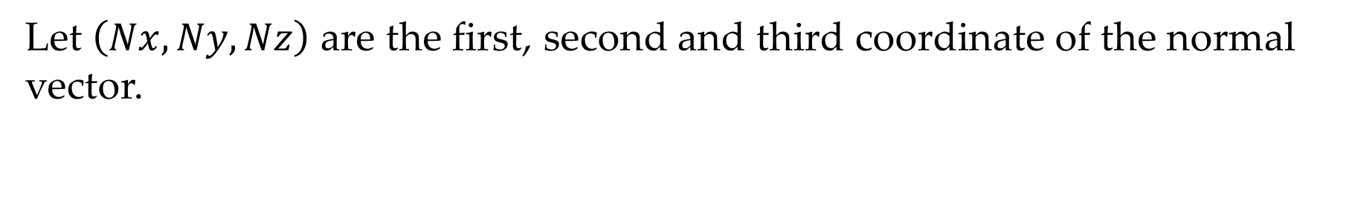
Motivation|| Problem Statement | Method | Experiments | Conclusion
Eye region
N$z$
y
N$y$
$\vec{n}$(X,Y,Z)
N$x$
O
x
z
Let $\left(Nx,Ny,Nz\right)$ are the first, second and third coordinate of the normal vector.

Slide 17

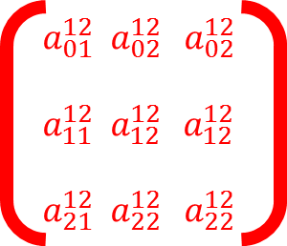
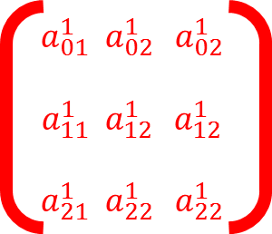
Motivation|| Problem Statement | Method | Experiments | Conclusion
Representation in approach Covariance matrix (Fehr et.al. [4])
Gradient grayscale
Normal
LBP
$$a_{01}^{1} a_{02 }^{1} a_{02}^{1}$$
$$a_{11}^{1} a_{12 }^{1} a_{12}^{1}$$
$$a_{21}^{1} a_{22 }^{1} a_{22}^{1}$$
$$a_{01}^{12} a_{02 }^{12} a_{02}^{12}$$
$$a_{11}^{12} a_{12 }^{12} a_{12}^{12}$$
$$a_{21}^{12} a_{22 }^{12} a_{22}^{12}$$
…..
…..
…..
…..
…..
cov
Covariance matrix

Slide 18
Discussion
Why the earlier combination of LBP and normal descriptor by represented by covariance descriptor attain high performance than others?
LBP is a kind of texture feature
Normal descriptor is a kind of shape feature

Slide 19
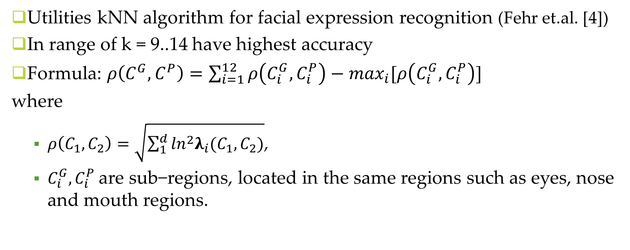
Motivation|| Problem Statement | Method | Experiments | Conclusion
Utilities kNN algorithm for facial expression recognition (Fehr et.al. [4])
In range of k = 9..14 have highest accuracy
Formula: $ρ\left(C^{G},C^{P}\right)=\sum_{i=1}^{12}{ρ\left(C_{i}^{G},C_{i}^{P}\right)}−\max_{i}⁡[ρ\left(C_{i}^{G},C_{i}^{P}\right)]$
where
$ρ\left(C_{1},C_{2}\right)=\sqrt{\sum_{1}^{d}{\ln^{2}λ_{i}(C_{1},C_{2})}}$,
$C_{i}^{G},C_{i}^{P}$are sub−regions, located in the same regions such as eyes, nose and mouth regions.

Slide 20
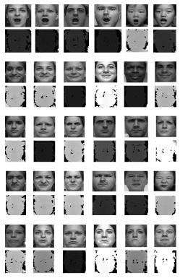
Motivation|| Problem Statement | Method | Experiments | Conclusion
Dataset: FaceWarehouse database [2]
Using a Kinect RGBD camera
Participant: 150 individuals aged 7-80 from various ethnic backgrounds
In this paper:
Recognize 6 facial expression: anger, fear, surprise, sadness, joy and disgust.
Total: 42 color images and depth images per facial expression

Slide 21
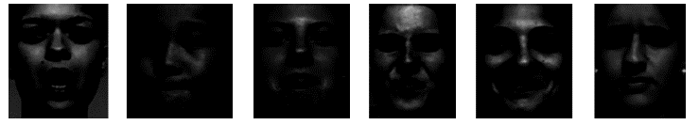
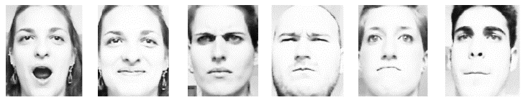
Motivation|| Problem Statement | Method | Experiments | Conclusion
Using FaceWarehouse database for our approach
Conduct 3 experiments under various illumination
Normalized illumination
Low, high illumination
Images are captured under low illuminant.
Images are captured under highly illuminant

Slide 22
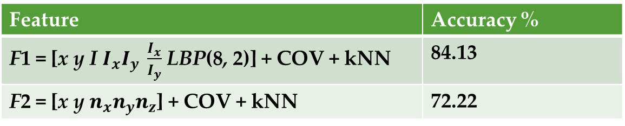
Motivation|| Problem Statement | Method | Experiments | Conclusion
Approach in grayscale and point cloud only under good illumination condition
Feature | Accuracy %
F1 = [x y I $I_{x}I_{y} \frac{I_{x}}{I_{y}}$LBP(8, 2)] + COV + kNN | 84.13
F2 = [x y $n_{x}n_{y}n_{z}$] + COV + kNN | 72.22

Slide 23
Motivation|| Problem Statement | Method | Experiments | Conclusion
Recognition rate (%) for recognition facial expression in 3-Fold and leaveone- out cross-validation
Datasets | Accuracy
 | Low illumination | High illumination
RGB dataset | 53.97 | 74.98
Depth dataset | 72.22 | 72.22
RGBD dataset | 73.81 | 76.57

Slide 24
Motivation|| Problem Statement | Method | Experiments | Conclusion
2 comparative methods based on FaceWarehouse database
Mao et al [3] ‘s Approach
Method: Aus, FPPs, FPs
Accuracy: <72% (4 expresions)
Our approach
Method: Normal descriptor, COV, kNN
Accuracy: 72.22% (6 expressions)

Slide 25
Motivation|| Problem Statement | Method | Experiments | Conclusion
Our contribution:
Propose the novel feature based on the covariance representation by fusing all of LBP, gradient and normal descriptor.
Prove that the features are extracted in combining depth and texture images to improves the performance more considerably than both depth image-only method and color image-only method under high and poor lighting condition.

Slide 26
Future work
We leave as future research the study of experiments which are based on an extension of our proposed framework in the challenge of head pose and occlusion.
Furthermore, the proposed framework used in this paper will be investigated for a video.

Slide 27
References
Ojala, T., Pietikainen, M., Maenpaa, T.: Multiresolution gray-scale and rotation invariant texture classification with local binary patterns. IEEE Trans. J. Pattern Anal. Mach. Intell. 24(7), 971–987 (2002)
Cao, C., Weng, Y., Zhou, S., Tong, Y., Zhou, K.: Facewarehouse: a 3D facial expression database for visual computing. IEEE Trans. J. Vis. Comput. Graph. 20(3), 413–425 (2014)
Mao, Q., Pan, X., Zhan, Y., Shen, X.: Using kinect for real-time emotion recognition via facial expressions. J. Front. Inf. Tech. Electr. Eng. 16, 272–282 (2015)
Fehr, D.A.: Covariance based point cloud descriptors for object detection and classification, University of Minnosita, August (2013)
Forstner, W., Moonen, B.: A metric for covariance matrices. In: Grafarend, E.W., Krumm, F.W., Schwarze, V.S. (eds.) Journal of Geodesy-The Challenge of the 3rd Millennium, pp. 299–309. Springer, Heidelberg (2003)
Milborrow, S., and F. Nicolls. "Active shape models with sift descriptors and mars. VISAPP, 2014.“
D Rusu, R.B., Cousins, S.: 3D is here: point cloud library (PCL). In: IEEE International Conference on Proceedings of Robotics and Automation (ICRA), Shanghai, China, 9–13 May 2011, pp. 1–4. IEEE (2011)

