Slide 1
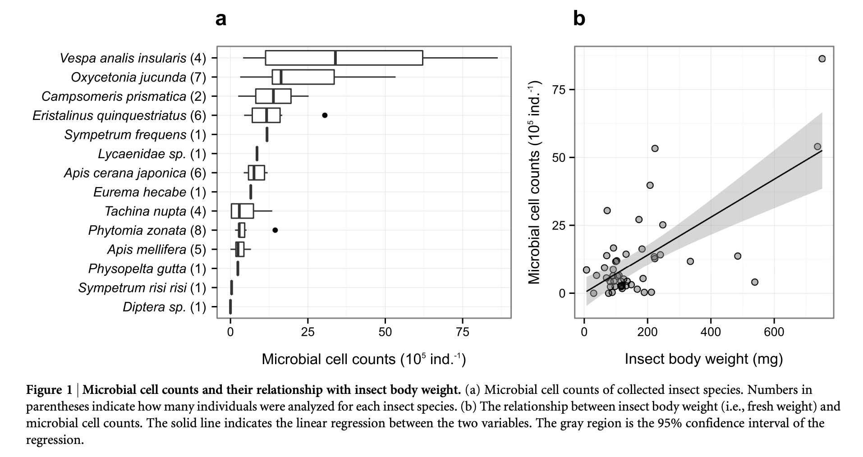
The number of microbial cells on the insect body surface
The right figure shows the number of microbial cells on the insect body surface. Figure 1a indicates the relationship between insect species and the number of microbial cell counts. Figure 1b indicates the relationship between the microbial cell counts and the insect body weight. Vespa analis insularis harbors the largest number of microbes, and there is a positive correlation between the microbial cell counts and insect body weight.
Ushio et al. (2015) Scientific Reports

