Slide 1
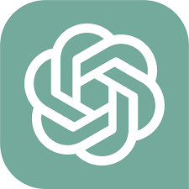



List of AI-tools
Chat GPT
Copilot
Gemini
Deepseek
These are great tools to help you learn programming!
There are other AI tools for more specific purposes, such as α-fold (for protein structure prediction), DeepL (language translation) etc.

