Slide 1
XRMS User Manual
DRAFT 1
May 18, 2004
This document originally Authored by Ken Gregoire. Open Source License applies.
XRMS User Manual - Version Draft 1
May 18, 2004

Slide 2
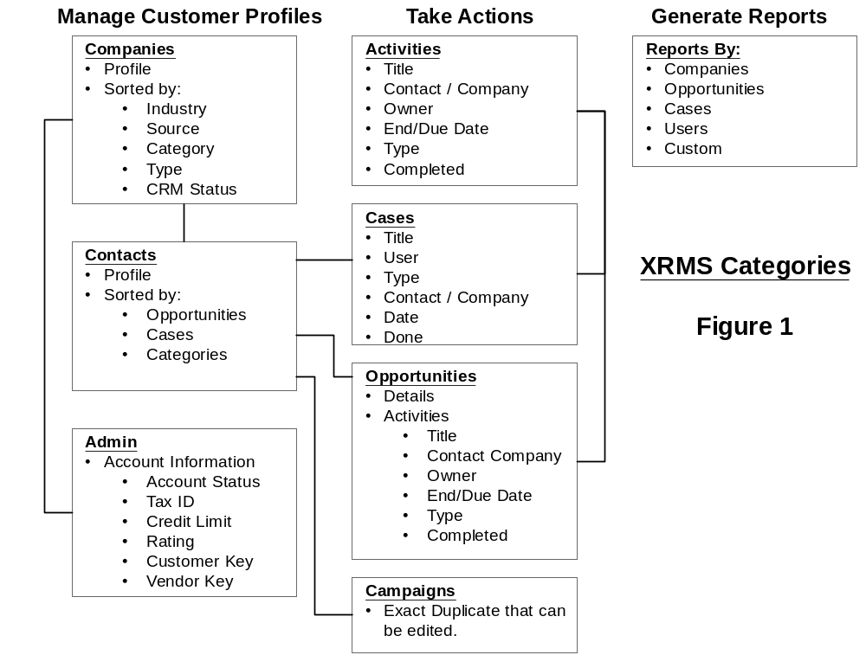

Slide 3
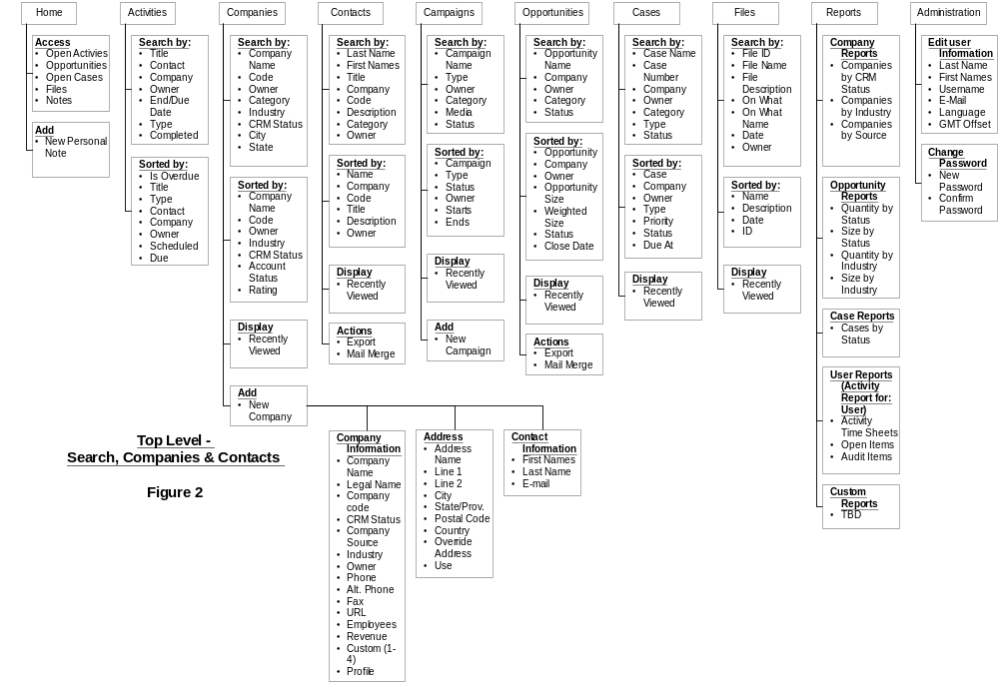

Slide 4
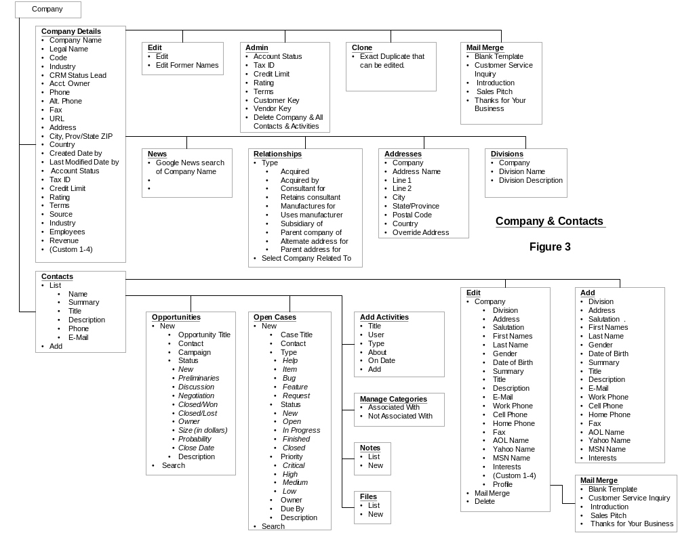

Slide 5
