Slide 1
Scala’s Trait

Slide 2
What is a trait?
OOP concept that represents a unit of functionality that is usable through mixin
Trait are built-in in Scala
Can include either concrete or abstract method/field

Slide 3
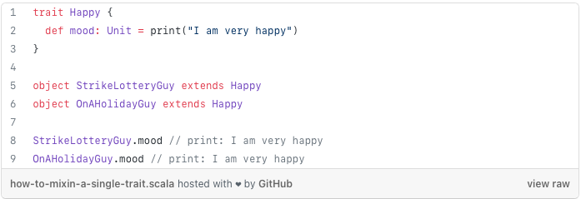
How to mixin a single trait in Scala

Slide 4
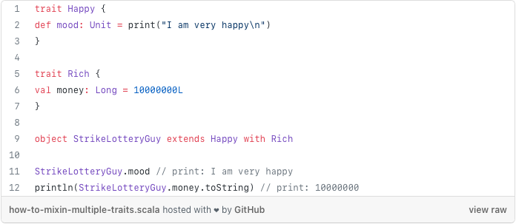
How to mixin multiple traits

Slide 5
How trait works under the hood
Scala runs on JVM
Scala code is compiled into Java Byte Code
Traits can be compiled into an equivalent representation in Java

Slide 6
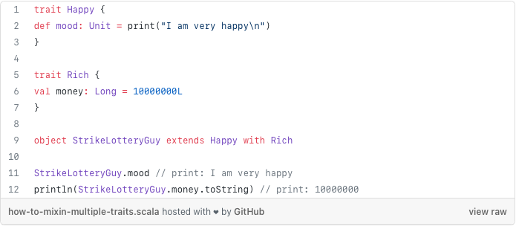
How trait works under the hood

Slide 7
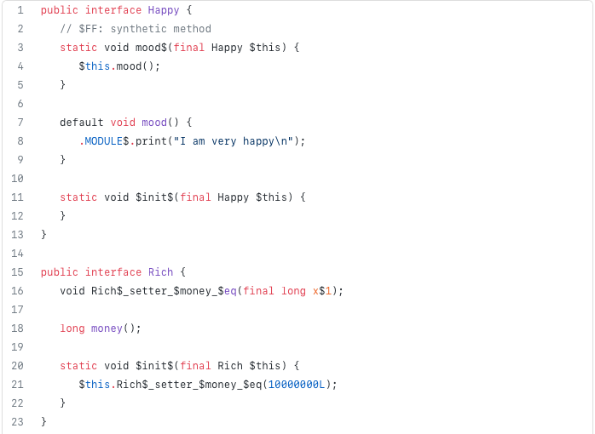
How trait works under the hood

Slide 8
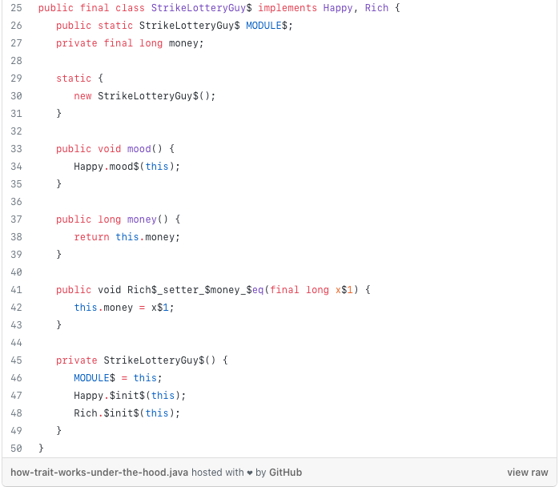
How trait works under the hood

Slide 9
How trait works under the hood
Scala(2.12) trait compiles to Java Interface with default methods
There is similarity when using Scala traits or Java Interface with default methods

Slide 10
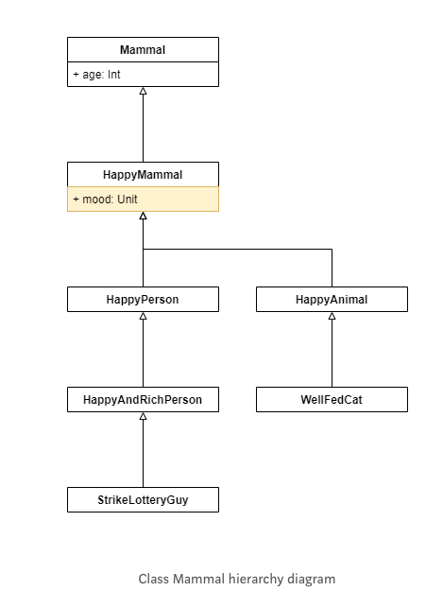
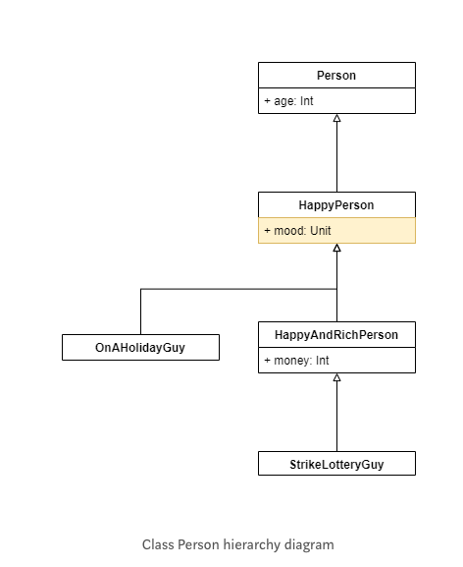
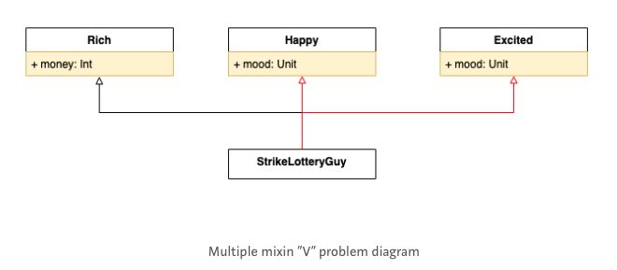
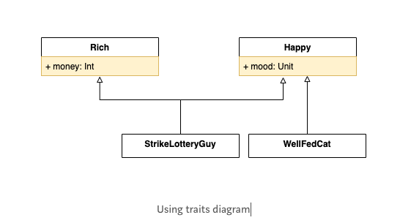
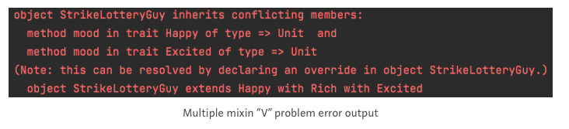
Similarities of Scala trait and Java Interface with default method
Pluggable
Reuse in multiple, unrelated class hierarchy
Both may create ambiguity
Multiple mixin of traits
Implementing multiple interface with default method
“V” problem

Slide 11
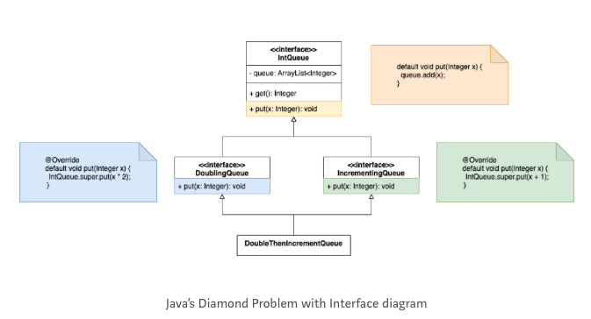
Differences between Scala trait and Java Interface with default methods
Diamond Problem (Java)

Slide 12
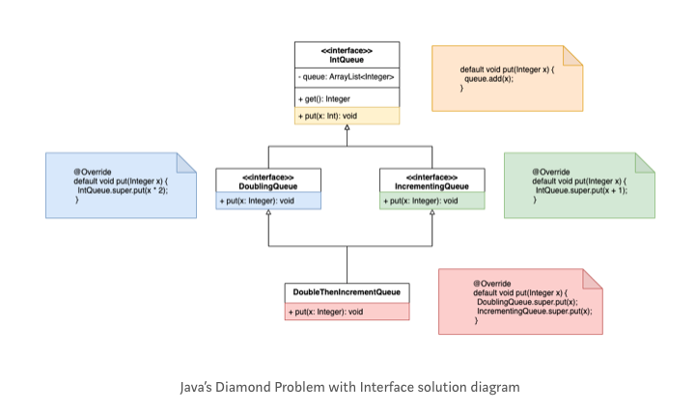
Differences between Scala trait and Java Interface with default methods
Diamond Problem (Java)

Slide 13
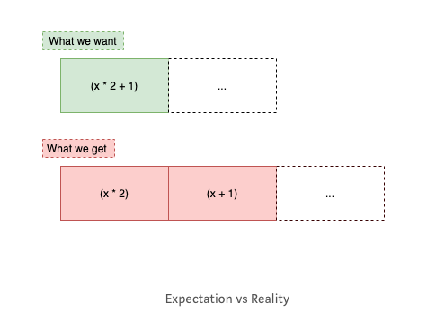
Differences between Scala trait and Java Interface with default methods
Diamond Problem (Java)

Slide 14
Differences between Scala trait and Java Interface with default methods
Diamond No-Problem (Scala)
A way to resolve “V” problem
The key difference is linearization

Slide 15
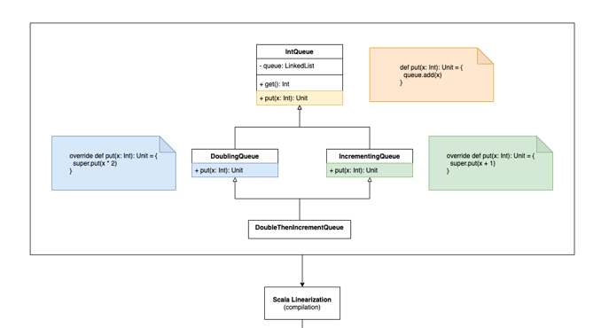
Differences between Scala trait and Java Interface with default methods

Slide 16
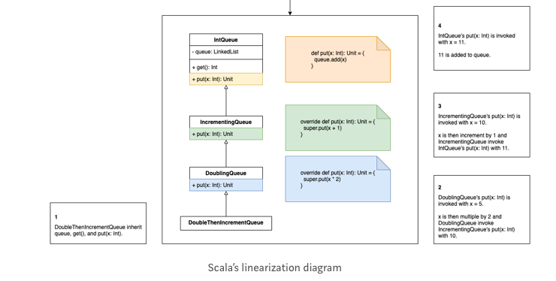
Differences between Scala trait and Java Interface with default methods

Slide 17
Differences between Scala trait and Java Interface with default methods
Scala linearization has resolved 2 problems
Diamond problem
No need to resolve ambiguity
Interpretation of super
“V” problem
You can translate it into Diamond no-problem
Grouping a group of traits that has similar behavior and provides a parent trait
Without translating “V” problem, it will still encounter the same issue
Diamond No-Problem is known as Scala Stackable Trait Pattern
Like Decorator Pattern

Slide 18
Conclusion (Java)
Key motivation of Java Interface is used to define the public API of the class that is implementing it.
Can also used to achieve
Abstraction
Functionality of multiple inheritance
Loose coupling
Main motivation of default methods is not for multiple inheritance
Hence there is still some issue

Slide 19
Conclusion (Scala)
Trait is not about achieving abstraction
Although you can
Key motivation is
To have trait to hold a fundamental of code that are easily reusable
During the early stages of development, each trait holds a fraction of the concept. As design solidifies, multiple traits are then mixins into a more complete concept.
Scala translated Diamond Problem into Stackable Trait Pattern which provides lots of flexibility.
The Queue example is an extreme case; with 3 traits can give 16 different behaviors because the order matters.
In the event where the order does not matter, it is still useful to avoid ambiguity.

Slide 20
Question / Feedback

