Slide 1
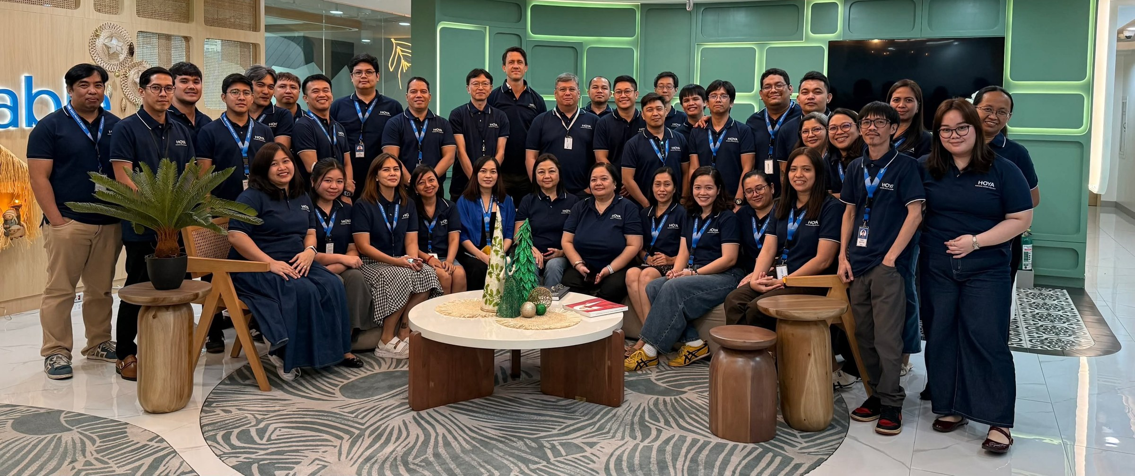

GD PeopleHub
Employee Information & Leave Management Platform for Group Digital - BSS

Slide 2




The Problem
Every stage of leave handling depends on manual effort
STEP 1
STEP 2
STEP 3
STEP 4
File
Notify
Track
Monitor
Leave filing is handled manually
Employees notify managers through chat or email
Leave tracking is maintained manually
Information is difficult to monitor consistently
Each manual step has a matching screen in the PeopleHub demo →

Slide 3





Who We Are Helping & What We Built
TARGET USERS
Employees eligible for leave
Managers who review leave requests
THE PROBLEM
THE PROTOTYPE (DEMO)
Leave filing is handled manually
Leave request screen
Employees submit a request
Employees notify managers through chat or email
Leave approval screen
Managers review requests
Leave tracking is maintained manually
Employee pages & directory
One place for employee information
Information is difficult to monitor consistently
Dashboard views
Leave information at a glance
Built with Copilot-assisted HTML / Power Platform concepts using test data

Slide 4
Current Status & Next Steps
WHERE WE ARE
WHAT COMES NEXT
Prototype stage only
Leave submission process
Replaces manual filing
1
Approval workflow
Replaces chat and email notifications
2
Uses basic information and sample data
Leave balance management
Replaces manual tracking
3
Notifications and reporting
Makes leave easier to monitor
4
Actual leave filing workflow is not yet implemented
Production data integration
Moves from sample to real data
5

