Slide 1
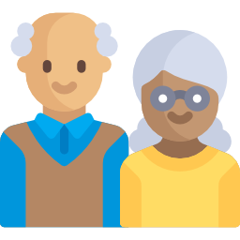










Who is typically excluded?
When designing digital services, include people from these groups on your team and as research and test participants. People may fit into more than one group and even be represented several times within one group (for example, people with multiple disabilities).
Also check out the persona spectrum microsoft.com/design/inclusive (Inclusive 101 page 42)
seniors
Remote + rural
women
immigrants
disabilities
racialized
LGBTQ2S+
low income
low literacy
Indigenous
ontario.ca/inclusivedesign
Notes:
Add religious groups?

