Slide 1
Computer System Engineering
Lab3: Banker’s Algorithm
Contact:
shuailong_liang@mymail.sutd.edu.sg

Slide 2
Objectives
Understand deadlock and implement Banker’s algorithm
Picture from: http://career.guru99.com/top-50-operating-system-interview-questions/

Slide 3
Deadlock and Banker’s algorithm
Reference: ch7-2017-release.pdf
What is Deadlock?
slides 7.5 – 7.16
What is Banker’s algorithm?
slides 7.33 – 7.37

Slide 4
Tasks:
1 . Implement a basic Bank system
2 . Implement safety check algorithm
3 . Analyse the complexity of banker’s algorithm

Slide 5
Task 1: Bank System
1 . Customers can request resources, while system can grant the request or deny it.
2 . Customers can release resources
3 . System can print its states by invoke special function

Slide 6
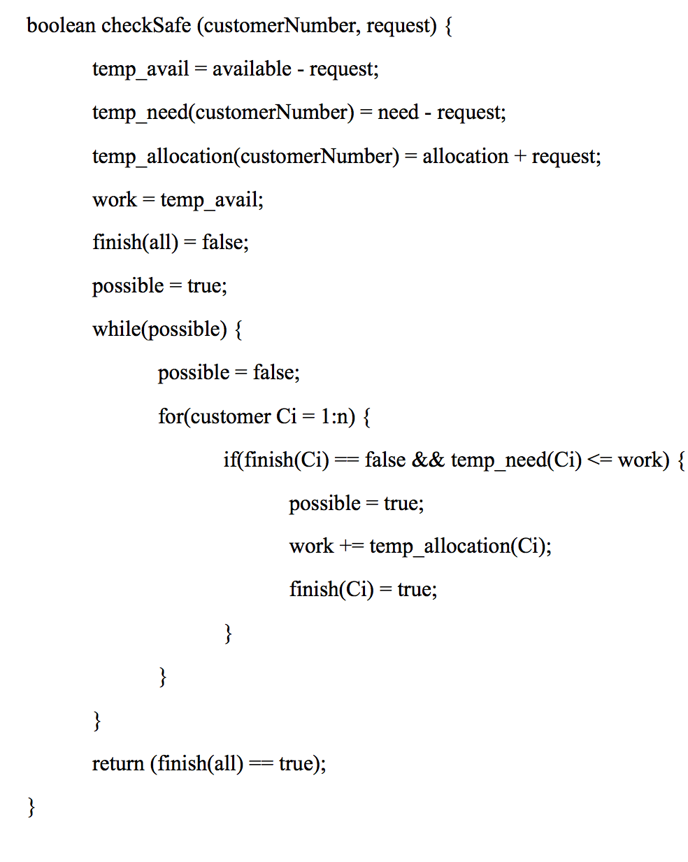
Task 2: Safety Check Algorithm
Safety Check:
when a process requests an available resource, system must decide if granting the request will leave the system in a safe state.
pseudo-code refer to appendix II of Lab3_bankerAlgorithm.pdf

Slide 7
Task 3: Complexity analysis
Please analyze the time complexity of Banker’s algorithm if:
1. there is n customers in total
2. There is m resources in total

Slide 8
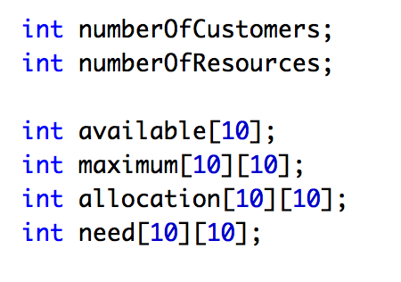
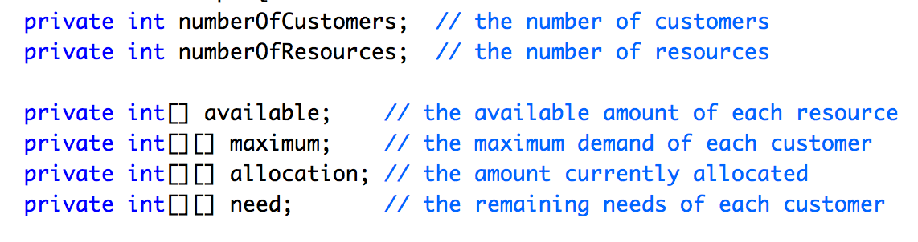
Code: data structure
C Version
Maximum number of number of customers and resources are both set to 10.
Java Version

Slide 9
Code: Q1-Bank System (Java)
You need to implement following functions:
public BankImpl(int[] resources, int numberOfCustomers);
// constructor, initialize available and customer number
public void addCustomer(int customerNumber, int[] maximumDemand);
// add a customer, with ID of customer and maximum demand
public void getState();
// Output system status, available/maximum/allocation/need
public boolean requestResources(int customerNumber, int[] request);
// Request resources, print error message if it’s denied
public void releaseResources(int customerNumber, int[] release);
// Release resources
public int getNumberOfCustomers(); // return customer number
Please refer to starting code for detail requirements

Slide 10
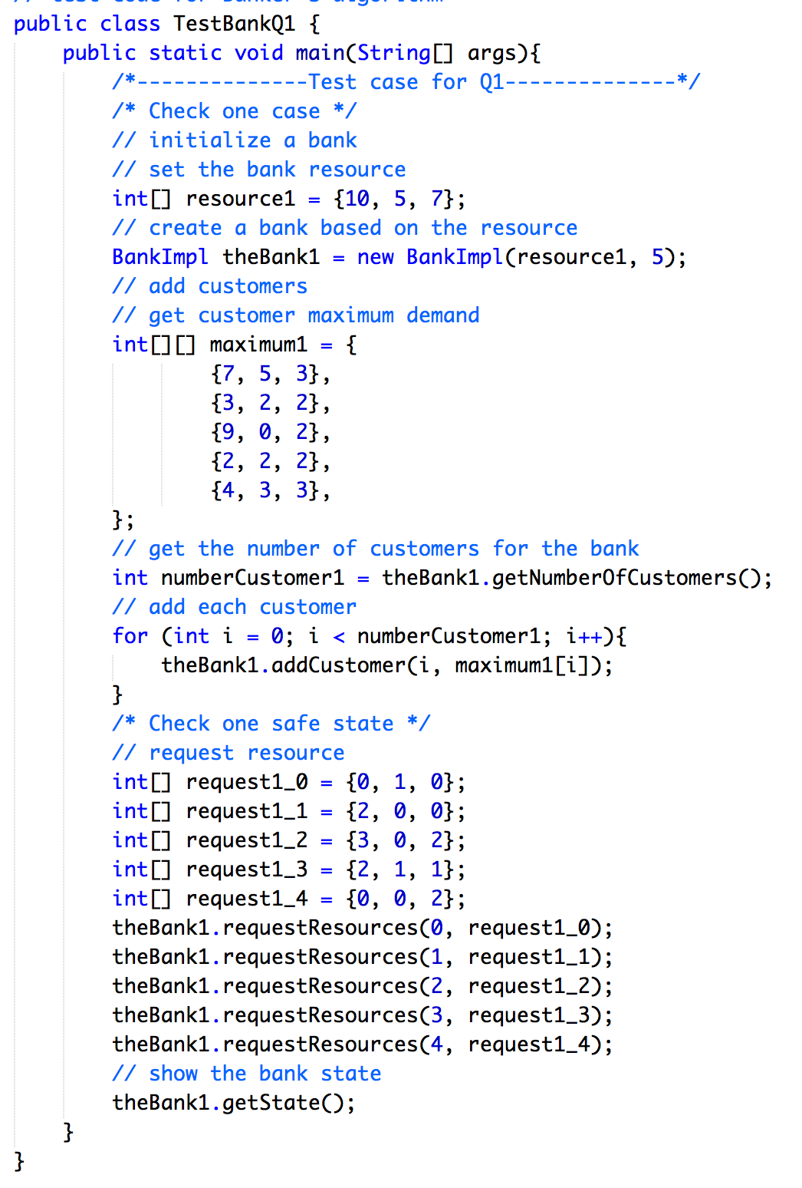
Code: Q1-Bank System (Java)
Test code for question 1: (already provided in TestBankQ1.java)

Slide 11
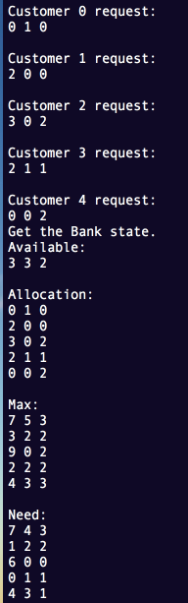
Code: Q1-Bank System (Java)
Test result for question 1:
(as example)

Slide 12
Code: Q1-Bank System (C)
You need to implement following functions:
void InitBank(int resources[], int resourcesNumber int customerNumber);
// initialize available and customer number
int addCustomer(int customerId, int maximumDemand[]);
// add a customer, with ID of customer and maximum demand
void showState();
// Output system status, available/maximum/allocation/need
int requestResources(int customerId, int request[]);
// Request resources, print error message if it’s denied
int releaseResources(int customerId, int release[]);
// Release resources
Please refer to starting code for detail requirements

Slide 13
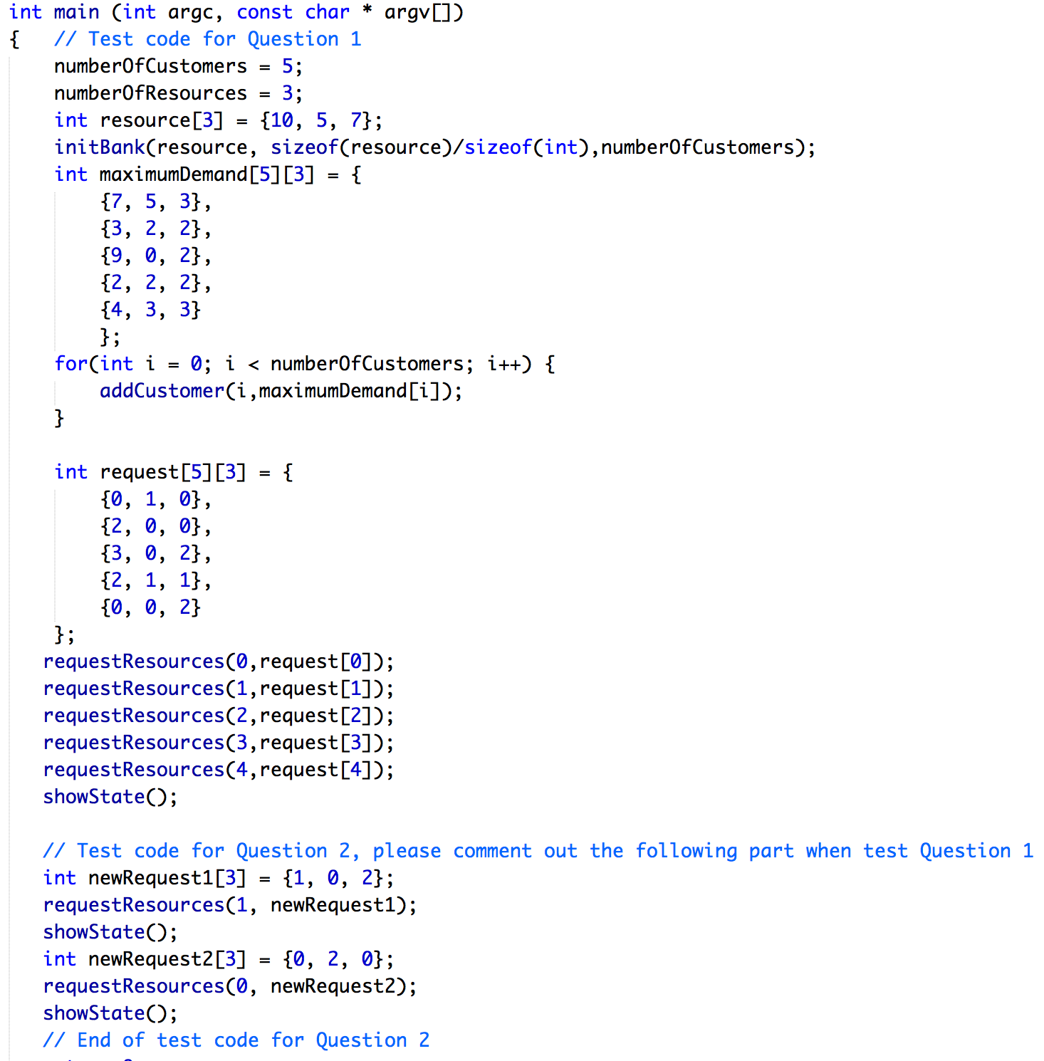
Code: Q1-Bank System (C)
Test code for question 1: (already provided in Banker_starting_Code.c)

Slide 14
Code: Q1-Bank System (C)
Test result for question 1:
(as example, same with Java version)

Slide 15
Code: Q2-Safety check (Java)
You need to implement checkSafe() functions:
public boolean checkSafe(int customerNumber, int[] request);
//Check if system grants the request, new state is safe or not
You also need to check safety before grant new request:
public boolean requestResources(int customerNumber, int[] request);
// Request resources, add safety check process, print error
// message if it’s denied
Please refer to starting code for detail requirements

Slide 16
Code: Q2-Safety check (C)
You need to implement checkSafe() functions:
int checkSafe(int customerId, int request[]);
//Check if system grants the request, new state is safe or not
You also need to check safety before grant new request:
int requestResources(int customerId, int request[]);
// Request resources, add safety check process, print error
// message if it’s denied
Please refer to starting code for detail requirements

Slide 17
Requirement
Put your result screenshots and analysis in a pdf file. Your submission should contain: one pdf report; source code. Please submit them before 11:59 PM, 1st March, 2017.
Good luck!

