Slide 1



Campus Ride-Sharing System with Parking System Integration
Software Requirements Engineering
TASK 1 - TASK 5 PRESENTATION
TT2L Group 7
YouTube Link:
https://youtu.be/5F9vkwhbXgY

Slide 2

Task 1a: Team Preliminary
Project Vision
A campus ride-sharing platform for students, staff, and faculty:
Integrates with campus parking system
Includes digital ID verificatoin
Shows real-time parking availability
Project Goal
Mobile app with ride-booking & parking availability
Target: Q4 2025, 80% adoption, 20% less parking usage

Slide 3
Task 1a: Team Preliminary
Project Scope
Communication Plan
Plan, design, and document the system
Form team and assign roles
Define project vision, scope, and goals
Identify context objects and requirement sources
Conduct elicitation
Apply Kano Model
Document findings and complete SRS
Weekly meetings for project status
Progress updates via MS Teams Chat
Task assignment via Google Docs
Coordination via MS Teams
Campus Ride-Sharing System

Slide 4
Task 1b: Team Roles
Role Assignment Table
Name | Role | Responsibilities
Ong Zi Xuan | Team Coordinator | Led coordination, interviews, SRS writing, formatting
Quek Jing Xiang | Elicitation Planner | Prepared Kano Plan, questions, techniques, Finalized SRS Requirements and Verification
Chin Jing Xuan | Elicitation Analyst | Analyzed responses, Kano categorization, document elicitation outputs
Jahed, Fahad Bin | Documentation Coordinator | Finalized SRS intro, references, appendices, and overall documentation coordination

Slide 5

Task 1b: Team Roles
Collaboration Method
WhatsApp: Quick chats, coordination, informal updates
MS Teams: File sharing, formal communication
Google Docs:
• Shared workspace
• Real-time editing & task table
• Not used in VS Code due to .docx binary format
GitHub Workflow:
Draft in Google Docs
Final copy moved to local repo
git pull → update file → git commit & push
Tracks contributions, allows future changes

Slide 6
Task 2: Context Sources
IT System Facet
Campus Parking Management System
MMU IDM System
GPS / Map Integration Services
Mobile Devices
Context Objects
Usage Facet
Students
Faculty and Staff
Parking Management Administration
Campus Security
Development Context
System Developers
UI / UX Designers
Subject Facet
Parking Lots
Ride Requests and Offers
User Accounts
Requirement Engineering Context
University IT Department
Legal / Policy Teams
Project Stakeholders

Slide 7
Task 2: Context Sources
Requirement Sources
Documents
MMU Student Handbook 2021 / 2022
MMU Privacy Notice (26 September 2022)
Stakeholders
Students
Faculty and Staff
Campus IT Department
Parking Management Administration
Existing Systems
Campus Parking Management System
MMU IDM System

Slide 8
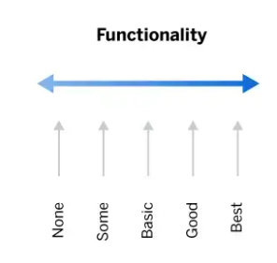
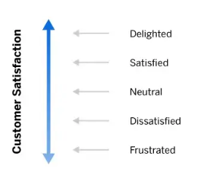
Task 3: Kano model
What is it?
analysis tool that enables you to understand how customer emotional responses to products or features can be measured and explored.
can be used to categorise product features across two-axis scales: Functionality & Satisfaction

Slide 9
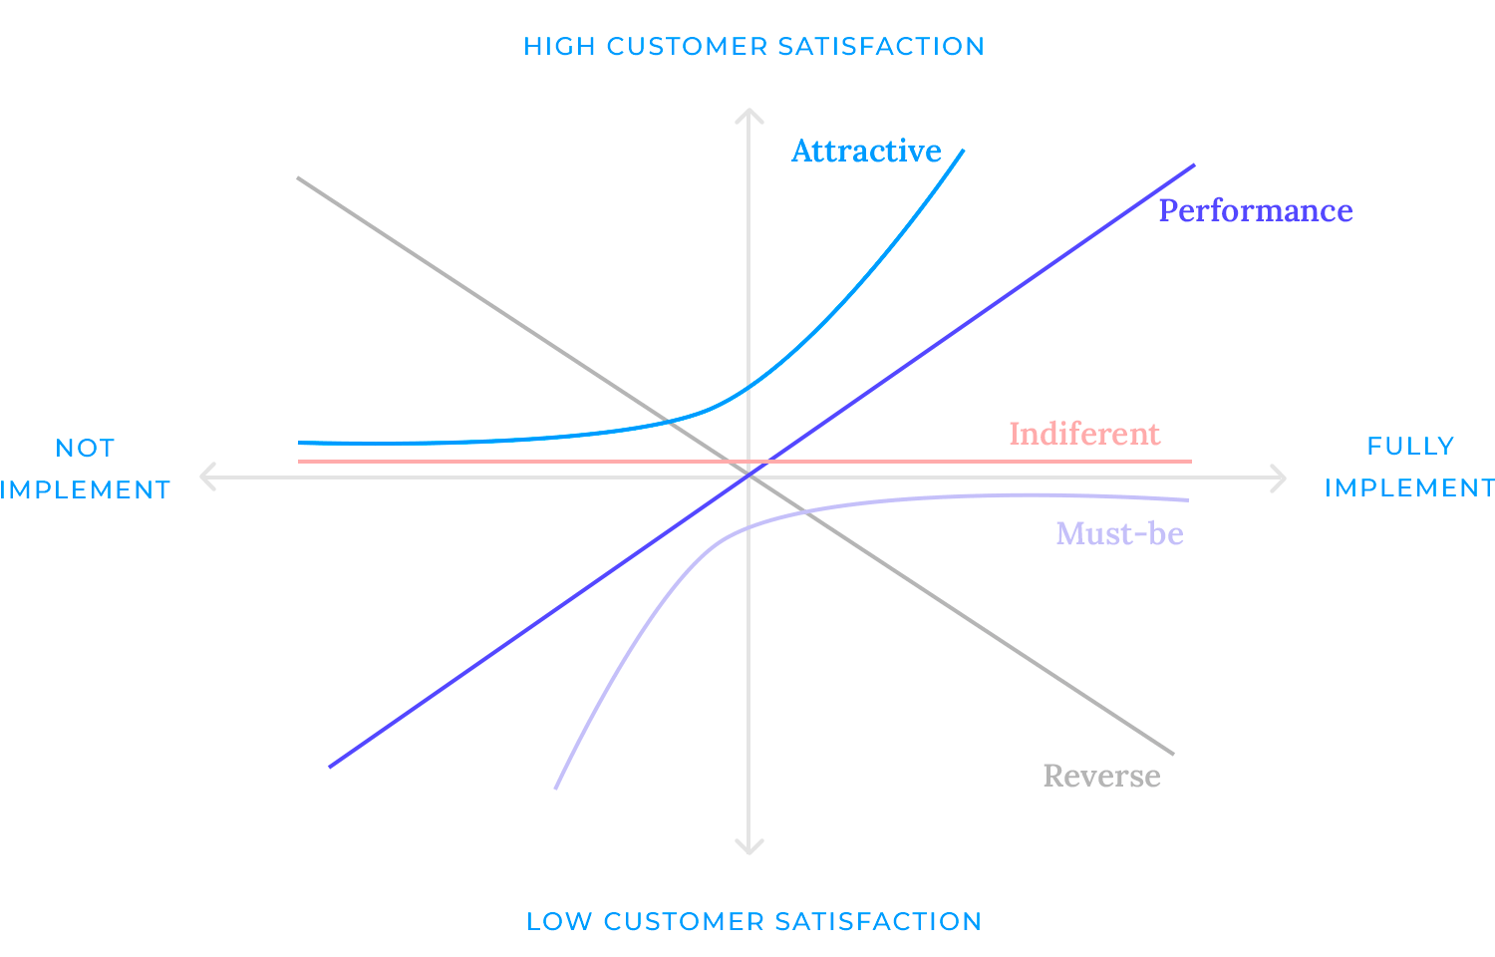
Task 3: Kano model

Slide 10
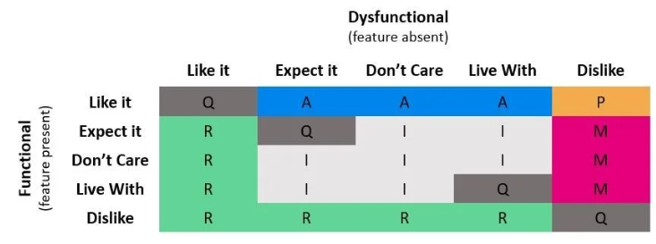
Task 3: Kano model
Feature categorisation

Slide 11
Task 4:Elicitation Output
Introduction
Multiple Elicitation Tools Used:
Interviews: Structured to obtain clear, logical answers.
Surveys/Questionnaires: Provided quantitative insights into user preferences.
Observations: Allowed us to witness real user behavior in context.
Key Benefits of This Approach:
Captured both stated and unstated user requirements.
Ensured a well-rounded understanding of actual user expectations.
Served as a strong foundation for feature prioritization and development planning.
TT2L GROUP 7

Slide 12

Elicitation Session Overview
Elicitation Season | Explanation
Structured Interview | -Interviewed university member. -Used predefined questions to assess: • Real-time parking tracking • Reservation systems • MMU ID integration
Questionnaire | -Distributed via Google Forms to students and staff. -Rated features like ride booking, live parking maps, notifications, and login methods. -Kano model applied to prioritize features based on satisfaction levels.
Observation | -Observed campus parking during peak and off-peak hours. -Studied user parking behavior, congestion levels, and environment suitability. -Verified assumptions and checked feasibility of features like parking sensors.

Slide 13
Requirement Categorization Using Kano Model
M
A
MUST-BE
ATTRACTIVE
Request ride
Offer ride
View ride details
Sign up using MMU ID/ Log in / Log out
Admin view user & car info
Advanced ride booking
Messaging functionality
In-app payment & wallet
Reserve parking
Report improper parking
P
I
PERFORMANCE
INDIFFERENT
Real-time location tracking
Notification system
Check real-time parking availability
View payment history
TT2L GROUP 7

Slide 14
Summary of Elicitation Outcomes
Objective: Understand stakeholders’ expectations and system feasibility.
Stakeholder: Campus IT Department (NICE)
1.Structured interview
Topic | Key Insights
Improper Parking Reporting | Technically possible; needs coordination with security. False reports are a concern, so some kind of verification is needed.
Parking Reservation | Possible in selected areas. Short-term reservations (30 mins–2 hours) are preferred. Unused spots should be auto-released.
Real-Time Parking Tracker | Can work using sensors or CCTV, but requires funding and may be rolled out in stages.
Admin Roles | Assigning admins is possible. Should work with existing campus roles.
MMU ID Integration | Feasible with proper data privacy measures and internal approval.
2.Questionnaire
3.Observation

Slide 15
Summary of Elicitation Outcomes
Objective: To understand user expectations for design, features, and app performance.
Audience: MMU students and staff
Method: Google Forms
1.Structured interview
2.Questionnaire
Feature | User Feedback
Improper Parking Reporting | Strongly support. Users want the ability to report issues.
Live Parking Map | Highly valued. Considered essential for the system to work well.
Parking Reservation | Mixed opinions. Should be optional and implemented fairly.
Ride Booking & Tracking | Mixed feedback. Tracking is useful but should respect privacy.
User Interface | Users prefer a modern, consistent design without pop-ups.
3.Observation

Slide 16
App Speed | Pages should load in 1–2 seconds. Parking data should refresh every 3–5 seconds.
Notifications & Chat | Notifications are important. Chat is helpful but not a must-have.
In-App Payments | Convenient for frequent users but not critical for everyone.
Admin Access | Supported for rule enforcement and safety.
Support & Errors | Clear error messages and helpful guides are important.
Themes | Consistent look preferred. Option to switch between light and dark modes is appreciated.
Device Support | Users want both web and mobile access.
Login Process | Too many logins are annoying. Persistent login is preferred.
Summary of Elicitation Outcomes
1.Structured interview
2.Questionnaire
3.Observation

Slide 17
Summary of Elicitation Outcomes
Objective: To see how parking and transportation work in real campus settings.
1.Structured interview
2.Questionnaire
Area | What Was Observed | Insight
FAIE Parking | Faculty arrive early and fill up spots. Smaller lots are often ignored. | Staff spots are limited. Small lots are underused.
FCI Parking | Students often take 5–10 minutes to find a space. Staff spaces are empty but off-limits to students. | High demand and stress for students. Good locations for sensors and cameras
Back of Library | Closed most of the time. Used only during events or deliveries. | Could be used as overflow parking if managed properly.
3.Observation

Slide 18
Elicitation Output:
Conclusion
By using interviews, surveys, and observation, we gained a clear picture of what MMU really need.
Each method gave us different insights:
Interviews showed what’s technically and institutionally possible.
Surveys highlighted user top priorities.
Observations confirmed real on-campus behavior.
User needs:
Live parking updates, fair reservations, carpool options, and a fast, easy-to-use app.

Slide 19

Task 5: SRS Part 1 Introduction
Purpose
scope
Create a secure and efficient application for the university community.
enhance user safety through integration with the university’s identity verification and parking management systems.
Mobile and web-based platform that integrates with MMU’s existing systems.
Supports core functions of the requirements.
Campus-specific system

Slide 20
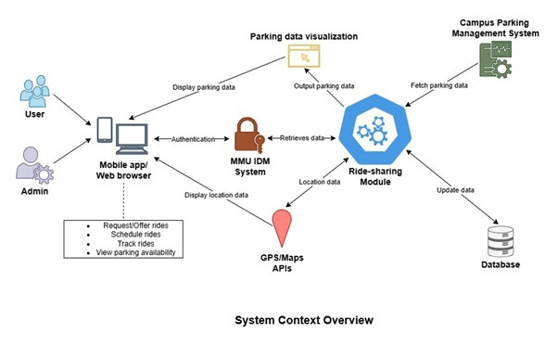
Product overview
Acts as centralized middlewire
Connects external systems
Secure connection and interactions

Slide 21
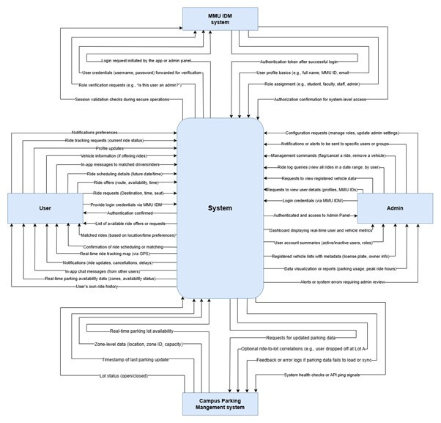
Product
perspective
Students, faculty, and staff provide inputs to the system.
The system processes these requests through modules.
The system returns the result of the input using the module.
Admins log in through a secure panel to access data.
For the verification the IDM verifies identity..
Context diagram

Slide 22
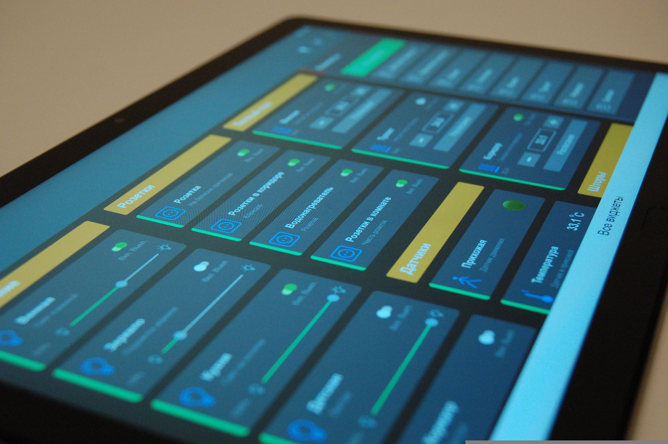
Product Functions
User Characteristics
User signup
User login & logout
Request & offer ride
View ride details
In-app messaging
Admin Login & Logout
View user information
User role | Technical Skill
Students | Basic computer literacy
Faculty/Staff | Moderate computer profieciency
Admin | Advanced IT dashboard usage

Slide 23

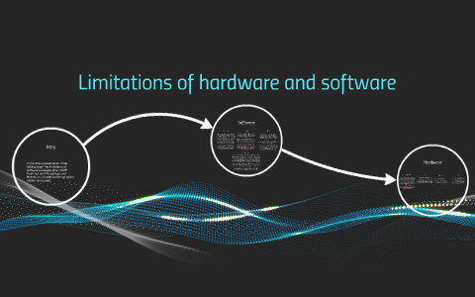
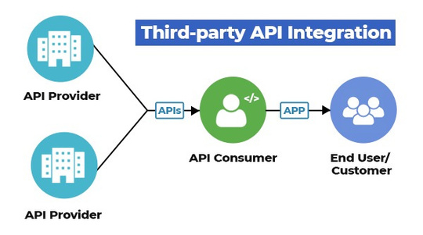
Limitations
components
Overview
When developing a platform that integrates a campus ride-sharing application with a university parking system and identity management system, several limitations must be considered to ensure operational efficiency, legal compliance, and system reliability.
PDPA
Hardware limitations
Dependency on third party API
Limitations to consider

Slide 24
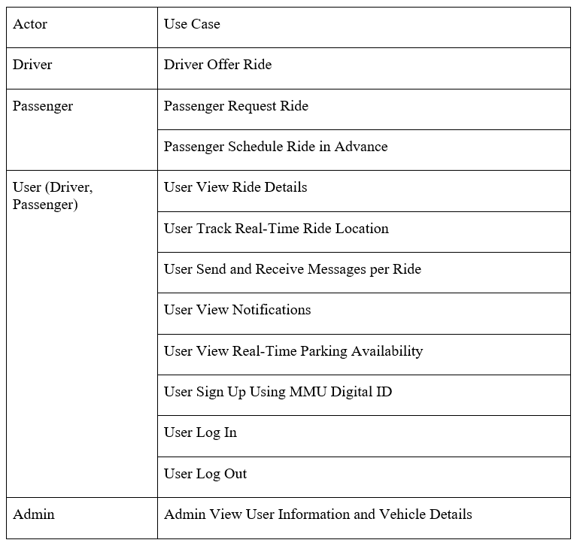
Task 5: SRS Part 3 Requirements
3.1 Functions
Overview
3.1 Functions
3.2 Performance Requirements
3.3 Usability Requirements
3.4 Interface Requirements
3.4.1 System Interfaces
3.4.2 User Interfaces
3.4.3 Hardware Interfaces
3.4.4 Software Interfaces
3.4.5 Communication Interfaces
3.5 Logical Database Requirements
3.6 Design Constraints
3.7 Software System Attributes

Slide 25
Task 5: SRS Part 3 Requirements
Performance
The product shall take initial load time depending on internet connection strength which also depends on the media from which the product is run, but is capped at a maximum of 2 seconds.
The users shall have their ride request accepted within a timeframe depending on the number of active drivers at the time, but capped at a maximum of 1 minute.
The maximum acceptable real-time parking availability update period shall be capped at 10 seconds.

Slide 26
Task 5: SRS Part 3 Requirements
Usability
The product shall include helpful, clear, comprehensible and accessible help menus for the functions the product provides.
The product shall include helpful, clean, clear and comprehensible error messages that are shown when errors occur.
The product should be accessible on mobile platforms in the form of an application on both android and iOS.

Slide 27
Task 5: SRS Part 3 Requirements
System interface
Web browser compatibility
User interface will be rendered on compatible web browsers.
The product shall be compatible with the latest stable version of major browsers like Google Chrome, Microsoft Edge, Mozilla Firefox and Brave Browser.
Platform compatibility
Product shall run on all major mobile platforms and desktop operating systems.
The product shall be compatible with mobile platforms like Android (10 +), iOS(13 +) and available on desktop operating systems like Windows (10/11) and macOS (Big Sur 11.0+).

Slide 28
Task 5: SRS Part 3 Requirements
User Interface
Utilisation of icons and toolbars
The product shall provide the use of icons and toolbars for ease of navigation.
Interactable elements shall have icons and tooltips to provide clarity on their functions.
Theme switching
The product shall allow users to switch between light and dark themes.
The default theme shall follow the device preference of the users.
Layout structure
The product shall have a well-structured and consistent layout where the menus and buttons are organised and intuitively placed.
Buttons with related functionalities shall be placed together.
Users shall be able to use the product with minimal help.

Slide 29
Task 5: SRS Part 3 Requirements
Hardware Interface
Hardware requirements for hosting:
Have NodeJS runtime environment (v18 +) installed.
Minimally 1GB of free hardware space.
Minimally 2GB of RAM
Hardware requirement for end-user devices:
with Pentium 4 processor or higher
with minimally 256MB of RAM.
with minimally 128MB of free space
that has an active internet connection.

Slide 30
Task 5: SRS Part 3 Requirements
Software Interface
MMU Digital ID Database
The product shall communicate with the MMU Digital ID Database for authentication.
Parking Sensor Management System
The product shall communicate with the parking sensor management system for parking availability.
User Management System
The product shall communicate with the user management system to get, update or delete the details of users and their vehicles.
E-hailing System
The product shall communicate with the e-hailing system to submit and get ride requests.
GPS System
The product shall communicate with the GPS system to get real-time driver’s location.
Notification System
The product shall communicate with the notification system to submit and get notifications.

Slide 31
Task 5: SRS Part 3 Requirements
Communication Interface
HTTPS protocol
To encrypt all communication over the internet
TLS 1.2+ required.
All API calls must use HTTPS.
Network Requirement
Ensure smooth data transfer and good user experience.
A minimum of 2MBps of internet speed shall be required.

Slide 32
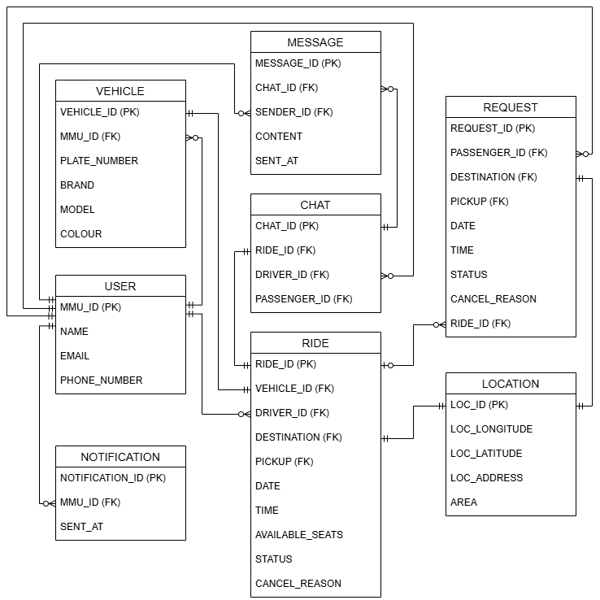
Task 5: SRS Part 3 Requirements
3.5 Logical Database Requirements
ERD

Slide 33
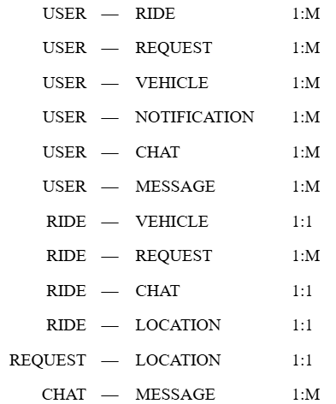
Task 5: SRS Part 3 Requirements
3.5 Logical Database Requirements
Entity
Relationship

Slide 34
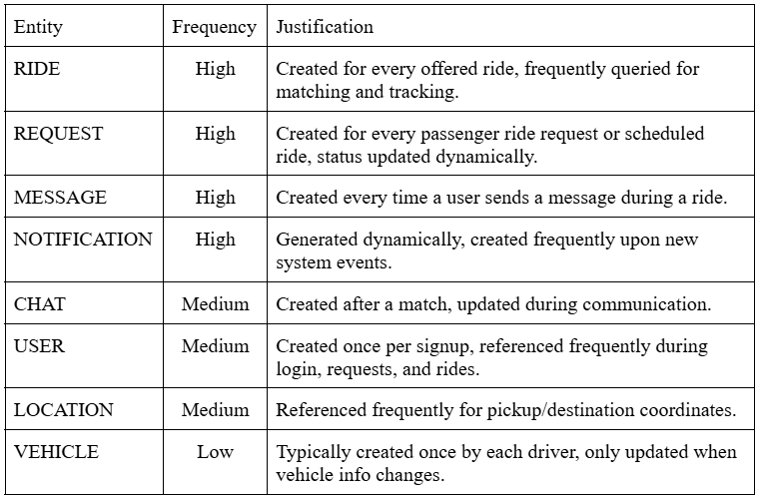
Task 5: SRS Part 3 Requirements
3.5 Logical Database Requirements
Frequency of Use

Slide 35
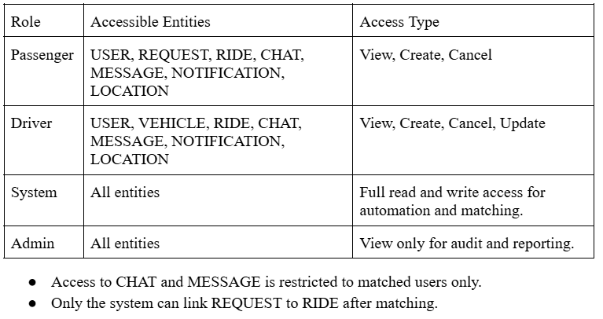
Task 5: SRS Part 3 Requirements
3.5 Logical Database Requirements
Accessing Capabilities

Slide 36
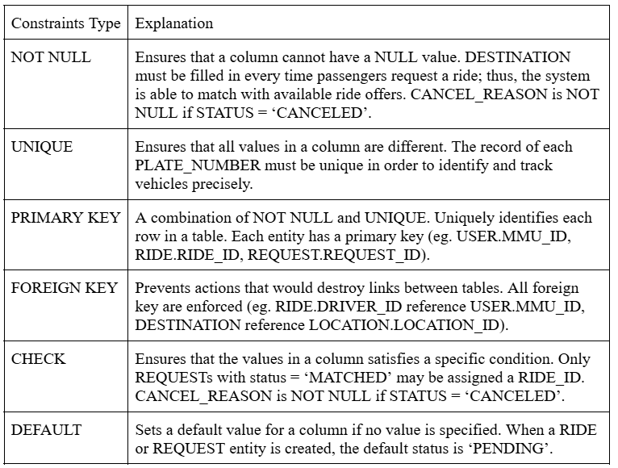
Task 5: SRS Part 3 Requirements
3.5 Logical Database Requirements
Integrity Constraints

Slide 37
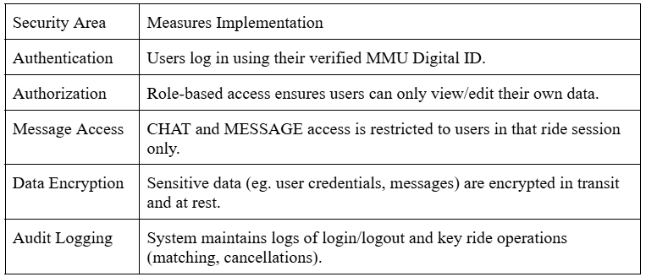
Task 5: SRS Part 3 Requirements
3.5 Logical Database Requirements
Security

Slide 38
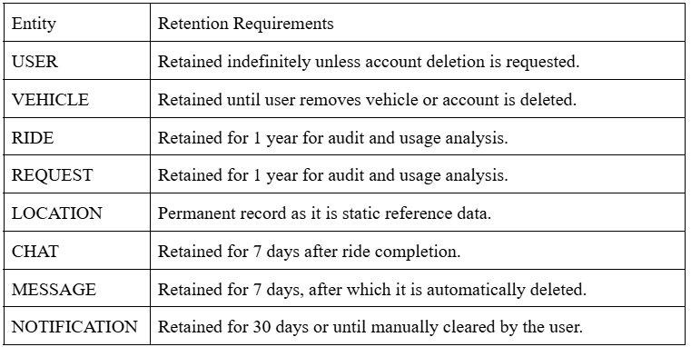
Task 5: SRS Part 3 Requirements
3.5 Logical Database Requirements
Data Retention Requirements

Slide 39

Task 5: SRS Part 3 Requirements
3.6 Design Constraints
External Constraints
Business Constraints
Organizational Constraints
Key Content Included:
Access: Only MMU students/staff via Digital ID
Scope: Campus-only ride-sharing & parking
UI: Must follow MMU branding (colors, fonts, layout)
Integration: MMU internal systems only — no 3rd party APIs
Regulatory Constraints
Data Protection and Privacy
Key Content Included:
User Consent & Transparency required
Data Use: Only for ride-sharing; no marketing
Retention: Delete/anonymize when no longer needed
Access Rights: Users can view/edit their data
Security: Use SSL/TLS, encryption, access control
Technical Constraints
Platform Constraints
Feature Behavior Constraints
Data Retention Constraints
Key Content Included:
Platform: Must be mobile-friendly (responsive UI)
Behavior: Auto-match rides; no manual selection
Chat: Enabled only during rides, deleted post-ride
Retention:
Chats: delete after 7 days
Notifications: auto-clear after 30 days
Campus Ride-Sharing System

Slide 40
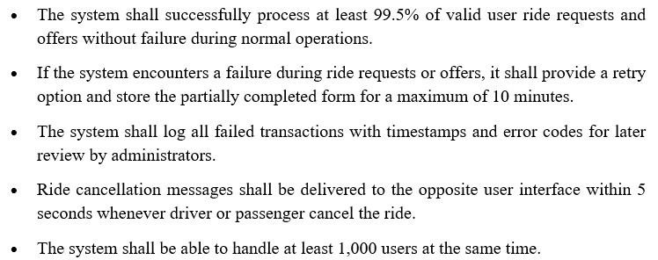
Task 5: SRS Part 3 Requirements
3.7 Software System Attributes
Reliability

Slide 41
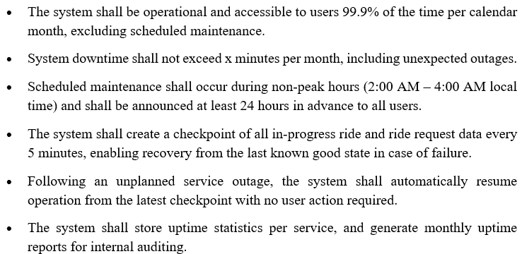
Task 5: SRS Part 3 Requirements
3.7 Software System Attributes
Availability

Slide 42
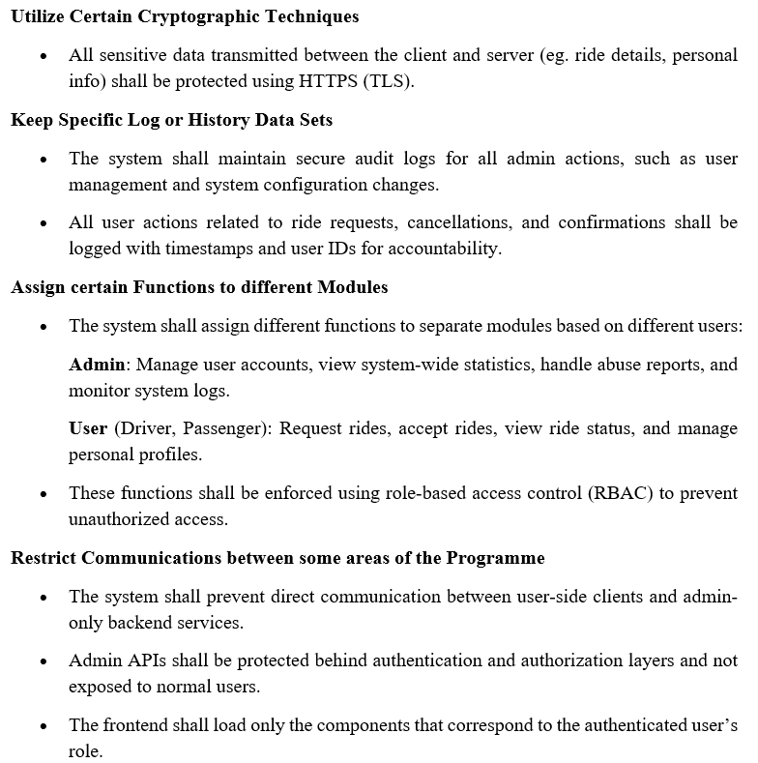
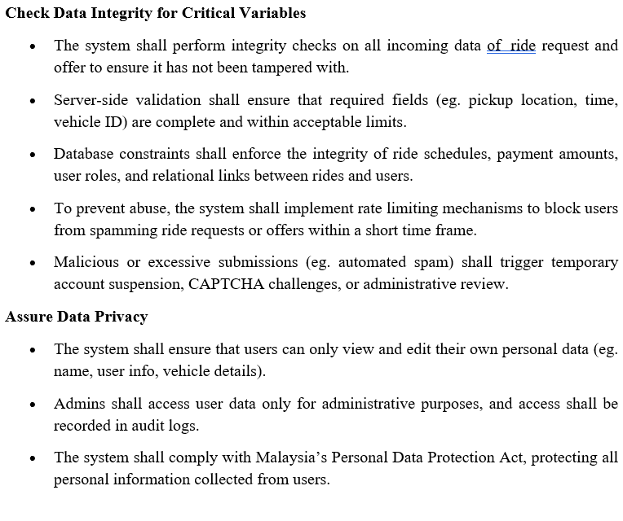
Task 5: SRS Part 3 Requirements
3.7 Software System Attributes
Security

Slide 43
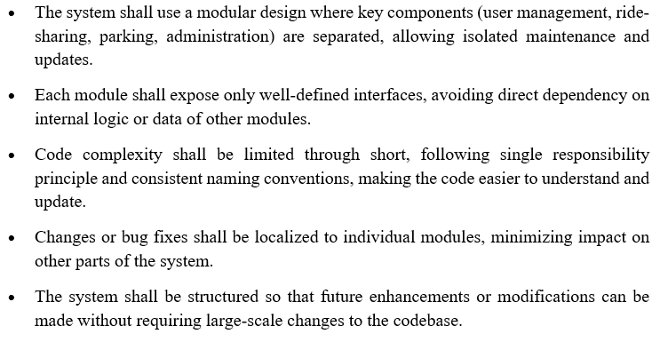
Task 5: SRS Part 3 Requirements
3.7 Software System Attributes
Maintainability

Slide 44
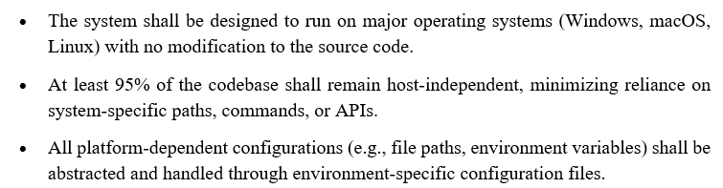
Task 5: SRS Part 3 Requirements
3.7 Software System Attributes
Portability

Slide 45
Task 5: SRS Part 4 Verification
4.0 Verification
Compatibility testing
To ensure that the software can run on specified platforms, environments and configurations without any errors.
The software is installed on different web browsers platforms, and environments of different versions that are specified as requirements above. Once installed, the software is tested by following basic workflows, ensuring all features function as expected without errors. Any error occurred during testing is documented.

Slide 46
Task 5: SRS Part 4 Verification
4.0 Verification
Stress Testing
To find out how much the system can handle using the given hardware in the specified requirement (2GB RAM, 1GB disk).
Simulate high traffic and resource demands using load-testing tools, while monitoring RAM, disk usage, and Node.js performance. Tests will push hardware to its limits (2GB RAM, 1GB disk) to verify stability, and recovery from stress.

Slide 47
Task 5: SRS Part 4 Verification
4.0 Verification
Component Testing
To ensure that individual software components function correctly and meet specific requirements in isolation before they are integrated into a larger system.
Component testing will validate functionality, input/output accuracy, and error handling using tools like Jest for unit/functional testing. Simulated dependency failures (e.g., database downtime) will test error resilience.

Slide 48
Task 5: SRS Part 4 Verification
4.0 Verification
Usability Testing
To understand how users navigate and use the application, ensuring that it is user-friendly and meets the needs and expectations of end users
50 participants of different age groups are then chosen to conduct the test remotely, with each participant given a task and is timed to measure the time taken to complete the tasks.

Slide 49
Task 5: SRS Part 4 Verification
4.0 Verification
Database Testing
To ensure the database is accurate, reliable and performant, and if the constraints are obeyed.
Several test scenarios are identified (database operations), and the database is initially seeded. Then, several test cases for each table are created based on the defined scenarios, and the test outcome is documented.

Slide 50
Task 5: SRS Part 4 Verification
4.0 Verification
API Testing
To ensure that the software API only accepts HTTPS traffic with version TLS 1.2 and above.
All endpoints are tested using the Postman API client using HTTP and HTTPS of different versions to ensure that only the correct protocol of compatible versions are accepted.

Slide 51

Task 5: SRS Part 5 Appendices
Assumptions &
Dependencies
Acronyms
Terms | Terms
IDM | PDPA
HTTPS | API
GPS | TLS
Working Internet
Stable GPS
MMU ID credentials
Correct driver input

Slide 52
THANK YOU

