Slide 1
XAGF Code
By Zhun-Yong Ong

Slide 2
Equation of motion for atoms in AGF system
Atomic displacement
Mass matrix
Interatomic force constant (IFC) matrix
The traditional AGF method models the system as comprising the semi-infinite left lead, the finite-volume center and the semi-infinite right lead
The equation of motion describes the time dependence of the atomic displacement degrees of freedom and depends on the mass and interatomic force constant (IFC) matrices
In principle, we are describing an open quantum system with an infinite number of degrees of freedom
To utilize the AGF method, we partition system into slices or principal layers

Slide 3
Partitioning open system into slices/principal layers
Left lead (semi-infinite)
Center
(finite volume)
Right lead (semi-infinite)
-1
0
1
2
N
N+1
N+2
Left lead
Center (scattering)
Right lead
Each principal layer has a finite number of degrees of freedom
All the principal layers in each lead (left or right) are identical
The principal layers in the center are not identical

Slide 4
Partitioning open system into slices/principal layers
-1
0
1
2
N
N+1
N+2
Left lead
Center (scattering)
Right lead
We partition the system into principal layers for computational/numerical efficiency
The partitioning splits the IFC matrix into a block-tridiagonal form
We associate four submatrices with each principal layer
Left lead: Left_KL, Left_KC, Left_KR, and Left_M
Right Lead: Right_KL, Right_KC, Right_KR, and Right_M
Center: Center_KLn, Center_KCn, Center_KRn, Center_Mn for layer n (n = 1,…,N)
There are 4N+8 submatrices (.agf files) in total

Slide 5
Mass submatrices and principal layer numbering
Block-diagonal mass matrix
Left lead (n = -inf to 0)
M_{n,n} = Left_M
Center (n = 1 to N)
M_{n,n} = Center_Mn
Right lead (n = N+1 to inf)
M_{n,n} = Right_M
-1
0
1
2
N
N+1
N+2
Left lead
Center (scattering)
Right lead

Slide 6
IFC submatrices and principal layer numbering
Block-tridiagonal IFC matrix
Left lead (n = -inf to 0)
K_{n,n-1} = Left_KL
K_{n,n} = Left_KC
K_{n,n+1} = Left_KR
Center (n = 1 to N)
K_{n,n-1} = Center_KLn
K_{n,n} = Center_KCn
K_{n,n+1} = Center_KRn
Right lead (n = N+1 to inf)
K_{n,n-1} = Right_KL
K_{n,n} = Right_KC
K_{n,n+1} = Right_KR
-1
0
1
2
N
N+1
N+2
Constraints
In general, K_{n,n-1} = (K_{n-1,n})^{T}
-> K_{1,0} = Left_KL
-> K_{N,N+1} = Right_KR
Left lead
Center (scattering)
Right lead

Slide 7
Acoustic sum rule
The conservation of linear momentum (or translational invariance) implies that the IFC matrix K must obey the so-called “acoustic sum rule”
Acoustic sum rule: if we add up the matrix elements of each row in K, the sum must be zero
Hence, the diagonal matrix element is given by
In the n-th principal layer, each row in the matrix [K_{n,n-1} K_{n,n} K_{n,n+1}] must sum to zero numerically
If the acoustic sum rule is not enforced, the AGF calculation may be messed up especially for low-frequency phonon transmission and reflection

Slide 8
Input files

Slide 9
Running the XAGF calculation
In Matlab, run “ExtendedAtomisticGreensFunctionTransmission(‘input_files_cnt’,’output_files_cnt’)”
The first argument “input_files_cnt” is the path to the directory containing the input files for the AGF calculations
The second argument “output_files_cnt” is the path to the directory containing the output files from the AGF calculations
The input files correspond to the CNT intermolecular junction (Example 2) described in Z.-Y. Ong, “Tutorial: Concepts and numerical techniques for modeling individual phonon transmission at interfaces,” J. Appl. Phys. 124, 151101 (2018). The left lead and right lead correspond to a pristine (16,0) CNT and (8,0) CNT, respectively.

Slide 10
Input files for AGF calculations
Left_Parameters.agf: parameters describing the layered structure of the left lead (carbon nanotube)
Left_KL.agf: submatrix K_{1,0}
Left_KC.agf: submatrix K_{0,0}
Left_KR.agf: submatrix K_{0,1}
Left_M.agf: submatrix M_{0,0}
Left_Phonon_Parameters.agf: parameters describing the mapping between the transverse unit cell and the primitive unit cell of the bulk phonons in left lead
Left_Phonon_K1.agf
Left_Phonon_K2.agf
Left_Phonon_K3.agf
Left_Phonon_M.agf
The same goes for the Right_*.agf files that describe the right lead (carbon nanotube)
Submatrices describing the bulk phonons in the left lead. The number of files is variable

Slide 11
Input files for AGF calculations
Input_Frequency.agf: frequency points for AGF calculations
Scattering_Output_Frequency.agf: frequency points for S-matrix calculations
Center_KLn.agf: submatrix K_{n,n-1}
Center_KCn.agf: submatrix K_{n,n}
Center_KRn.agf: submatrix K_{n,n+1}
Center_Mn.agf: submatrix M_{n,n}
Submatrices describing the layers in the device region
The index n runs from 1 to N

Slide 12
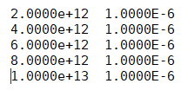
Input_Frequency.agf
Frequency (rad/s)
Delta
Frequency points for AGF computation
This is some dimensionless number that should be small, used for setting retarded functions

Slide 13
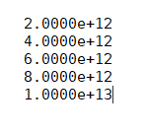
Scattering_Output_Frequency.agf
Frequency (rad/s)
Frequency points for AGF S-matrix computation

Slide 14
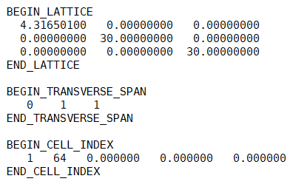
Left_Parameters.agf
These describe the non-primitive unit cell in the layer
Lattice vector in longitudinal (x) direction (in angstroms)
Lattice vector in transverse (y) direction (in angstroms)
Lattice vector in transverse (z) direction (in angstroms)
N_{y} = number of repeating units in transverse (y) direction in each layer;
equals 1 in a pure 1D system
N_{z} = Number of repeating units in transverse (z) direction in each layer;
equals 1 in a pure 1D system
Each row describes a transverse unit cell
Relative position of transverse unit cell in layer. In a pure 1D system, they are just set to “0 0 0” because there is only one entry.
Number of atoms in transverse unit cell. In a pure 1D system, it is the number of atoms in each layer of the left lead. There are 64 atoms in each layer of the (16,0) carbon nanotube
Index of transverse unit cell in each layer (1, …, N_{y}N_{z})

Slide 15
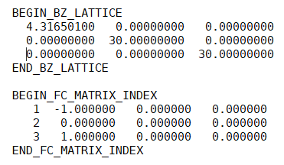
Left_Phonon_Parameters.agf
R₁ = lattice vector in longitudinal (x) direction (in angstroms)
R₂ = lattice vector in transverse direction (in angstroms)
R₃ = lattice vector in transverse direction (in angstroms)
These describe the primitive unit cell
Position of K1 submatrix = -1.00×R₁ + 0.00×R₂ + 0.00×R₃
Position of K2 submatrix = 0.00×R₁ + 0.00×R₂ + 0.00×R₃
Position of K3 submatrix = 1.00×R₁ + 0.00×R₂ + 0.00×R₃
Index of phonon matrix files (Left_Phonon_K1.agf, Left_Phonon_K2.agf, and Left_Phonon_K3.agf)

Slide 16
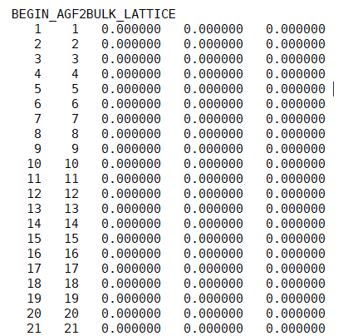
Column 1: Index of atoms in transverse unit cell of AGF layer. In the (16,0) carbon, it runs from 1 to 64 because there are 64 atoms in the transverse unit cell
Column 2: Index of atoms in primitive unit cell
Columns 3 to 5: Relative position of the atoms in the primitive unit cell with respect to the transverse unit cell. This only matters if the primitive unit cell is different from the transverse unit cell.

Slide 17
Output files

Slide 18
Output files for AGF calculations
Output_Transmission.dat: Standard total transmission results for AGF calculations
Output_Left_Transmission.dat: Mode-resolved transmission coefficients results for left lead
Output_Right_Transmission.dat: Mode-resolved transmission coefficients results for right lead
Output_Left_Reflection.dat: Mode-resolved reflection coefficients results for left lead
Output_Right_Reflection.dat: Mode-resolved reflection coefficients results for right lead
Output_Channels_n.dat: Information on phonon modes at nth frequency (from Scattering_Output_Frequency.agf)
Output_Smatrix_n.dat: Transpose of S matrix at nth frequency
Output_Scattering_n.dat: Table of transition probabilities for forward and backward scattering at nth frequency

Slide 19
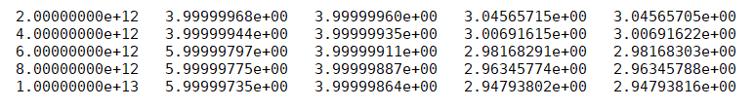
Output_Transmission.dat
[1]
[2]
[3]
[4]
[5]
Column [1]: Frequency (rad/s)
Column [2]: Maximum left-lead transmission (ideally equal to number of left-lead modes, an integer)
Column [3]: Maximum right-lead transmission (ideally equal to number of right-lead modes, an integer)
Column [4]: Total transmission (Caroli formula)
Column [5]: Total transmission (sum of mode-resolved transmission coefficietns)

Slide 20
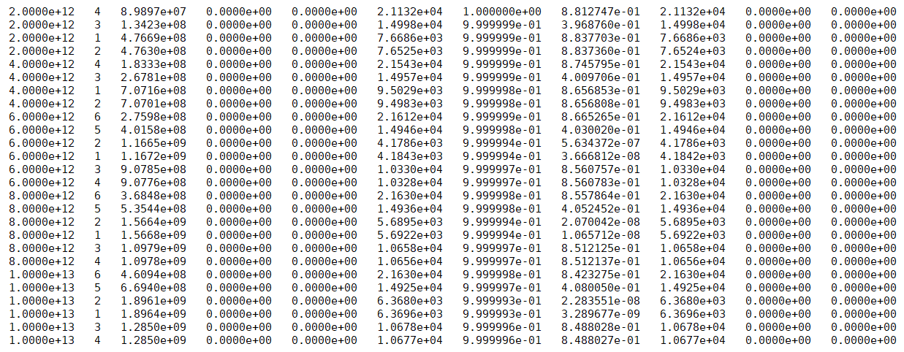
Output_Left_Transmission.dat
[1]
[2]
[3]
[4]
[5]
[6]
[7]
[8]
[9]
[10]
[11]

Slide 21
Column [1]: Frequency (rad/s)
Column [2]: Band index
Column [3]: q_{x} (x-component of mode wave vector) in m⁻¹
Column [4]: q_{y} (y-component of mode wave vector) in m⁻¹
Column [5]: q_{z} (z-component of mode wave vector) in m⁻¹
Column [6]: Longitudinal velocity of mode in ms⁻¹
Column [7]: Maximum mode-resolved transmission coefficient (should be as close to 1 as possible)
Column [8]: AGF mode-resolved transmission coefficient (between 0 and 1)
Column [9]: v_{x} (x-component of mode group velocity) in ms⁻¹, should be as close to column [6] as possible
Column [10]: v_{y} (y-component of mode group velocity) in ms⁻¹
Column [11]: v_{z} (z-component of mode group velocity) in ms⁻¹
Output_Right_Transmission.dat has the same format.
Output_Left_Reflection.dat and Output_Right_Reflection.dat have a similar format except that columns [7] and [8] represent the maximum mode-resolved reflection coefficient and AGF mode-resolved reflection coefficient, respectively

Slide 22
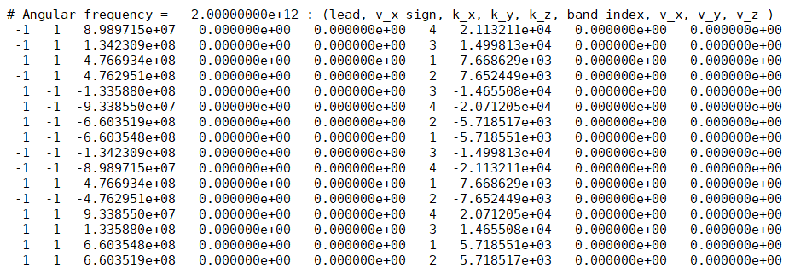
Output_Channels_1.dat
N incoming modes
N outgoing modes
Column [1]: Lead (-1 for left, +1 for right)
Column [2]: Sign of group velocity (-1 for negative, +1 for positive)
Column [3]: q_{x} (x-component of mode wave vector) in m⁻¹
Column [4]: q_{y} (y-component of mode wave vector) in m⁻¹
Column [5]: q_{z} (z-component of mode wave vector) in m⁻¹
Column [6]: v_{x} (x-component of mode group velocity) in ms⁻¹
Column [7]: v_{y} (y-component of mode group velocity) in ms⁻¹
Column [8]: v_{z} (z-component of mode group velocity) in ms⁻¹

Slide 23
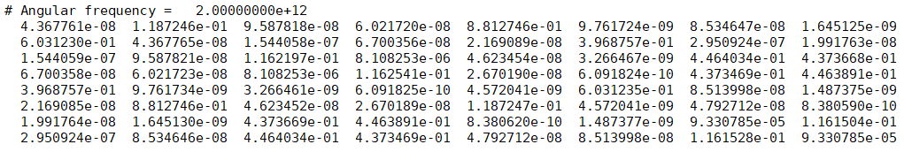
Output_Scattering_1.dat
Each row corresponds to an incoming phonon mode in Output_Channels_1.dat
Each column corresponds to an outgoing phonon mode in Output_Channels_1.dat
There are N x N matrix elements
The (m,n)-th matrix element corresponds to the transition probability between the m-th incoming mode and the n-th outgoing mode
The sum of each row or column should equal 1 ideally because of the unitarity of the S matrix

