Slide 1

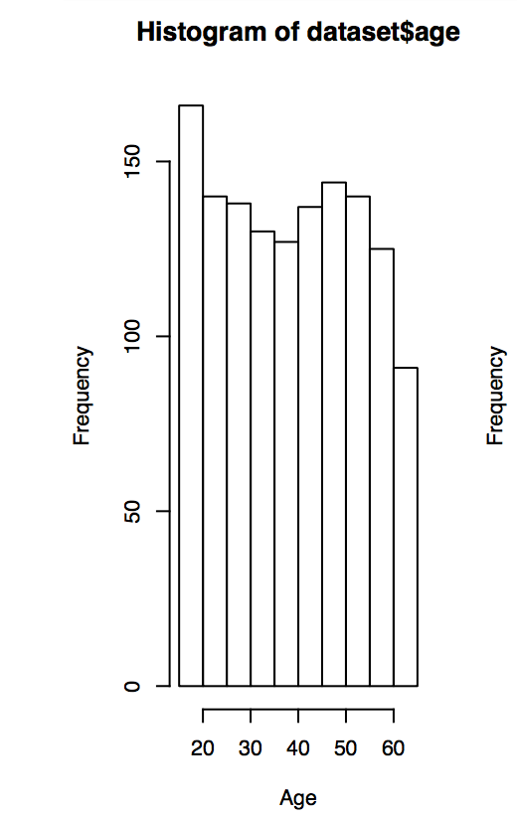
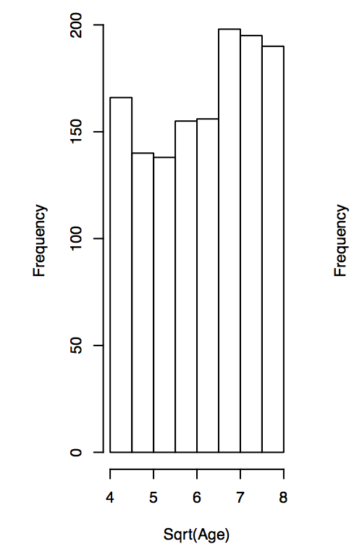
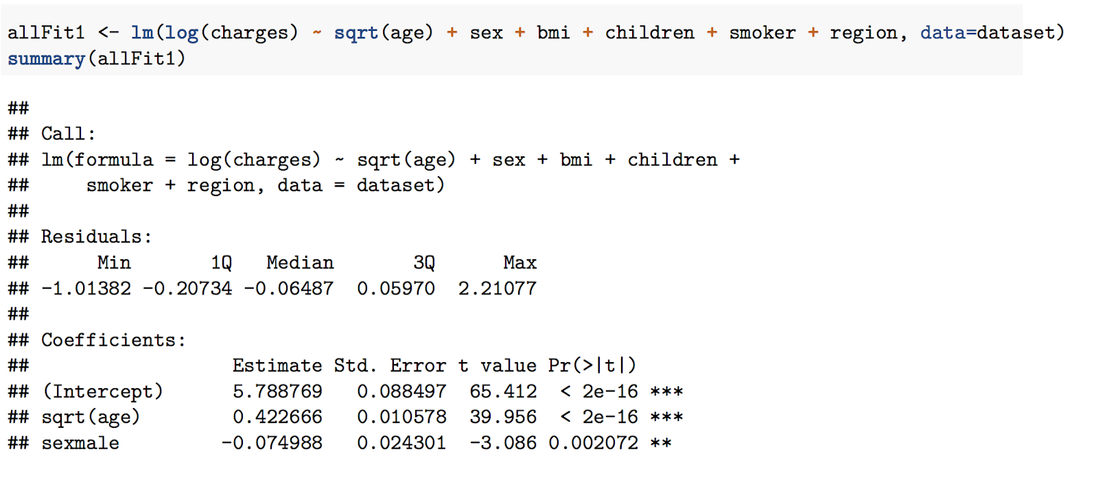
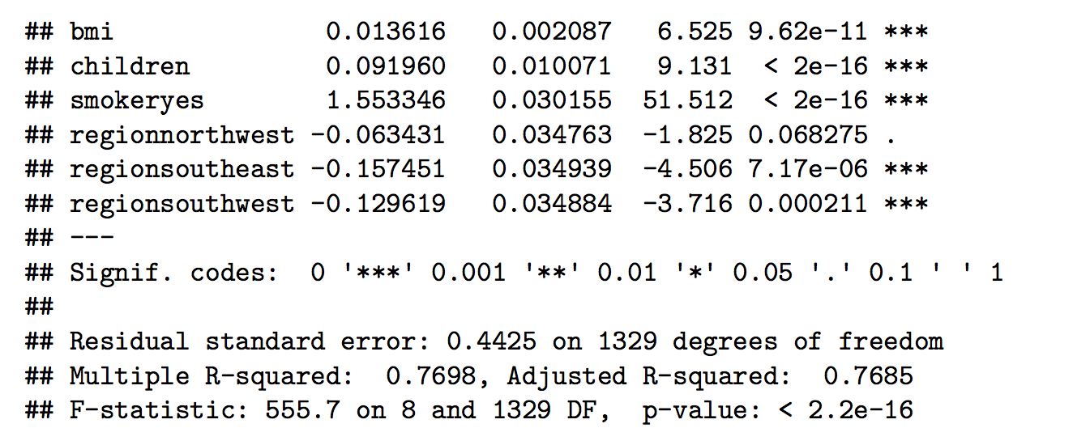
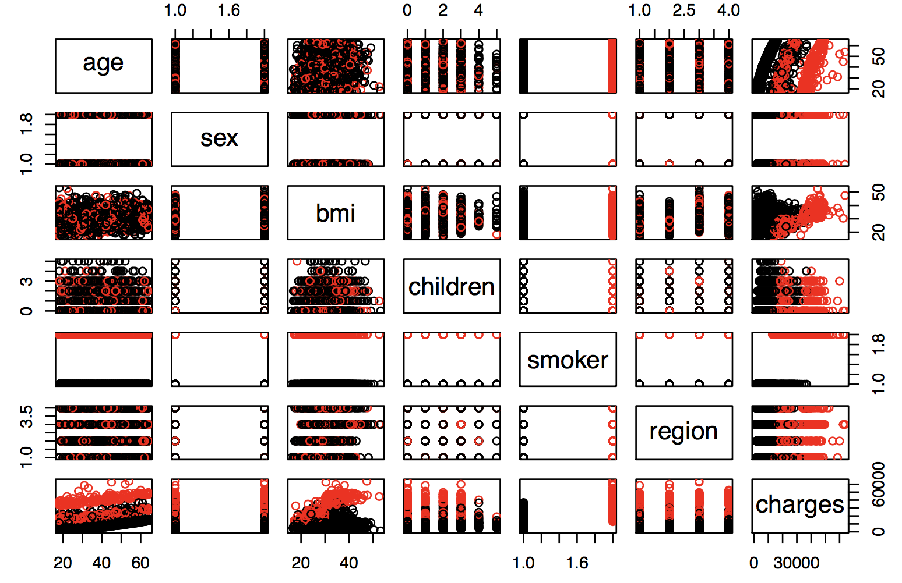
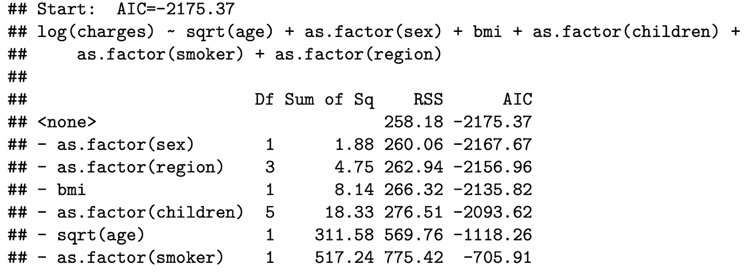
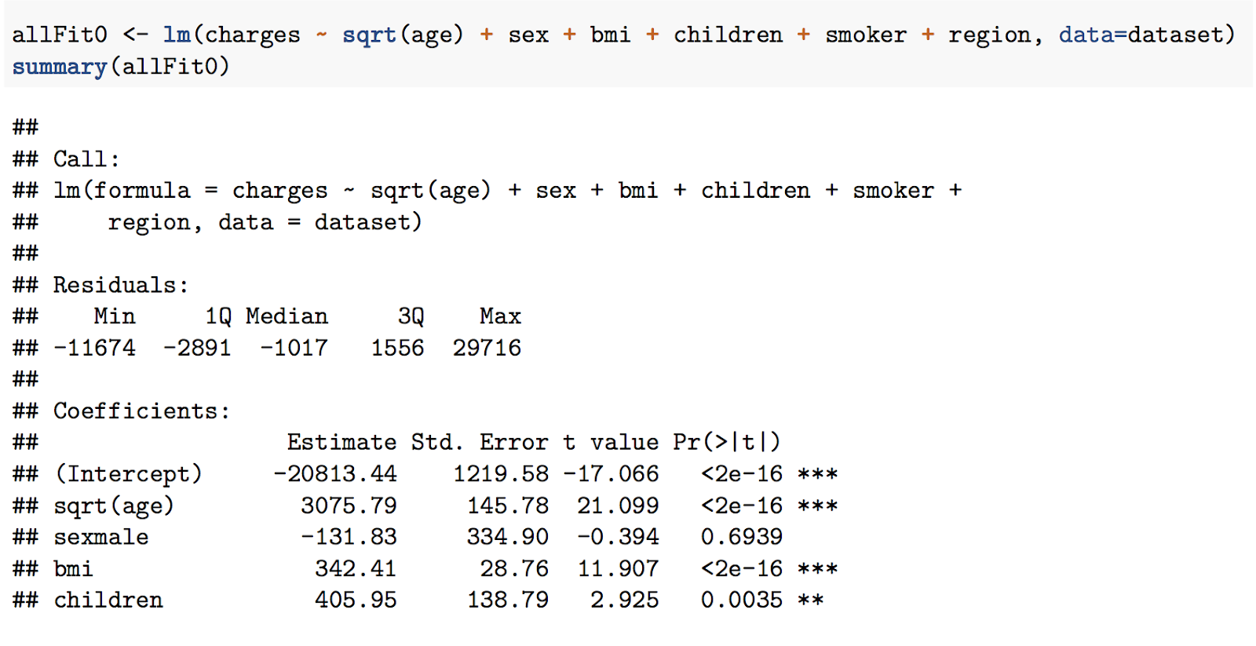
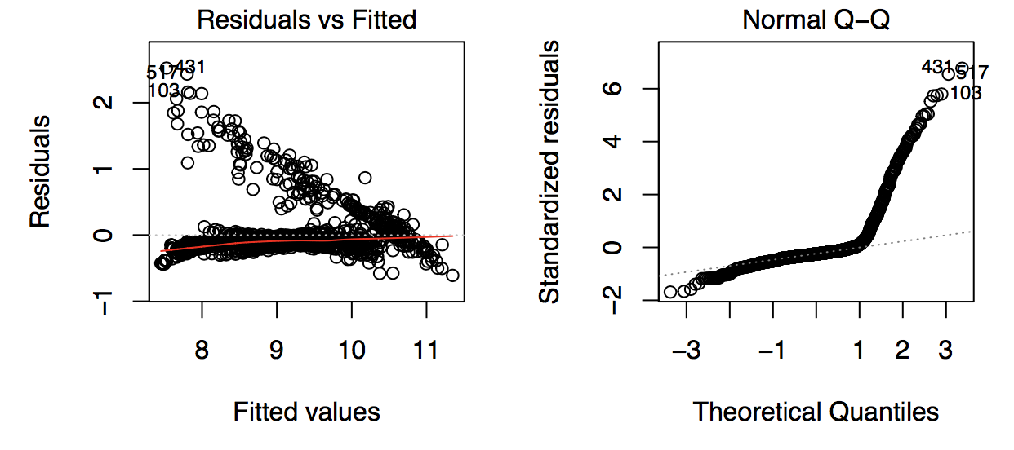
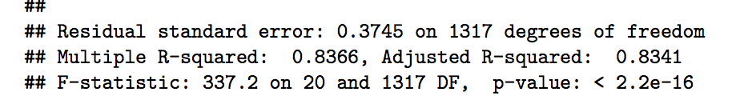

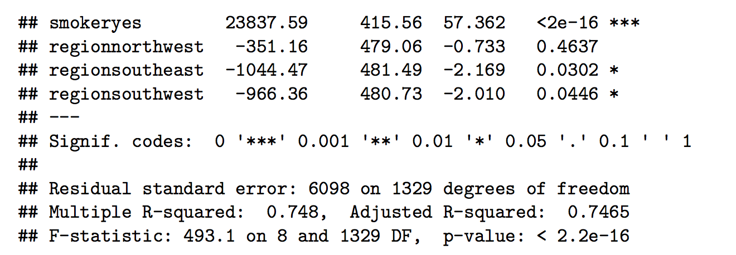
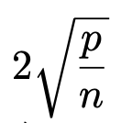
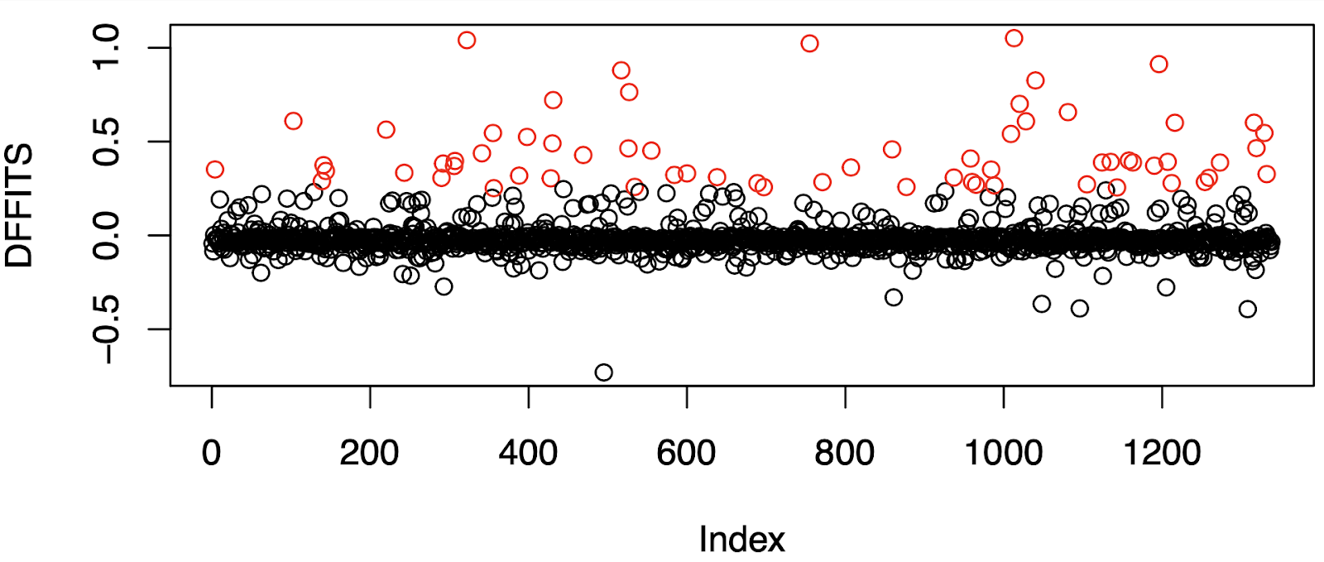
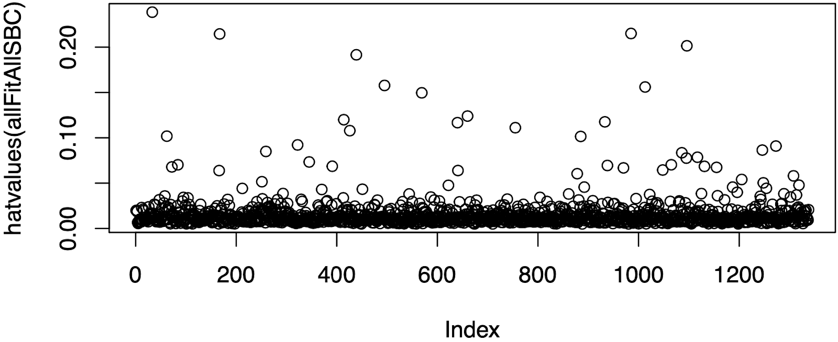
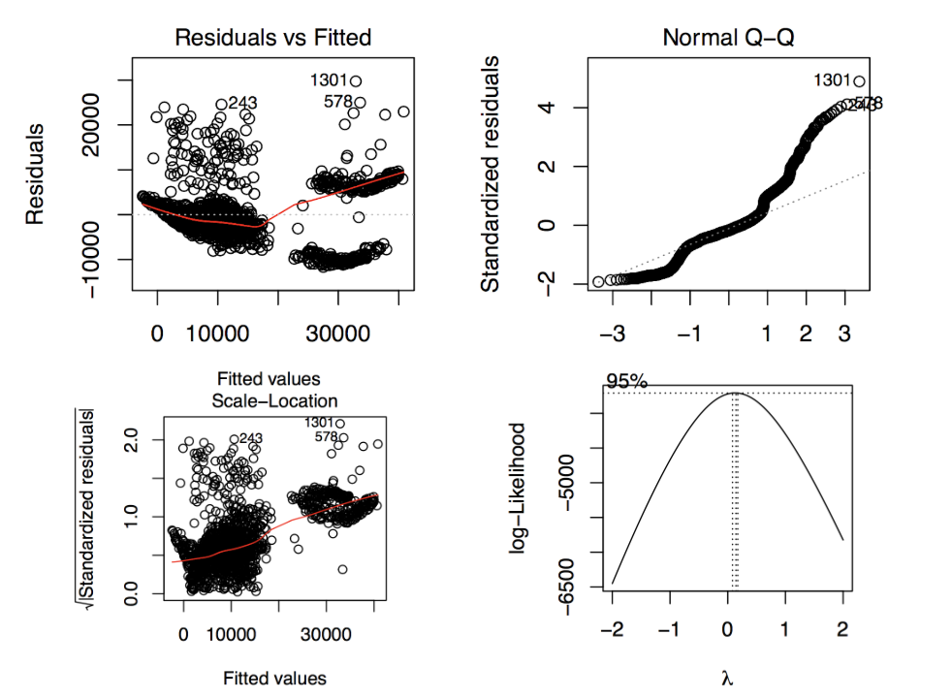
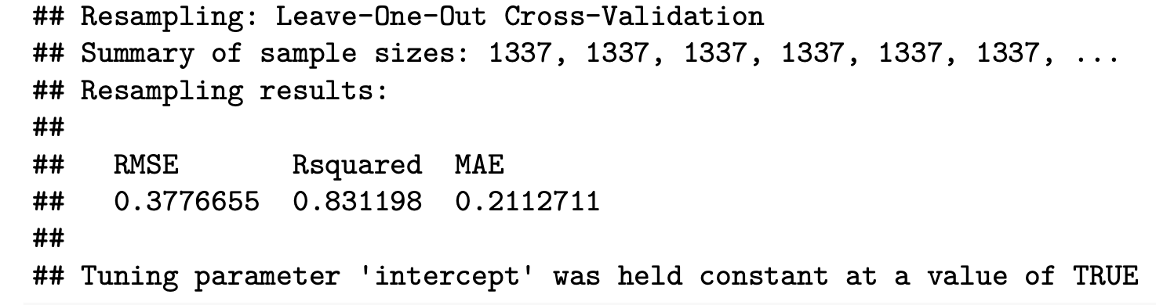
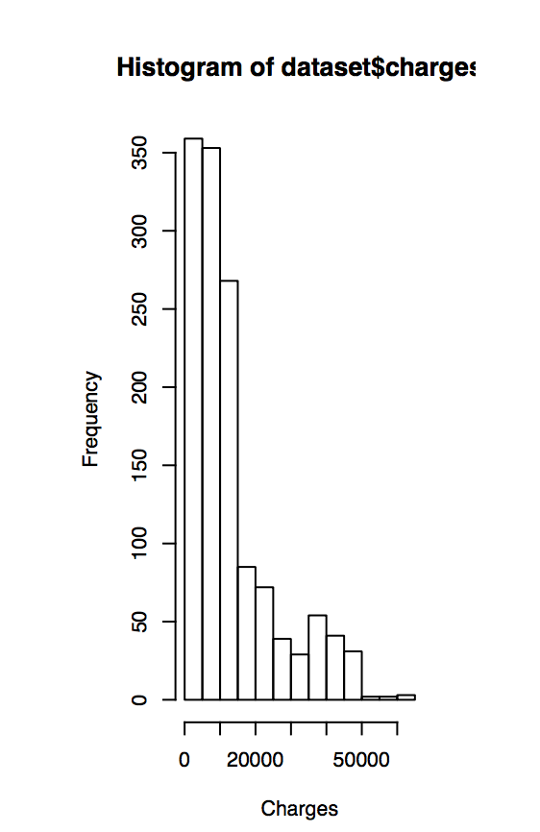
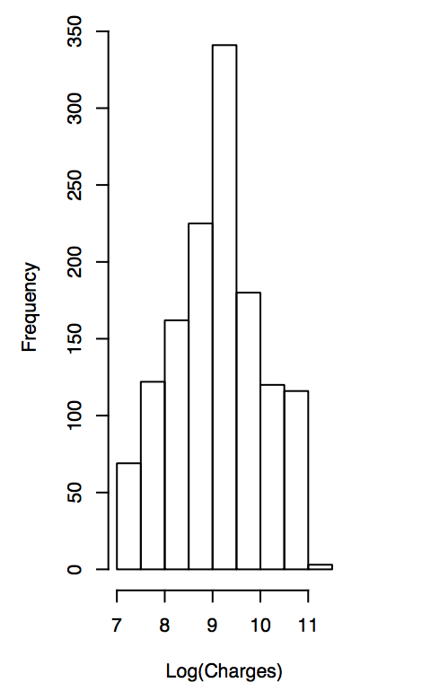
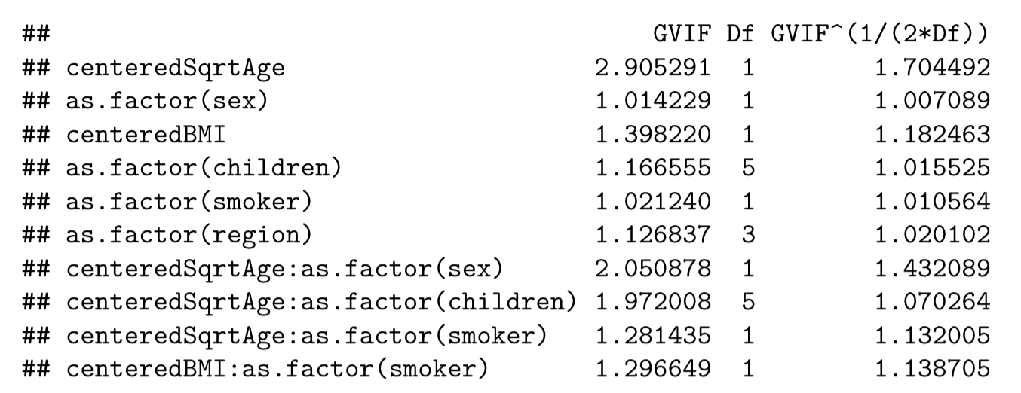
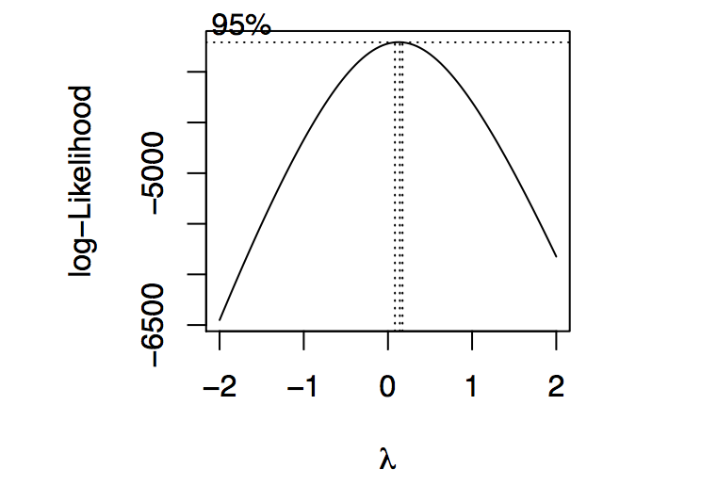
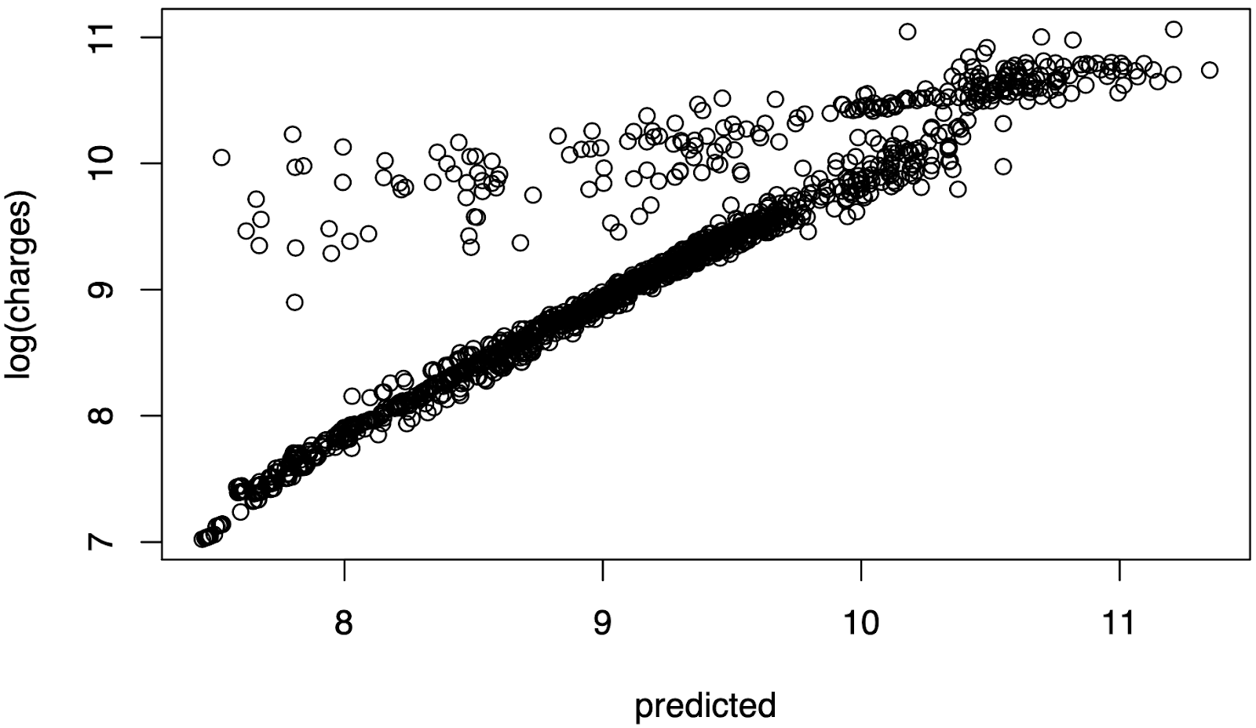
MATH-327
Exploring Medical Cost Influences
David Oniani, Madeline Pope, Zachary Sturgeon
Advisor: Dr. Phillip Iversen
Abstract
After examination of distributions of all response variables, it appears that the distribution of age would benefit from transformation, as the distribution is far from normal. We attempt both log and square root transformations and find that the square root transformation, while still not ideal, achieves the distribution closest to normal. Seen below is the original distribution of age as well as the square root transformed distribution.
Intermittent Model
We analyze the dataset describing personal medical costs for 1,339 individuals (posted on Kaggle by Miri Choi). It consists of 6 predictor variables and one response variable. The dataset is diverse featuring both numerical and categorical variables. We will conduct a general analysis of the dataset utilizing a number of statistical approaches. That said, we are particularly interested in exploring the relationships between medical costs and the rest of the numerical variables. Throughout the report, we use a number of statistical methods including linear regression, stepwise regression, and cross validation.
This model removes the least significant predictors which are region and sex. With the removal of these predictors, model accuracy improvement was marginal, with 76.85% of the variation in medical charges explained. An analysis of residuals also shows evidence of curvature, suggesting little improvement over the first order model.
Data Exploration
Below are the initial correlation plots of all variables in the dataset. Plots are colored by smoker status (smoker in red, non-smoker in black) to highlight the positive correlation between smoking status and medical charges. Other notable plots include age and medical charges (bottom left) appearing to have a positive correlation, as well as age and BMI.
First Order Model
Interaction Effects and Final Analysis
Our first order model included all variables, with square root of age being our only modification. Our response variable, medical charges, is not transformed In this model. 74.56% of the variation in medical charges in this model can be explained by the relationship of included variables. On average, predictions of this model are $6,098 away from the actual charges.
With interaction effects incorporated in the stepwise regression, 83.41% of variation in medical charges are explained. Additionally, residual vs fitted values show much less curvature than previous models.
As the threshold for Hat Matrix Diagonals (left) is , the few points points that are over the threshold are not far enough from the threshold to be of concern. In the DFFITS plot (right), the threshold for coloring is , showing possible leverage points.
Variable Transformations
Our residuals vs fitted plot shows possible evidence of curvature. In the normal Q-Q plot, there is weak evidence of both sets of residuals coming from normal distributions. Square Root of Standardized Residuals VS Fitted values shows a line which looks curved. This suggests that the residuals are not spread equally along the ranges of predictors and that the variance is not constant. The Box-Cox reinforces our previous notion that log transforming charges is acceptable.
The original histogram of the response variable charges as seen below shows a right-skewed distribution. We believe that this variable would benefit from a log transformation in order to achieve a more normal distribution. A box-cox analysis confirms that this variable would benefit from a log transformation. Pictured below are the original histogram of charges as well as the log transformed histogram with a distribution much closer to normal.
Variance Inflation Factors (left) displays all values less than 5, with no indication of problematic collinearity. 10-fold cross validation (right) shows 83.11% of the variation in charges explained by the model. Additionally, actual VS Predicted plot is approximately y = x.
References
https://www.kaggle.com/mohansacharya/graduate-admissions

