Slide 1
SMA: Software Modeling and Analysis
Practical Session
Week 02

Slide 2
You have to attend the lecture to reveal such slides.*
:-)
*Disclaimer: The content that has been shown on this slide is irrelevant for the exam.
02 / 20

Slide 3
You have to attend the lecture to reveal such slides.*
:-)
*Disclaimer: The content that has been shown on this slide is irrelevant for the exam.
03 / 20

Slide 4
You have to attend the lecture to reveal such slides.*
:-)
*Disclaimer: The content that has been shown on this slide is irrelevant for the exam.
04 / 20

Slide 5
You have to attend the lecture to reveal such slides.*
:-)
*Disclaimer: The content that has been shown on this slide is irrelevant for the exam.
05 / 20

Slide 6
You have to attend the lecture to reveal such slides.*
:-)
*Disclaimer: The content that has been shown on this slide is irrelevant for the exam.
06 / 20

Slide 7

Fun Facts
02 / 20

Slide 8
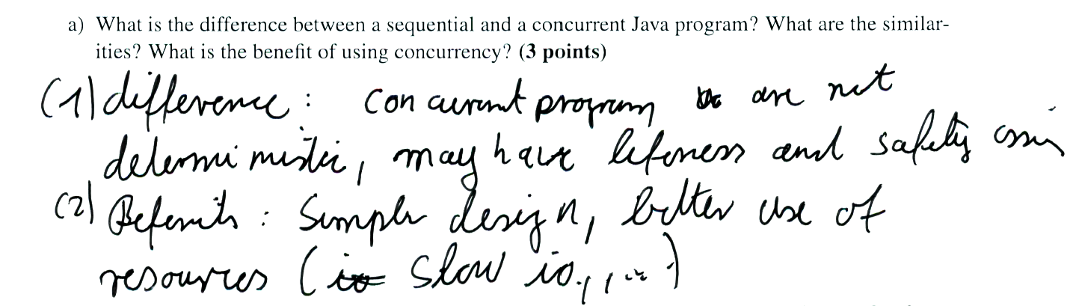
Deciphering Handwriting #1
03 / 20

Slide 9
Deciphering Handwriting #1
difference: concurrent program are not
deterministic, may have lifeness and safety issues
Benefits: Simpler design better use of
resources ( slow IO, …)
04 / 20

Slide 10
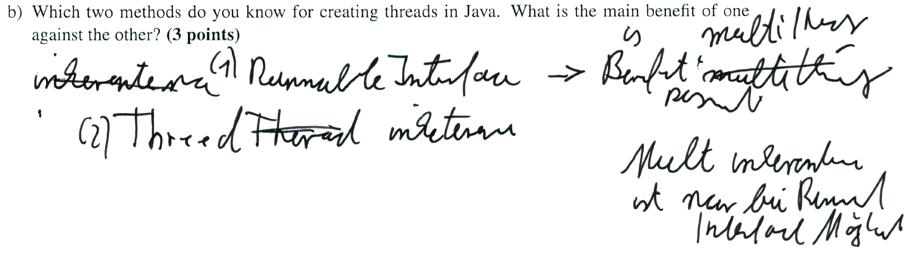
Deciphering Handwriting #2
05 / 20

Slide 11
Deciphering Handwriting #2
multi inheritance
Benefits:
Runnable interface
present
Multi inheritance
Thread inheritance
ist nur bei Runnable interface möglich
06 / 20

Slide 12
Assignment 02
Discussion
07 / 20

Slide 13
A02 - Exercise 01
Nature of Smalltalk and Pharo.
a) Name three major benefits Pharo provides in comparison to Java.
intercession, everything can be changed, live environment
b) How can you export the current image of your Pharo working environment? left mouse click on the workbench → “Save” or “Save as”
08 / 20

Slide 14
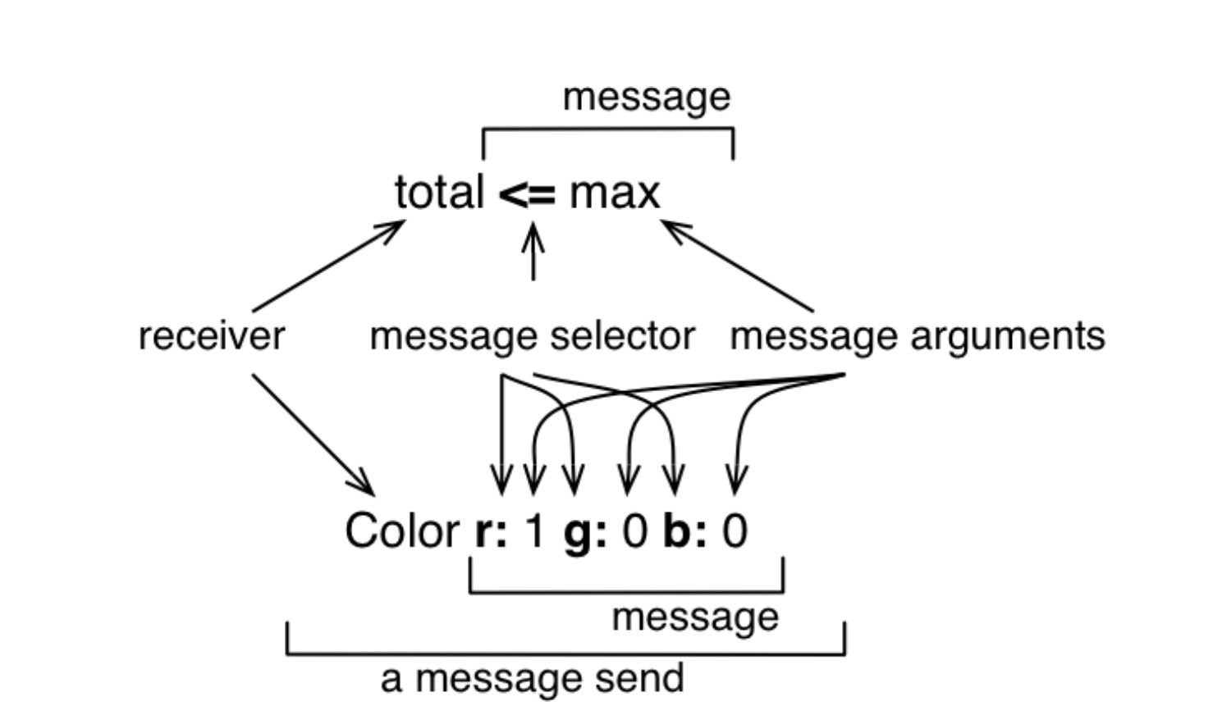
A02 - Exercise 01
Nature of Smalltalk and Pharo.
c) What is a message in Pharo?
d) What is a block in Pharo? A block can be thought of as a lambda-expression defining an anonymous function, or as a function object.
09 / 20

Slide 15
A02 - Exercise 02
Pharo object inspection.
a) What is the message that is sent to a superclass to find all its subclasses?
subclasses
b) What is the difference between a String and a Symbol object in Pharo? Why is it important?
Symbols are immutable and unique. Strings are mutable and not unique. The benefit of using Symbols is the performance gain due to less expensive value comparisons.
10 / 20

Slide 16
A02 - Exercise 02
Pharo object inspection.
c) How can you create an abstract method in Pharo? sampleAbstractMethod ^self subclassResponsibility.
d) Write the a Smalltalk block, and execute it with some specific values. Please consider solution sheet (downloadable solution available).
11 / 20

Slide 17
A02 - Exercise 03
Even more Pharo coding.
Find the top 10 most frequently invoked methods.
Find the top 10 methods invoked on the largest number of different objects.
Find all static methods. Please consider solution sheet (downloadable solution available).
12 / 20

Slide 18
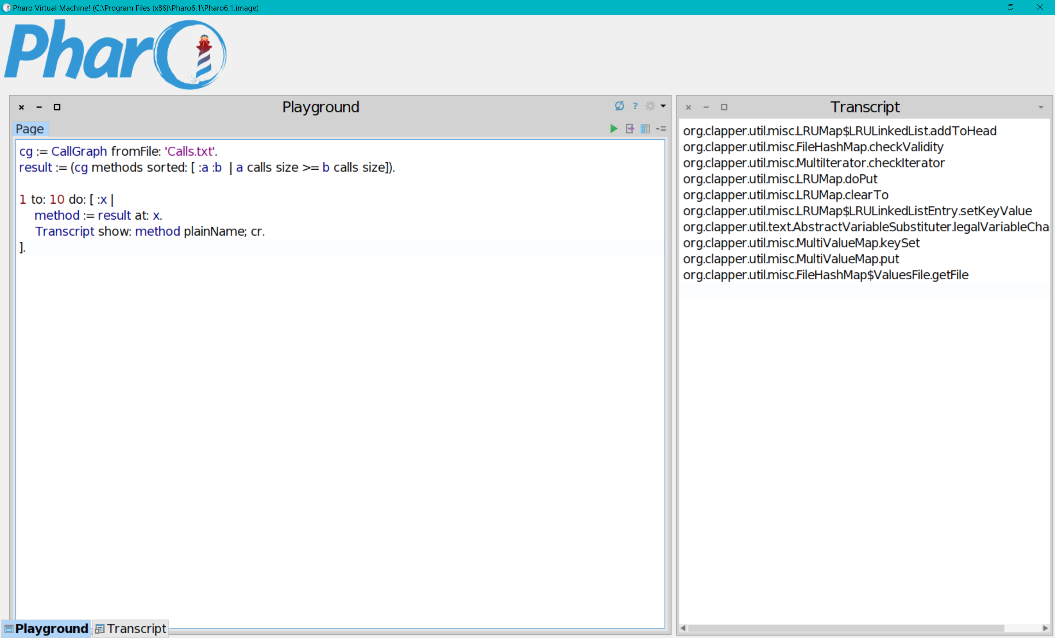
code that accesses the CallGraph APIs
result
13 / 20

Slide 19
A02 - Exercise 03
Exercise Procedure
Add method name accessor
Add and implement receiver accessor
Use the CallGraph API to gather all data
14 / 20

Slide 20
Assignment 03
Preview
15 / 20

Slide 21
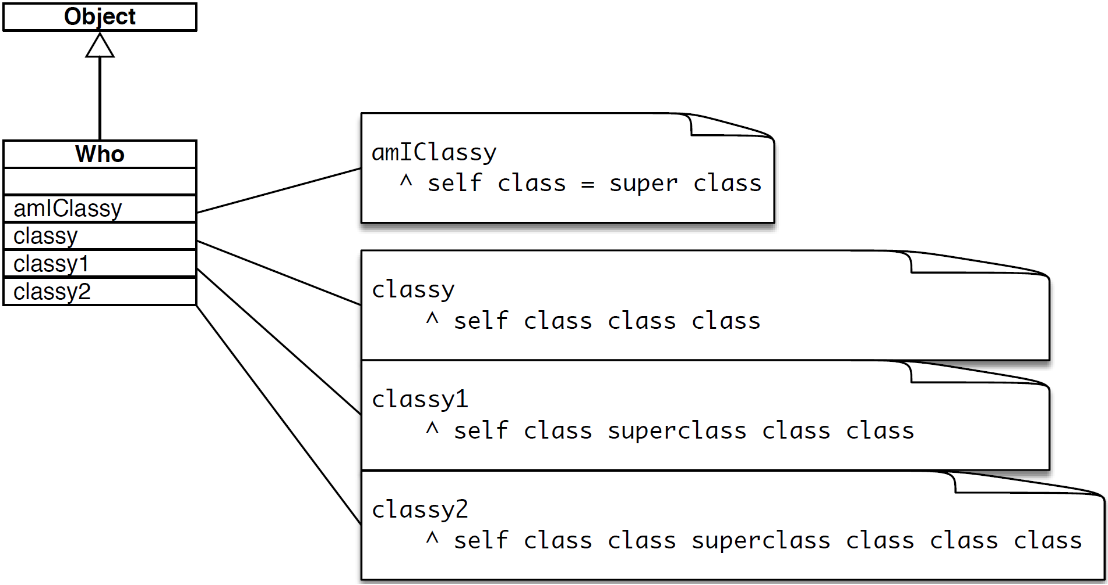
A03 - Exercise 01 | Class identity
Evaluate Smalltalk code.
Who new amIClassy.
Who new classy = Who new classy1.
Who new classy1 = Who new classy2.
16 / 20

Slide 22
A03 - Exercise 02 | Abstract methods
Pharo object inspection.
Find all abstract methods of the class Collection
17 / 20

Slide 23
A03 - Exercise 03 | Class hierarchy
Pharo object inspection #2.
What is the name of Pharo’s class hierarchy root class?
What is its purpose?
18 / 20

Slide 24
A03 - Exercise 04 | Sub and super classes
Pharo object inspection #3.
How many super classes does the class Collection have?
How many direct and indirect subclasses does it have?
19 / 20

Slide 25
A03 - Exercise 05 | Object instantiation
Pharo architecture review.
Where is “new” defined?
Describe also Pharo’s method resolution strategy for the “new” message.
20 / 20

