Slide 1
SMA: Software Modeling and Analysis
Practical Session
Week 03

Slide 2
Assignment 02
Discussion

Slide 3
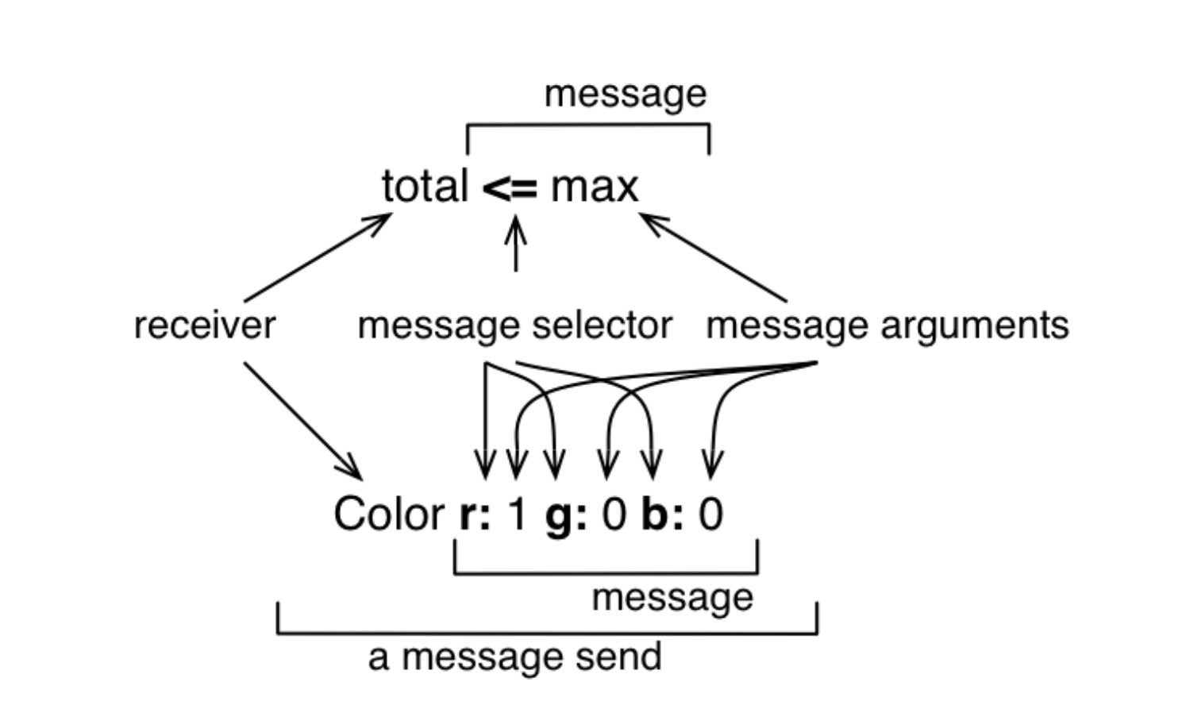
A02 - Exercise 01
Nature of Smalltalk and GT
a) Which threat arises when you develop in a live system? Execution of random code might alter the execution environment and introduce future problems.
b) What is a message in Smalltalk?

Slide 4
A02 - Exercise 01
Nature of Smalltalk and GT
c) What is a block in Smalltalk? Lambda-expression-like construct that defines an anonymous function. Blocks may take one or more arguments and can have local variables.
Their syntax is: ( [ :i :j :k | ... ] )
d) How do Smalltalk, Pharo and GT relate to each other? Smalltalk is the programming language used in Pharo and GT. Pharo is (mostly) implemented in Smalltalk. GT is a sophisticated framework written in Smalltalk on top of Pharo that uses a headless VM.

Slide 5
A02 - Exercise 01
Nature of Smalltalk and GT
e) What are counterparts of GT tools in your favorite development environment?
Playground a sophisticated shell with inspection capabilities
Coder an integrated development environment (IDE)
Git a Git client
Monitor resource viewer / task-manager
ExamplesExplorer (offline) help resources
Transcript debug or console output window
Morphic World the base Pharo windowing system and IDE
Spotter a search that inspects names and file content

Slide 6
A02 - Exercise 02
Object inspection
a) What is the difference between a String and a Symbol in Smalltalk?
Why is it important?
Symbols are immutable and unique. Strings are mutable and not unique. Because Symbols are immutable, they should never be used when their value has to change over time.

Slide 7
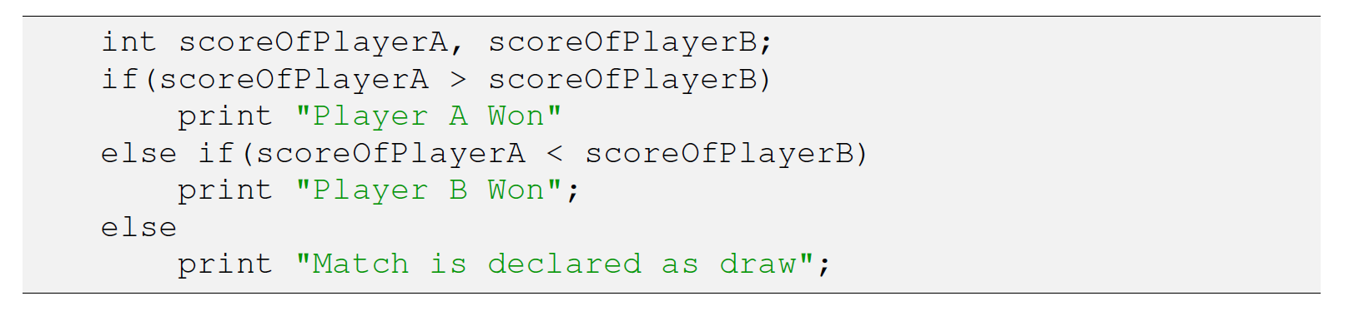
A02 - Exercise 02
Object inspection
b) Implement provided pseudo code in Smalltalk.
[ :scoreOfPlayerA :scoreOfPlayerB | (scoreOfPlayerA > scoreOfPlayerB)
ifTrue:[ Transcript show:'Player A won';cr. ]
ifFalse:[ (scoreOfPlayerA < scoreOfPlayerB)
ifTrue:[
Transcript show:'Player B won';cr.]
ifFalse:[
Transcript show:'Match is declared as draw';cr.
]
]
] value:38 value:44.

Slide 8
A02 - Exercise 02
c) includes: anObject
How many classes in GT implement the message above?
How many messages in GT use that particular message?
We found 60 classes that implement that message, and more than four thousand messages that use it (e.g., 4 531 in the current Apple macOS GT build).
d) Which message in GT can be sent to a class to find all its subclasses?
subclasses

Slide 9
A02 - Exercise 03
CallGraph
Find the top ten most frequently invoked methods in the provided CallGraph representation.
Code: cg := CallGraph fromFile: 'Calls.txt’. result := (cg methods sorted: [ :a :b | a calls size >= b calls size]).
Result: org.clapper.util.misc.LRUMap$LRULinkedList.addToHead org.clapper.util.misc.FileHashMap.checkValidity org.clapper.util.misc.MultiIterator.checkIterator org.clapper.util.misc.LRUMap.doPut org.clapper.util.misc.LRUMap.clearTo org.clapper.util.misc.LRUMap$LRULinkedListEntry.setKeyValue org.clapper.util.text.AbstractVariableSubstituter.legalVariableCharacter org.clapper.util.misc.MultiValueMap.keySet org.clapper.util.misc.MultiValueMap.put org.clapper.util.misc.FileHashMap$ValuesFile.getFile

Slide 10
Assignment 03
Preview

Slide 11
A03 - Exercise 01
Metamodels (2.5 pts)
i) What is a metamodel?
ii) How are metamodels used in Pharo?
iii) What are responsibilities of a metaclass in Pharo?
iv) Where is ProtoObject located in Pharo’s class hierarchy?
v) What is the purpose of the class ProtoObject?

Slide 12
A03 - Exercise 02
Sub and super classes (3 pts)
(you have to provide your code snippet and the result)
i) How many superclasses does Collection have?
ii) How many direct subclasses does Collection have?
iii) How many indirect subclasses does Collection have?

Slide 13
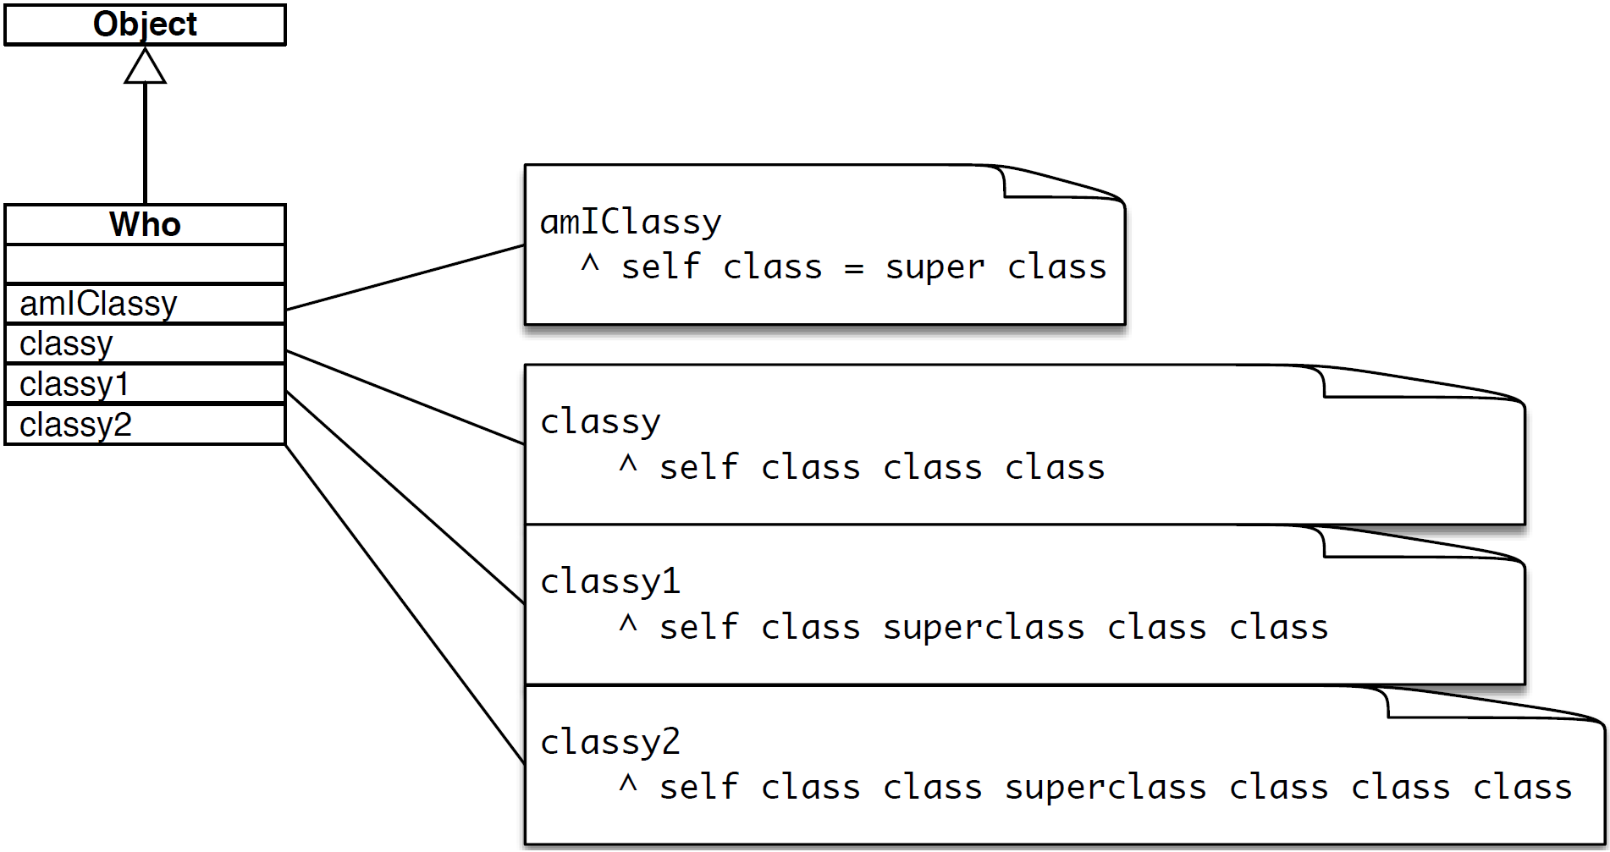
A03 - Exercise 03
Class identity (3 pts)
Who new amIClassy.
Who new classy = Who new classy1.
Who new classy1 = Who new classy2.
03 / 14

Slide 14
A03 - Exercise 04
Object instantiation (1.5 pts)
i) Where is new defined?
ii) Explain Pharo’s message implementation resolution strategy for the new message.
iii) List the concrete code in GT finally executed by the message new.

