Slide 1
SMA: Software Modeling and Analysis
Practical Session
Week 04

Slide 2
Assignment 03
Discussion

Slide 3
A03 - Exercise 01
Metamodels (2.5 pts)
i) What is a metamodel? A model of a model; a prescriptive view on an existing model. It determines the syntax and semantics of models that conform to it.
ii) How are metamodels used in Pharo? Every object is an instance of a class. Every class inherits from Object. Every class is an instance of its (unique) metaclass, which inherits from Class. Every metaclass is an instance of Metaclass, which is itself a class.
iii) What are responsibilities of a metaclass in Pharo?
Instance creation, creating initialized instances of the metaclass’s sole instance, initialization of classvariables, method compilation, ...

Slide 4
A03 - Exercise 01
Metamodels (2.5 pts)
iv) Where is ProtoObject located in Pharo’s class hierarchy? ProtoObject is the root class for all other classes including Object. ProtoObject is the superclass of Object.
v) What is the purpose of the class ProtoObject?
The class ProtoObject only contains the core behavior needed to make the system work. The idea of ProtoObject is to have a lean class that separates the concerns.

Slide 5
A03 - Exercise 02
Sub and super classes (3 pts)
(you have to provide your code snippet and the result)
i) How many superclasses does Collection have?
2: Collection allSuperclasses size. ii) How many direct subclasses does Collection have?
32: Collection subclasses size.
iii) How many indirect subclasses does Collection have?
129: Collection allSubclasses size - Collection subclasses size.

Slide 6
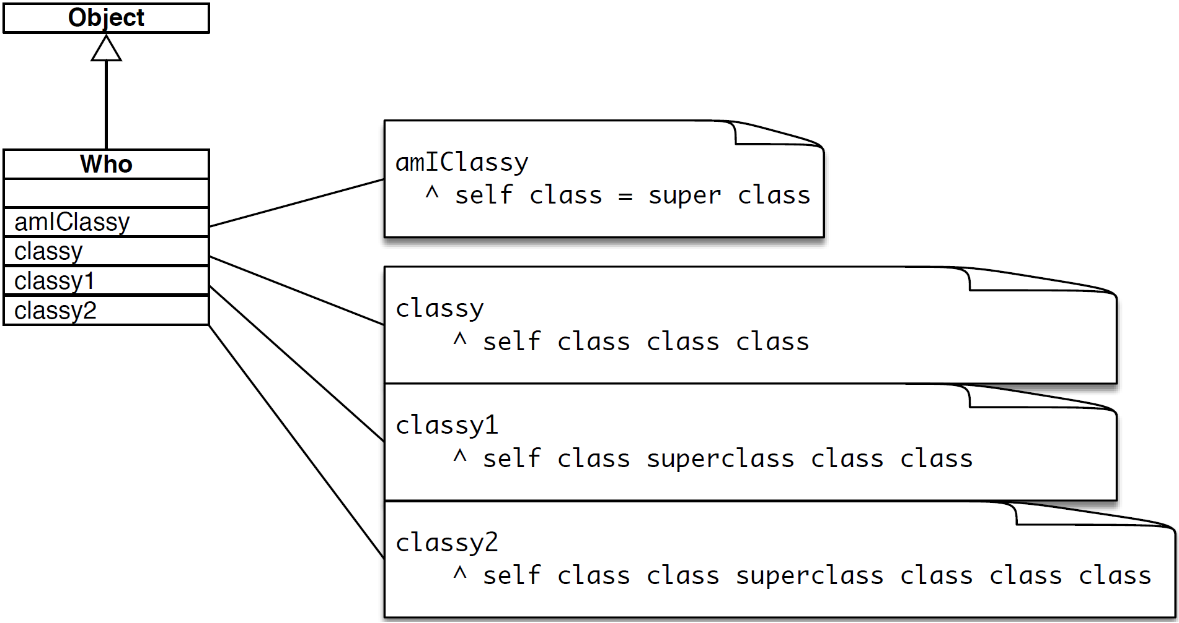
A03 - Exercise 03
Class identity (3 pts)
a) Who new amIClassy.
True: Super is used in the context of the class of the method implementation.
b) Who new classy = Who new classy1.
True: Both elements represent the same object.
c) Who new classy1 = Who new classy2. True: Both elements represent the same object.

Slide 7
A03 - Exercise 04
Object instantiation (1.5 pts)
i) Where is new defined? It is first defined in the class Behavior.
ii) Explain Pharo’s message implementation resolution strategy for the new message.
When the new is sent to a class it is being resolved throughout its metaclass chain.
The search ultimately ends in Behavior.
iii) List the concrete code in GT finally executed by the message new. self basicNew initialize in the class Behaviour.

Slide 8
Assignment 04
Preview

Slide 9
A04 - Exercise 01 | Hierarchy traversal
Write a method.
Find the longest inheritance chain among all Smalltalk classes in the Pharo programming environment.
NB:
To access all classes of Smalltalk, you can use
SystemNavigation default allClasses

Slide 10
A04 - Exercise 02 | Method overrides
Write a method.
Find all abstract method overrides in the Pharo system.

Slide 11
A04 - Exercise 03 | Query methods
Write a method.
Find all query method implementing classes.
NB:
Query methods test a property of an object. Such methods are prefixed with "is", "was" or "will".

Slide 12
A04 - Exercise 04 | Root methods
Write a method.
i) Find all root methods in GT.
NB:
A "root method" is a method whose selector has been implemented in a class, such that the super classes of that class do not understand it.
ii) (BONUS) Find all duck-typed methods in GT.
Duck-typed methods have the same selector but are not related by inheritance. That is, af-ter finding all root methods, find those with the same selector.

Slide 13
A04 - Exercise 05 | Dynamic coding
Dynamic extension of code.
Step 1: Redefine Call>>doesNotUnderstand: aMessage.
-> Add dynamically an instance variable to the class Call.
Step 2: Add dynamically the provided method to the class Call.
Step 3: Resend the initial message to self.

