Slide 1
SMA: Software Modeling and Analysis
Practical Session
Week 06

Slide 2
Assignment 05
Discussion

Slide 3
A05 - Exercise 01 | General questions
Is code reading a problem? Argue the answer. Yes, it is! Developers spend usually more than 50% of their time on code reading.
Give an example where a custom tool improved the productivity in addressing a problem or issue. status indicators → awareness of project state customized IDE plug-ins → report a variety of issues DIY tools → help in fixing things...

Slide 4
A05 - Exercise 02 | Inspector extensions
i) How many classes in Pharo contain the <gtView> pragma?
547 classes have built-in support for GT inspector.
Code:
results := Set new.
#gtView gtPragmas do: [ :method | results add: (method classBinding value name)].
results sorted: [ :a :b | a < b ].

Slide 5
A05 - Exercise 02 | Inspector extensions
ii) Improve DateAndTime so that GT inspector can visualize them with the following “Human Readable” format: YYYY-MM-DD HH:MM
DateAndTime>>gtHumanReadableFor: aView
<gtView>
^aView textEditor title: ‘Human Readable’; text: [self asStringYMDHM]

Slide 6
A05 - Exercise 03 | Live documents
i) What are supported annotation names in live documents?
Example: ${class:Object}$ contains the annotation name class which tells the live document to use the appropriate visualization for classes. 11 annotation names can be found in GtDocumentConstants: changes, class, example, examples, explanation, icebergFile, inputFile, method, parametrizedExample, slides, xdocList

Slide 7
A05 - Exercise 03 | Live documents
ii) Create a live document that always shows the current number of classes available in Pharo.
Expected result: I consist of 18605 classes. Live document code: I consist of ${example: BaselineOfGToolkit>>#allClasses| label=#size}$classes.
Corresponding logic code:
BaselineOfGToolkit>>#allClasses <gtExample> ^ SystemNavigation default allClasses

Slide 8
Assignment 06
Preview

Slide 9

+ RT3
Download and set up Pharo 9.0 with the full version of Roassal3.

Slide 10
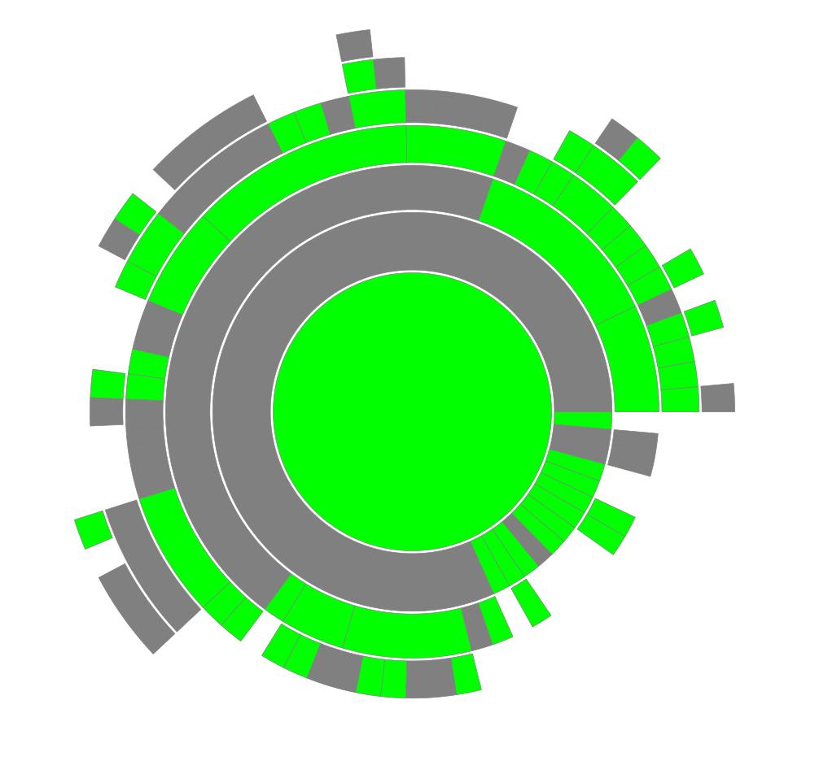
A06 - Exercise 01 | Sunburst Visualization
Smalltalk coding. Build a sunburst visualization to analyze test coverage of the Collection class hierarchy.

Slide 11
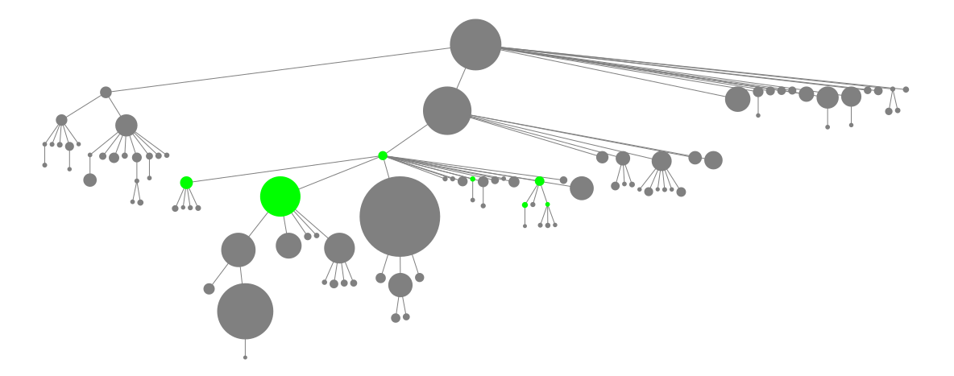
A06 - Exercise 02 | Tree Layout Visualization
Smalltalk coding. Build a tree layout visualization to gather an overview of classes with subclasses that contain the string Array in their names.

Slide 12
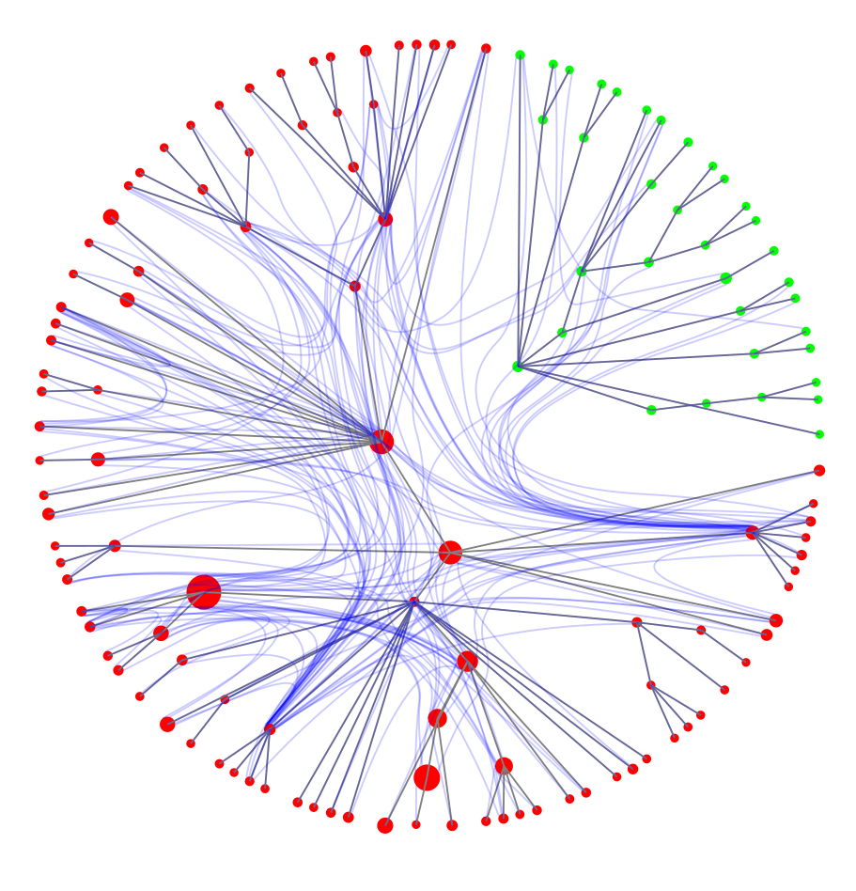
A06 - Exercise 03 | Node-link Visualization
Smalltalk coding. Create a visualization to analyze the class dependencies between the Collection class hierarchy and the RSLayout class hierarchy.

Slide 13
A06 - Exercise 04 | Discussion
Visualization reasoning. Comment on the strenghts and limitations of each visualization you just created.
Sunburst visualization Strengths: ... Limitations: ...
Tree layout visualization Strengths: ... Limitations: ...
Node-link visualization: Strengths: ... Limitations: ...

