Slide 1
SMA: Software Modeling and Analysis
Practical Session
Week 07

Slide 2
Assignment 06
Discussion

Slide 3
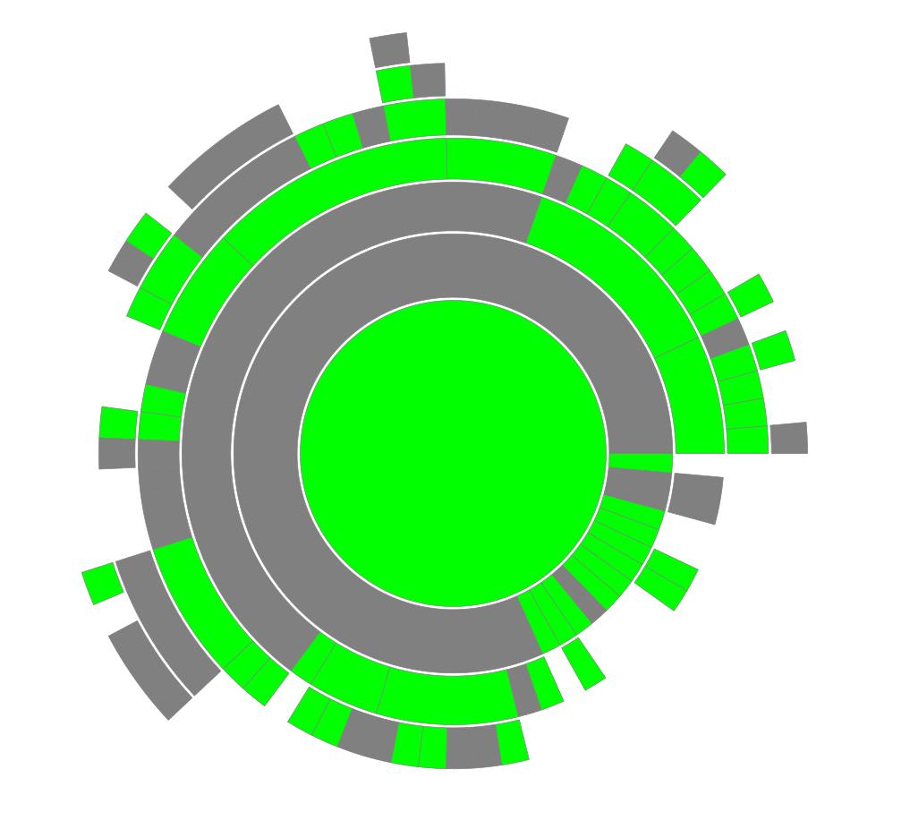
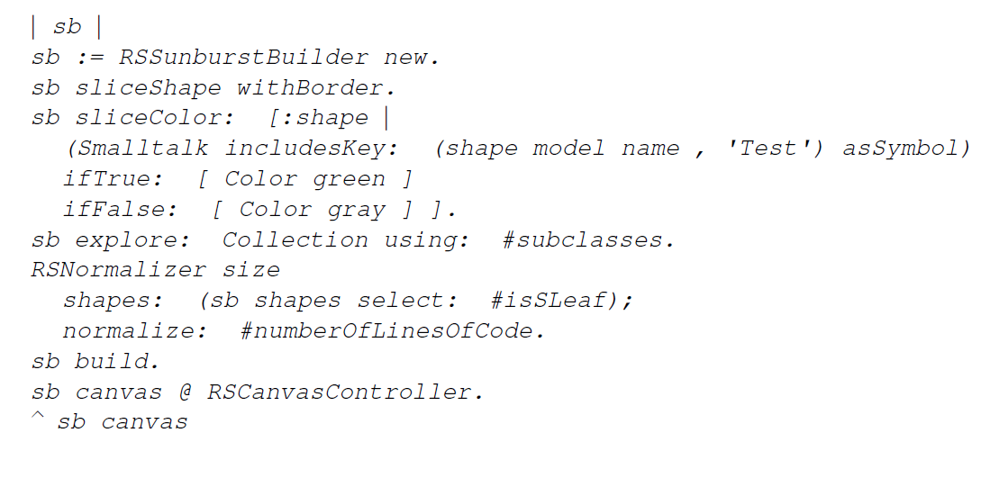
A06 - Exercise 01 | Sunburst Visualization
Smalltalk coding. Build a sunburst visualization to analyze test coverage of the Collection class hierarchy.

Slide 4
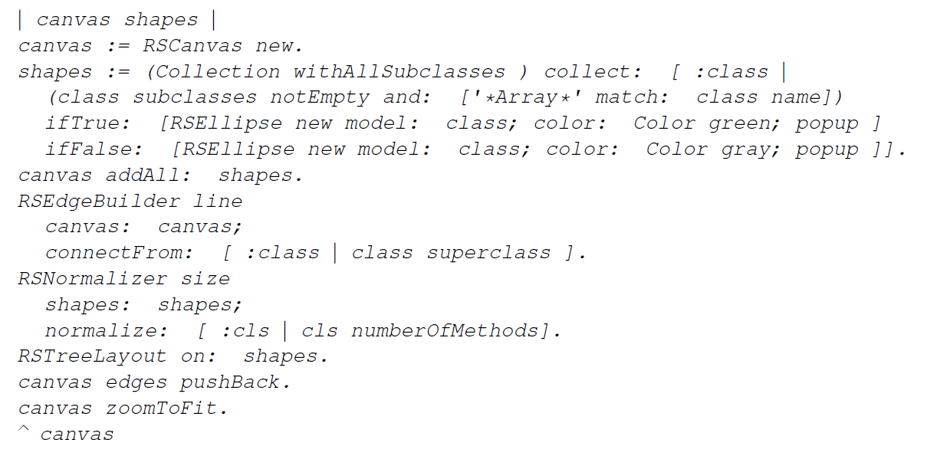
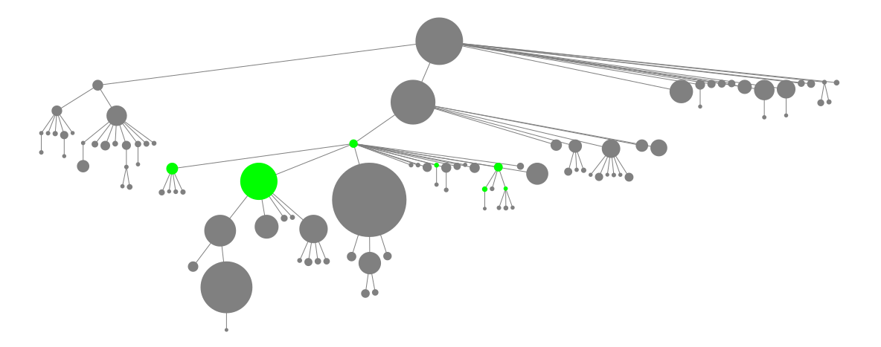
A06 - Exercise 02 | Tree Layout Visualization
Smalltalk coding. Build a tree layout visualization to gather an overview of classes with subclasses that contain the string Array in their names.

Slide 5
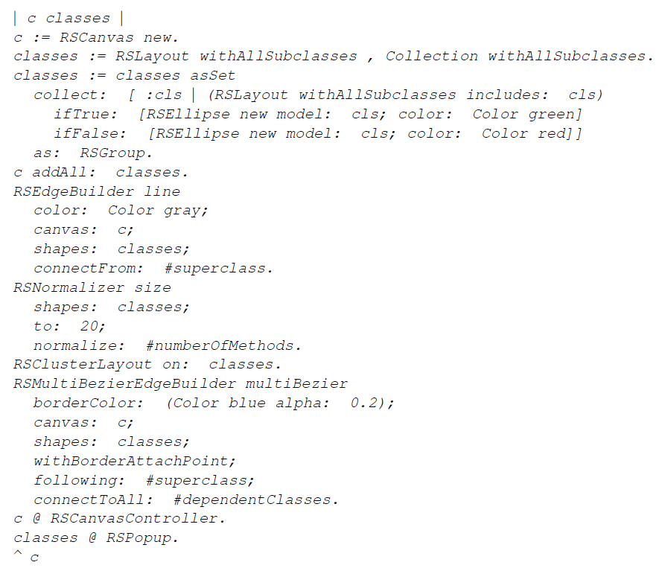
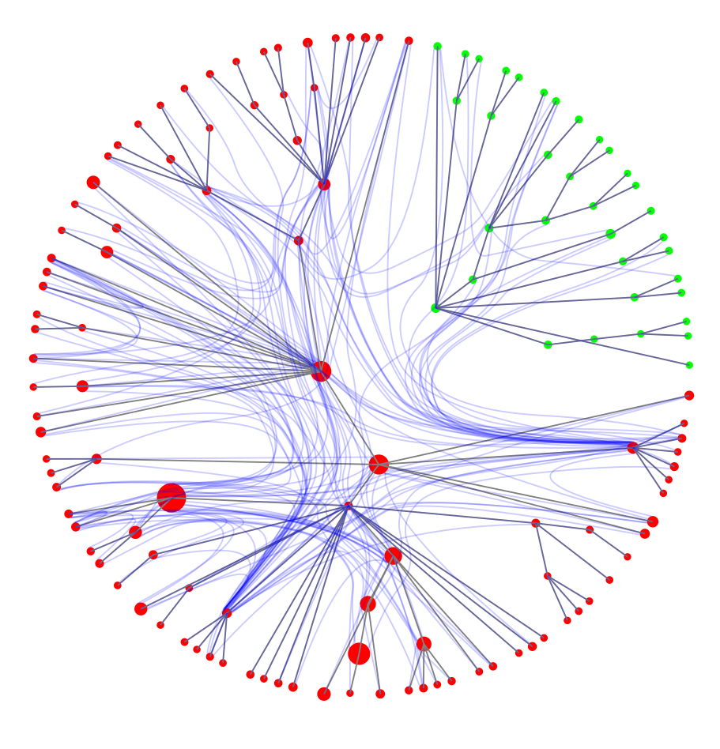
A06 - Exercise 03 | Node-link Visualization
Smalltalk coding. Create a visualization to analyze the class dependencies between the Collection class hierarchy and the RSLayout class hierarchy.

Slide 6
A06 - Exercise 04 | Discussion
Visualization reasoning. Comment on the strenghts and limitations of each visualization you just created.
Sunburst visualization Strengths: nice for hierarchies, tiles reveal relationship to parent tile Limitations: hard to evaluate manually (circular sections are hard to estimate)
Tree layout visualization Strengths: advantages like sunburst + area easier to estimate Limitations: requires much space
Node-link visualization Strengths: advantages from sunburst and tree layout, supports multiple overlaid relation visualizations Limitations: very high resolution needed for further manual inspection

Slide 7
Assignment 07
Preview

Slide 8
A07 - Exercise 01 | Code metrics in theory
General knowledge.
a) What is the cyclomatic complexity? Explain!
b) Which other metrics do you know?
c) Do metrics always express problems?
d) How and when are nowadays metrics integrated into development processes?

Slide 9
A07 - Exercise 02 | Simple code metrics in practice
Writing code.
Find all classes that have > 100 methods in modelArgo.

Slide 10
A07 - Exercise 03 | Advanced code metrics in practice
Writing code and interpretation of the results.
a) Find all methods in modelArgo that have:
1) > 150 lines of code, and
2) an acyclomatic complexity of < 4
b) Apply your implementation to modelSolr. Which differences can you see in the result? c) Is it appropriate to use the same thresholds for any models? Justify!

Slide 11
A07 - Exercise 04 | Expert code metrics in practice
Writing code.
Add a method to FAMIXType to obtain the ATFD metric for its instances.
Important:
1) ATFD counts the attributes from other classes used by a class. 2) We only care for methods that begin with “set” or “get”.

