Slide 1
Evolutionary Fuzzy Markup Language for Computer Go Competition
Yuichi Omozaki¹, Toshiki Urita, Naoki Masuyama¹,
Yusuke Nojima¹, and Hisao Ishibuchi²
¹ Osaka Prefecture University, Japan
² Southern University of Science and Technology, China

Slide 2
Overview
Introduction
Hoge
Hogehoge
Higehoge

Slide 3
Optimize the Rule Base Initialize Rule Base Population
A training dataset is divided into two subsets, the training subset for learning the conclusion part of a rule and evaluation subset for evaluating a population.
An initial population is initialized by the heuristic rule generation method using the training subset.
Training
Dataset
Heuristic
Rule
Generation
Individual
Individual
…
Evaluation
Training
Individual

Slide 4
Optimize the Rule Base Heuristic Rule Generation
A fuzzy if-then rule is generated for covering a randomly selected pattern.
The most compatible fuzzy set is used for each attribute. The consequent output is specified by that of the selected pattern.
x₂
If patterns 1, 2, and 7 are randomly selected, the following three rules are generated.
VL
1
L
2
R₁: If x₁ is S and x₂ is L then b₁ = y₁
R₂: If x₁ is M and x₂ is L then b₂ = y₂
R₃: If x₁ is L and x₂ is S then b₃ = y₇
M
3
4
S
5
6
7
VS
x₁
VS
S
M
L
VL

Slide 5
Optimize the Rule Base Heuristic Rule Generation
A fuzzy if-then rule is generated for covering a randomly selected pattern.
The most compatible fuzzy set is used for each attribute. The consequent output is specified by that of the selected pattern.
x₂
If patterns 1, 2, and 7 are randomly selected, the following three rules are generated.
VL
1
L
2
R₁: If x₁ is S and x₂ is L then b₁ = y₁
R₂: If x₁ is M and x₂ is DC then b₂ = y₂
R₃: If x₁ is DC and x₂ is S then b₃ = y₇
M
3
4
S
5
6
7
VS
x₁
VS
S
M
L
VL
Some attribute conditions are replaced with don’t care to make the rule generalized.

Slide 6
Optimize the Rule Base Initialize Rule Base Population
A training dataset is divided into two subsets, the training subset for learning the conclusion part of a rule and evaluation subset for evaluating a population.
An initial population is initialized by the heuristic rule generation method using the training subset.
An offspring is generated by the genetic algorithm.
Individual
Learning the conclusion part
Evaluate the fitness
Training
Evaluation

Slide 7
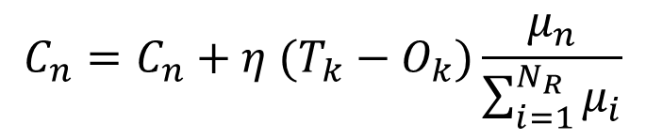
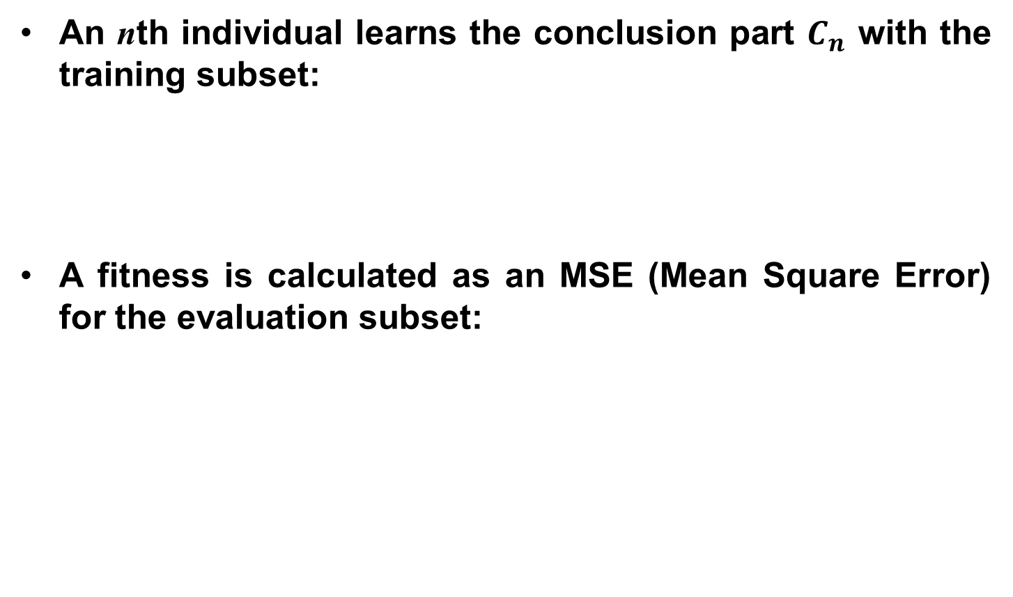
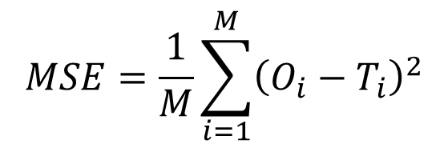
Optimize the Rule Base Evaluate Rule Base
An nth individual learns the conclusion part $C_{n}$ with the training subset:
A fitness is calculated as an MSE (Mean Square Error) for the evaluation subset:
$$C_{n}=C_{n}+η (T_{k}−O_{k})\frac{μ_{n}}{\sum_{i=1}^{N_{R}}{μ_{i}}}$$
$$MSE=\frac{1}{M}\sum_{i=1}^{M}{{\left(O_{i}−T_{i}\right)}^{2}}$$

Slide 8
Optimize the Rule Base Generate Rule Base Offspring
A new rule base is generated by Uniform Crossover from two parents selected by Binary Tournament.
The mutation is applied according to the mutation rate.
One clause of an antecedent part is randomly changed from another fuzzy set or Don’t Care.
Parent 1
Parent 2
Child
UX

Slide 9
Optimize the Rule Base Generate Rule Base Offspring
A new rule base is generated by Uniform Crossover from two parents selected by Binary Tournament.
The mutation is applied according to the mutation rate.
One clause of an antecedent part is randomly changed from another fuzzy set or Don’t Care.
R₁: If x₁ is S and x₂ is L then b₁ = y₁
R₂: If x₁ is M and x₂ is L then b₂ = y₂
If rules 1, 2, are randomly satisfied the mutation rate, the rules is changed as follow.
R₁: If x₁ is M and x₂ is L then b₁ = y₁
R₂: If x₁ is M and x₂ is DC then b₂ = y₂

Slide 10
Optimize the Rule Base Rule Pruning
After genetic operations, the compatibility of each rule in a new offspring model is examined for training data.
Rules which do not cover any patterns with more than 0.5 degree are removed from the offspring model.
x₂
Assume that a new model with the following rules is generated by genetic operations.
VL
1
L
2
R₁: If x₁ is M and x₂ is M then b₁
R₂: If x₁ is L and x₂ is DC then b₂
R₃: If x₁ is DC and x₂ is L then b₃
M
3
4
S
5
6
7
VS
x₁
R₁ does not cover any patterns with more than 0.5 degree.
VS
S
M
L
VL

Slide 11
Optimize the Rule Base Rule Pruning
After genetic operations, the compatibility of each rule in a new offspring model is examined for training data.
Rules which do not cover any patterns with more than 0.5 degree are removed from the offspring model.
x₂
Assume that a new model with the following rules is generated by genetic operations.
VL
1
L
2
R₁: If x₁ is M and x₂ is M then b₁
R₂: If x₁ is L and x₂ is DC then b₂
R₃: If x₁ is DC and x₂ is L then b₃
M
3
4
S
5
6
7
VS
x₁
R₁ does not cover any patterns with more than 0.5 degree. => R₁ is removed.
VS
S
M
L
VL

Slide 12
Optimize the Rule Base Rule Addition by Heuristic Rule Generation
After genetic operations, the compatibility of each rule in a new offspring model is examined for training data.
Rules which do not cover any patterns with more than 0.5 degree are removed from the offspring model.
Instead, new rules are generated in a heuristic manner.
x₂
A pattern which is not well covered by any rule is randomly selected for each new rule.
VL
1
L
2
R₁: If x₁ is S and x₂ is M then b₁
R₂: If x₁ is L and x₂ is DC then b₂
R₃: If x₁ is DC and x₂ is L then b₃
M
3
4
S
5
6
7
VS
x₁
VS
S
M
L
VL

Slide 13
Optimize the Rule Base Rule Addition by Heuristic Rule Generation
After genetic operations, the compatibility of each rule in a new offspring model is examined for training data.
Rules which do not cover any patterns with more than 0.5 degree are removed from the offspring model.
Instead, new rules are generated in a heuristic manner.
x₂
A pattern which is not well covered by any rule is randomly selected for each new rule.
VL
1
L
2
R₁: If x₁ is S and x₂ is DC then b₁
R₂: If x₁ is L and x₂ is DC then b₂
R₃: If x₁ is DC and x₂ is L then b₃
M
3
4
S
5
6
7
VS
x₁
Some attribute conditions are replaced with don’t care to make the rule generalized.
VS
S
M
L
VL

Slide 14
Optimize the Rule Base Population Update
The next population is selected from the parent and offspring population.
The selected individuals have a higher fitness value than the unselected individuals.
If the termination condition is not satisfied, then continue to generate offspring.
Otherwise, output the rule base which has the highest fitness in the final generation.
The best one
goto
Optimize the knowledge base

Slide 15
Optimize the Knowledge Base Generate Knowledge Base Population
Some new knowledge bases are generated by the obtained optimal knowledge base.
Each parameter of the new knowledge base is generated by perturbing to the obtained knowledge base.
The parameters (the mean and the variance) are added random scalar values.

Slide 16
Optimize the Knowledge Base Evaluate the Knowledge Base
Each individual consists of the knowledge base and obtained an optimal rule base.
A fitness is calculated as an MSE for evaluation set using the knowledge base and the obtained rule base.
The obtained optimal rule base
Individual 1
Individual 2
Individual 3
Knowledge base
Knowledge base
Knowledge base

Slide 17
Optimize the Knowledge Base Population Update
A individual which has a highest fitness in current generation is selected as next generation.
If the termination condition is not satisfied, then continue to generate new offspring.
Otherwise, output the knowledge base which has the highest fitness in the final generation.
best
The optimal rule base
perturbation
best
best
perturbation

Slide 18
hogehoge
hogehoge

Slide 19
hogehoge
hogehoge

