Slide 1
Evolutionary Fuzzy Markup Language -based Genetic Algorithm for Computer Go Competition
Yuichi Omozaki¹, Toshiki Urita, Naoki Masuyama¹,
Yusuke Nojima¹, and Hisao Ishibuchi²
¹ Osaka Prefecture University, Japan
² Southern University of Science and Technology, China

Slide 2
Overview
Introduction
Optimize the Rule Base
Optimize the Knowledge Base
Results

Slide 3
Evolutionary FML-based Genetic Algorithm
We optimized the knowledge base and the rule base by the Genetic Algorithm (GA) based on Fuzzy Markup Language (FML) using a simplified fuzzy inference system.
First, we optimized the rule base using a fixed knowledge base by GA. Then, we optimized the knowledge base by applying perturbations to the previous knowledge base with an optimized rule base.
Iterate adobe procedure.
RB
phase
optimize
Rule base
GA
Optimal
rule base
Initial
knowledge base
fix

Slide 4
Evolutionary FML-based Genetic Algorithm
We optimized the knowledge base and the rule base by the Genetic Algorithm (GA) based on Fuzzy Markup Language (FML) using a simplified fuzzy inference system.
First, we optimized the rule base using a fixed knowledge base by GA. Then, we optimized the knowledge base by applying perturbations to the previous knowledge base with an optimized rule base.
Iterate adobe procedure.
KB
phase
optimize
Knowledge base
Optimal
rule base
Optimal
rule base
fix

Slide 5
Evolutionary FML-based Genetic Algorithm
We optimized the knowledge base and the rule base by the Genetic Algorithm (GA) based on Fuzzy Markup Language (FML) using a simplified fuzzy inference system.
First, we optimized the rule base using a fixed knowledge base by GA. Then, we optimized the knowledge base by applying perturbations to the previous knowledge base with an optimized rule base.
Iterate adobe procedure.
KB
phase
optimize
Knowledge base
GA
Optimal
Knowledge base
Optimal
rule base
fix

Slide 6
Evolutionary FML-based Genetic Algorithm
We optimized the knowledge base and the rule base by the Genetic Algorithm (GA) based on Fuzzy Markup Language (FML) using a simplified fuzzy inference system.
First, we optimized the rule base using a fixed knowledge base by GA. Then, we optimized the knowledge base by applying perturbations to the previous knowledge base with an optimized rule base.
Iterate adobe procedure.
RB
phase
optimize
Rule base
Optimal
knowledge base
Optimal
knowledge base
fix

Slide 7
Algorithm of EFML
Initialize the knowledge base.
Optimize the rule base.
Initialize population by the heuristic generate method.
Generate and mutate offspring.
Prune rules.
Evaluate offspring and update population.
Optimize the knowledge base.
Generate population by perturbing original know-ledge base.
Evaluate offspring and update population.

Slide 8
Optimize the Rule Base Initial Knowledge Base
We initialized the knowledge base using five fuzzy sets and Don’t Care.

Slide 9
Optimize the Rule Base Initialize Population
A training dataset is divided into two subsets, the training subset for learning the conclusion part of a rule and evaluation subset for evaluating a population.
An initial population is initialized by the heuristic rule generation method using the training subset.
Training
Dataset
Heuristic
Rule
Generation
Individual
Individual
…
Evaluation
Training
Individual

Slide 10
Optimize the Rule Base Heuristic Rule Generation
A fuzzy if-then rule is generated for covering a randomly selected pattern.
The most compatible fuzzy set is used for each attribute. The consequent output is specified by that of the selected pattern.
x₂
If patterns 1, 2, and 7 are randomly selected, the following three rules are generated.
VL
1
L
2
R₁: If x₁ is S and x₂ is L then b₁ = y₁
R₂: If x₁ is M and x₂ is L then b₂ = y₂
R₃: If x₁ is L and x₂ is S then b₃ = y₇
M
3
4
S
5
6
7
VS
x₁
VS
S
M
L
VL

Slide 11
Optimize the Rule Base Heuristic Rule Generation
A fuzzy if-then rule is generated for covering a randomly selected pattern.
The most compatible fuzzy set is used for each attribute. The consequent output is specified by that of the selected pattern.
x₂
If patterns 1, 2, and 7 are randomly selected, the following three rules are generated.
VL
1
L
2
R₁: If x₁ is S and x₂ is L then b₁ = y₁
R₂: If x₁ is M and x₂ is DC then b₂ = y₂
R₃: If x₁ is DC and x₂ is S then b₃ = y₇
M
3
4
S
5
6
7
VS
x₁
VS
S
M
L
VL
Some attribute conditions are replaced with don’t care to make the rule generalized.

Slide 12
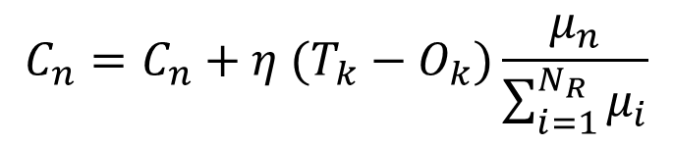
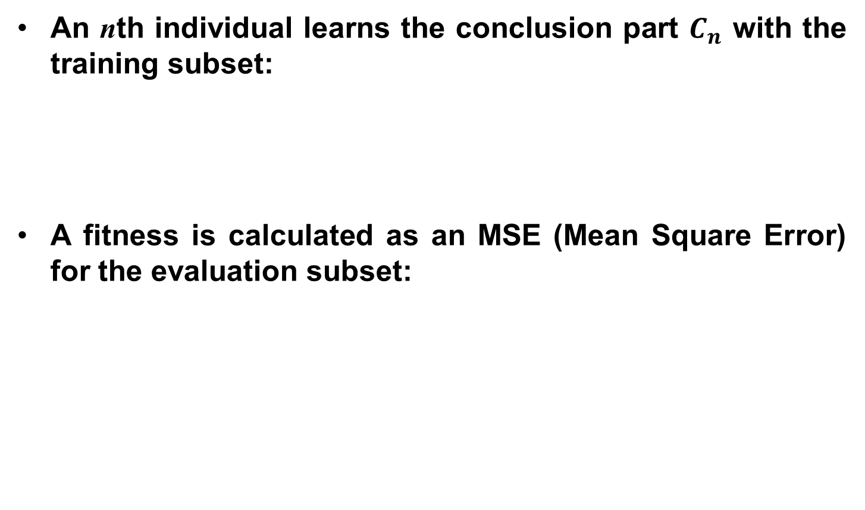
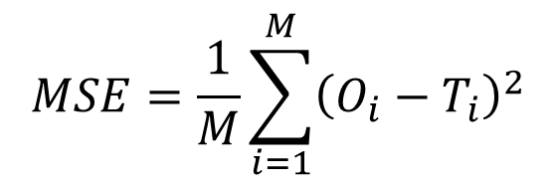
Optimize the Rule Base Evaluate Population
An nth individual learns the conclusion part $C_{n}$ with the training subset:
A fitness is calculated as an MSE (Mean Square Error) for the evaluation subset:
$$C_{n}=C_{n}+η (T_{k}−O_{k})\frac{μ_{n}}{\sum_{i=1}^{N_{R}}{μ_{i}}}$$
$$MSE=\frac{1}{M}\sum_{i=1}^{M}{{\left(O_{i}−T_{i}\right)}^{2}}$$

Slide 13
Optimize the Rule Base Crossover and Mutation
A new rule base is generated by Uniform Crossover from two parents selected by Binary Tournament.
The mutation is applied according to the mutation rate.
One clause of an antecedent part is randomly changed from another fuzzy set or Don’t Care.
Parent 1
Parent 2
Child
UX

Slide 14
Optimize the Rule Base Crossover and Mutation
A new rule base is generated by Uniform Crossover from two parents selected by Binary Tournament.
The mutation is applied according to the mutation rate.
One clause of an antecedent part is randomly changed from another fuzzy set or Don’t Care.
If rules 1, 2, are randomly satisfied the mutation rate, the rules is changed as follow.
R₁: If x₁ is S and x₂ is L then b₁ = y₁
R₂: If x₁ is M and x₂ is L then b₂ = y₂
R₁: If x₁ is M and x₂ is L then b₁ = y₁
R₂: If x₁ is M and x₂ is DC then b₂ = y₂

Slide 15
Optimize the Rule Base Rule Pruning
After genetic operations, the compatibility of each rule in a new offspring model is examined for training data.
Rules which do not cover any patterns with more than 0.5 degree are removed from the offspring model.
x₂
Assume that a new model with the following rules is generated by genetic operations.
VL
1
L
2
R₁: If x₁ is M and x₂ is M then b₁
R₂: If x₁ is L and x₂ is DC then b₂
R₃: If x₁ is DC and x₂ is L then b₃
M
3
4
S
5
6
7
VS
x₁
R₁ does not cover any patterns with more than 0.5 degree.
VS
S
M
L
VL

Slide 16
Optimize the Rule Base Rule Pruning
After genetic operations, the compatibility of each rule in a new offspring model is examined for training data.
Rules which do not cover any patterns with more than 0.5 degree are removed from the offspring model.
x₂
Assume that a new model with the following rules is generated by genetic operations.
VL
1
L
2
R₁: If x₁ is M and x₂ is M then b₁
R₂: If x₁ is L and x₂ is DC then b₂
R₃: If x₁ is DC and x₂ is L then b₃
M
3
4
S
5
6
7
VS
x₁
R₁ does not cover any patterns with more than 0.5 degree. => R₁ is removed.
VS
S
M
L
VL

Slide 17
Optimize the Rule Base Rule Addition by Heuristic Rule Generation
After genetic operations, the compatibility of each rule in a new offspring model is examined for training data.
Rules which do not cover any patterns with more than 0.5 degree are removed from the offspring model.
Instead, new rules are generated in a heuristic manner.
x₂
A pattern which is not well covered by any rule is randomly selected for each new rule.
VL
1
L
2
R₁: If x₁ is S and x₂ is M then b₁
R₂: If x₁ is L and x₂ is DC then b₂
R₃: If x₁ is DC and x₂ is L then b₃
M
3
4
S
5
6
7
VS
x₁
VS
S
M
L
VL

Slide 18
Optimize the Rule Base Rule Addition by Heuristic Rule Generation
After genetic operations, the compatibility of each rule in a new offspring model is examined for training data.
Rules which do not cover any patterns with more than 0.5 degree are removed from the offspring model.
Instead, new rules are generated in a heuristic manner.
x₂
A pattern which is not well covered by any rule is randomly selected for each new rule.
VL
1
L
2
R₁: If x₁ is S and x₂ is DC then b₁
R₂: If x₁ is L and x₂ is DC then b₂
R₃: If x₁ is DC and x₂ is L then b₃
M
3
4
S
5
6
7
VS
x₁
Some attribute conditions are replaced with don’t care to make the rule generalized.
VS
S
M
L
VL

Slide 19
Optimize the Rule Base Population Update
The next population is selected from the parent and offspring population.
The selected individuals have a higher fitness value than the unselected individuals.
If the termination condition is not satisfied, then continue to generate offspring.
Otherwise, output the rule base which has the highest fitness in the final generation.
The best one
goto
Optimize the knowledge base

Slide 20
Optimize the Knowledge Base Generate Knowledge Base Population
Some new knowledge bases are generated by the obtained optimal knowledge base.
Each parameter of the new knowledge base is generated by perturbing to the obtained knowledge base.
The parameters (the mean and the variance) are added random scalar values.

Slide 21
Optimize the Knowledge Base Evaluate the Knowledge Base
Each individual consists of the knowledge base and obtained an optimal rule base.
A fitness is calculated as an MSE for evaluation set using the knowledge base and the obtained rule base.
The obtained optimal rule base
Individual 1
Individual 2
Individual 3
Knowledge base
Knowledge base
Knowledge base

Slide 22
Optimize the Knowledge Base Population Update
A individual which has a highest fitness in current generation is selected as next generation.
If the termination condition is not satisfied, then continue to generate new offspring.
Otherwise, output the knowledge base which has the highest fitness in the final generation.
best
The optimal rule base
perturbation
best
best
perturbation

Slide 23
Experiment
Parameter setting

Slide 24
Results The Initial Knowledge Base
hogehoge

Slide 25
Results The obtained Knowledge Base
hogehoge

Slide 26
Results Obtained Regression Model
The win rate curve of EBWR predicted by ELF OpenGo, and the obtained EFML-based Fuzzy Inference System for the training dataset.
Last MSE : 0.00001
Traですよ！

Slide 27
Results Obtained Regression Model
The win rate curve of EBWR predicted by ELF OpenGo, and the obtained EFML-based Fuzzy Inference System for the test dataset.
Last MSE : 0.00001

Slide 28
Results Partial Obtained Optimal Rule Base
The rule base shown as follow was obtained by EFML-based.
ruleNo | DBSN | DWSN | DBWR | DWWR | DBTMR | DWTMR
1 | Don't Care | Medium | Don't Care | Don't Care | VeryLarge | VeryLarge
2 | VerySmall | VerySmall | VeryLarge | Medium | Large | Large
3 | Don't Care | Small | Don't Care | Medium | Medium | VeryLarge
4 | Small | Small | Don't Care | Medium | Medium | Don't Care
499 | Medium | Don't Care | Don't Care | Medium | Large | VeryLarge
500 | Medium | Medium | Medium | Don't Care | Don't Care | Large

Slide 29
hoge
hogehogehoge

Slide 30
hoge
hogehogehoge

Slide 31
hoge
hogehogehoge

