Slide 1

€F
EuroFoods S.A.
DATA FOR FP&A · 2026
Healthy growth, missed plan.
A two-year FP&A diagnosis of EuroFoods.
Mattéo DAVID, James WILLEMS, Corentin CHARPENTIER, Kirsten CHANG
REVENUE 2024
YOY GROWTH
BUDGET VAR.
MARGIN
€2.36M
+5.4%
−4.6%
38.7%
FP&A Analytics · Power BI · DAX · Scenario modelling · Data as of December 2024

Slide 2
€F
CONTEXT & APPROACH
02
Two years of data, one star schema
THE BUSINESS
THE DATA MODEL
3 countries
France · Germany · UK
Dim_Date
Dim_Products
20 SKUs
across 4 categories
Transactions
25,200 · fact
4 channels
Hyper · Super · Conv · Online
Dim_Customers
Budget
36 customers
named retail accounts
25,200 rows
weekly, Jan 2023 – Dec 2024
Challenge solved: transactions aggregated to (Year,Month,Country,Category) to join Budget's monthly grain.
DAX foundation: Total Revenue · Gross Margin · Margin % · Revenue PY (SAMEPERIODLASTYEAR) · YoY Growth · Revenue Variance · Forecast Revenue (What-If) — built on a calendar table marked as a date table.

Slide 3
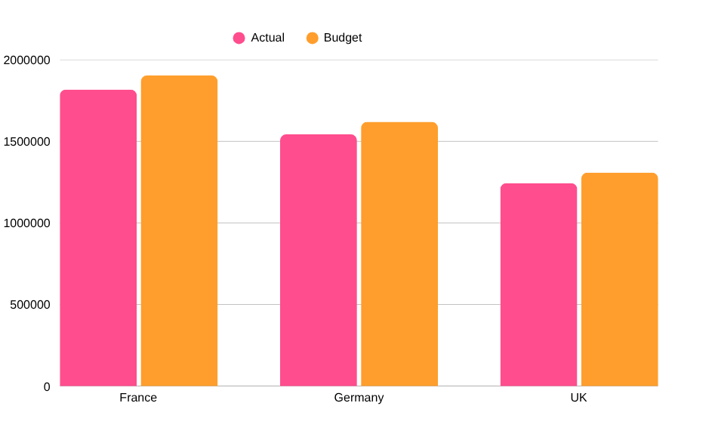
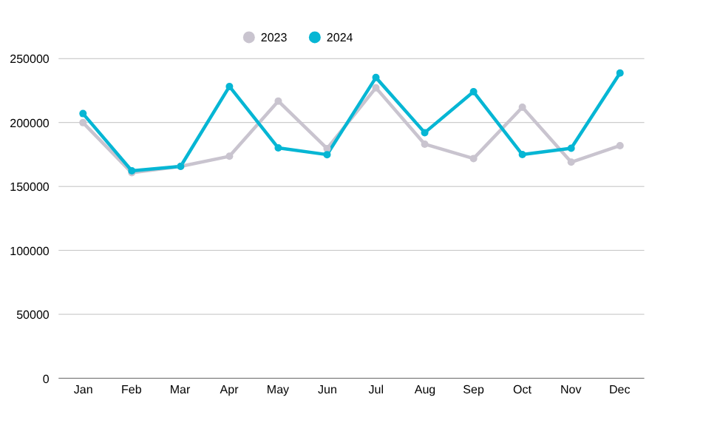
€F
2024 PERFORMANCE
03
The headline: grew, profited, but under plan
REVENUE 2024
GROSS MARGIN
BUDGET VARIANCE
Q3 2024 YOY
€2.36M
€915k
−€115k
+11.9%
+5.4% vs 2023
38.7% — held flat
−4.6% unfavourable
summer acceleration
Revenue by country
Monthly revenue

Slide 4
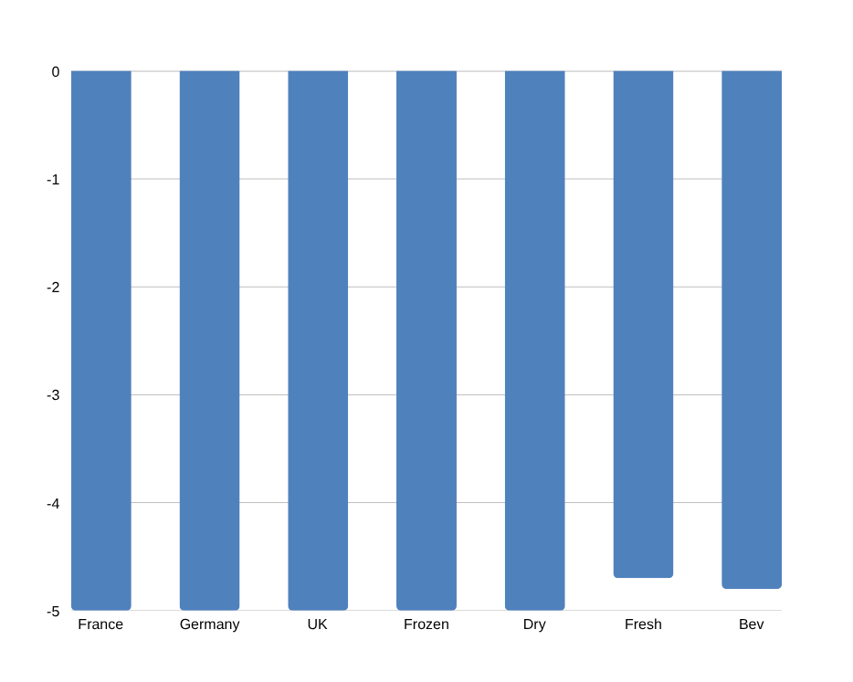
€F
FINDING 01
04
The budget gap is volume, not price
Variance is uniform across every market (% vs budget)
THE PRICE–VOLUME BRIDGE
−€226k
volume effect (selling fewer units)
≈ €0
price / mix effect
Actual prices landed on target. The entire shortfall is ~4.7% fewer units than planned — a planning error, not a discounting problem.

Slide 5
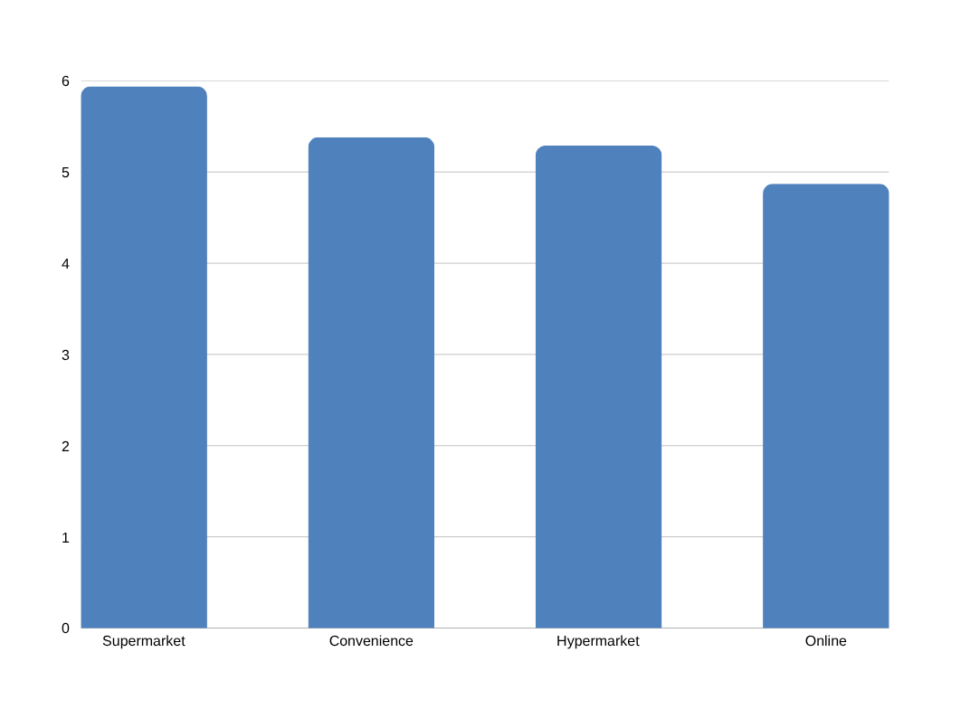
€F
FINDING 02
05
Online is the slowest channel, not the fastest
Revenue growth 2023 → 2024 by segment
WHY IT MATTERS
Supermarket leads
+5.9% — 33.6% of revenue, the real growth engine
Online lags
+4.9%, the slowest of all four channels
Brick-and-mortar +6.0%
actually outgrew Online (+5.0%)
The opportunity
Online is 22.6% of revenue but under-invested

Slide 6
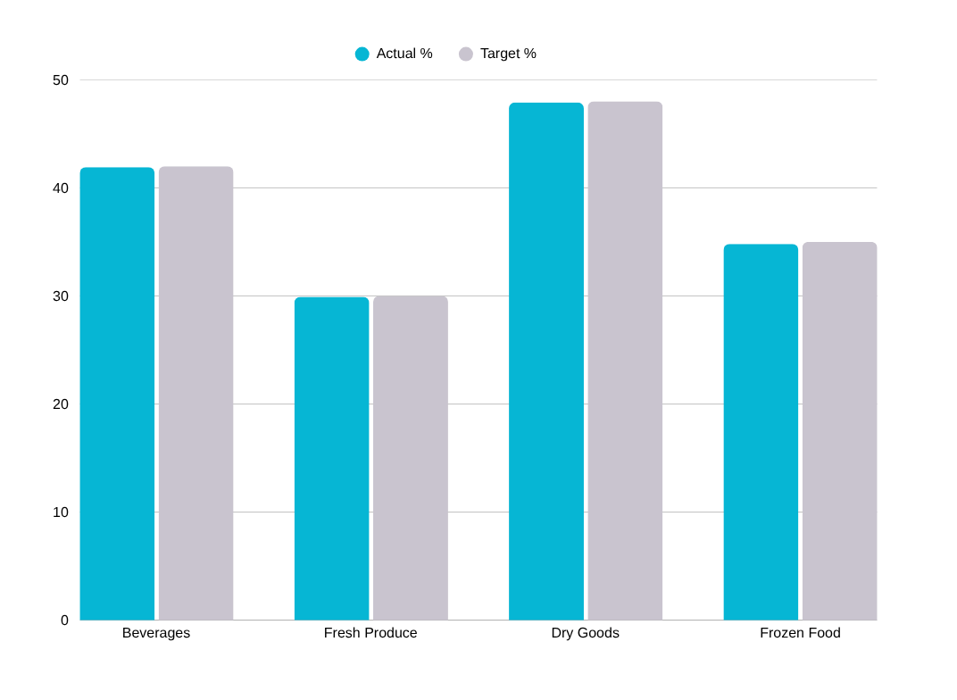
€F
FINDING 03
06
Frozen Food is the structural margin drag
Margin % vs category target
THE FROZEN PROBLEM
All 5 Frozen Food SKUs sit below the 35% target.
€1.42M
largest category by revenue — yet the lowest margin band.
Verdict: a category-wide sourcing issue, not weak individual products. No SKU warrants discontinuation.

Slide 7

€F
BUDGET VARIANCE
07
Every market missed — by almost exactly the same %
ACTUAL (2YR)
BUDGET (2YR)
VARIANCE
VOL. VAR
€4.60M
€4.83M
−€227k
−4.7%
−4.7% unfavourable
Actual vs budget revenue by country
THE DIAGNOSIS
Variance band: −5.0% to −3.9% across all 3 countries × 4 categories × 8 quarters.
Such uniformity is the signature of a top-down budget set ~5% too high — not localised execution failures.
Fix: re-baseline 2025 on the real run-rate.

Slide 8
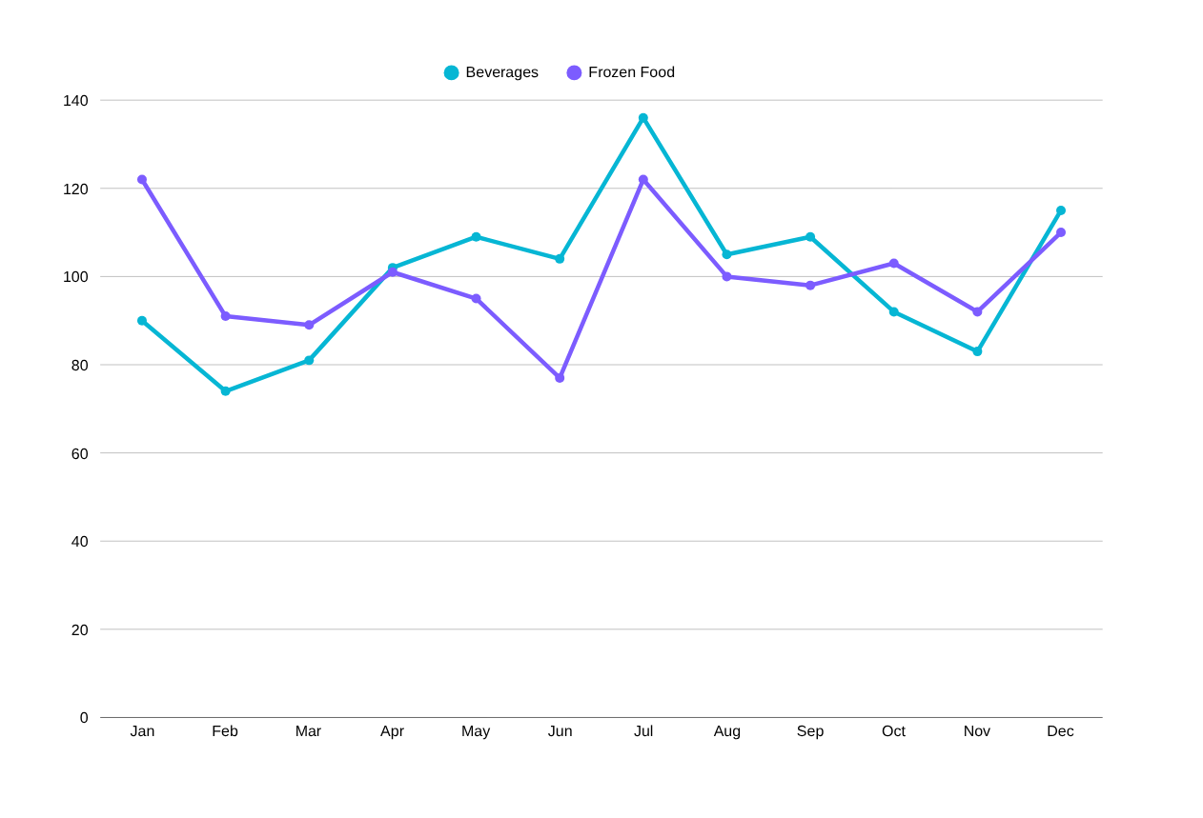
€F
SEASONALITY
08
Beverages swing hardest — a planning signal
INDEX (100 = AVG)
Beverages
Peak Jul 136 · trough Feb 74 — widest swing (±62).
Frozen Food
Peaks Jan 122 (winter) — counter-seasonal to drinks.
Action: phase inventory & promo by category season.

Slide 9
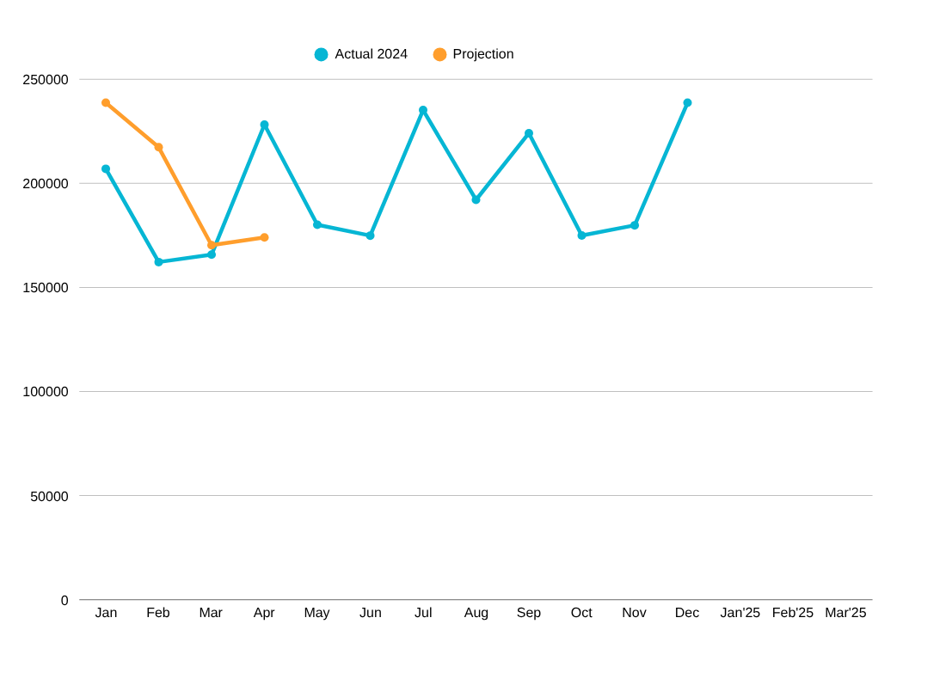
€F
FORECAST & WHAT-IF
09
Reaching €2.5M in 2025 is within reach
Monthly revenue + Q1-2025 projection (central +5%)
SCENARIO MODELLING
Online +20% & Convenience −10%
net impact on 2024 revenue:
+€68k +2.9%
To hit €2.5M in 2025
requires +5.8% growth — just above the +5.4% delivered in 2024.
The Online push alone bridges most of that gap.

Slide 10
€F
RECOMMENDATIONS
10
Three actions, quantified
01
ACT NOW
Rebuild plan volumes on the actual run-rate, not the +5% top-down assumption that missed every cell.
▲ IMPACT
Removes the chronic ≈€115k/yr unfavourable variance
Re-baseline the 2025 budget
02
GROW
Reinvest behind the fastest channel and rehabilitate Online with promo & assortment.
▲ IMPACT
Online +20% nets +€68k (+2.9%) — covers the gap to €2.5M
Push Supermarket & fix Online
03
PROTECT
Renegotiate Frozen sourcing to the 35% target; hedge sterling on the 27%-of-revenue UK book.
▲ IMPACT
+2pp on €1.42M ≈ +€28k GM; caps a ~6% FX swing
Fix Frozen margin & hedge GBP

Slide 11
€F
RISKS & CLOSE
11
What could go wrong — and the bottom line
Budget premise
Assumes the uniform 5% gap is planning optimism, not demand erosion. Monitor the volume trend monthly.
THE BOTTOM LINE
A profitable, growing business
held back by an over-optimistic plan, not by execution.
Rebaseline, back the winners, protect margin → €2.5M in 2025.
Scenario independence
The +€68k uplift treats segments as independent; real Online/Convenience cannibalisation would reduce it.
Margin & FX
Forecasts hold margin at 38.7% and assume no FX shock. EUR/GBP swung ~6% — a weaker pound compresses 27% of revenue.
Thank you. Questions?
EuroFoods S.A. · FP&A Analytics · Live Power BI dashboard + interactive companion available on screen
Mattéo DAVID, James WILLEMS, Corentin CHARPENTIER, Kirsten CHANG

