Slide 1
Reducing Food Waste Through Mobile Donations: Our App's Impact

Slide 2
Agenda
1
Introduction: The Challenge of Food Waste
2
Overview of the Mobile App: FoodShare
3
The Donation Process: From Users to NGOs
4
Benefits of Using FoodShare
5
Impact Measurement: Tracking Success
6
Challenges and Solutions
7
Future Developments and Features
8
Conclusion: Join Us in Reducing Food Waste

Slide 3
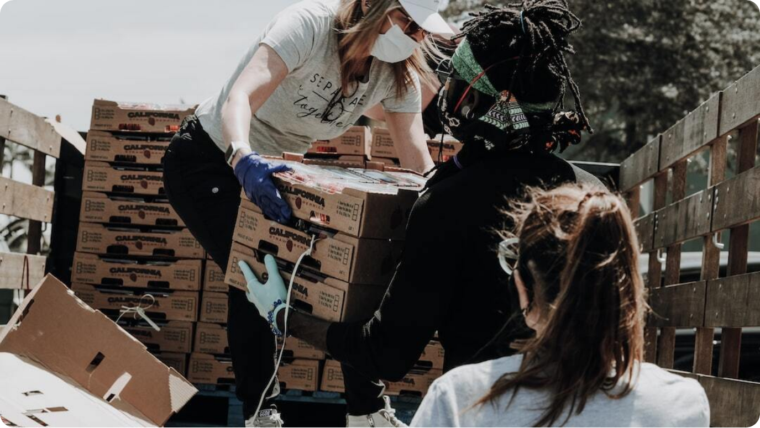
Introduction: The Challenge of Food Waste
Understanding the Scope and Importance of Addressing Food Waste
Statistics on Food Waste: It is estimated that roughly one-third of all food produced for human consumption is wasted each year, translating to approximately 1.3 billion tons globally. This staggering figure underscores the scale of food waste as a critical issue requiring urgent action.
Environmental Impact: Food waste contributes significantly to greenhouse gas emissions as rotting food in landfills produces methane, a potent greenhouse gas. Reducing food waste is crucial not only for conserving resources but for mitigating climate change.
Social Responsibility: Every year, billions of people go hungry while mountains of food are wasted. Addressing food waste is not merely an environmental concern; it is a pressing moral issue that aligns with our collective social responsibility to promote equity and sustainability.
Introduction to the App: Our mobile app, FoodShare, serves as an innovative solution to connect food donors with local NGOs, facilitating easier donation processes and promoting community engagement in food redistribution efforts.

Slide 4
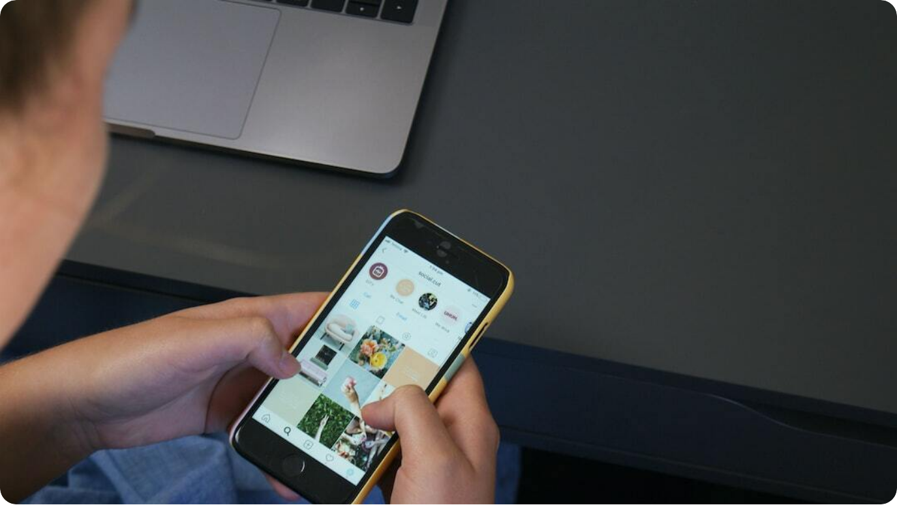
Overview of the Mobile App: FoodShare
A Comprehensive Look at App Features and Target Audience
App Functionality: FoodShare offers users the ability to easily donate food with just a few clicks. It allows users to track their donations, view local NGOs in need, and receive notifications about their impact.
User Interface: Designed with user-friendliness in mind, the app's interface employs intuitive navigation and responsive design. It employs visuals and tooltips to guide users through the donation process smoothly.
Target Audience: Our primary audience includes local businesses, restaurants, and grocery stores that have excess food.
How It Works: Users can register, report surplus food and that’s it! It only takes a few clicks to safely dispose of your excess products. After the donation process, NGOs can reserve the desired products to pick them up later. After scheduling a pickup, donations are securely tracked through the app, providing transparency and accountability.

Slide 5




The Donation Process: From Users to NGOs
Streamlined Food Donation Made Easy for All
Step-by-Step Donation Process
Upon entering the app, users can navigate the process of donating food by selecting the type and amount of food available, NGOs being able to see the current available products.
Partnerships with NGOs
We have established collaborative partnerships with various NGOs that specialize in food recovery and redistribution, ensuring that donations reach those in need quickly and efficiently.
Logistics of Product Pickup
Logistical considerations are streamlined; users can schedule a pickup time that is convenient for them, providing flexibility and maximizing convenience.
User Experience
The user interface prioritizes a positive experience by providing real-time updates and feedback on the donation process, reinforcing user engagement and satisfaction.

Slide 6



Benefits of using FoodShare
Creating Inclusive Solutions to Fight Food Waste
Reducing Food Waste
By facilitating direct food donation, our app plays an integral role in reducing the volume of food that would otherwise contribute to landfills, thus positively impacting the environment.
Supporting Local NGOs
Donations made through our app directly support the work of local NGOs, enabling them to serve their communities better and extend their reach to those suffering from food insecurity.
Community Engagement
The app fosters community spirit by connecting individuals and local organizations, promoting solidarity and cooperation in the common goal of combating food waste.

Slide 7
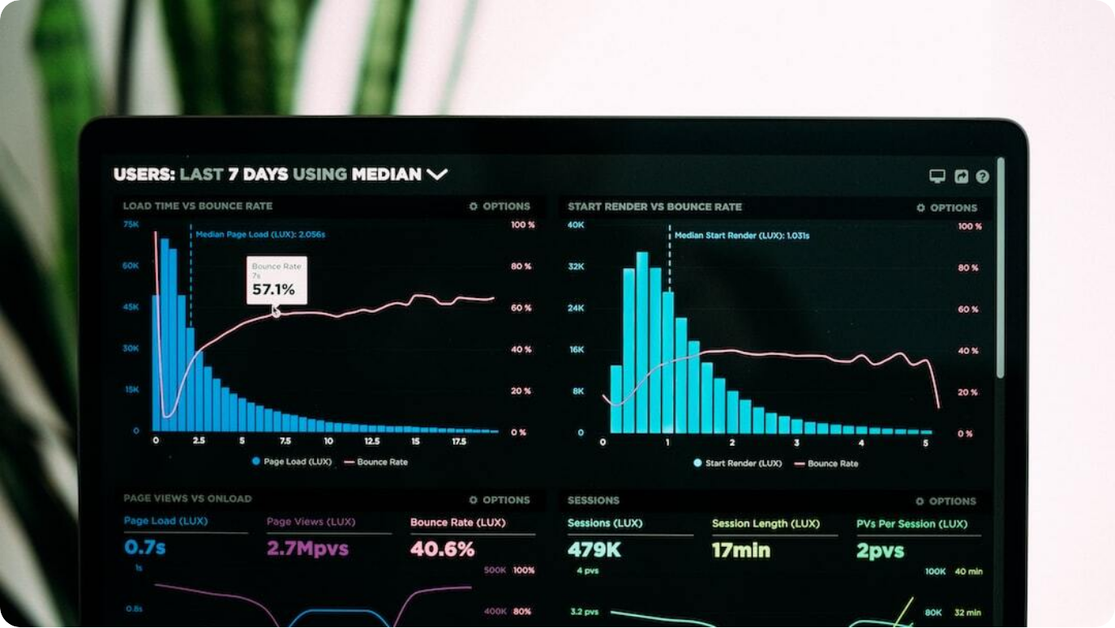
Impact Measurement: Tracking Success
Evaluating the FoodShare's Effectiveness and Reach
Metrics for Success: Key performance indicators include the amount of food donated, number of active users, and frequency of pickups, providing a clear view of the app’s reach and effectiveness.
User Feedback: Collecting user feedback through in-app surveys allows for continuous improvement and ensures that app features align with user needs and experiences.
NGO Partnerships: The success of the app is also reflected in the strength of our partnerships with NGOs, evaluated through cooperative metrics such as successful donation rates and community impact reports.
Environmental Impact Assessment: Regular assessments help in quantifying the positive environmental impact of the app, such as reductions in landfill waste and decreased carbon emissions due to food recovery.

Slide 8



Challenges and Solutions
Addressing Potential Barriers to Success
User Adoption
Encouraging users to regularly engage with the app requires strategic marketing initiatives and community outreach programs that emphasize the app's value.
Logistical Issues
The complexity of coordinating pickups and deliveries poses challenges that necessitate careful planning and reliable communication channels between users and NGOs.
Innovative Solutions
Implementing tech-driven solutions like real-time tracking and predictive analytics will enhance operational efficiencies and improve user experiences.

Slide 9
Future Developments and Features
Looking Ahead: Enhancing Our Offering
Upcoming Features
Future enhancements will include advanced analytics for users to see the impact of their donations over time.
Expansion Plans
Targeted efforts will be made to expand the app’s reach into new communities and regions, along with a focus on onboarding more NGO partners to amplify our impact.
User Engagement Strategies
We plan to implement targeted campaigns to engage users more meaningfully, such as community events and educational content about food waste and sustainability.
Long-Term Vision
Our goal is to become the leading platform for food donations in Romania, actively contributing to food security while reducing waste on an unprecedented scale.

Slide 10




Conclusion: Join Us in Reducing Food Waste
A Call to Action for Community Participation
Recap of Key Points
A brief summary highlighting the pervasive issue of food waste, the functionality of the app, and the benefits it provides to users, NGOs, and the environment.
Call to Action
We encourage everyone to take an active stance in this critical issue by downloading the app and participating in efforts to combat food waste within their communities.
Encouragement to Download the App
Promoting the app as a user-friendly platform that empowers individuals to make a significant impact through simple actions.
Final Thoughts
Together, we can create a sustainable future by transforming surplus food into a resource that nourishes those in need, effectively combating waste.

